Slide 1
GreenBot — Integrated Device
Annotated views of actuators, sensors, joints & subsystems
MEC ENG 102B · Mechatronics Design · Spring 2026 · Group 22
Bader AlKhawashki · Fritz Kuermayr · Salvador Gonzalez · Arunima Basu
LABEL COLORS
Actuator
Sensor
Moving part / joint
Subsystem

Slide 2
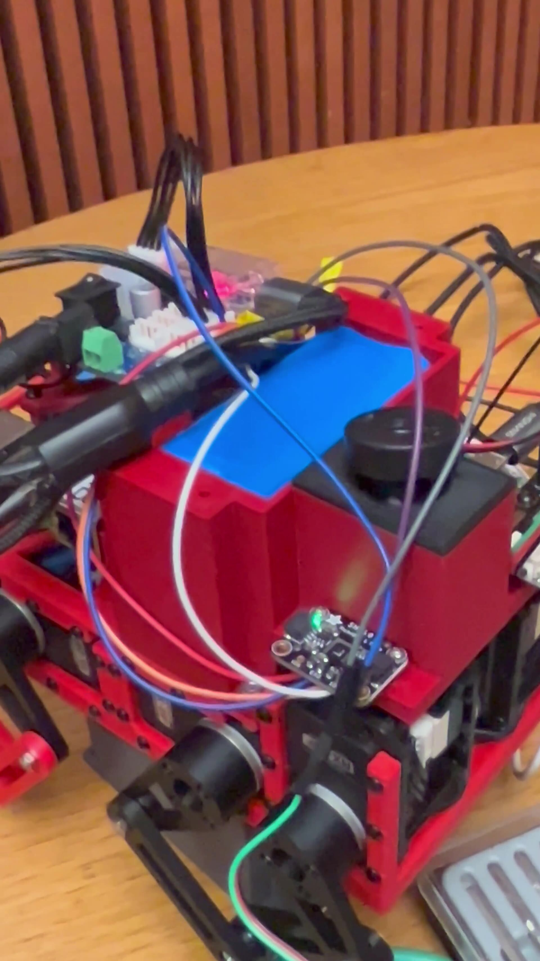
Overview — Fully Integrated GreenBot
Group 22 • GreenBot
Side view: humidity-control payload, electronics rack, and 8-DOF quadruped legs
Mister / Ultrasonic Humidifier (diffuser head)
SHT40 Humidity & Temperature Sensor (I²C, with status LED)
12 V · 5000 mAh Li-Ion Battery Pack
Raspberry Pi (control unit) running gait + humidity loop
3D-printed top housing (electronics & battery)
Cytron MD13S Motor Driver (per-side PWM control)
Mister Tank / Nozzle Arm (piezo + water tube)
Front-Right Dynamixel RX-24F KNEE actuator
Power-Distribution PCB (buck converter + terminals)
Upper Leg Link (red 3D-printed, 32 mm lever)
Front-Left Dynamixel RX-24F HIP actuator
Rear-Right Hip Joint (press-fit ball bearings)
Rear-Left Knee Joint (4-bar linkage, 638ZZ bearings)
Foot Contact Point (rubberized 3D-printed tip)
Color-coded labels — see legend / title slide

Slide 3
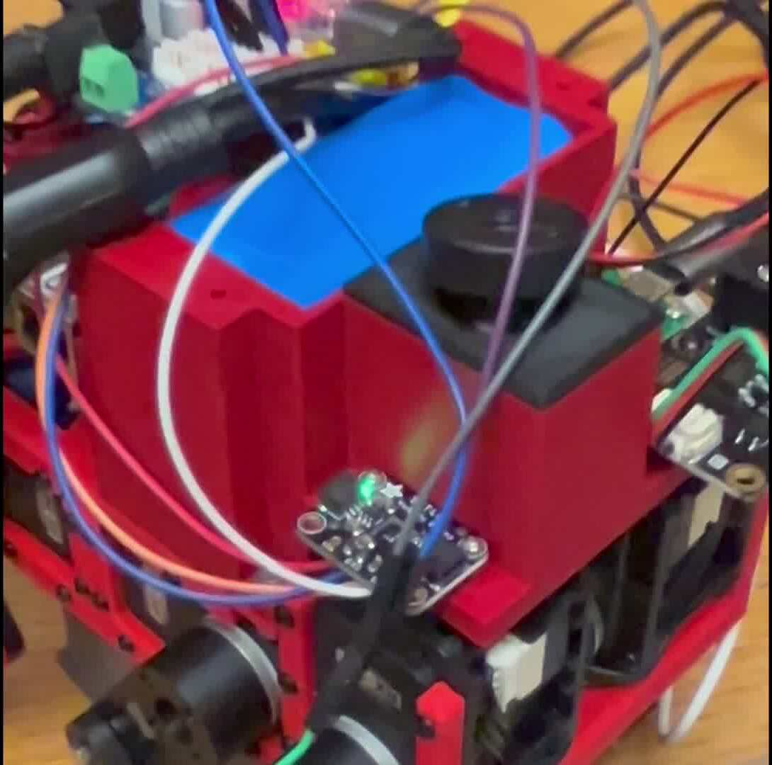
Detail — Humidity Payload & Top Body
Group 22 • GreenBot
Sensor, mister diffuser, and battery housing
KEY OF TERMS
Mister diffuser
Piezoelectric ultrasonic humidifier head, MOSFET-switched on GPIO 17.
SHT40 humidity sensor
Adafruit I²C breakout (SDA = GPIO2, SCL = GPIO3); reads RH and temp at 0.5 Hz.
3D-printed top housing
FDM PETG enclosure for Pi + drivers; mounts to red lower chassis.
12 V Li-Ion battery
Visible blue cell pack; powers motor bus and 5 V rail via buck.
Mister tank arm
Bottle + silicone water tube to diffuser; held by clip on chassis.
Front Dynamixel motor
RX-24F serial-bus servo, 2.6 N·m stall, 1 Mbaud on /dev/ttyUSB0.

Slide 4
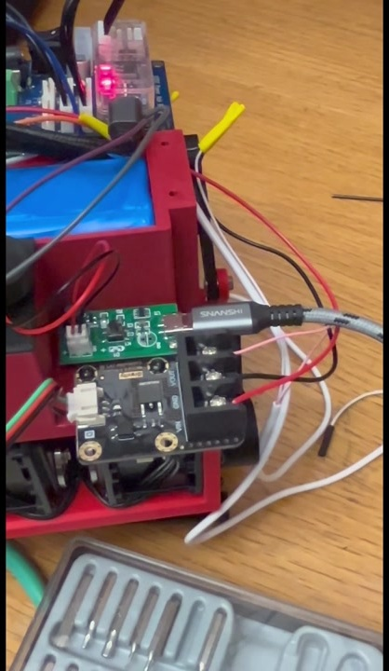
Detail — Power & Driver Electronics (side panel)
Group 22 • GreenBot
Buck converter, MOSFET driver, motor-bus connections
KEY OF TERMS
Raspberry Pi (status LED)
Inside acrylic case at top; runs main control loop and SSH/keyboard interface.
12 V Li-Ion battery (top)
Blue cell pack in red 3D-printed housing — feeds motors directly, Pi via buck.
Buck converter (5 V rail)
Green PCB step-down regulator powering the Pi and logic-side electronics.
MOSFET humidifier driver
Black PCB; gates 5 V rail to mister via Pi GPIO 17 (PWM not required).
Screw-terminal interface
Yellow ferrules + screw block carry battery & motor power to drivers.
Reference: Components List + FINAL REPORT.docx (Group 22). Edit labels and arrow positions as needed before pasting screenshots into the report.

