Slide 1

IBM Data Science Project
* SPACE EX*
Frederick Duff

Slide 2

Table of Contents
1. URL of Github: https://github.com/FritzLD/IBM_Project_Spacex
I. Executive Summary
II. Introduction Slide
III. Data collection and data wrangling methodology
IV. EDA and interactive visual analytics methodology
V. predictive analysis methodology
VI. EDA with visualization results
VII. EDA with SQL results
VIII. Interactive map with folium results
IX. Plotly Dash dashboard results
X. Predictive analysis ( classification) results
XI. Conclusion
XII. Innovative insights

Slide 3
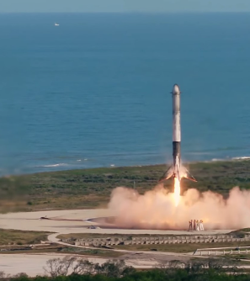
I. Executive Summary
Launching a Falcon 9 rocket costs an estimated $67 million, with the booster making up 60% of the cost. However, since the booster is recoverable, the cost can be reduced significantly if it's reused for subsequent launches. The upper stage, fairing, and launch costs make up the remaining 40%. Due to the need for the booster to retain enough fuel for landing, there's a payload reduction, but this can be compensated for by recovering the booster multiple times. To estimate the cost of a launch, it's essential to predict whether a booster will be recovered.
In summary, the Falcon 9's relatively low cost is due in large part to SpaceX's ability to recover and reuse the booster. By doing so, SpaceX can significantly reduce the overall cost of launching a rocket. Additionally, the ability to predict whether the booster will be reusable for future launches is crucial in creating a proforma and estimating the cost of a launch. Overall, understanding the costs associated with launching rockets is crucial in developing and supporting new rocket companies that can compete with industry leaders like SpaceX.
Overall, this project aims to provide insight into the cost-effectiveness of rocket launches and support the development of new rocket companies like Space Y that can compete with industry leaders like SpaceX.

Slide 4
Introductory Slide
Fundamentally if we can determine a predictability to the ability to recover stages of the Falcoln 9 , then we can develop a competitive business model . Further if we are able to determine factors which enhance recovery then we may be able to alter the curve and develop a superior model for competitiveness and efficiency.

Slide 5


Data collection and data wrangling
Imported data from the SpaceX API-
Data wrangling- checked for null ( missingness) we used the mean value to substitute

Slide 6
Exploratory Data Analysis
1. Determined the number of launches from each site:
  CCAFS SLC 40 ( Cape Canaveral) – 55
  KSC LC 39a ( Kennedy Space Center complex 39a) – 22
  VAFB SLC 4E ( Vandenberg Air Force Base ) - 13

Slide 7
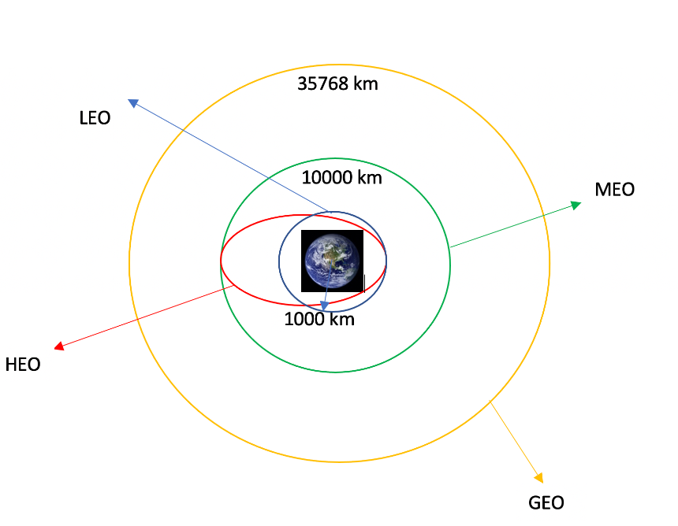
Exploratory Data Analysis – Orbit types
LEO: Low Earth orbit (LEO)is an Earth-centred orbit with an altitude of 2,000 km (1,200 mi) or less (approximately one-third of the radius of Earth),[1] or with at least 11.25 periods per day (an orbital period of 128 minutes or less) and an eccentricity less than 0.25.[2] Most of the manmade objects in outer space are in LEO [1].
VLEO: Very Low Earth Orbits (VLEO) can be defined as the orbits with a mean altitude below 450 km. Operating in these orbits can provide a number of benefits to Earth observation spacecraft as the spacecraft operates closer to the observation[2].
GTO A geosynchronous orbit is a high Earth orbit that allows satellites to match Earth's rotation. Located at 22,236 miles (35,786 kilometers) above Earth's equator, this position is a valuable spot for monitoring weather, communications and surveillance. Because the satellite orbits at the same speed that the Earth is turning, the satellite seems to stay in place over a single longitude, though it may drift north to south,” NASA wrote on its Earth Observatory website [3] .
SSO (or SO): It is a Sun-synchronous orbit also called a heliosynchronous orbit is a nearly polar orbit around a planet, in which the satellite passes over any given point of the planet's surface at the same local mean solar time [4] .
ES-L1 :At the Lagrange points the gravitational forces of the two large bodies cancel out in such a way that a small object placed in orbit there is in equilibrium relative to the center of mass of the large bodies. L1 is one such point between the sun and the earth [5] .
HEO A highly elliptical orbit, is an elliptic orbit with high eccentricity, usually referring to one around Earth [6].
ISS A modular space station (habitable artificial satellite) in low Earth orbit. It is a multinational collaborative project between five participating space agencies: NASA (United States), Roscosmos (Russia), JAXA (Japan), ESA (Europe), and CSA (Canada) [7]
MEO Geocentric orbits ranging in altitude from 2,000 km (1,200 mi) to just below geosynchronous orbit at 35,786 kilometers (22,236 mi). Also known as an intermediate circular orbit. These are "most commonly at 20,200 kilometers (12,600 mi), or 20,650 kilometers (12,830 mi), with an orbital period of 12 hours [8]
HEO Geocentric orbits above the altitude of geosynchronous orbit (35,786 km or 22,236 mi) [9]
GEO It is a circular geosynchronous orbit 35,786 kilometres (22,236 miles) above Earth's equator and following the direction of Earth's rotation [10]
PO It is one type of satellites in which a satellite passes above or nearly above both poles of the body being orbited (usually a planet such as the Earth [11]

Slide 8
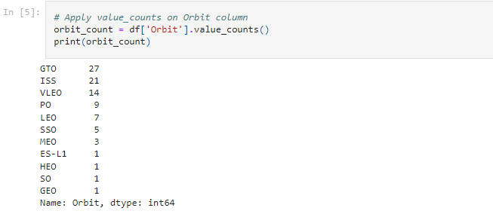
Exploratory Data Analysis (cont)
2 – Calculate the number and occurrence of each orbit
- geosynchronous orbit led the number of types of orbit with a total count of 27

Slide 9
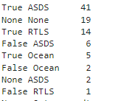
Exploratory Data Analysis –(cont)
3. Number of occurrences of mission outcomes of the orbits
  True Ocean – successful landing in a region in the ocean- 5
  False Ocean- unsuccessful landing in a region in the ocean- 2
  True RTLS- mission outcome successfully landed on a ground pad- 14
  False RTLS- unsuccessful landing on the ground pad- 1
  True ASDS – mission outcome was successful landing on a drone ship- 41 observations
  False ASDS – mission outcome was unsuccessful landing on a drone ship- 6

Slide 10

Exploratory Data Analysis ( cont)
66% of landings were successful , meaning we have a lot of room for development and improvement

Slide 11
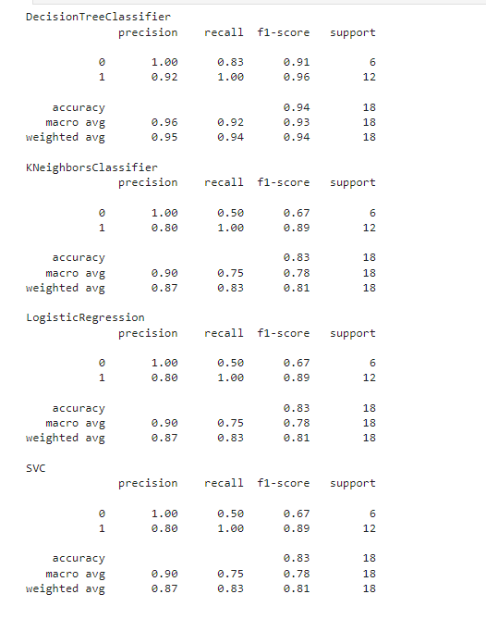
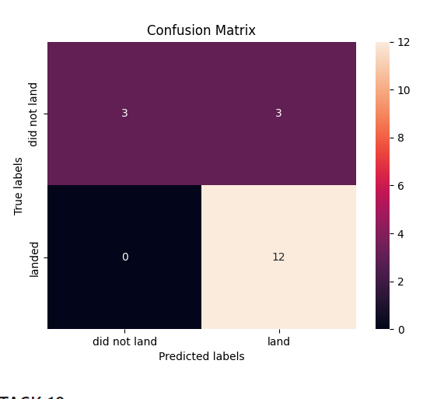
Predictive Analytics
Decision Tree performed best with a F1 score of .94 and similar accuracy from the other models. Going forward
In production we would want to pay close attention since Decision trees are notorious for overfitting

Slide 12
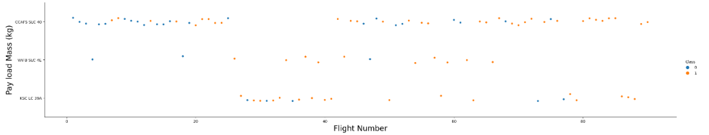
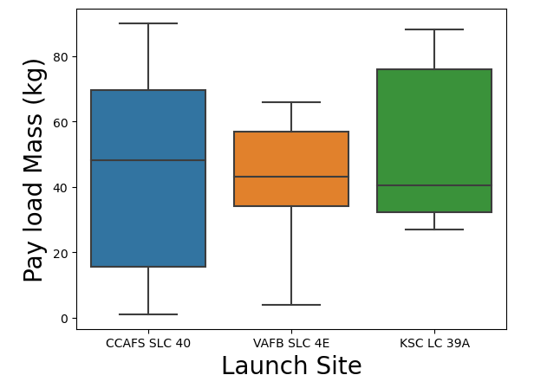
EDA with visualization results
CCAFS had a large range of payloads and on average were higher masses than the other launch sites

Slide 13
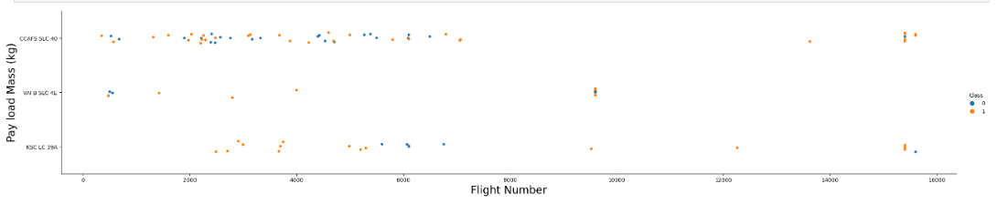
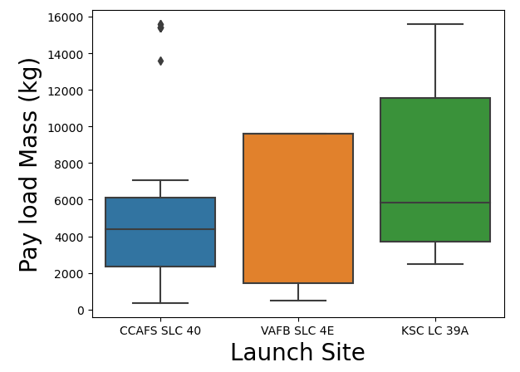
EDA with visualization results- cont
We can see that the payload mass was higher for
KSC

Slide 14
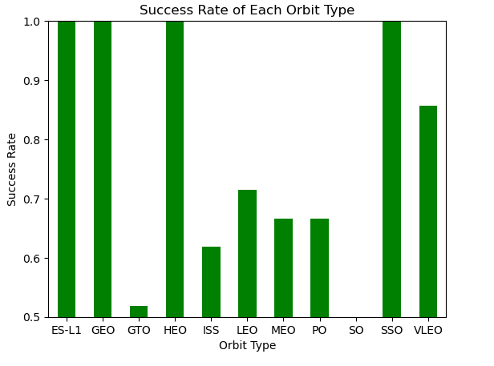
EDA with visualization results- cont
Types of orbits that were more successful
ES-L1, GEO , HEO and SSO

Slide 15
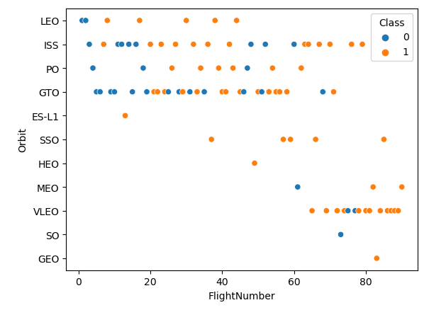
EDA with visualization results- cont
Does not seem to be a relationship with the flight number and the orbit type

Slide 16
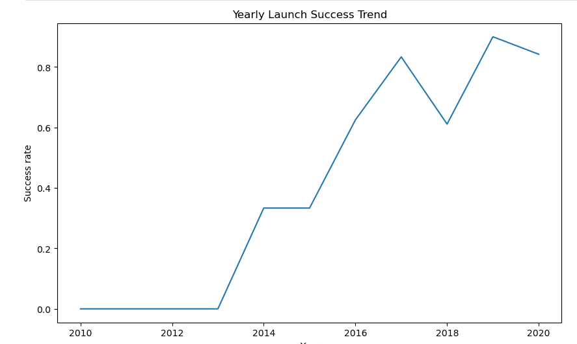
EDA with visualization
Clearly as development and testing
occur the success has trended upward
with the exception of 2018.

Slide 17
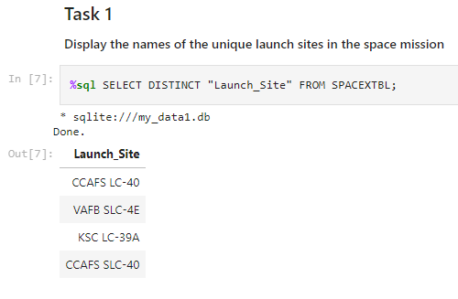
EDA with EDA- SQL
Displayed the names of each unique launch site

Slide 18
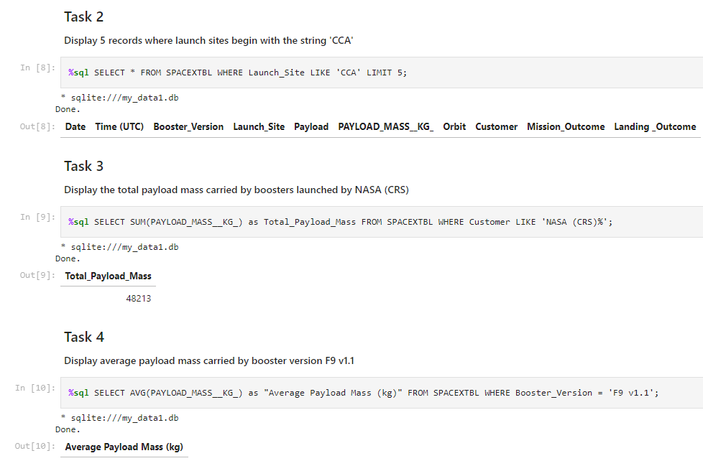
EDA with EDA- SQL

Slide 19
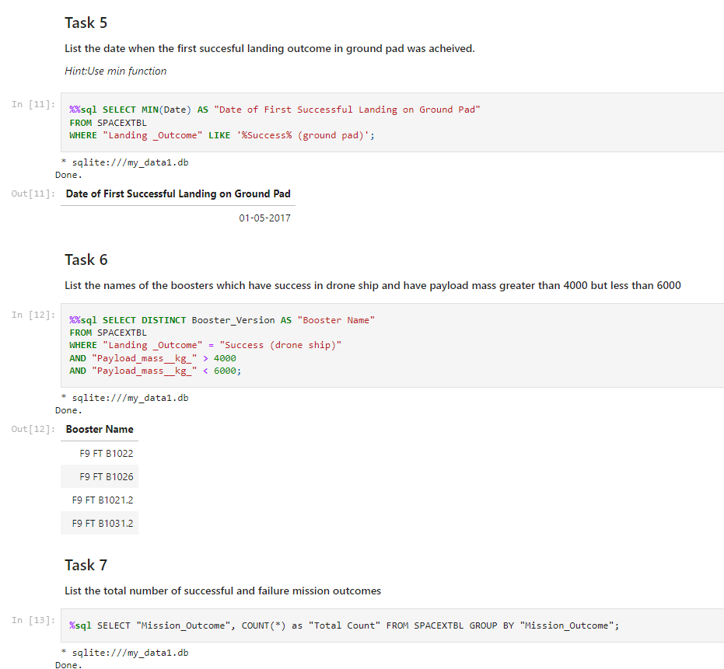
EDA with EDA- SQL

Slide 20
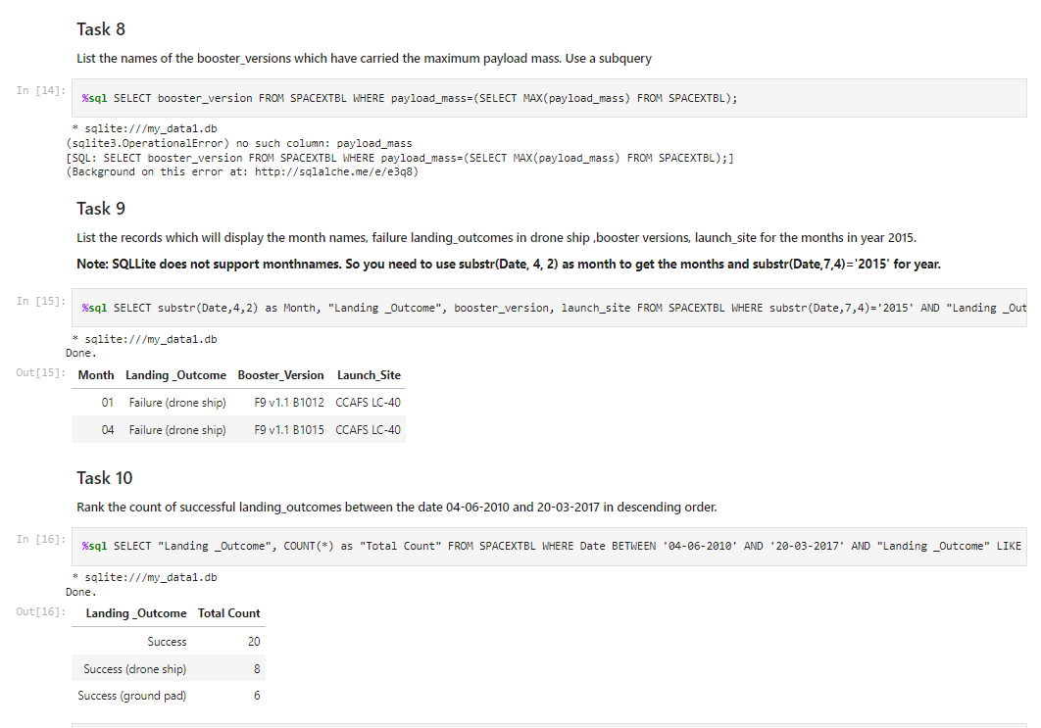
EDA with EDA- SQL

Slide 21
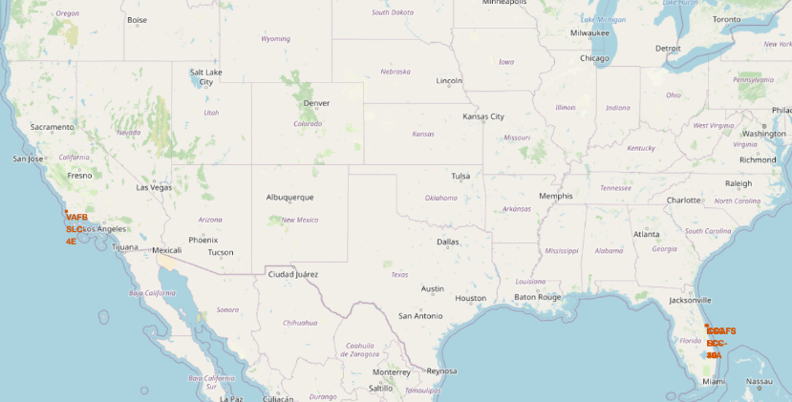
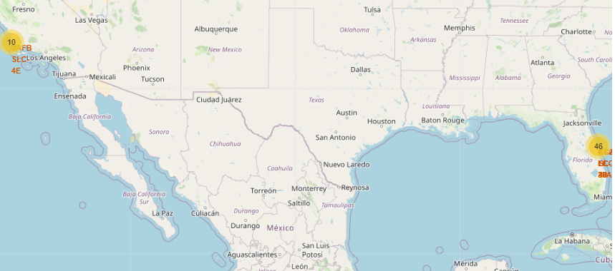
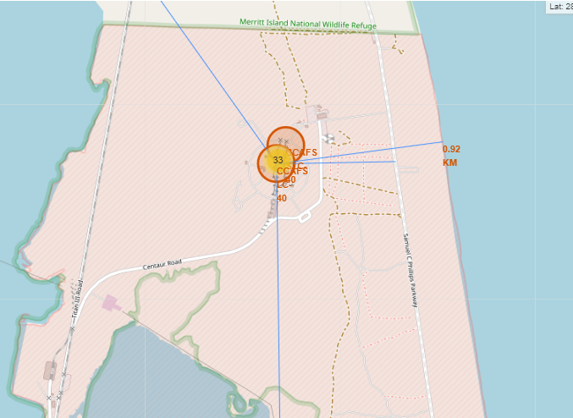

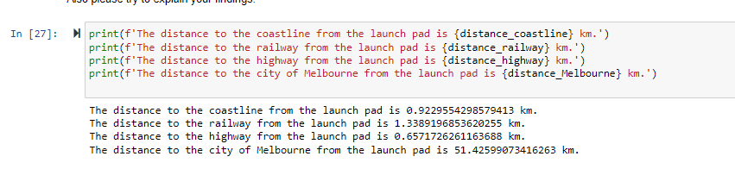
Interactive map with folium results

Slide 22
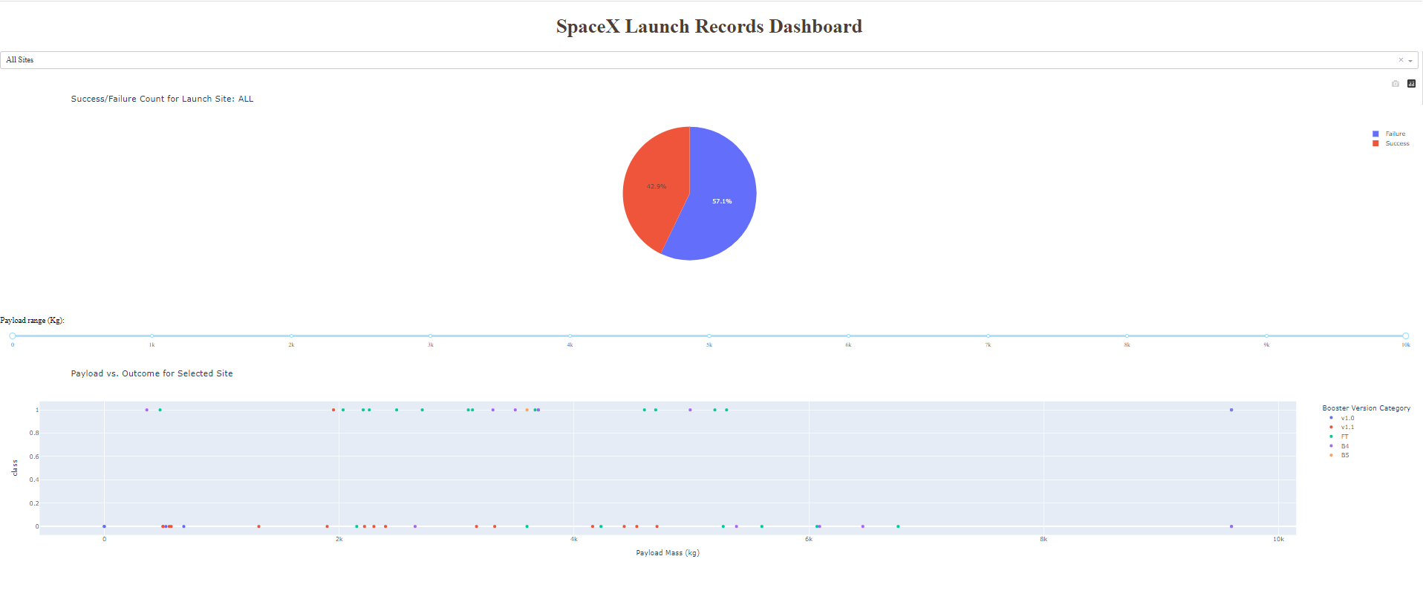
Plotly Dash Results

Slide 23
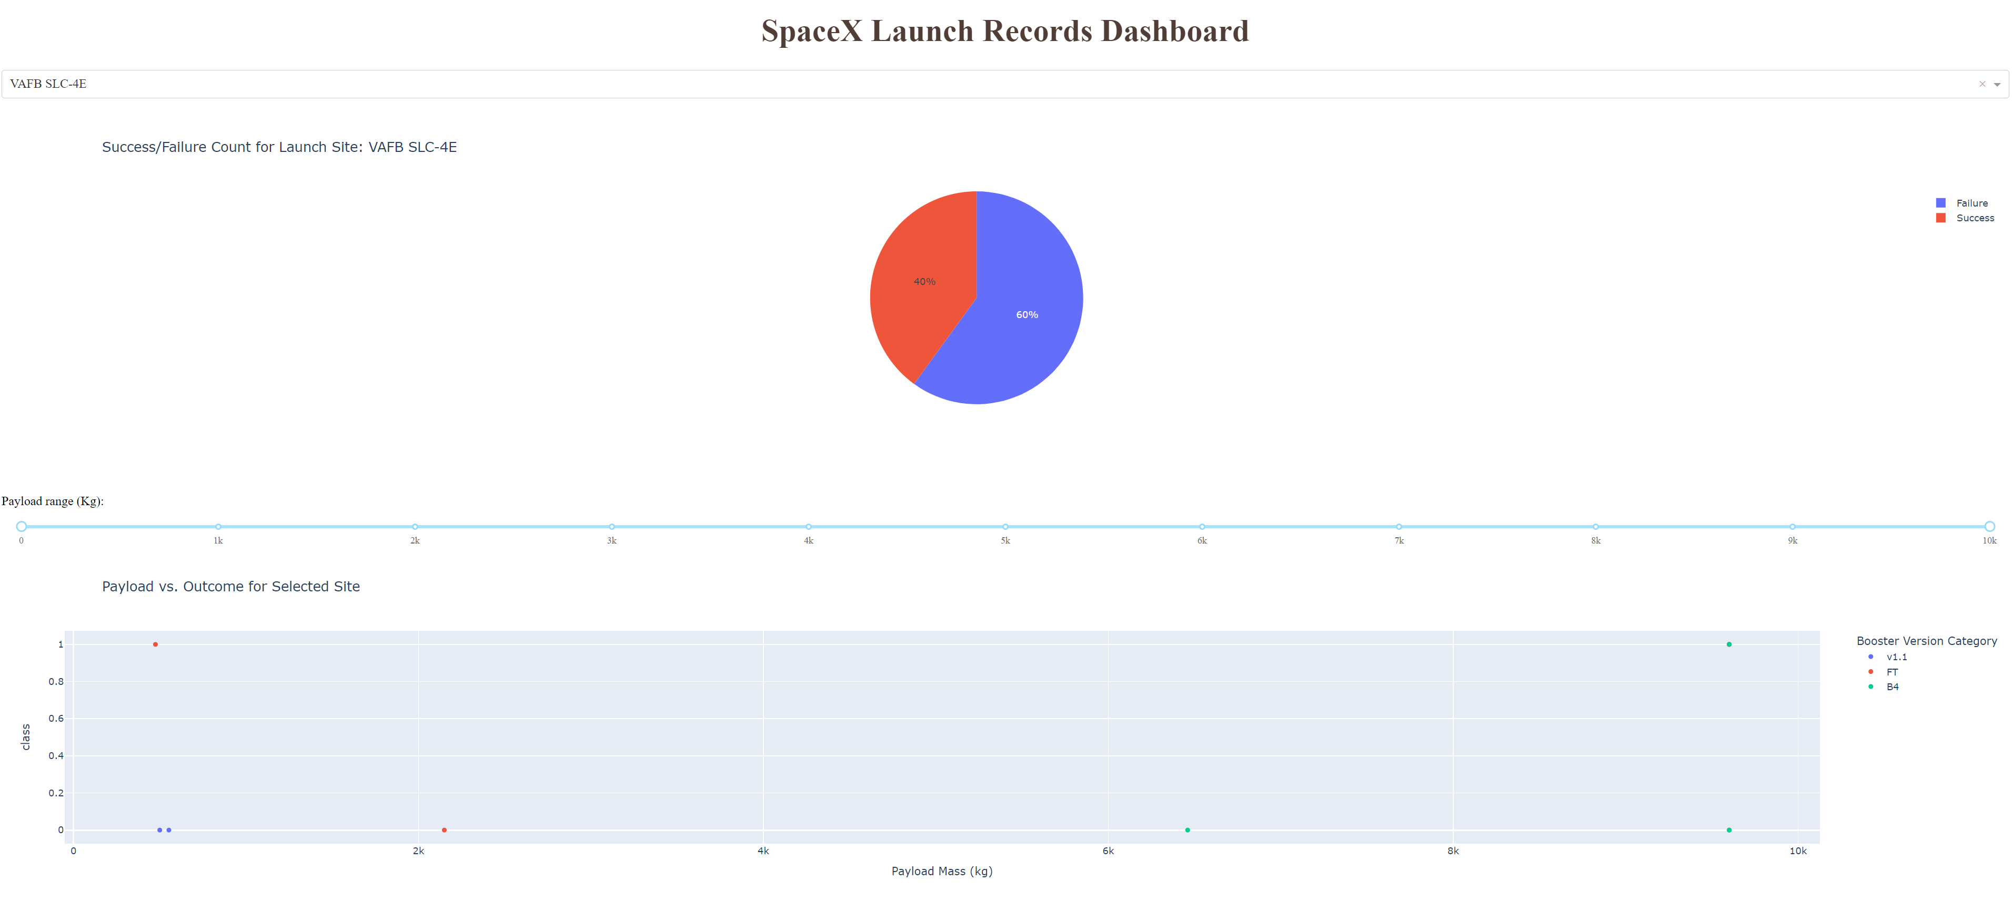
Plotly Dash Results- largest successful launches

Slide 24
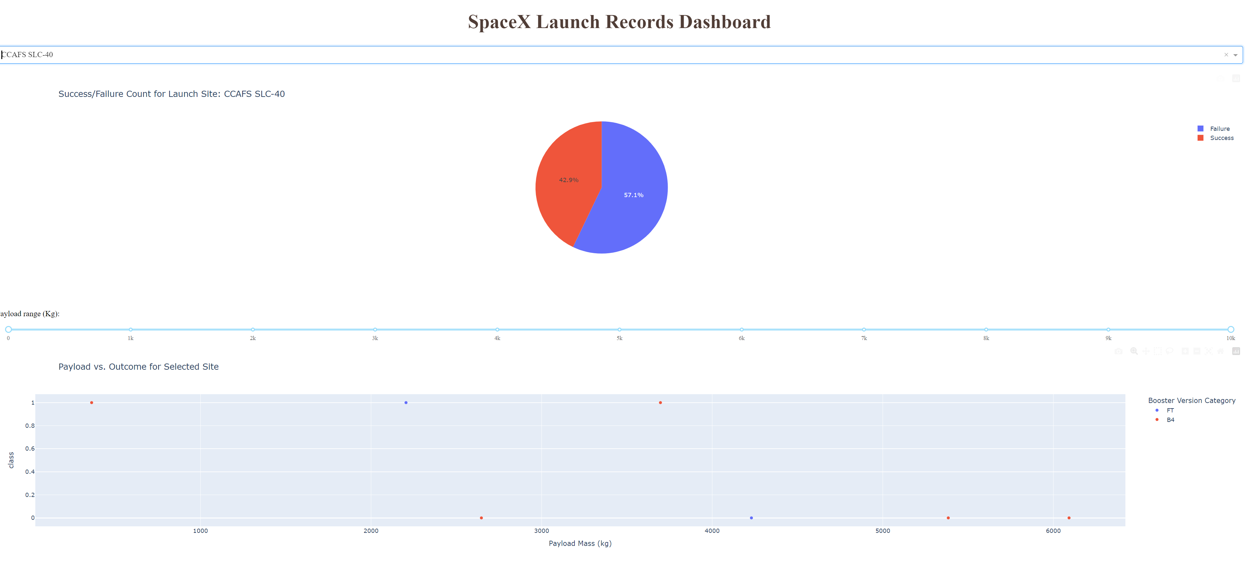
Plotly Dash Results – highest launch success rate

Slide 25
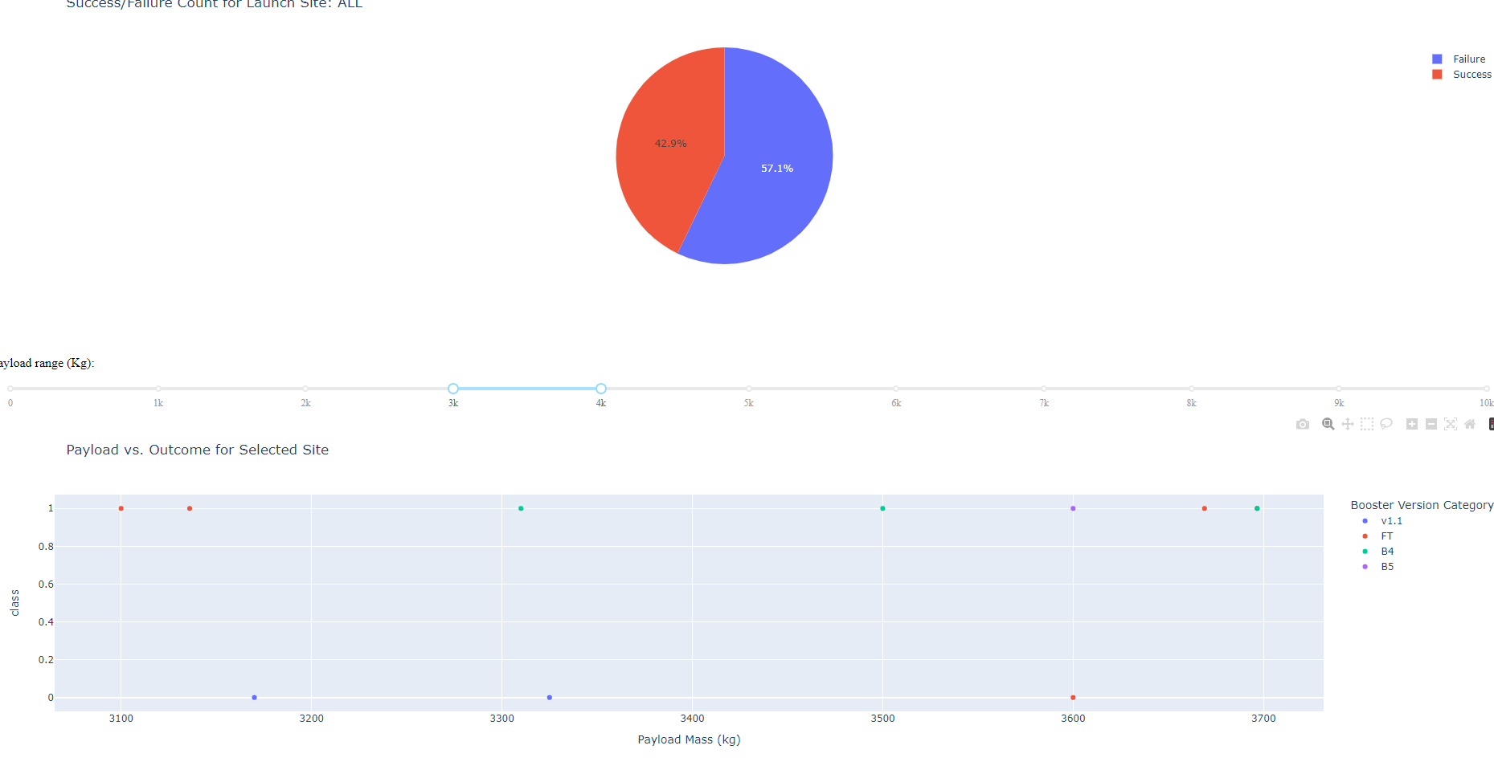
Plotly Dash Results- payload success 3k-4k

Slide 26
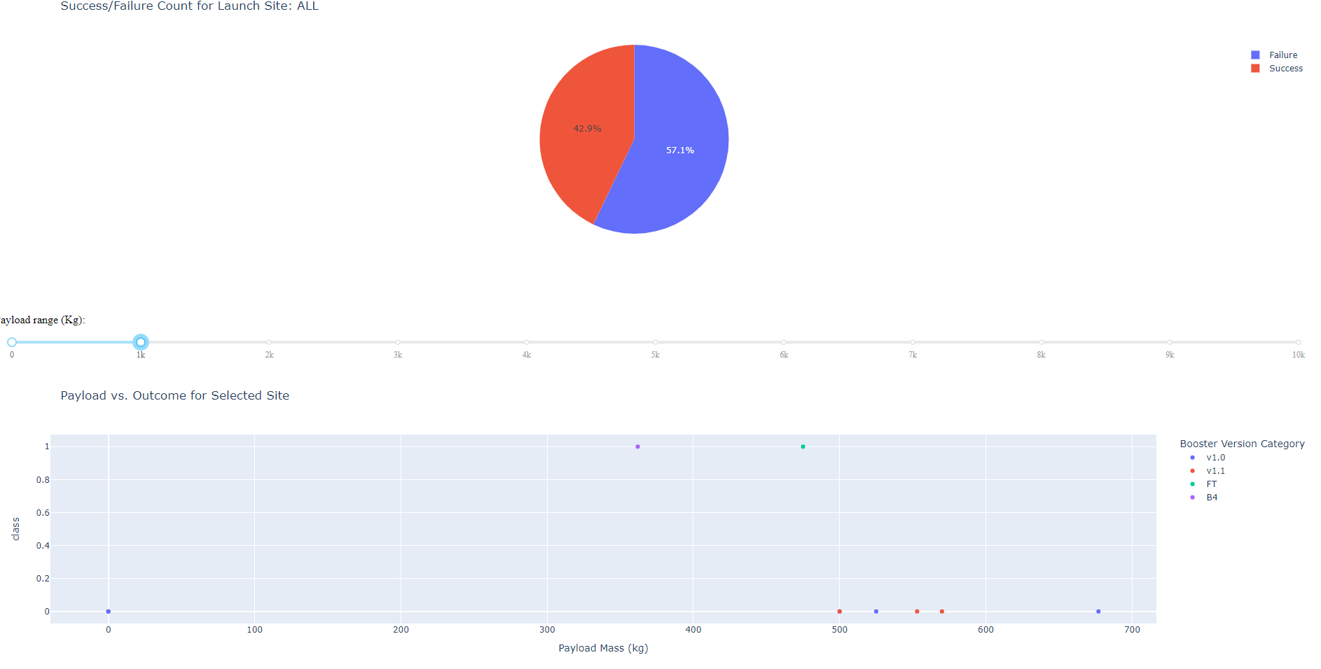
Plotly Dash Results- payload with lowest success rates

Slide 27
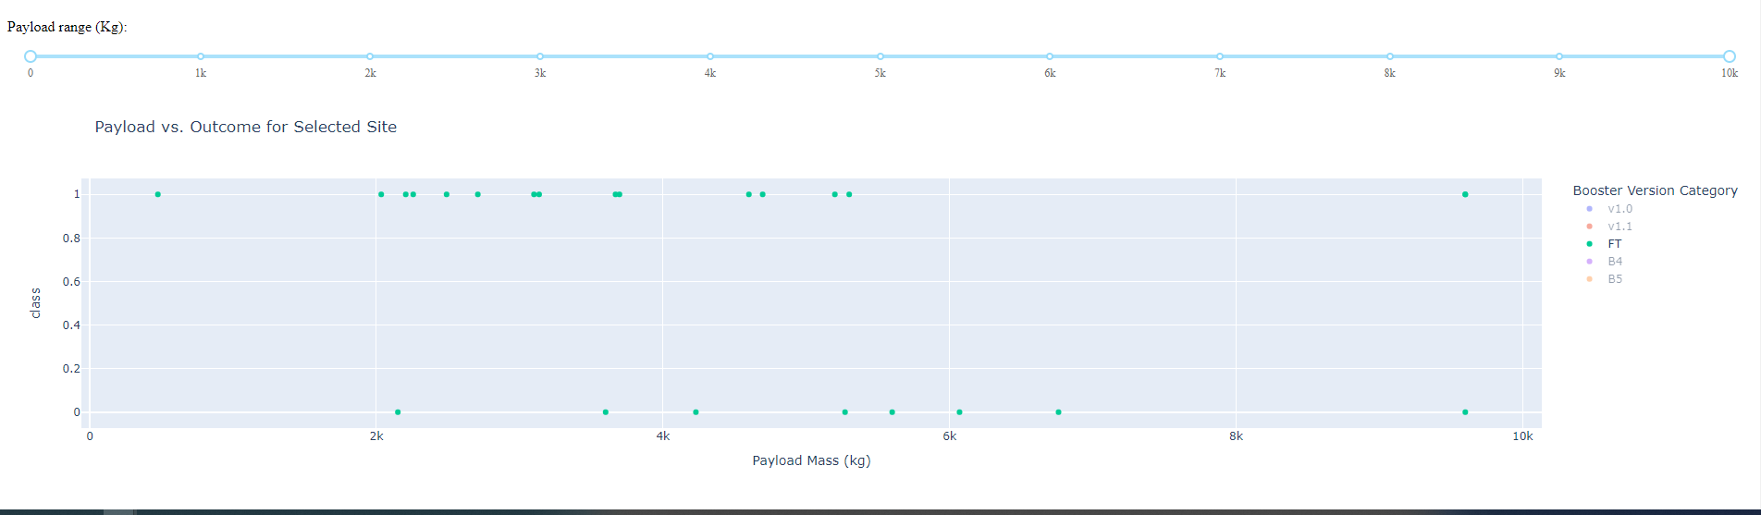
Plotly Dash Results- highest success rated booster- FT

Slide 28
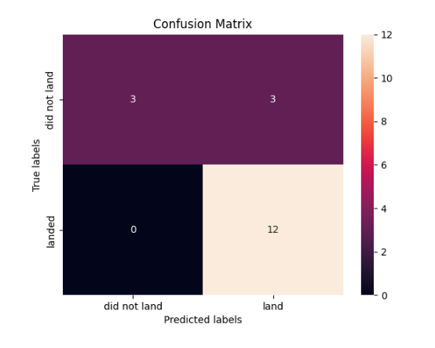
Predicted analysis
We are able to predict 66% of the time
a successful launch retrieval.
We are able to determine
similarly 33% of the time a unsuccessful recovery

Slide 29
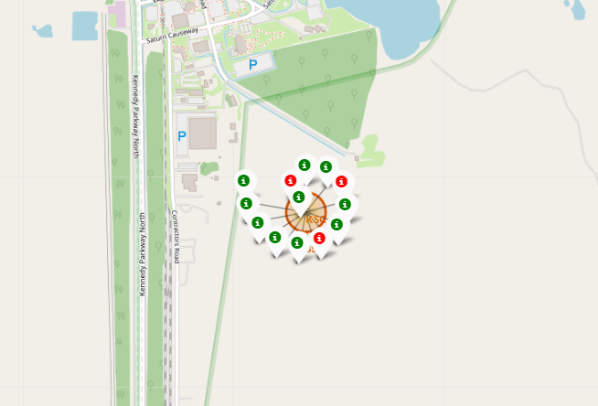
Conclusion
  KSC LC 39a has the highest success rate from the launch sites available. Further insight needs to be placed on why
  This is the case
  Try to keep payloads between 3k and 4k as much as possible to have a increased booster return rate. Avoid the high load and low loads as much as possible.
  Use drone ships as often as possible (ASDS)
  Have boosters poised for geosynchronous orbits to improve return potential.

Slide 30
Innovative insights
There needs to be a full evaluation on the dates which the flights occurred to insure that they were not in the early stage of development. Insight from failed launches early on are outliers which were needed to learn to successfully execute the return effort.
Also , I am skeptical about the launch sites – further analysis needs to be taken on the conditions for which launch site is determined. I would further like to see weather, humidity, wind considered.
As additional tests are run, the modeling would need to be run again to insure that overfitting was not occurring.

Slide 31
The END.
Thank you.
Frederick Duff

