Slide 1

UNIVERSIDAD NACIONAL AUTONOMA DE MEXICO
FACULTY OF ENGINEERING
TEAM MEMBERS:
Aguilar Gonzalez Oscar
Campos Rodriguez Leonardo Jose
Flores Licea Lars Alain
Hernandez Jimenez Diana Lisset
Jorge Romero Fernando
Reyes Marin Alexander

Slide 2

Task Assistant

Slide 3


Slide 4
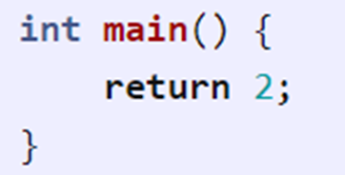
Objective
The objective of this first delivery is to create a functional C compiler using the Elixir language as the core.
Introduce list of tokens
Creating the most important parts of the compiler
lexer
parser
code generator

Slide 5

Introduction
Elixir is a functional programming language. It is built on top of the Erlang virtual machine. It is a dynamic language with a flexible syntax and supported by macros.

Slide 6
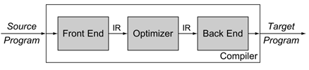
Architecture
The traditional compiler design consists of three parts:

Slide 7

The modules mentioned above process the code sequentially as seen in the following diagram.

Slide 8

The lexer (scanner or tokenizer) is the phase of the compiler that breaks up a string into a list of tokens.
Lexer
Sanitize the code
Create initial list of expressions
Parser
Assign Tokens
Create AST tree structure

Slide 9

The lexer (scanner or tokenizer) is the phase of the compiler that breaks up a string into a list of tokens.
Code Generator
Tour AST
Linker
Call the gcc compiler

Slide 10
Tests
A series of tests were generated in an automated way, with the intention of saving time and making the compiler more efficient.
We use Nora Sandler's recommendations.
The tests are in two folders inside another folder called "test": "valid" and "invalid".

Slide 11
Tests
The "valid" folder has 8 tests that contain different scenarios in the code and the compiler must pass:
multi_digit.c
newlines.c
no_newlines.c
return_0.c
return_2.c: this number is the one specified as the return integer value for this delivery.
spaces.c
OUR TESTS
return002.c
tabulador.c

Slide 12
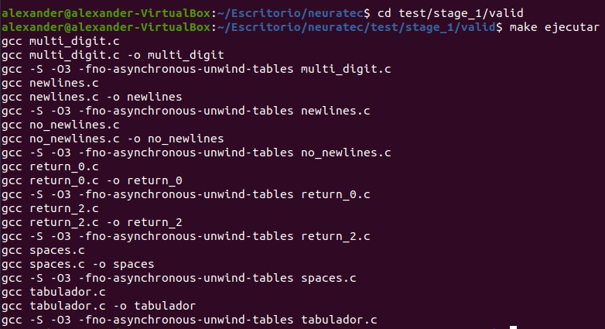
Tests
Inside the folder there’s a make that when called with the command "make ejecutar" executes the automated tests and creates an assembler of the programs.

Slide 13
Tests
The second folder, "invalid", has 11 tests that contain different scenarios in the code and the compiler should reject::
missing_paren.c
missing_retval.c
no_brace.c
no_semicolon.c
no_space.c
wrong_case.c:
OUR TESTS
doble_punto.c - returnC.c.
nt_missing.c - returnLong.c
return2_0.c

Slide 14
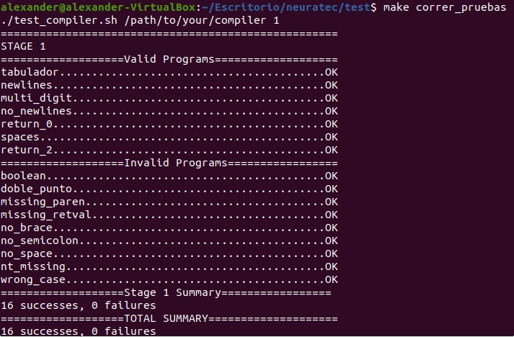
Tests
Inside the "test" folder there’s a make that when called with the "make correr_pruebas" command executes the automated tests of the "valid" and "invalid" folders.

Slide 15
Difficulties
It was a challenge to adapt to a new programming paradigm with the Elixir Language
It was a challenge to adapt to a new programming paradigm with the Elixir Language. Also explore Elixir.
Add a new operative system in our computer.
The organization of the teamwork, cause the coordination through services such meet or zoom is really hard.
The application of the theoretical knowledge for make some useful in the real world.

Slide 16
Conclusions
Through this first installment were thoroughly analyzed the way a compiler works, as well as the components that make it up.
About of architecture, the structure of a compiler need 3 things for be a REAL compiler, the frontend, the optimizer, and the back end.
We need to aplicate all the possible cases for generate a good alpha versión.
Print the ast-tree is important for debug some part of frontend.

Slide 17
Bibliographies
Nora Sandler. (2017). Writing a C Compiler, Part 1. Retrieved on October 1, 2020, from: https://norasandler.com/2017/11/29/Write-a-Compiler.html.
Eng. Norberto Jesus Ortigoza Marquez. (2020). Compilers. UNAM. Faculty of Engineering. Retrieved on November 1, 2020.

