Slide 1
Development of a data monitoring tool for the leming experiment
- Updated Leming browser
Progress Meeting #1
August 6th, 2026

Slide 2
Agenda
01
Evolution of the Data Architecture
Legacy structure → New architecture
02
The New LEMING Browser
Architecture, robustness, maintainability & features
03
Software Architecture
Design principles, classes & implementation
04
Usage Demonstration
Typical workflows and examples
05
Results & Future Work
Performance, conclusions and outlook

Slide 3
Legacy LEMING Browser
Main Capabilities
• ROOT-based graphical interface
• Interactive histogram visualization
• Detector-specific cuts & corrections
• Comparison of two datasets
• Configuration save/load
Workflow
ROOT File → Select Run(s) → Select Histograms→ Draw Histograms

Slide 4
Challenges of the Legacy Implementation
Architecture
• Monolithic implementation
• GUI tightly coupled with data processing
• Histogram logic embedded in GUI
• Growing number of special-case implementations
Maintainability
• Difficult to extend for new detectors
• Slow performance due to the need to load histogram files before analysis.
• File-loading overhead significantly increased startup and browsing times.
• No multi-threading support
• Hardcoded energy & time cuts
• Multiple files modified for new features
• Increasing code complexity
Motivation
A complete redesign was required to support the new BT26 data architecture while improving modularity, maintainability and extensibility.

Slide 5
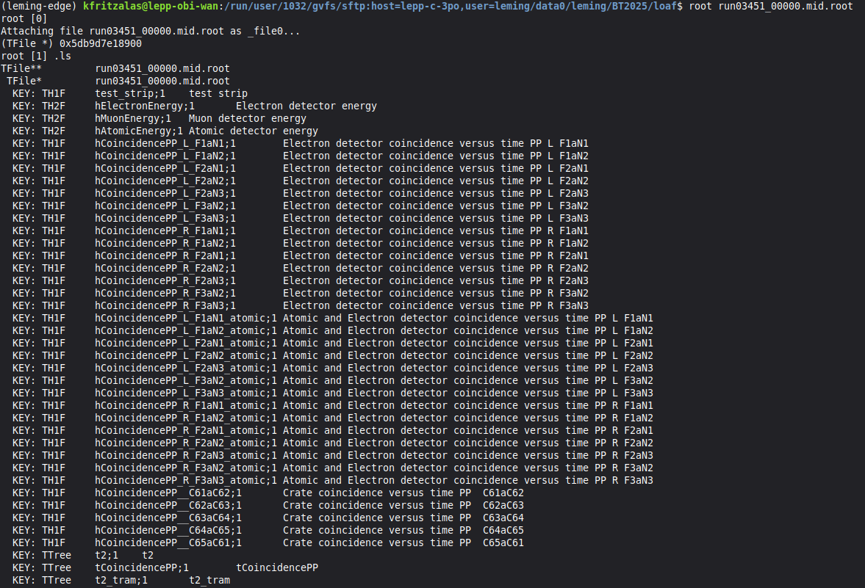
Legacy ROOT File Structure
Highlights
• Precomputed TH1/TH2 histograms stored directly in the ROOT file
• Small number of TTrees with analysis-specific content

Slide 6
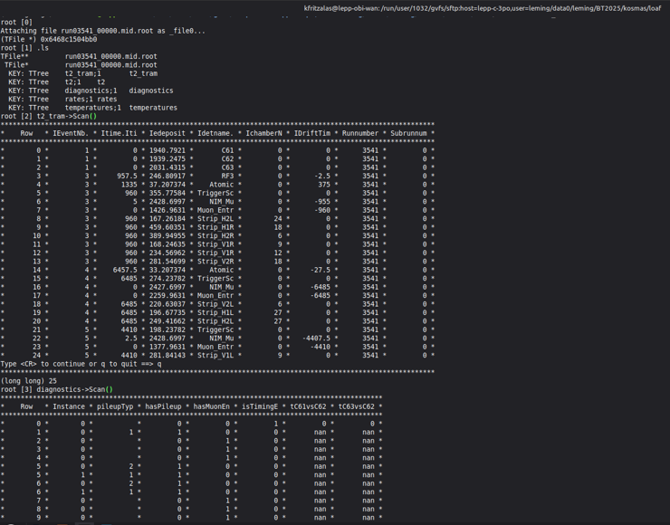
New ROOT File Structure
Highlights
• Event-based TTrees store raw detector information
• Histograms are generated dynamically during processing
• Naturally extensible to additional detectors and observables
• Designed for modular, multi-threaded RDataFrame workflows

Slide 7
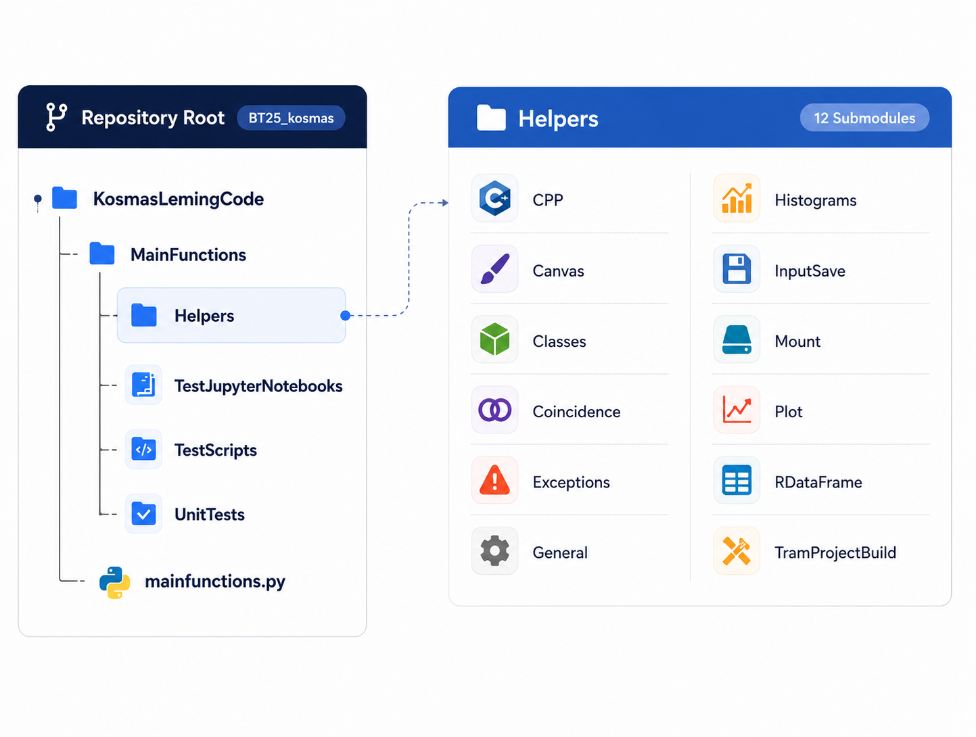
New LEMING Browser –
Code Architecture
New Implementation Improvements
• Multi-threaded processing (work no longer runs in the main thread)
• No GUI dependency — data-processing code can evolve independently
• Modular architecture enables special-case implementations without increasing complexity
• Easily extensible to support new detector types
• Native support for processing multiple datasets
• Processing logic separated into dedicated Python helper modules
• Cleaner, simpler and more maintainable codebase
These architectural improvements are explained in the following slides.

Slide 8
C++ Helper Layer
Why C++ Helpers?
• Core data operations run in ROOT C++, because Python functions (e.g., filtering, grouping, or accessing the first element with get(0)) cannot be executed efficiently in a multi-threaded RDataFrame loop.
• Enable efficient multi-threaded execution through ROOT's C++ backend.
• Python is used for the overall workflow and setup, while the event processing is done in ROOT's multi-threaded C++ backend.
Implemented Helpers
• Detector identification (GetDetectorName)
• Run/Subrun extraction from filenames
• Smart vector filtering for RVec columns
• Mask broadcasting and validation
Result: Fast, reusable C++ primitives that seamlessly integrate with Python and RDataFrame.

Slide 9
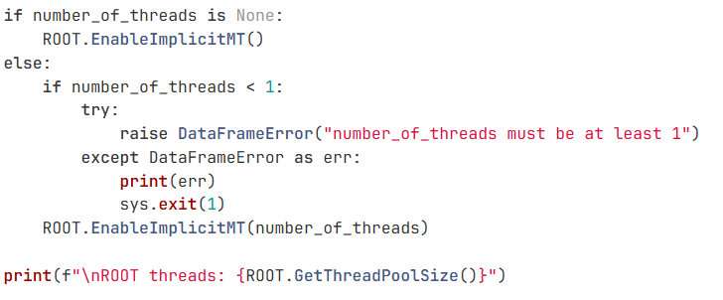
RDataFrame Helper
Main Responsibilities
• Resolve run specifications into ROOT files
• Configure ROOT thread pool
• Add Run/Subrun metadata from filenames
• Apply smart scalar and RVec cuts
• Create derived columns for straight coincidences

Slide 10
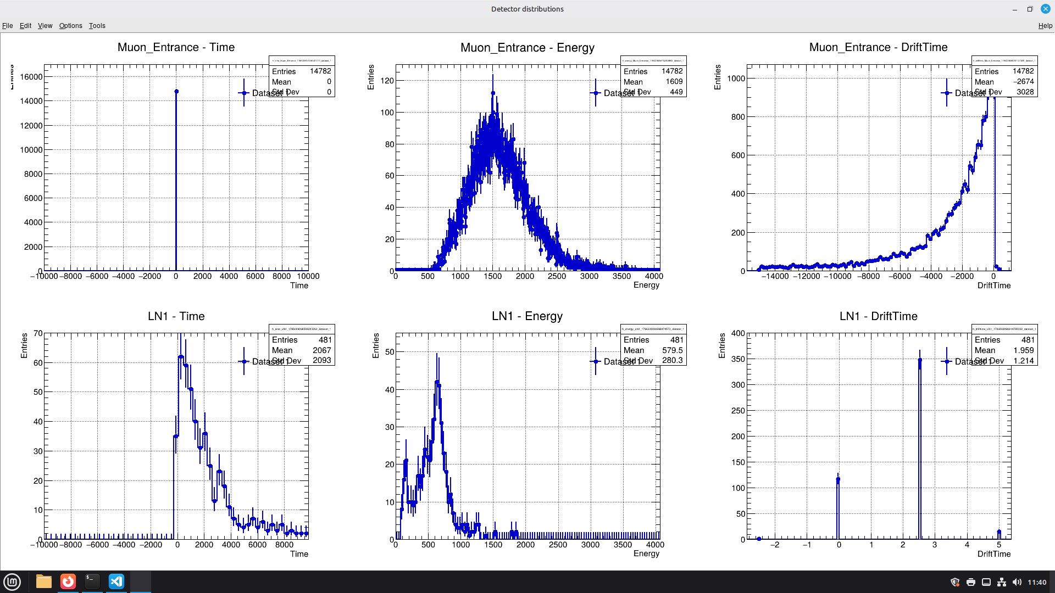
Histogram Helper
Main Responsibilities
• Parse 1D/2D quantity expressions
• Resolve histogram settings from configuration
• Create ROOT TH1/TH2 histograms with RDataFrame
• Support multiple datasets simultaneously
• Apply normalization, lifetime and background corrections

Slide 11
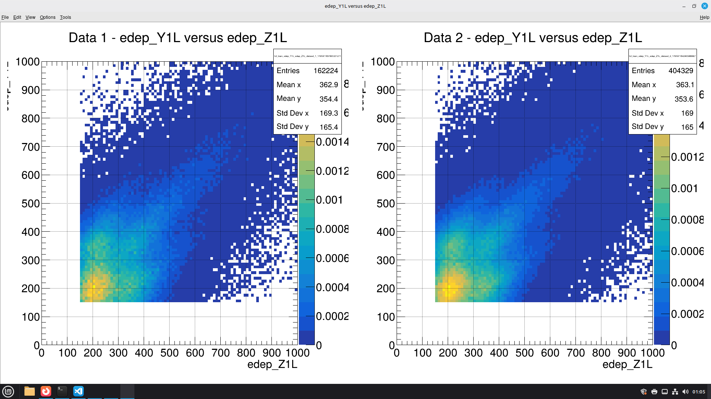
Canvas Helper
Main Responsibilities
• Builds one ROOT TCanvas with one pad per selected quantity
• Handles colors, markers, grids, ticks and legends
• Supports normalized and non-normalized y-axis labels
• Creates separate canvases for each 2D expression
• Uses safe ROOT names for dynamically generated canvas objects

Slide 12
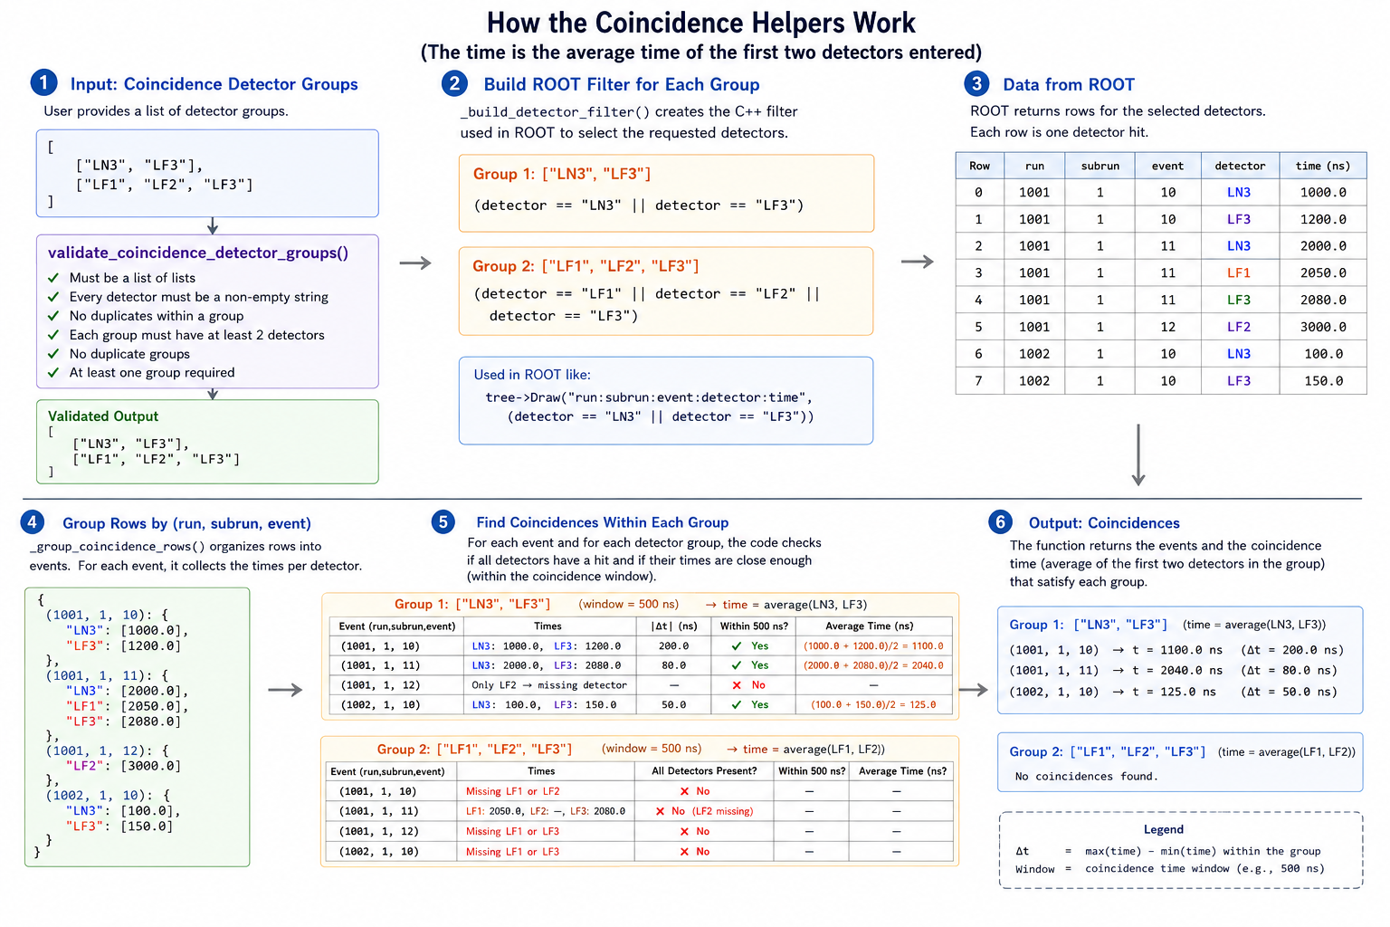
Coincidence Helper
• Filter requested detector combinations
• Group rows by run, subrun and event
• Require each detector exactly once
• Compute coincidence average time from detector pairs
• Automatically determine histogram ranges and labels

Slide 13
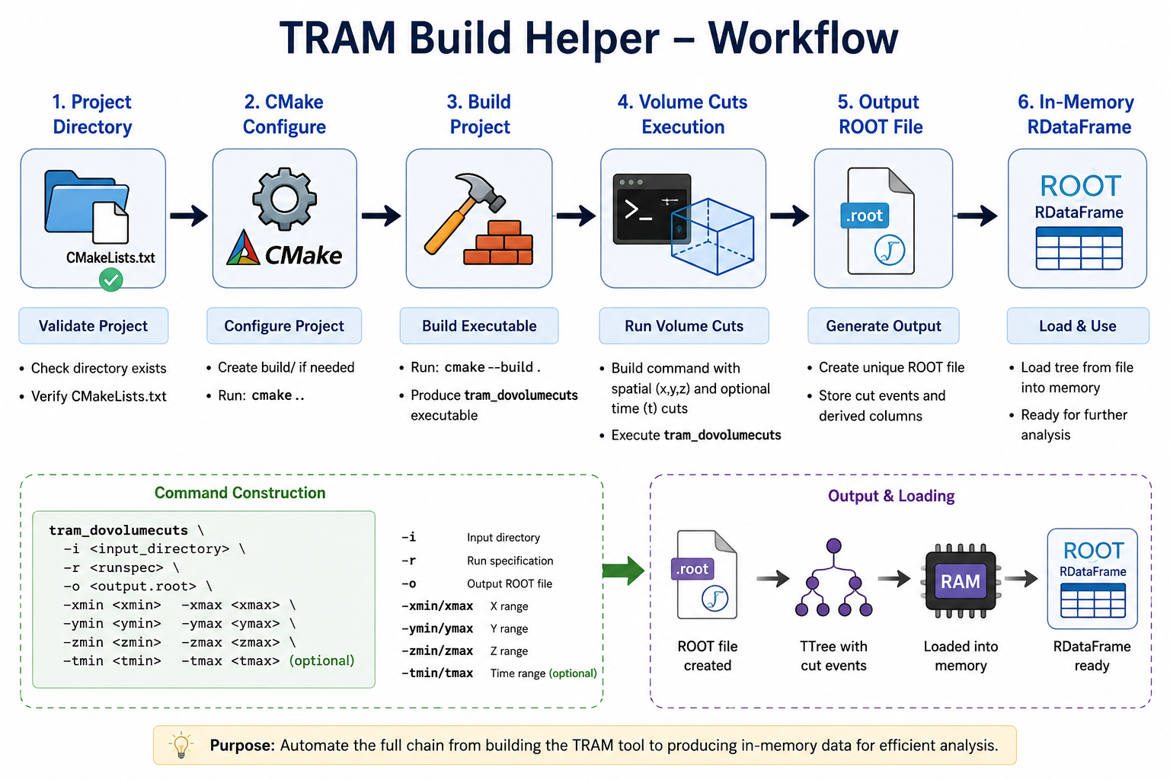
TRAM Build Helper
Key Responsibilities
• Validate TRAM project and CMake configuration
• Automatically configure and build the project
• Generate unique ROOT output files
• Execute volume-cut commands
• Load output TTrees directly into memory
• Clean up temporary files automatically

Slide 14
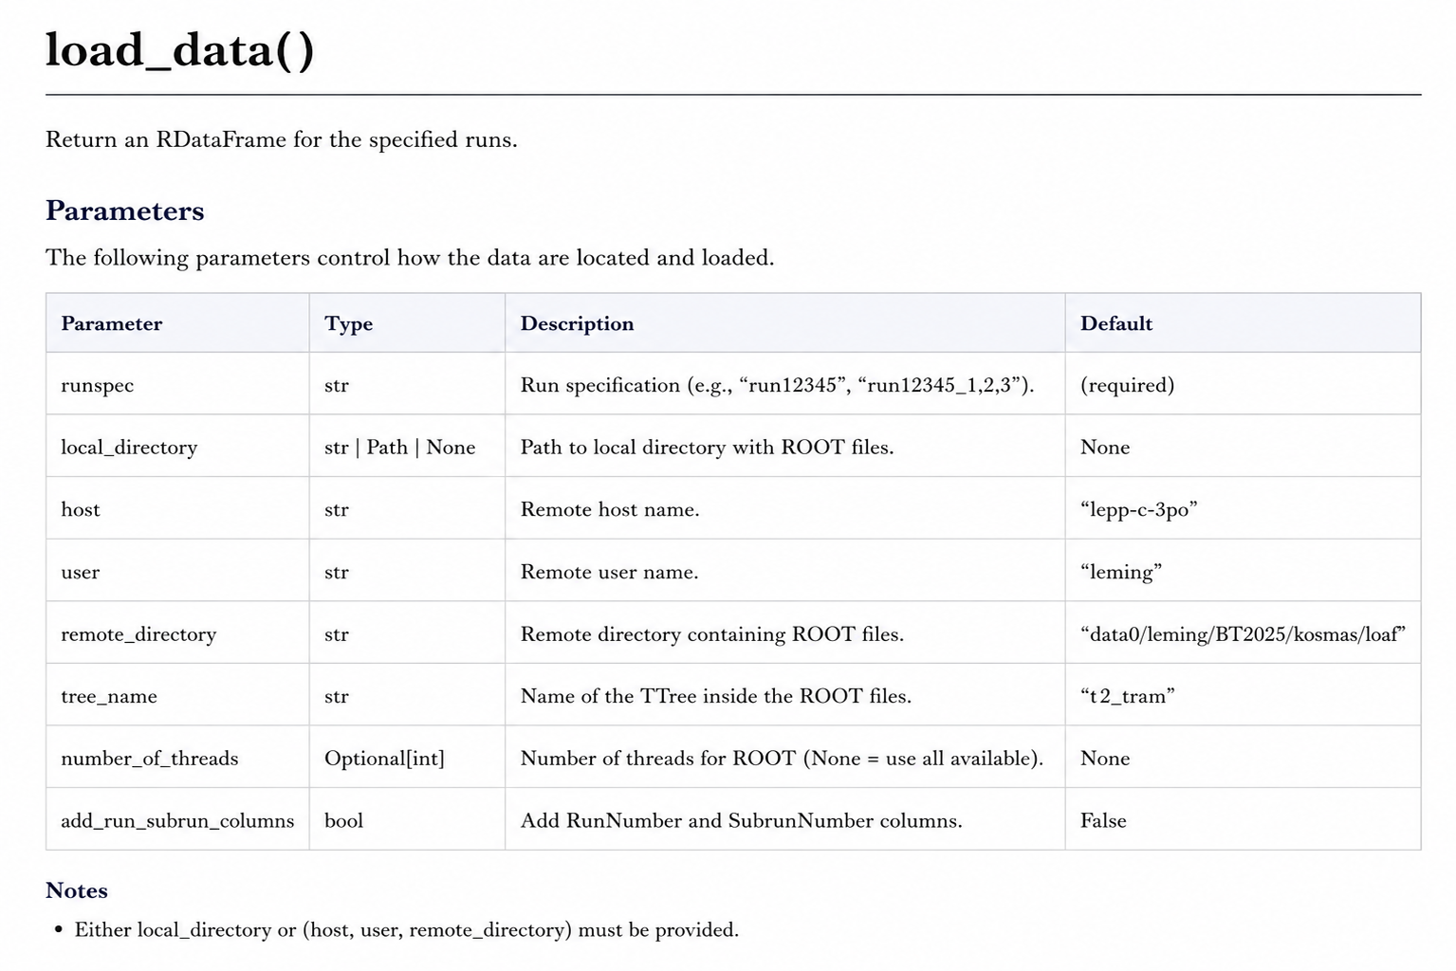
Load Data to RDataFrame

Slide 15
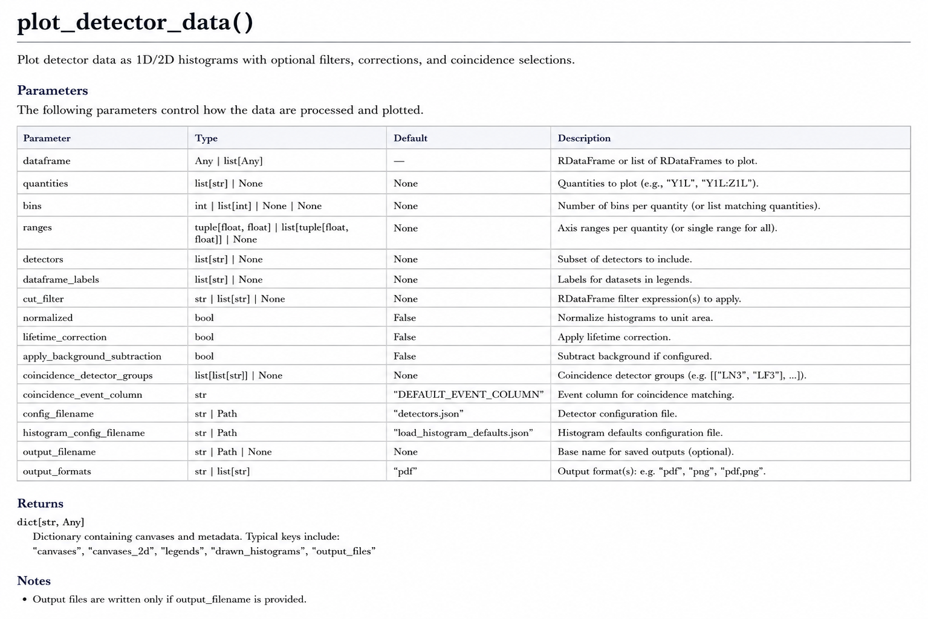
Plot Detector Data from Loaf files

Slide 16
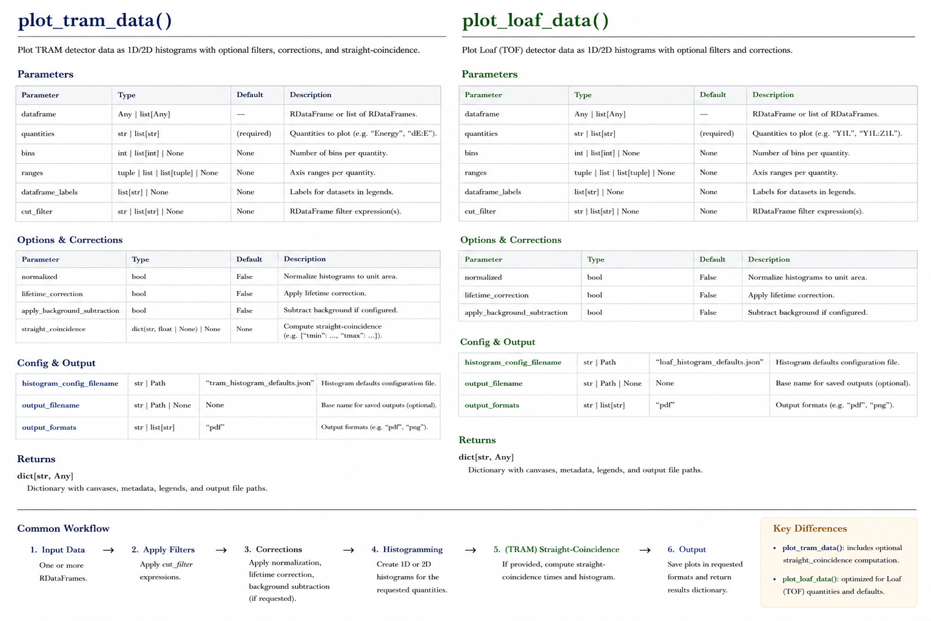
Plot Data from Loaf & Tram files

Slide 17
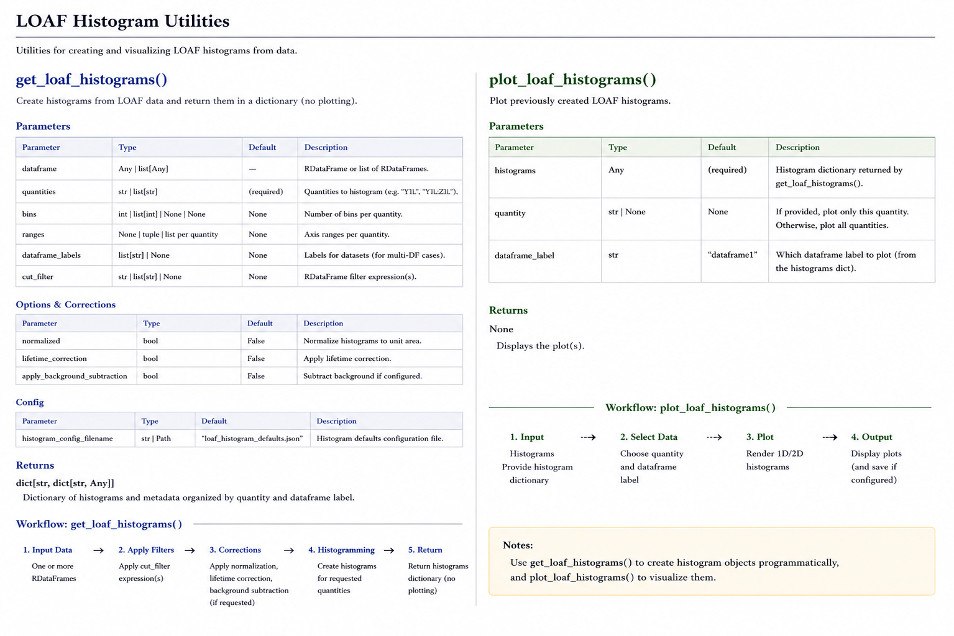
Get Loaf Histograms & Plot Loaf Histograms

Slide 18
Clear Results
Feature | Benefit
Release ROOT objects and canvases | Frees memory after each analysis
Prevent memory leaks | Keeps repeated analyses stable
Close temporary ROOT files | Removes unused in-memory files
Disable implicit multithreading | Useful when multithreading is not needed or causes conflicts
✓ Best Practice: Call exit_detector_data() at the end of every notebook or analysis script to ensure all ROOT resources are released before the next execution.

Slide 19
Live Demonstration

Slide 20
Future Developments
1) muSR Automatic Analysis
Automatically generate muSR plots when the required condition is detected.
2) Ranging Plots
3) Histogram Algebra
Direct addition, subtraction and arithmetic operations between histograms without manual extraction.
4) Live Monitoring Web Dashboard
Web server that automatically updates after each completed run and displays online plots (e.g. hitmaps, scintillators), potentially using the ROOT Web Server.

Slide 21

Thank you!!!

Slide 22
Backup

Slide 23
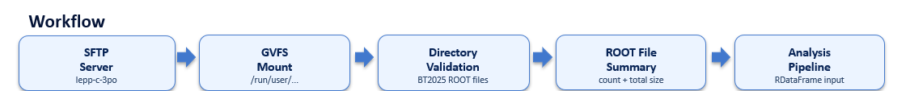
Mount Helper
Why Mounting Helpers?
• Automatically mounts the remote SFTP data location (or a specific local directory)
• Hides connection details from analysis notebooks
• Checks that the target ROOT-file directory exists
• Reports number and total size of available .root files
• Provides clear MountError / DataFrameError failures
Main Responsibilities
• Builds the GVFS mount path from host and user
• Uses gio mount with password handling through pexpect
• Supports both remote mounted data and local directories
• Prints a reusable ROOT-directory summary
• Returns a validated local target directory for processing

