Slide 1
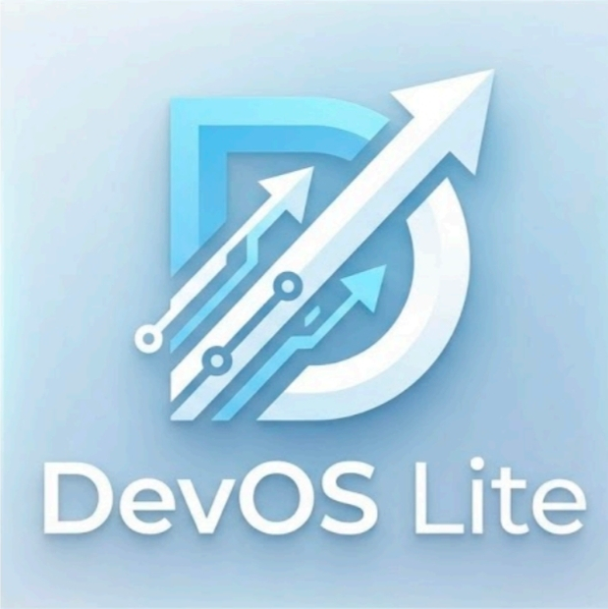
DevOS Lite
A floating AI desktop assistant for code repair, environment setup, and safe project organization.
5 min
90 sec
3 workflows
Cloud + Local
presentation target
live demo
fix, setup, organize
AI routing
Electron
React + TypeScript
IPC safety boundary
Ollama / Cloud AI
Rollback-safe FS ops
DevOS Lite final presentation
01

Slide 2
PROBLEM TO PRODUCT
DevOS Lite compresses scattered developer chores into one guided desktop loop.
Before
After
- Switch between editor, terminal, docs, file explorer
- Floating Shimeji entry point stays available
- Manual setup steps are easy to miss
- AI setup, code repair, and file planning in one app
- Bulk file cleanup can damage project structure
- Preview-first operations before file changes
- AI output still needs safety checks
- Rollback metadata protects applied moves
DevOS Lite final presentation
02

Slide 3
ARCHITECTURE
The system keeps UI, privileged operations, AI routing, and file mutation behind clear boundaries.
React UI
Preload IPC
Electron main
Feature modules
System layer
Shimeji, feature menu, overlays, settings
Typed safe bridge: window.electronAPI
IPC handlers, orchestration, tray/window control
Code Fixer, Env Builder, Organizer, Chat
Filesystem, clipboard, rollback logs, optional Java
AI Router
Safety engine
Cloud APIs or local Ollama; same app workflows
Preview, protected paths, apply, rollback
Key design choice: renderer never directly owns Node/Electron filesystem power.
DevOS Lite final presentation
03

Slide 4
FEATURE PROOF
The demo focuses on implemented workflows, not a mock interface.
Workflow
What it does
Proof in codebase
Demo value
Code Fixer
AI-assisted repair with project-aware flow
CodeFixerAgentOverlay + feature service
Show fix suggestion flow
Environment Builder
Scans package files and setup requirements
detectEnv IPC + scanProject tests
Generate setup steps
File Organizer
Preview, dry-run, apply, rollback
FileOrganizerService + SafeFileOperationExecutor
Move messy files safely
AI Settings
Switch cloud API or local Ollama model
AIRouter, OllamaClient, API client
Show local/cloud routing
Compact demo order: AI Settings -> File Organizer -> Env Builder -> Code Fixer.
DevOS Lite final presentation
04

Slide 5
SAFETY
The strongest engineering decision is preview-first automation with rollback instead of blind file mutation.
Scan
Plan
Preview
Apply
Rollback
Read project files and ignore protected paths
AI or heuristic plan generates proposed moves
User sees risk, moves, and destinations first
Executor creates parent dirs and moves files safely
JSONL batch metadata restores original paths
Guardrails implemented
- Protected paths: .git, node_modules, lockfiles, .env*, build outputs
- Dry-run tests confirm preview does not mutate source files
- Apply + rollback tests verify reversible organization
- User-facing file count excludes internal recovery folders
DevOS Lite final presentation
05

Slide 6
EXECUTION
Member 1 owned the core engineering path; the rest of the team supported around it.
Week 1
Week 2
Week 3
Week 4
Week 5
Concept, stack choice, Electron/React shell
AI routing, settings, first-run setup
Code Fixer and Environment Builder
File Organizer safety, preview/apply/rollback
UI polish, tests, Java optional backend, demo prep
Member 1: Lead engineer / presenter
Architecture, Electron IPC, AI routing, core features, safety engine, tests, demo flow
70%
Member 2: Support
Light UI/content review, small documentation support, demo checklist help
20%
Member 3: Minimal support
Basic slide/demo timing support and final review
10%
DevOS Lite final presentation
06

Slide 7
DEMO HANDOFF
The live demo should prove the product loop in 90 seconds.
0:00-0:15
Open Shimeji and show AI Settings
Cloud/local routing is configurable
0:15-0:45
Run File Organizer preview on sample clutter
Preview before apply, clean destinations
0:45-1:05
Show apply/rollback status
Automation is reversible
1:05-1:25
Open Environment Builder or Code Fixer
Same assistant handles setup or repair
1:25-1:30
Close with architecture sentence
Safe desktop AI, not just a chatbot
Closing line: DevOS Lite is a safe AI workflow layer for local developer work.
DevOS Lite final presentation
07

