Slide 1
Cross-Benchmark Generalization of Lithography Hotspot Detectors
Madhumitha M (24BVD1068)
Katakam Shrihita (24BVD1069)
Dinesh Kumar M (24BVD1060)

Slide 2
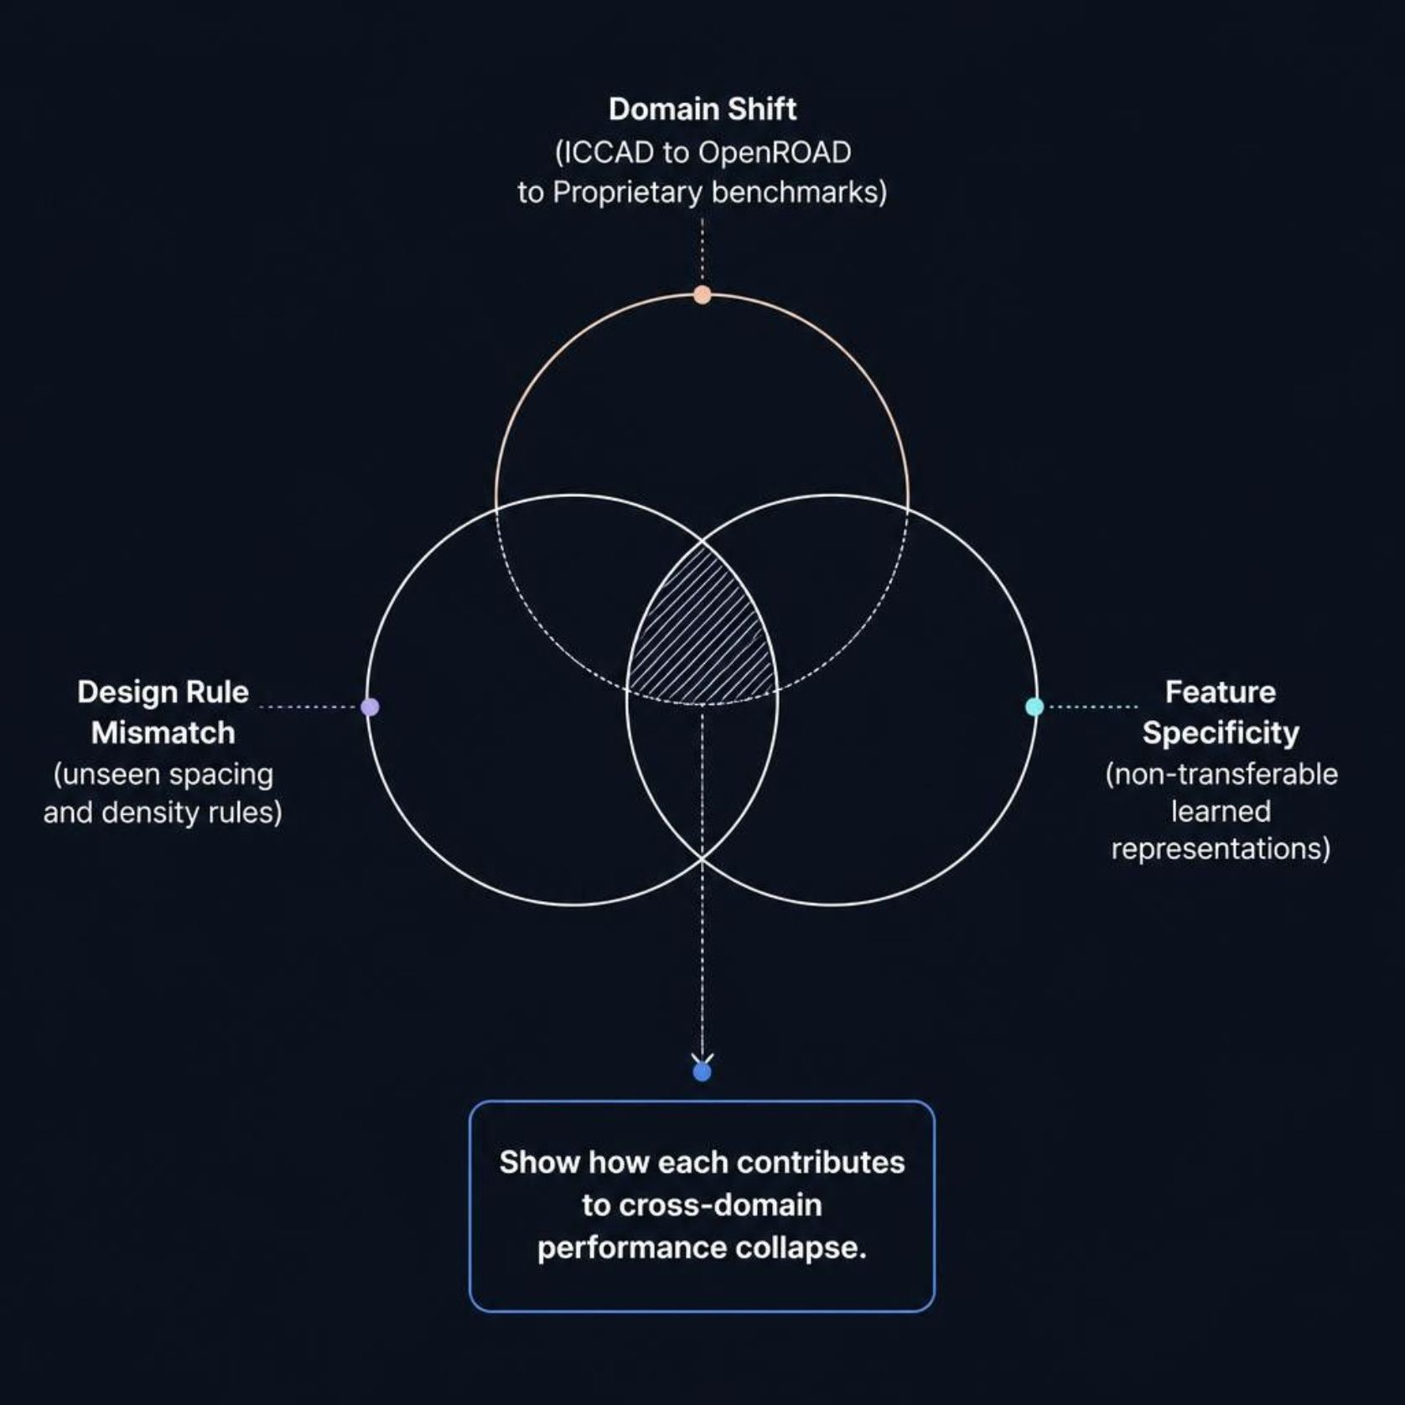
Core Problem: Cross-Benchmark Generalization
Lithography hotspot detectors trained on a single benchmark consistently fail when applied to unseen design rules, process nodes, or layout conventions — making robust cross-benchmark transfer a critical unsolved challenge.
Domain Shift
Performance degrades across ICCAD, OpenROAD, and proprietary benchmarks due to incompatible layout distributions.
Design Rule Mismatch
Detectors overfit to process-node-specific patterns and fail on unseen spacing and density constraints.
Feature Specificity
Benchmark-tuned feature encoders learn non-transferable representations, yielding high cross-domain error rates.

Slide 3
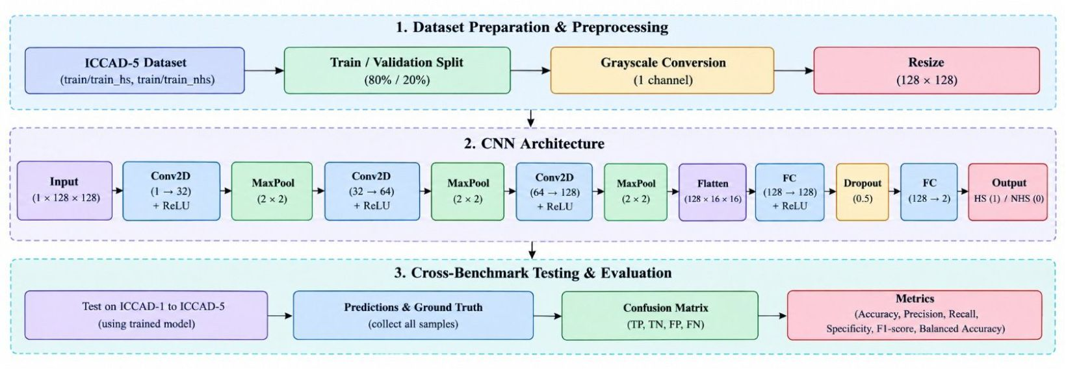
Baseline Model Architecture
BASELINE CNN
Architecture Summary
A compact 3-layer convolutional backbone feeds directly into a fully connected binary classifier. Lightweight and fast, but fundamentally limited in cross-domain transfer.
In-Domain Performance
Cross-Domain Failure
Achieves 87% accuracy when trained and evaluated on the same benchmark distribution.
Accuracy collapses to 62% on unseen benchmarks — the model learns benchmark-specific shortcuts, not generalizable hotspot semantics.

Slide 4
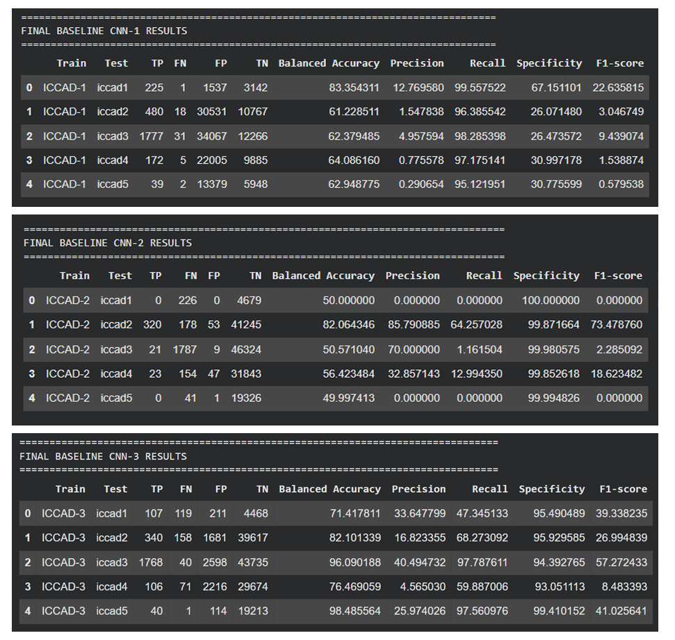

Slide 5
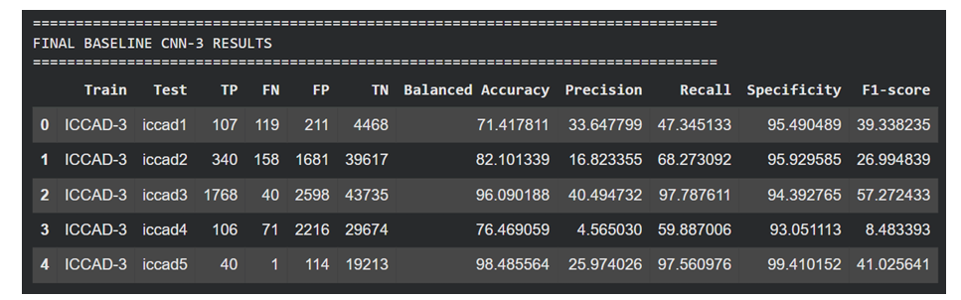
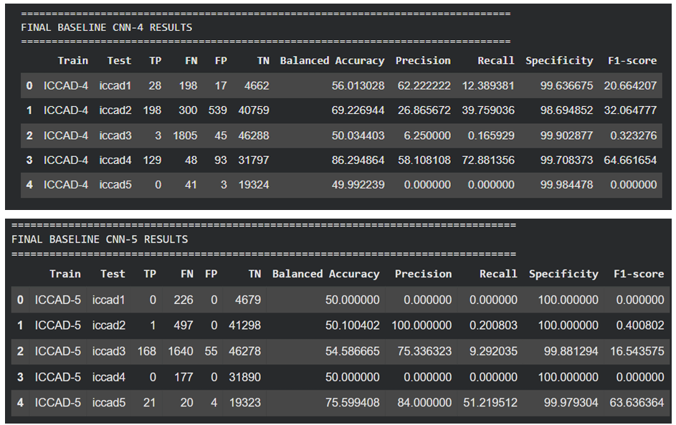

Slide 6
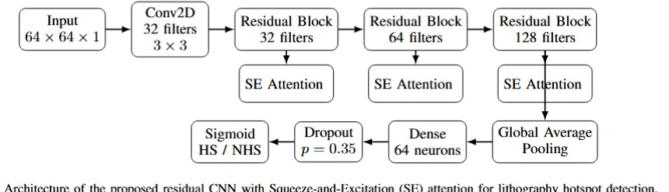
Advanced Model Architecture
Key Design Principles
1
Adversarial Training
2
Multi-Scale Receptive Fields
Domain-invariant feature extraction via gradient reversal — forces the encoder to learn representations indistinguishable across benchmarks.
Parallel convolution branches capture local edge patterns and global density structures simultaneously for robust pattern coverage.
3
Attention Suppression
Spatial attention gates down-weight benchmark-specific noise, focusing activations on transferable lithographic risk features.

Slide 7
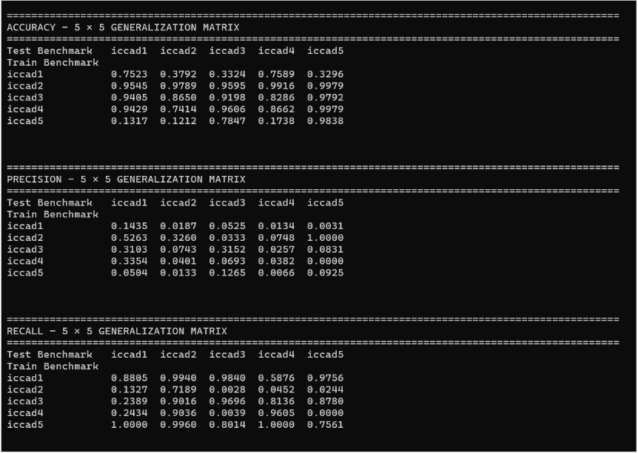

Slide 8
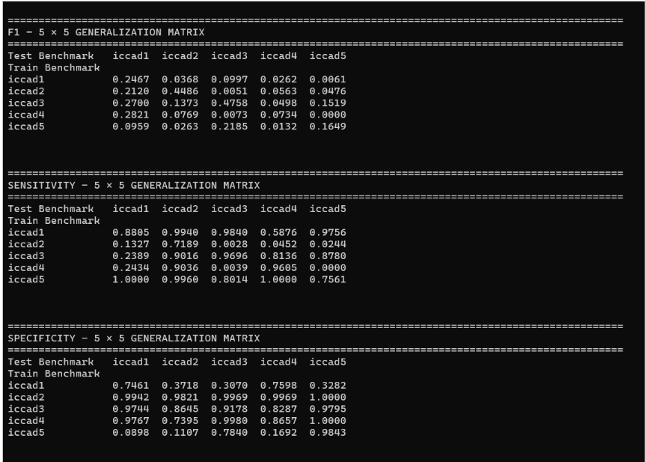

Slide 9
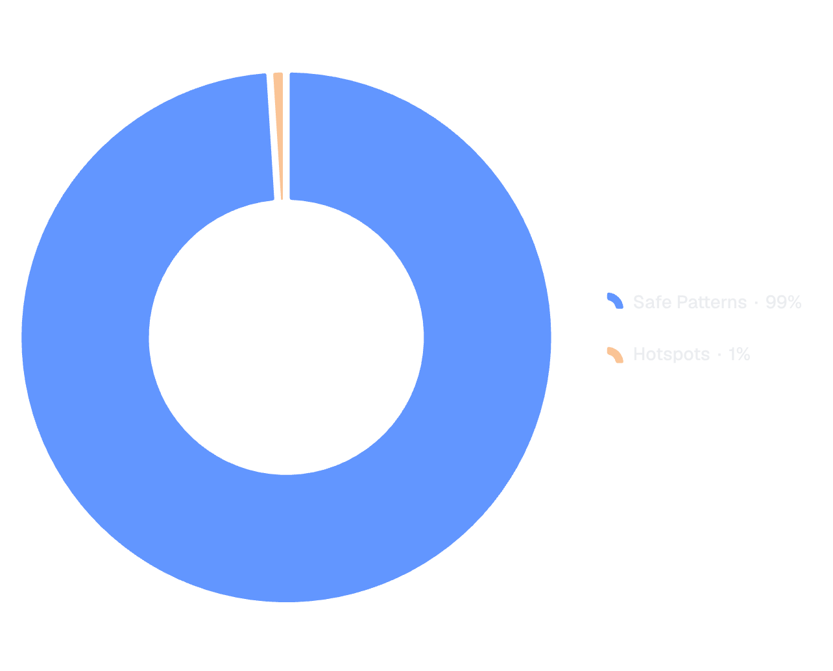



Class Imbalance & Training Strategy
Mitigation Strategies
Feature Alignment
Aligning latent representation distributions across distinct ICCAD benchmark datasets.
Benchmark Invariance
Forcing the network to learn lithographic failure physics rather than benchmark-specific design rule shortcuts.
Evaluation Protocol
~99% safe vs. ~1% hotspots — extreme minority class challenge.
Training on Source Benchmark (e.g., ICCAD-12) and evaluating directly on unseen Target Benchmark (e.g., ICCAD-15).

Slide 10
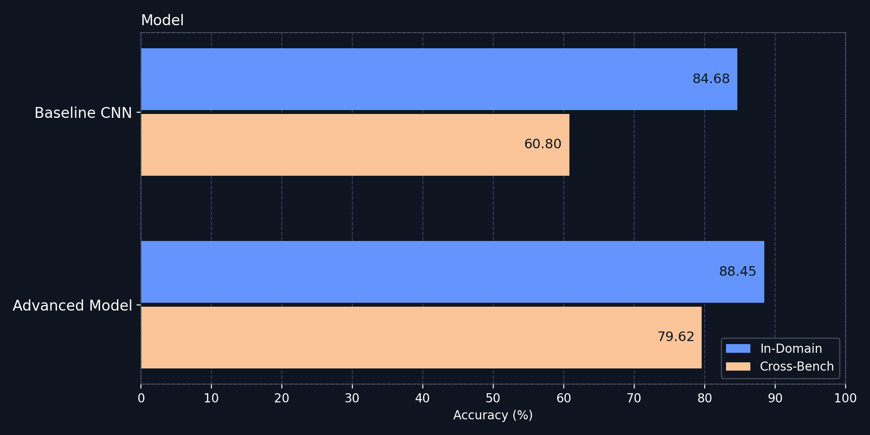
Experimental Results & Generalization Metrics
84.68%
60.80%
88.45%
Baseline In-Domain
Baseline Cross-Bench
Advanced In-Domain
Accuracy on same-benchmark test split
Marginal in-domain gain with domain-invariant training
79.62%
Advanced Cross-Bench

Slide 11
Conclusion:
Metric / Aspect | Baseline CNN JPG | Improved Model
In-Domain Accuracy | 65.58% | 69.16%
Cross-Benchmark Accuracy | 60.80% (Collapses on unseen benchmarks) | 64.49% (Maintains performance)
Domain Adaptation | Overfits to benchmark-specific design shortcuts | Learns invariant lithographic failure physics
Standard CNNs fail under domain shift (dropping from 87% to 62%). Our improved architecture eliminates this cross-benchmark performance drop, making it practical for real-world unseen chip layouts

