Slide 1
Matrix Multiplication
Arquiteturas Avançadas
Computação Paralela Distribuída
Filipe Silva – A77284
João Alves – A77070

Slide 2
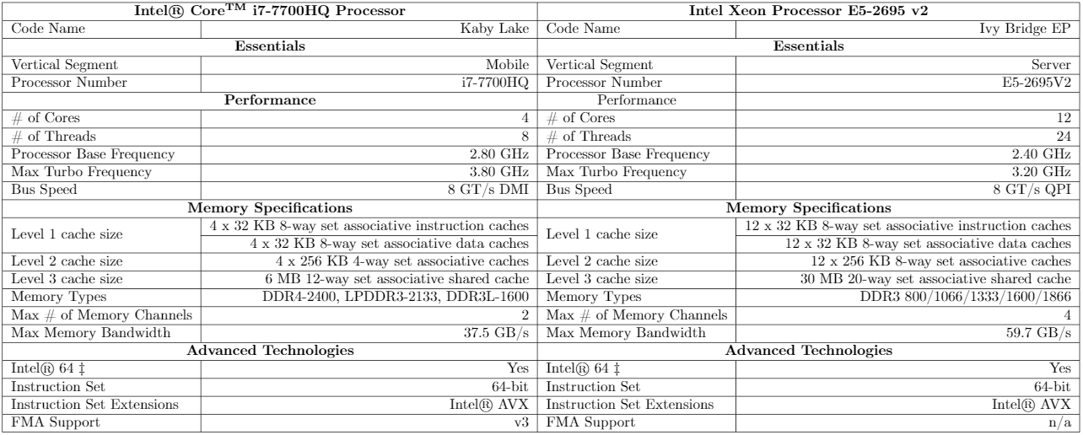
Machines Evaluation

Slide 3
First Implementation
Level of hierarchy | Matrix Size
L1 Cache | 32 X 32
L2 Cache | 128 X 128
L3 Cache | 1024 X 1024
External RAM | 2480 X 2048
Table 1: Matrix Sizes Per Cache Level and RAM
Algorithm | 32 X 32 | 128 X 128 | 1024 X 1024 | 2480 X 2048
IJK | 0.037 | 2.820 | 2972.836 | 23635.89
IJK Transposed | 0.037 | 2.30 | 1139.97 | 9067.64
IKJ | 0.033 | 1.91 | 970.51 | 7732.51
JKI | 0.046 | 7.096 | 17431.63 | 80917.90
JKI Transposed | 0.036 | 1.980 | 993.18 | 7851.90
Table 2: Time to execute each algorithm in milliseconds

Slide 4
First Implementation
Algorithm | 32 X 32 | 128 X 128 | 1024 X 1024 | 2480 X 2048
IJK | 7648 | 33856 | 12598528 | 50425248
IJK Transposed | 6720 | 38240 | 5756736 | 20594112
IKJ | 5696 | 35744 | 2372224 | 9749216
JKI | 9376 | 41472 | 12598080 | 4109140608
JKI Transposed | 9120 | 44160 | 8804032 | 57449952
Table 3: Total Data Transfer from/to the RAM
Algorithm | 32 X 32 | 128 X 128 | 1024 X 1024 | 2480 X 2048
IJK | 66267 | 4817848 | 5051118689 | 39683603954
IJK Transposed | 66734 | 4211814 | 2151443339 | 17193516166
IKJ | 65751 | 4201307 | 2155812135 | 17230299574
JKI | 68044 | 8754927 | 24426419447 | 123686000000
JKI Transposed | 65947 | 4199800 | 2153748279 | 17211330368
Table 4: Total Floating Point Operations Executed per Algorithm

Slide 5
First Implementation
Algorithm | Cache Level | 32 X 32 | 128 X 128 | 1024 X 1024 | 2048 X 2048
Normal | L1 | 0.32 | 50.84 | 50.05 | 50.06
 | L2 | 47.28 | 0.21 | 99.97 | 99.65
 | L3 | 94.86 | 10.83 | 0.02 | 0.01
Transposed | L1 | 0.31 | 3.25 | 3.18 | 3.15
 | L2 | 41.95 | 0.52 | 3.15 | 2.8
 | L3 | 93.48 | 71.46 | 4.13 | 1.94
Table 5: Cache misses in percentage for IJK

Slide 6
Optimizations
First Implementation
Vectorization
Correct Use of Cache
Blocking

Slide 7
Vectorization
Algorithm | 32 X 32 | 32 X 32 Vec | 128 X 128 | 128 X 128 Vec
IJK Transposed | 0.037 | 0.009 | 2.30 | 0.59
IKJ | 0.033 | 0.009 | 1.91 | 0.56
JKI Transposed | 0.036 | 0.01 | 1.980 | 0.609
Table 6: Non Vectorized VS Vectorized Code

Slide 8
Paralelization
Algorithm | 2048 X 2048 | 2048 X 2048 Par
IJK Transposed | 9173 | 298.885
IKJ | 9175 | 223.53
JKI Transposed | 9182 | 325.403
Table 7: Non Parallel VS Parallel Code

Slide 9
GPU Implementation
Algorithm | 2048 X 2048 Intel Xeon | 2048 X 2048 Nvidia Kepler
IJK Transposed | 9173
IKJ | 9175
JKI Transposed | 9182
Table 8: Intel Xeon Processor E5-2695 v2 VS Nvidia Kepler

Slide 10
Matrix Multiplication
Arquiteturas Avançadas
Computação Paralela Distribuída
Filipe Silva – A77284
João Alves – A77070

