Slide 1
Project Presentation: IE500 Data Mining
Ethnic Bias and Generalization in Facial Attractiveness Prediction from Geometric Beauty Markers
Team Number: 3
Maxim Froehlich, David Siregar, Timon Kuhl, Lars Bullmahn, Simon Heinz

Slide 2
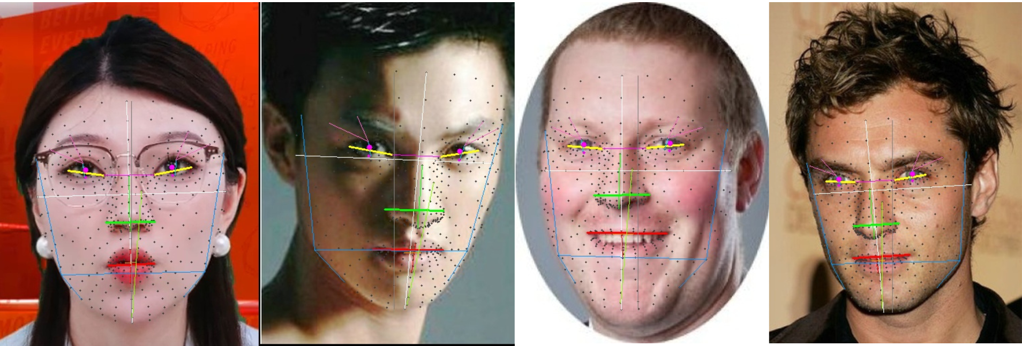
Problem Statement
Real world decisions
Social Media Recommendations
Surgical planning
employment
Facial features
Cultural preferences
Social stereotypes
Perceived Facial attractiveness
influences
influence

Slide 3
Dataset Overview
Dataset | N | Scale | Ethnicities | Raters/Image
SCUT-FBP5500 | 5.500 | 1-5 | Asian, Caucasian | 60
MEBeauty | 2.370 | 1-10 | 6 groups | ~300
LiveBeauty | 10.000 | 1-5 | Asian | ~20
Combined: 17,870 faces

Slide 4
Ethnic Distribution
Ethnicity | N | %
Asian | 14,351 | 80.3%
Caucasian | 2,480 | 13.9%
Black | 296 | 1.7%
Hispanic | 296 | 1.7%
Mid-Eastern | 291 | 1.6%
Indian | 156 | 0.9%
Heavy imbalance
80% Asian faces due to the LiveBeauty dataset. minority groups have very few samples

Slide 5
Research Questions
Generalization
RQ1: Do models generalize across ethnicities?
Interpretability
RQ2: Which geometric facial measurements drive attractiveness predictions across ethnic groups

Slide 6
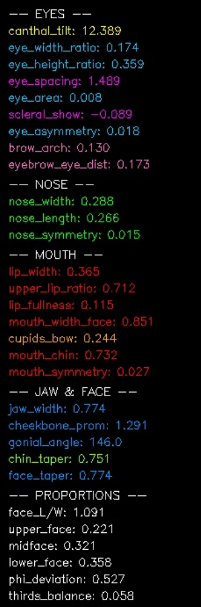
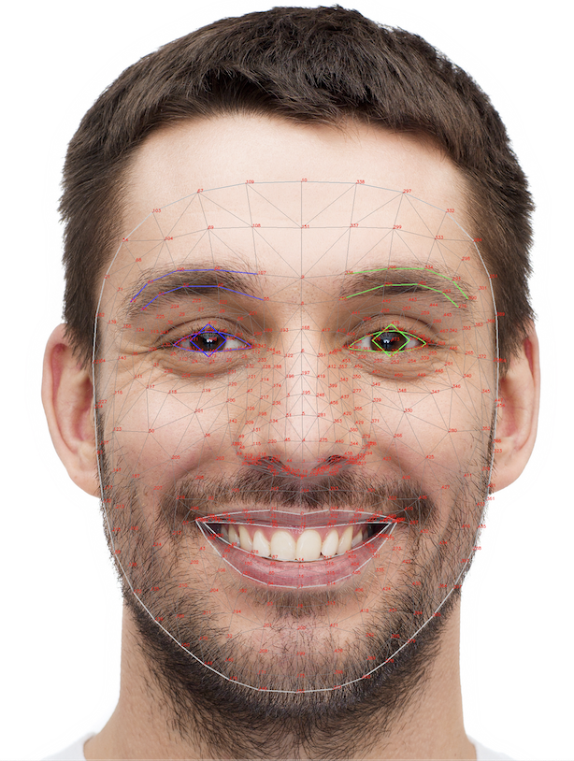

Method overview
Face images from
MediaPipe Landmarks
Transformation tabular data
Data mining process
SCUT-FBP5500
MEBeauty
Fairness & Generalization Analysis
LiveBeauty

Slide 7
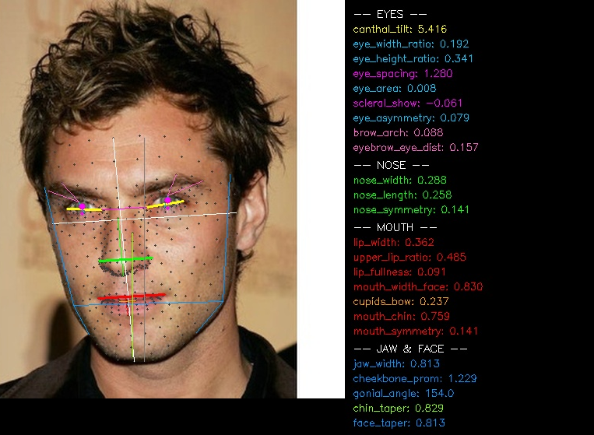
Feature Extraction
478 facial landmarks per image (Google MediaPipe Face Mesh)
30 geometric ratios (e.g., eye width ratio / lip width ratio)
9 expression features (smile, frown, jaw open)
Face rating normalization is necessary due to scale differences

Slide 8
Model Overview
Model | Type
Global Mean | Baseline
Ridge Regression | Linear
Decision Tree | Interpretable
XGBoost | Boosted Trees
LightGBM | Boosted Trees
CatBoost | Boosted Trees
Stacking | Ensemble
MLP | Neural Network
Evaluation via Spearman ρ, Pearson r, MAE Improvement (%) (in comp. to Global Mean Predictor baseline)
Notes:
XGBoost + RandomForrest + Gradient Boosting Machine + Ridge → Ridge meta

Slide 9
Hyperparameter Optimization
Optuna Automated hyperparameter search applied to every model with tunable hyperparameters
Evaluation: 5-Fold CV 10% validation held out within each fold for early stopping.

Slide 10
Overall Model Performance
Model | Spearman ρ | Pearson r | MAE Improvement (%)
Global Mean (baseline) | — | — | —
Ridge Regression | 0.650 | 0.660 | 30.0%
Decision Tree | 0.538 | 0.546 | 22.7%
Random Forest | 0.648 | 0.657 | 27.8%
XGBoost | 0.700 | 0.708 | 35.4%
LightGBM | 0.697 | 0.705 | 35.2%
CatBoost | 0.701 | 0.709 | 35.3%
Stacking Ensemble | 0.702 | 0.710 | 35.4%
MLP | 0.706 | 0.714 | 36.6%
Implication
All models beat
baseline strongly.
Geometric landmarks
contain real predictive
value.
XGBoost chosen for following analyses (near-best-accuracy, interpretable via SHAP)

Slide 11
Cross-Dataset Generalization
RQ1: Do models generalize across ethnicities?
Experiment | Spearman ρ
SCUT → MEBeauty | 0.29
SCUT → LiveBeauty | 0.50
MEBeauty → SCUT | 0.37
MEBeauty → LiveBeauty | 0.51
LiveBeauty → MEBeauty | 0.43
LiveBeauty → SCUT | 0.52
Combined | 0.70
SCUT → MEBeauty: p = 0.29
Asian/Caucasian only training fails on diverse populations.
MEBeauty → LiveBeauty: p = 0.51
Diverse training generalizes; monoculture doesn't

Slide 12
SHAP Feature Importance
RQ2: Which geometric features drive predictions?
Ethnicity | Top-4 (Shared) | #5 | Nose Width SHAP
Asian | nose width, eye width, mouth-chin ratio, eye area | lip fullness | 0.264
Black | " | lip fullness | 0.677
Caucasian | " | brow arch | 0.263
Hispanic | " | brow arch | 0.319
Indian | " | jaw width | 0.330
Mid-Eastern | " | lip fullness | 0.318
Top-4 features are identical across all ethnic groups
Magnitude differs: nose width is 2.6× more important for Black faces (0.677) than Asian (0.264): Universal features, culture specific weights

Slide 13
Comparison to SOTA
Academic SOTA: FPEM (Li et al., 2025, arXiv:2501.02509)
multi-modal deep model (Swin Transformer + ViT + FaceNet + CLIP)
Dataset | FPEM (ρ) | Ours (ρ) | Gap (ρ)
SCUT-FPB5500 | 0.931 | 0.700 | −0.231
LiveBeauty | 0.925 | 0.706 | −0.219
MEBeauty | 0.787 | 0.648 | −0.139
Geometry-only trails by ~0.22 ρ on Asian-majority datasets (SCUT, LiveBeauty)
Gap shrinks to −0.14ρ on MEBeauty (most diverse): geometry matters more where appearance varies most

Slide 14
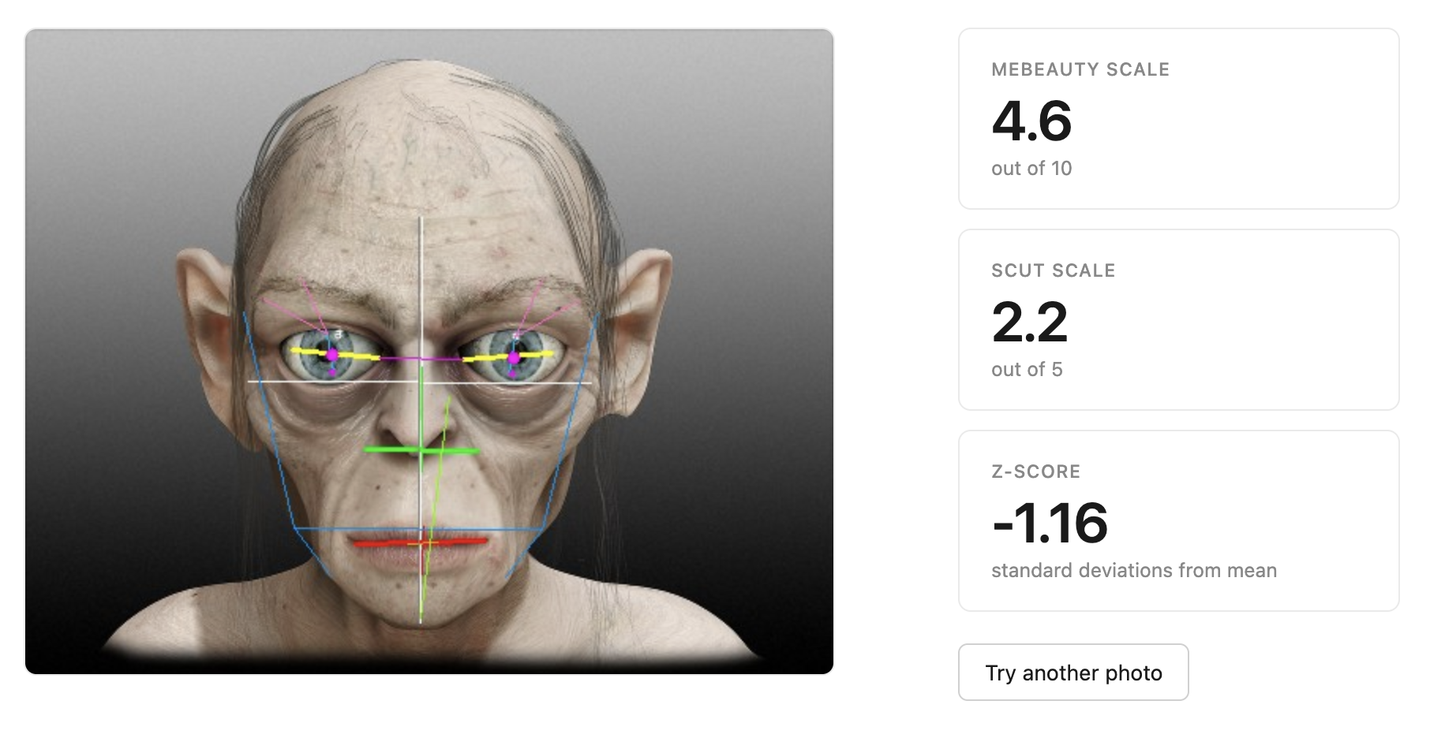
Out of distribution Check
MediaPipe locks onto Gollum's features
XGBoost pulls out of distribution inputs toward training-data territory

Slide 15
Limitations

Slide 16
Conclusion

Slide 17
Summary of Findings
Geometry + expressions work: 30 facial ratios + 9 expression features reach ρ=0.70 (35% MAE reduction over baseline)
Monoculture training fails (RQ1): SCUT-only models drop to ρ=0.29 on diverse populations; combining datasets recovers ρ=0.70.
Universal features but group-specific weights (RQ2): Top-4 features are identical across ethnicities but magnitudes vary up to 2.6×
SOTA gap still exists. Closing the gap means adding texture cues (e.g. skin, hair)

Slide 18




Questions?
Lars Bullmahn
-Report Creation
-Testing
Simon Heinz
-Outline Creation
-Testing
David Siregar
-Implementation
Timon Kuhl
-Report Creation
-Testing
Maxim Froehlich
-Implementation

