Slide 1
Peer reviewer

Slide 2
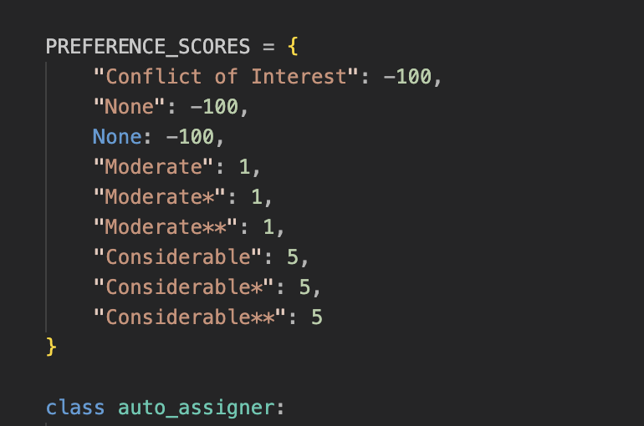
How it works:
Attributes:
simmatrix: The prepared matrix of scores:
demand: Number of reviewers needed per paper.
ability: Maximum number of papers a reviewer can review.
function: Transformation function for score processing (often the identity function).
iter_limit and time_limit: Limits to control runtime: not acutally used in our case, our program running time lower than 50ms. (0.05sec)

Slide 3
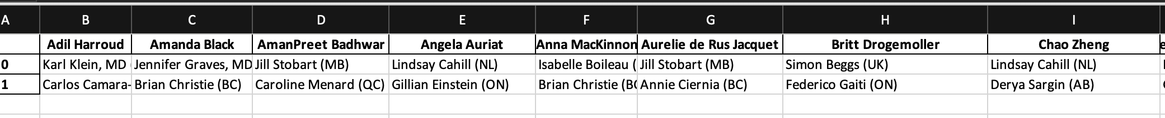
Outputs:
Final assignments are stored in model.fa.
Overall quality score is available in model.best_quality. (sorry i forgot to store the output :), but that’s how we figured out those attributes settings.

Slide 4
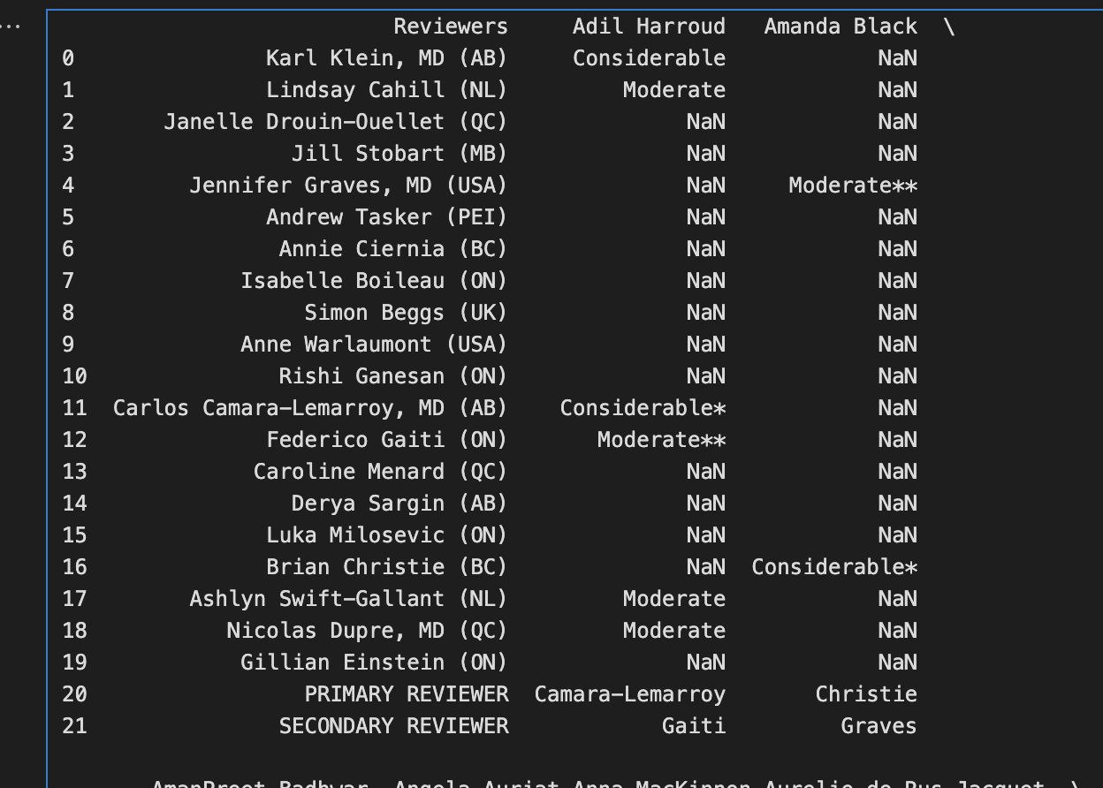
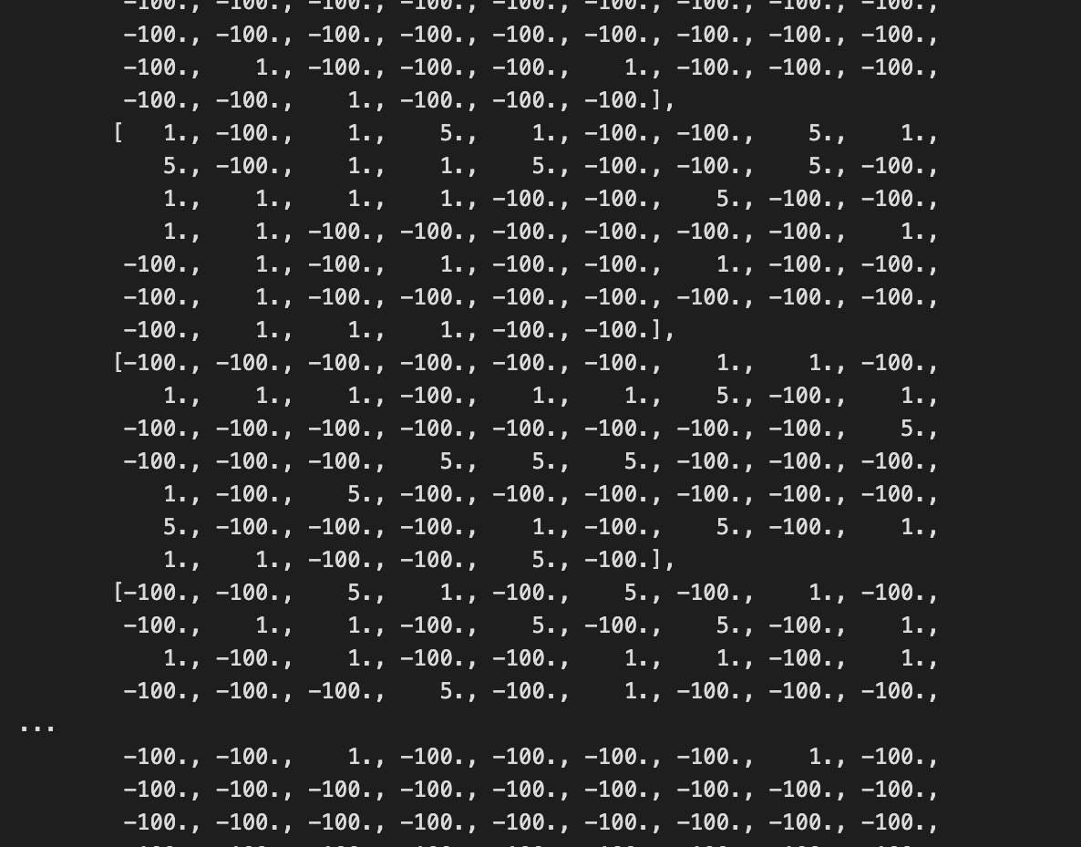
Transform those Considerable, Moderate, conflict of interest:
Into: 5, 1, -100, (missing cells are also filled with -100)
How to choose:
Only the matches with non-negative scores
Binary search: adds the highest-scoring matches (the best edges) until there are enough connections so that every paper can potentially be reviewed the required number of times.
makes sure every paper received the minimum amount of reviewers

