Slide 1
IronHack Data Science & Machine Learning Bootcamp
Google Play Store
Exploratory Data Analysis & SQL
Business Challenge: EDA & SQL · 10 Business Questions · Dataset: Kaggle
Ekaterina Levchenko

Slide 2
Agenda
01
02
Dataset Introduction
Data Cleaning & Assumptions
Overview of the Google Play Store dataset and business context
Steps taken to prepare and validate the data
03
04
Business Questions
Conclusions
10 SQL-powered answers to key product & market questions
Key insights and takeaways

Slide 3
Dataset Introduction
Google Play Store Apps — Kaggle
2.3 M apps
24 attributes
Source: Kaggle
App Name
App Id
Category
Application display name
Unique package identifier (e.g. com.example.app)
Store category (e.g. Games, Tools, Finance)
Rating
Rating Count
Installs
Average user rating (1.0 – 5.0)
Total number of user ratings submitted
Install range string (e.g. '1,000,000+')
Minimum Installs
Maximum Installs
Free
Lower bound of install count (numeric)
Actual install count (numeric)
Boolean — app is free to download
Price
Currency
Size
Purchase price (0.0 for free apps)
Price currency code (e.g. USD)
APK size (e.g. '12M', 'Varies with device')
Minimum Android
Developer Id
Developer Website
Minimum required Android OS version
Developer's unique store identifier
URL to the developer's public website
Developer Email
Released
Privacy Policy
Developer's contact e-mail address
Original app release date
URL to the app's privacy policy page
Last Updated
Content Rating
Ad Supported
Date of the most recent app update
Audience age group (Everyone / Teen / Mature 17+)
Boolean — app contains advertising
In App Purchases
Editor's Choice
Scraped Time
Boolean — app offers in-app purchases
Boolean — featured as a Google Editor's Choice
Timestamp of when the app record was scraped

Slide 4
Data Cleaning & Assumptions
No Nulls or Missing Values
Dropped Broken System App Rows
The dataset had no null or missing values — it is a very clean dataset. No rows needed to be dropped for completeness issues.
Some system apps (e.g. Google Camera) showed Maximum Installs = 1 but an impossibly high Rating Count. These rows were dropped: data = data[data['Rating Count'] < data['Maximum Installs']]
Date Columns → datetime
maximum_installs Used Directly
'Released', 'Last Updated' and 'Scraped Time' were converted from string to datetime so SQL could recognise them as DATE columns.
No normalisation was needed. The 'Maximum Installs' numeric column was used as-is for all SQL comparisons and aggregations.
No Duplicates Found
Free / Paid — No Inconsistencies
There were no duplicate app entries in the dataset. The data is clean and each App Id appears uniquely.
The 'Free' boolean and 'Price' columns were fully consistent. No cross-check issues were found; CAST was used in SQL where arithmetic on these fields was required.

Slide 5
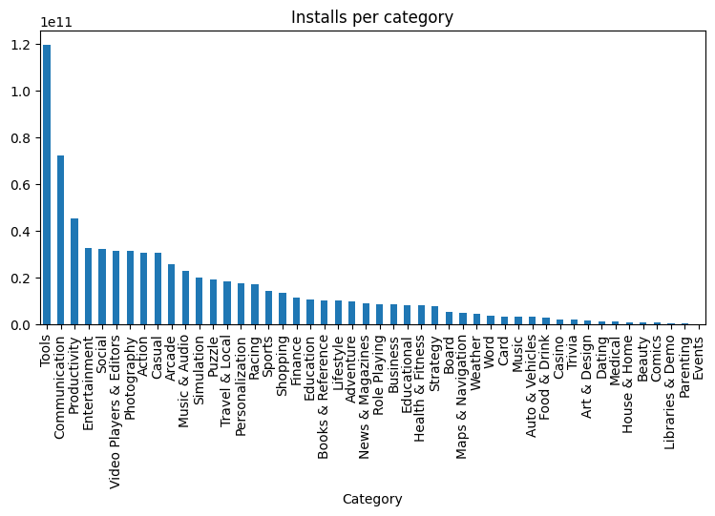
Q1 · Business Question
What are the Top 10 categories by total installs?
-- Top 10 categories by total installs
SELECT
category,
SUM(maximum_installs) AS total_installs
FROM google_play_store
GROUP BY category
ORDER BY total_installs DESC
LIMIT 10;
Query Insight
Tools leads by a wide margin with 119.8 B total installs, followed by Communication and Productivity. The long tail of niche categories shows how fragmented the market is beyond the top 3.
Python EDA · Total installs per category
Category | Total Installs
Tools | 119.8 B
Communication | 72.3 B
Productivity | 45.4 B
Entertainment | 32.5 B
Social | 32.2 B

Slide 6
Q2 · Business Question
Which app is the best-rated per category (within the Top 10 most installed)?
-- Create a view: best app per category by rating
CREATE VIEW best_app_per_category AS
SELECT app_id, app_name, category, rating,
RANK() OVER (
PARTITION BY category
ORDER BY rating DESC, rating_count DESC
) AS rnk
FROM google_play_store;
-- Join with Top 10 install categories
SELECT cat_totals.category,
cat_totals.total_installs,
b.app_name,
b.rating
FROM (
SELECT category,
SUM(maximum_installs) AS total_installs
FROM google_play_store
GROUP BY category
ORDER BY total_installs DESC
LIMIT 10
) AS cat_totals
JOIN best_app_per_category AS b
ON b.category = cat_totals.category
AND b.rnk = 1
ORDER BY cat_totals.total_installs DESC;
Query Insight
RANK() OVER (PARTITION BY category) finds the best-rated app inside each category. The result is then joined with the Top 10 categories by installs to see which app tops each major segment.
Category | Total Installs | App Name | Rating
Tools | 119.8 B | QR code scanner | 5
Communication | 72.3 B | Cooperations office | 5
Productivity | 45.4 B | Calculator Plus | 5
Entertainment | 32.5 B | Maps Master for Minecraft | 5
Social | 32.2 B | DJJS | 5

Slide 7
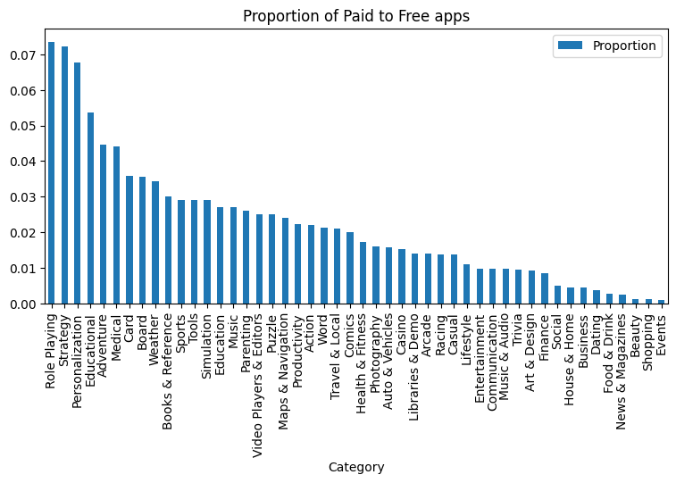
Q3 · Business Question
Which categories have the highest proportion of paid apps?
-- Proportion of paid vs free apps by category
SELECT
category,
SUM(CASE WHEN free <> 'True'
THEN 1 ELSE 0 END) AS paid_amount,
COUNT(*) AS total_amount
FROM google_play_store
GROUP BY category
ORDER BY
CAST(paid_amount AS FLOAT)
/ total_amount DESC
LIMIT 10;
Query Insight
Role Playing leads with ~7% paid apps. Most categories stay well below 5%, confirming free is the dominant business model. Niche/premium categories are the exception.
Python EDA · Paid-to-Free ratio per category
Category | Paid Amount | Total Amount
Role Playing | 660 | 9631
Strategy | 553 | 8221
Personalization | 5624 | 88,777
Educational | 1070 | 20,996
Adventure | 969 | 22,733

Slide 8
Q4 · Business Question
Which developers have published the most apps on the Play Store?
-- Top 10 developers by number of published apps
SELECT
developer_id,
COUNT(*) AS total_apps
FROM google_play_store
GROUP BY developer_id
ORDER BY total_apps DESC
LIMIT 10;
Query Insight
Grouping by developer_id and counting rows uncovers prolific publishers. High app counts may signal content farms or SDK testing accounts — a useful quality filter for any recommendation system.
Developer Id | Total Apps
Subsplash Inc | 5394
TRAINERIZE | 4923
ChowNow | 4808
OrderYOYO | 2831
Phorest | 2743

Slide 9
Q5 · Business Question
Which developers have the most total installs across all their apps?
-- Top 10 developers by total installs
SELECT
developer_id,
SUM(installs) AS total_installs
FROM google_play_store
GROUP BY developer_id
ORDER BY total_installs DESC
LIMIT 10;
Query Insight
The top developers by total installs are largely the same names as in Q4. The order shifts slightly — a few highly viral apps can push a developer up the ranking — but the dominant publishers remain the same in both queries.
Developer Id | Total Installs
Subsplash Inc | 625,253
ChowNow | 335,424
OrderYOYO | 290,641
Branded Apps by MINDBODY | 210,893
Phorest | 173,053

Slide 10
Q6 · Business Question
Which apps are underrated — high review engagement but low installs?
-- Underrated apps:
-- high review ratio relative to installs
SELECT
app_name,
rating_count,
maximum_installs
FROM google_play_store
ORDER BY
CAST(rating_count AS FLOAT)
/ maximum_installs DESC
LIMIT 10;
Query Insight
Ordering by the ratio of rating_count to maximum_installs surfaces apps where almost every installer also left a review. A ratio close to 100% is suspicious — reviews may have been written by friends or purchased on third-party sites rather than earned organically.
App Name | Rating Count | Maximum Installs
Hi Speed Radar,Camera, Blitzi, Traffic,… | 224 | 225
All in one Status Saver: Save HD Images… | 95 | 96
Choper Slice - Master Chef | 81 | 82
LigaLigura: The Ultimate Precious Metal… | 146 | 148
McPAID | 50 | 51

Slide 11
SQL Concept
Common Table Expression
WITH clause · CTE
A CTE is a temporary, named result set defined at the start of a query using the WITH keyword. It makes complex queries easier to read by breaking them into named steps, and can be referenced multiple times in the same query.
-- Define a CTE
WITH top_apps AS (
SELECT app_name, rating
FROM google_play_store
ORDER BY rating DESC
LIMIT 5
)
-- Use it like a regular table
SELECT * FROM top_apps;
Used in Q7 · Q8

Slide 12
Q7 · Business Question
Which apps are overhyped — massive installs but low ratings?
-- Step 1: avg installs of top 5% of apps
WITH total AS (
SELECT
CAST(COUNT(*) * 0.05 AS INTEGER)
AS top_n
FROM google_play_store
)
SELECT AVG(maximum_installs) AS avg_installs
FROM google_play_store
ORDER BY maximum_installs DESC
LIMIT (SELECT top_n FROM total);
-- Result: ~324,704
-- Step 2: overhyped apps
SELECT *
FROM google_play_store
WHERE maximum_installs > 324704
AND rating_count > 0
ORDER BY rating ASC
LIMIT 10;
Query Insight
A CTE first computes the average installs for the top 5% of apps (~324K). Apps above this threshold with at least one review are then sorted by rating ascending. These apps have viral reach but fail to satisfy users.
App Name | Category | Rating | Maximum Installs
Offroad car driving:4x4 off-road rally … | Racing | 1 | 331,076
TV9 Telugu | News & Magazines | 1.10 | 2.2 M
Thingiverse | Social | 1.10 | 659,787
Android TV Home | Tools | 1.10 | 60.7 M
Destiny Teller | Entertainment | 1.10 | 1.4 M

Slide 13
Q8 · Business Question
What percentage of apps have fewer than 100 reviews?
-- % of apps with fewer than 100 reviews
WITH stat AS (
SELECT COUNT(*) AS few_reviews
FROM google_play_store
WHERE rating_count < 100
)
SELECT
few_reviews,
(SELECT COUNT(*) FROM google_play_store)
AS total_count,
ROUND(
(CAST(few_reviews AS FLOAT)
/ (SELECT COUNT(*)
FROM google_play_store))
* 100, 2
) AS percentage
FROM stat;
Query Insight
Only 17.5% of apps have more than 100 reviews, meaning the vast majority of apps go unnoticed. Discoverability is a major challenge on the Play Store.
Few Reviews | Total Count | Percentage
1.9 M | 2.3 M | 82.40

Slide 14
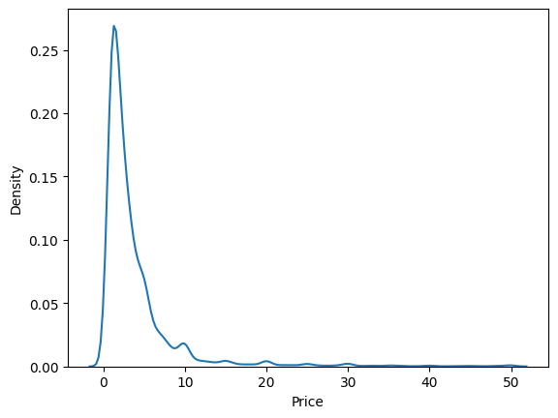
Q9 · Business Question
What are the most common price points for paid apps? Is there a 'sweet spot'?
-- Most common price points for paid apps
SELECT
price,
COUNT(*) AS app_count
FROM google_play_store
WHERE price > 0
GROUP BY price
ORDER BY COUNT(*) DESC
LIMIT 10;
Query Insight
$0.99 is the clear mode. The KDE shows a massive spike below $2, then a long tail. The answer is yes — the sweet spot is $0.99, with $1.99 and $2.99 as secondary peaks.
Python EDA · Price distribution for paid apps (price < $50)
Price | App Count
0.99 | 11,455
1.99 | 5687
2.99 | 3818
1.49 | 3683
4.99 | 2434

Slide 15
Q10 · Business Question
Which content rating (Everyone, Teen, Mature 17+) dominates by number of apps?
-- Content rating distribution
SELECT
content_rating,
COUNT(*) AS app_count
FROM google_play_store
GROUP BY content_rating
ORDER BY COUNT(*) DESC;
Query Insight
'Everyone' has ~2M apps — dwarfing all others. Teen is second with ~180K. This confirms the Play Store is overwhelmingly family-friendly by design.
Content Rating | App Count
Everyone | 2.0 M
Teen | 192,750
Mature 17+ | 59,608
Everyone 10+ | 33,085
Unrated | 154
Adults only 18+ | 132

Slide 16
Key Conclusions
Tools, Communication & Productivity dominate
These three categories account for the largest share of total installs on the Play Store — with Tools alone exceeding 119 billion installs.
Most apps have very little engagement
A large percentage of apps have fewer than 100 reviews, showing that discoverability is a major challenge.
Paid apps cluster at psychological price points
$0.99, $1.99 and $2.99 dominate, confirming that low prices reduce friction for paid downloads.
Prolific developers = Most-installed developers
Q4 and Q5 surface almost identical top names — high app output and high install reach go hand in hand. However, Python EDA shows that past a certain threshold, publishing more apps correlates negatively with average rating: volume hurts quality.
'Everyone' content rating dominates
Over 80% of apps target all age groups, reflecting broad audience strategies over niche targeting.
Thank you · Questions?

