Slide 1
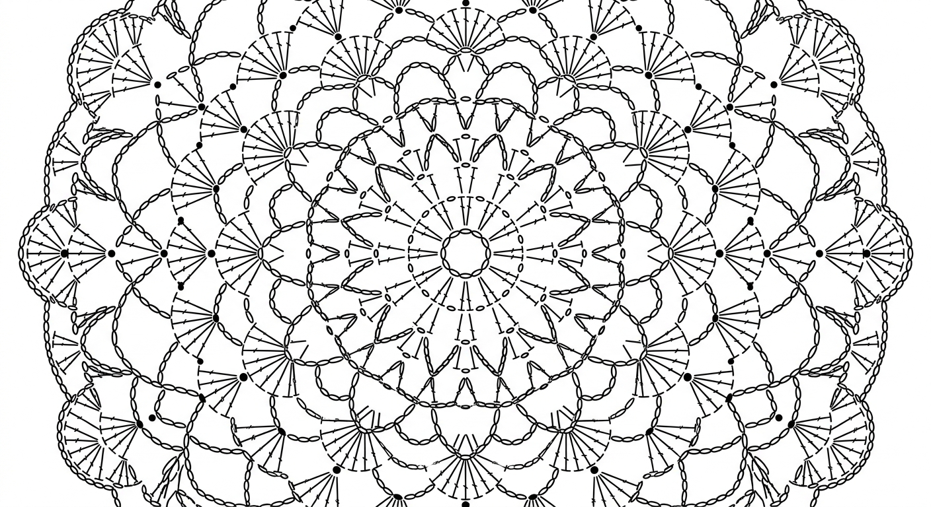
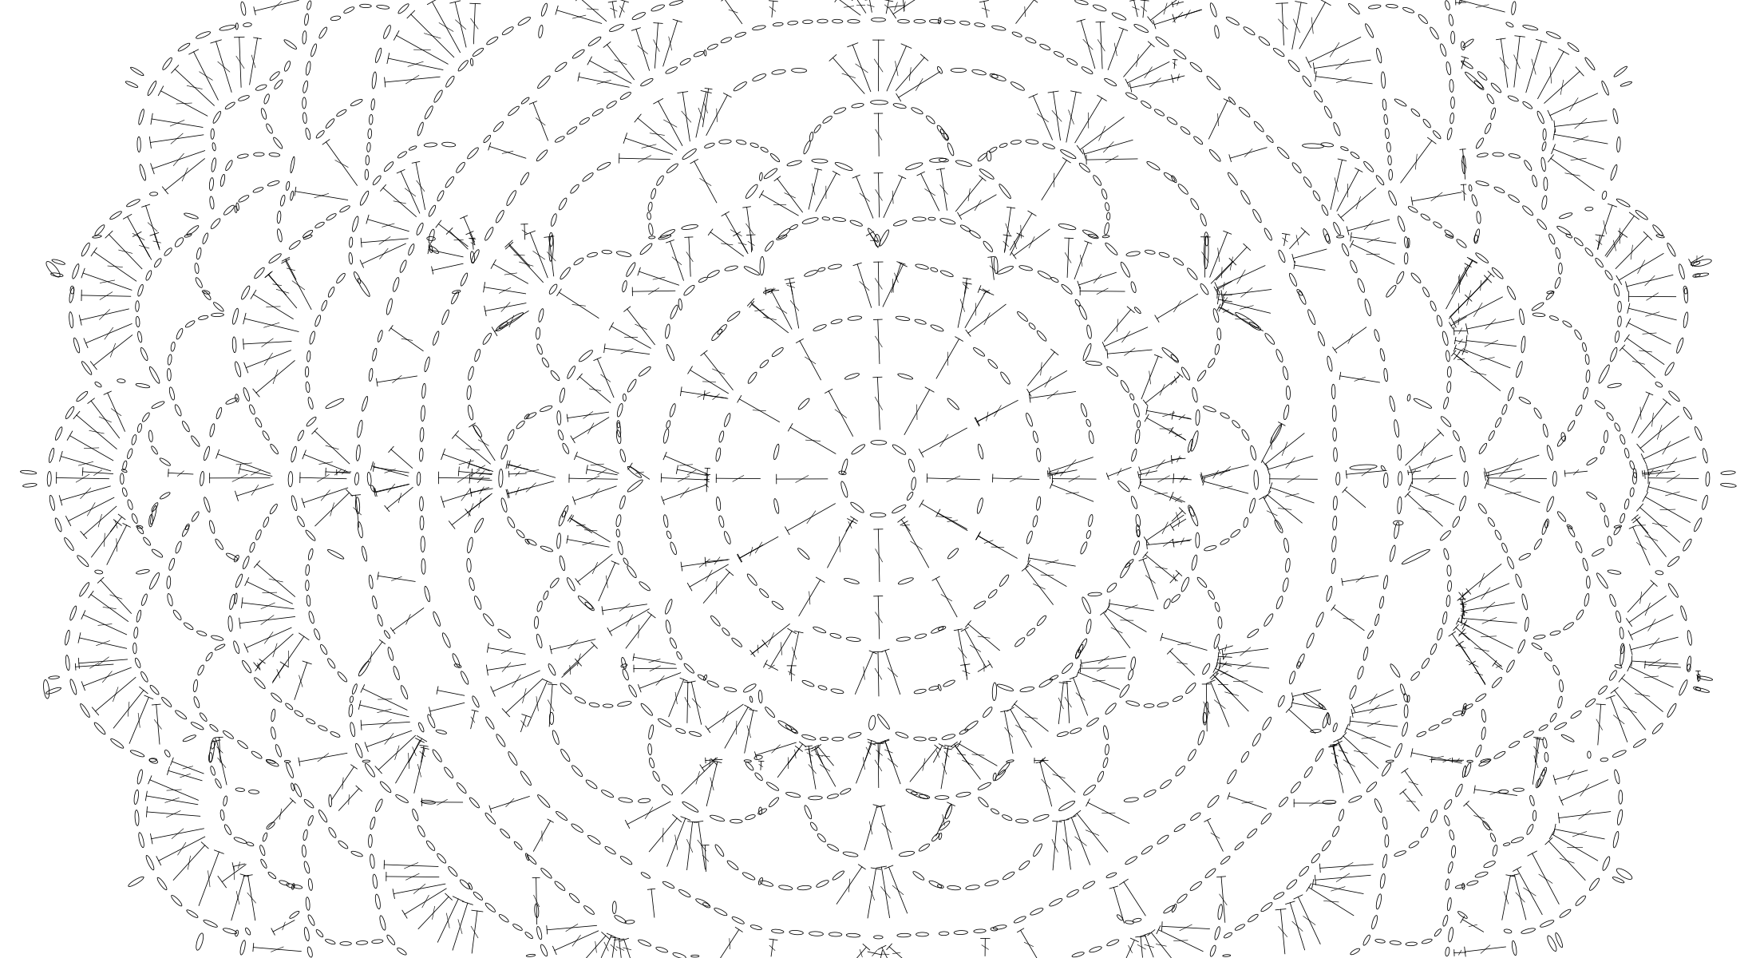
Crochet
AI-Powered Crochet Pattern
Verification & Generation
Bridging Generative AI and Computer Vision
to validate craft patterns humans can trust
Ekaterina Levchenko

Slide 2


The Problem
AI-generated crochet patterns
are flooding the market
My Solution: CrochetCV
Generate crochet patterns with Generative AI, then verify them with Computer Vision. A YOLOv8n OBB model detects every stitch symbol, reconstructs the scheme, and enables structural validation.
Online marketplaces are full of crochet instructions generated by AI that have never been tested by a real crafter. Buyers pay for patterns that contain impossible stitch combinations, broken repeat sequences, and nonsensical construction steps.
Generate with AI. Verify with CV. Trust the result.
Nobody is checking if these AI patterns actually work.

Slide 3

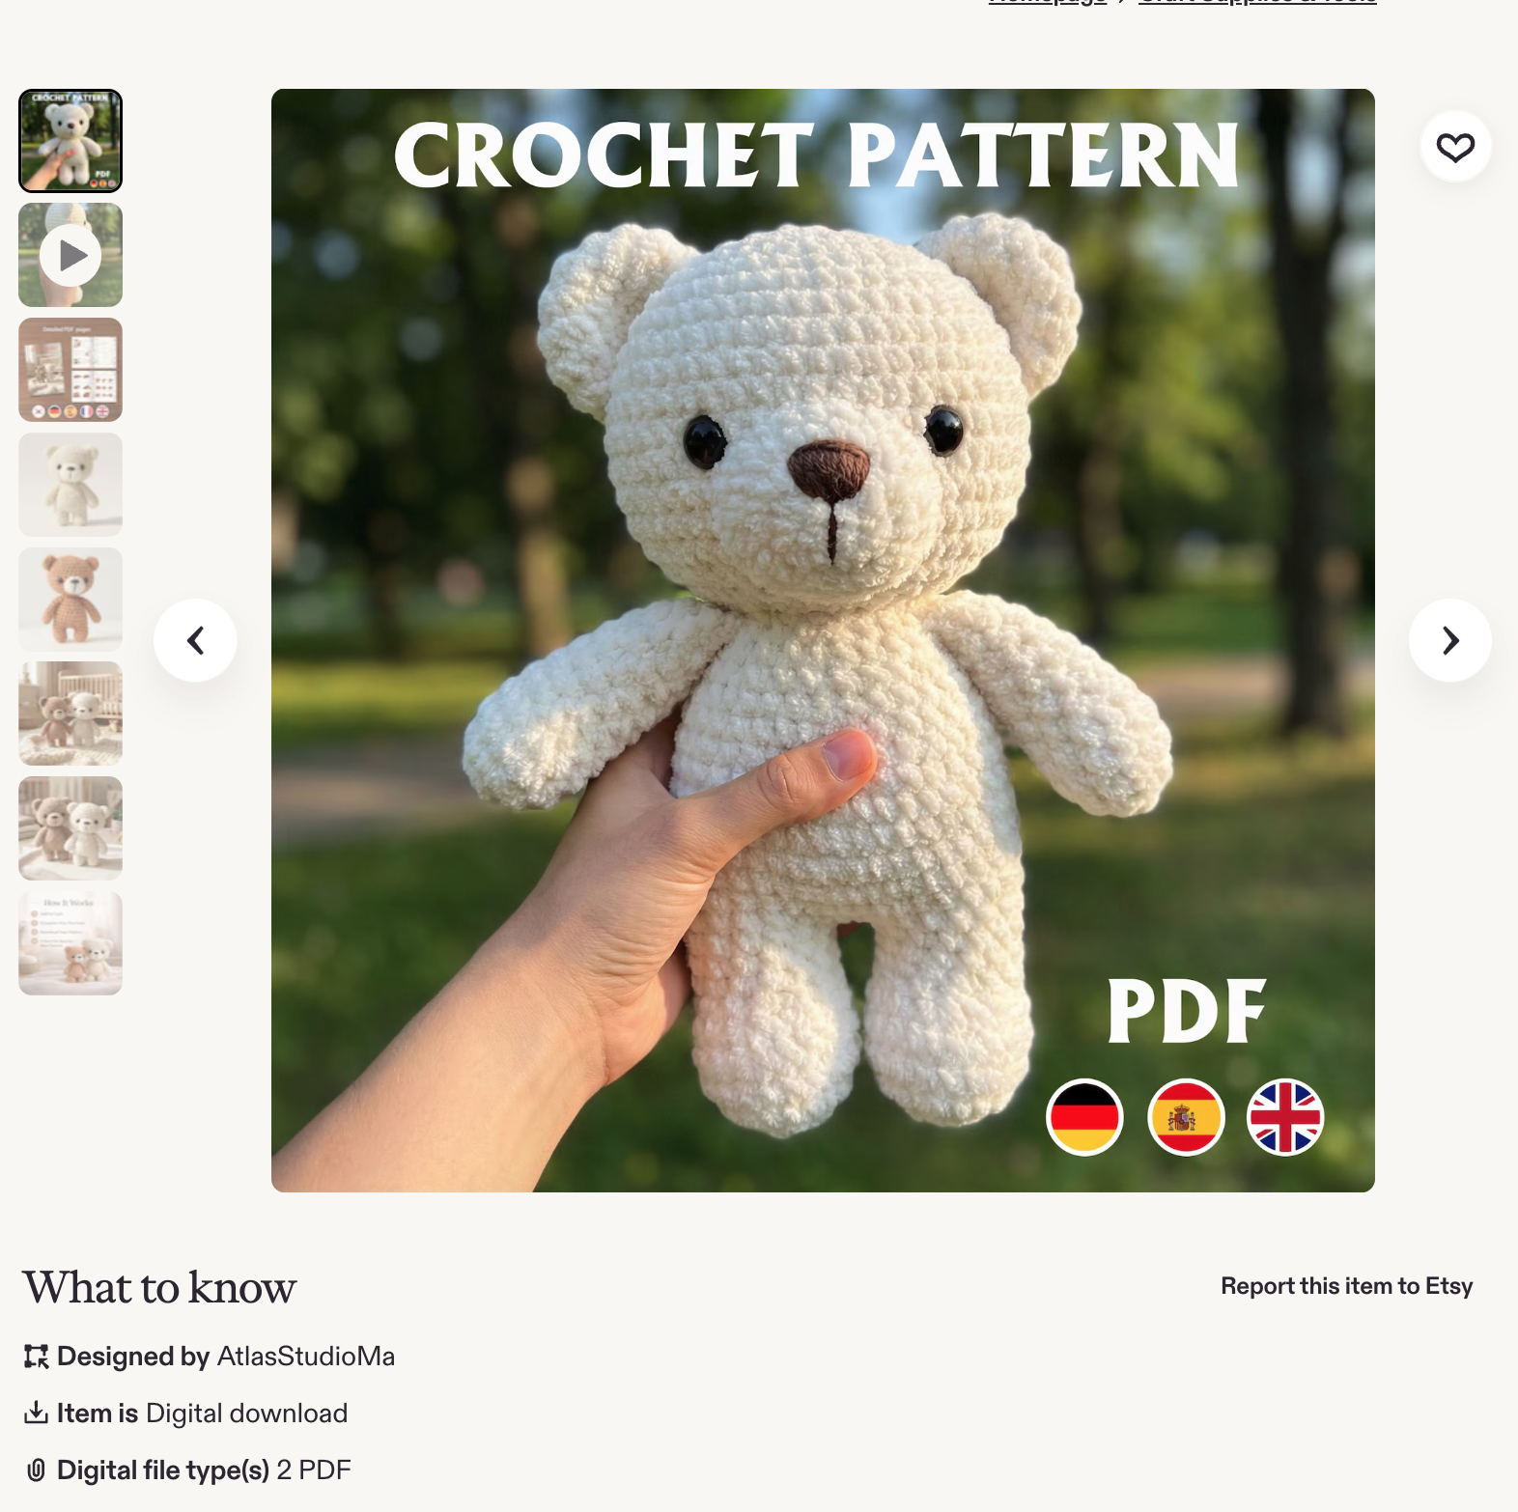
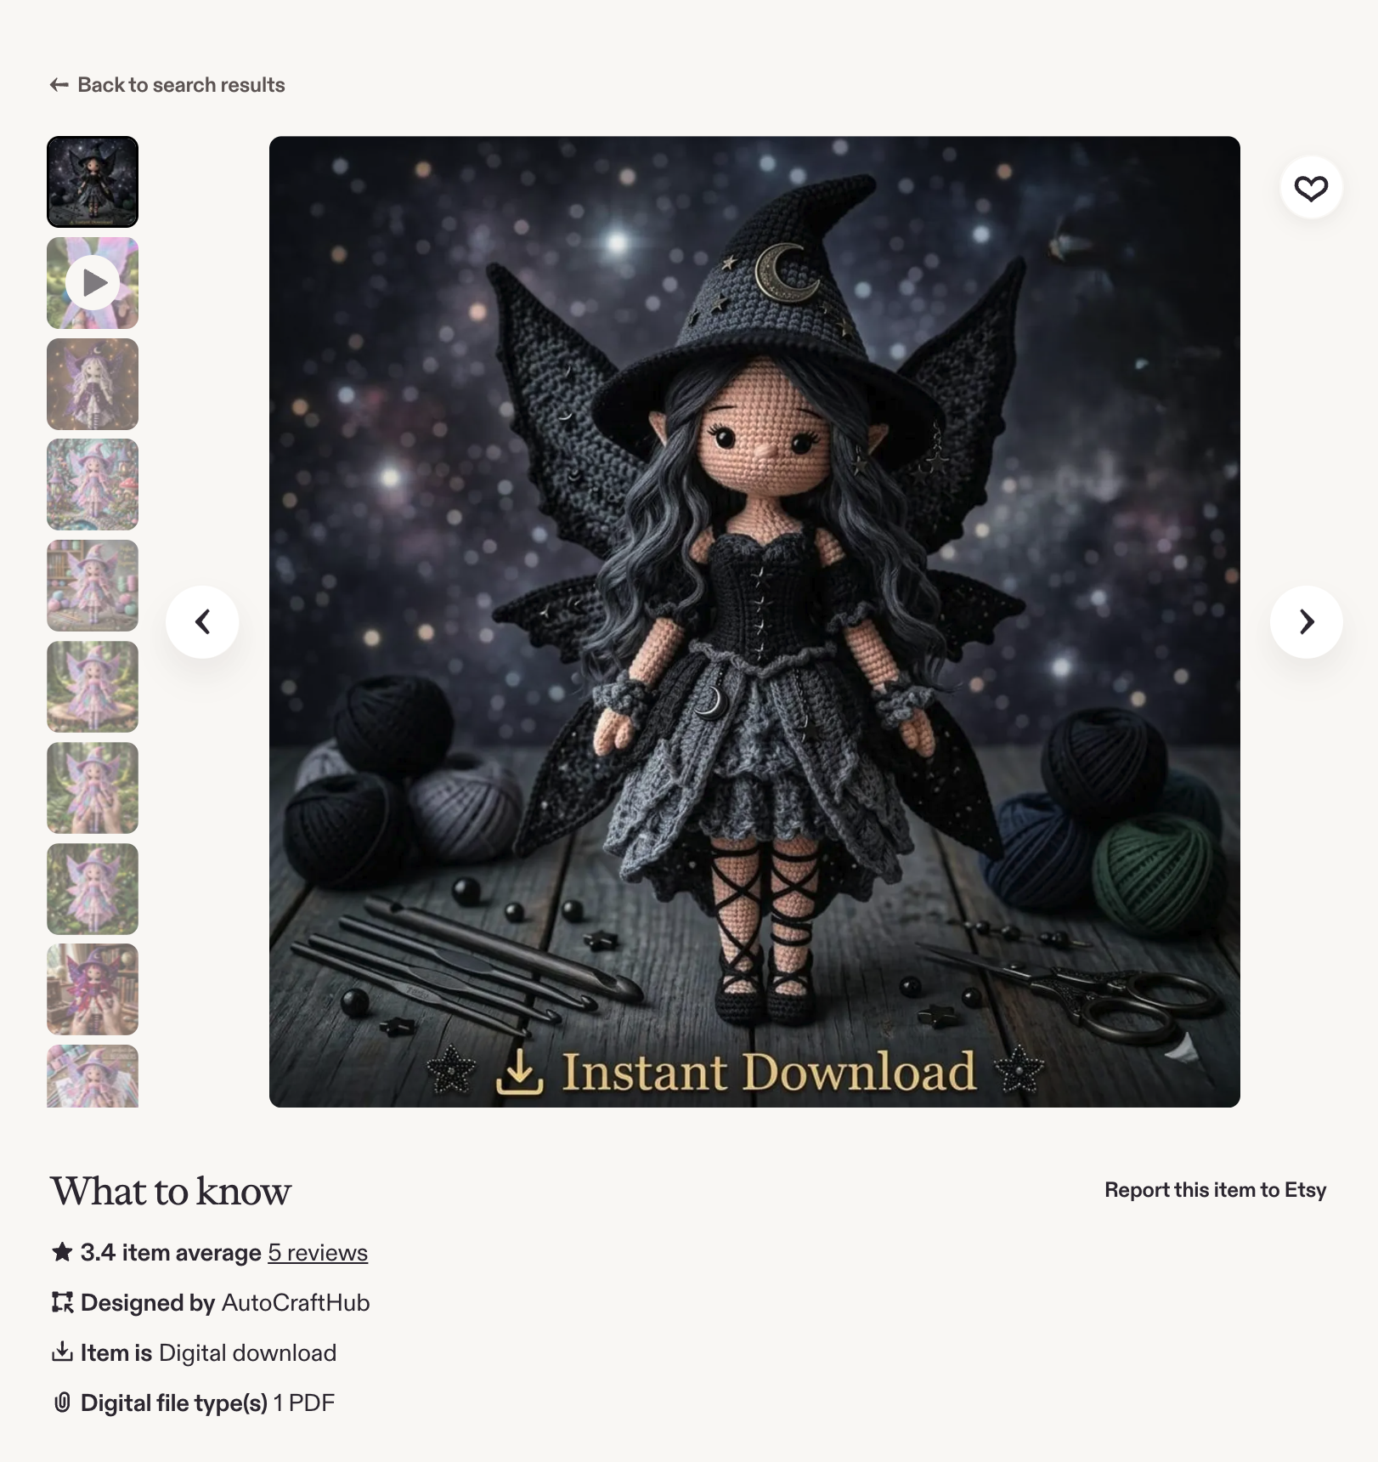
The Marketplace Reality
AI-generated patterns sold online — untested, unverified, often impossible to follow

Slide 4
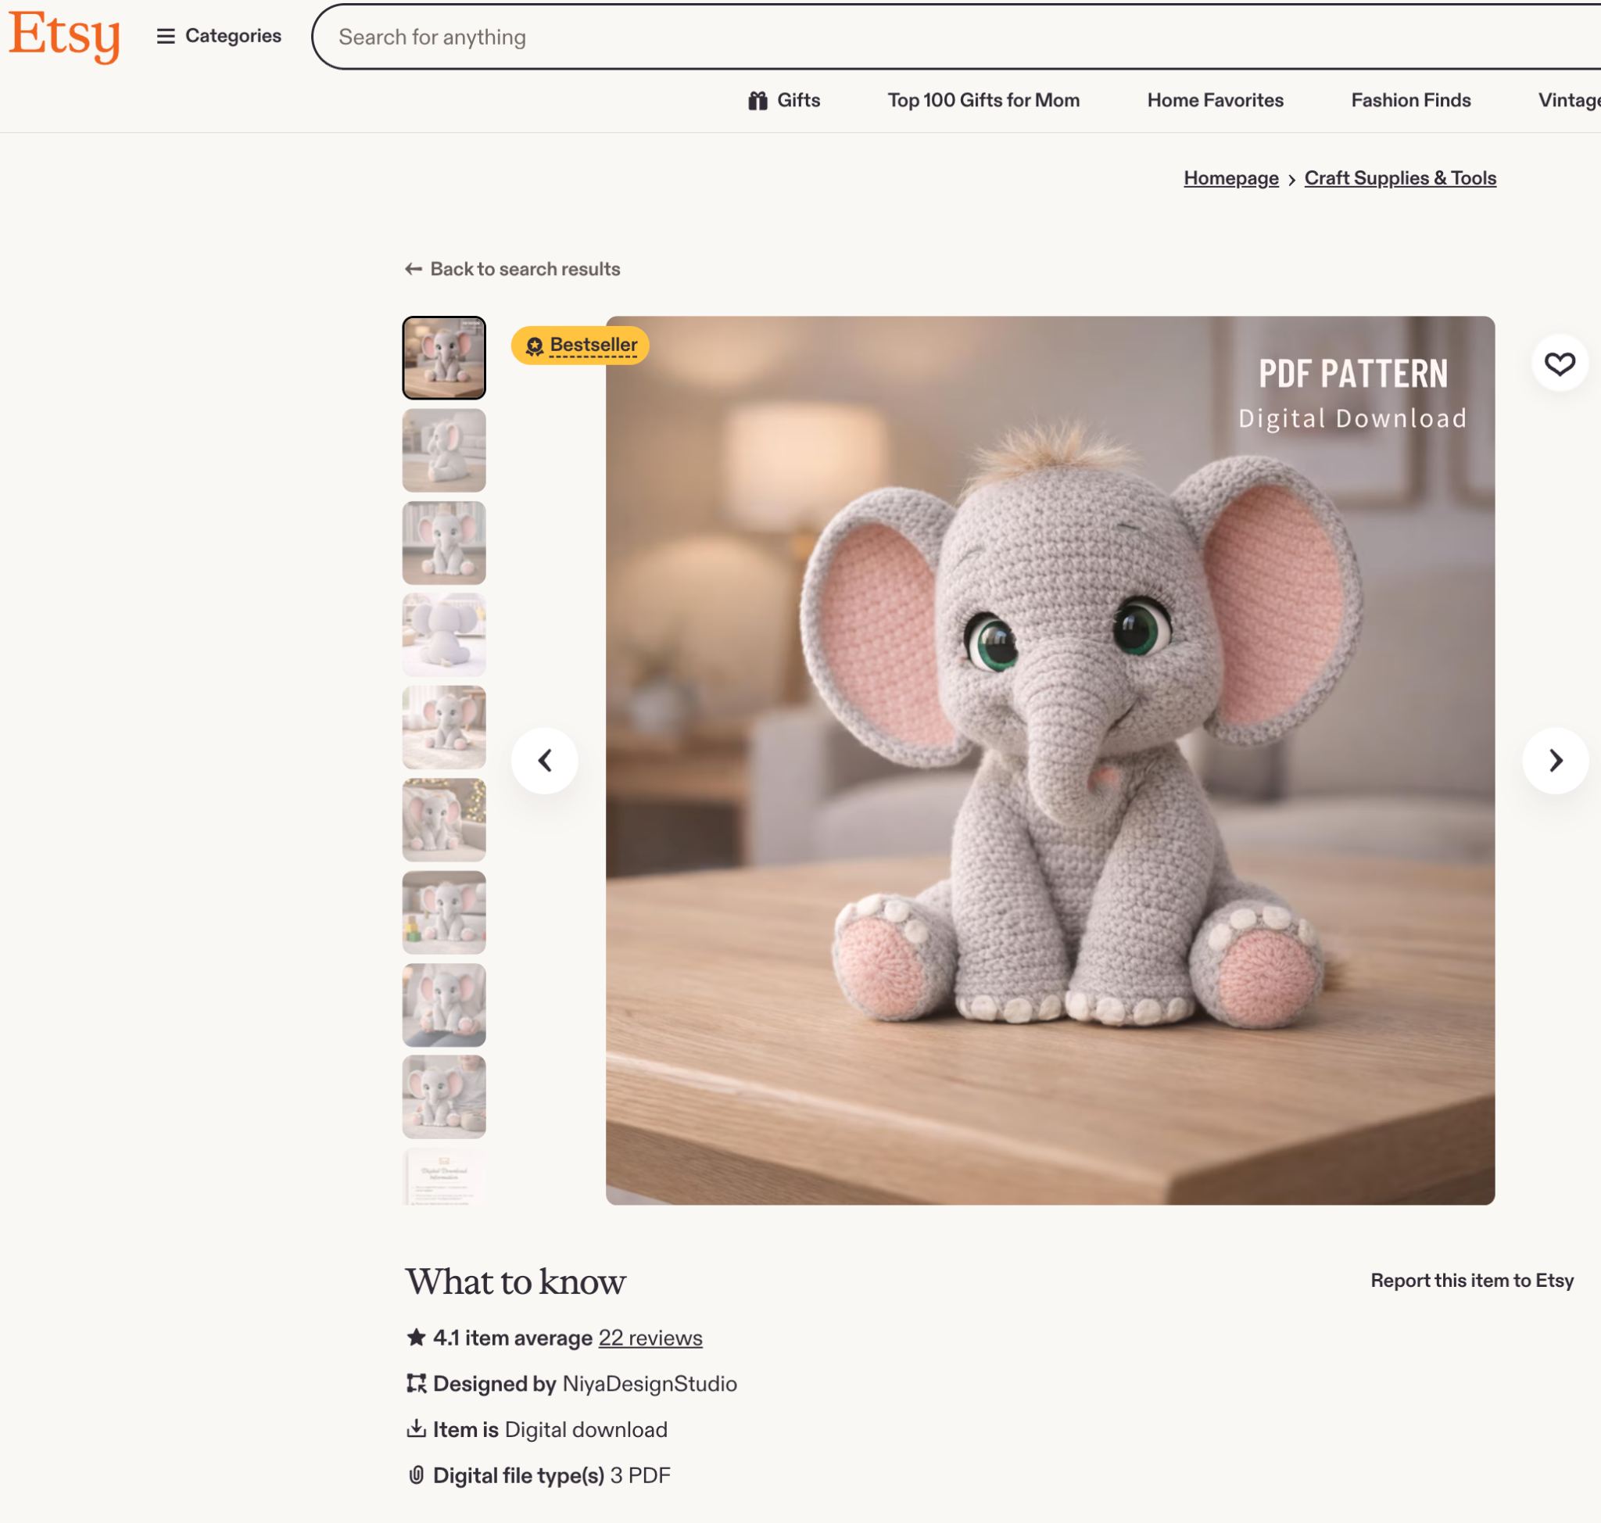
System Architecture

Slide 5

Main focus: 2D pipeline
Demo time!

Slide 6

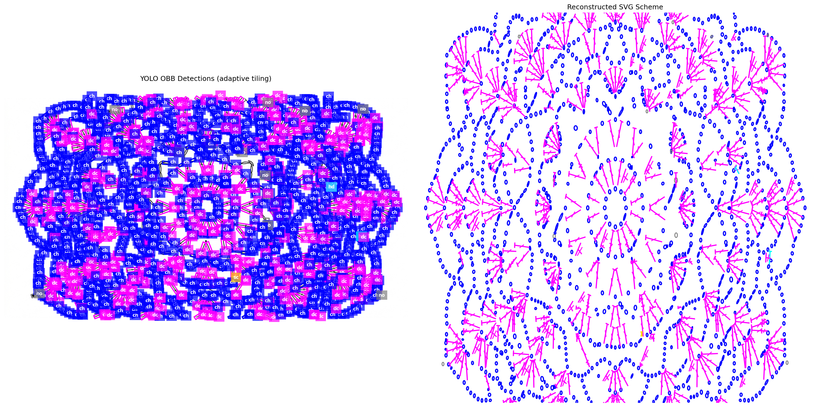
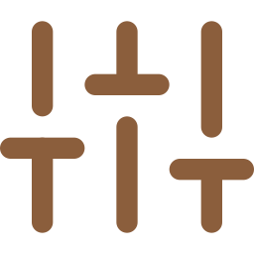

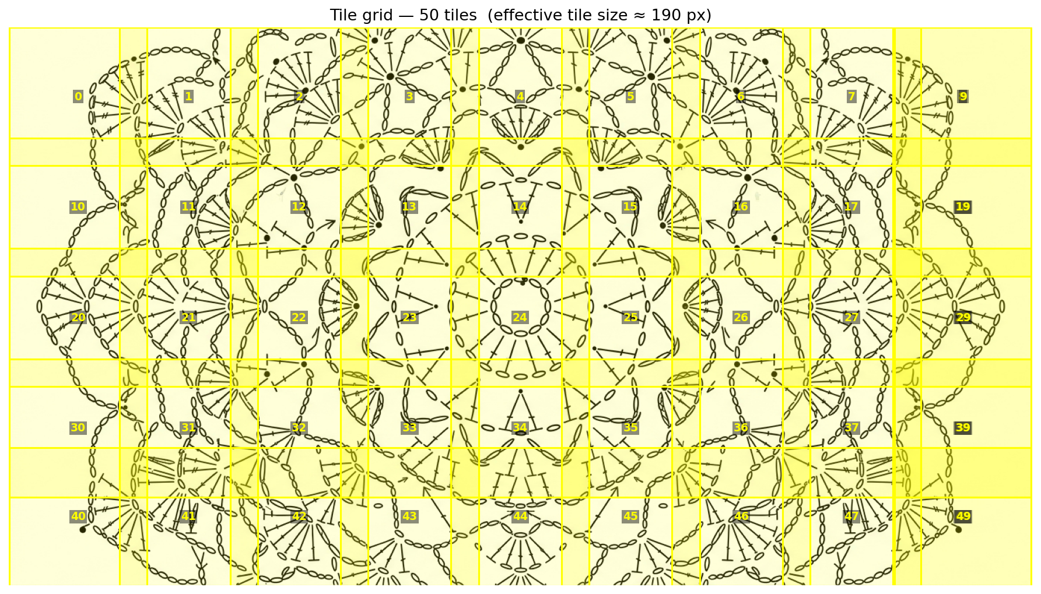

Adaptive Tiling Strategy
1
Estimate
Low-confidence YOLO pass to measure median stitch size
2
Calculate
Dynamic tile size so stitches land at ~100 px target resolution
3
Tile & Detect
Overlapping tiles with per-tile inference
4
Merge & NMS
Translate coords back, class-aware deduplication
This enables handling high-density patterns of any size without manual configuration

Slide 7
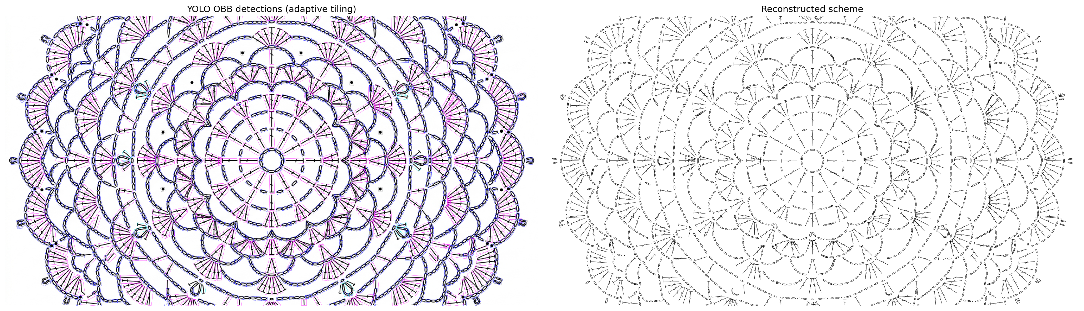



The Core: YOLOv8n OBB Detection
Why OBB?
Oriented Bounding Boxes
Crochet stitches are rotated symbols. Standard axis-aligned boxes fail; OBB captures angle and shape.
Nano model (YOLOv8n)
Fast enough for real-time web app. Generation takes 20 sec to 2 min depending on complexity.
7 stitch classes
chain, single, double, treble, double treble, half double, noise

Slide 8



Challenges & How I Solved Them
No Dataset
Model Selection
Pattern Verification
No public oriented bounding box dataset for crochet stitch symbols existed. I manually labeled data, trained an initial model, used it to pre-label more images, then hand-corrected those labels to speed up annotation.
I tried classical CV (HOG + SVM), various architectures, and different detection approaches before converging on YOLOv8n OBB as the best balance of accuracy, speed, and rotated-symbol handling.
Proofreading schemes requires building a directional graph of stitch connections. The CrochetPARADE DSL can represent this, but code generation from detected JSON is a complex, ongoing task.

Slide 9



Data & Training Strategy
1
Manual Labeling
Hand-annotated crochet scheme images with oriented bounding boxes for 7 stitch classes using Label Studio
2
Initial Training
Trained YOLOv8n OBB on the manually labeled dataset to bootstrap the detection pipeline
3
Semi-Auto Labeling
Used the trained model to pre-label new images, then manually corrected the predictions to increase labeling speed
4
Data Synthesis
Attempted synthetic data generation to augment training. While not close enough to replace real data, it contributed to improving the model score

Slide 10
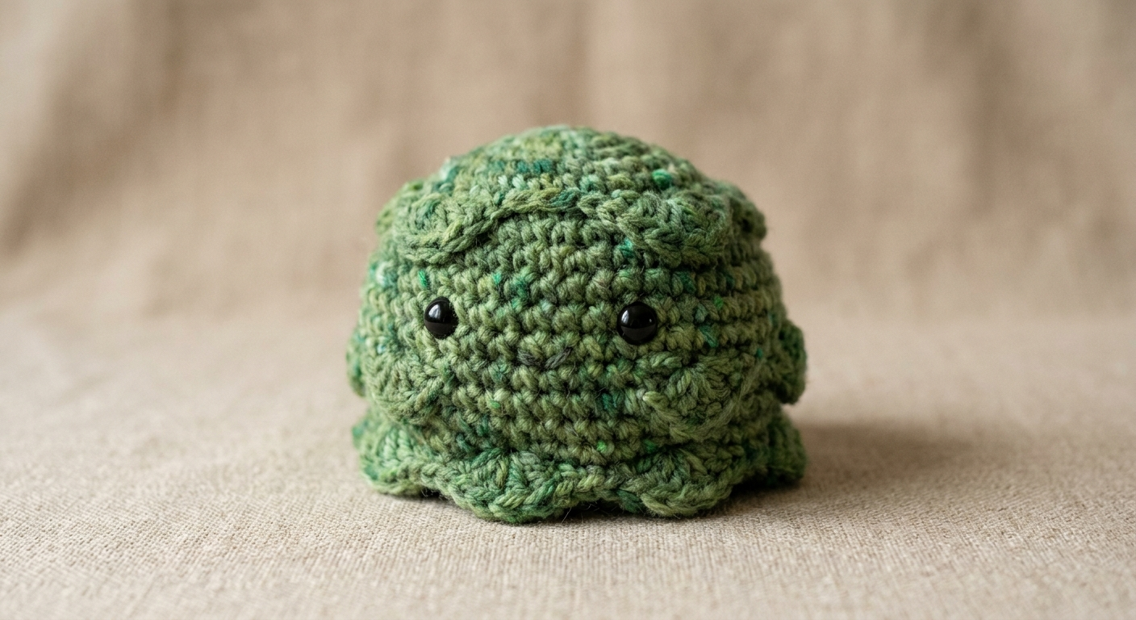
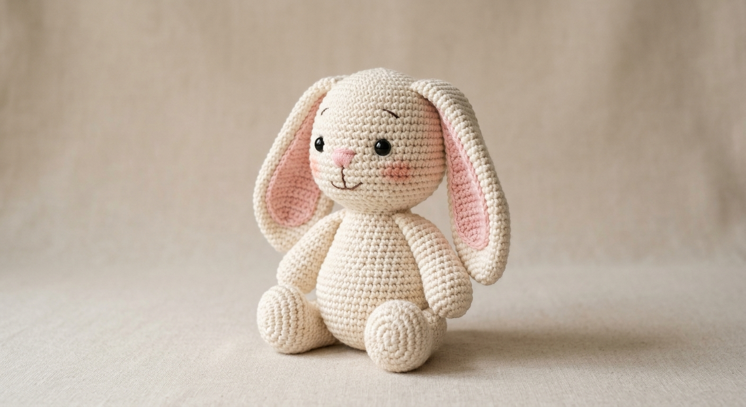
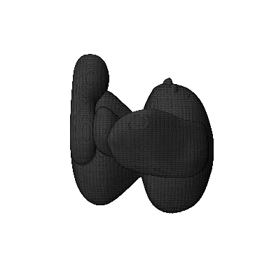



3D Amigurumi Pipeline
1
2
3
4
Reference Image
3D Mesh
Horizontal Slicing
Row Instructions
Mesh cut into rounds;
perimeter measured per layer
Perimeter-to-stitch calibration
generates amigurumi pattern
Gemini generates
a reference from prompt
Hunyuan3D converts
2D image → 3D model (.glb)

Slide 11



Beyond Crochet
The same pattern applies to any domain where AI generates visual plans and CV verifies them
Architecture
Fashion
Any Craft Domain
AI generates floor plan layouts. CV reads walls, rooms, and dimensions. Output: validated CAD drawings.
AI generates garment sketches. CV extracts pattern pieces and measurements. Output: sewing instructions or 3D model code.
Same framework: generative AI creates, computer vision validates structure, domain-specific DSL enables proofreading.

Slide 12


Future Work & Takeaways
Next Steps
Key Takeaways
Pattern verification via CrochetPARADE DSL
YOLOv8n OBB is the right tool
Build directional graph from detected stitches to prove pattern correctness
for rotated symbol detection in dense craft patterns
Auto-fix broken patterns
Manual labeling was essential
Detect structural errors and suggest repairs using the DSL
synthetic data helped but couldn't replace real annotations
Expand training data
GenAI + CV is a powerful combo
Improve synthetic data quality to close the domain gap
generate fast, verify reliably, applicable beyond crochet

Slide 13
Live Demo
crochet.webapp
Generate a pattern | Explore the reconstructed scheme

Slide 14
Thank You
Questions?
Ekaterina Levchenko

