Slide 1

Budget.io
Fenner Froillo Raquinio(200456222)
Mazen Abid(200464618)

Slide 2

Agenda
Introduction
Problem Definition
Design Requirements
Solutions
Project Management
Conclusion and Future Work

Slide 3

Introduction
In today’s day and age, with rising grocery prices, easy access to fast food, online ads and subscription services offered everywhere it can be difficult to keep track of where money is being spent. Considering Canada’s annual interest rate of 3.1%, Canadians use digital tools for budgeting to stay on top of their bills and monthly cashflow.
Budget.io is a website that was developed in hopes of being able to automate everything starting with income, budgets and transactions. Our vision was to leave almost nothing for the user to do.

Slide 4
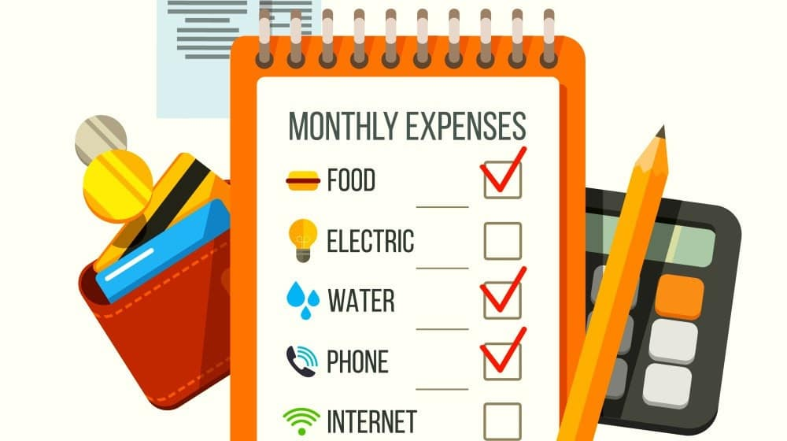
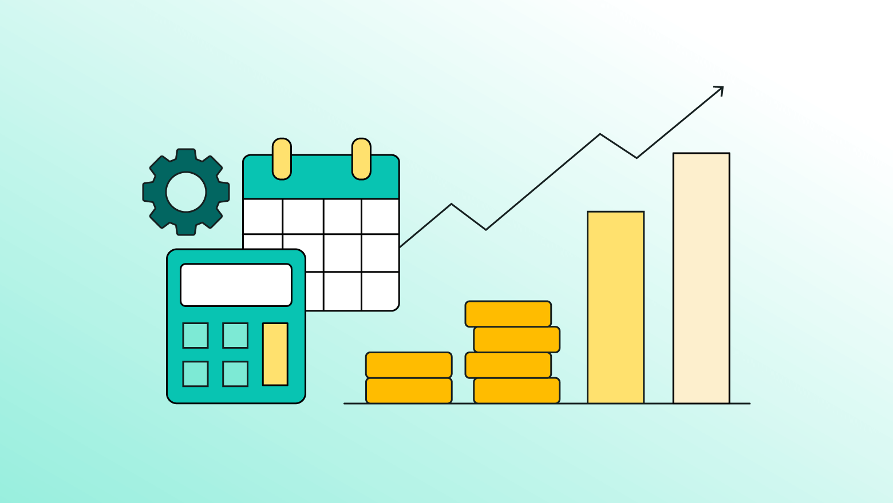

Problem Definition
What is the problem we are trying to solve?

Slide 5
Problems and Solutions
Simplified Data Entry (User Input)
  The website allows easy input of financial data, such as expenses, income and savings, possibly through intuitive interfaces manually, or hypothetically by syncing with bank accounts.
Real-Time Feedback (User Output)
  The website provides real-time feedback on how expenses affect budget limits, saving goals, and overall financial health.
User-driven Customization (User Input)
  Allows users to customize categories, set their budgeting intervals, and create personalized financial plans.

Slide 6
Design Requirements
Functions
Objectives
Goal Tracking
Budget Planning
Integrating Financial Institutions
Expense Tracking
Promote Financial Discipline and Literacy
Facilitate Goal Achievement
Ease of Financial Management

Slide 7
Design Requirements
Constraints
Economic Factors
User Interface and Experience
  Balanced complexity and usability. Considering how this is a budgeting app, we made this a low floor website. The last thing a user needs to do is have a hard time figuring out how to use our product.
User Privacy and Data Security
  Passport was used to hash passwords.
Reliability
  Local host was used so this wasn’t an issue. EJS and MongoDB are pretty straightforward. Countless tests were done to make sure functions work.
Integration Challenge
  For obvious reasons we are unable to connect with banks; therefore, we simulated financial management(MongoDB) with manually inputted data instead of automated data.

Slide 8
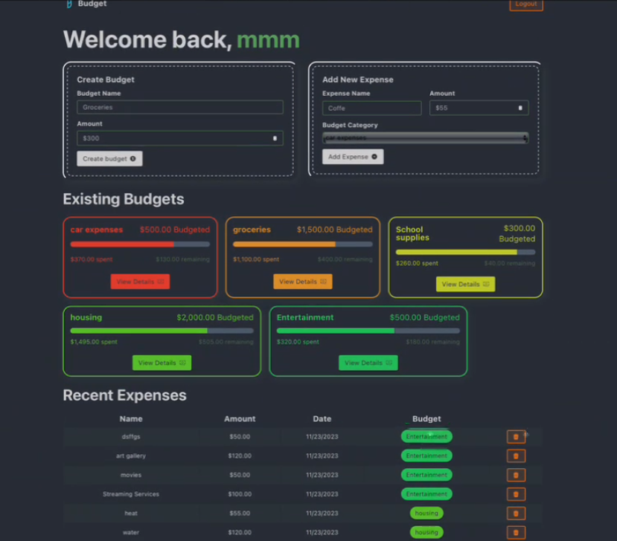
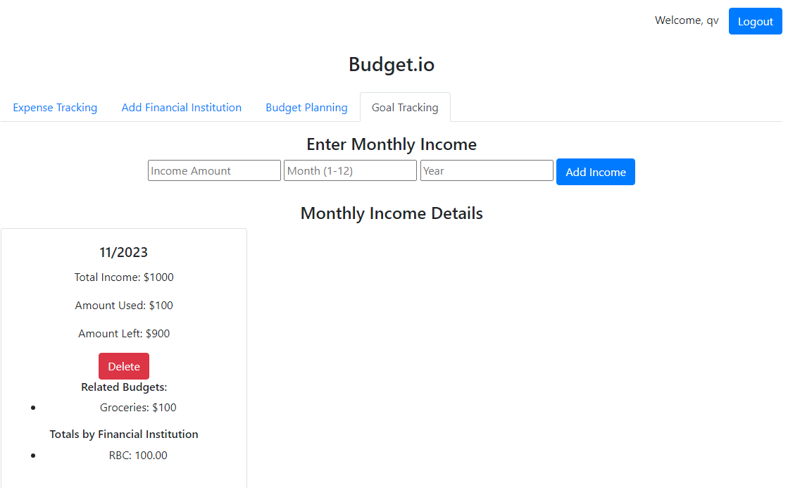
Solutions(React vs EJS)
React
EJS

Slide 9
Solutions
 | Learnability | Looks | Database Integration | Decision
MERN | React was explored, but it required us to learn how it works on our own. | Incomplete product looked better and user-friendly. | Implementing MongoDB is another learning experience that required time. | Although viable, it would’ve taken us a long time. We didn’t think it was worth it.
EJS, Node.js, Express.js | Learned in our labs so this was easier. | Bootstrap is good enough to make a website look fine but nothing spectacular. | MongoDB was easy to integrate with the guidance of our lab instructor. | We chose this since we already accumulated experience throughout the labs and it can easily satisfy the project description and requirements

Slide 10
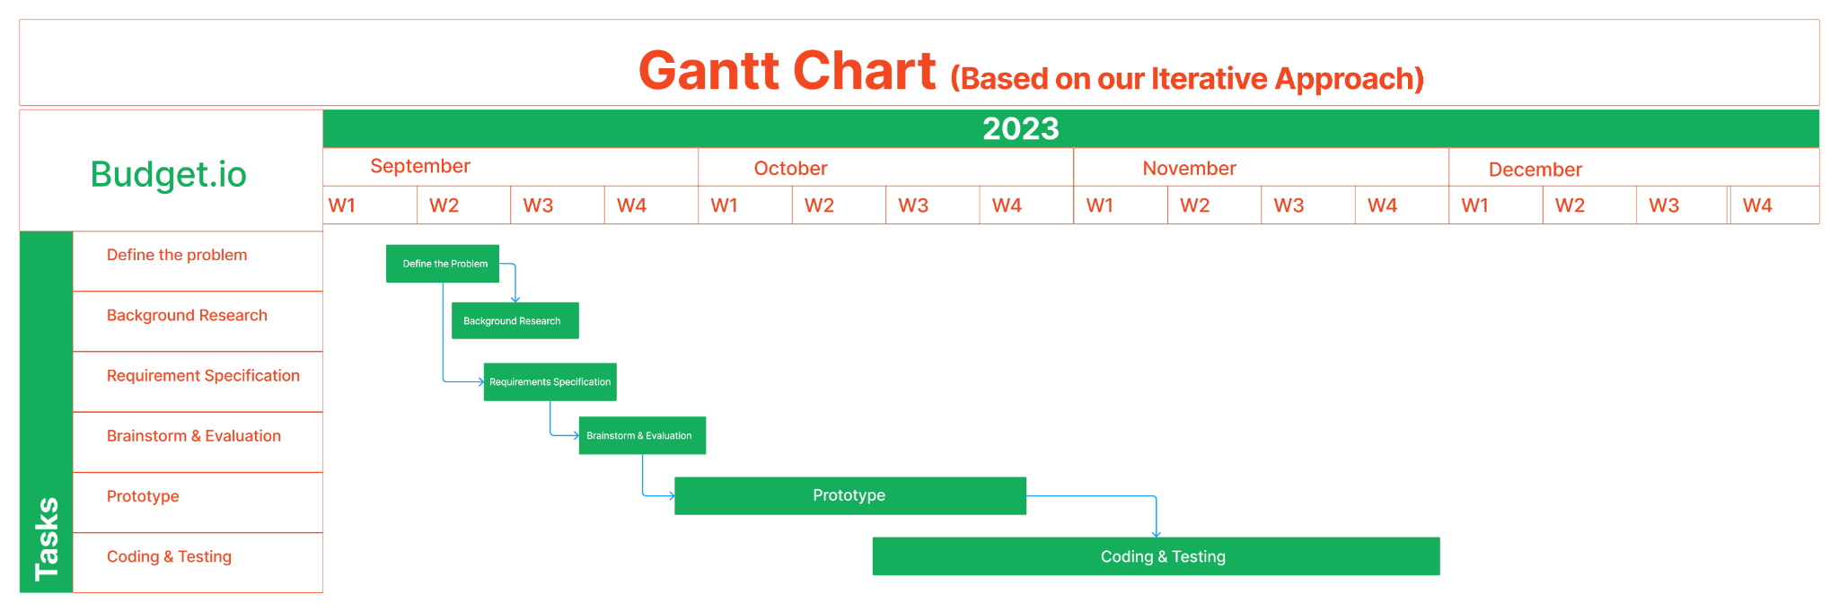
Project Management

Slide 11
Demo Time

Slide 12
Conclusion
In summary, our budgeting website represents a transformative approach to personal finance management. We've seen how its intuitive design simplifies budgeting and its real-time tracking helps users with immediate insights. Unfortunately, we weren’t able to automate everything as we had no access to financial institutions. Otherwise, we showed how well automated goal tracking, budget planning and expense tracking can benefit a user.

Slide 13


Thank you

