Slide 1
Ship Battle Royale 2.0
w/ Cheese
By Curtis and Jim

Slide 2

Framework
We first wanted to use ReactJS and uWebsockets.
I later found out creating the uWebSockets server will take up the most time on our project.
So we switched to purely NodeJS and Rekit, which works out fairly well for our project.
Using the Rekit environment is easy, creating a component is as easy as clicking a button.
Best thing since canned bread.

Slide 3
Our Goal
Fancy, flashy graphics with exploding ships and 3D rendering.
Real-time debugging with ReactJS.
A tool that will help you with ANY homework, so that we can play endless hours of Ship Battle Royale.
P2P gameplay with up to 2 players!

Slide 4
Our Goal
As seen on Github:
User Stories | Difficulty (in points/10)
Neat and usable UI | 4
Be able to play anywhere | 3
Vs. Multiplayer or vs. COM | 6
Place ships easily | 8
Beautiful graphics and sfx | 9
Does your homework so you have more time for Ship Battle Royale 2.0 w/ cheese | 1

Slide 5
We’ve gone through many different versions
Through failure and experience, we finally narrowed down to have a simple interface.
Tests were failing from unknown errors.
Pages failing to load due to errors from calling <div> tags.
Didn’t want to deal with the errors at the time, so we started fresh from the beginning.

Slide 6
Thoughts (Jim)
It was like a step-by-step guide on how to get crazy in less than a month.

Slide 7
Thoughts (Curtis)
Paired programming was a great learning experience for things we didn’t know
Not so great when neither of us understand what is broken and why.
Test driven development turned out to be more of a hindrance in our case
I blame the framework we had for testing as it was able to somehow make changes to the code it wasn’t supposed to in places we couldn’t find, causing us to have to refresh the project.
Our achilles heel was infrequency of pushing to the repo
Had we pushed more often we could have avoided refreshing the project due to unsolvable errors. Lesson learned.
Total approx. man hours : 15
A lot of my time was spent learning a foreign language and becoming literate in the shortest time possible. Use more familiar languages for individual projects, another lesson learned.

Slide 8
Portfolio samples

Slide 9
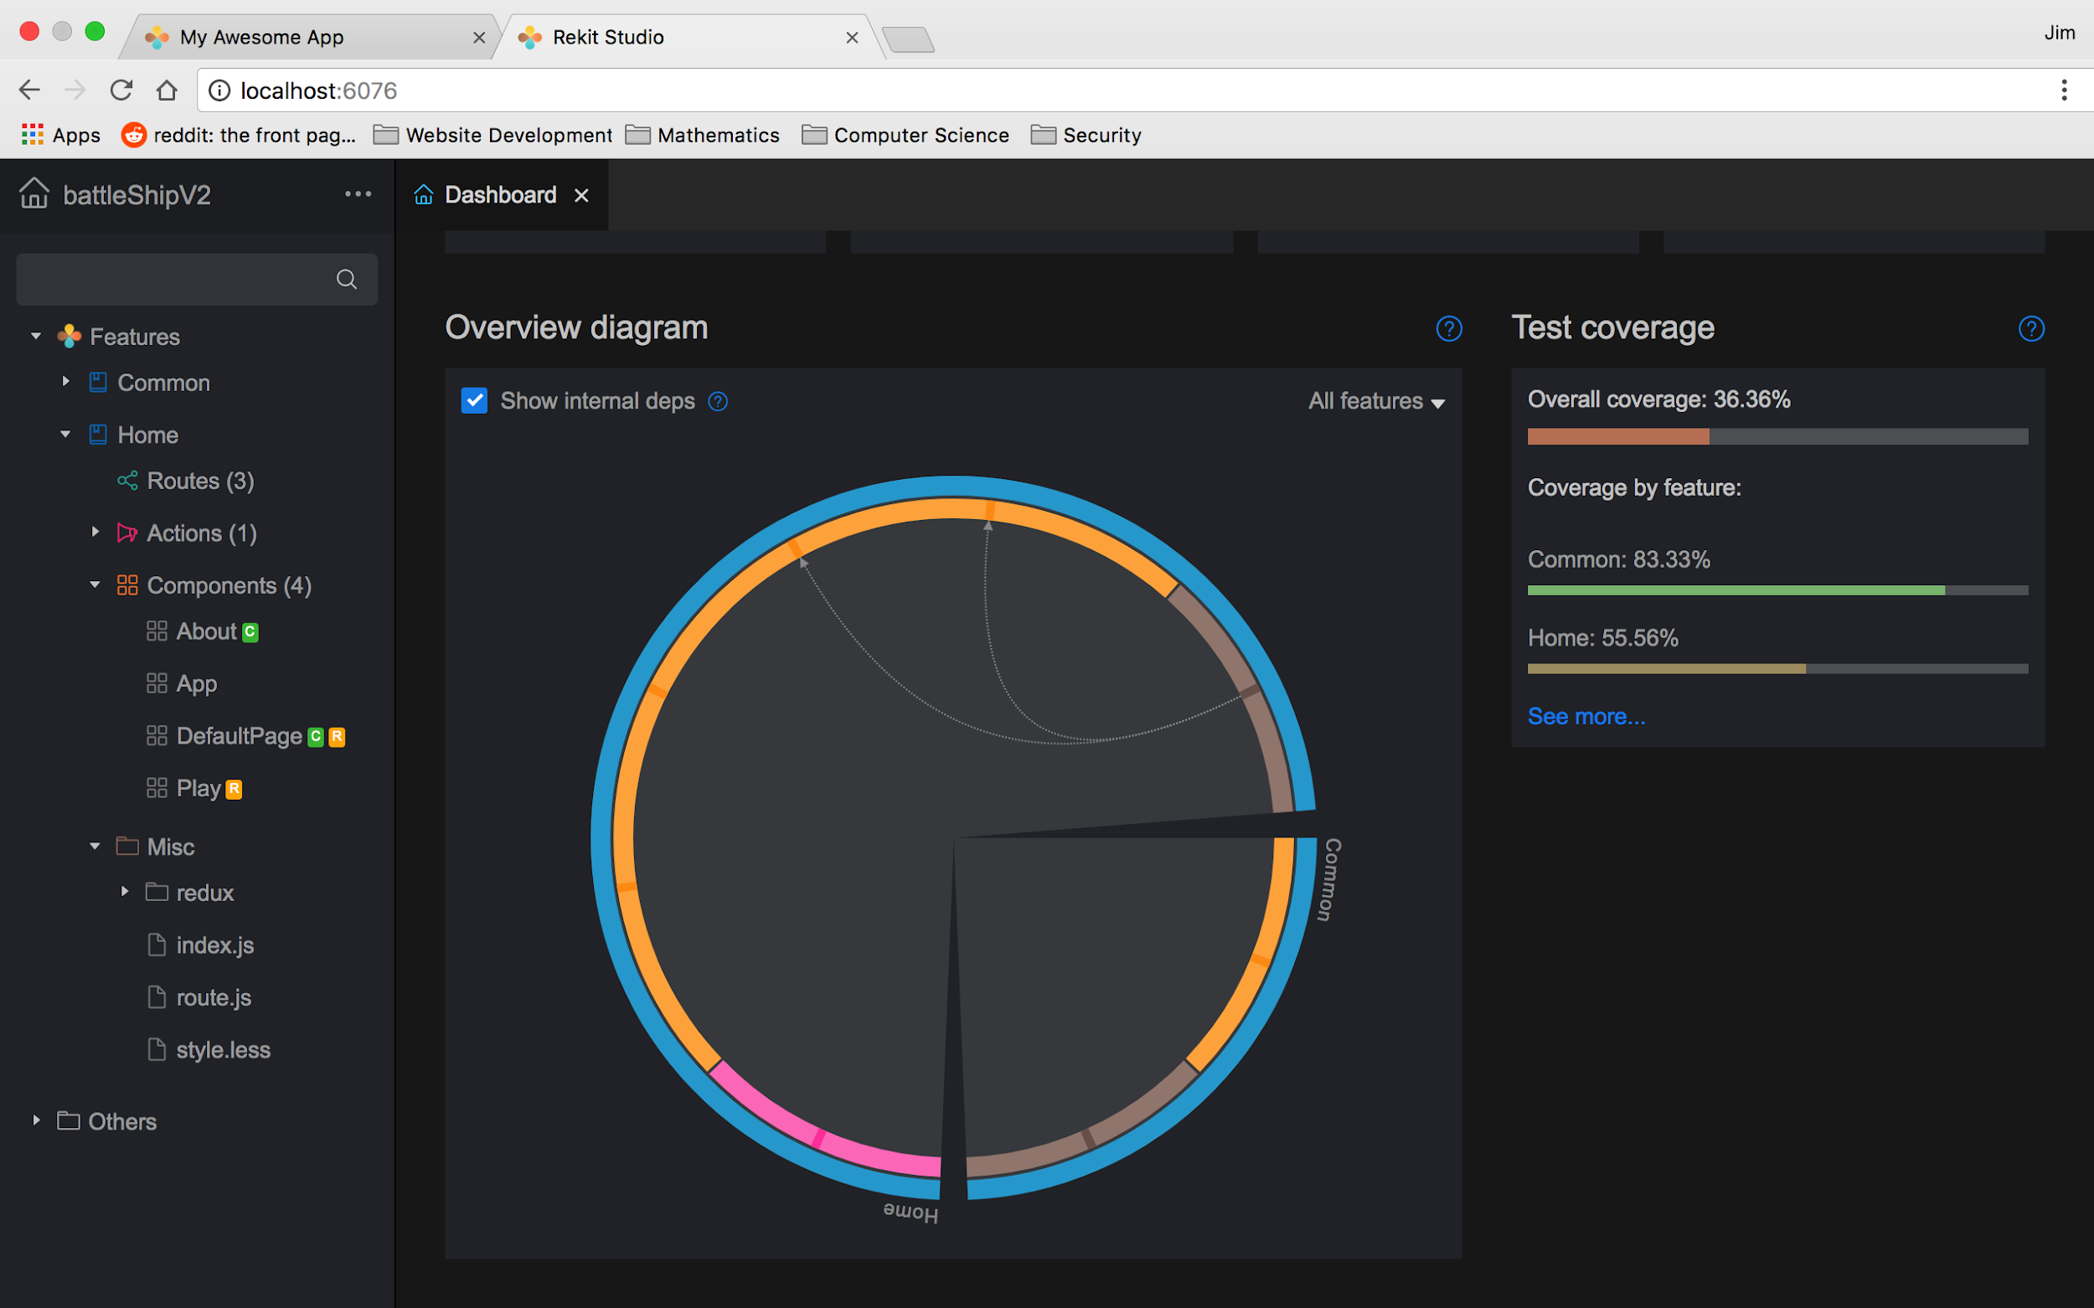

Slide 10
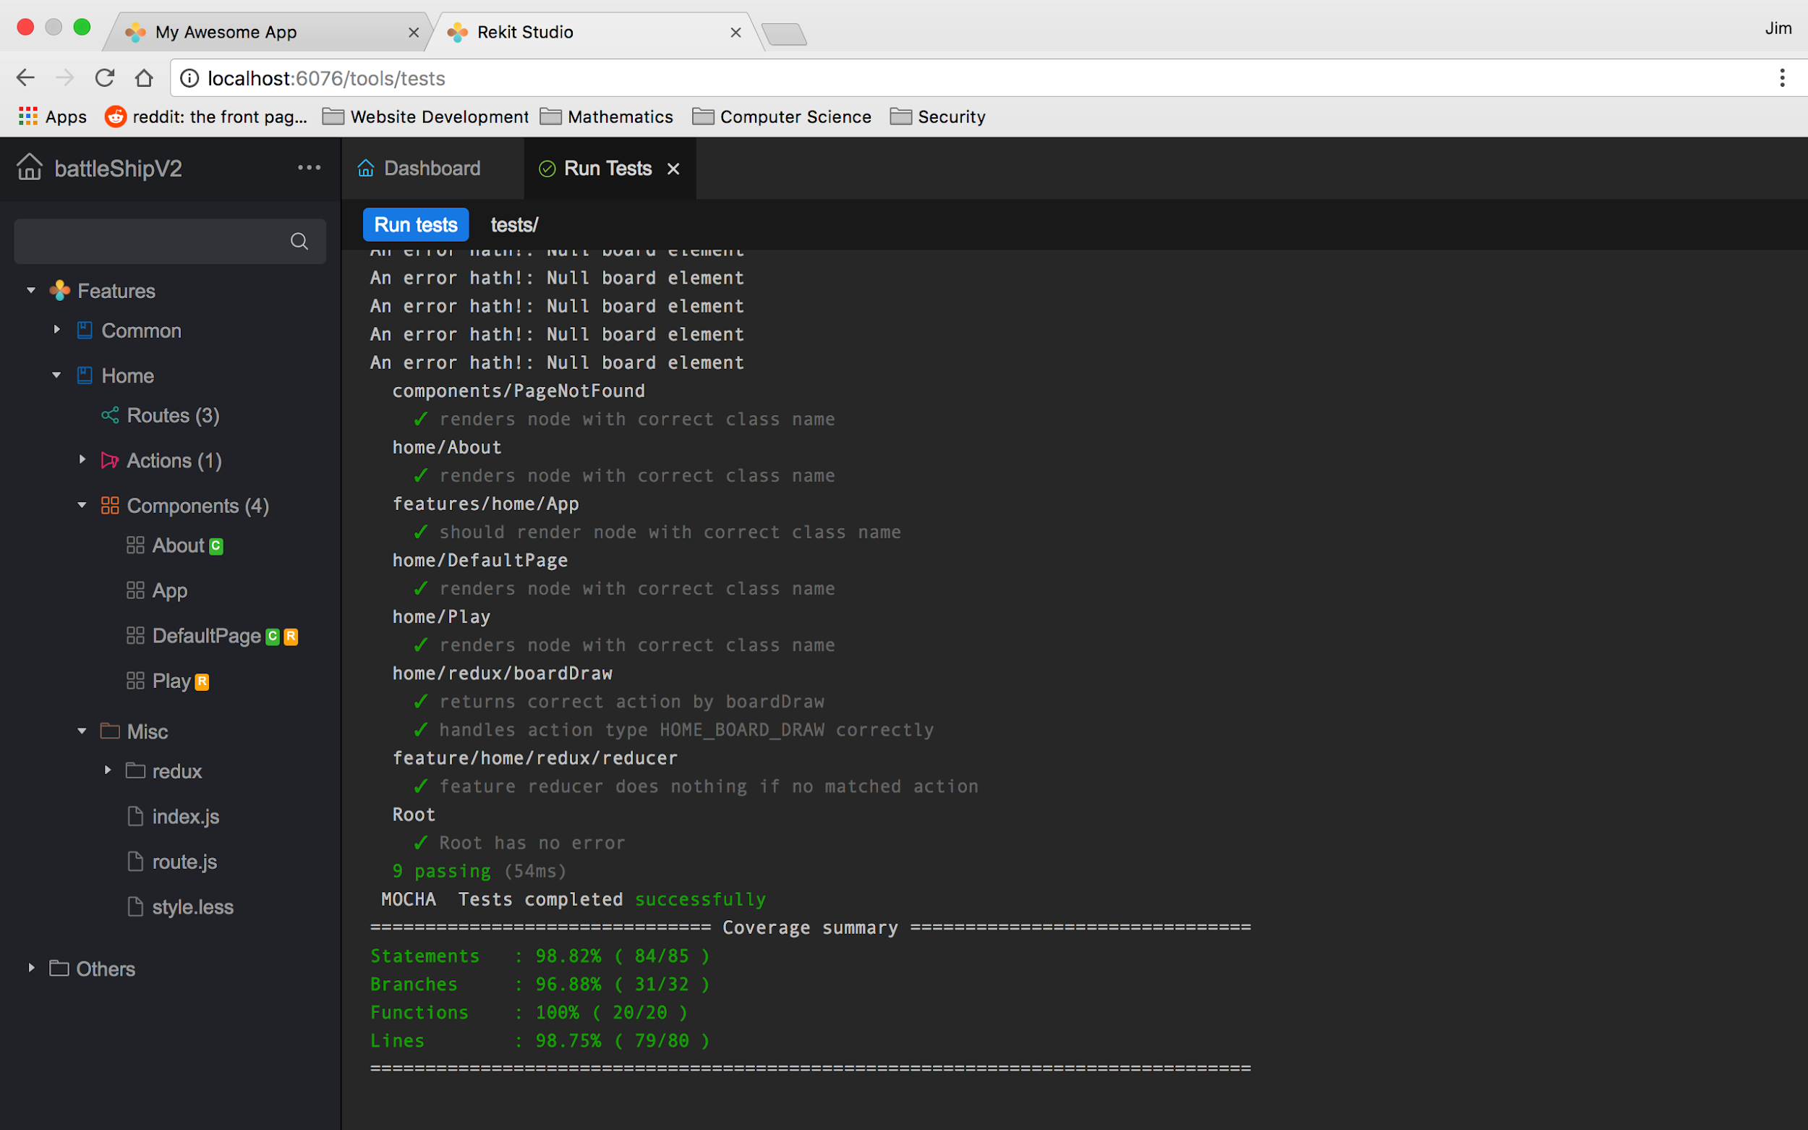

Slide 11
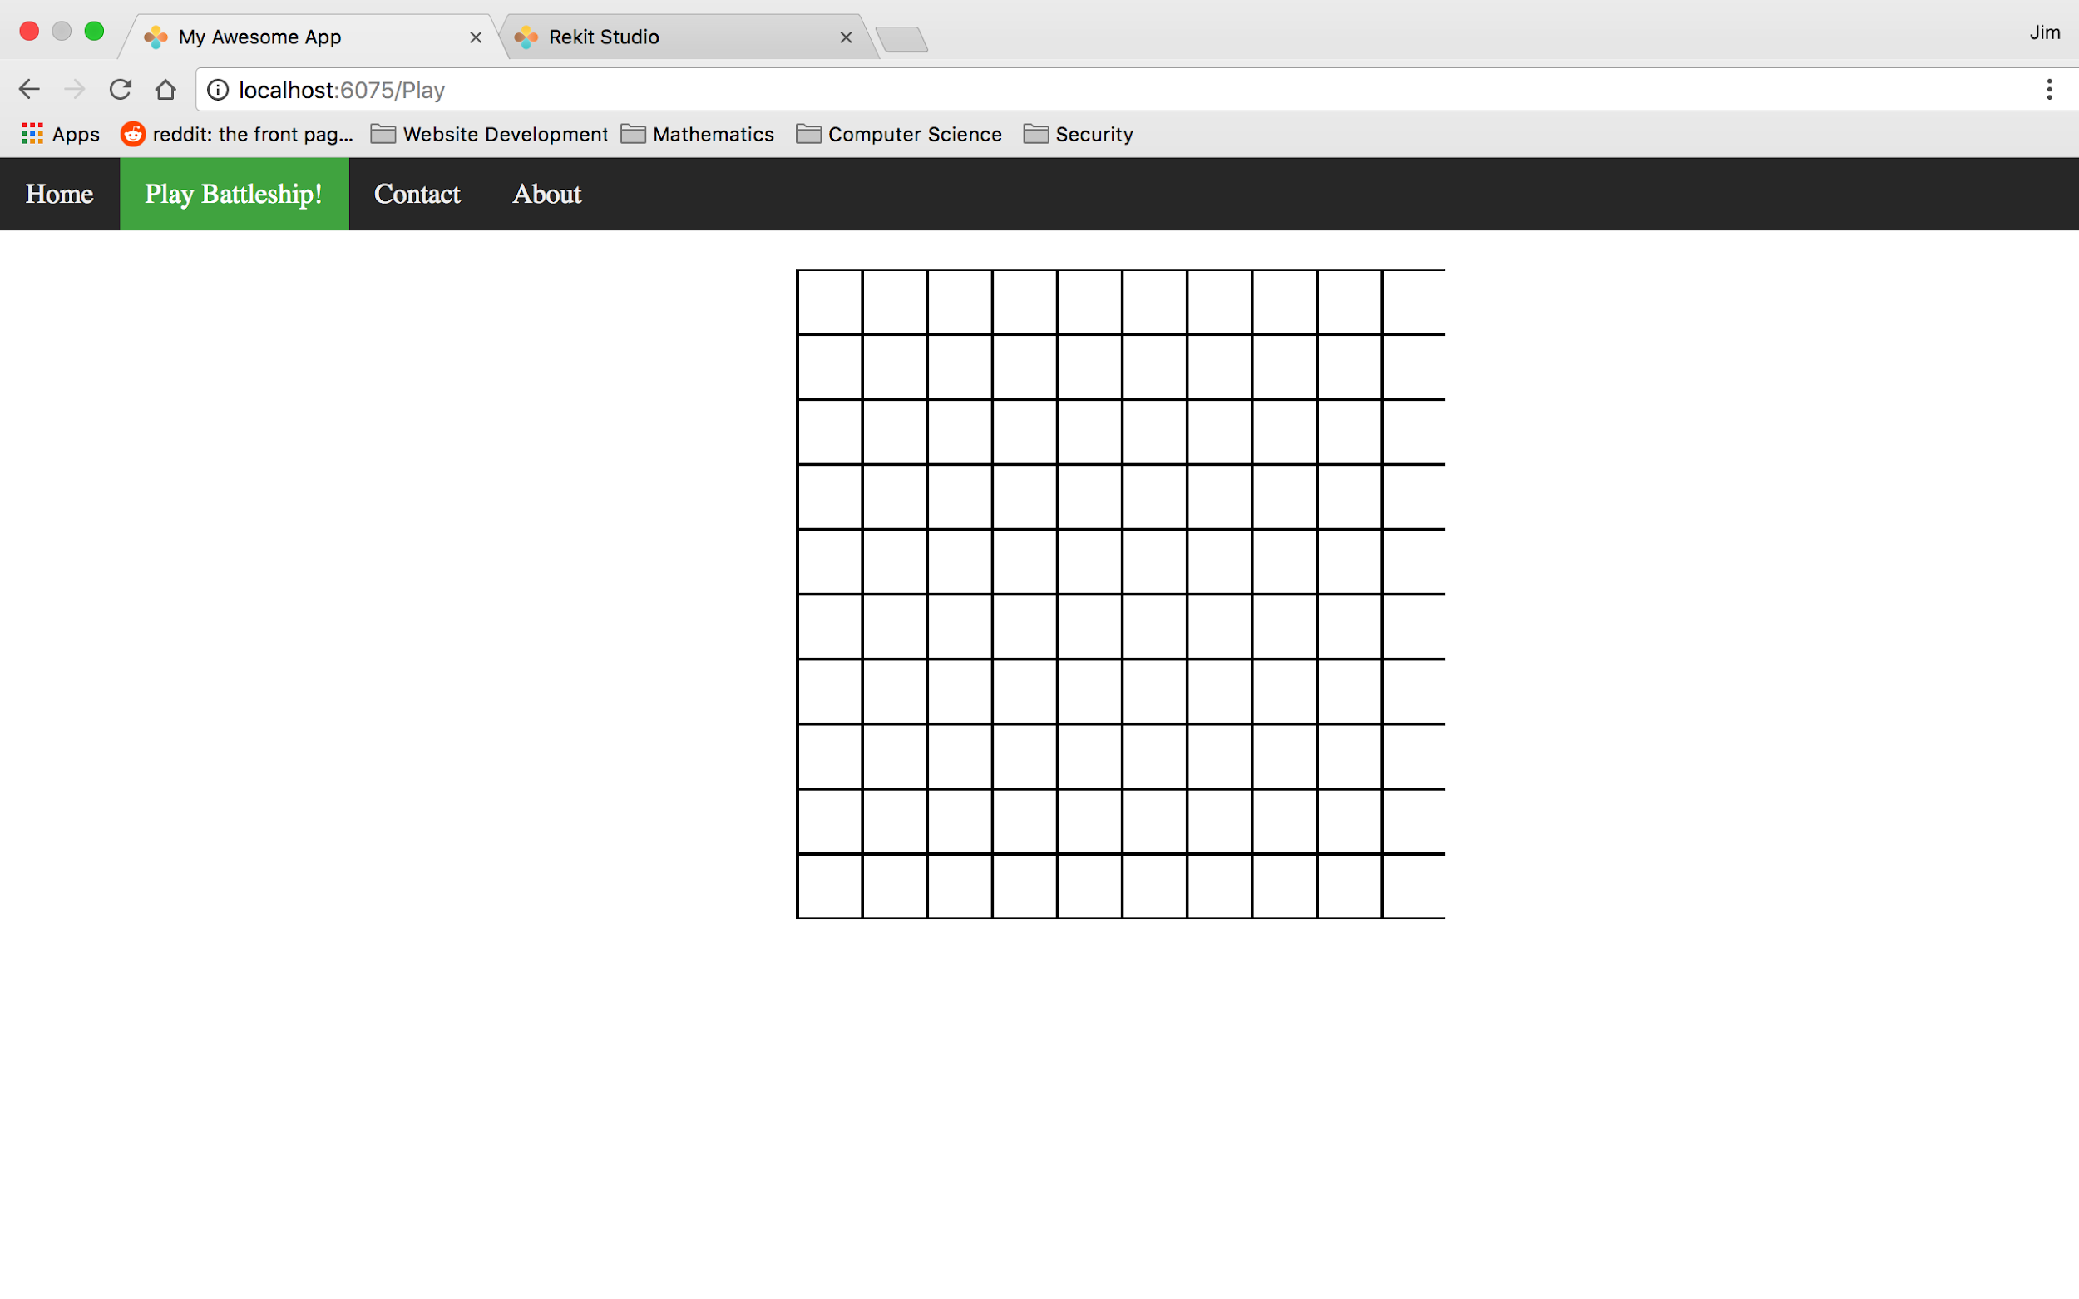

Slide 12
