Slide 1
Virtual Memory and Pipelining

Slide 2
Memory Management
In a Multiprogramming System
  Each user could run many processes
  Each process has access to some section of memory
  Memory requirements of the processes might exceed that of actual physical memory
  Operating System plus the hardware has the task of managing memory
Options
  Swapping
  Partitioning
  Paging

Slide 3
Swapping
Problem: I/O is so slow compared with CPU that even in multi-programming systems, the CPU can be idle most of the time
Swapping
  Long term queue of processes stored on disk
  Processes “swapped” into main memory as space becomes available or process completes
  If none of the processes in memory are ready (i.e. all I/O blocked)
    Swap out a blocked process to intermediate queue
    Swap in a ready process or a new process
I/O intensive, limited by physical memory

Slide 4
Partitioning
Splitting memory into sections to allocate to processes (including Operating System)
Fixed-sized partitions
  May not be equal size
  Process is fitted into smallest hole that will take it (best fit)
  Some wasted memory
  Leads to variable sized partitions

Slide 5
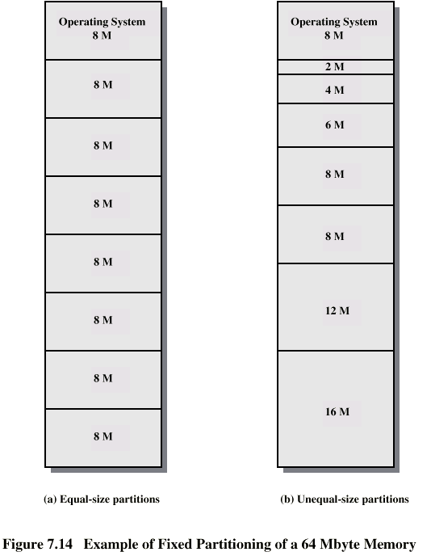
Fixed
Partitioning

Slide 6
Relocation
No guarantee that process will load into the same place in memory
Instructions contain addresses
  Locations of data
  Addresses for instructions (branching)
Logical address - relative to beginning of program
Physical address - actual location in memory (this time)
Automatic conversion using base address

Slide 7
Paging
Technique used today, superior to the previous schemes
Split memory into sized, small chunks
  Called pages, frames, or blocks
Split programs (processes) into equal sized pages
Allocate some number of page frames to a process
Operating System maintains list of free frames
A process does not require contiguous page frames
  Use page table to keep track
  With virtual memory, pages could be on disk

Slide 8
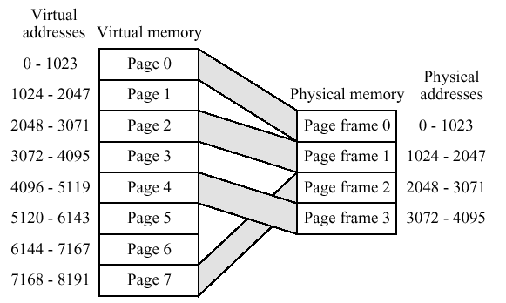
Allocation of Pages

Slide 9
Allocation of Free Frames
Each process given their own Page Table. Here, add Process A:
Free Frame List
13
14
15
18
20
Process A:
Page 0
Page 1
Page 2
Page 3
Free Frame List
20
Process A:
Page 0 : 13
Page 1 : 14
Page 2 : 15
Page 3 : 18
Memory Frames
Memory Frames
…
13 | Free
14 | Free
15 | Free
16 | Used
17 | Used
18 | Free
19 | Used
20 | Free
21 | Used
…
…
13 | A: Page 0
14 | A : Page 1
15 | A : Page 2
16 | Used
17 | Used
18 | A : Page 3
19 | Used
20 | Free
21 | Used
…

Slide 10
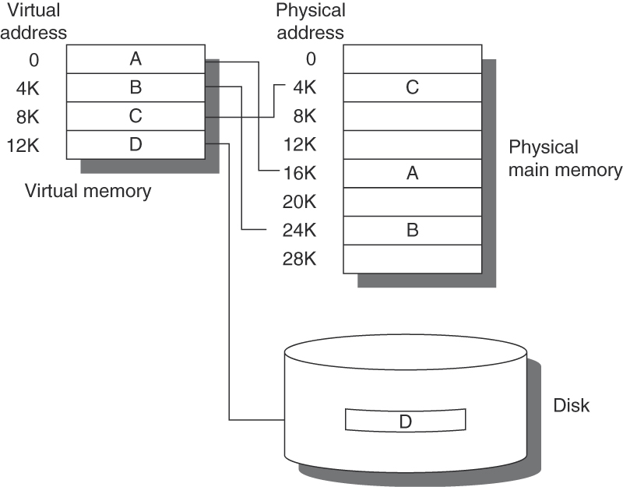
Page frames could be on disk
Notes:
Swap in disk to memory block if accessing disk; if no frames free then have to throw something out. Can use LRU.

Slide 11
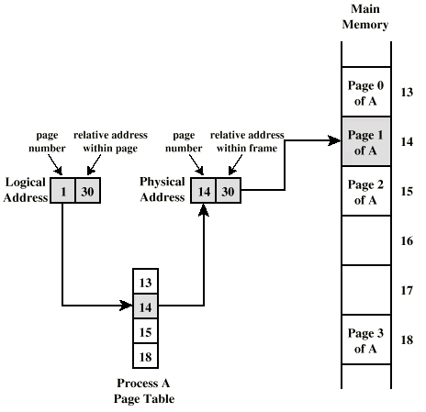
Logical and Physical Addresses - Paging

Slide 12
Virtual Memory
Demand paging
  Do not require all pages of a process in memory
  Bring in pages as required
Page fault
  Required page is not in memory
  Operating System must swap in required page
  May need to swap out a page to make space
  Select page to throw out based on recent history
    Just like caching!
  Needless to say this is very time consuming! Good thing we can process-switch to something else that is hopefully ready to do work, while we wait for a page to load from disk (many cycles)
Notes:
Spectre flaw related to page fault
Tenex bug
For i = 0 to len(typed_password)
if i >= len(actual_password) fail;
if typed_password[i] != actual_password[i] fail;
if i < len(actual_password) fail;
Success;
Flaw: Attacker could put candidate password in memory overlapping
page boundaries. First letter on one page, second letter on the next, if the
first letter was correct there was a pause while the page for the second letter
loaded

Slide 13
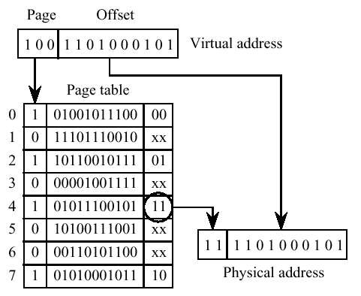
Virtual Addressing
Page #
for Process
Present?
Page in Memory
Disk Address

Slide 14
Thrashing
What if we have a large number of processes running with too little memory?
  Operating System spends all its time swapping
  Little or no real work is done
    All the time is spent in overhead in process switching
    Could happen if you fork off too many processes uncontrollably
  Disk light is on all the time
Solutions
  Good page replacement algorithms
  Reduce number of processes running
  Fit more memory

Slide 15
Bonus
We do not need all of a process in memory for it to run
We can swap in pages as required
So - we can now run processes that are bigger than total memory available
User/programmer sees much bigger memory than physical memory- virtual memory

Slide 16
Problems with Virtual Memory
Each process can see a big virtual memory
  This means each process has its own Page Table
  Page table can be big
    E.g. Given a 32 bit virtual addresses with 4K page size
    2¹² = 4K, leaves 2³² / 2¹² = 2²⁰ pages per process
      Storing 2²⁰ entries per process takes a lot of memory
      Actually only 2¹⁶ if we use 4 bits for a segment discussed later
    Solutions
      Store page table itself in virtual memory; page table could be swapped in and out
      Inverted schemes

Slide 17
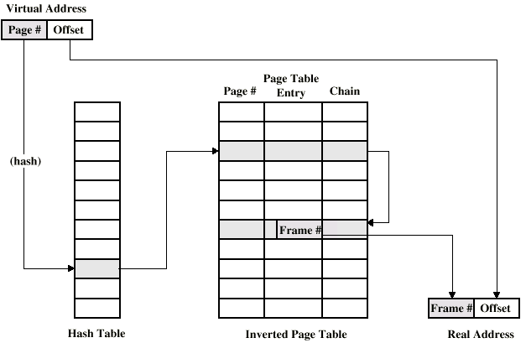
Inverted Page Table Structure
Table for Real Memory Pages
- Stored in fixed proportion of real memory
Not one per virtual page
Use hashing to lookup frame #
Add ID based on PID
ID+
ID+

Slide 18
Translation Lookaside Buffer
Virtual memory reference can cause two physical memory accesses
  Fetch appropriate page table entry
  Fetch desired data
  Could double memory access time
Solution
  Create a special cache for page table entries
  Called the TLB (Translation Lookaside Buffer)
  Functions just like a memory cache, associative or direct map
    Contains page table entries most recently used
    Complicates things even more for just a single memory reference
      Look to see if virtual address is in the TLB
        If yes, use it. If not, we must fetch it from memory or disk
      Decode the virtual address via the Page Table to a physical address
      Send the physical address to the data cache to see if it’s in the cache
        All our usual stuff with cache hits/misses

Slide 19
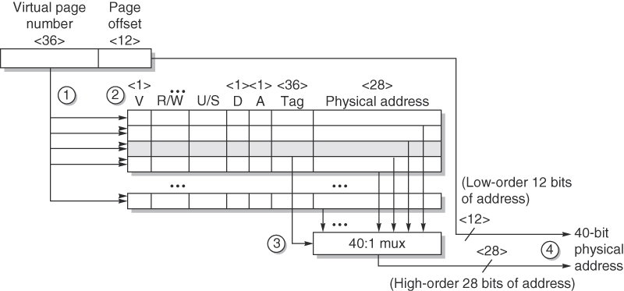
Figure B.24 Operation of the Opteron data TLB during address translation. The four steps of a TLB hit are shown as circled numbers. This TLB has 40 entries. Section B.5 describes the various protection and access fields of an Opteron page table entry.
Notes:
Fully associative
1 and 2) page number sent to all 40 entries of TLB
3) Matching tag sends physical address of page in memory (28 bits) to bus; combine with 12 bit offset

Slide 20
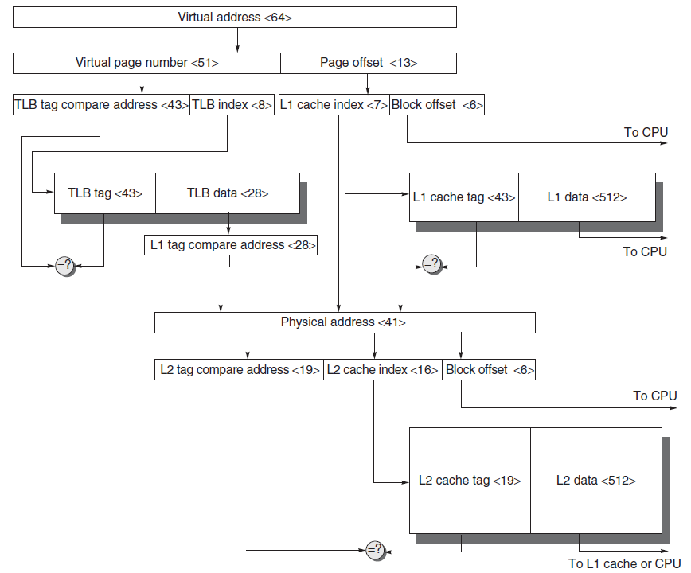
Figure B.25 The overall picture of a hypothetical memory hierarchy going from virtual address to L2 cache access. The page size is 8 KB. The TLB is direct mapped with 256 entries. The L1 cache is a direct-mapped 8 KB, and the L2 cache is a direct-mapped 4 MB. Both use 64-byte blocks. The virtual address is 64 bits and the physical address is 41 bits. The primary difference between this simple figure and a real cache is replication of pieces of this figure.
Notes:
If 8Kb page size, how many bits to address 8K? 2^13
If 64 bit virtual address, and 13 bits per page, 64-13 = 51 bits to number each of the pages
TLB = 8 bits because 256 entries, 2^8 = 256; like a direct mapped cache
Supplies 28 bits from TLB of a physical address (why 28? 28 + 13 = 41)
On L1 cache, uses 64 byte blocks. Need 6 bits. Out of 8Kb (13 bits – 6= 7 bits for addressing the blocks)

Slide 21
Pipelining

Slide 22
What is Pipelining?
Like an Automobile Assembly Line for Instructions
  Each step does a little job of processing the instruction
  Ideally each step operates in parallel
Simple Model
  Instruction Fetch
  Instruction Decode
  Instruction Execute
F1
D1
E1
F2
D2
E2
F3
D3
E3

Slide 23

Ideal Pipeline Performance
If stages are perfectly balanced:
The more stages the better?
  Each stage typically corresponds to a clock cycle
  Stages will not be perfectly balanced
  Synchronous: Slowest stage will dominate time
  Many hazards await us
Two ways to view pipelining
  Reduced CPI (when going from non-piped to pipelined)
  Reduced Cycle Time (when increasing pipeline depth)

Slide 24
Ideal Pipeline Performance
Implemented completely in hardware
  Exploits parallelism in a sequential instruction stream
Invisible to the programmer!
  Not so for other forms of parallelism we will see
  Not invisible to programmer looking to optimize
  Compiler must become aware of pipelining issues
All modern machines use pipelines
  Widely used in 80’s
  Multiple pipelines in 90’s

Slide 25
Stages for an Unpipelined RISC-V Style Machine
Every instruction for our hypothetical RISC-V machine can be executed in 5 steps which maps to 5 cycles
1. IF – Instruction Fetch
  IR ←Mem[PC]
  NPC ← PC + 4 ; Next Program Counter
2. ID – Instruction Decode / Register Fetch
  Read A ← RS
  Read B ← RD
  Read Imm value
  Fetch operands in parallel for later use.
    Might not be used!
    Fixed Field decoding

Slide 26
Classic Pipeline Stages
3. EX - Execution / Effective Address Cycle
  There are four operations depending on the opcode decoded from the previous stage
  Memory Reference
    ALUOutput ← A + Imm ; Compute effective address
  Register-Register ALU Operation
    ALUOutput ← A func B ; e.g. R1 + R2
  Register-Immediate ALU Operation
    ALUOutput ← A op Imm ; e.g. R1 + 10
  Branch (can be done in Stage 2 if aggressive)
    ALUOutput ← NPC + Imm ; PC based offset
    Cond ← A op 0 ; e.g. op is == for BEQZ
  Note that the load/store architecture means that effective address and execution cycles can be combined into one clock cycle since no instruction needs to simultaneously calculate a data address and perform an ALU op

Slide 27
Classic Pipeline Stages
4. MEM – Memory Access / Branch Completion
  There are two cases, one for memory references and one for branches
  Both cases
    PC ← NPC ; Update PC
  Memory reference
    LMD ←Mem[ALUOutput] ; for memory Loads
    Mem[ALUOutput] ← B ; or Stores
    Note the address was previously computed in step 3
  Branch
    If (cond) PC ← ALUOutput ; PC gets new address
Notes:
LMD = Load Memory Data register

Slide 28
Stages for a MIPS-like Machine
5. WB – Write Back
  Writes data back to the register file
    Memory writes were done in step 4
  Options
    ALUOutput to a register
    LMD to a register

Slide 29
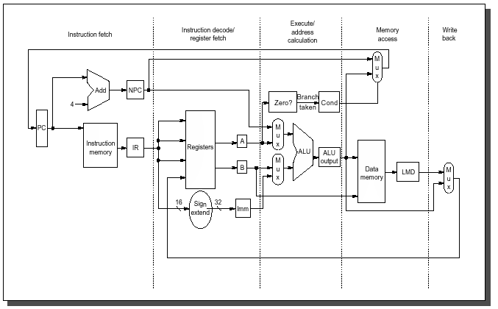
Hardware Implementation of the Datapath
Registers between stages → Pipelined

Slide 30
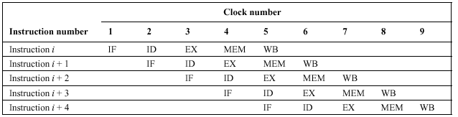
Adding Pipelining
Run each stage concurrently
Need to add registers to hold data between stages
  Pipeline registers or Pipeline latches
  Rather than ~5 cycles per instruction, 1 cycle per instruction!
  Ideal case:
Really this simple?
  No, but it is a good idea… but there are pitfalls

Slide 31
Important Pipeline Characteristics
Latency
  Time required for an instruction to propagate through the pipeline
  Based on the Number of Stages * Cycle Time
  Dominant if there are lots of exceptions / hazards, i.e. we have to constantly be re-filling the pipeline
Throughput
  The rate at which instructions can start and finish
  Dominant if there are few exceptions and hazards, i.e. the pipeline stays mostly full
Note we need an increased memory bandwidth over the non-pipelined processor

Slide 32
Pipelining Example
Assume the 5 stages take time 10ns, 8ns, 10ns, 10ns, and 7ns respectively
Unpipelined
  Ave instr execution time = 10+8+10+10+7= 45 ns
Pipelined
  Each stage introduces some overhead, say 1ns per stage
  We can only go as fast as the slowest stage!
  Each stage then takes 11ns; in steady state we execute each instruction in 11ns
  Speedup = UnpipelinedTime / Pipelined Time
    = 45ns / 11ns = 4.1 times or about a 4X speedup
    Note: Actually a higher latency for pipelined instructions!

Slide 33
Pipelining Hazards
Unfortunately, the picture presented so far is a bit too good to be true… we have problems with hazards
Structural
  Resource conflicts when the hardware can’t support all combinations of overlapped stages
  e.g. Might use ALU to add 4 to PC and execute op
Data
  An instruction depends on the results of some previous instruction that is still being processed in the pipeline
  e.g. R1 = R2 + R3; R4 = R1 + R6; problem here?
Control
  Branches and other instructions that change the PC
  If we branch, we may have the wrong instructions in the pipeline

Slide 34
Structural Hazards
Overlapped execution may require duplicate resources
Clock 4:
  Memory access for i may conflict with IF for i+4
    May solve via separate cache/buffer for instructions, data
  If IF didn’t have its own adder but had to use the ALU then that would conflict with EX

Slide 35
Dealing with Hazards
One solution: Stall
  Let the instructions later in the stage continue, and stall the earlier instruction
    Need to do in this order, since if we stalled the later instructions, they would become a bottleneck and nothing else could move out of the pipeline
  Once the problem is cleared, the stall is cleared
  Often called a pipeline bubble since it floats through the pipeline but does no useful work
Stalls increase the CPI from its ideal value of 1

Slide 36
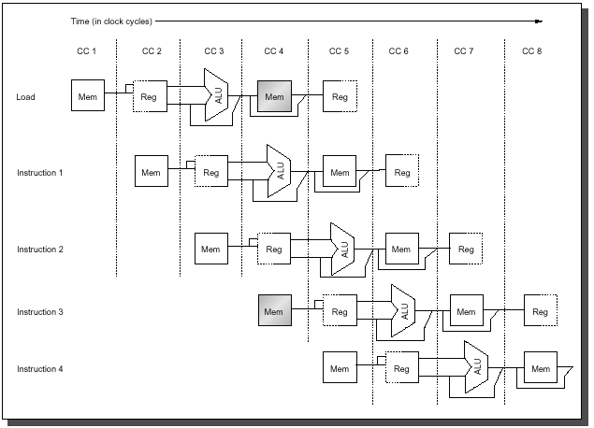
Structural Hazard Example

Slide 37
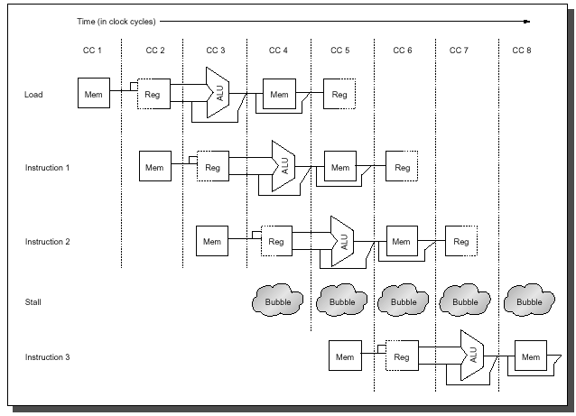
Structural Hazard Example
No Instr finished in CC8
What if Instruction 1 is also a LOAD?

Slide 38
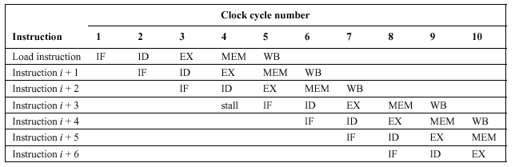
Alternate Depiction of Stall

Slide 39
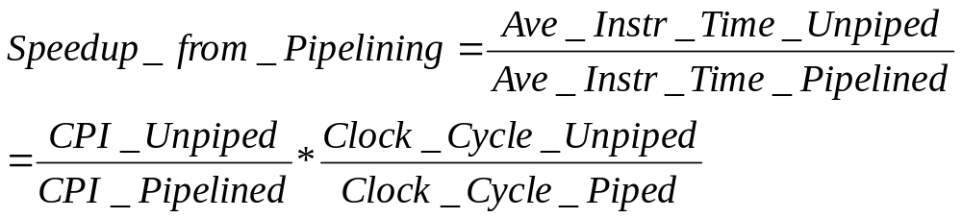
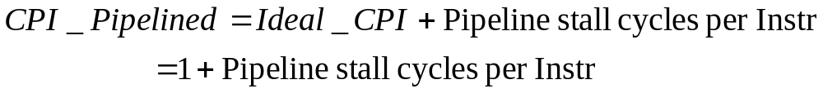
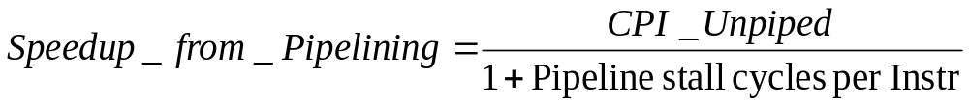
Measuring Performance with Stalls
We also know that the Ideal CPI is 1:
Assuming an identical clock cycle, substitution yields:

Slide 40
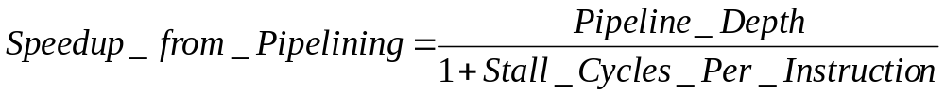
Measuring Stall Performance
Given:
In our simple case each instruction takes the same number of cycles, which is equal to the number of pipeline stages or the pipeline depth:
If there are no pipeline stalls we get the intuitive result that
pipelining can improve performance by the depth of the pipeline.

Slide 41
How Realistic is the Pipeline Speedup Equation?
Good for a ballpark figure, comes close to a SWAG
Overhead in pipeline latches shouldn’t be ignored
Effects of pipeline depth
  Deeper pipelines have a higher probability of stalls
  Also requires additional replicated resources and higher cost
Need to run simulations with memory, I/O systems, cache, etc. to get a better idea of speedup
Data hazards and control hazards further complicate our simple pipeline

Slide 42
Data Hazards
Data hazards occur when the pipeline changes the order of read/write accesses to operands that differs from the normal sequential order
Example:
  ADD R1, R2, R3
  SUB R4, R1, R5
  AND R6, R1, R7
  OR R8, R1, R9
  XOR R10, R1, R11
Looks pretty innocent, what is the problem?

Slide 43
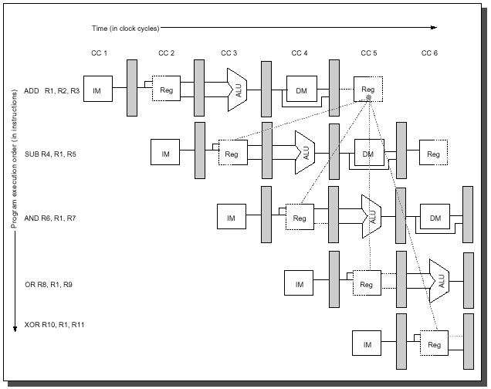
Data Hazard Example
Split
Cycle
Results of first ADD not available when the SUB needs it!
Any instructions correct?
Could be even worse with memory-based operands

Slide 44
Forwarding
Technique to minimize data stalls as in the previous example
Note we’ve actually computed the correct result needed by the other instructions, but it’s in an earlier stage
  ADD R1, R2, R3 R1 at ALUOutput
  SUB R4, R1, R4 Need R1 at ALUInput
Forward this data to subsequent stages where it may be needed
  ALU result automatically fed back to input latch for next stage
  Need control logic to detect if the feedback should be selected, or the normal input operands

Slide 45
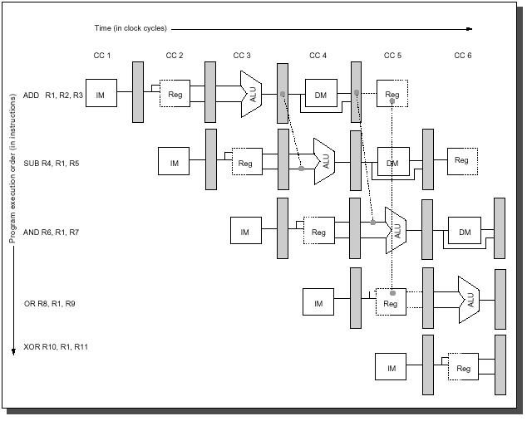
Forwarding

Slide 46
Another Data Hazard Example
What are the hazards here?
  DADD R1, R2, R3
  LD R4, 0(R1)
  SD R4, 12(R1)
Need forwarding to other stages
IF
ID
EX
M
WB
IF
ID
EX
M
WB
IF
ID
EX
M
WB

Slide 47
Data Hazard Classification
Three types of data hazards
Instruction i comes before instruction j
  RAW : Read After Write
    j tries to read a source before i writes it, so j incorrectly gets the old value. Solve via forwarding or stall.
  WAW : Write After Write
    j tries to write an operand before it is written by i, so we end up writing values in the wrong order
    Only occurs if we have writes in multiple stages
      Not a problem with single cycle integer instructions
      We’ll see this when we do floating point

Slide 48
Data Hazard Classification
WAR : Write After Read
  j tries to write a destination before it is read by i, so i incorrectly gets the new value
  For this to happen we need a pipeline that writes results early in the pipeline, and then other instruction read a source later in the pipeline
  Can this happen in our RISC-V machine?
  This problem led to a flaw in the VAX
RAR : Read After Read
  Is this a hazard?

Slide 49
Forwarding is not Infallible
Unfortunately, forwarding does not handle all cases, e.g.:
  LW R1, 0(R2)
  SUB R4, R1, R5
  AND R6, R1, R7
  OR R8, R1, R9
Load of R1 not available until MEM, but we need it for the second instruction in ALU

Slide 50
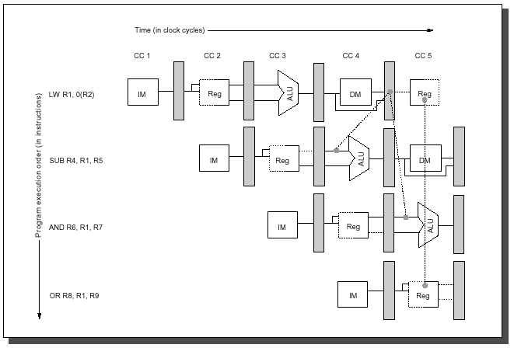
Data Hazard Requiring Stall
Result needed before it is even computed!

Slide 51
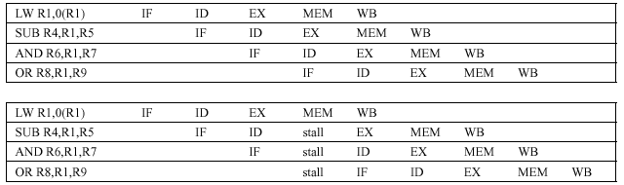
Data Hazard Stall
Need hardware (pipeline interlock) to detect the data hazard and introduce a vertical pipeline bubble
Other stalls possible too
  Cache miss, stall until data available

Slide 52
Compilers to the Rescue
Compilers can help arrange instructions to avoid pipeline stalls, called Instruction Scheduling
Compiler knows delay slots (the next instruction that may conflict with a load) for typical instruction types
  Try to move other instructions into this slot that don’t conflict
  If one can’t be found, insert a NOP
  More formal methods to do this using dataflow graphs

Slide 53
Compiler Scheduling Example
A=B+C; D =E+F
  LW R1, B
  LW R2, C
  ADD R3, R1, R2 ← Need to stall for R2
  SW R3, A
  LW R4, E
  LW R5, F
  ADD R6, R4, R5 ← Need to stall for R5
  SW R6, D

Slide 54
Compiler Scheduling Example
A=B+C; D =E+F
  LW R1, B
  LW R2, C
  LW R4, E ← Swap instr, no stall
  ADD R3, R1, R2
  LW R5, F
  SW R3, A
  ADD R6, R4, R5
  SW R6, D

Slide 55
Compiler Scheduling a Big Help
Study of percentage of loads causing stalls
  TeX
    Unscheduled 65%
    Scheduled 25%
  SPICE
    Unscheduled 42%
    Scheduled 14%
  GCC
    Unscheduled 54%
    Scheduled 31%

Slide 56
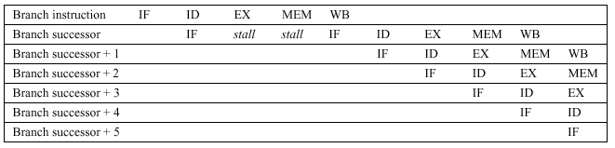
Control Hazards
Control hazards result when we branch to a new location in the program, invalidating everything we have loaded in our pipeline
  Potentially a greater performance loss than data hazards
  Simplest solution: Stall until we know the branch
    Actually a three cycle stall, since we may need a new IF

Slide 57
Control Hazards
Big hit in performance – can reduce pipeline efficiency by over 1/2
To reduce the clock cycles in a branch stall:
  Find out whether the branch is taken or not taken earlier in the pipeline
    Avoids longer stalls of everything else in the pipeline
  Compute the taken PC earlier
    Lets us fetch the next instruction with fewer stalls

Slide 58
Original Datapath
Branch not computed until EX stage, stored in Mem

Slide 59
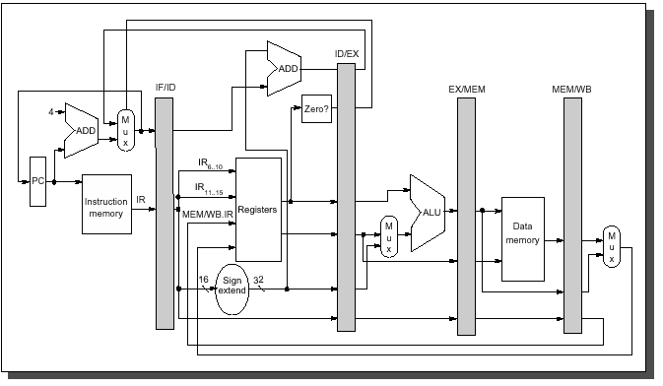
Revised Datapath
Move branch logic to ID stage to reduce branch penalty
Downside – may make ID stage longer, more circuitry

Slide 60
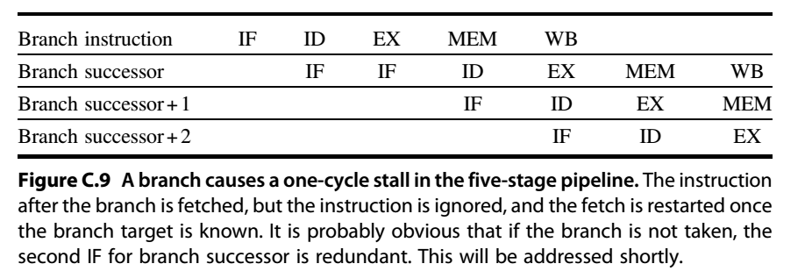
Stall due to Branch
We only need to stall one cycle now with the target known after the ID stage

Slide 61
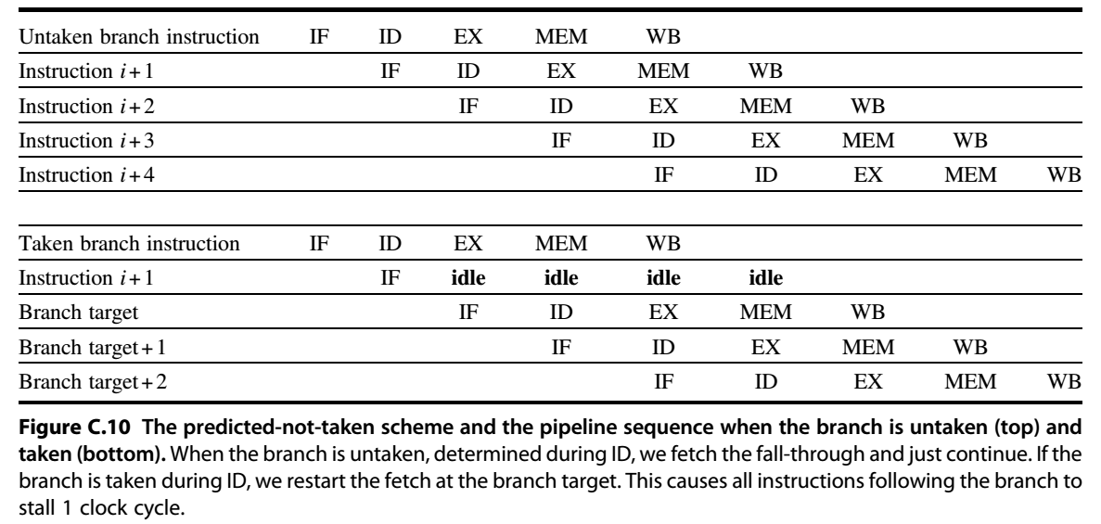
Reducing Branch Penalty
Options
  Freeze or flush the pipeline until branch destination known (last slide)
  Treat every branch as not taken and back out if we do take it

Slide 62
Delayed Branch Option
Perform instruction scheduling into branch delay slots (instructions after a branch)
  Always execute instructions following a branch regardless of whether or not we take it
  Compiler will find some instructions we’ll always execute, regardless of whether or not we take the branch, and put in there
  Put a NOP if we can’t find anything

Slide 63
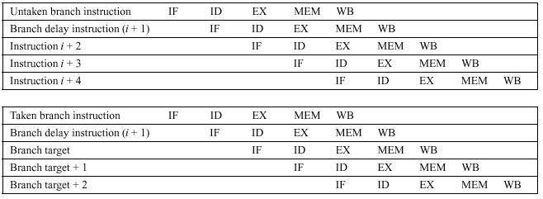
Delayed Branch with One Delay Slot
Instruction in delay slot always executed
Another branch instruction not allowed to be in the delay slot

Slide 64
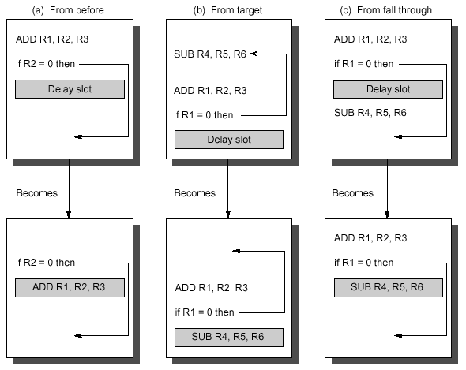
Example: Delay Slot Scheduling
B) and C) execute code that may or may not be used, but better than a NOP
Form of branch prediction – compiler predicts based on context

Slide 65
Delay Slot Effectiveness
On benchmarks
  Delay slot allowed branch hazards to be hidden 70% of the time
  About 20% of delay slots filled with NOPs
  Delay slots we can’t easily fill: when target is another branch
Philosophically, delay slots good?
  No longer hides the pipeline implementation from the programmers (although it will if through a compiler)
  Does allow for compiler optimizations, other schemes don’t
  Not very effective with modern machines that have deep pipelines, too difficult to fill multiple delay slots
Complications if an exception occurs and resuming exact state

Slide 66
MultiCycle Operations
Unfortunately, it is impractical to require all floating point operations to complete in one clock cycle (or even two)
  Consider instead the following units:
    Integer EX
    FP Multiply
    FP Add
    FP Divide
  Problem: The FP units require multiple cycles to complete

Slide 67
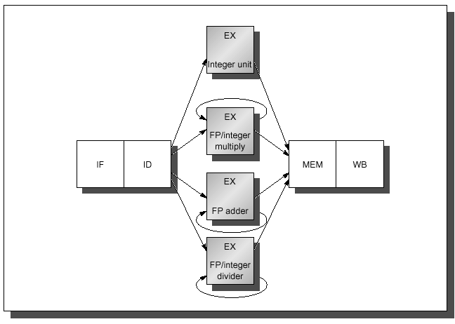
Unpipelined FP Units
Unit Latency
Int 0
FPAdd 3
FPMult 6
FPDiv 24
Solution: Pipeline FP units

Slide 68
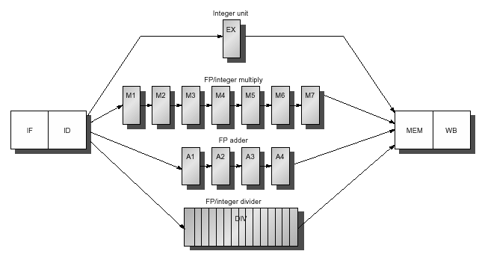
Example: Pipelined FP Units
Not pipelined
Need 24 cycles
Allows 4 outstanding adds, 7 multiplies, 1 int, 1 divide

Slide 69
New Hazard Problems!
Structural hazards with divide unit not fully pipelined
WAW hazards now possible since instructions can reach WB stage at different times
  At least WAR hazards not possible, since reads still occur early in the ID stage
Instructions can complete in a different order than issued, causing more problems with exception handling
Longer latency increases frequency of stalls for RAW hazards

Slide 70
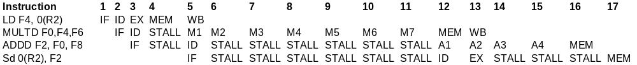
Example FP Sequence with RAW Hazard
Uses forwarding for each stage when data is available
SD stalled one extra cycle for MEM to not conflict with ADDD

Slide 71
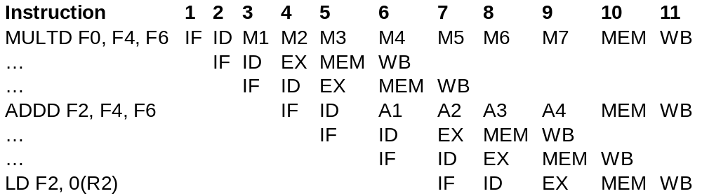
Example FP Sequence with Hazards
Cycle 10: three requirements for memory
Cycle 11: three requirements for write-back
More stalls
What if the last instruction was issued one cycle earlier?
We have a WAW conflict

Slide 72
FP Pipelining Performance
Given all the new problems, is it worth it?
  Overall answer is yes
    Latency varies from 46-59% of functional units on the benchmarks
  Fortunately, divides are rare
  As before, compiler scheduling can help a lot

