Slide 1
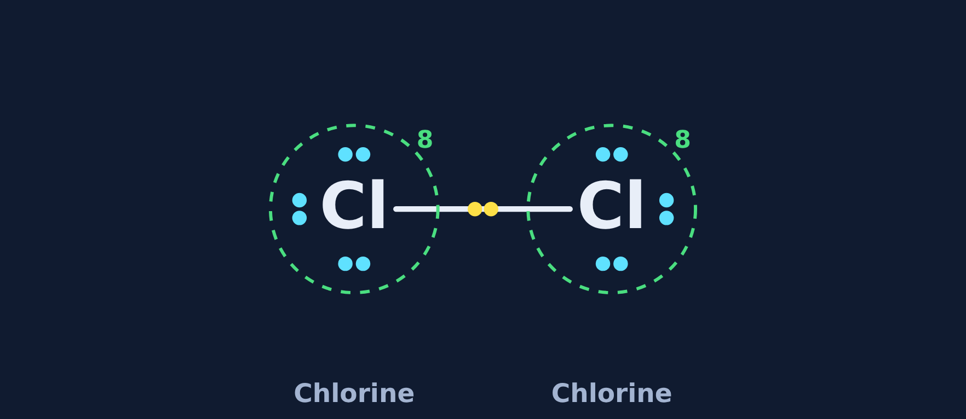
Covalent Bonding
Chemistry · Unit 2: Ions, Periodic Trends, and Bonding · about 40 minutes
Notes:
Two atoms that both want an electron still stick together. Today we find out how.

Slide 2
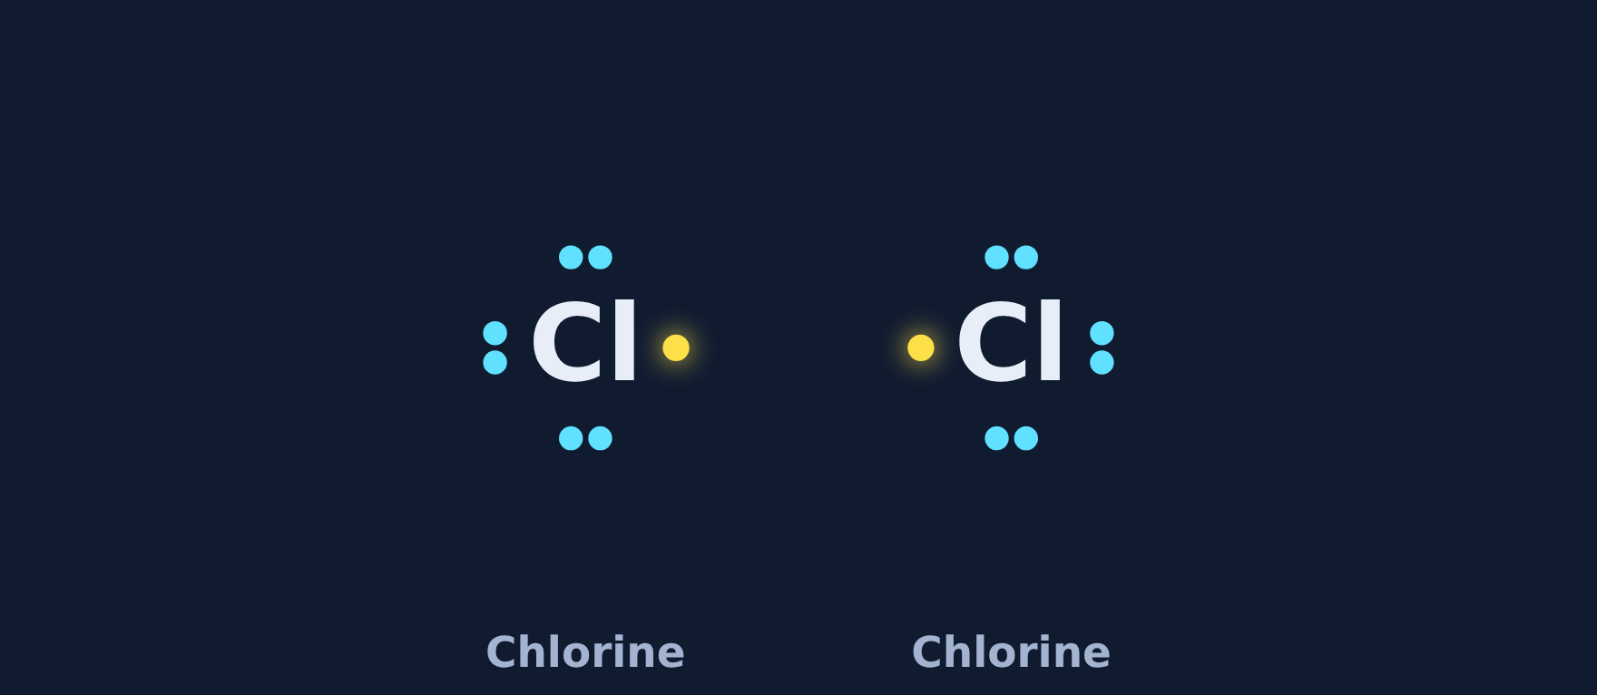
Two atoms that both want more
Phenomenon
Chlorine gas is Cl₂: two chlorine atoms stuck together. In ionic bonding one atom gives an electron away, but both chlorine atoms need one more. What holds them together?
A. One chlorine atom gives an electron to the other
B. The two atoms share a pair of electrons, so both count 8
Make a prediction. We'll find out in Section 2.
C. Chlorine atoms never stick together
D. They swap protons
Notes:
Students commit to a prediction (required in the lesson). The answer (B) is revealed on the "Back to the phenomenon" slide in Section 2.

Slide 3









How the lesson works
Why do nonmetals share?
Sharing one pair
How many bonds?
about 4 min
about 5 min
about 4 min
Lewis structures
Double and triple bonds
Build it yourself
about 4 min
about 4 min
about 7 min
Covalent vs. ionic properties
Spot the mistake
Final check
about 3 min
about 3 min
about 7 min
Notes:
Nine short sections, about 40 minutes, then 20 to 30 minutes of worksheet practice.

Slide 4
Why do nonmetals share?
Section 1 of 9 · about 4 min
In this section
To unlock the next section
Phenomenon
Cl₂: how do they bond?
Make a prediction
Read
When both atoms want electrons
Sort the pairs into ionic and covalent
Try it
Ionic or covalent?
Answer the quick check correctly
Quick check
Why share?
Notes:
Section 1 takes about 4 minutes.

Slide 5
When both atoms want electrons
Read
An ionic bond needs a metal that gives electrons away. When two nonmetals meet, both want to gain electrons, so neither gives one up.
Instead they share. Each atom puts an electron into a pair between them. The shared pair counts for both atoms: a covalent bond. Atoms joined this way make a molecule.
nonmetal
+
nonmetal
=
share electrons (covalent)
metal
+
nonmetal
=
transfer electrons (ionic)
Notes:
Contrast with last lesson: ionic = transfer (metal + nonmetal); covalent = share (two nonmetals).

Slide 6
Ionic or covalent?
Try it
Sort each pair: ionic (metal + nonmetal) or covalent (two nonmetals)?
Ionic (metal + nonmetal)
Covalent (two nonmetals)
Na + Cl
C + O
H + O
Mg + O
N + H
K + F
Notes:
In the lesson students place every card, then check once; it only says "all correct" or "something is in the wrong spot."

Slide 7
Ionic or covalent?
Try it
Answer
Sort each pair: ionic (metal + nonmetal) or covalent (two nonmetals)?
Ionic (metal + nonmetal)
Covalent (two nonmetals)
Na + Cl
C + O
Mg + O
H + O
K + F
N + H
Notes:
Na, Mg, and K are metals, so those pairs are ionic. C, O, H, and N are all nonmetals, so those pairs share.

Slide 8
Quick check
Quick check
Why do two nonmetal atoms share electrons instead of transferring them?
A
They both have too many protons
B
Both want to gain electrons, so neither gives one away
C
Nonmetals have no valence electrons
D
Sharing only happens with metals
Notes:
A: protons don't change in bonding. C: nonmetals have many valence electrons. D: metals transfer electrons; sharing is between nonmetals.

Slide 9
Quick check
Quick check
Answer
Why do two nonmetal atoms share electrons instead of transferring them?
A
They both have too many protons
B
Both want to gain electrons, so neither gives one away
C
Nonmetals have no valence electrons
D
Sharing only happens with metals
Why: Nonmetals are close to a full outer shell, so both want electrons. Sharing lets both count the shared pair.
Notes:
A: protons don't change in bonding. C: nonmetals have many valence electrons. D: metals transfer electrons; sharing is between nonmetals.

Slide 10
Sharing one pair
Section 2 of 9 · about 5 min
In this section
To unlock the next section
Read
Watch two chlorine atoms share
Watch two chlorine atoms share
Try it
Make the bond
Make the bond for 3 molecules
Phenomenon
Back to the phenomenon
Answer the quick check correctly
Quick check
What does the line mean?
Notes:
Section 2 takes about 5 minutes.

Slide 11

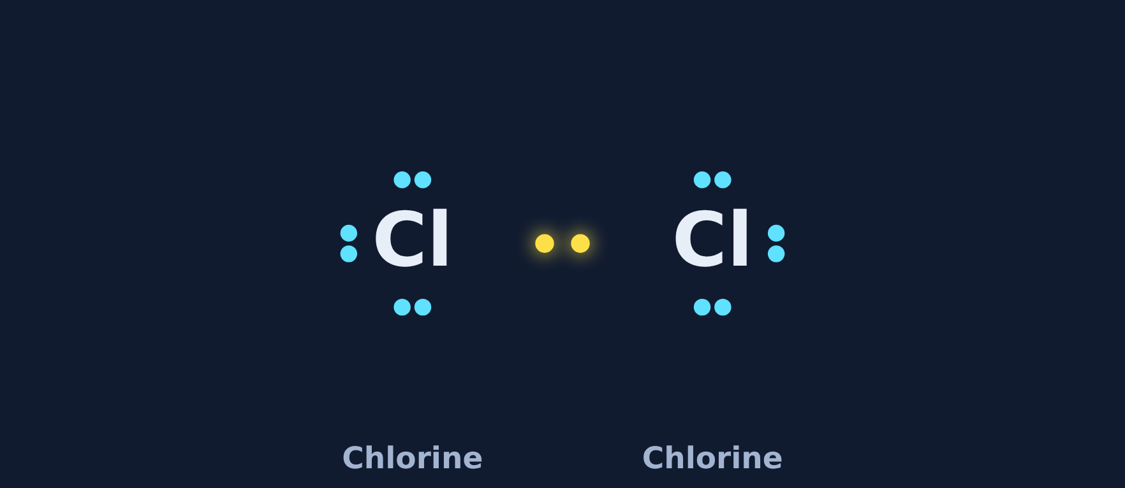
Watch two chlorine atoms share
Read
Each chlorine has 7 valence electrons: 3 lone pairs and 1 unpaired electron (gold).
The two unpaired electrons move into the space between the atoms and become a shared pair, drawn as a line: Cl–Cl.
Count around each atom: 6 + 2 = 8. Hydrogen is full with just 2.
1 Before
2 The electrons move
3 Shared pair
Notes:
Point to the green ring and the number 8 around each atom after sharing: the shared pair counts for both.

Slide 12
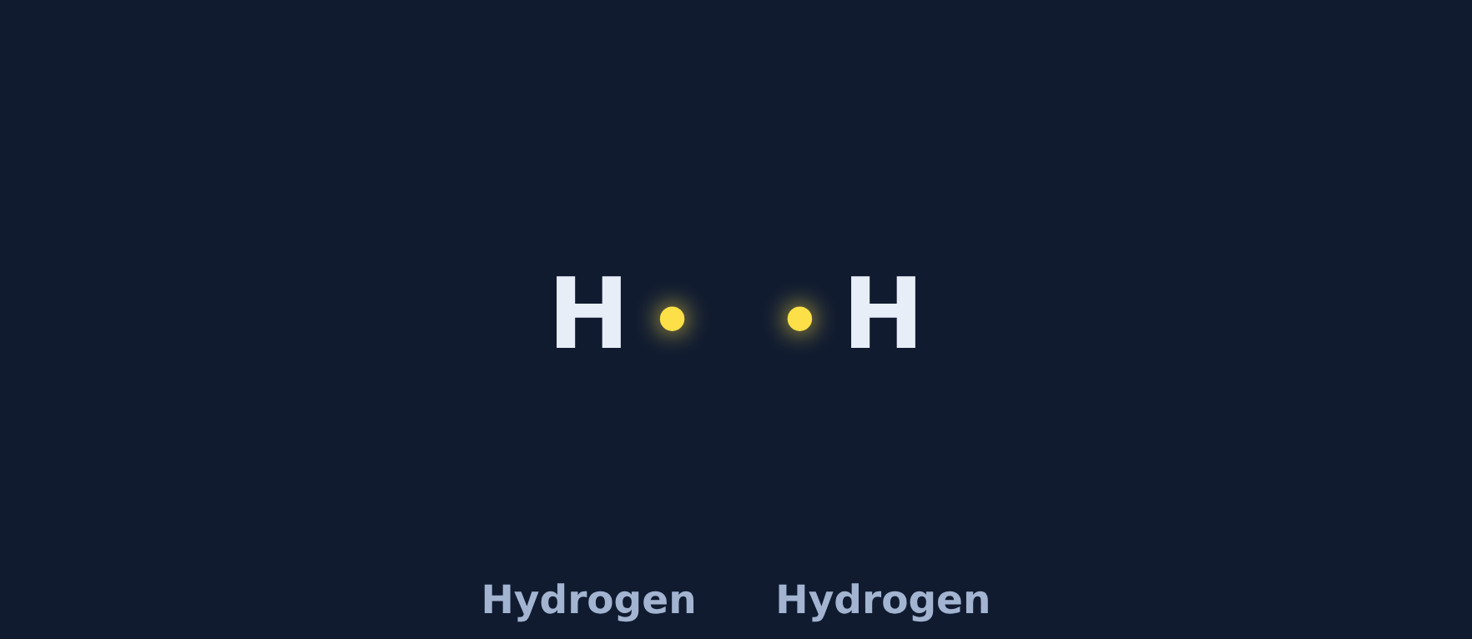
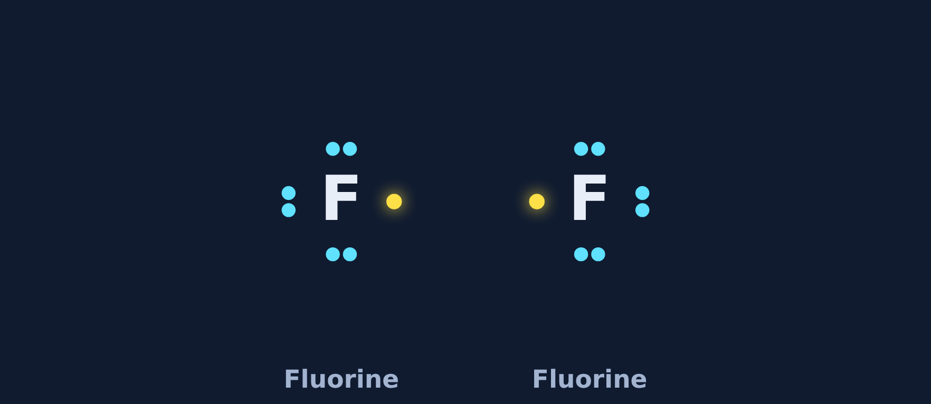

Make the bond
Try it
For each molecule: what bond forms, and how many electrons does each atom count?
H₂
What bond? How many electrons around each atom?
F₂
What bond? How many electrons around each atom?
HCl
What bond? How many electrons around each atom?
Notes:
In the lesson students tap an atom and watch the electrons pair up.

Slide 13

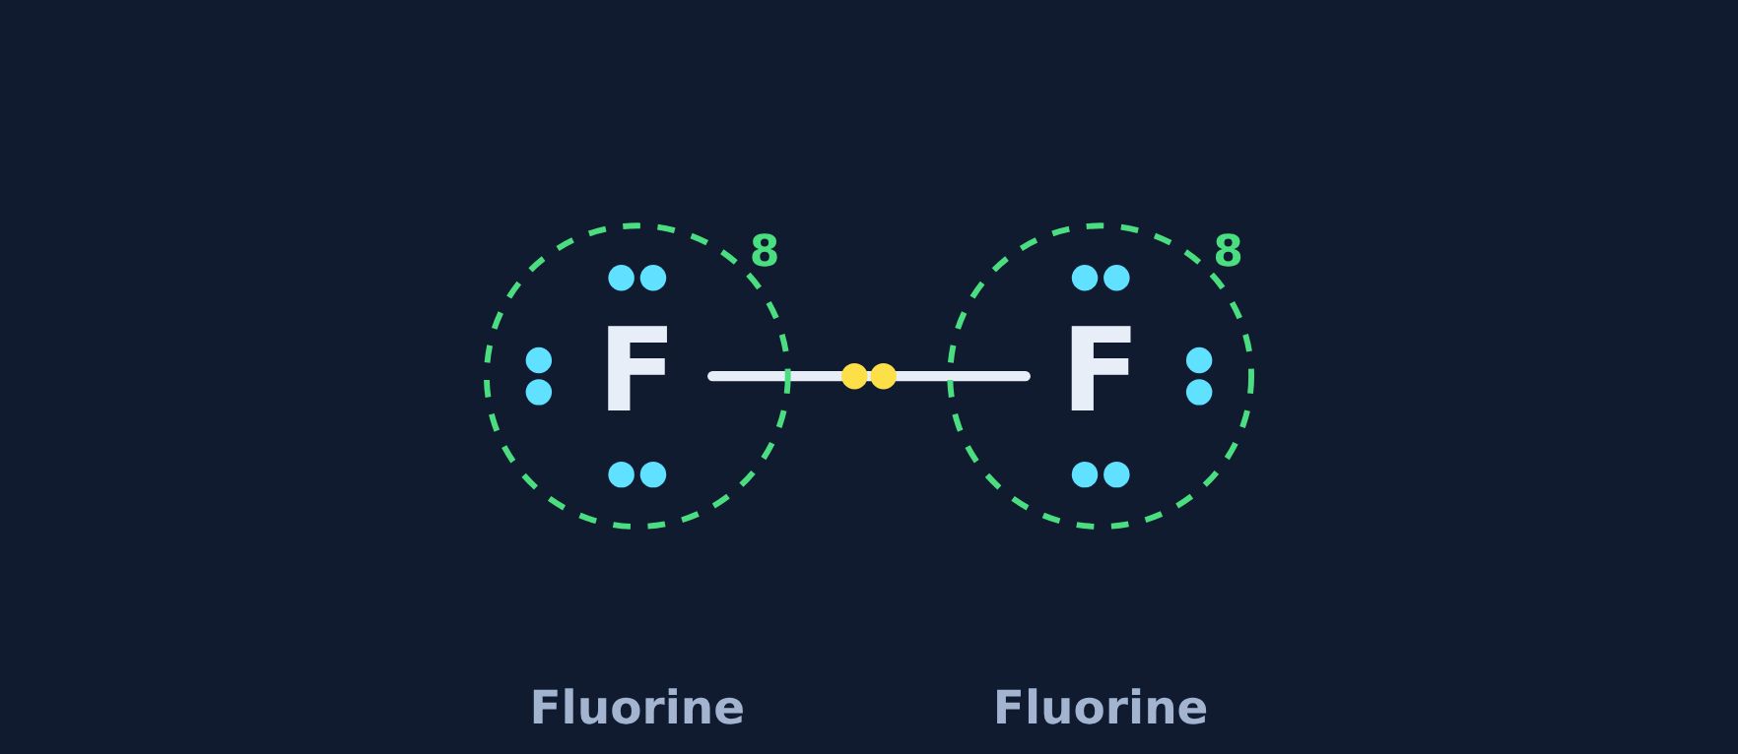
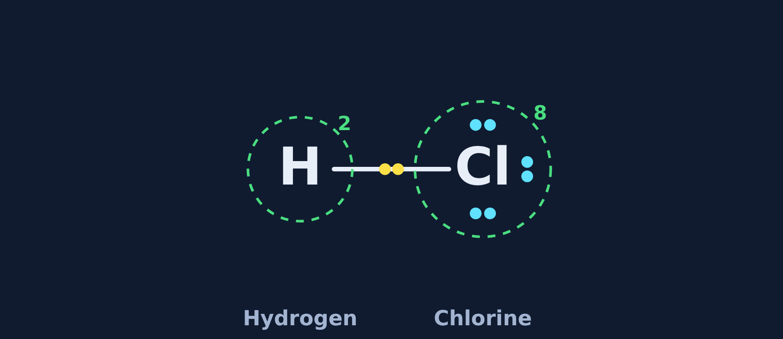
Make the bond
Try it
Answer
Each atom shares one electron; each line is one shared pair.
H₂
One shared pair. Each H counts 2 (full for hydrogen).
F₂
One shared pair. Each F counts 6 + 2 = 8.
HCl
One shared pair. H counts 2; Cl counts 8.
Notes:
If students say H counts 8, remind them hydrogen only has one small shell that holds 2.

Slide 14
Back to the phenomenon
Phenomenon
Answer
Answer: B. They share a pair of electrons.
Each chlorine has 7 and needs 1 more. Neither will give one away, so each puts 1 electron into a shared pair.
The pair counts for both atoms: 6 + 2 = 8 each. That shared pair is the covalent bond holding Cl₂ together.
Notes:
Close the loop on the opening prediction.

Slide 15
Quick check
Quick check
In Cl–Cl, what does the line between the atoms stand for?
A
One electron
B
A pair of shared electrons
C
A proton
D
An electron given away
Notes:
A: a line is two electrons, not one. C: protons stay in the nucleus. D: nothing is given away in a covalent bond.

Slide 16
Quick check
Quick check
Answer
In Cl–Cl, what does the line between the atoms stand for?
A
One electron
B
A pair of shared electrons
C
A proton
D
An electron given away
Why: Each line in a Lewis structure is one shared pair: 2 electrons, one from each atom.
Notes:
A: a line is two electrons, not one. C: protons stay in the nucleus. D: nothing is given away in a covalent bond.

Slide 17
How many bonds?
Section 3 of 9 · about 4 min
In this section
To unlock the next section
Read
Count what each atom needs
Sort the elements by number of bonds
Try it
How many bonds?
Answer the quick check correctly
Quick check
Nitrogen's bonds
Notes:
Section 3 takes about 4 minutes.

Slide 18

Count what each atom needs
Read
An atom makes one bond for every electron it still needs to reach a full outer shell.
The halogens (F, Cl) have 7 valence electrons, so they make 1 bond, just like hydrogen.
Notes:
Bonds = electrons needed to reach 8 (or 2 for hydrogen).

Slide 19
How many bonds?
Try it
How many bonds does each element usually make?
Fluorine
Sulfur
Carbon
7 valence
6 valence
4 valence
? bonds
? bonds
? bonds
Chlorine
Nitrogen
Oxygen
7 valence
5 valence
6 valence
? bonds
? bonds
? bonds
Notes:
Students sort the cards in the lesson, then check once.

Slide 20
How many bonds?
Try it
Answer
How many bonds does each element usually make?
Fluorine
Sulfur
Carbon
7 valence
6 valence
4 valence
1 bond
2 bonds
4 bonds
Chlorine
Nitrogen
Oxygen
7 valence
5 valence
6 valence
1 bond
3 bonds
2 bonds
Notes:
Common mistake: matching the bond number to the valence number (for example, saying N makes 5). Bonds = 8 minus valence.

Slide 21
Quick check
Quick check
Nitrogen has 5 valence electrons. How many covalent bonds does it usually make?
A
5
B
1
C
8
D
3
Notes:
A matches the valence number instead of what is needed. B is for halogens and hydrogen. C is the full-shell number, not bonds.

Slide 22
Quick check
Quick check
Answer
Nitrogen has 5 valence electrons. How many covalent bonds does it usually make?
A
5
B
1
C
8
D
3
Why: Nitrogen needs 3 more electrons to reach 8, so it makes 3 bonds (like in NH₃).
Notes:
A matches the valence number instead of what is needed. B is for halogens and hydrogen. C is the full-shell number, not bonds.

Slide 23
Lewis structures
Section 4 of 9 · about 4 min
In this section
To unlock the next section
Read
Drawing a Lewis structure
Build 3 Lewis structures
Try it
Build it, then count
Answer the quick check correctly
Quick check
Center of water
Notes:
Section 4 takes about 4 minutes.

Slide 24

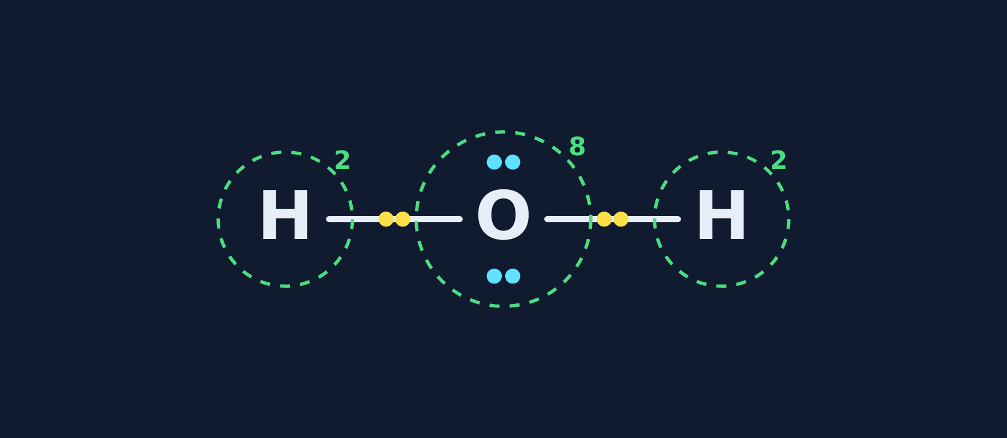
Drawing a Lewis structure
Read
1. Put the atom that makes the most bonds in the center (never hydrogen).
2. Share one pair between the center and each outer atom.
3. Check: every atom has 8 (hydrogen 2). Leftover pairs are lone pairs.
Before
After
Notes:
Water: O in the center, two shared pairs, two lone pairs on O.

Slide 25
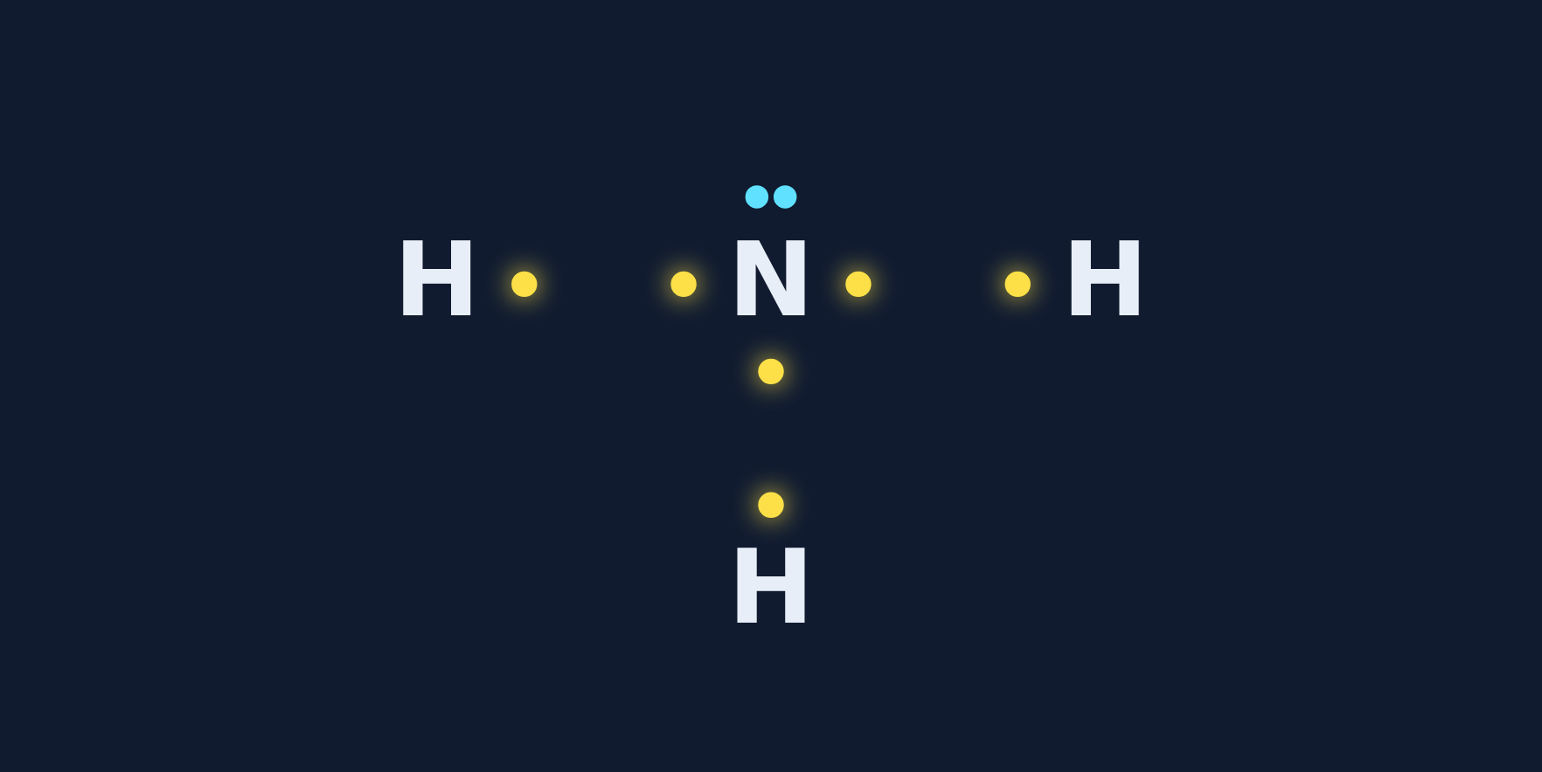
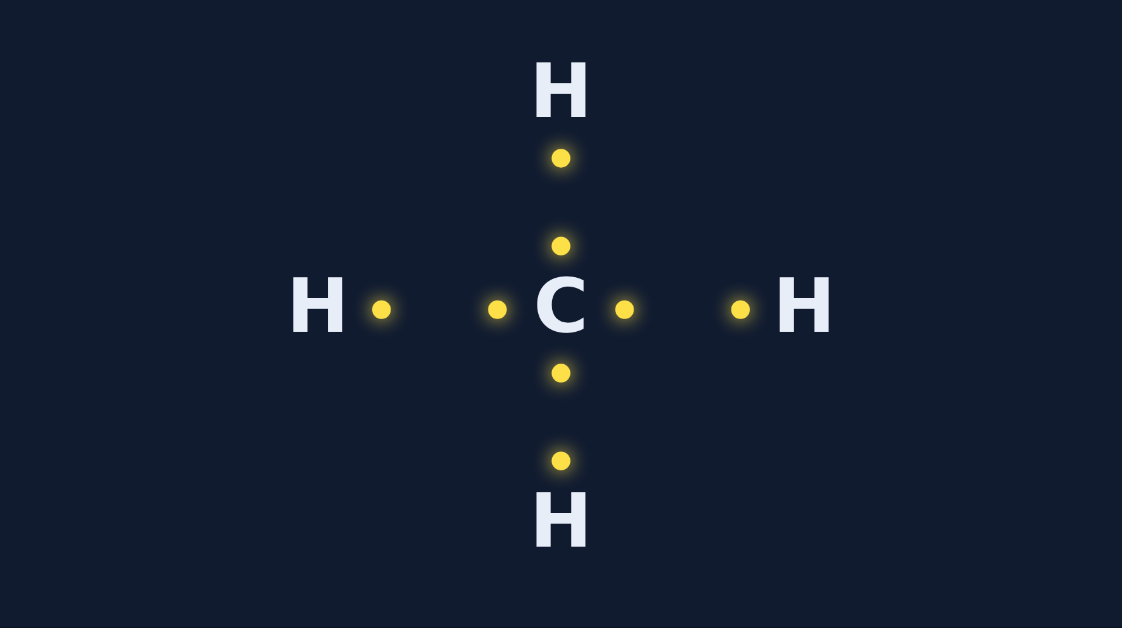
Build it, then count
Try it
How many lone pairs are on the center atom?
NH₃
CH₄
Lone pairs on the center atom: ?
Lone pairs on the center atom: ?
Notes:
In the lesson students tap to share each pair, then answer the lone-pair question.

Slide 26
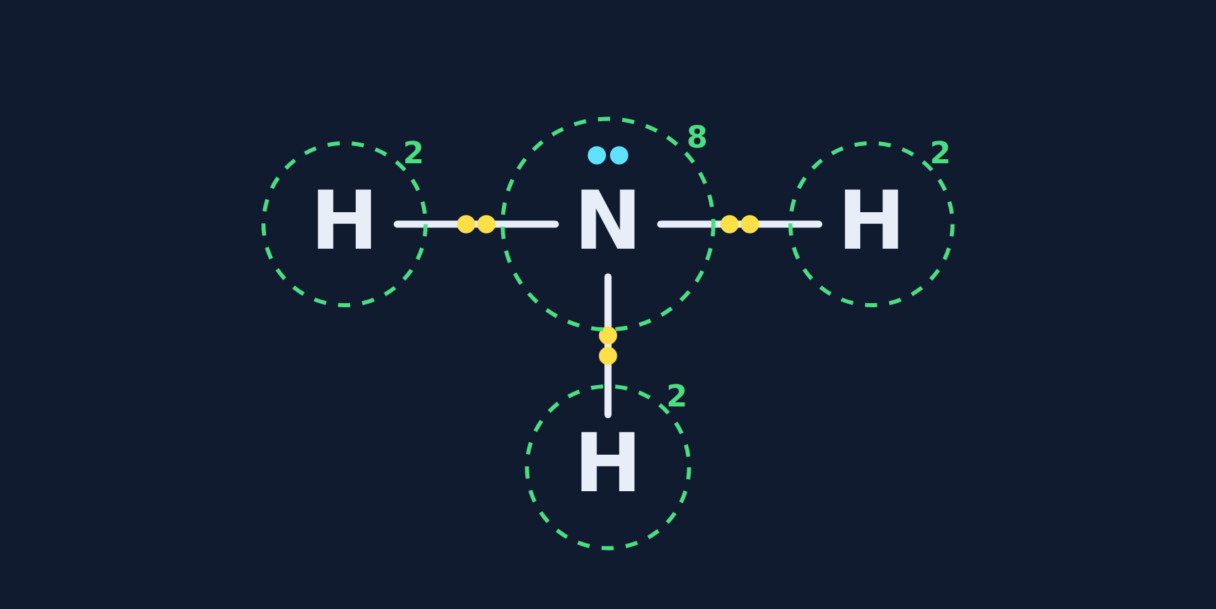
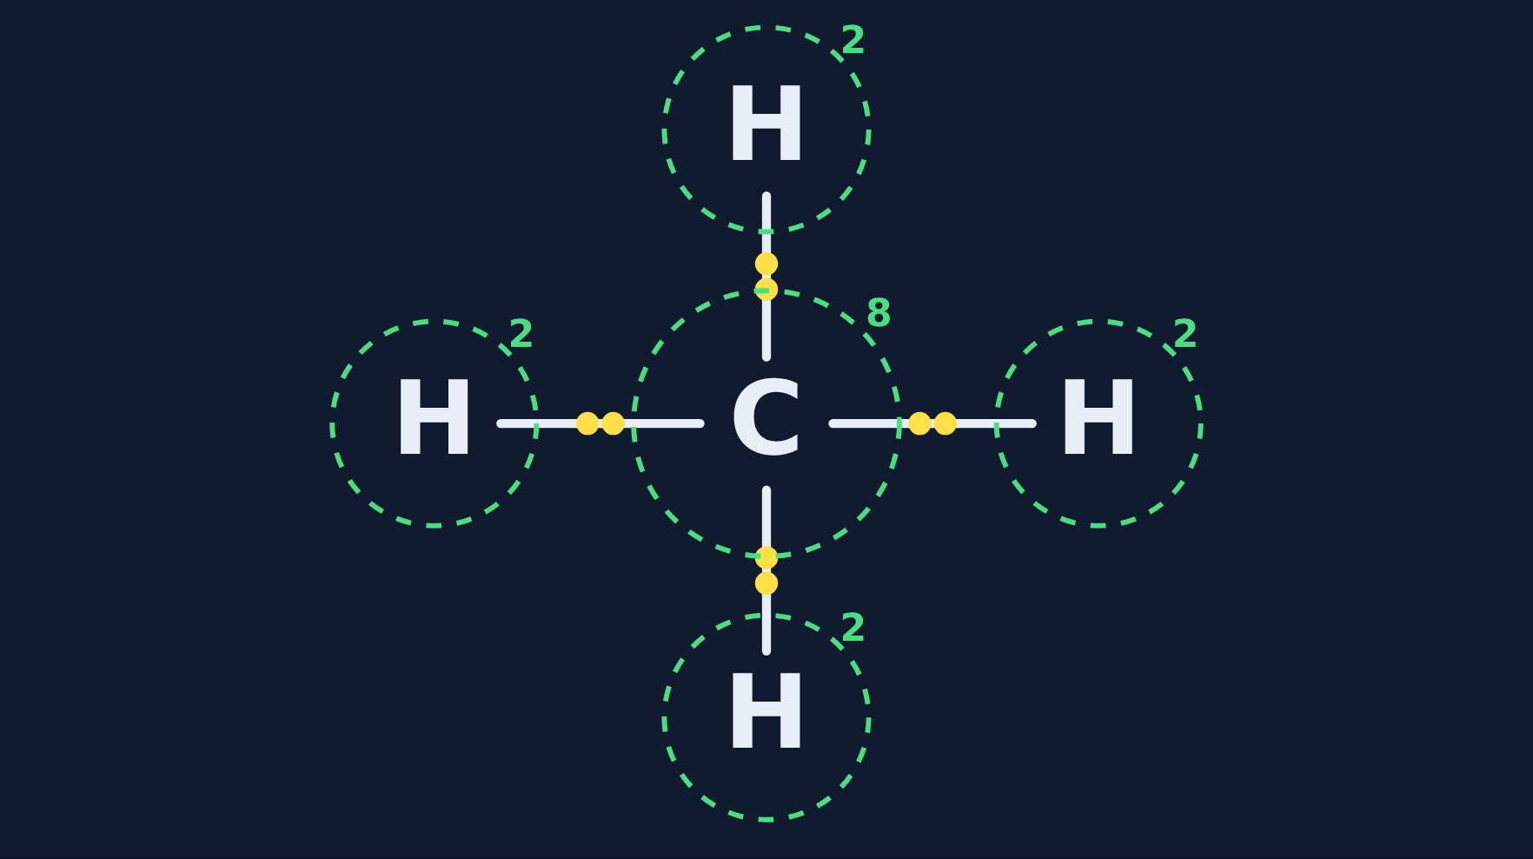
Build it, then count
Try it
Answer
How many lone pairs are on the center atom?
NH₃
CH₄
N has 1 lone pair (3 bonds + 1 pair = 8)
C has 0 lone pairs (4 bonds = 8)
Notes:
Students often forget nitrogen's lone pair. Nitrogen has 5: 3 in bonds and 2 left as a pair.

Slide 27
Quick check
Quick check
In a Lewis structure of water (H₂O), which atom goes in the center?
A
Hydrogen
B
Oxygen
C
Either one
D
Neither: they go in a line H–H–O
Notes:
A and D: hydrogen can only make 1 bond, so it can never be in the middle. C: the center is always the atom that makes the most bonds.

Slide 28
Quick check
Quick check
Answer
In a Lewis structure of water (H₂O), which atom goes in the center?
A
Hydrogen
B
Oxygen
C
Either one
D
Neither: they go in a line H–H–O
Why: Oxygen makes 2 bonds and hydrogen only 1, so oxygen is in the center: H–O–H.
Notes:
A and D: hydrogen can only make 1 bond, so it can never be in the middle. C: the center is always the atom that makes the most bonds.

Slide 29
Double and triple bonds
Section 5 of 9 · about 4 min
In this section
To unlock the next section
Read
Sharing more than one pair
Pick the right bond for 3 molecules
Try it
Single, double, or triple?
Answer the quick check correctly
Quick check
Electrons in a double bond
Notes:
Section 5 takes about 4 minutes.

Slide 30
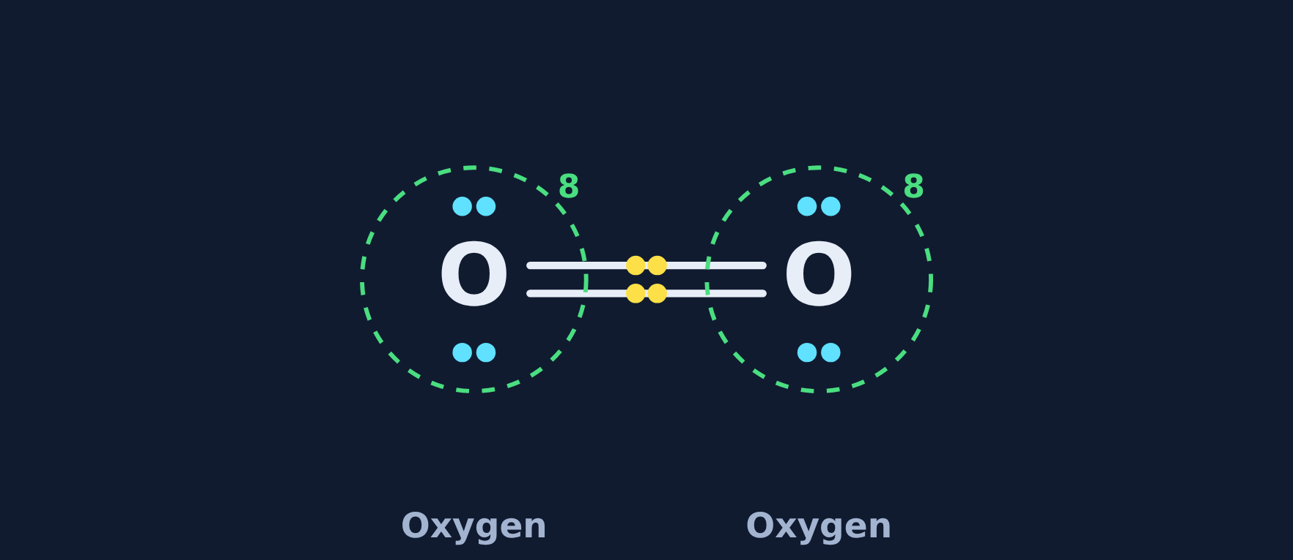
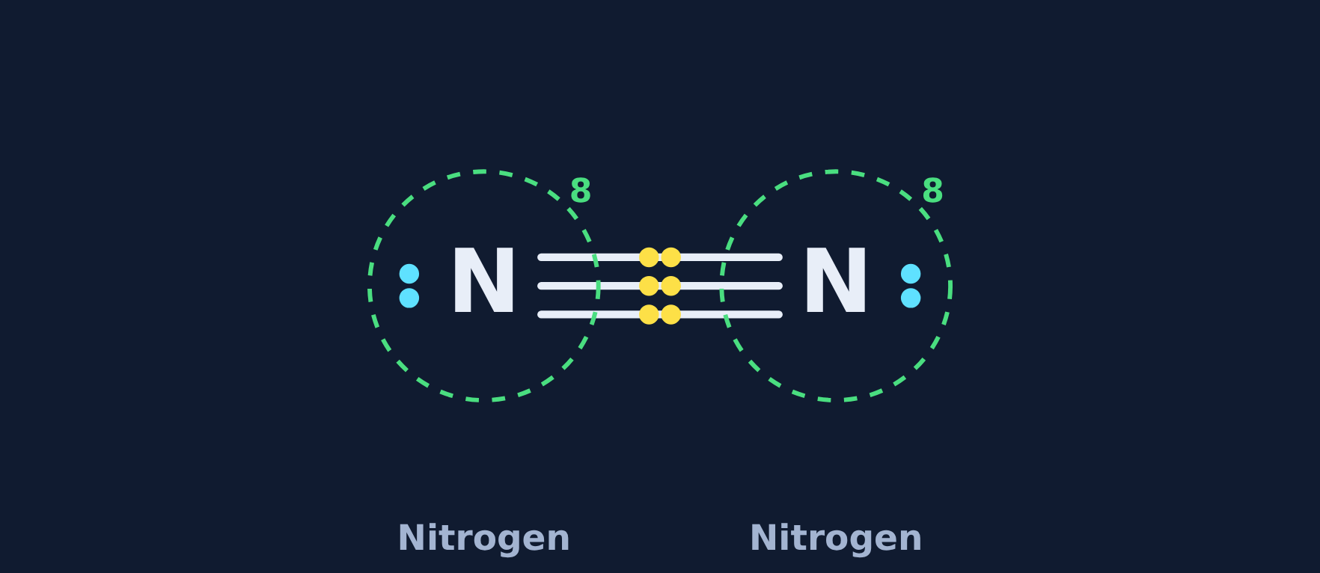
Sharing more than one pair
Read
Each oxygen needs 2 more electrons, so two oxygens share two pairs: a double bond, O=O.
Each nitrogen needs 3, so two nitrogens share three pairs: a triple bond, N≡N. Each N: 2 (lone pair) + 6 (shared) = 8.
O₂
N₂
Notes:
Each line is one shared pair. A double bond = 4 electrons; a triple bond = 6.

Slide 31
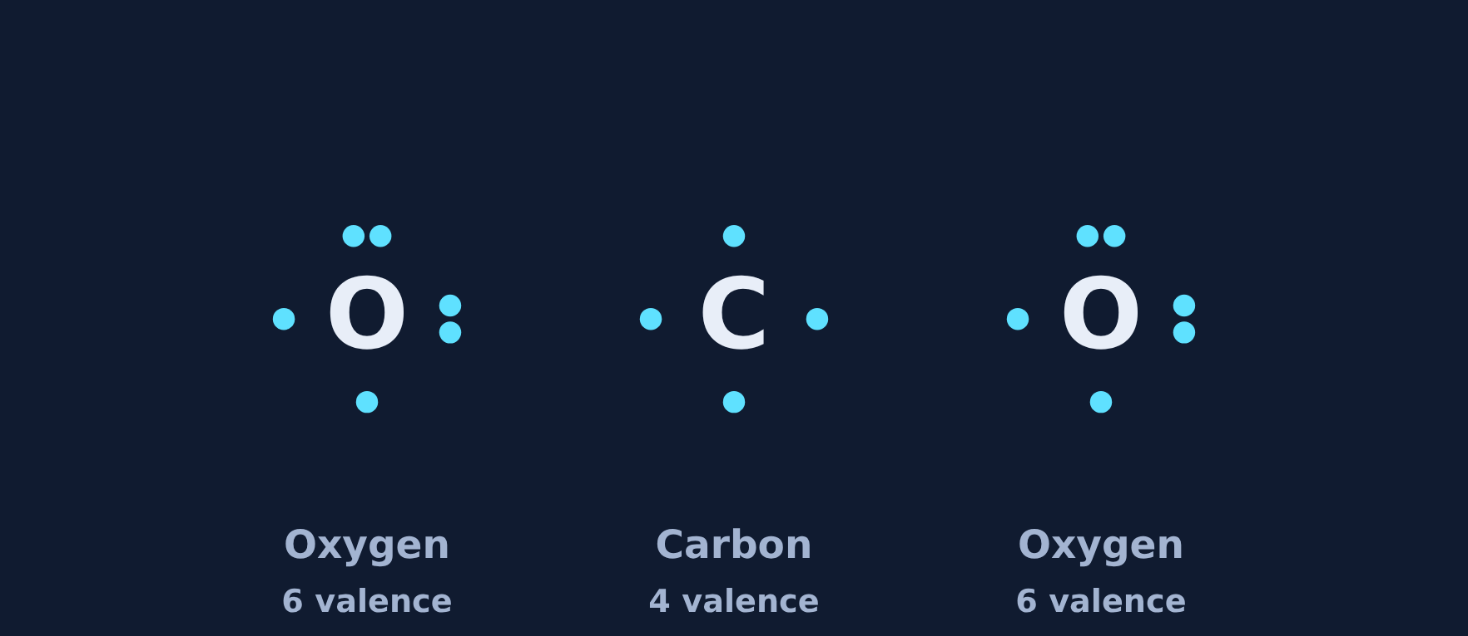
Single, double, or triple?
Try it
Carbon dioxide (O–C–O): which bond goes between carbon and each oxygen?
Single, double, or triple?
Notes:
Have students count around each atom for each option before revealing.

Slide 32
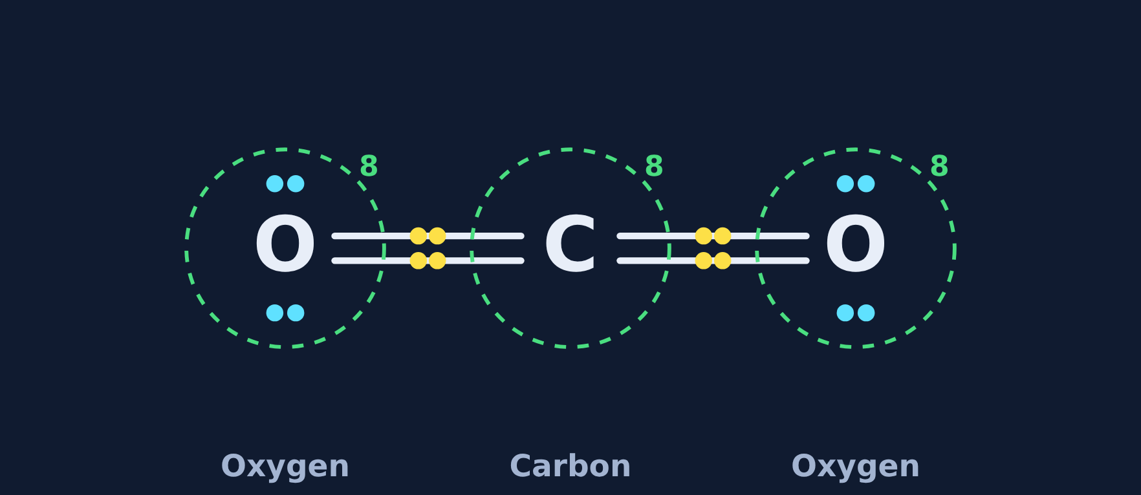
Single, double, or triple?
Try it
Answer
Carbon dioxide (O–C–O): which bond goes between carbon and each oxygen?
Double bonds: O=C=O. Carbon makes 4 bonds (2 + 2); each oxygen makes 2.
Notes:
With single bonds, carbon would count only 6 and each oxygen 7. That is the feedback students see in the lesson when they pick single.

Slide 33
Quick check
Quick check
How many electrons are shared in a double bond?
A
2
B
4
C
6
D
8
Notes:
A is a single bond. C is a triple bond. D is a full outer shell, not one bond.

Slide 34
Quick check
Quick check
Answer
How many electrons are shared in a double bond?
A
2
B
4
C
6
D
8
Why: A double bond is two shared pairs: 2 × 2 = 4 electrons.
Notes:
A is a single bond. C is a triple bond. D is a full outer shell, not one bond.

Slide 35
Build it yourself
Section 6 of 9 · about 7 min
In this section
To unlock the next section
Read
Your turn to draw
Build 3 Lewis structures yourself
Try it
Build it yourself
Answer the quick check correctly
Quick check
Finishing CO₂
Notes:
Section 6 takes about 7 minutes. This is the main drawing practice.

Slide 36
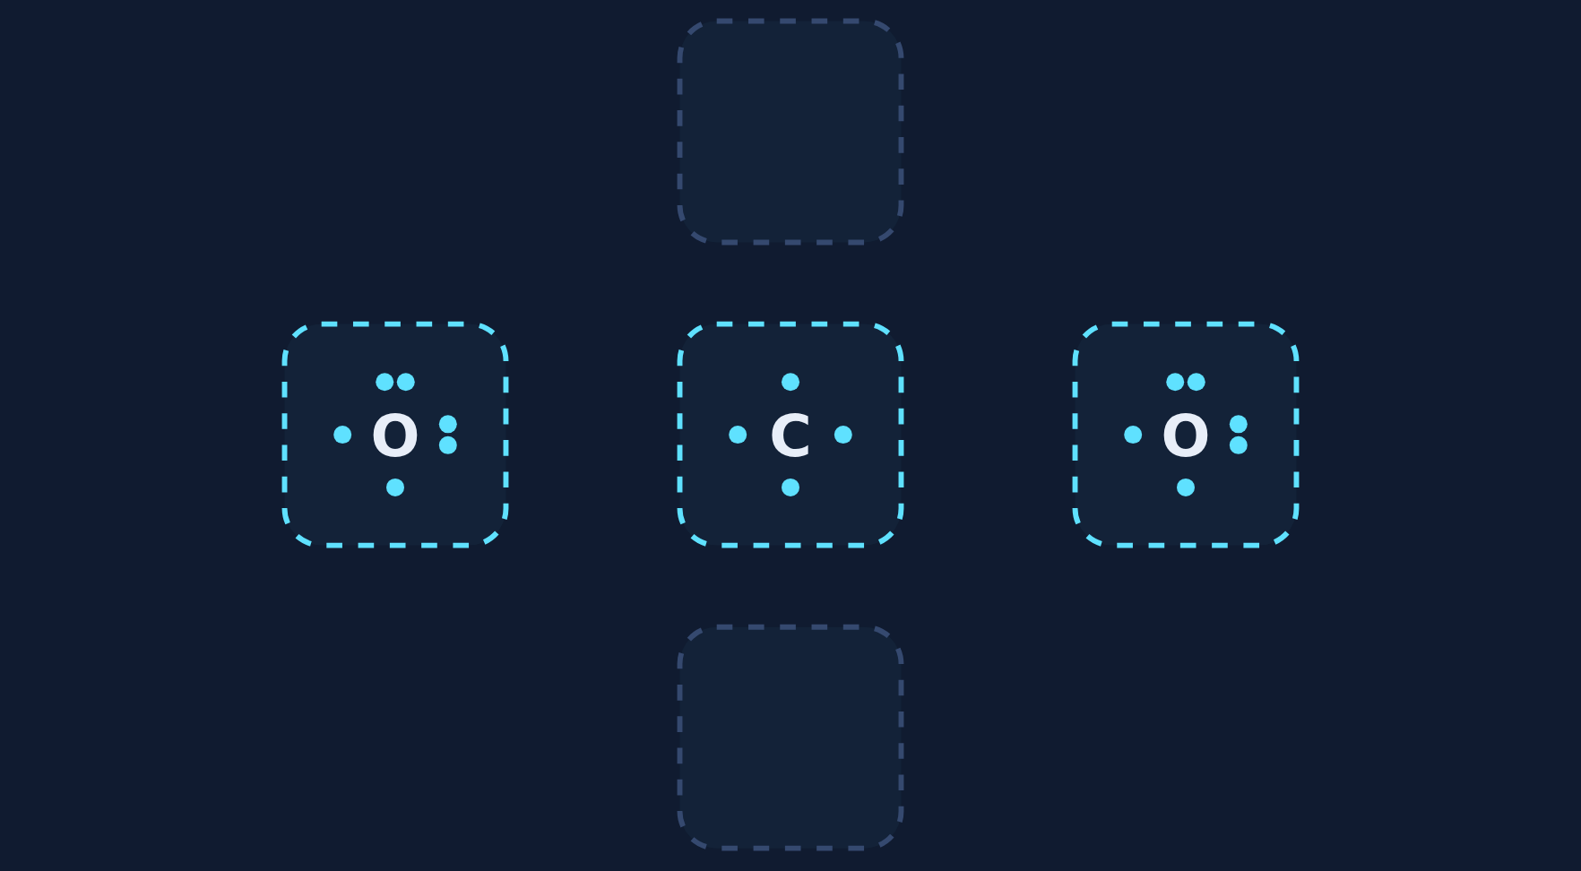
Your turn to draw
Read
1. Place the atoms. The atom that makes the most bonds goes in the center.
2. Pair the electrons. Find an unpaired electron (one by itself) on one atom and one on its neighbor. They become a shared pair.
3. Keep going until no unpaired electrons are left. Atoms that still need more share a second or third pair.
4. Check: every atom has 8 (H has 2).
Step 1: place the atoms
Notes:
In the lesson every electron looks the same, so students must find the unpaired ones themselves. Tapping a lone-pair electron gives a hint.

Slide 37
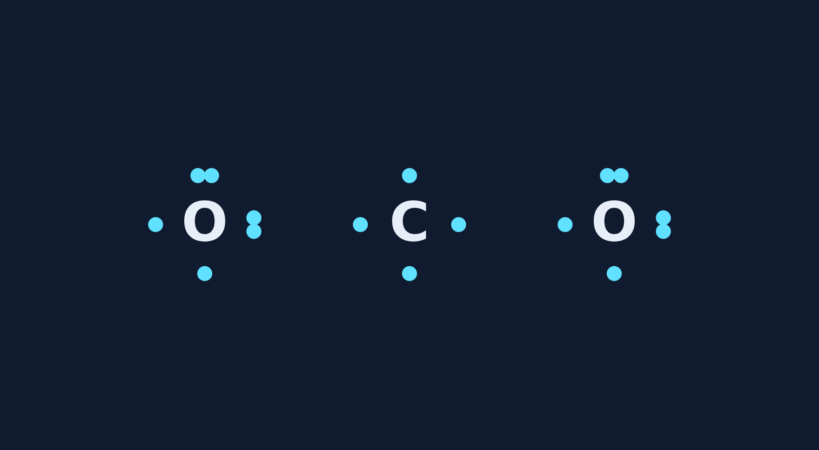
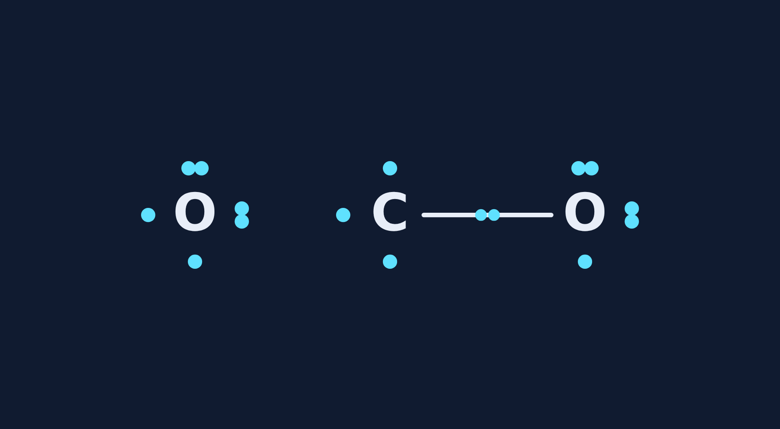
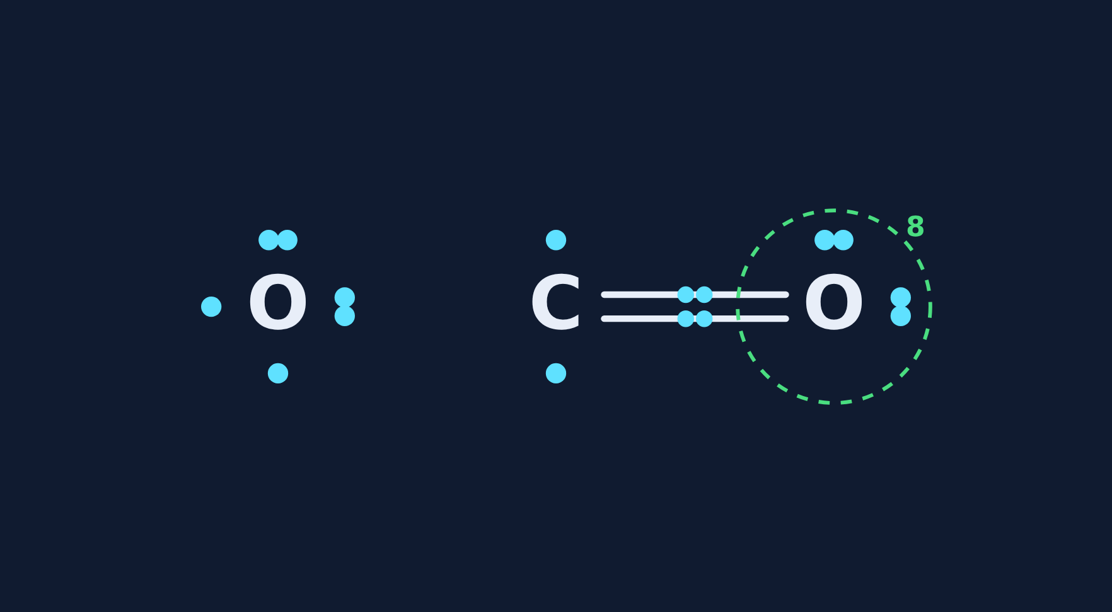
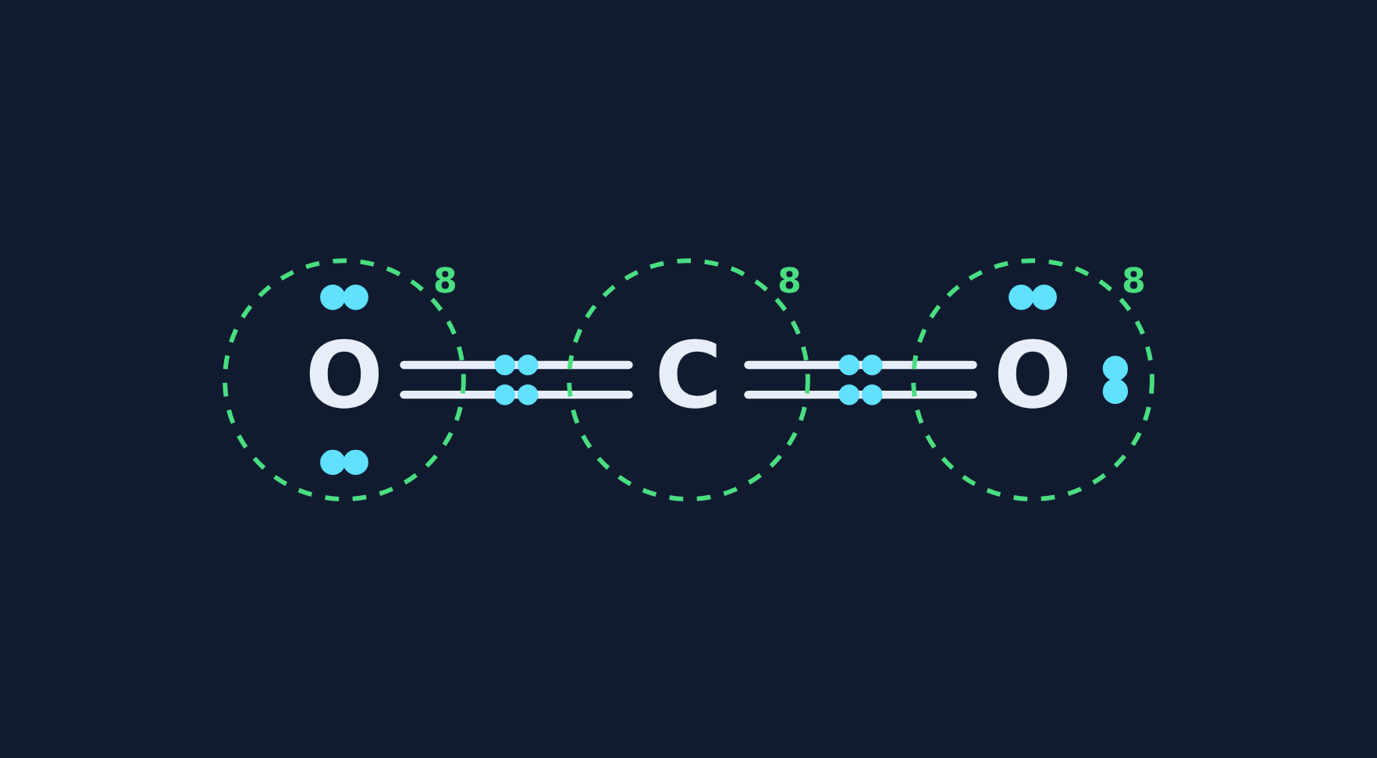
Build CO₂ step by step
Try it
1 Atoms placed
2 First shared pair
3 Second pair: double bond
4 Every atom has 8
Notes:
Model one build together, then let students do H₂O, NH₃, CH₄, or N₂ on their own in the lesson.

Slide 38
Quick check
Quick check
Building CO₂, a student made single bonds from C to each O. Carbon still has 2 unpaired electrons and each oxygen has 1. What next?
A
Stop: the structure is done
B
Pair each oxygen's last electron with one of carbon's, making two double bonds
C
Move carbon's electrons onto one oxygen as a lone pair
D
Add another hydrogen
Notes:
A leaves atoms with unpaired electrons. C turns shared electrons into a lone pair that belongs to only one atom. D adds an atom that isn't in CO₂.

Slide 39
Quick check
Quick check
Answer
Building CO₂, a student made single bonds from C to each O. Carbon still has 2 unpaired electrons and each oxygen has 1. What next?
A
Stop: the structure is done
B
Pair each oxygen's last electron with one of carbon's, making two double bonds
C
Move carbon's electrons onto one oxygen as a lone pair
D
Add another hydrogen
Why: Each C–O pair shares one more pair, giving O=C=O. Now carbon has 8 and each oxygen has 8.
Notes:
A leaves atoms with unpaired electrons. C turns shared electrons into a lone pair that belongs to only one atom. D adds an atom that isn't in CO₂.

Slide 40
Covalent vs. ionic properties
Section 7 of 9 · about 3 min
In this section
To unlock the next section
Read
Molecules vs. crystals
Sort the property cards
Try it
Ionic or covalent?
Answer the quick check correctly
Quick check
Sugar water
Notes:
Section 7 takes about 3 minutes.

Slide 41
Molecules vs. crystals
Read
Ionic compounds are giant crystals of ions. Covalent compounds are separate molecules: strong bonds inside, weak pulls between molecules.
Low melting and boiling points: many are liquids or gases (water, CO₂, O₂).
Don't conduct electricity, even dissolved: no ions to carry charge.
Notes:
Connect to the ionic lesson: salt water lights the bulb, sugar water does not.

Slide 42
Ionic or covalent?
Try it
Is each property ionic (like salt) or covalent (like water or sugar)?
Melts at 801 °C
?
Melts at 0 °C
?
Conducts when dissolved
?
Does not conduct when dissolved
?
Notes:
Students sort these, then check once.

Slide 43
Ionic or covalent?
Try it
Answer
Is each property ionic (like salt) or covalent (like water or sugar)?
Melts at 801 °C
Ionic
Melts at 0 °C
Covalent
Conducts when dissolved
Ionic
Does not conduct when dissolved
Covalent
Notes:
Covalent: low melting point, does not conduct. Ionic: high melting point, conducts when dissolved.

Slide 44
Quick check
Quick check
Sugar dissolves in water, but the solution does not light a bulb. Why?
A
Sugar is made of molecules, not ions, so nothing carries a charge
B
Sugar has metal atoms
C
The water is too cold
D
Sugar forms a crystal lattice of ions
Notes:
B: sugar has no metals. C: temperature isn't the reason. D describes an ionic compound.

Slide 45
Quick check
Quick check
Answer
Sugar dissolves in water, but the solution does not light a bulb. Why?
A
Sugar is made of molecules, not ions, so nothing carries a charge
B
Sugar has metal atoms
C
The water is too cold
D
Sugar forms a crystal lattice of ions
Why: Sugar is covalent. It dissolves into molecules, not ions, so there are no moving charges.
Notes:
B: sugar has no metals. C: temperature isn't the reason. D describes an ionic compound.

Slide 46
Spot the mistake
Section 8 of 9 · about 3 min
In this section
To unlock the next section
Read
Check the work
Find the mistake in 3 student examples
Try it
Spot the mistake
Answer the quick check correctly
Quick check
Correct water structure
Notes:
Section 8 takes about 3 minutes.

Slide 47
Check the work
Read
1
Bond type
2
Count
Are both atoms nonmetals? Then they share.
Does every atom have 8 (hydrogen 2)?
3
Center
4
Leftovers
Is the atom with the most bonds in the center?
Are any electrons unpaired or missing?
Notes:
A four-step checklist for any Lewis structure.

Slide 48
Spot the mistake
Try it
Each student example has one mistake. Find it.
1. A student says the bond in Cl₂ is ionic because one chlorine gives an electron to the other.
What is wrong?
2. A student drew O–O with one bond for O₂.
What is wrong?
3. A student drew NH₃ with three N–H bonds and no lone pair on N.
What is wrong?
Notes:
Let groups discuss before revealing.

Slide 49
Spot the mistake
Try it
Answer
Each student example has one mistake. Find it.
1. A student says the bond in Cl₂ is ionic because one chlorine gives an electron to the other.
Fix: Two identical nonmetals share a pair; the bond is covalent.
2. A student drew O–O with one bond for O₂.
Fix: Each O would only count 7; O₂ needs a double bond (O=O).
3. A student drew NH₃ with three N–H bonds and no lone pair on N.
Fix: Nitrogen only counts 6; it needs a lone pair to reach 8.
Notes:
Which checklist step catches each one? 1: bond type. 2: count. 3: count / leftovers.

Slide 50
Quick check
Quick check
Which Lewis structure of water is correct?
A
H–H–O with no lone pairs
B
H=O=H with no lone pairs
C
H–O–H with two lone pairs on O
D
H–O–H with one lone pair on O
Notes:
A puts H in the center. B gives hydrogen too many electrons. D leaves oxygen with only 6.

Slide 51
Quick check
Quick check
Answer
Which Lewis structure of water is correct?
A
H–H–O with no lone pairs
B
H=O=H with no lone pairs
C
H–O–H with two lone pairs on O
D
H–O–H with one lone pair on O
Why: Oxygen goes in the center with two single bonds and two lone pairs: 4 + 4 = 8. Each H has 2.
Notes:
A puts H in the center. B gives hydrogen too many electrons. D leaves oxygen with only 6.

Slide 52
Final check
Section 9 of 9 · about 7 min
In this section
To unlock the next section
Read
Ten questions on the Chromebook
Score 8 or more out of 10
Try it
Multiple choice, two-part, select all
Notes:
The final check is done in the lesson on the Chromebook. It is not in these slides.

Slide 53
Wrap-up: how does a covalent bond form?
1
2
3
4
Two nonmetals both want electrons
Each puts in one electron
The shared pair counts for both
Every atom reaches 8 (H: 2)
Next: 20 to 30 minutes of worksheet practice, including 5 Lewis structures to build.
Notes:
Have students explain the four steps using H₂O or N₂.

