Slide 1

Metallic Bonding
Chemistry · Unit 2: Ions, Periodic Trends, and Bonding · about 35 minutes
Notes:
Opening image: metal ions in a moving sea of electrons. Today we explain why metals behave the way they do.

Slide 2

Why does copper bend but salt shatter?
Phenomenon
You can bend a copper wire and run electricity through it. Hit a salt crystal and it shatters, and solid salt doesn't conduct. What holds copper atoms together?
A. Copper atoms are glued together by the factory
B. The metal's electrons are free to move and hold the atoms together, even when layers slide
Make a prediction. We'll find out in Section 5.
C. Copper is made of ions locked in a crystal, like salt
D. Copper atoms share electrons only in pairs
Notes:
Students commit to a prediction (required in the lesson). The answer (B) is revealed in Section 5.

Slide 3









How the lesson works
What makes metals different?
A sea of electrons
How many electrons join the sea?
about 4 min
about 4 min
about 3 min
Conducting electricity
Bending without breaking
Shiny and good at heat
about 4 min
about 4 min
about 3 min
Ionic, covalent, or metallic?
Spot the mistake
Final check
about 4 min
about 3 min
about 6 min
Notes:
Nine short sections, about 35 minutes, then worksheet practice.

Slide 4
What makes metals different?
Section 1 of 9 · about 4 min
In this section
To unlock the next section
Phenomenon
Copper bends, salt shatters
Make a prediction
Read
A third kind of bond
Sort the substances
Try it
Which have metallic bonds?
Answer the quick check correctly
Quick check
Where are metallic bonds?
Notes:
Section 1 takes about 4 minutes.

Slide 5
A third kind of bond
Read
Ionic: a metal gives electrons to a nonmetal.
Covalent: two nonmetals share pairs.
Metallic: in a pure metal, every atom lets go of its few valence electrons. The atoms become positive ions, and the freed electrons move through the whole metal. The attraction between the positive ions and the free electrons is the metallic bond.
Notes:
Metals have only 1 to 3 valence electrons, held loosely.

Slide 6
Which have metallic bonds?
Try it
Sort each substance: metallic bond (pure metal) or not metallic?
Metallic bond
Not metallic
Copper wire (Cu)
Table salt (NaCl)
Aluminum foil (Al)
Water (H₂O)
Iron nail (Fe)
Carbon dioxide (CO₂)
Notes:
Students place every card, then check once.

Slide 7
Which have metallic bonds?
Try it
Answer
Sort each substance: metallic bond (pure metal) or not metallic?
Metallic bond
Not metallic
Copper wire (Cu)
Table salt (NaCl)
Aluminum foil (Al)
Water (H₂O)
Iron nail (Fe)
Carbon dioxide (CO₂)
Notes:
Copper, aluminum, and iron are pure metals. Salt is ionic; water and CO₂ are covalent.

Slide 8
Quick check
Quick check
A metallic bond is found in…
A
a pure metal, like a copper wire
B
table salt
C
water
D
carbon dioxide
Notes:
B is ionic (metal + nonmetal). C and D are covalent (nonmetals only).

Slide 9
Quick check
Quick check
Answer
A metallic bond is found in…
A
a pure metal, like a copper wire
B
table salt
C
water
D
carbon dioxide
Why: Metallic bonds hold metal atoms to each other. Salt is ionic; water and CO₂ are covalent.
Notes:
B is ionic (metal + nonmetal). C and D are covalent (nonmetals only).

Slide 10
A sea of electrons
Section 2 of 9 · about 4 min
In this section
To unlock the next section
Read
Positive ions in a sea of electrons
Step through how the electron sea forms
Try it
Step through it
Answer the quick check correctly
Quick check
What the electrons do
Notes:
Section 2 takes about 4 minutes.

Slide 11

Positive ions in a sea of electrons
Read
The valence electrons don't belong to any one atom. They are delocalized: free to move anywhere in the metal, like water flowing around rocks.
The atoms become positive ions in neat rows. The positive ions and the negative sea attract each other in every direction. That holds the metal together.
Step 1: atoms hold their electrons
Steps 2–3: a sea of free electrons
Notes:
In the lesson this animates: electrons start near each atom, then spread out and move freely.

Slide 12
Quick check
Quick check
In a metallic bond, what are the valence electrons doing?
A
Moving freely through the whole metal
B
Shared in pairs between two atoms
C
Given to a nonmetal
D
Stuck in the nucleus
Notes:
B is covalent. C is ionic. D: electrons never move into the nucleus.

Slide 13
Quick check
Quick check
Answer
In a metallic bond, what are the valence electrons doing?
A
Moving freely through the whole metal
B
Shared in pairs between two atoms
C
Given to a nonmetal
D
Stuck in the nucleus
Why: The valence electrons are delocalized: they form a sea that moves through the whole metal.
Notes:
B is covalent. C is ionic. D: electrons never move into the nucleus.

Slide 14
How many electrons join the sea?
Section 3 of 9 · about 3 min
In this section
To unlock the next section
Read
More valence electrons, more sea
Finish 3 metals
Try it
Build the metal
Answer the quick check correctly
Quick check
Stronger bond
Notes:
Section 3 takes about 3 minutes.

Slide 15

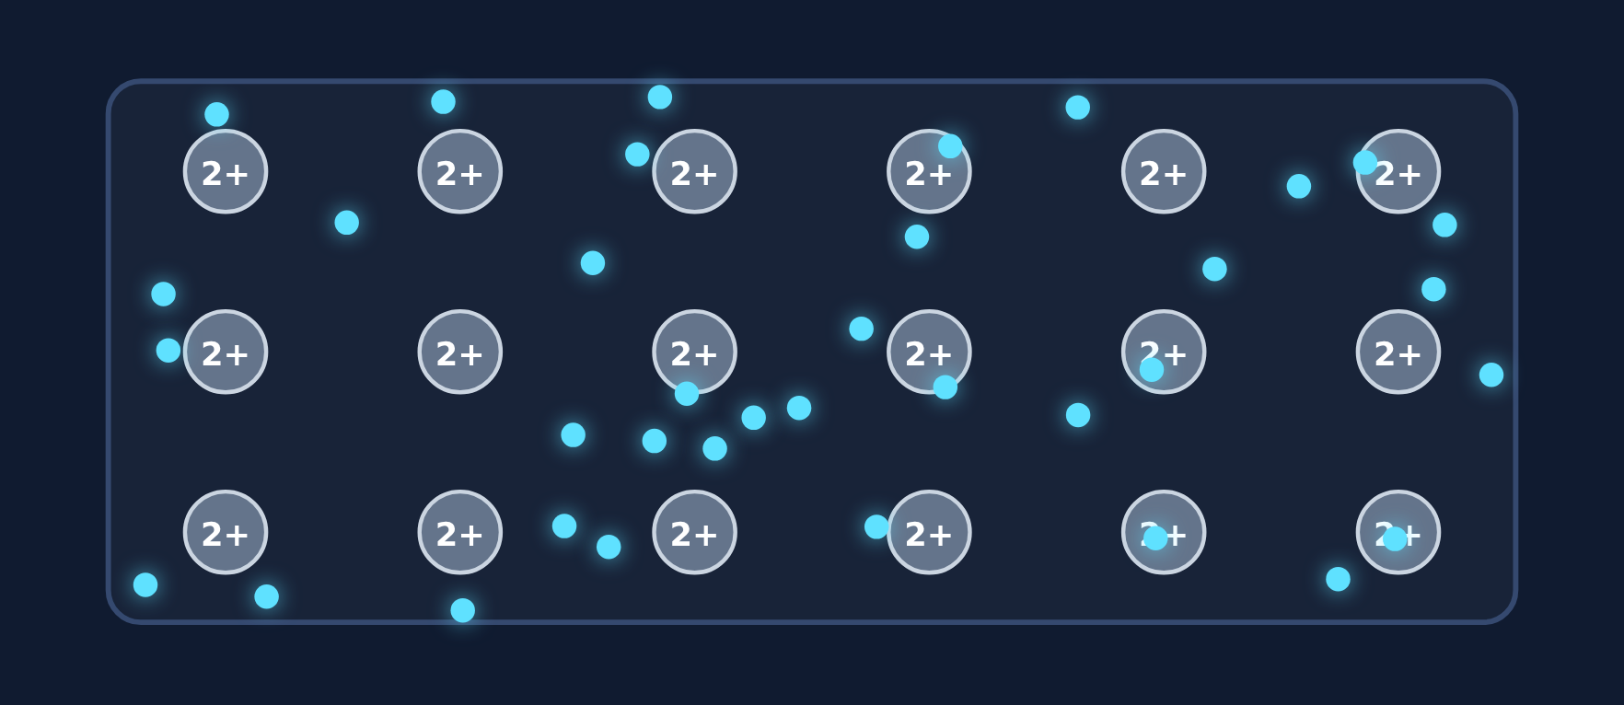

More valence electrons, more sea
Read
Each atom adds all of its valence electrons to the sea, and becomes an ion with that charge. More electrons and more charge mean a stronger bond.
Sodium: adds 1 → Na⁺ (melts at 98 °C)
Magnesium: adds 2 → Mg²⁺ (650 °C)
Aluminum: adds 3 → Al³⁺ (660 °C)
Notes:
The sea gets denser and the ion charges grow from Na to Al.

Slide 16
Build the metal
Try it
How many electrons does each atom add to the sea? What ion forms?
Potassium
Calcium
Gallium
group 1
group 2
group 13
?
?
?
Notes:
In the lesson students pick the number and watch the sea change.

Slide 17
Build the metal
Try it
Answer
How many electrons does each atom add to the sea? What ion forms?
Potassium
Calcium
Gallium
group 1
group 2
group 13
1 → K⁺
2 → Ca²⁺
3 → Ga³⁺
Notes:
Group number tells the valence electrons for groups 1 and 2; group 13 has 3.

Slide 18
Quick check
Quick check
Which metal has the stronger metallic bond?
A
Sodium (adds 1 electron per atom)
B
Magnesium (adds 2 electrons per atom)
C
They are the same
D
Neither has a metallic bond
Notes:
A has fewer electrons in the sea. C ignores the charge difference. D: both are metals.

Slide 19
Quick check
Quick check
Answer
Which metal has the stronger metallic bond?
A
Sodium (adds 1 electron per atom)
B
Magnesium (adds 2 electrons per atom)
C
They are the same
D
Neither has a metallic bond
Why: Magnesium adds more electrons to the sea and its ions have a bigger charge, so the attraction is stronger.
Notes:
A has fewer electrons in the sea. C ignores the charge difference. D: both are metals.

Slide 20
Conducting electricity
Section 4 of 9 · about 4 min
In this section
To unlock the next section
Read
Free electrons can flow
Connect the battery to the metal
Try it
Circuit simulator
Sort what conducts as a solid
Try it
Conducts as a solid?
Answer the quick check correctly
Quick check
Why metals conduct
Notes:
Section 4 takes about 4 minutes.

Slide 21
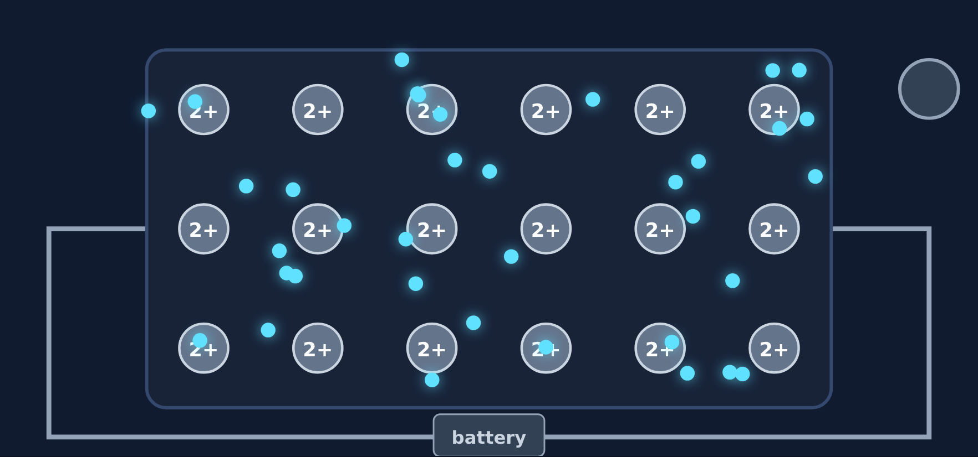
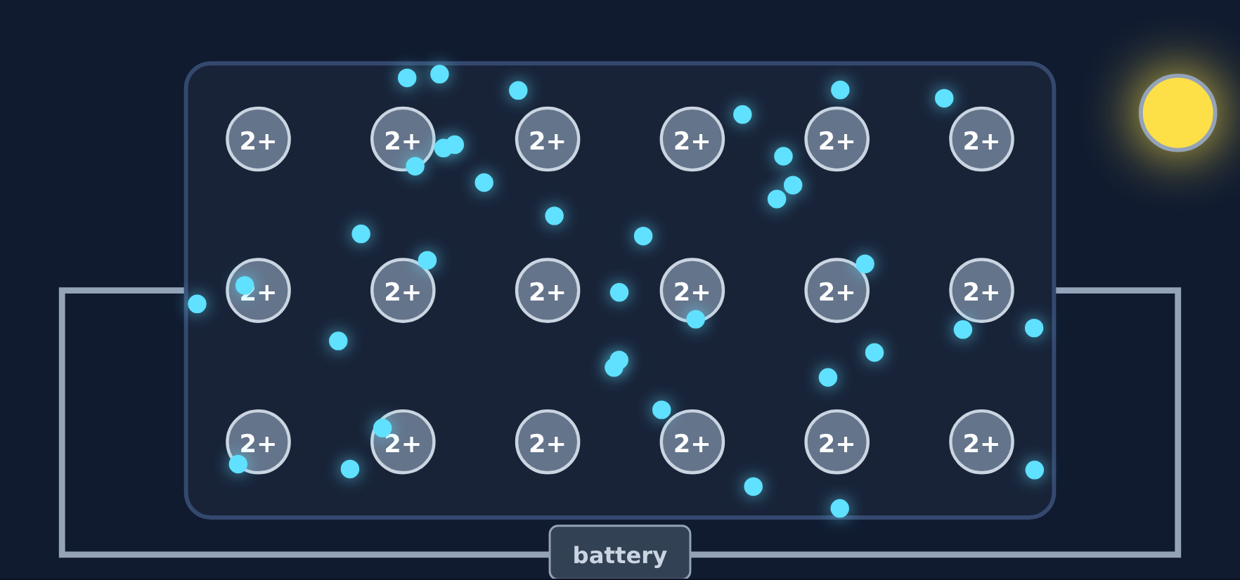
Free electrons can flow
Read
Electricity is moving charge. Connect a battery, and the electron sea drifts in one direction: a current. Metals conduct as solids; ionic compounds only when melted or dissolved; covalent usually not at all.
Battery off: random motion
Battery on: electrons drift, bulb lights
Notes:
The ions stay in their rows; only the electrons drift.

Slide 22
Conducts as a solid?
Try it
Does each solid conduct electricity?
Copper wire
?
Solid table salt
?
Aluminum foil
?
Solid sugar
?
Notes:
Students sort these in the lesson.

Slide 23
Conducts as a solid?
Try it
Answer
Does each solid conduct electricity?
Copper wire
Yes
Solid table salt
No
Aluminum foil
Yes
Solid sugar
No
Notes:
Metals conduct as solids. Salt's ions are locked; sugar has no ions or free electrons.

Slide 24
Quick check
Quick check
Why does a solid metal conduct electricity?
A
Its electrons are free to move through the metal
B
Its ions can move around in the solid
C
It has no electrons
D
It is made of molecules
Notes:
B: the ions are fixed in rows. C: metals have plenty of electrons. D describes covalent compounds.

Slide 25
Quick check
Quick check
Answer
Why does a solid metal conduct electricity?
A
Its electrons are free to move through the metal
B
Its ions can move around in the solid
C
It has no electrons
D
It is made of molecules
Why: The sea of electrons can flow. The ions stay in place, but the electrons move.
Notes:
B: the ions are fixed in rows. C: metals have plenty of electrons. D describes covalent compounds.

Slide 26
Bending without breaking
Section 5 of 9 · about 4 min
In this section
To unlock the next section
Read
Malleable and ductile
Hammer the metal and the ionic crystal
Try it
Hammer test
Answer the quick check correctly
Phenomenon
Back to the phenomenon
Quick check
Hammering a sheet
Notes:
Section 5 takes about 4 minutes.

Slide 27


Malleable and ductile
Read
Malleable: hammered into sheets. Ductile: pulled into wires.
When hit, layers of metal ions slide, and the electron sea flows with them, so the metal stays bonded. In an ionic crystal, sliding lines up like charges, which repel, and it shatters.
Metal: before
Ionic crystal: before
Notes:
Ask: what will happen when we hit each one? Then show the next slide.

Slide 28
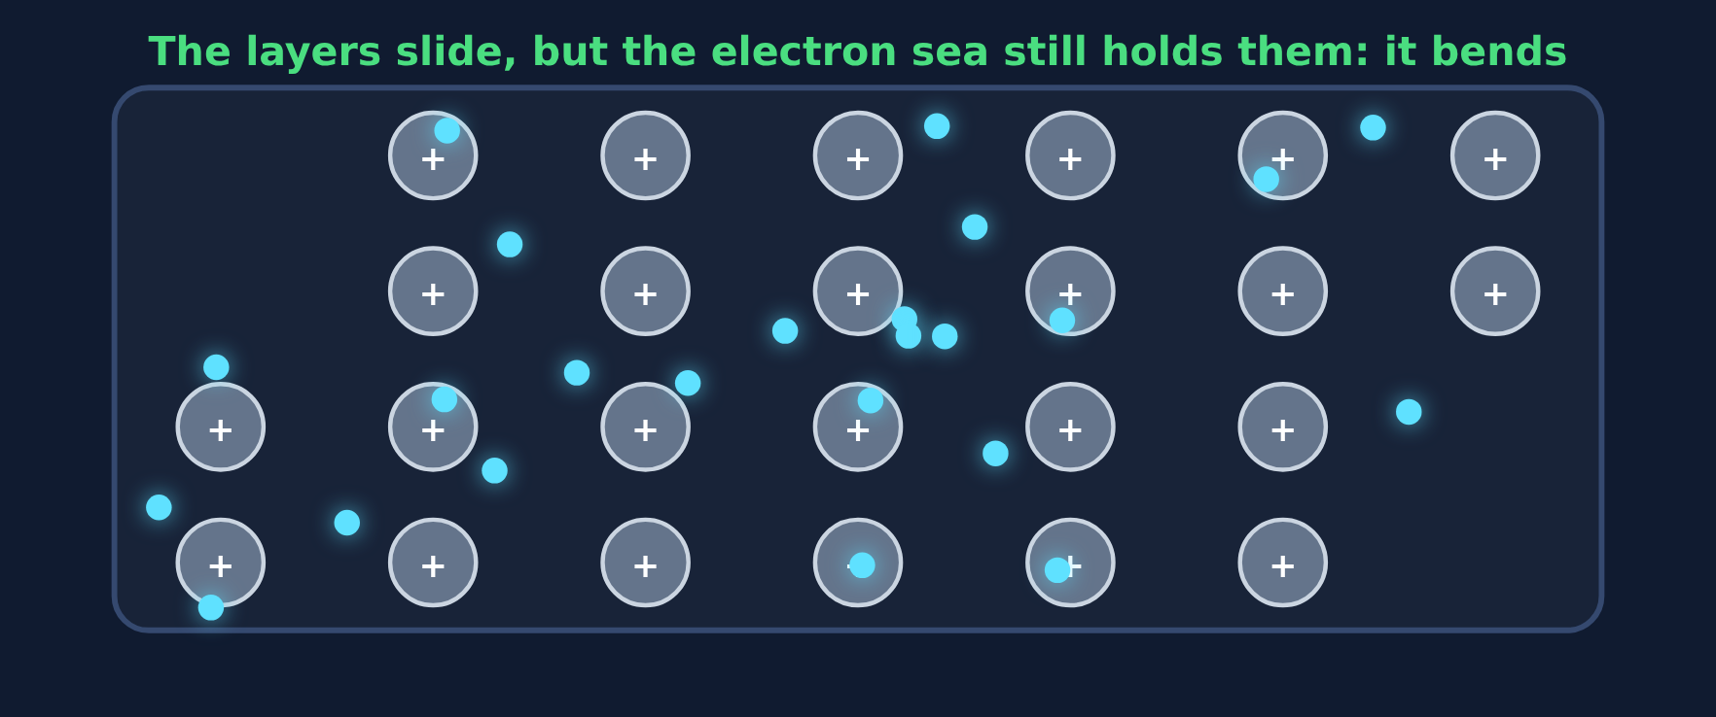
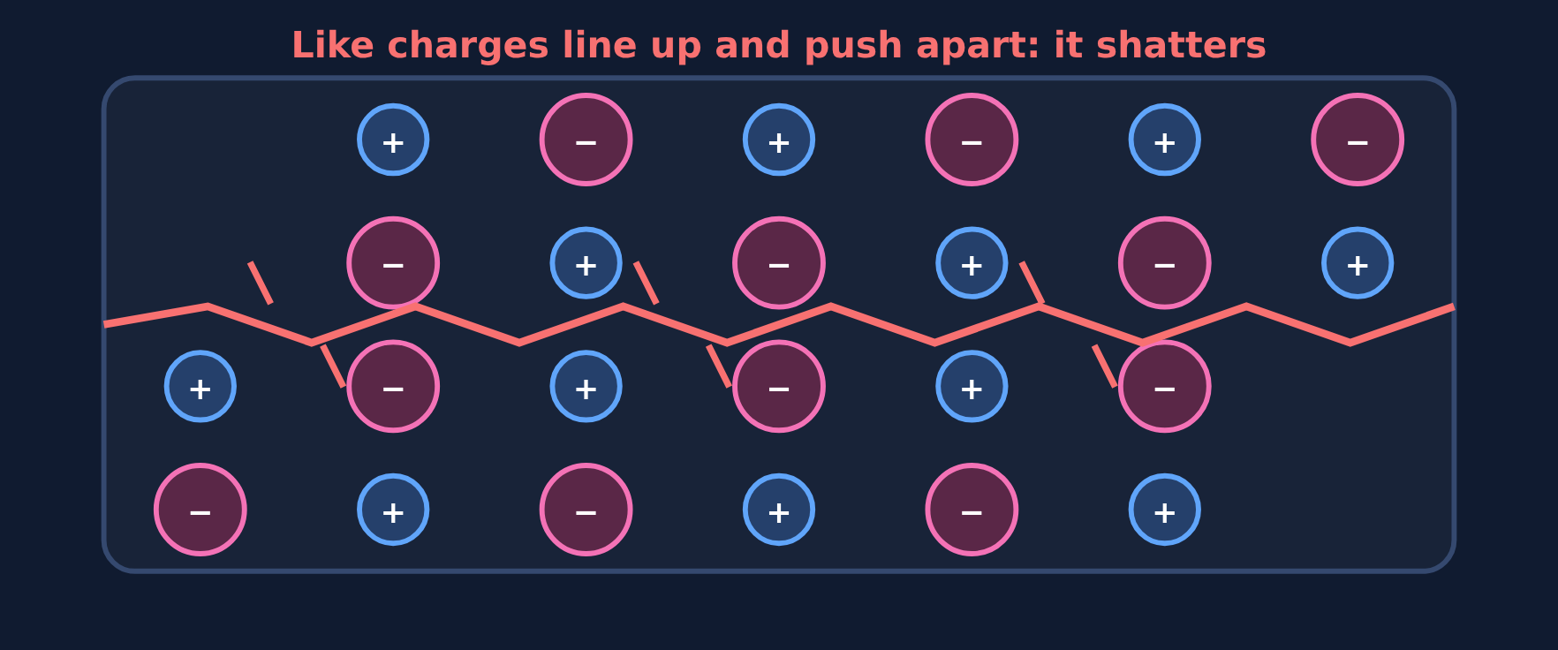
Hammer test: after
Try it
Answer
Metal bends: the sea still holds every ion.
Ionic crystal shatters: like charges repel.
Notes:
This is the answer to the opening phenomenon.

Slide 29
Back to the phenomenon
Phenomenon
Answer
Answer: B. The electrons are free to move and hold the atoms together.
In copper, each atom gives its valence electrons to a shared sea that flows around all the copper ions. When you bend the wire, layers slide, but the sea moves with them, so the wire bends instead of breaking.
The same free electrons flow through the wire as an electric current.
Notes:
Close the loop on the opening prediction.

Slide 30
Quick check
Quick check
Why can a metal be hammered into a thin sheet without breaking?
A
The layers of ions slide, and the sea of electrons keeps holding them together
B
Metals have no bonds
C
Like charges line up and attract
D
Hammering adds more electrons
Notes:
B: metals are strongly bonded. C: like charges repel, which is why ionic crystals shatter. D: hammering doesn't add electrons.

Slide 31
Quick check
Quick check
Answer
Why can a metal be hammered into a thin sheet without breaking?
A
The layers of ions slide, and the sea of electrons keeps holding them together
B
Metals have no bonds
C
Like charges line up and attract
D
Hammering adds more electrons
Why: The electron sea moves with the sliding ions, so the metal stays bonded. That makes metals malleable.
Notes:
B: metals are strongly bonded. C: like charges repel, which is why ionic crystals shatter. D: hammering doesn't add electrons.

Slide 32
Shiny and good at heat
Section 6 of 9 · about 3 min
In this section
To unlock the next section
Read
More metal properties
Sort the properties
Try it
Metal property or not?
Answer the quick check correctly
Quick check
Hot soup spoon
Notes:
Section 6 takes about 3 minutes.

Slide 33
More metal properties
Read
Luster (shiny)
Free electrons absorb light and give it right back off, so metals reflect light.
Conduct heat
Moving electrons carry energy quickly from the hot end to the cold end.
High melting points (mostly)
It takes lots of energy to pull ions away from the sea. Mercury and sodium are exceptions.
Notes:
Connect each property back to the free electrons.

Slide 34
Metal property or not?
Try it
Is each one a property of metals?
Shiny surface
?
Shatters when hit
?
Conducts heat well
?
Can be pulled into wire
?
Does not conduct as a solid
?
Notes:
Students sort these in the lesson.

Slide 35
Metal property or not?
Try it
Answer
Is each one a property of metals?
Shiny surface
Yes
Shatters when hit
No
Conducts heat well
Yes
Can be pulled into wire
Yes
Does not conduct as a solid
No
Notes:
Shattering and not conducting as a solid are ionic properties.

Slide 36
Quick check
Quick check
Why does a metal spoon in hot soup heat up quickly?
A
Its free electrons carry energy quickly through the metal
B
It is made of molecules
C
Its ions are free to move
D
It reflects light
Notes:
B is covalent. C: the ions stay in place. D explains shine, not heating.

Slide 37
Quick check
Quick check
Answer
Why does a metal spoon in hot soup heat up quickly?
A
Its free electrons carry energy quickly through the metal
B
It is made of molecules
C
Its ions are free to move
D
It reflects light
Why: Moving electrons carry energy fast, so metals are good heat conductors.
Notes:
B is covalent. C: the ions stay in place. D explains shine, not heating.

Slide 38
Ionic, covalent, or metallic?
Section 7 of 9 · about 4 min
In this section
To unlock the next section
Read
Three kinds of bonds
Sort the bond-type cards
Try it
Ionic, covalent, or metallic?
Answer the quick check correctly
Quick check
Brass
Notes:
Section 7 takes about 4 minutes.

Slide 39
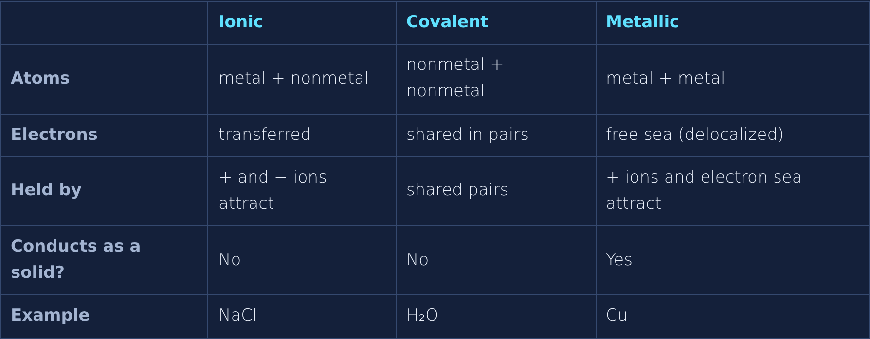
Three kinds of bonds
Read
Notes:
Ionic = transferred. Covalent = shared pairs. Metallic = sea. Only metallic conducts as a solid.

Slide 40
Ionic, covalent, or metallic?
Try it
Which kind of bond is each card?
KCl
?
CH₄
?
Zinc (Zn)
?
Electrons transferred
?
Electrons shared in pairs
?
Sea of free electrons
?
Notes:
Students sort these into three boxes in the lesson.

Slide 41
Ionic, covalent, or metallic?
Try it
Answer
Which kind of bond is each card?
KCl
Ionic
CH₄
Covalent
Zinc (Zn)
Metallic
Electrons transferred
Ionic
Electrons shared in pairs
Covalent
Sea of free electrons
Metallic
Notes:
Zinc is a pure metal. KCl is a metal + nonmetal. CH₄ is two nonmetals.

Slide 42
Quick check
Quick check
Brass is a mix of copper and zinc. What kind of bonding holds it together?
A
Ionic
B
Covalent
C
Metallic
D
No bonding
Notes:
A needs a nonmetal. B needs two nonmetals. D: brass is a strong solid, so it is bonded.

Slide 43
Quick check
Quick check
Answer
Brass is a mix of copper and zinc. What kind of bonding holds it together?
A
Ionic
B
Covalent
C
Metallic
D
No bonding
Why: Copper and zinc are both metals, so they share one electron sea. A metal mixture like brass is called an alloy.
Notes:
A needs a nonmetal. B needs two nonmetals. D: brass is a strong solid, so it is bonded.

Slide 44
Spot the mistake
Section 8 of 9 · about 3 min
In this section
To unlock the next section
Read
Check the work
Find the mistake in 3 student examples
Try it
Spot the mistake
Answer the quick check correctly
Quick check
Correct statement
Notes:
Section 8 takes about 3 minutes.

Slide 45
Spot the mistake
Try it
Each student example has one mistake. Find it.
1. A student says copper atoms are held together by sharing electrons in pairs.
What is wrong?
2. A student says metals conduct because their ions move through the solid.
What is wrong?
3. A student says hammering a metal makes it shatter because like charges line up.
What is wrong?
Notes:
Let groups discuss before revealing.

Slide 46
Spot the mistake
Try it
Answer
Each student example has one mistake. Find it.
1. A student says copper atoms are held together by sharing electrons in pairs.
Fix: That is covalent; copper has a sea of free electrons.
2. A student says metals conduct because their ions move through the solid.
Fix: The ions stay in rows; the free electrons carry the current.
3. A student says hammering a metal makes it shatter because like charges line up.
Fix: That is an ionic crystal; metals bend because the sea holds the sliding layers.
Notes:
Ask: what are the electrons doing, and what are the ions doing, in each example?

Slide 47
Quick check
Quick check
Which statement about metals is correct?
A
The ions move to carry current
B
Valence electrons are shared in pairs
C
Positive ions are held by a sea of free electrons
D
Metals shatter when hammered
Notes:
A: electrons carry current. B: that is covalent. D: metals bend; ionic crystals shatter.

Slide 48
Quick check
Quick check
Answer
Which statement about metals is correct?
A
The ions move to carry current
B
Valence electrons are shared in pairs
C
Positive ions are held by a sea of free electrons
D
Metals shatter when hammered
Why: That's the metallic bond: positive ions attracted to a sea of delocalized electrons.
Notes:
A: electrons carry current. B: that is covalent. D: metals bend; ionic crystals shatter.

Slide 49
Final check
Section 9 of 9 · about 6 min
In this section
To unlock the next section
Read
Ten questions on the Chromebook
Score 8 or more out of 10
Try it
Multiple choice, two-part, select all
Notes:
The final check is done in the lesson on the Chromebook. It is not in these slides.

Slide 50
Wrap-up: what is a metallic bond?
1
2
3
4
Metal atoms release their valence electrons
Electrons form a free-moving sea
Positive ions and the sea attract
Explains conducting, bending, and shine
Next: about 20 minutes of worksheet practice.
Notes:
Have students explain why a copper wire bends AND conducts using the four steps.

