Slide 1
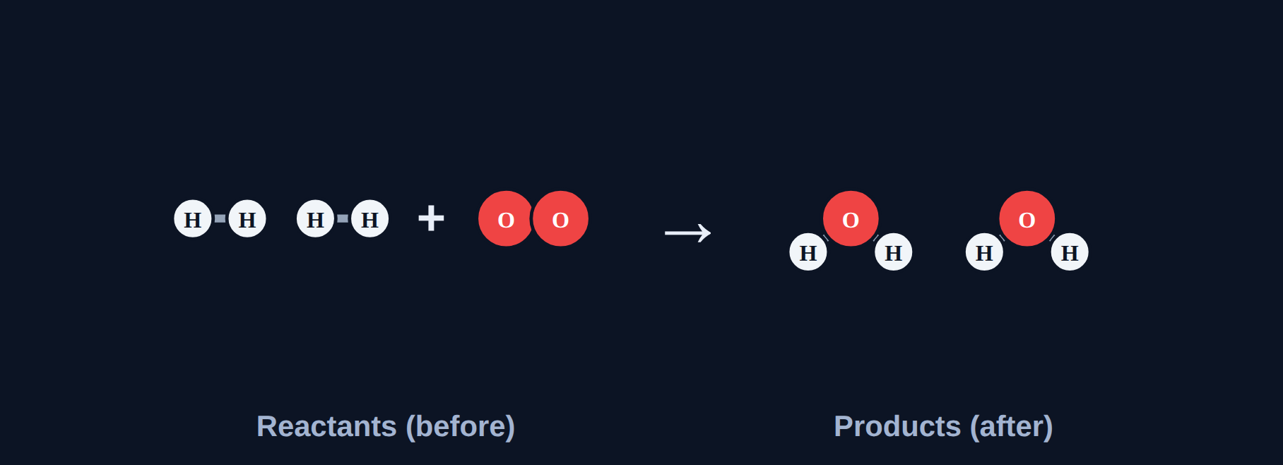
Balancing Equations
Chemistry · Unit 3: Chemical Reactions · about 40 minutes
Notes:
Atoms are conserved, so equations must be balanced.

Slide 2
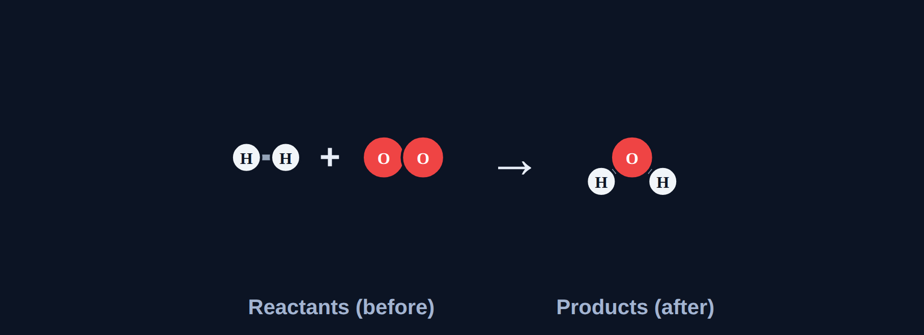
Where did the oxygen go?
Phenomenon
A student writes H₂ + O₂ → H₂O. The left has 2 O atoms, but the right has only 1. How should the student fix it?
A. The oxygen atom really disappeared
B. Change water to H₂O₂
We'll find out in Section 7.
C. Put numbers in front: 2H₂ + O₂ → 2H₂O
D. Equations don't need to match
Notes:
Answer (C) revealed in Section 7.

Slide 3









How the lesson works
Why balance?
Coefficients, not subscripts
Balance step by step
about 4 min
about 4 min
about 5 min
A strategy that works
Polyatomic ions as units
Balancing combustion
about 5 min
about 5 min
about 5 min
Smallest whole numbers
Spot the mistake
Final check
about 3 min
about 3 min
about 6 min
Notes:
Nine short sections, about 40 minutes.

Slide 4
Why balance?
Section 1 of 9 · about 4 min
In this section
To unlock the next section
Phenomenon
Where did the oxygen go?
Make a prediction
Read
Atoms are conserved
Sort the equations
Try it
Balanced or not?
Answer the quick check correctly
Quick check
Why balance
Notes:
Section 1 takes about 4 minutes.

Slide 5
Atoms are conserved
Read
The law of conservation of mass: atoms are not created or destroyed in a reaction. They only rearrange.
So a correct equation has the same number of each atom on both sides: a balanced equation.
Notes:
Count with the class: 4 H and 2 O on each side.

Slide 6
Balanced or not?
Try it
Count the atoms on each side.
2H₂ + O₂ → 2H₂O
?
H₂ + Cl₂ → HCl
?
N₂ + 3H₂ → 2NH₃
?
Mg + O₂ → MgO
?
Notes:
Students sort these in the lesson.

Slide 7
Balanced or not?
Try it
Answer
Count the atoms on each side.
2H₂ + O₂ → 2H₂O
Balanced
H₂ + Cl₂ → HCl
Not balanced: H and Cl are 2 vs 1
N₂ + 3H₂ → 2NH₃
Balanced
Mg + O₂ → MgO
Not balanced: O is 2 vs 1
Notes:
Check every element, not just the first one.

Slide 8
Quick check
Quick check
Why must a chemical equation be balanced?
A
To make it look neat
B
Atoms are not created or destroyed in a reaction
C
Products always have more atoms
D
The arrow means "equals"
Notes:
C contradicts conservation. D: the arrow means "makes."

Slide 9
Quick check
Quick check
Answer
Why must a chemical equation be balanced?
A
To make it look neat
B
Atoms are not created or destroyed in a reaction
C
Products always have more atoms
D
The arrow means "equals"
Why: Conservation of mass.
Notes:
C contradicts conservation. D: the arrow means "makes."

Slide 10
Coefficients, not subscripts
Section 2 of 9 · about 4 min
In this section
To unlock the next section
Read
Change the number of molecules
Answer 3 rounds
Try it
Allowed or not?
Answer the quick check correctly
Quick check
What may change
Notes:
Section 2 takes about 4 minutes.

Slide 11
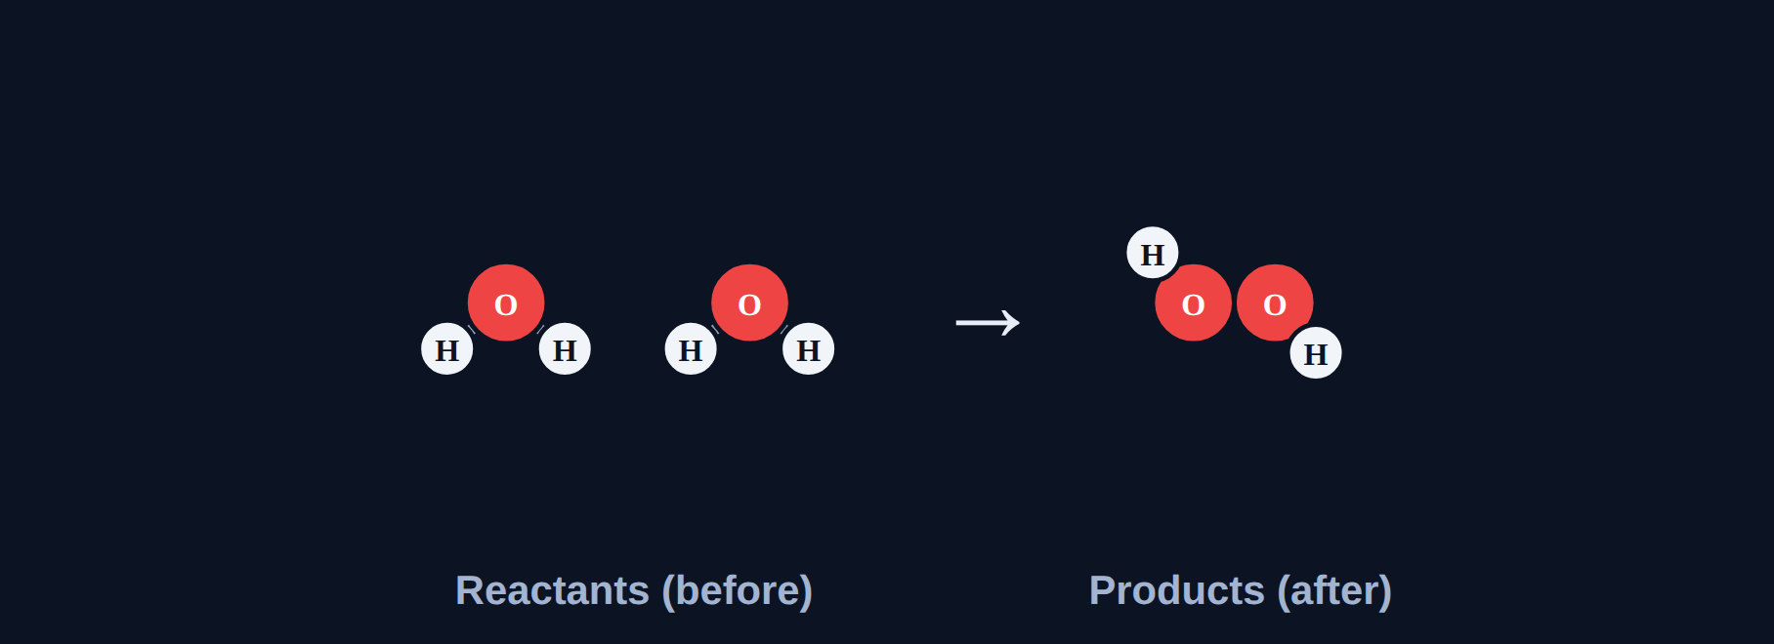
Coefficients, not subscripts
Read
A coefficient changes HOW MANY molecules. A subscript is part of the formula; changing it makes a DIFFERENT substance.
Rule: change only coefficients.
2H₂O (water) is not the same substance as H₂O₂ (hydrogen peroxide).
Notes:
Hydrogen peroxide bleaches hair; water doesn't. Different substances!

Slide 12
Allowed or not?
Try it
Is each change allowed?
Change H₂O to H₂O₂ to balance oxygen
?
Put a 2 in front of H₂O
?
In 3CO₂, change the 3
?
Notes:
Have students vote with thumbs up/down.

Slide 13
Allowed or not?
Try it
Answer
Is each change allowed?
Change H₂O to H₂O₂ to balance oxygen
Not allowed: that makes hydrogen peroxide
Put a 2 in front of H₂O
Allowed: a coefficient
In 3CO₂, change the 3
Allowed: the 3 is a coefficient
Notes:
Only coefficients may change.

Slide 14
Quick check
Quick check
When balancing an equation, you may change…
A
subscripts only
B
coefficients only
C
both
D
the arrow
Notes:
A and C change the substances.

Slide 15
Quick check
Quick check
Answer
When balancing an equation, you may change…
A
subscripts only
B
coefficients only
C
both
D
the arrow
Why: Coefficients change how many molecules; subscripts would change the substance.
Notes:
A and C change the substances.

Slide 16
Balance step by step
Section 3 of 9 · about 5 min
In this section
To unlock the next section
Read
Balance one element at a time
Balance 3 equations
Try it
Balancer
Answer the quick check correctly
Quick check
Quick check
Notes:
Section 3 takes about 5 minutes.

Slide 17
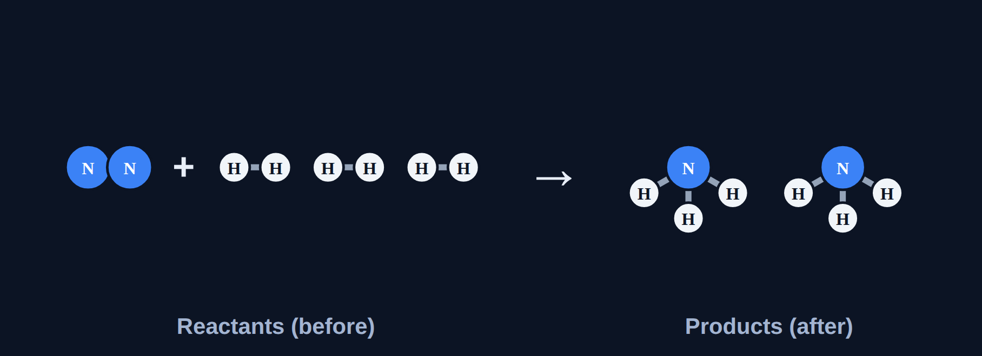
Balance one element at a time
Read
Count each element. Fix one with a coefficient, then RECOUNT everything. Example: N₂ + H₂ → NH₃ → put 2 on NH₃ (N), then 3 on H₂ (H).
Notes:
In the lesson, students use the balancer: + and − buttons, molecules that multiply, and a table that turns green.

Slide 18
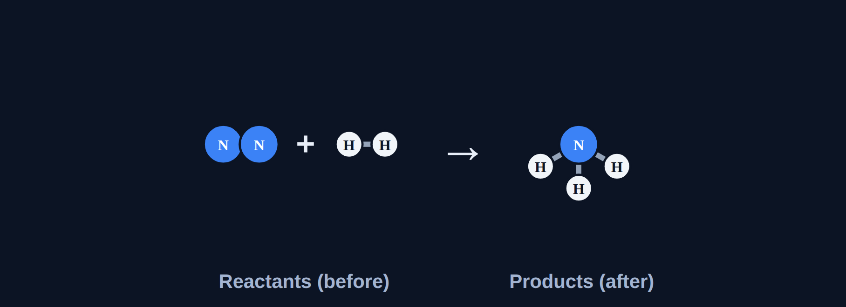
Balancer
Try it
Balance: N₂ + H₂ → NH₃
As written: count each element. What coefficients balance it?
Notes:
Nitrogen first, then hydrogen.

Slide 19
Balancer
Try it
Answer
N₂ + 3H₂ → 2NH₃
Balanced: every element matches.
Notes:
Nitrogen first, then hydrogen.

Slide 20
Quick check
Quick check
After you add a coefficient, what should you always do next?
A
Stop; you're done
B
Recount every element on both sides
C
Change a subscript
D
Erase the other coefficients
Notes:
A skips checking. C breaks the rule. D undoes your work.

Slide 21
Quick check
Quick check
Answer
After you add a coefficient, what should you always do next?
A
Stop; you're done
B
Recount every element on both sides
C
Change a subscript
D
Erase the other coefficients
Why: A coefficient changes every atom in that formula.
Notes:
A skips checking. C breaks the rule. D undoes your work.

Slide 22
A strategy that works
Section 4 of 9 · about 5 min
In this section
To unlock the next section
Read
A strategy that works
Balance 3 equations
Try it
Balancer
Answer the quick check correctly
Quick check
Quick check
Notes:
Section 4 takes about 5 minutes.

Slide 23
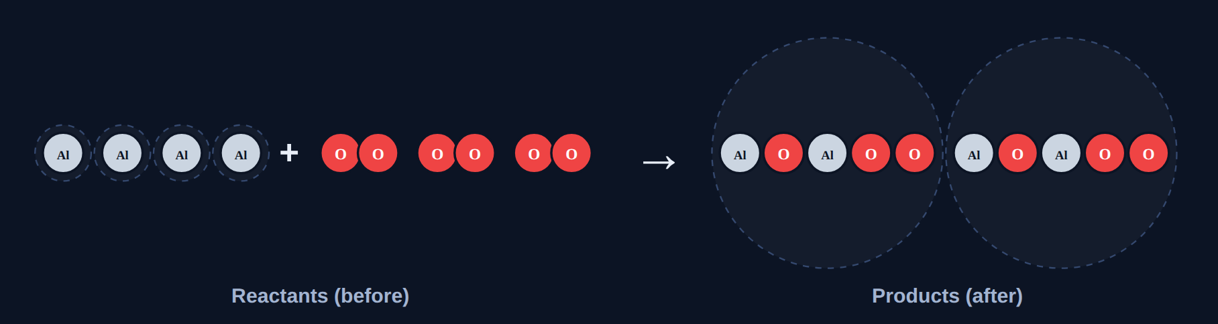
A strategy that works
Read
Metals first, then other nonmetals, and lone elements like O₂ LAST. Example: Al + O₂ → Al₂O₃: make O 6 on both sides (3O₂, 2Al₂O₃), then 4Al.
Notes:
In the lesson, students use the balancer: + and − buttons, molecules that multiply, and a table that turns green.

Slide 24
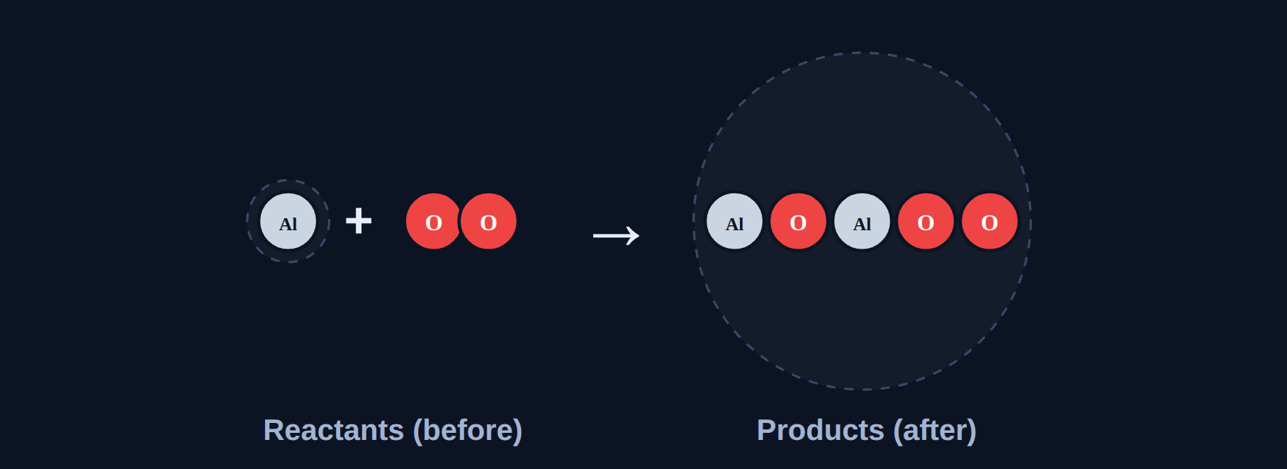
Balancer
Try it
Balance: Al + O₂ → Al₂O₃
As written: count each element. What coefficients balance it?
Notes:
Least common multiple of 2 and 3 is 6.

Slide 25
Balancer
Try it
Answer
4Al + 3O₂ → 2Al₂O₃
Balanced: every element matches.
Notes:
Least common multiple of 2 and 3 is 6.

Slide 26
Quick check
Quick check
Why balance O₂ last in 4Fe + 3O₂ → 2Fe₂O₃?
A
It is a lone element, so changing it affects nothing else
B
Oxygen is heaviest
C
It is always 1
D
It is a metal
Notes:
B and C are false; D: oxygen is a nonmetal.

Slide 27
Quick check
Quick check
Answer
Why balance O₂ last in 4Fe + 3O₂ → 2Fe₂O₃?
A
It is a lone element, so changing it affects nothing else
B
Oxygen is heaviest
C
It is always 1
D
It is a metal
Why: Lone elements only affect one count.
Notes:
B and C are false; D: oxygen is a nonmetal.

Slide 28
Polyatomic ions as units
Section 5 of 9 · about 5 min
In this section
To unlock the next section
Read
Keep polyatomic groups together
Balance 3 equations
Try it
Balancer
Answer the quick check correctly
Quick check
Quick check
Notes:
Section 5 takes about 5 minutes.

Slide 29
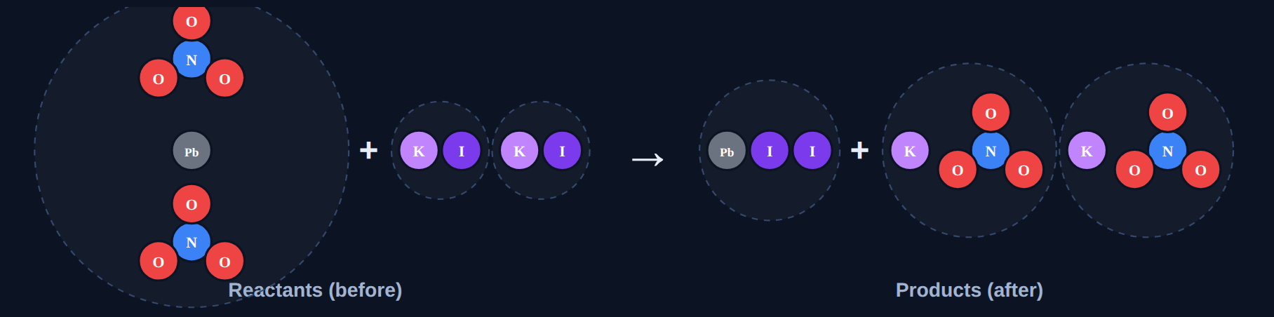
Keep polyatomic groups together
Read
If a group like NO₃, SO₄, or OH is the same on both sides, count it as one unit. Example: Pb(NO₃)₂ + KI → PbI₂ + KNO₃: 2 NO₃ on the left → 2KNO₃ → 2KI.
Notes:
In the lesson, students use the balancer: + and − buttons, molecules that multiply, and a table that turns green.

Slide 30
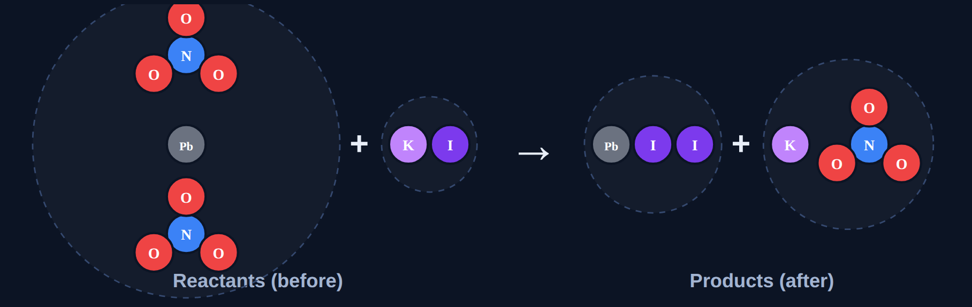
Balancer
Try it
Balance: Pb(NO₃)₂ + KI → PbI₂ + KNO₃
As written: count each element. What coefficients balance it?
Notes:
Count NO₃ groups, not N and O separately.

Slide 31
Balancer
Try it
Answer
Pb(NO₃)₂ + 2KI → PbI₂ + 2KNO₃
Balanced: every element matches.
Notes:
Count NO₃ groups, not N and O separately.

Slide 32
Quick check
Quick check
In Pb(NO₃)₂ + 2KI → PbI₂ + 2KNO₃, how many NO₃ groups are on each side?
A
1 and 2
B
2 and 2
C
3 and 3
D
6 and 6
Notes:
D counts O atoms, not groups.

Slide 33
Quick check
Quick check
Answer
In Pb(NO₃)₂ + 2KI → PbI₂ + 2KNO₃, how many NO₃ groups are on each side?
A
1 and 2
B
2 and 2
C
3 and 3
D
6 and 6
Why: Pb(NO₃)₂ has 2; 2KNO₃ has 2.
Notes:
D counts O atoms, not groups.

Slide 34
Balancing combustion
Section 6 of 9 · about 5 min
In this section
To unlock the next section
Read
Combustion: C, then H, then O
Balance 3 equations
Try it
Balancer
Answer the quick check correctly
Quick check
Quick check
Notes:
Section 6 takes about 5 minutes.

Slide 35
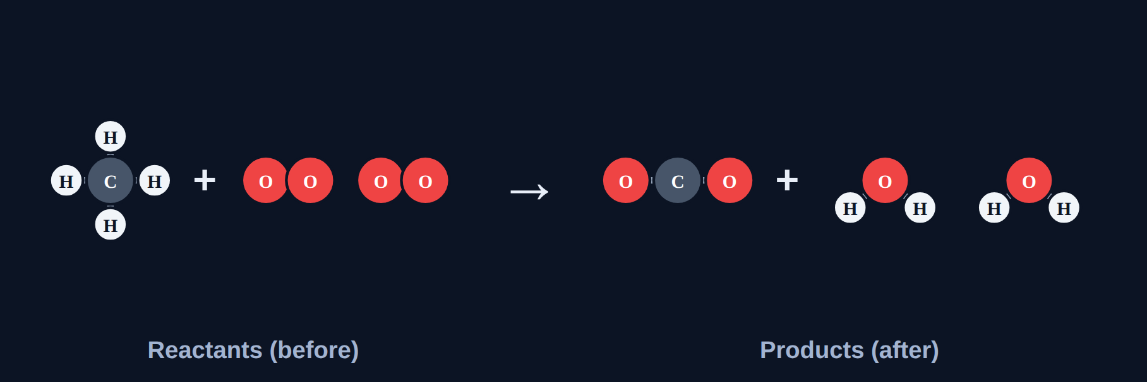
Combustion: C, then H, then O
Read
Balance C (on CO₂), then H (on H₂O), then O last (on O₂). If O₂ would need a half, double everything. Example: CH₄ + 2O₂ → CO₂ + 2H₂O.
Notes:
In the lesson, students use the balancer: + and − buttons, molecules that multiply, and a table that turns green.

Slide 36
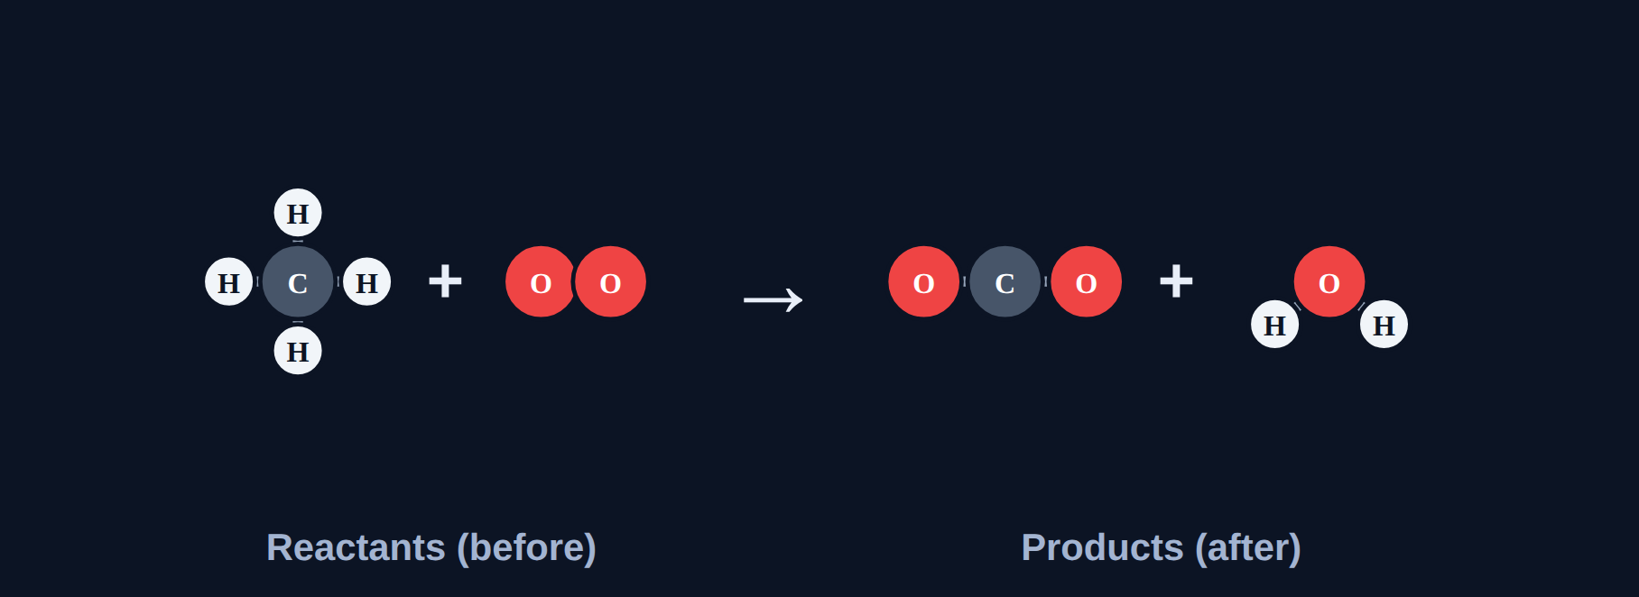
Balancer
Try it
Balance: CH₄ + O₂ → CO₂ + H₂O
As written: count each element. What coefficients balance it?
Notes:
Products have 2 + 2 = 4 O, so 2O₂.

Slide 37
Balancer
Try it
Answer
CH₄ + 2O₂ → CO₂ + 2H₂O
Balanced: every element matches.
Notes:
Products have 2 + 2 = 4 O, so 2O₂.

Slide 38
Quick check
Quick check
When balancing combustion, which element do you balance last?
A
Carbon
B
Hydrogen
C
Oxygen
D
It doesn't matter
Notes:
Balancing O first usually has to be redone.

Slide 39
Quick check
Quick check
Answer
When balancing combustion, which element do you balance last?
A
Carbon
B
Hydrogen
C
Oxygen
D
It doesn't matter
Why: O₂ stands alone on the left.
Notes:
Balancing O first usually has to be redone.

Slide 40
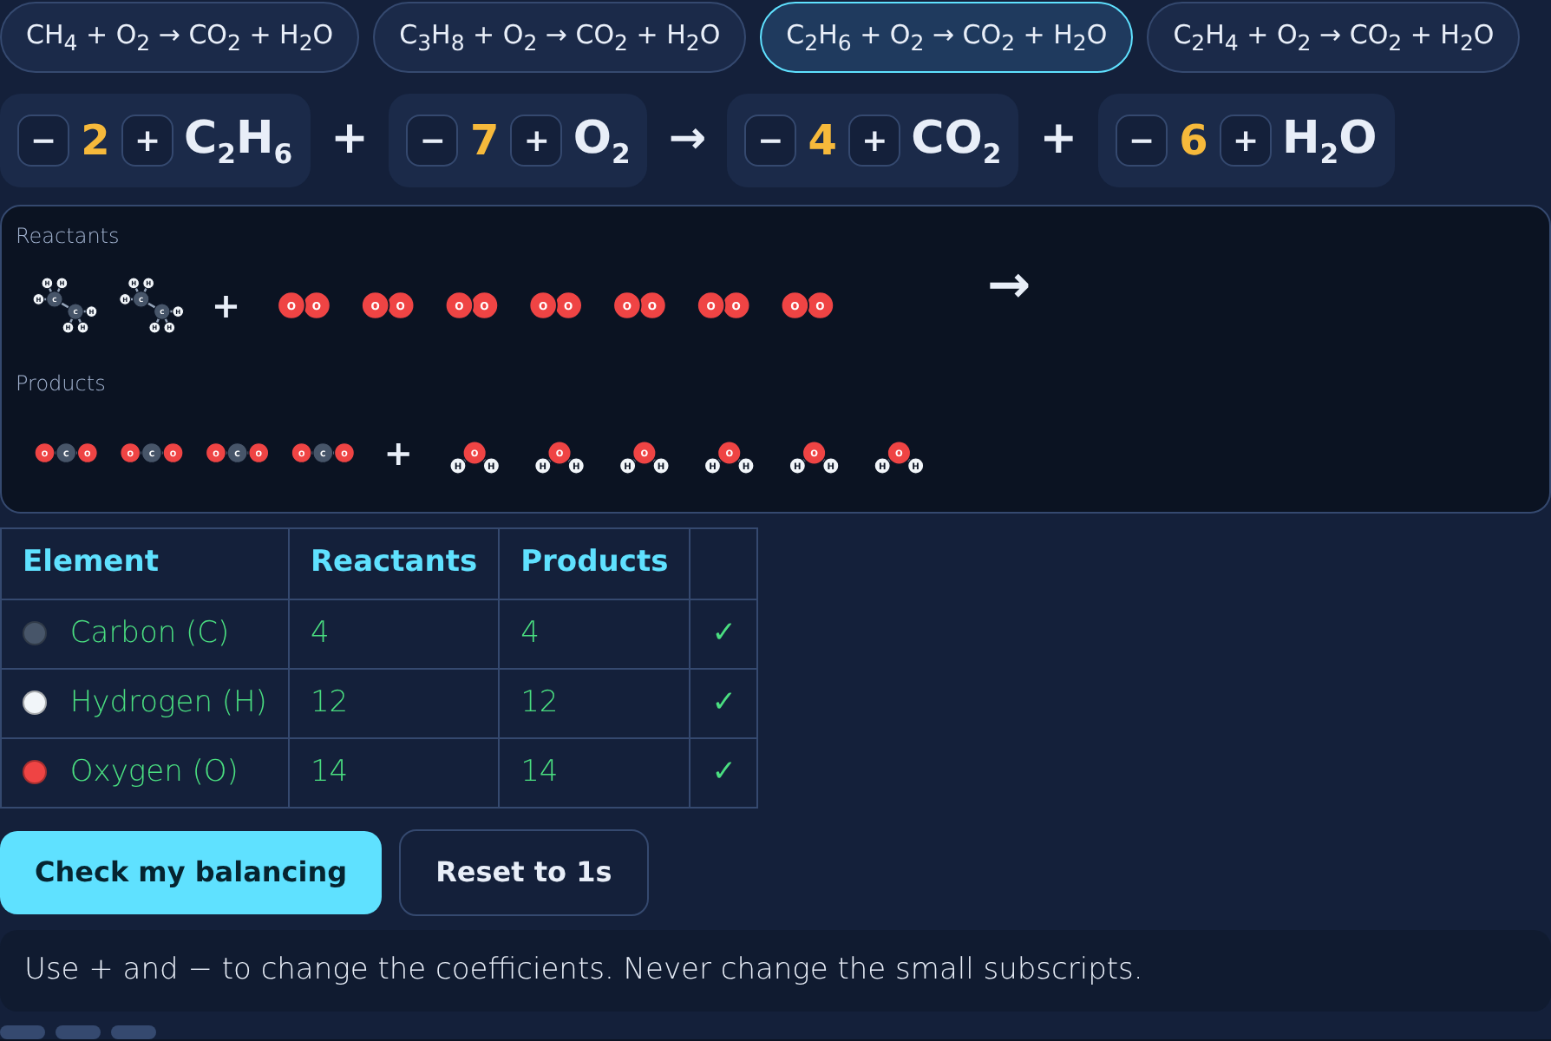
The balancer: 2C₂H₆ + 7O₂ → 4CO₂ + 6H₂O
Try it
Answer
Notes:
C₂H₆: C → 2CO₂, H → 3H₂O, O needs 3.5O₂ → double: 2, 7, 4, 6.

Slide 41
Smallest whole numbers
Section 7 of 9 · about 3 min
In this section
To unlock the next section
Read
Smallest whole numbers
Answer 3 rounds
Try it
Reduce and check
Answer the quick check correctly
Phenomenon
Back to the phenomenon
Quick check
Lowest terms
Notes:
Section 7 takes about 3 minutes.

Slide 42
Use the smallest whole numbers
Read
If every coefficient can be divided by the same number, divide. A coefficient of 1 isn't written. Finish with one last recount.
Notes:
4H₂ + 2O₂ → 4H₂O divides by 2.

Slide 43
Reduce and check
Try it
Is each answer in the smallest whole numbers?
4H₂ + 2O₂ → 4H₂O
?
N₂ + 3H₂ → 2NH₃
?
2CH₄ + 4O₂ → 2CO₂ + 4H₂O
?
Notes:
Look for a common factor.

Slide 44
Reduce and check
Try it
Answer
Is each answer in the smallest whole numbers?
4H₂ + 2O₂ → 4H₂O
No: divide by 2 → 2H₂ + O₂ → 2H₂O
N₂ + 3H₂ → 2NH₃
Yes
2CH₄ + 4O₂ → 2CO₂ + 4H₂O
No: divide by 2 → CH₄ + 2O₂ → CO₂ + 2H₂O
Notes:
Every coefficient must share the factor to reduce.

Slide 45
Back to the phenomenon
Phenomenon
Answer
Answer: C. 2H₂ + O₂ → 2H₂O.
The oxygen atom never disappeared; the equation just didn't show enough molecules. Changing to H₂O₂ would describe a different substance.
Notes:
Now each side has 4 H and 2 O.

Slide 46
Quick check
Quick check
Which balanced equation is in lowest terms?
A
6Na + 3Cl₂ → 6NaCl
B
2Na + Cl₂ → 2NaCl
C
4Na + 2Cl₂ → 4NaCl
D
2Na + 2Cl₂ → 2NaCl
Notes:
A and C reduce; D isn't balanced.

Slide 47
Quick check
Quick check
Answer
Which balanced equation is in lowest terms?
A
6Na + 3Cl₂ → 6NaCl
B
2Na + Cl₂ → 2NaCl
C
4Na + 2Cl₂ → 4NaCl
D
2Na + 2Cl₂ → 2NaCl
Why: 2, 1, 2 can't be reduced.
Notes:
A and C reduce; D isn't balanced.

Slide 48
Spot the mistake
Section 8 of 9 · about 3 min
In this section
To unlock the next section
Read
Check the work
Find the mistake in 3 student examples
Try it
Spot the mistake
Answer the quick check correctly
Quick check
Correctly balanced
Notes:
Section 8 takes about 3 minutes.

Slide 49
Spot the mistake
Try it
Each student example has one mistake. Find it.
"H₂ + O₂ → H₂O₂"
?
"2Al + 3O₂ → 2Al₂O₃"
?
"4K + 2Br₂ → 4KBr"
?
Notes:
Let groups discuss before revealing.

Slide 50
Spot the mistake
Try it
Answer
Each student example has one mistake. Find it.
"H₂ + O₂ → H₂O₂"
A subscript was changed; use 2H₂ + O₂ → 2H₂O
"2Al + 3O₂ → 2Al₂O₃"
Al is 2 vs 4: it should be 4Al
"4K + 2Br₂ → 4KBr"
Reduce: 2K + Br₂ → 2KBr
Notes:
Subscripts, recounting, and lowest terms.

Slide 51
Quick check
Quick check
Which equation is correctly balanced?
A
Fe + Cl₂ → FeCl₃
B
2Fe + 3Cl₂ → 2FeCl₃
C
Fe + 3Cl → FeCl₃
D
2Fe + 2Cl₂ → 2FeCl₃
Notes:
A isn't balanced; C changes Cl₂ to Cl; D has 4 Cl vs 6.

Slide 52
Quick check
Quick check
Answer
Which equation is correctly balanced?
A
Fe + Cl₂ → FeCl₃
B
2Fe + 3Cl₂ → 2FeCl₃
C
Fe + 3Cl → FeCl₃
D
2Fe + 2Cl₂ → 2FeCl₃
Why: 2 Fe and 6 Cl on each side.
Notes:
A isn't balanced; C changes Cl₂ to Cl; D has 4 Cl vs 6.

Slide 53
Final check
Section 9 of 9 · about 6 min
In this section
To unlock the next section
Read
Ten questions on the Chromebook
Score 8 or more out of 10
Try it
Multiple choice, two-part, select all
Notes:
The final check is done in the lesson on the Chromebook.

Slide 54
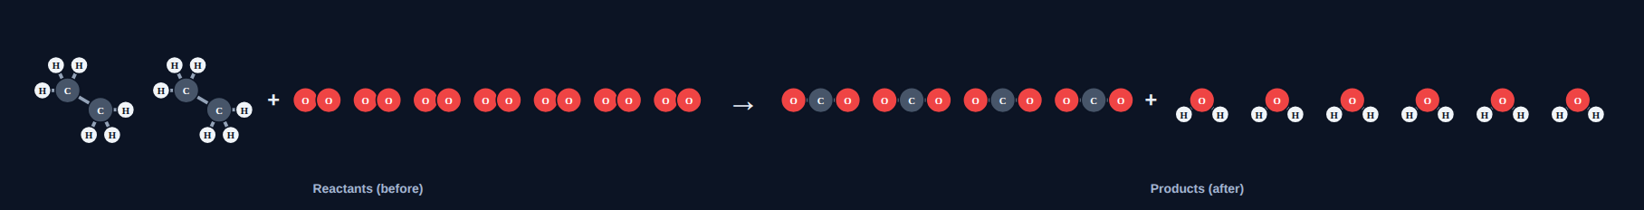
Wrap-up: how to balance
1
2
3
4
Count each element on both sides
Change only coefficients
Metals → nonmetals → lone elements last
Reduce and recount
Notes:
Next: worksheet practice balancing 10 equations.

