Slide 1
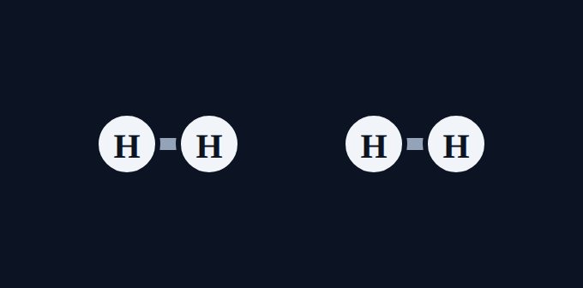

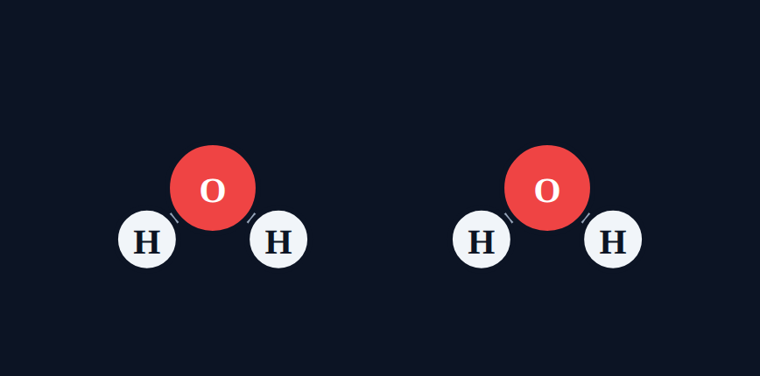
Counting Atoms
Chemistry · Unit 3: Chemical Reactions · about 40 minutes
+
→
2H₂ + O₂ → 2H₂O
Notes:
Opening phenomenon: hydrogen burns to make water.

Slide 2
Where do the atoms go?
Phenomenon
When hydrogen gas burns in oxygen, it makes water: 2H₂ + O₂ → 2H₂O. When the water forms, what happens to the atoms?
A. Some atoms disappear when the water forms
B. New atoms are created to make the water
Make a prediction. We'll find out in Section 7.
C. The same atoms are rearranged, so the count stays the same
D. You can't count atoms in an equation
Notes:
Students commit to a prediction. The answer (C) is revealed in Section 7.

Slide 3









How the lesson works
What a formula tells you
Subscripts
Coefficients
about 4 min
about 5 min
about 4 min
Parentheses
Putting it all together
Particle diagrams
about 5 min
about 4 min
about 4 min
Counting both sides
Spot the mistake
Final check
about 5 min
about 3 min
about 6 min
Notes:
Nine short sections, about 40 minutes, then worksheet practice.

Slide 4
What a formula tells you
Section 1 of 9 · about 4 min
In this section
To unlock the next section
Phenomenon
Where do the atoms go?
Make a prediction
Read
Reading a chemical formula
Sort the formulas
Try it
How many elements?
Answer the quick check correctly
Quick check
What the 2 means
Notes:
Section 1 takes about 4 minutes.

Slide 5
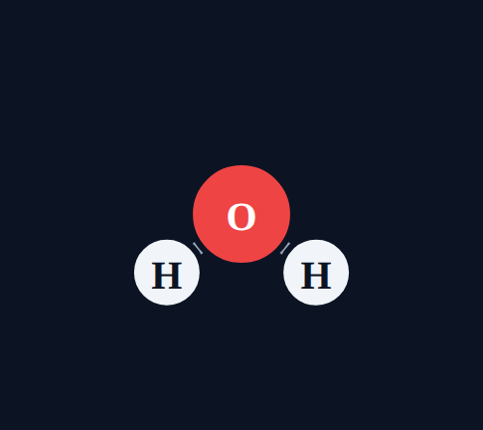
Reading a chemical formula
Read
Each capital letter starts a new element symbol: in NaCl, Na and Cl.
A small low number after a symbol is a subscript. It counts the atoms of the element right before it.
No subscript means 1 atom. H₂O = 2 H + 1 O.
H₂O: 2 hydrogen, 1 oxygen
Notes:
Point out the shape: water is bent. Each white ball is H, red is O.

Slide 6
How many elements?
Try it
How many different elements does each formula have?
O₂
NaCl
H₂O
?
?
?
N₂
C₆H₁₂O₆
CaCO₃
?
?
?
Notes:
Students sort these in the lesson.

Slide 7
How many elements?
Try it
Answer
How many different elements does each formula have?
O₂
NaCl
H₂O
1 element
2 elements
2 elements
N₂
C₆H₁₂O₆
CaCO₃
1 element
3 elements
3 elements
Notes:
Count capital letters. C₆H₁₂O₆ has 3 elements even though it has 24 atoms.

Slide 8
Quick check
Quick check
In the formula CO₂, what does the small 2 tell you?
A
There are 2 carbon atoms
B
There are 2 oxygen atoms
C
There are 2 molecules
D
The molecule has a charge of 2
Notes:
A puts the 2 on the wrong symbol. C describes a coefficient. D: subscripts are not charges.

Slide 9
Quick check
Quick check
Answer
In the formula CO₂, what does the small 2 tell you?
A
There are 2 carbon atoms
B
There are 2 oxygen atoms
C
There are 2 molecules
D
The molecule has a charge of 2
Why: A subscript counts the atom right before it, so the 2 belongs to oxygen.
Notes:
A puts the 2 on the wrong symbol. C describes a coefficient. D: subscripts are not charges.

Slide 10
Subscripts
Section 2 of 9 · about 5 min
In this section
To unlock the next section
Read
Subscripts count atoms
Count the atoms in 3 formulas
Try it
Atom counter
Answer the quick check correctly
Quick check
Atoms in CH₄
Notes:
Section 2 takes about 5 minutes.

Slide 11
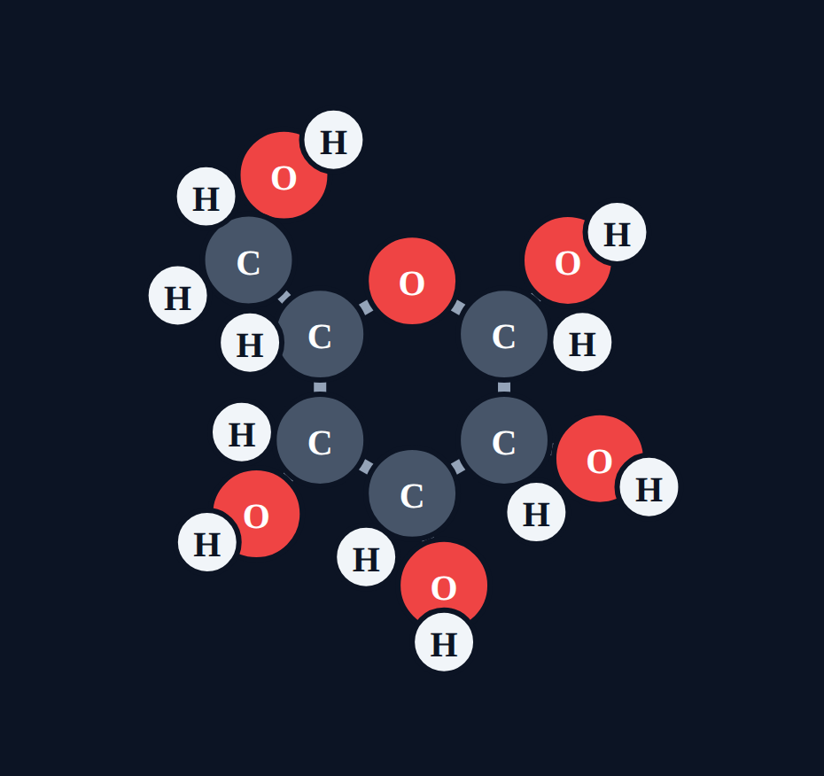
Subscripts count atoms
Read
Read a formula one element at a time. Each subscript tells how many atoms of that element are in ONE molecule. Glucose, C₆H₁₂O₆: 6 C + 12 H + 6 O = 24 atoms.
Notes:
Glucose drawn as its ring: 5 C and 1 O in the ring, with OH and H groups around it.

Slide 12
Atom counter
Try it
Count the atoms of each element.
NH₃
Nitrogen (N)
?
Hydrogen (H)
?
Total atoms
?
Notes:
NH₃ is a pyramid: nitrogen on top, three hydrogens below.

Slide 13
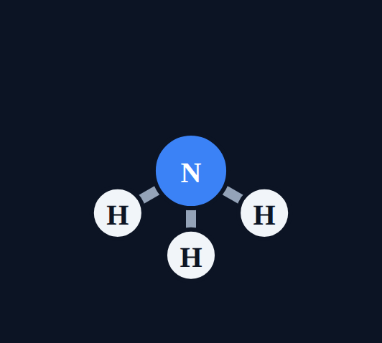
Atom counter
Try it
Answer
Count the atoms of each element.
NH₃
Nitrogen (N)
1
Hydrogen (H)
3
Total atoms
4
The 3 belongs to H. N has no subscript, so it is 1.
Notes:
NH₃ is a pyramid: nitrogen on top, three hydrogens below.

Slide 14
Atom counter
Try it
Count the atoms of each element.
CO₂
Carbon (C)
?
Oxygen (O)
?
Total atoms
?
Notes:
CO₂ is a straight line: O, C, O.

Slide 15

Atom counter
Try it
Answer
Count the atoms of each element.
CO₂
Carbon (C)
1
Oxygen (O)
2
Total atoms
3
C has no subscript; the 2 belongs to O.
Notes:
CO₂ is a straight line: O, C, O.

Slide 16
Quick check
Quick check
How many atoms in total are in one molecule of CH₄?
A
4
B
5
C
1
D
6
Notes:
A forgets the carbon. C counts only carbon. D adds an atom that is not there.

Slide 17
Quick check
Quick check
Answer
How many atoms in total are in one molecule of CH₄?
A
4
B
5
C
1
D
6
Why: 1 carbon + 4 hydrogen = 5 atoms.
Notes:
A forgets the carbon. C counts only carbon. D adds an atom that is not there.

Slide 18
Coefficients
Section 3 of 9 · about 4 min
In this section
To unlock the next section
Read
Coefficients count molecules
Count the atoms in 3 formulas
Try it
Atom counter
Answer the quick check correctly
Quick check
Hydrogen in 5H₂O
Notes:
Section 3 takes about 4 minutes.

Slide 19
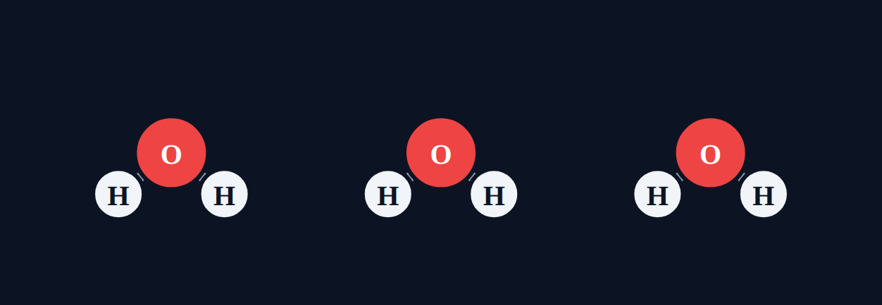
Coefficients count molecules
Read
A big number in front is a coefficient. It counts molecules. Multiply it by every subscript.
3H₂O: H = 3 × 2 = 6, O = 3 × 1 = 3.
Notes:
Three separate molecules: that is what the 3 means.

Slide 20
Atom counter
Try it
Count the atoms of each element.
2CO₂
Carbon (C)
?
Oxygen (O)
?
Notes:
Common mistake: forgetting to multiply the oxygen.

Slide 21

Atom counter
Try it
Answer
Count the atoms of each element.
2CO₂
Carbon (C)
2
Oxygen (O)
4
Multiply: C = 2 × 1 = 2, O = 2 × 2 = 4.
Notes:
Common mistake: forgetting to multiply the oxygen.

Slide 22
Atom counter
Try it
Count the atoms of each element.
4NH₃
Nitrogen (N)
?
Hydrogen (H)
?
Notes:
Four pyramids, each with 1 N and 3 H.

Slide 23
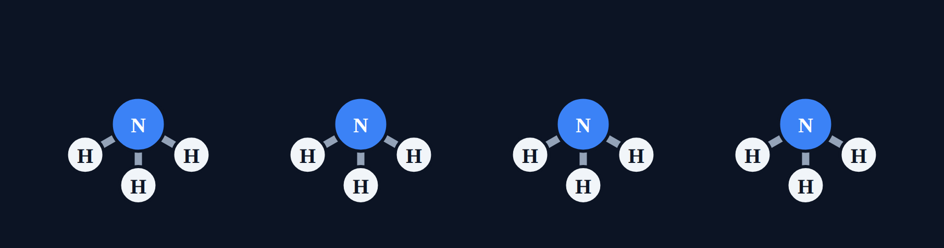
Atom counter
Try it
Answer
Count the atoms of each element.
4NH₃
Nitrogen (N)
4
Hydrogen (H)
12
N = 4 × 1 = 4, H = 4 × 3 = 12.
Notes:
Four pyramids, each with 1 N and 3 H.

Slide 24
Quick check
Quick check
How many hydrogen atoms are in 5H₂O?
A
2
B
7
C
10
D
5
Notes:
A ignores the coefficient. B adds instead of multiplying. D ignores the subscript.

Slide 25
Quick check
Quick check
Answer
How many hydrogen atoms are in 5H₂O?
A
2
B
7
C
10
D
5
Why: 5 molecules × 2 hydrogen each = 10.
Notes:
A ignores the coefficient. B adds instead of multiplying. D ignores the subscript.

Slide 26
Parentheses
Section 4 of 9 · about 5 min
In this section
To unlock the next section
Read
Subscripts outside parentheses
Count the atoms in 3 formulas
Try it
Atom counter
Answer the quick check correctly
Quick check
Oxygen in Ca(NO₃)₂
Notes:
Section 4 takes about 5 minutes.

Slide 27
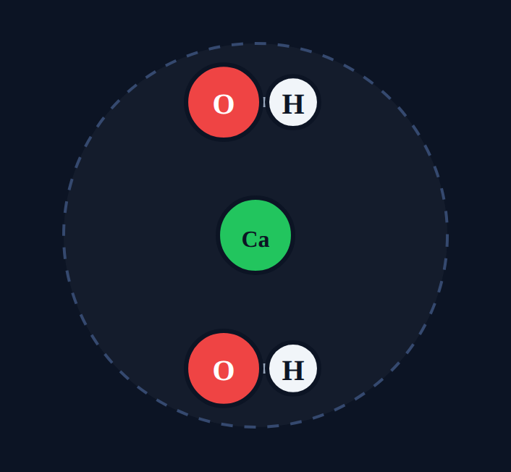
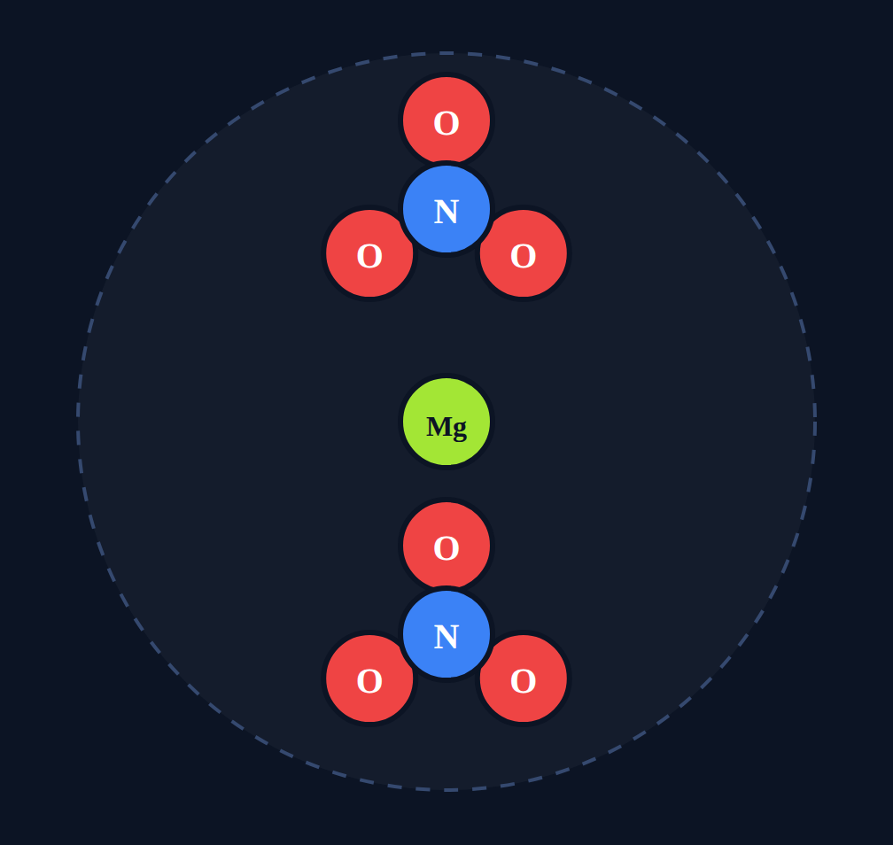
Subscripts outside parentheses
Read
A subscript outside parentheses multiplies everything inside.
Ca(OH)₂: Ca 1, O 2, H 2.
Mg(NO₃)₂: Mg 1, N 2, O 6.
Ca(OH)₂
Mg(NO₃)₂
Notes:
The dashed circle shows one unit of an ionic compound: the metal ion surrounded by its groups. Nitrate (NO₃) is a flat triangle.

Slide 28
Atom counter
Try it
Count the atoms of each element.
Mg(NO₃)₂
Magnesium (Mg)
?
Nitrogen (N)
?
Oxygen (O)
?
Notes:
Most common mistake: 3 oxygen (forgetting the outside 2).

Slide 29
Atom counter
Try it
Answer
Count the atoms of each element.
Mg(NO₃)₂
Magnesium (Mg)
1
Nitrogen (N)
2
Oxygen (O)
6
Inside: 1 N and 3 O. Multiply both by 2.
Notes:
Most common mistake: 3 oxygen (forgetting the outside 2).

Slide 30
Atom counter
Try it
Count the atoms of each element.
Al₂(SO₄)₃
Aluminum (Al)
?
Sulfur (S)
?
Oxygen (O)
?
Notes:
Students sometimes multiply the Al by 3 too. The 3 only multiplies what is inside the parentheses.

Slide 31
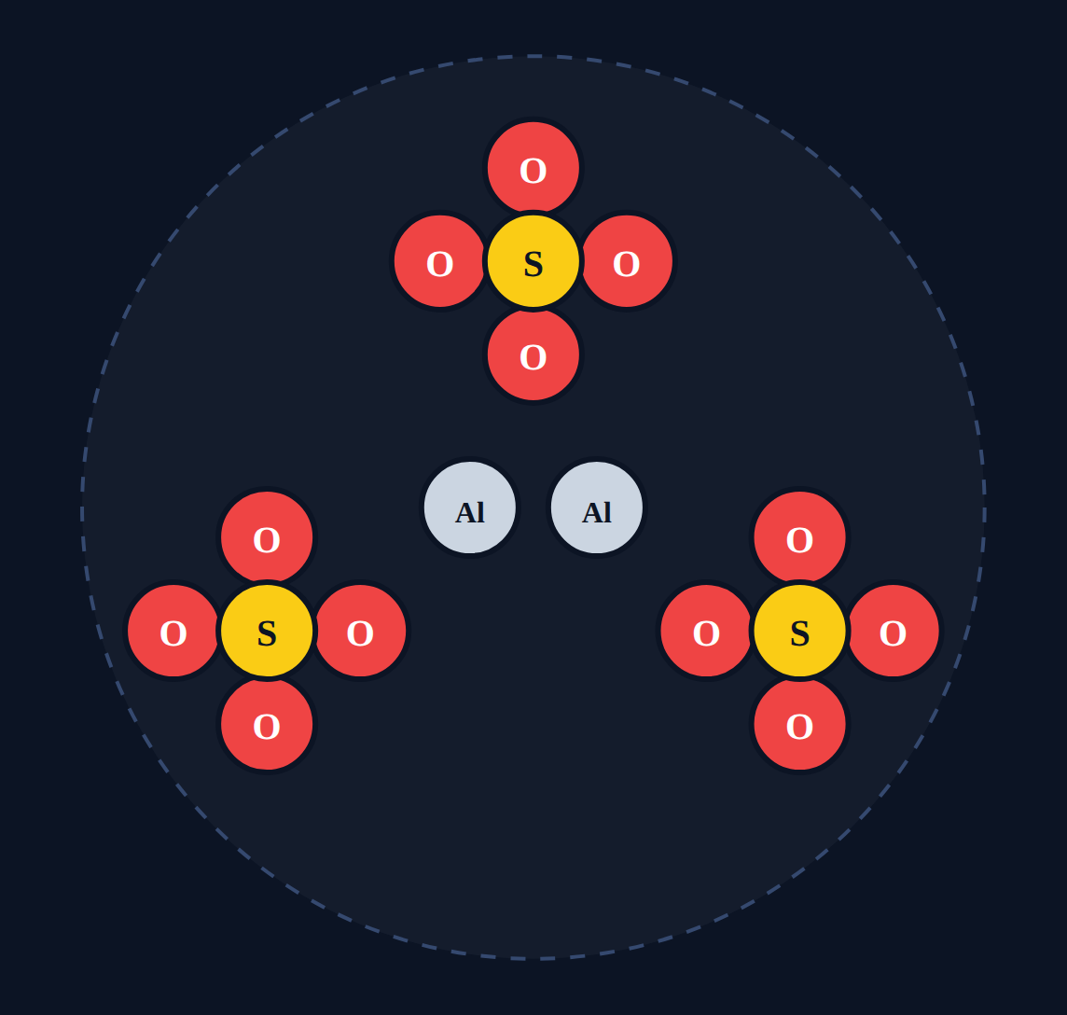
Atom counter
Try it
Answer
Count the atoms of each element.
Al₂(SO₄)₃
Aluminum (Al)
2
Sulfur (S)
3
Oxygen (O)
12
Al has its own subscript 2. Inside: 1 S and 4 O, each × 3.
Notes:
Students sometimes multiply the Al by 3 too. The 3 only multiplies what is inside the parentheses.

Slide 32
Quick check
Quick check
How many oxygen atoms are in Ca(NO₃)₂?
A
3
B
5
C
6
D
2
Notes:
A forgets the outside 2. B adds 3 + 2. D counts only the outside subscript.

Slide 33
Quick check
Quick check
Answer
How many oxygen atoms are in Ca(NO₃)₂?
A
3
B
5
C
6
D
2
Why: Each NO₃ has 3 O, and there are 2 of them: 3 × 2 = 6.
Notes:
A forgets the outside 2. B adds 3 + 2. D counts only the outside subscript.

Slide 34
Putting it all together
Section 5 of 9 · about 4 min
In this section
To unlock the next section
Read
Coefficient × parentheses × subscript
Count the atoms in 3 formulas
Try it
Atom counter
Answer the quick check correctly
Quick check
Hydrogen in 3(NH₄)₂SO₄
Notes:
Section 5 takes about 4 minutes.

Slide 35
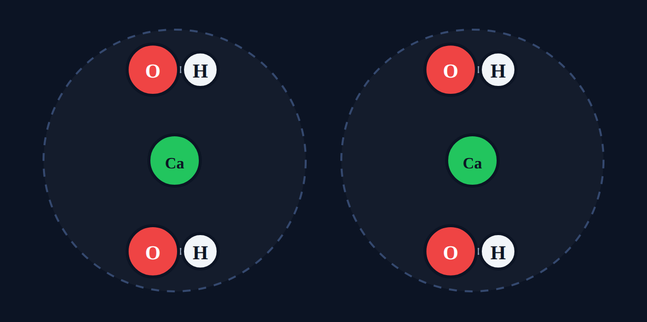
Coefficient × parentheses × subscript
Read
Count one unit first, then multiply by the coefficient. 2Ca(OH)₂: Ca 1 × 2 = 2, O 1 × 2 × 2 = 4, H 1 × 2 × 2 = 4.
Notes:
Two units of Ca(OH)₂.

Slide 36
Atom counter
Try it
Count the atoms of each element.
3Mg(NO₃)₂
Magnesium (Mg)
?
Nitrogen (N)
?
Oxygen (O)
?
Notes:
Encourage students to write the one-unit count first.

Slide 37
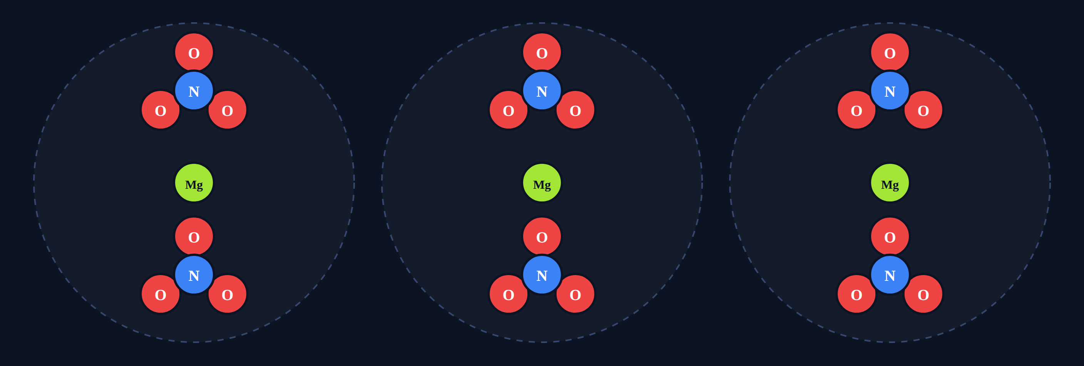
Atom counter
Try it
Answer
Count the atoms of each element.
3Mg(NO₃)₂
Magnesium (Mg)
3
Nitrogen (N)
6
Oxygen (O)
18
One Mg(NO₃)₂ has 1, 2, 6. Times 3: 3, 6, 18.
Notes:
Encourage students to write the one-unit count first.

Slide 38
Quick check
Quick check
How many hydrogen atoms are in 3(NH₄)₂SO₄?
A
8
B
12
C
24
D
4
Notes:
A forgets the coefficient. B multiplies only 4 × 3. D ignores both multipliers.

Slide 39
Quick check
Quick check
Answer
How many hydrogen atoms are in 3(NH₄)₂SO₄?
A
8
B
12
C
24
D
4
Why: One unit has 4 × 2 = 8 H. Three units: 8 × 3 = 24.
Notes:
A forgets the coefficient. B multiplies only 4 × 3. D ignores both multipliers.

Slide 40
Particle diagrams
Section 6 of 9 · about 4 min
In this section
To unlock the next section
Read
Drawings show molecules
Match 3 particle diagrams
Try it
Match the drawing
Answer the quick check correctly
Quick check
Four clusters
Notes:
Section 6 takes about 4 minutes.

Slide 41
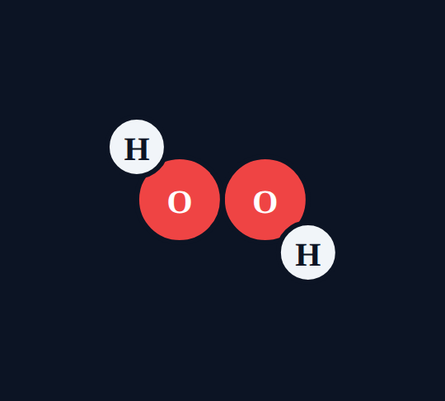
Drawings show molecules
Read
Separate clusters show the coefficient. The atoms inside one cluster show the subscripts.
2H₂O: two separate molecules
H₂O₂: one molecule, 4 atoms
Notes:
Same atoms (4 H, 2 O)? No: 2H₂O has 4 H and 2 O; H₂O₂ has 2 H and 2 O. Have students count.

Slide 42
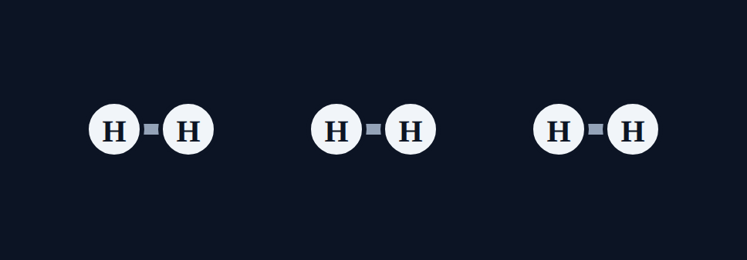
Match the drawing
Try it
CO₂
2CO₂
C₂O₄
H₆
3H₂
H₃
Notes:
Have students count clusters first, then atoms per cluster.

Slide 43
Match the drawing
Try it
Answer
CO₂
2CO₂
C₂O₄
H₆
3H₂
H₃
Notes:
C₂O₄ and H₆ would be ONE connected molecule. Separate clusters mean a coefficient.

Slide 44
Quick check
Quick check
A drawing shows 4 separate clusters, each made of 2 oxygen atoms. What is the formula?
A
O₈
B
4O₂
C
2O₄
D
4O
Notes:
A treats it as one molecule. C swaps the numbers. D forgets the subscript.

Slide 45
Quick check
Quick check
Answer
A drawing shows 4 separate clusters, each made of 2 oxygen atoms. What is the formula?
A
O₈
B
4O₂
C
2O₄
D
4O
Why: 4 separate molecules (coefficient 4), each with 2 O (subscript 2).
Notes:
A treats it as one molecule. C swaps the numbers. D forgets the subscript.

Slide 46
Counting both sides
Section 7 of 9 · about 5 min
In this section
To unlock the next section
Read
Reactants and products
Count both sides of 2 equations
Try it
Count both sides
Answer the quick check correctly
Phenomenon
Back to the phenomenon
Quick check
Why both sides match
Notes:
Section 7 takes about 5 minutes.

Slide 47
Reactants and products
Read
Reactants (left) → products (right). Count each formula on a side, then add. A balanced equation has the same number of each atom on both sides: atoms are rearranged, never created or destroyed (conservation of mass).
+
→
Notes:
Count with the class: 4 H and 2 O on each side.

Slide 48
Count both sides
Try it
CH₄ + 2O₂ → CO₂ + 2H₂O
Element
Reactants
Products
C
?
?
H
?
?
O
?
?
Is it balanced?
Notes:
Have students fill in the table on paper before revealing.

Slide 49
Count both sides
Try it
Answer
CH₄ + 2O₂ → CO₂ + 2H₂O
Element
Reactants
Products
C
1
1
H
4
4
O
4
4
Balanced: every element matches.
Notes:
O on the right: CO₂ has 2, 2H₂O has 2, total 4. Students often forget to add both products.

Slide 50
Back to the phenomenon
Phenomenon
Answer
Answer: C. The same atoms are rearranged.
Left: 2H₂ = 4 H, O₂ = 2 O. Right: 2H₂O = 4 H and 2 O. The numbers match: atoms are never created or destroyed in a reaction.
Notes:
This is the law of conservation of mass, which we use to balance equations next.

Slide 51
Quick check
Quick check
Why must both sides of a balanced equation have the same number of each atom?
A
Atoms are not created or destroyed in a reaction
B
The arrow means "equals"
C
Reactions always make more atoms
D
Products are always heavier
Notes:
B: the arrow means "makes." C and D contradict conservation of mass.

Slide 52
Quick check
Quick check
Answer
Why must both sides of a balanced equation have the same number of each atom?
A
Atoms are not created or destroyed in a reaction
B
The arrow means "equals"
C
Reactions always make more atoms
D
Products are always heavier
Why: That is the law of conservation of mass: atoms only rearrange.
Notes:
B: the arrow means "makes." C and D contradict conservation of mass.

Slide 53
Spot the mistake
Section 8 of 9 · about 3 min
In this section
To unlock the next section
Read
Check the work
Find the mistake in 3 student examples
Try it
Spot the mistake
Answer the quick check correctly
Quick check
Correct count
Notes:
Section 8 takes about 3 minutes.

Slide 54
Spot the mistake
Try it
Each student example has one mistake. Find it.
1. A student says CO₂ has 2 carbon atoms.
What is wrong?
2. A student says 3H₂O has 2 hydrogen atoms.
What is wrong?
3. A student says Ca(OH)₂ has 1 O and 2 H.
What is wrong?
Notes:
Let groups discuss before revealing.

Slide 55
Spot the mistake
Try it
Answer
Each student example has one mistake. Find it.
1. A student says CO₂ has 2 carbon atoms.
Fix: The 2 belongs to oxygen: 1 C and 2 O.
2. A student says 3H₂O has 2 hydrogen atoms.
Fix: Multiply by the coefficient: 3 × 2 = 6 H.
3. A student says Ca(OH)₂ has 1 O and 2 H.
Fix: The 2 outside the parentheses doubles both: 2 O and 2 H.
Notes:
Subscript placement, coefficients, parentheses: the three most common counting errors.

Slide 56
Quick check
Quick check
Which count is correct for 2Al₂O₃?
A
Al 2, O 3
B
Al 4, O 6
C
Al 2, O 6
D
Al 4, O 3
Notes:
A ignores the coefficient. C and D multiply only one element.

Slide 57
Quick check
Quick check
Answer
Which count is correct for 2Al₂O₃?
A
Al 2, O 3
B
Al 4, O 6
C
Al 2, O 6
D
Al 4, O 3
Why: One Al₂O₃ has 2 Al and 3 O. Times 2: 4 Al and 6 O.
Notes:
A ignores the coefficient. C and D multiply only one element.

Slide 58
Final check
Section 9 of 9 · about 6 min
In this section
To unlock the next section
Read
Ten questions on the Chromebook
Score 8 or more out of 10
Try it
Multiple choice, two-part, select all
Notes:
The final check is done in the lesson on the Chromebook.

Slide 59
Wrap-up: counting atoms
1
2
3
4
Subscript: counts the atom right before it
Coefficient: multiplies the whole formula
Parentheses: outside number multiplies everything inside
Both sides of a balanced equation match
Next: worksheet practice.
Notes:
Have students count 3Mg(NO₃)₂ out loud: Mg 3, N 6, O 18.

