Slide 1
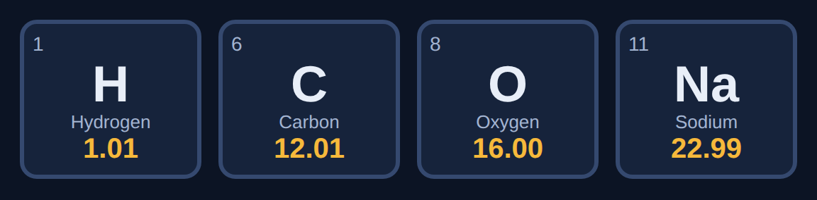
Molar Mass
Chemistry · Unit 3: Chemical Reactions · about 40 minutes
Notes:
Counting particles by weighing them.

Slide 2
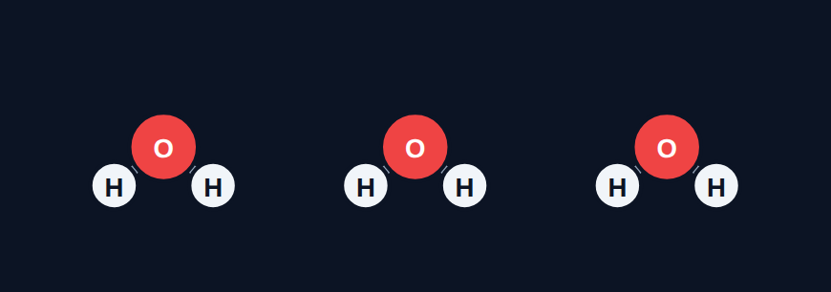
How many molecules in a drop?
Phenomenon
A single drop of water holds about 1.7 × 10²¹ water molecules. How do chemists figure out how many particles they have?
A. Count them one at a time with a microscope
B. Weigh them and use a counting unit, like a "dozen" for atoms
We'll find out in Section 7.
C. It is impossible to know
D. Every substance has the same number of particles per gram
Notes:
Answer (B) revealed in Section 7.

Slide 3









How the lesson works
Counting by the mole
Atomic mass on the periodic table
Molar mass of a compound
about 4 min
about 4 min
about 5 min
Parentheses and bigger formulas
Same count, different mass
Grams ↔ moles
about 5 min
about 4 min
about 5 min
Mass is conserved in equations
Spot the mistake
Final check
about 4 min
about 3 min
about 6 min
Notes:
Nine short sections, about 40 minutes.

Slide 4
Counting by the mole
Section 1 of 9 · about 4 min
In this section
To unlock the next section
Phenomenon
How many molecules in a drop?
Make a prediction
Read
The mole is a counting unit
Sort the counting units
Try it
How many is that?
Answer the quick check correctly
Quick check
Molecules in a mole
Notes:
Section 1 takes about 4 minutes.

Slide 5
The mole is a counting unit
Read
A pair is 2. A dozen is 12. A ream is 500.
A mole is 6.02 × 10²³, called Avogadro's number.
One mole of anything has 6.02 × 10²³ particles. Atoms are so tiny it takes this many to make an amount you can hold.
Notes:
A mole of pennies would cover the Earth many times over.

Slide 6
How many is that?
Try it
How many does each counting unit stand for?
1 pair
?
1 dozen
?
1 ream
?
1 mole
?
Notes:
Students sort these in the lesson.

Slide 7
How many is that?
Try it
Answer
How many does each counting unit stand for?
1 pair
2
1 dozen
12
1 ream
500
1 mole
6.02 × 10²³
Notes:
The mole is just a much bigger counting unit.

Slide 8
Quick check
Quick check
How many molecules are in 1 mole of water?
A
18
B
6.02 × 10²³
C
1
D
12
Notes:
A confuses the molar mass with the count.

Slide 9
Quick check
Quick check
Answer
How many molecules are in 1 mole of water?
A
18
B
6.02 × 10²³
C
1
D
12
Why: One mole of anything is 6.02 × 10²³ particles.
Notes:
A confuses the molar mass with the count.

Slide 10
Atomic mass on the periodic table
Section 2 of 9 · about 4 min
In this section
To unlock the next section
Read
Read it off the periodic table
Answer 3 rounds
Try it
Read the tile
Answer the quick check correctly
Quick check
Magnesium
Notes:
Section 2 takes about 4 minutes.

Slide 11
Read it off the periodic table
Read
The atomic mass (the decimal number) is the molar mass of an element in g/mol. Carbon: 12.01 g/mol. Don't use the atomic number (the whole number).
Notes:
Point to each tile: atomic number top left, atomic mass at the bottom.

Slide 12
Read the tile
Try it
What is the molar mass?
Sodium (11, Na, 22.99)
?
Iron (26, Fe, 55.85)
?
Oxygen atoms (8, O, 16.00)
?
Notes:
Use the decimal number.

Slide 13
Read the tile
Try it
Answer
What is the molar mass?
Sodium (11, Na, 22.99)
22.99 g/mol
Iron (26, Fe, 55.85)
55.85 g/mol
Oxygen atoms (8, O, 16.00)
16.00 g/mol
Notes:
11, 26, and 8 are atomic numbers, not masses.

Slide 14
Quick check
Quick check
Magnesium's tile shows 12 and 24.31. What is the molar mass of magnesium?
A
12 g/mol
B
24.31 g/mol
C
36.31 g/mol
D
6.02 × 10²³ g/mol
Notes:
A is the atomic number; C adds them.

Slide 15
Quick check
Quick check
Answer
Magnesium's tile shows 12 and 24.31. What is the molar mass of magnesium?
A
12 g/mol
B
24.31 g/mol
C
36.31 g/mol
D
6.02 × 10²³ g/mol
Why: The decimal number is the atomic mass.
Notes:
A is the atomic number; C adds them.

Slide 16
Molar mass of a compound
Section 3 of 9 · about 5 min
In this section
To unlock the next section
Read
Add up the atoms
Find the molar mass of 3 compounds
Try it
Molar mass calculator
Answer the quick check correctly
Quick check
Molar mass of O₂
Notes:
Section 3 takes about 5 minutes.

Slide 17
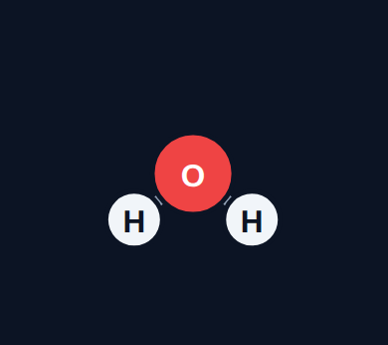
Add up the atoms
Read
For each element: number of atoms × atomic mass. Then add the subtotals.
Element
Atoms
× Atomic mass
= Subtotal
H
2
× 1.01
= 2.02
O
1
× 16.00
= 16.00
Molar mass
18.02 g/mol
Notes:
1 mol of H₂O has a mass of 18.02 g.

Slide 18
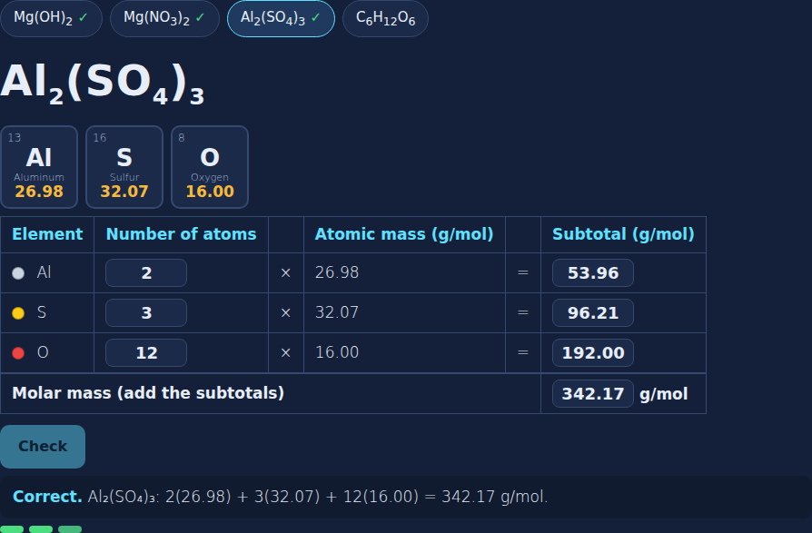
The molar mass calculator
Try it
Notes:
In the lesson, students fill in atoms, subtotals, and the total; hints point to the exact mistake.

Slide 19
Molar mass calculator
Try it
Find each molar mass.
CO₂
?
NaCl
?
NH₃
?
Notes:
Have students work these on paper first.

Slide 20
Molar mass calculator
Try it
Answer
Find each molar mass.
CO₂
12.01 + 2(16.00) = 44.01 g/mol
NaCl
22.99 + 35.45 = 58.44 g/mol
NH₃
14.01 + 3(1.01) = 17.04 g/mol
Notes:
Count atoms carefully, then multiply.

Slide 21
Quick check
Quick check
What is the molar mass of O₂?
A
16.00 g/mol
B
32.00 g/mol
C
8.00 g/mol
D
6.02 g/mol
Notes:
A forgets the subscript; C uses the atomic number.

Slide 22
Quick check
Quick check
Answer
What is the molar mass of O₂?
A
16.00 g/mol
B
32.00 g/mol
C
8.00 g/mol
D
6.02 g/mol
Why: 2 × 16.00 = 32.00.
Notes:
A forgets the subscript; C uses the atomic number.

Slide 23
Parentheses and bigger formulas
Section 4 of 9 · about 5 min
In this section
To unlock the next section
Read
Use what you know about counting atoms
Find the molar mass of 3 compounds
Try it
Molar mass calculator
Answer the quick check correctly
Quick check
Oxygen in Ca(NO₃)₂
Notes:
Section 4 takes about 5 minutes.

Slide 24
Parentheses multiply everything inside
Read
Count atoms like before: the 2 in Ca(OH)₂ doubles both O and H.
Element
Atoms
× Atomic mass
= Subtotal
Ca
1
× 40.08
= 40.08
O
2
× 16.00
= 32.00
H
2
× 1.01
= 2.02
Molar mass
74.10 g/mol
Notes:
Most common mistake: 1 O and 1 H.

Slide 25
Molar mass calculator
Try it
Find each molar mass.
Mg(OH)₂
?
Mg(NO₃)₂
?
Al₂(SO₄)₃
?
Notes:
Count atoms first.

Slide 26
Molar mass calculator
Try it
Answer
Find each molar mass.
Mg(OH)₂
24.31 + 2(16.00) + 2(1.01) = 58.33 g/mol
Mg(NO₃)₂
24.31 + 2(14.01) + 6(16.00) = 148.33 g/mol
Al₂(SO₄)₃
2(26.98) + 3(32.07) + 12(16.00) = 342.17 g/mol
Notes:
Parentheses multiply everything inside.

Slide 27
Quick check
Quick check
How many oxygen atoms do you count when finding the molar mass of Ca(NO₃)₂?
A
3
B
6
C
2
D
5
Notes:
A forgets the outside 2; D adds.

Slide 28
Quick check
Quick check
Answer
How many oxygen atoms do you count when finding the molar mass of Ca(NO₃)₂?
A
3
B
6
C
2
D
5
Why: 3 inside × 2 = 6.
Notes:
A forgets the outside 2; D adds.

Slide 29
Same count, different mass
Section 5 of 9 · about 4 min
In this section
To unlock the next section
Read
Same count, different mass
Answer 3 rounds
Try it
Compare the moles
Answer the quick check correctly
Quick check
NaCl vs. water
Notes:
Section 5 takes about 4 minutes.

Slide 30
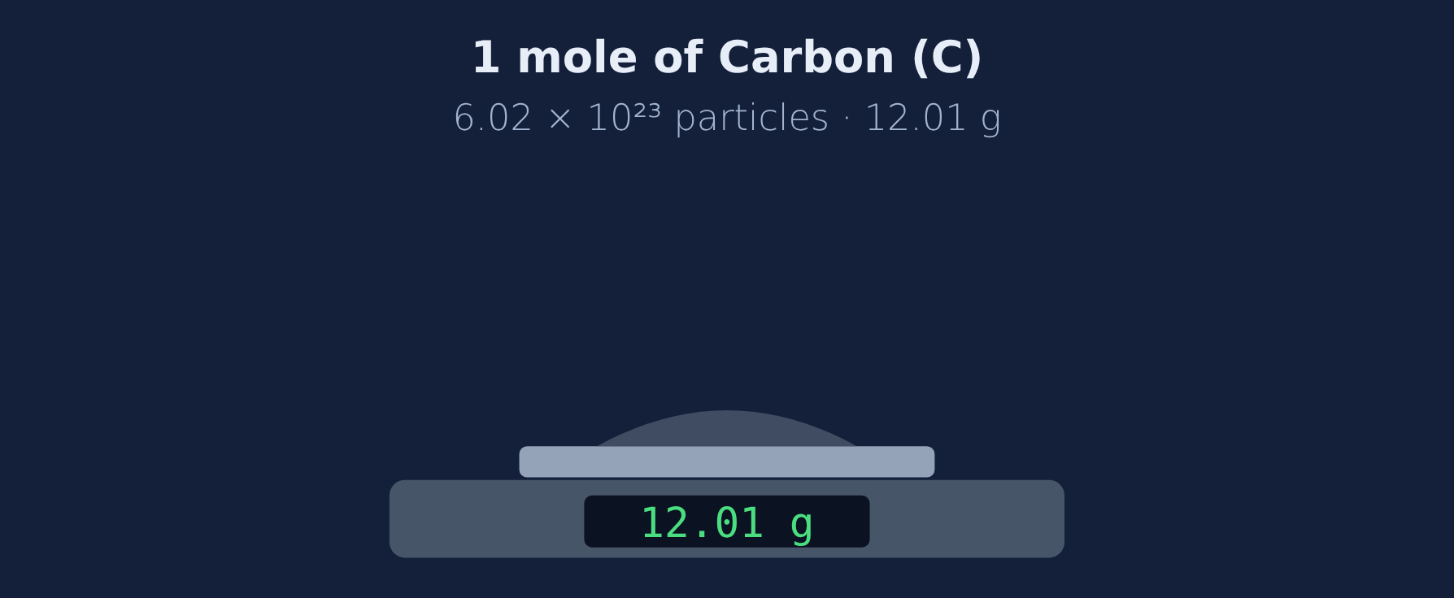
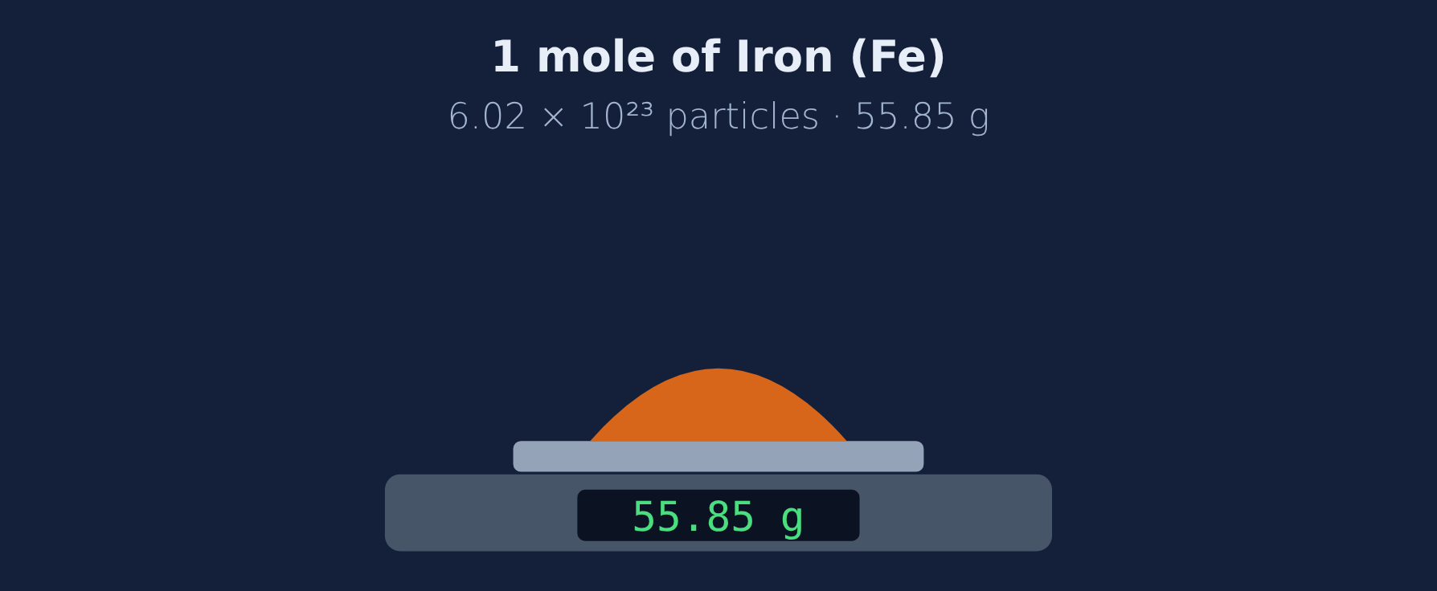
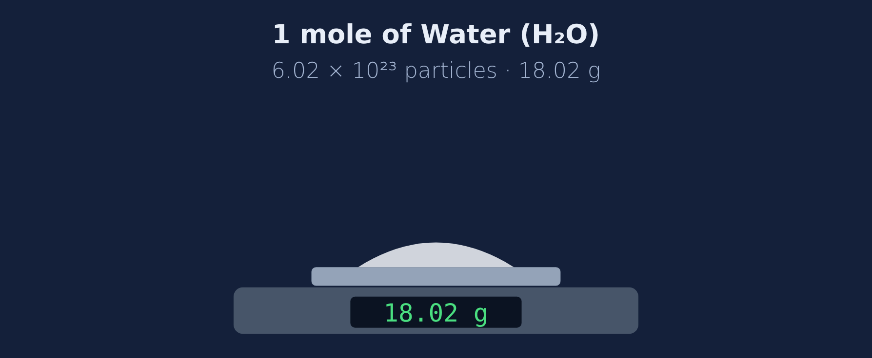
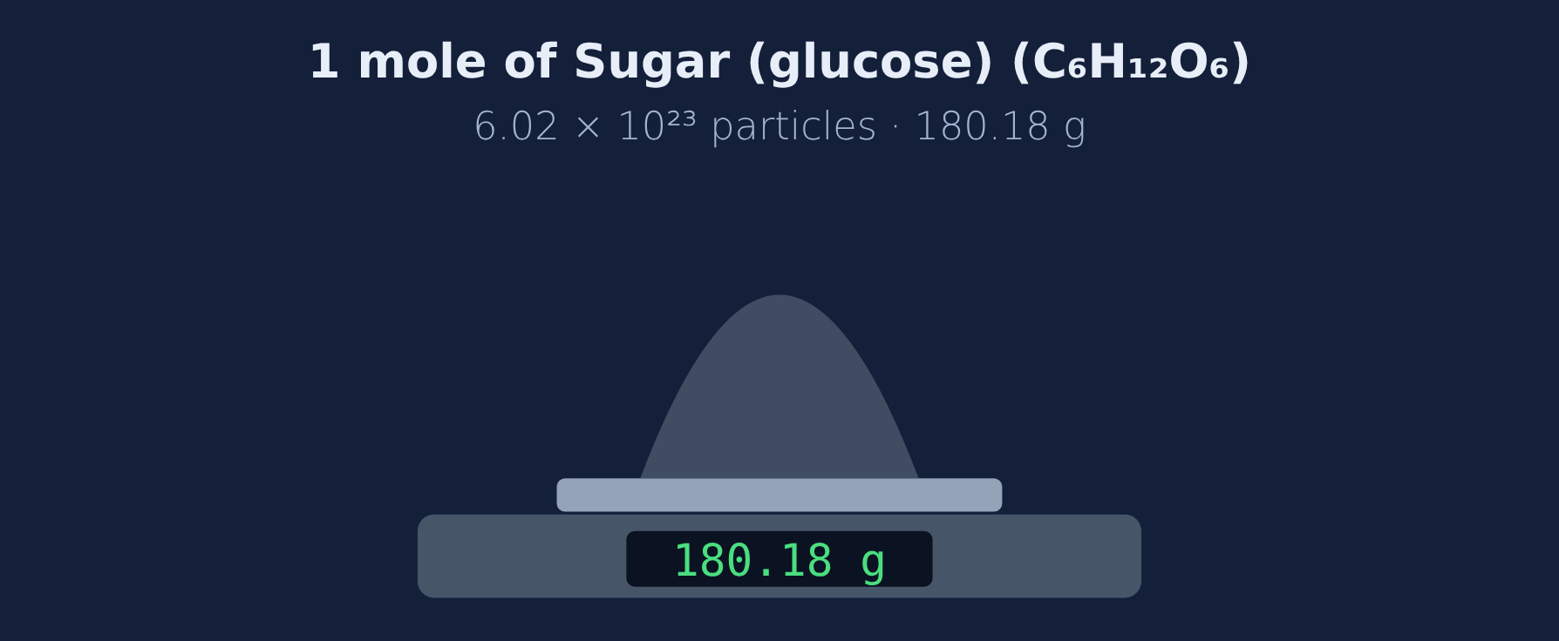
Same count, different mass
Read
One mole always has 6.02 × 10²³ particles, but different particles have different masses. A dozen eggs vs. a dozen watermelons: same count, different weight.
Notes:
In the lesson students put 1 mole of each sample on the scale.

Slide 31
Compare the moles
Try it
Answer each one.
More mass: 1 mol Fe or 1 mol Al?
?
More particles: 1 mol water or 1 mol sugar?
?
Why is 1 mol of sugar heavier than 1 mol of water?
?
Notes:
Have students vote first.

Slide 32
Compare the moles
Try it
Answer
Answer each one.
More mass: 1 mol Fe or 1 mol Al?
1 mol Fe (55.85 g vs 26.98 g)
More particles: 1 mol water or 1 mol sugar?
The same: 6.02 × 10²³ each
Why is 1 mol of sugar heavier than 1 mol of water?
Each sugar molecule is heavier
Notes:
Count stays the same; mass changes.

Slide 33
Quick check
Quick check
1 mol of NaCl and 1 mol of H₂O are compared. Which is true?
A
They have the same mass
B
They have the same number of particles but different masses
C
NaCl has more particles
D
Water has more particles
Notes:
A mole fixes the count, not the mass.

Slide 34
Quick check
Quick check
Answer
1 mol of NaCl and 1 mol of H₂O are compared. Which is true?
A
They have the same mass
B
They have the same number of particles but different masses
C
NaCl has more particles
D
Water has more particles
Why: Same count, different masses.
Notes:
A mole fixes the count, not the mass.

Slide 35
Grams ↔ moles
Section 6 of 9 · about 5 min
In this section
To unlock the next section
Read
The mole map
Solve 3 conversion problems
Try it
Convert
Answer the quick check correctly
Quick check
Grams to moles
Notes:
Section 6 takes about 5 minutes.

Slide 36

The mole map
Read
Grams → moles: 36.04 g H₂O ÷ 18.02 g/mol = 2.00 mol
Moles → grams: 3.00 mol H₂O × 18.02 g/mol = 54.06 g
Check: more grams than the molar mass → more than 1 mole.
Notes:
Look at the units: g ÷ g/mol = mol.

Slide 37
Convert
Try it
Solve each one.
Moles in 88.02 g of CO₂ (44.01 g/mol)?
?
Mass of 0.50 mol NaCl (58.44 g/mol)?
?
Moles in 9.01 g of H₂O (18.02 g/mol)?
?
Notes:
Decide multiply or divide first.

Slide 38
Convert
Try it
Answer
Solve each one.
Moles in 88.02 g of CO₂ (44.01 g/mol)?
88.02 ÷ 44.01 = 2.00 mol
Mass of 0.50 mol NaCl (58.44 g/mol)?
0.50 × 58.44 = 29.22 g
Moles in 9.01 g of H₂O (18.02 g/mol)?
9.01 ÷ 18.02 = 0.50 mol
Notes:
Grams → moles divide; moles → grams multiply.

Slide 39
Quick check
Quick check
To change grams into moles, you…
A
multiply by the molar mass
B
divide by the molar mass
C
add the molar mass
D
multiply by 6.02 × 10²³
Notes:
A goes the wrong direction.

Slide 40
Quick check
Quick check
Answer
To change grams into moles, you…
A
multiply by the molar mass
B
divide by the molar mass
C
add the molar mass
D
multiply by 6.02 × 10²³
Why: g ÷ g/mol = mol.
Notes:
A goes the wrong direction.

Slide 41
Mass is conserved in equations
Section 7 of 9 · about 4 min
In this section
To unlock the next section
Read
Masses balance too
Solve 2 problems
Try it
Check conservation
Answer the quick check correctly
Phenomenon
Back to the phenomenon
Quick check
Why masses match
Notes:
Section 7 takes about 4 minutes.

Slide 42
Masses balance too
Read
Coefficients are moles. Multiply each by its molar mass. 2H₂ + O₂ → 2H₂O: 2(2.02) + 32.00 = 36.04 g → 2(18.02) = 36.04 g ✓
Notes:
Atoms are conserved, so mass is conserved.

Slide 43
Check conservation
Try it
Find the total mass.
CH₄ + 2O₂ → CO₂ + 2H₂O: reactants?
?
2Na + Cl₂ → 2NaCl: products?
?
Notes:
Multiply by coefficients.

Slide 44
Check conservation
Try it
Answer
Find the total mass.
CH₄ + 2O₂ → CO₂ + 2H₂O: reactants?
16.05 + 2(32.00) = 80.05 g (products are also 80.05 g)
2Na + Cl₂ → 2NaCl: products?
2 × 58.44 = 116.88 g
Notes:
Both sides always match.

Slide 45
Back to the phenomenon
Phenomenon
Answer
Answer: B. Chemists count particles by weighing them.
A drop of water (0.05 g) ÷ 18.02 g/mol ≈ 0.0028 mol ≈ 1.7 × 10²¹ molecules.
Notes:
The mole connects what we weigh to how many particles there are.

Slide 46
Quick check
Quick check
Why does the total mass of reactants equal the total mass of products?
A
Atoms are conserved in reactions
B
Products are always lighter
C
Coefficients are always 1
D
Gas has no mass
Notes:
D: gases do have mass.

Slide 47
Quick check
Quick check
Answer
Why does the total mass of reactants equal the total mass of products?
A
Atoms are conserved in reactions
B
Products are always lighter
C
Coefficients are always 1
D
Gas has no mass
Why: Same atoms on both sides.
Notes:
D: gases do have mass.

Slide 48
Spot the mistake
Section 8 of 9 · about 3 min
In this section
To unlock the next section
Read
Check the work
Find the mistake in 3 student examples
Try it
Spot the mistake
Answer the quick check correctly
Quick check
Molar mass of CO₂
Notes:
Section 8 takes about 3 minutes.

Slide 49
Spot the mistake
Try it
Each student example has one mistake. Find it.
"H₂O = 1.01 + 16.00 = 17.01 g/mol"
?
"Mg(OH)₂ = 24.31 + 16.00 + 1.01 = 41.32"
?
"36.04 g × 18.02 = 649 mol"
?
Notes:
Let groups discuss before revealing.

Slide 50
Spot the mistake
Try it
Answer
Each student example has one mistake. Find it.
"H₂O = 1.01 + 16.00 = 17.01 g/mol"
H has 2 atoms: 18.02 g/mol
"Mg(OH)₂ = 24.31 + 16.00 + 1.01 = 41.32"
The 2 doubles O and H: 58.33 g/mol
"36.04 g × 18.02 = 649 mol"
Divide: 36.04 ÷ 18.02 = 2.00 mol
Notes:
Subscripts, parentheses, and multiply vs. divide.

Slide 51
Quick check
Quick check
Which molar mass is correct for CO₂?
A
28.01 g/mol
B
44.01 g/mol
C
22.00 g/mol
D
6.02 g/mol
Notes:
A forgets the second O.

Slide 52
Quick check
Quick check
Answer
Which molar mass is correct for CO₂?
A
28.01 g/mol
B
44.01 g/mol
C
22.00 g/mol
D
6.02 g/mol
Why: 12.01 + 2(16.00).
Notes:
A forgets the second O.

Slide 53
Final check
Section 9 of 9 · about 6 min
In this section
To unlock the next section
Read
Ten questions on the Chromebook
Score 8 or more out of 10
Try it
Multiple choice, two-part, select all
Notes:
The final check is done in the lesson on the Chromebook.

Slide 54
Wrap-up: molar mass
1
2
3
4
A mole is 6.02 × 10²³ particles
Molar mass = atomic masses added up (g/mol)
Grams ÷ molar mass = moles
Moles × molar mass = grams
Notes:
Next: worksheet practice.

