Slide 1
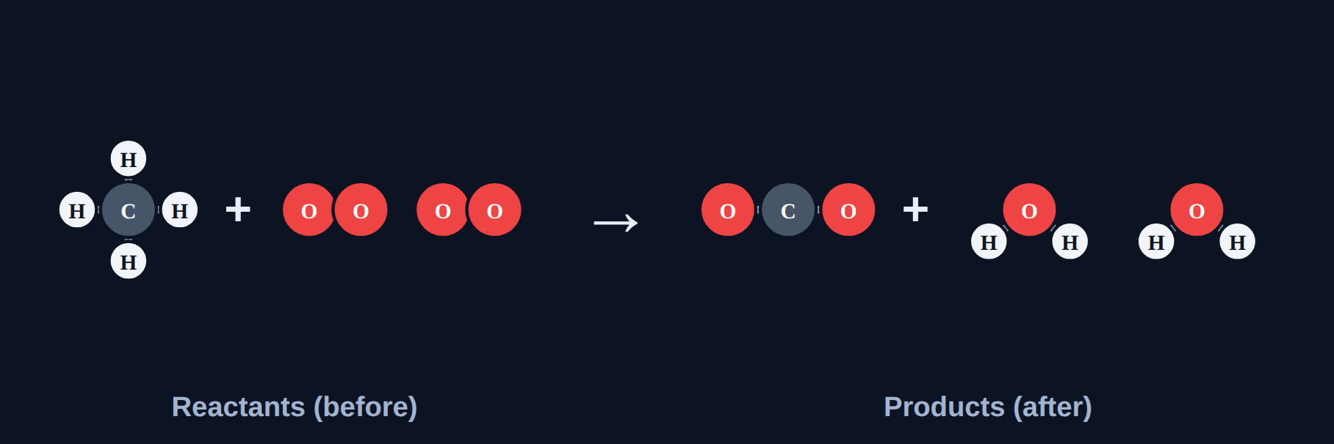
Types of Reactions
Chemistry · Unit 3: Chemical Reactions · about 40 minutes
Notes:
Five patterns of rearranging atoms. The title shows methane burning.

Slide 2
Five everyday reactions
Phenomenon
Iron rusting
4Fe + 3O₂ → 2Fe₂O₃
Are they all the same kind of reaction? Predict: A) all the same, B) each a different pattern, C) not reactions, D) differ only in color.
Water splitting
2H₂O → 2H₂ + O₂
Zinc in acid
Zn + 2HCl → ZnCl₂ + H₂
Two clear solutions make a solid
AgNO₃ + NaCl → AgCl + NaNO₃
A gas stove flame
CH₄ + 2O₂ → CO₂ + 2H₂O
We'll find out in Section 7.
Notes:
Answer (B) revealed in Section 7.

Slide 3









How the lesson works
Reactions follow patterns
Synthesis
Decomposition
about 4 min
about 4 min
about 4 min
Single replacement
Double replacement
Combustion
about 5 min
about 5 min
about 4 min
Classify them all
Spot the mistake
Final check
about 5 min
about 3 min
about 6 min
Notes:
Nine short sections, about 40 minutes.

Slide 4
Reactions follow patterns
Section 1 of 9 · about 4 min
In this section
To unlock the next section
Phenomenon
Five everyday reactions
Make a prediction
Read
Reactions follow patterns
Sort the equations
Try it
Count the substances
Answer the quick check correctly
Quick check
Trading partners
Notes:
Section 1 takes about 4 minutes.

Slide 5
Reactions follow patterns
Read
Synthesis
A + B → AB
two things combine into one
Decomposition
AB → A + B
one thing breaks apart
Single replacement
A + BC → AC + B
one element swaps in
Double replacement
AB + CD → AD + CB
two compounds trade partners
Combustion
fuel + O₂ → CO₂ + H₂O
something burns in oxygen
Notes:
Quick clue: count substances. Many → 1 suggests synthesis; 1 → many suggests decomposition.

Slide 6
Count the substances
Try it
Many → 1 or 1 → many?
2Mg + O₂ → 2MgO
?
CaCO₃ → CaO + CO₂
?
2Na + Cl₂ → 2NaCl
?
2H₂O₂ → 2H₂O + O₂
?
Notes:
Students sort these in the lesson.

Slide 7
Count the substances
Try it
Answer
Many → 1 or 1 → many?
2Mg + O₂ → 2MgO
Many → 1
CaCO₃ → CaO + CO₂
1 → many
2Na + Cl₂ → 2NaCl
Many → 1
2H₂O₂ → 2H₂O + O₂
1 → many
Notes:
Coefficients don't change the number of substances.

Slide 8
Quick check
Quick check
Which general pattern shows two compounds trading partners?
A
A + B → AB
B
AB → A + B
C
A + BC → AC + B
D
AB + CD → AD + CB
Notes:
A is synthesis, B decomposition, C single replacement.

Slide 9
Quick check
Quick check
Answer
Which general pattern shows two compounds trading partners?
A
A + B → AB
B
AB → A + B
C
A + BC → AC + B
D
AB + CD → AD + CB
Why: In double replacement, A and C trade partners.
Notes:
A is synthesis, B decomposition, C single replacement.

Slide 10
Synthesis
Section 2 of 9 · about 4 min
In this section
To unlock the next section
Read
Two (or more) combine into one
Watch the reaction
Try it
Synthesis or not?
Answer 3 rounds
Quick check
Quick check
Answer the quick check correctly
Notes:
Section 2 takes about 4 minutes.

Slide 11
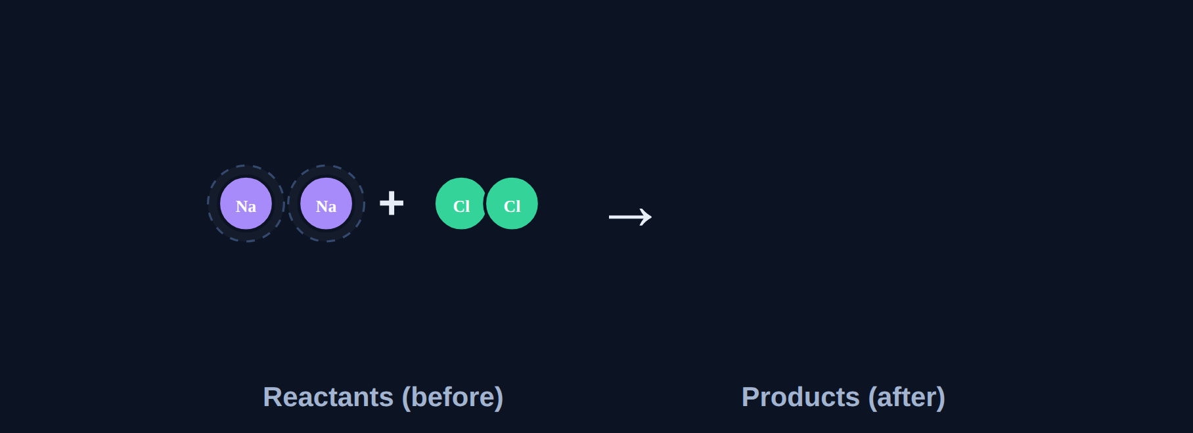
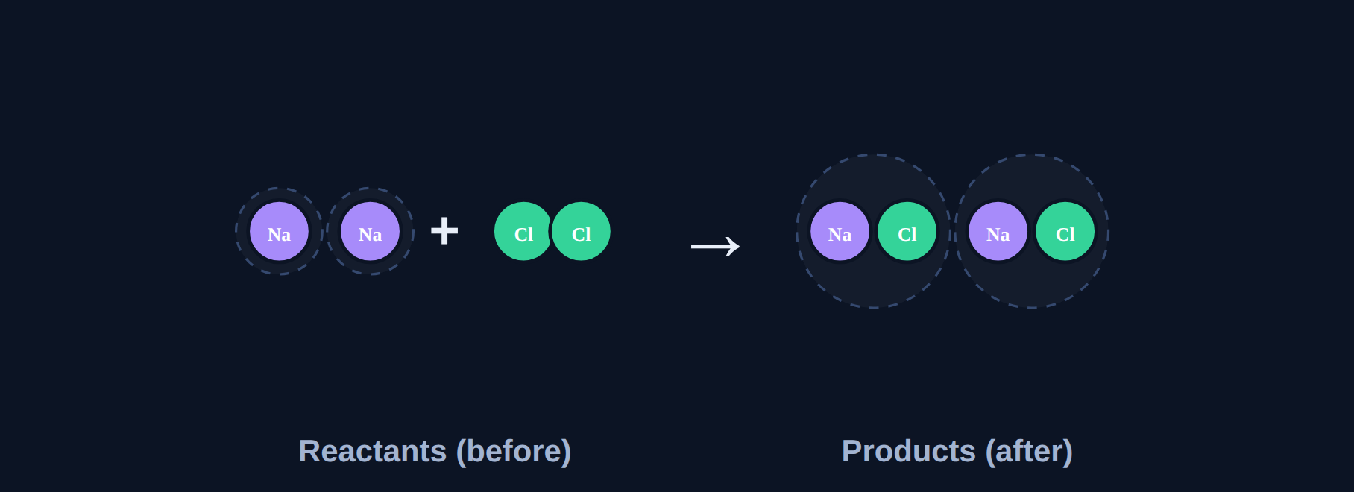
Two (or more) combine into one
Read
In synthesis, two or more reactants combine into ONE product: A + B → AB. Example: 2Na + Cl₂ → 2NaCl. Rusting is synthesis too.
Before the reaction
After: atoms rearranged
Notes:
In the lesson students press play and watch copies of the atoms fly from the reactants to build the products. The reactants stay on screen.

Slide 12
Synthesis or not?
Try it
Answer each one.
2H₂ + O₂ → 2H₂O
?
2KClO₃ → 2KCl + 3O₂
?
2Mg + O₂ → 2MgO
?
Notes:
Have students answer on whiteboards before revealing.

Slide 13
Synthesis or not?
Try it
Answer
Answer each one.
2H₂ + O₂ → 2H₂O
Synthesis
2KClO₃ → 2KCl + 3O₂
Not synthesis (one reactant breaks apart)
2Mg + O₂ → 2MgO
Synthesis
Notes:
Check that each metal ends up paired with a nonmetal part.

Slide 14
Quick check
Quick check
Which equation is a synthesis reaction?
A
CaCO₃ → CaO + CO₂
B
N₂ + 3H₂ → 2NH₃
C
CH₄ + 2O₂ → CO₂ + 2H₂O
D
Zn + CuCl₂ → ZnCl₂ + Cu
Notes:
A is decomposition, C combustion, D single replacement.

Slide 15
Quick check
Quick check
Answer
Which equation is a synthesis reaction?
A
CaCO₃ → CaO + CO₂
B
N₂ + 3H₂ → 2NH₃
C
CH₄ + 2O₂ → CO₂ + 2H₂O
D
Zn + CuCl₂ → ZnCl₂ + Cu
Why: N₂ and H₂ combine into one product.
Notes:
A is decomposition, C combustion, D single replacement.

Slide 16
Decomposition
Section 3 of 9 · about 4 min
In this section
To unlock the next section
Read
One breaks into two (or more)
Watch the reaction
Try it
Decomposition or not?
Answer 3 rounds
Quick check
Quick check
Answer the quick check correctly
Notes:
Section 3 takes about 4 minutes.

Slide 17
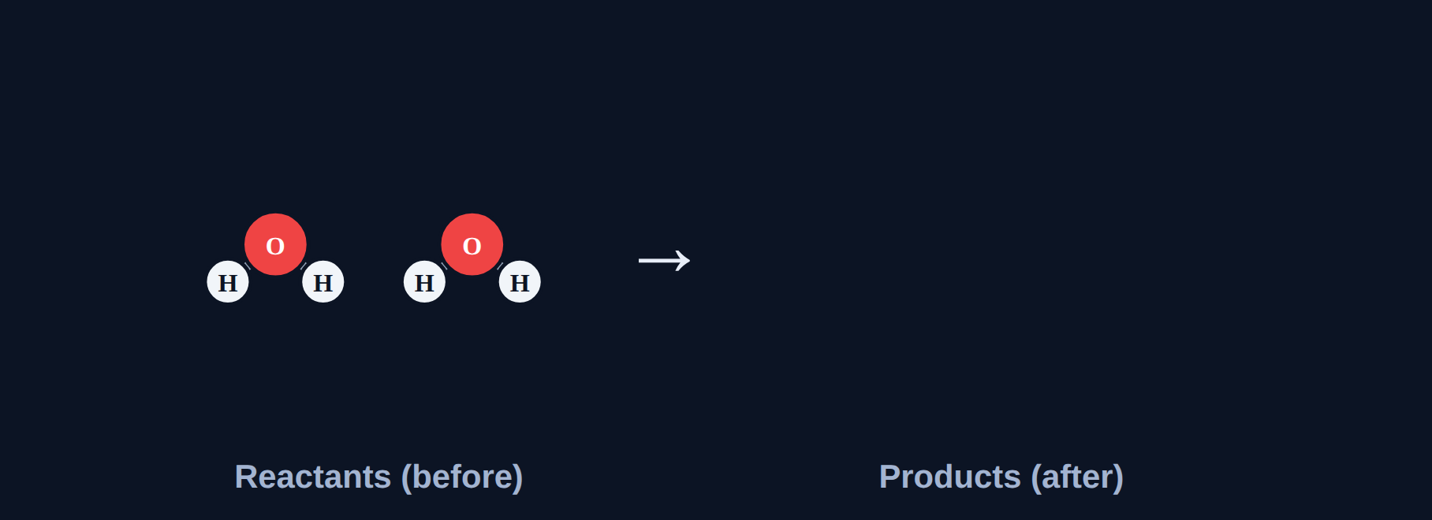
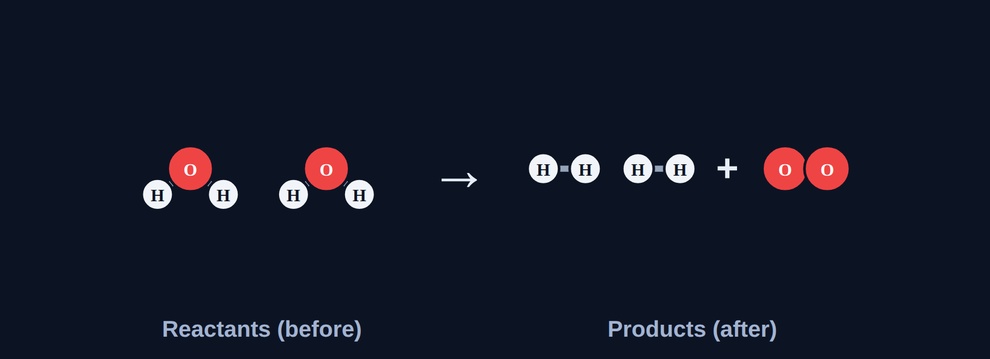
One breaks into two (or more)
Read
In decomposition, ONE reactant breaks into two or more products: AB → A + B. It is the reverse of synthesis. Example: 2H₂O → 2H₂ + O₂.
Before the reaction
After: atoms rearranged
Notes:
In the lesson students press play and watch copies of the atoms fly from the reactants to build the products. The reactants stay on screen.

Slide 18
Decomposition or not?
Try it
Answer each one.
CaCO₃ → CaO + CO₂
?
2Na + Cl₂ → 2NaCl
?
2HgO → 2Hg + O₂
?
Notes:
Have students answer on whiteboards before revealing.

Slide 19
Decomposition or not?
Try it
Answer
Answer each one.
CaCO₃ → CaO + CO₂
Decomposition
2Na + Cl₂ → 2NaCl
Not decomposition (synthesis)
2HgO → 2Hg + O₂
Decomposition
Notes:
Check that each metal ends up paired with a nonmetal part.

Slide 20
Quick check
Quick check
What is the general pattern for decomposition?
A
A + B → AB
B
AB → A + B
C
A + BC → AC + B
D
AB + CD → AD + CB
Notes:
A is synthesis, C single replacement, D double replacement.

Slide 21
Quick check
Quick check
Answer
What is the general pattern for decomposition?
A
A + B → AB
B
AB → A + B
C
A + BC → AC + B
D
AB + CD → AD + CB
Why: One compound breaks apart.
Notes:
A is synthesis, C single replacement, D double replacement.

Slide 22
Single replacement
Section 4 of 9 · about 5 min
In this section
To unlock the next section
Read
One element kicks another out
Watch the reaction
Try it
Predict the products
Answer 3 rounds
Quick check
Quick check
Answer the quick check correctly
Notes:
Section 4 takes about 5 minutes.

Slide 23
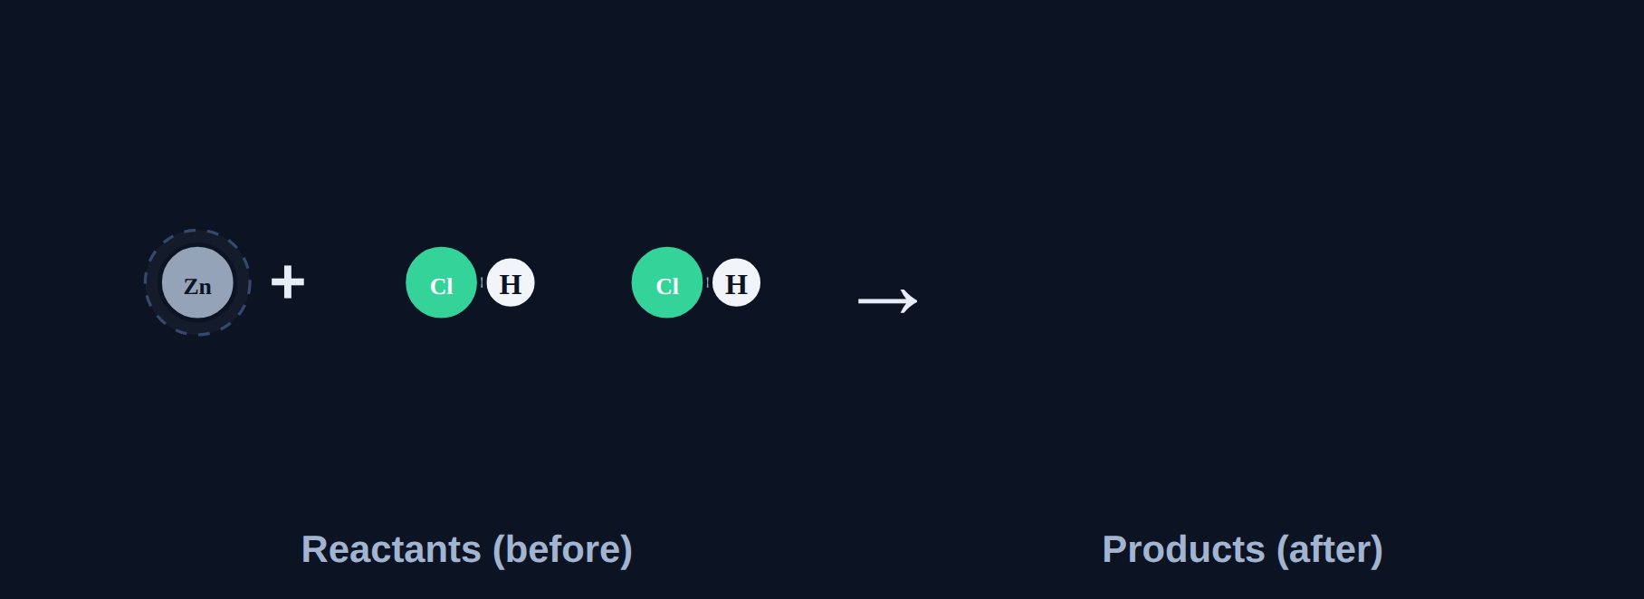
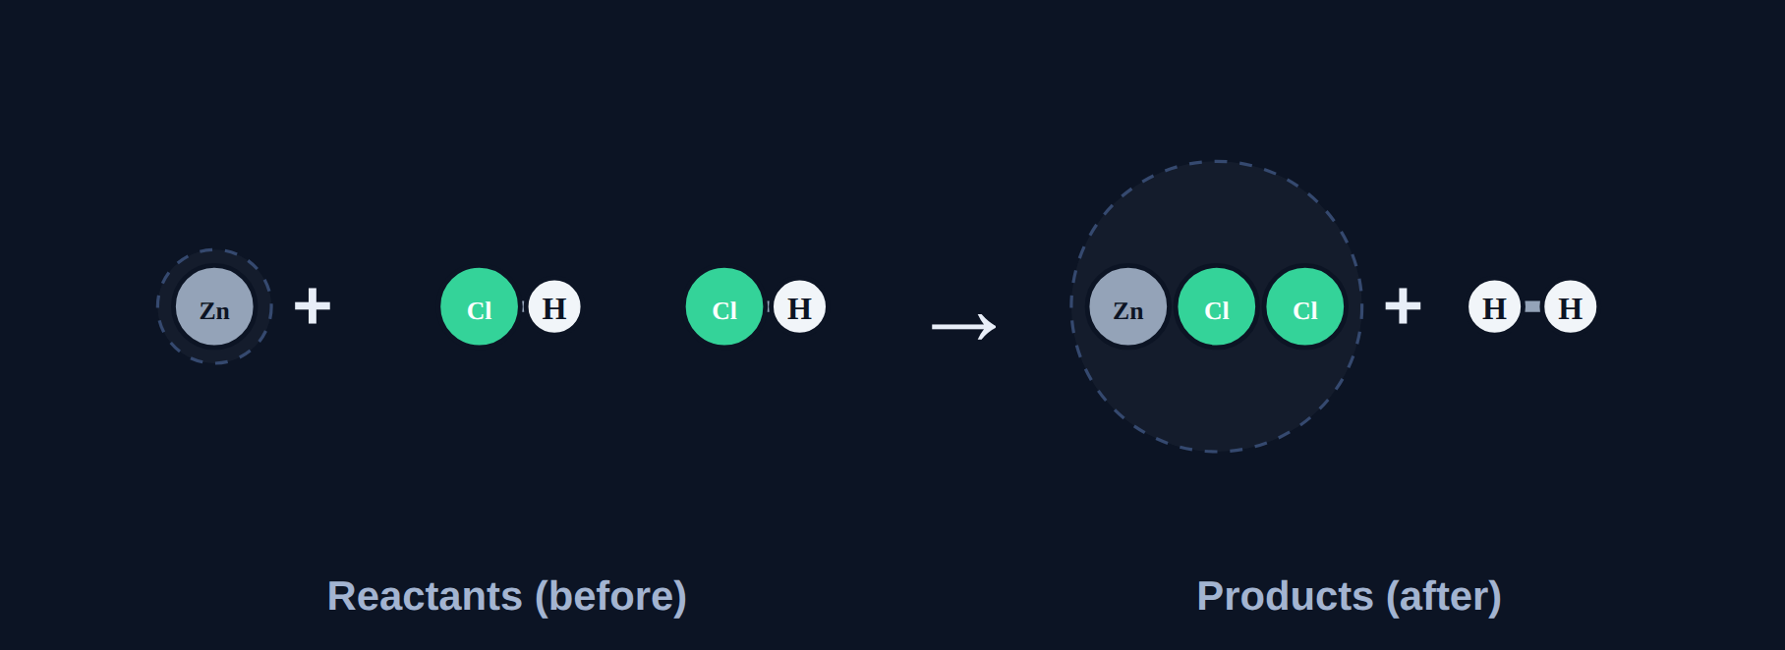
One element kicks another out
Read
In single replacement, a lone ELEMENT replaces another element in a compound: A + BC → AC + B. Metals replace metals (or H); nonmetals replace nonmetals. Example: Zn + 2HCl → ZnCl₂ + H₂.
Before the reaction
After: atoms rearranged
Notes:
In the lesson students press play and watch copies of the atoms fly from the reactants to build the products. The reactants stay on screen.

Slide 24
Predict the products
Try it
Predict the products.
Fe + CuSO₄ → ?
?
Mg + 2HCl → ?
?
Cl₂ + 2NaBr → ?
?
Notes:
Have students answer on whiteboards before revealing.

Slide 25
Predict the products
Try it
Answer
Predict the products.
Fe + CuSO₄ → ?
FeSO₄ + Cu
Mg + 2HCl → ?
MgCl₂ + H₂
Cl₂ + 2NaBr → ?
2NaCl + Br₂
Notes:
Check that each metal ends up paired with a nonmetal part.

Slide 26
Quick check
Quick check
Which equation is a single replacement reaction?
A
2H₂ + O₂ → 2H₂O
B
Fe + CuSO₄ → FeSO₄ + Cu
C
NaOH + HCl → NaCl + H₂O
D
2H₂O → 2H₂ + O₂
Notes:
Look for a lone element on BOTH sides. Only B has that.

Slide 27
Quick check
Quick check
Answer
Which equation is a single replacement reaction?
A
2H₂ + O₂ → 2H₂O
B
Fe + CuSO₄ → FeSO₄ + Cu
C
NaOH + HCl → NaCl + H₂O
D
2H₂O → 2H₂ + O₂
Why: Fe (a lone element) replaces Cu.
Notes:
Look for a lone element on BOTH sides. Only B has that.

Slide 28
Double replacement
Section 5 of 9 · about 5 min
In this section
To unlock the next section
Read
Two compounds trade partners
Watch the reaction
Try it
Predict the products
Answer 3 rounds
Quick check
Quick check
Answer the quick check correctly
Notes:
Section 5 takes about 5 minutes.

Slide 29
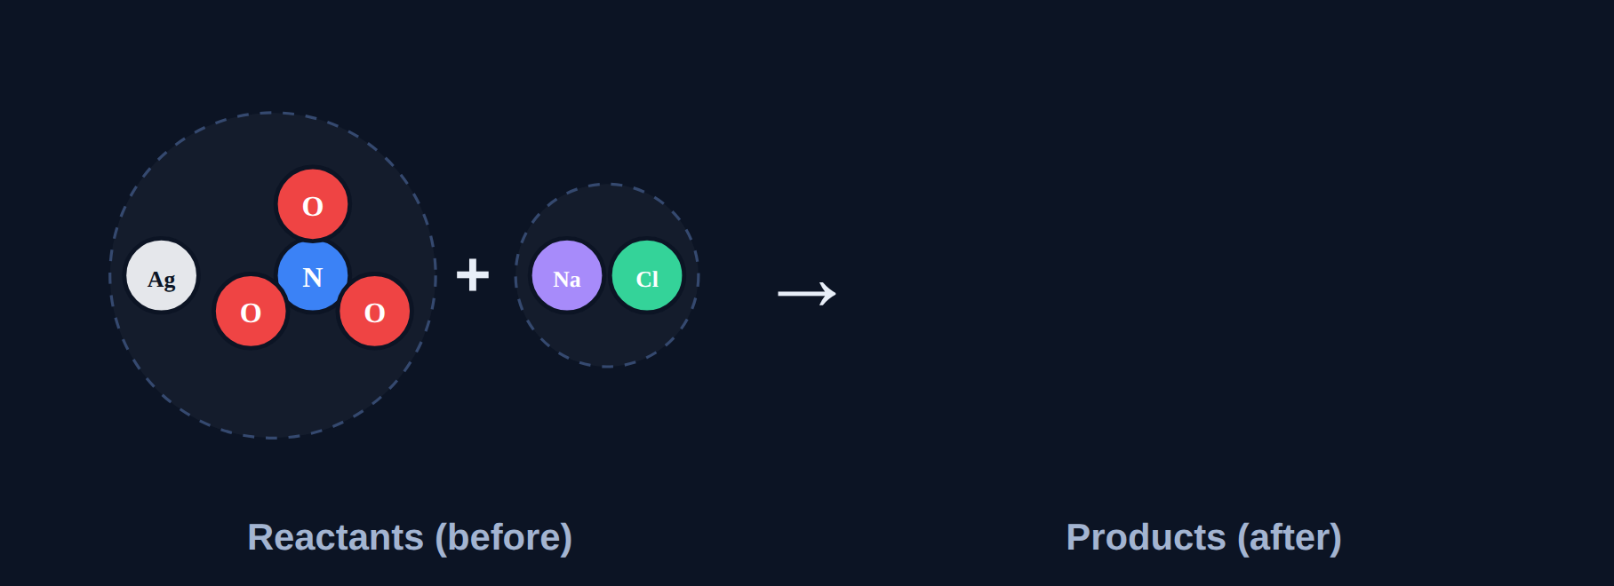
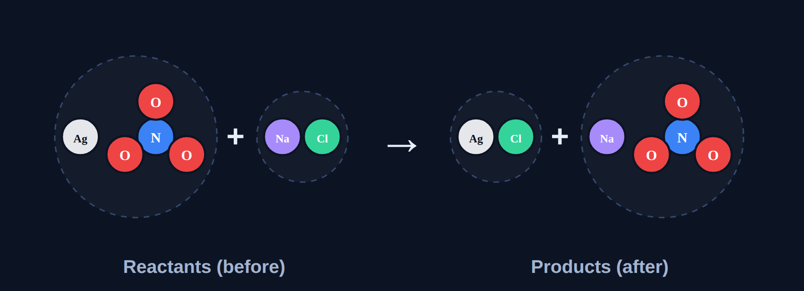
Two compounds trade partners
Read
In double replacement, two compounds trade partners: AB + CD → AD + CB. Often one product is a solid called a precipitate. Example: AgNO₃ + NaCl → AgCl + NaNO₃.
Before the reaction
After: atoms rearranged
Notes:
In the lesson students press play and watch copies of the atoms fly from the reactants to build the products. The reactants stay on screen.

Slide 30
Predict the products
Try it
Predict the products.
AgNO₃ + KCl → ?
?
NaOH + HCl → ?
?
Pb(NO₃)₂ + 2KI → ?
?
Notes:
Have students answer on whiteboards before revealing.

Slide 31
Predict the products
Try it
Answer
Predict the products.
AgNO₃ + KCl → ?
AgCl + KNO₃
NaOH + HCl → ?
NaCl + H₂O
Pb(NO₃)₂ + 2KI → ?
PbI₂ + 2KNO₃ (yellow precipitate)
Notes:
Check that each metal ends up paired with a nonmetal part.

Slide 32
Quick check
Quick check
In double replacement, what do the two compounds do?
A
Combine into one
B
Break apart into elements
C
Trade partners
D
Burn in oxygen
Notes:
A is synthesis, B decomposition, D combustion.

Slide 33
Quick check
Quick check
Answer
In double replacement, what do the two compounds do?
A
Combine into one
B
Break apart into elements
C
Trade partners
D
Burn in oxygen
Why: AB + CD → AD + CB.
Notes:
A is synthesis, B decomposition, D combustion.

Slide 34
Combustion
Section 6 of 9 · about 4 min
In this section
To unlock the next section
Read
Burning in oxygen
Watch the reaction
Try it
Combustion clues
Answer 3 rounds
Quick check
Quick check
Answer the quick check correctly
Notes:
Section 6 takes about 4 minutes.

Slide 35
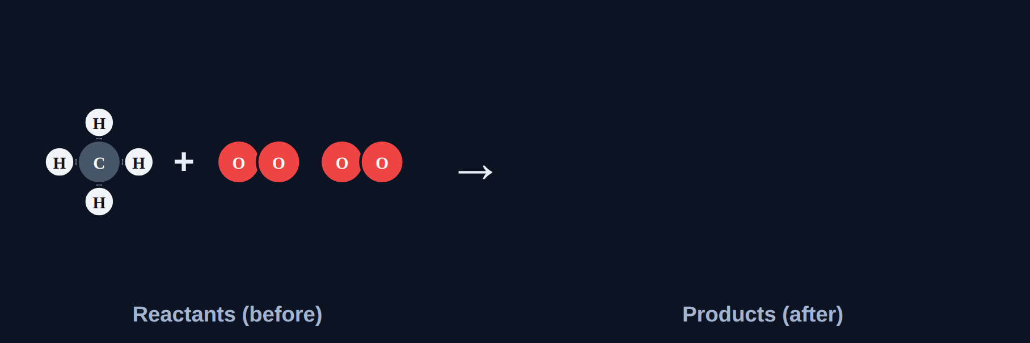
Burning in oxygen
Read
In combustion, a fuel burns in O₂, releasing heat and light. A hydrocarbon fuel always makes CO₂ and H₂O: fuel + O₂ → CO₂ + H₂O. Example: CH₄ + 2O₂ → CO₂ + 2H₂O.
Before the reaction
After: atoms rearranged
Notes:
In the lesson students press play and watch copies of the atoms fly from the reactants to build the products. The reactants stay on screen.

Slide 36
Combustion clues
Try it
Answer each one.
C₃H₈ + 5O₂ → 3CO₂ + 4H₂O: what type?
?
Which reactant must every combustion have?
?
Products when CH₄ burns completely?
?
Notes:
Have students answer on whiteboards before revealing.

Slide 37
Combustion clues
Try it
Answer
Answer each one.
C₃H₈ + 5O₂ → 3CO₂ + 4H₂O: what type?
Combustion
Which reactant must every combustion have?
O₂ (oxygen)
Products when CH₄ burns completely?
CO₂ + H₂O
Notes:
Check that each metal ends up paired with a nonmetal part.

Slide 38
Quick check
Quick check
Which equation is combustion?
A
2H₂O → 2H₂ + O₂
B
C₆H₁₂O₆ + 6O₂ → 6CO₂ + 6H₂O
C
Zn + 2HCl → ZnCl₂ + H₂
D
N₂ + 3H₂ → 2NH₃
Notes:
Look for O₂ in and CO₂ + H₂O out.

Slide 39
Quick check
Quick check
Answer
Which equation is combustion?
A
2H₂O → 2H₂ + O₂
B
C₆H₁₂O₆ + 6O₂ → 6CO₂ + 6H₂O
C
Zn + 2HCl → ZnCl₂ + H₂
D
N₂ + 3H₂ → 2NH₃
Why: Glucose + O₂ → CO₂ + H₂O (cellular respiration!).
Notes:
Look for O₂ in and CO₂ + H₂O out.

Slide 40
Classify them all
Section 7 of 9 · about 5 min
In this section
To unlock the next section
Read
Classify any reaction
Sort all 10 equations
Try it
Sort all 10
Answer the quick check correctly
Phenomenon
Back to the phenomenon
Quick check
Aluminum and copper
Notes:
Section 7 takes about 5 minutes.

Slide 41
Classify any reaction
Read
1
O₂ in, CO₂ + H₂O out? → combustion
2
Only one product? → synthesis
3
Only one reactant? → decomposition
4
A lone element on each side? → single replacement
5
Two compounds trading partners? → double replacement
Notes:
Check combustion first, since it can look like other types.

Slide 42
Sort all 10
Try it
4Fe + 3O₂ → 2Fe₂O₃
2H₂O → 2H₂ + O₂
?
?
Zn + 2HCl → ZnCl₂ + H₂
AgNO₃ + NaCl → AgCl + NaNO₃
?
?
CH₄ + 2O₂ → CO₂ + 2H₂O
N₂ + 3H₂ → 2NH₃
?
?
CaCO₃ → CaO + CO₂
Cl₂ + 2NaBr → 2NaCl + Br₂
?
?
Pb(NO₃)₂ + 2KI → PbI₂ + 2KNO₃
C₃H₈ + 5O₂ → 3CO₂ + 4H₂O
?
?
Notes:
Students sort these in the lesson; one check says all correct or something is wrong.

Slide 43
Sort all 10
Try it
Answer
4Fe + 3O₂ → 2Fe₂O₃
2H₂O → 2H₂ + O₂
Synthesis
Decomposition
Zn + 2HCl → ZnCl₂ + H₂
AgNO₃ + NaCl → AgCl + NaNO₃
Single replacement
Double replacement
CH₄ + 2O₂ → CO₂ + 2H₂O
N₂ + 3H₂ → 2NH₃
Combustion
Synthesis
CaCO₃ → CaO + CO₂
Cl₂ + 2NaBr → 2NaCl + Br₂
Decomposition
Single replacement
Pb(NO₃)₂ + 2KI → PbI₂ + 2KNO₃
C₃H₈ + 5O₂ → 3CO₂ + 4H₂O
Double replacement
Combustion
Notes:
Two of each type.

Slide 44
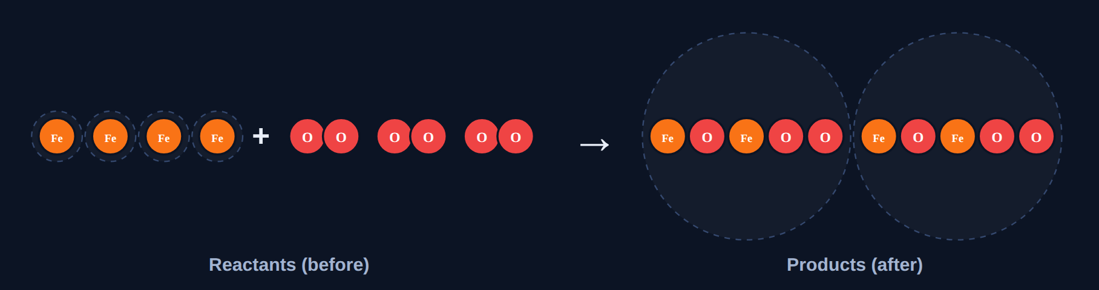
Back to the phenomenon
Phenomenon
Answer
Answer: B. Each reaction follows a different pattern.
Rusting: synthesis. Splitting water: decomposition. Zinc in acid: single replacement. Two solutions making a solid: double replacement. Gas stove: combustion.
Notes:
Atoms rearrange in all five, but in different ways.

Slide 45
Quick check
Quick check
2Al + 3CuCl₂ → 2AlCl₃ + 3Cu is…
A
synthesis
B
decomposition
C
single replacement
D
double replacement
Notes:
Two products rule out synthesis; two reactants rule out decomposition; only one compound per side rules out double replacement.

Slide 46
Quick check
Quick check
Answer
2Al + 3CuCl₂ → 2AlCl₃ + 3Cu is…
A
synthesis
B
decomposition
C
single replacement
D
double replacement
Why: A lone element (Al) replaces another (Cu).
Notes:
Two products rule out synthesis; two reactants rule out decomposition; only one compound per side rules out double replacement.

Slide 47
Spot the mistake
Section 8 of 9 · about 3 min
In this section
To unlock the next section
Read
Check the work
Find the mistake in 3 student examples
Try it
Spot the mistake
Answer the quick check correctly
Quick check
Correct classification
Notes:
Section 8 takes about 3 minutes.

Slide 48
Spot the mistake
Try it
Each student example has one mistake. Find it.
"2KClO₃ → 2KCl + 3O₂ is synthesis."
?
"Fe + CuSO₄ → FeCu + SO₄."
?
"CH₄ + 2O₂ → CO₂ + 2H₂O is synthesis."
?
Notes:
Let groups discuss before revealing.

Slide 49
Spot the mistake
Try it
Answer
Each student example has one mistake. Find it.
"2KClO₃ → 2KCl + 3O₂ is synthesis."
One reactant breaks apart: decomposition.
"Fe + CuSO₄ → FeCu + SO₄."
Iron replaces copper: FeSO₄ + Cu.
"CH₄ + 2O₂ → CO₂ + 2H₂O is synthesis."
A fuel burning in O₂ with two products is combustion.
Notes:
Count reactants and products, and check which parts pair up.

Slide 50
Quick check
Quick check
Which classification is correct?
A
2HgO → 2Hg + O₂ is synthesis
B
NaOH + HCl → NaCl + H₂O is double replacement
C
Mg + 2HCl → MgCl₂ + H₂ is decomposition
D
2H₂ + O₂ → 2H₂O is combustion of water
Notes:
A is decomposition. C is single replacement. D: water is the product, not the fuel.

Slide 51
Quick check
Quick check
Answer
Which classification is correct?
A
2HgO → 2Hg + O₂ is synthesis
B
NaOH + HCl → NaCl + H₂O is double replacement
C
Mg + 2HCl → MgCl₂ + H₂ is decomposition
D
2H₂ + O₂ → 2H₂O is combustion of water
Why: Na and H trade partners: double replacement.
Notes:
A is decomposition. C is single replacement. D: water is the product, not the fuel.

Slide 52
Final check
Section 9 of 9 · about 6 min
In this section
To unlock the next section
Read
Ten questions on the Chromebook
Score 8 or more out of 10
Try it
Multiple choice, two-part, select all
Notes:
The final check is done in the lesson on the Chromebook.

Slide 53
Wrap-up: five reaction types
Synthesis
Decomposition
Single replacement
Double replacement
Combustion
Next: worksheet practice classifying and predicting products.
Notes:
Have students give one example of each type from memory.

