Slide 1

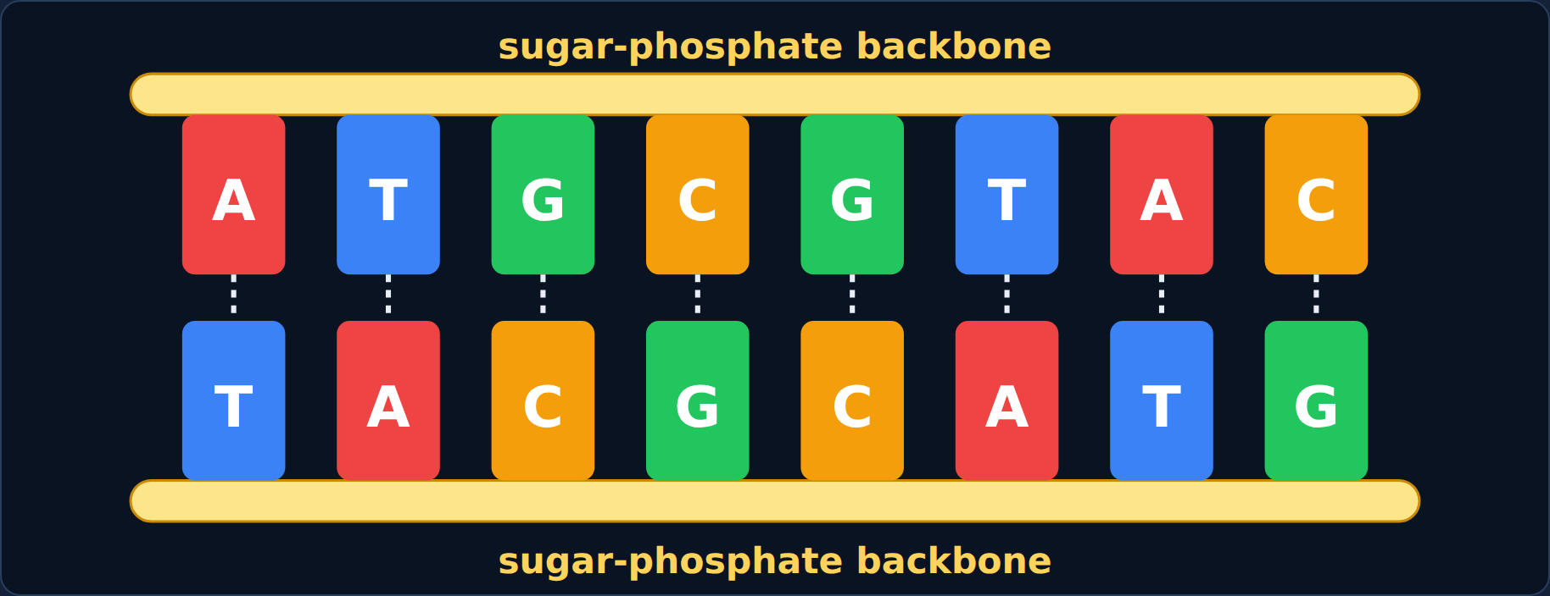
DNA Replication
Biology · Unit 3: DNA and Protein Synthesis
How every new cell gets a perfect copy of your DNA
Notes:
Students work through the lesson on their Chromebooks (about 40 minutes) while filling in their Cornell notes. Use this deck to go through it together.

Slide 2

1
Section 1 of 8 · about 5 min
One cell, trillions of copies
Copies
Notes:
Section 1: One cell, trillions of copies.

Slide 3
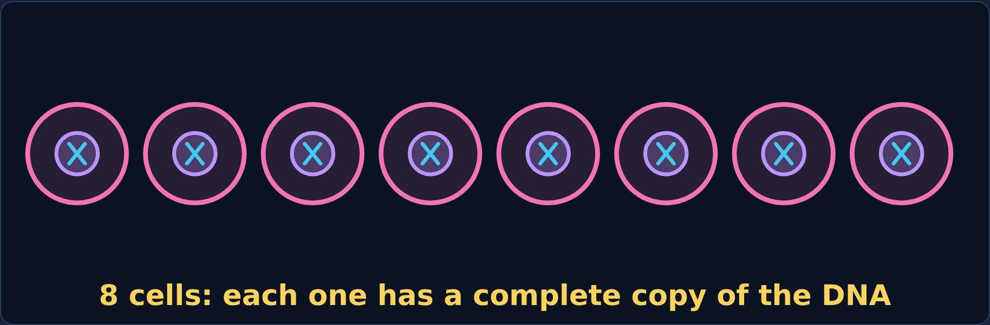
Phenomenon
Phenomenon: a scraped knee
You scrape your knee. Within a week, new skin covers it. Your body made those cells by dividing old ones: 1 → 2 → 4 → 8.
Every one of those new cells has a complete, exact copy of your DNA: about 2 meters of it, packed inside each cell.
DNA Replication
3
Notes:
Read aloud, then press Divide in the lesson three times. Ask: if every cell needs all the DNA, what must happen before a cell splits?

Slide 4
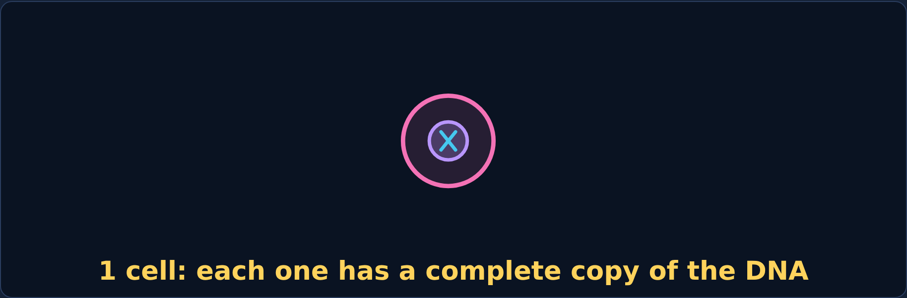
Phenomenon
Your first idea
Your first idea: How could a cell make an exact copy of all its DNA before it divides?
DNA Replication
4
Notes:
Have students write a first idea in the lesson. Don't explain yet; Section 7 comes back to it.

Slide 5

2
Section 2 of 8 · about 5 min
Where DNA lives
Zoom
Notes:
Section 2: Where DNA lives.

Slide 6
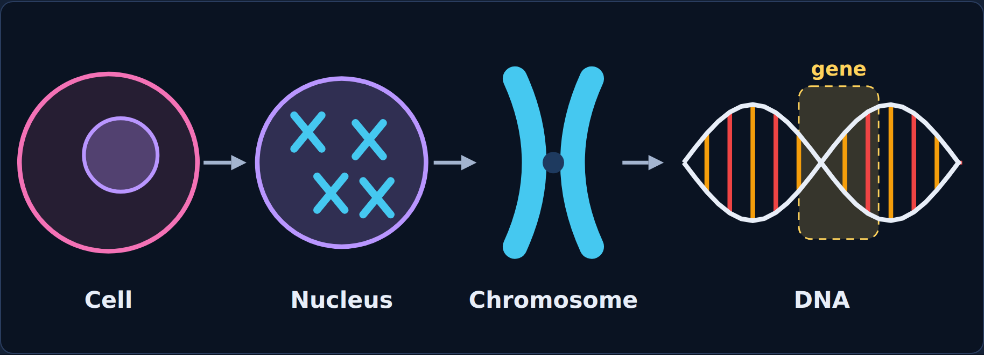
Read
From cell to gene
DNA is the instruction book for your body. In your cells it is kept in the nucleus, coiled tightly into chromosomes.
A gene is one section of DNA with the instructions for one trait.
DNA Replication
6
Notes:
Point out the levels: cell → nucleus → chromosome → DNA → gene.

Slide 7

Step through
Zoom in: step 1 of 4
A cell. The dark circle inside is the nucleus.
DNA Replication
7
Notes:
Step 1 of the lesson's zoom.

Slide 8
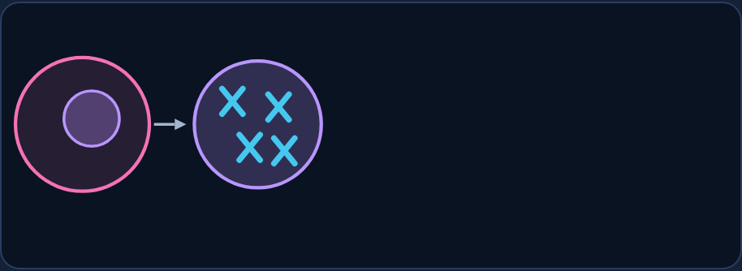
Step through
Zoom in: step 2 of 4
The nucleus holds the chromosomes.
DNA Replication
8
Notes:
Step 2 of the lesson's zoom.

Slide 9
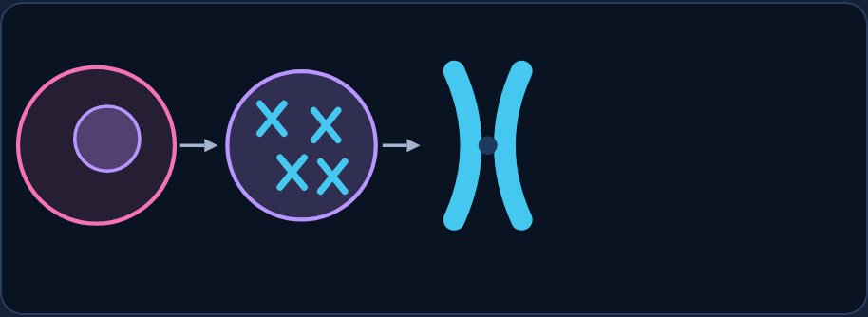
Step through
Zoom in: step 3 of 4
One chromosome is a tightly coiled package of DNA.
DNA Replication
9
Notes:
Step 3 of the lesson's zoom.

Slide 10
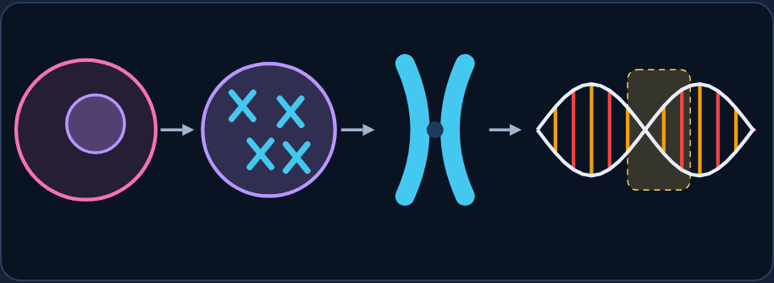
Step through
Zoom in: step 4 of 4
DNA is a twisted ladder (a double helix). The highlighted section is one gene.
DNA Replication
10
Notes:
Step 4 of the lesson's zoom.

Slide 11
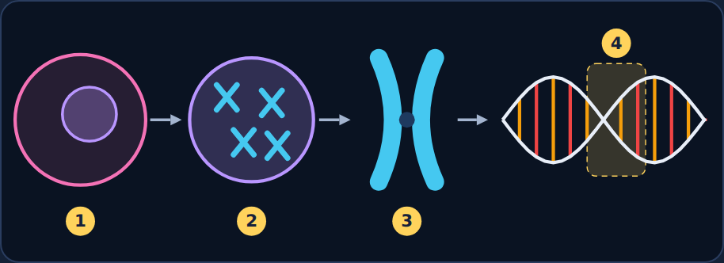
Try it
Try it: label the levels
Label spots 1–4: Cell · Nucleus · Chromosome · Gene · Ribosome
DNA Replication
11
Notes:
Students label spots 1–4 in the lesson. Choices: cell, nucleus, chromosome, gene, ribosome.

Slide 12
Answer
Try it: label the levels
1 Cell 2 Nucleus 3 Chromosome 4 Gene
DNA Replication
12
Notes:
1 cell, 2 nucleus, 3 chromosome, 4 gene. Ribosome isn't part of this zoom.

Slide 13
Quick check
Quick check
What is a gene?
A section of DNA with instructions for one trait
A
A whole chromosome
B
The nucleus of the cell
C
A type of cell
D
DNA Replication
13
Notes:
Give students a moment to choose before showing the answer.

Slide 14
Answer
Quick check
What is a gene?
A section of DNA with instructions for one trait ✓
Why
A
A gene is one section of the DNA in a chromosome.
A whole chromosome
B
The nucleus of the cell
C
A type of cell
D
DNA Replication
14
Notes:
Correct: A section of DNA with instructions for one trait. A gene is one section of the DNA in a chromosome. Why not the others: "A whole chromosome": A chromosome holds many genes. "The nucleus of the cell": The nucleus holds the chromosomes. "A type of cell": Genes are inside cells.

Slide 15

3
Section 3 of 8 · about 4 min
Nucleotides: DNA's building blocks
Nucleotide
Notes:
Section 3: Nucleotides: DNA's building blocks.

Slide 16
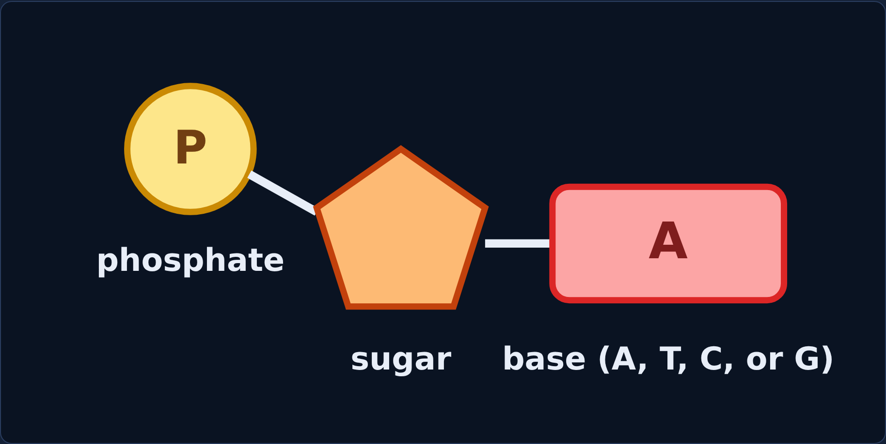
Read
Three parts, four letters
DNA is a long chain of nucleotides. Each nucleotide has three parts: a phosphate, a sugar (deoxyribose), and a base.
There are only four bases: A (adenine), T (thymine), C (cytosine), and G (guanine).
DNA Replication
16
Notes:
The order of the bases spells out the instructions, like letters spell words.

Slide 17
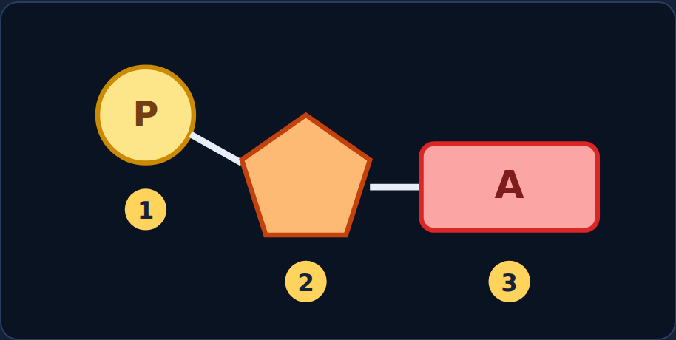
Try it
Try it: label a nucleotide
Label spots 1–3.
Phosphate · Sugar · Base · Nucleus
DNA Replication
17
Notes:
Students label spots 1–3. Choices: phosphate, sugar, base, nucleus.

Slide 18
Answer
Try it: label a nucleotide
1 Phosphate
2 Sugar
3 Base
DNA Replication
18
Notes:
1 phosphate, 2 sugar, 3 base. Nucleus isn't part of a nucleotide.

Slide 19
Quick check
Quick check
Which part of a nucleotide carries the "letter" (A, T, C, or G)?
The sugar
A
The phosphate
B
The nucleus
C
The base
D
DNA Replication
19
Notes:
Give students a moment to choose before showing the answer.

Slide 20
Answer
Quick check
Which part of a nucleotide carries the "letter" (A, T, C, or G)?
The sugar
Why
A
The base is the letter; sugar and phosphate form the backbone.
The phosphate
B
The nucleus
C
The base ✓
D
DNA Replication
20
Notes:
Correct: The base. The base is the letter; sugar and phosphate form the backbone. Why not the others: "The sugar": The sugar is part of the backbone. "The phosphate": The phosphate is part of the backbone. "The nucleus": The nucleus isn't part of a nucleotide.

Slide 21

4
Section 4 of 8 · about 5 min
Base pairing and the double helix
Pairing
Notes:
Section 4: Base pairing and the double helix.

Slide 22
Read
A twisted ladder
DNA has two strands twisted into a double helix, like a ladder:
• The sides are the sugar-phosphate backbone.
• The rungs are pairs of bases, held by weak bonds.
Base-pairing rule: A pairs with T, and C pairs with G.
DNA Replication
22
Notes:
If you know one strand, you know the other: the strands are complementary.

Slide 23
Try it
Try it: build the matching strand
Original | T | A | C | G | G | A | T | C
Matching | ? | ? | ? | ? | ? | ? | ? | ?
A pairs with T, and C pairs with G.
DNA Replication
23
Notes:
Students pick the partner for each base in the lesson.

Slide 24
Answer
Try it: build the matching strand
Original | T | A | C | G | G | A | T | C
Matching | A | T | G | C | C | T | A | G
A pairs with T, and C pairs with G.
DNA Replication
24
Notes:
T→A, A→T, C→G, G→C, G→C, A→T, T→A, C→G.

Slide 25
Quick check
Quick check
One strand reads A G T C. What does the matching strand read?
G A C T
A
U C A G
B
T C A G
C
A G T C
D
DNA Replication
25
Notes:
Give students a moment to choose before showing the answer.

Slide 26
Answer
Quick check
One strand reads A G T C. What does the matching strand read?
G A C T
Why
A
A→T, G→C, T→A, C→G.
U C A G
B
T C A G ✓
C
A G T C
D
DNA Replication
26
Notes:
Correct: T C A G. A→T, G→C, T→A, C→G. Why not the others: "A G T C": That's the same strand, not its match. "G A C T": Check the rule: A pairs with T. "U C A G": DNA doesn't use U.

Slide 27

5
Section 5 of 8 · about 6 min
How DNA copies itself
Replication
Notes:
Section 5: How DNA copies itself.

Slide 28
Read
Unzip, match, and join
Before a cell divides, it copies all its DNA: DNA replication. It happens in the nucleus:
1. Unzip. The enzyme helicase breaks the weak bonds between base pairs.
2. Match. Free nucleotides pair with the exposed bases (A–T, C–G). DNA polymerase joins them into a new strand.
3. Two copies. Two DNA molecules, exactly the same as the original.
DNA Replication
28
Notes:
Replication happens in the nucleus before a cell divides.

Slide 29
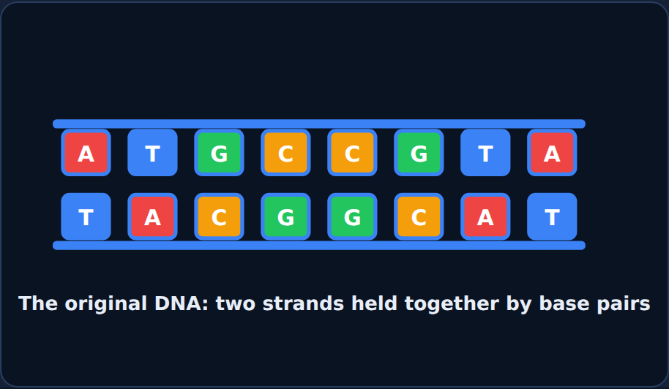
Step through
Replication: step 1 of 4
The original DNA: two strands held together by base pairs.
DNA Replication
29
Notes:
Step 1 of the lesson's step-through.

Slide 30
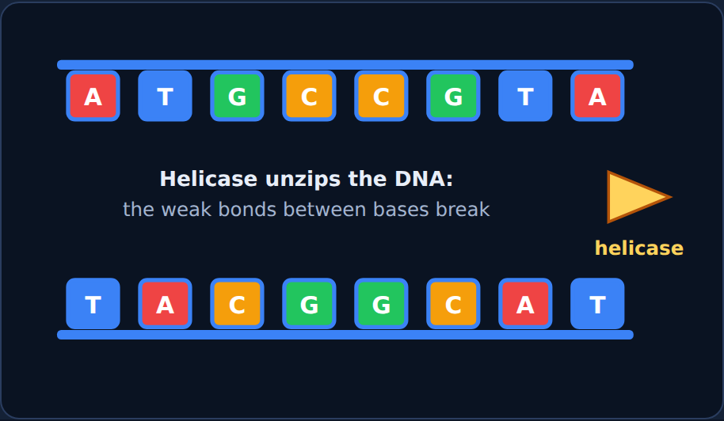
Step through
Replication: step 2 of 4
Unzip: helicase breaks the weak bonds between the bases.
DNA Replication
30
Notes:
Step 2 of the lesson's step-through.

Slide 31
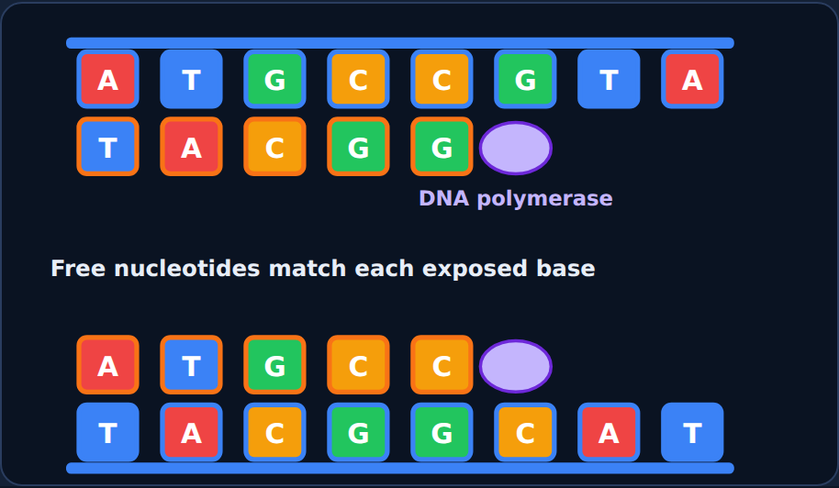
Step through
Replication: step 3 of 4
Match: free nucleotides pair with each exposed base; DNA polymerase joins them.
DNA Replication
31
Notes:
Step 3 of the lesson's step-through.

Slide 32
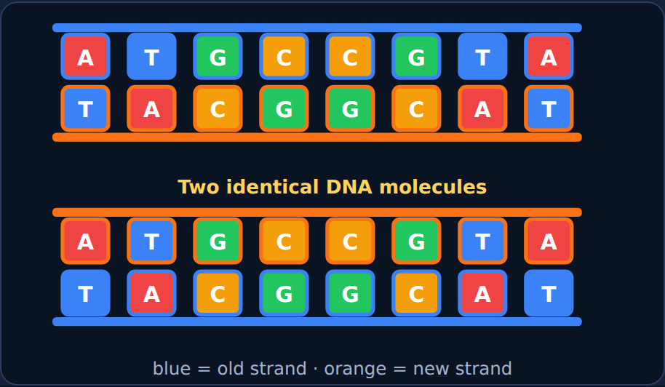
Step through
Replication: step 4 of 4
Two copies: blue is an old strand; orange is a new strand.
DNA Replication
32
Notes:
Step 4 of the lesson's step-through.

Slide 33
Try it
Try it: sort the steps
Which step does each event belong to?
Helicase breaks the weak bonds between bases
The two strands separate like a zipper
Free nucleotides pair with exposed bases
DNA polymerase joins the new nucleotides
Two identical DNA molecules form
Each copy has one old and one new strand
Step 1: Unzip
Step 2: Match
Step 3: Two copies
DNA Replication
33
Notes:
Students sort these in the lesson. Have them decide each card before showing the answer.

Slide 34
Answer
Try it: sort the steps
Which step does each event belong to?
Step 1: Unzip
Step 2: Match
Step 3: Two copies
Helicase breaks the weak bonds between bases
Free nucleotides pair with exposed bases
Two identical DNA molecules form
The two strands separate like a zipper
DNA polymerase joins the new nucleotides
Each copy has one old and one new strand
DNA Replication
34
Notes:
Unzip → match → two copies.

Slide 35
Quick check
Quick check
What does the enzyme helicase do?
Breaks DNA into single nucleotides
A
Unzips the DNA by breaking the weak bonds between bases
B
Joins new nucleotides into a strand
C
Makes new chromosomes from scratch
D
DNA Replication
35
Notes:
Give students a moment to choose before showing the answer.

Slide 36
Answer
Quick check
What does the enzyme helicase do?
Breaks DNA into single nucleotides
Why
A
Helicase unzips; DNA polymerase builds.
Unzips the DNA by breaking the weak bonds between bases ✓
B
Joins new nucleotides into a strand
C
Makes new chromosomes from scratch
D
DNA Replication
36
Notes:
Correct: Unzips the DNA by breaking the weak bonds between bases. Helicase unzips; DNA polymerase builds. Why not the others: "Joins new nucleotides into a strand": That's DNA polymerase. "Makes new chromosomes from scratch": Replication copies existing DNA. "Breaks DNA into single nucleotides": Helicase only separates the strands.

Slide 37

6
Section 6 of 8 · about 4 min
Half old, half new
Old + new
Notes:
Section 6: Half old, half new.

Slide 38
Read
Each copy keeps one old strand
Each new DNA molecule has one old strand and one new strand. This is semi-conservative replication.
DNA polymerase checks its work, so copying is very accurate. When a mistake slips through, the change in the base sequence is a mutation. Most mutations do nothing; some are harmful, and a few are helpful.
DNA Replication
38
Notes:
"Semi" means half: half of the old DNA is saved in each copy.

Slide 39
Try it
Try it: copy both strands
Old strand 1 | G | A | T | T | C
New partner | ? | ? | ? | ? | ?
Old strand 2 | C | T | A | A | G
New partner | ? | ? | ? | ? | ?
DNA Replication
39
Notes:
Students build the new partner for each old strand in the lesson.

Slide 40
Answer
Try it: copy both strands
Old strand 1 | G | A | T | T | C
New partner | C | T | A | A | G
Old strand 2 | C | T | A | A | G
New partner | G | A | T | T | C
DNA Replication
40
Notes:
G A T T C → C T A A G, and C T A A G → G A T T C. Each new strand matches the other old strand, so the two copies are identical.

Slide 41
Quick check
Quick check
After replication, what is each new DNA molecule made of?
One old strand and one new strand
A
Two new strands
B
Two old strands
C
Half of each base
D
DNA Replication
41
Notes:
Give students a moment to choose before showing the answer.

Slide 42
Answer
Quick check
After replication, what is each new DNA molecule made of?
One old strand and one new strand ✓
Why
A
Each copy keeps one original strand as a template.
Two new strands
B
Two old strands
C
Half of each base
D
DNA Replication
42
Notes:
Correct: One old strand and one new strand. Each copy keeps one original strand as a template. Why not the others: "Two new strands": The old strands aren't thrown away. "Two old strands": Each old strand gets a new partner. "Half of each base": Bases aren't split in half.

Slide 43

7
Section 7 of 8 · about 4 min
Spot the mistake
Mistake
Notes:
Section 7: Spot the mistake.

Slide 44
Quick check
Maya's mistake
Original strand: A T G C. Maya's matching strand: A T G C. What's wrong?
She used the letter U
A
She used too many bases
B
Nothing is wrong
C
She copied the same letters instead of the matching partners
D
DNA Replication
44
Notes:
Give students a moment to choose before showing the answer.

Slide 45
Answer
Maya's mistake
Original strand: A T G C. Maya's matching strand: A T G C. What's wrong?
She used the letter U
Why
A
The matching strand follows A–T and C–G.
She used too many bases
B
Nothing is wrong
C
She copied the same letters instead of the matching partners ✓
D
DNA Replication
45
Notes:
Correct: She copied the same letters instead of the matching partners. The matching strand follows A–T and C–G. Why not the others: "She used the letter U": She didn't use U. "She used too many bases": She has the right number of bases. "Nothing is wrong": Check the pairing rule.

Slide 46
Quick check
Now fix it
What is the correct matching strand for A T G C?
G C A T
A
T A G C
B
T A C G
C
A T G C
D
DNA Replication
46
Notes:
Give students a moment to choose before showing the answer.

Slide 47
Answer
Now fix it
What is the correct matching strand for A T G C?
G C A T
Why
A
A→T, T→A, G→C, C→G.
T A G C
B
T A C G ✓
C
A T G C
D
DNA Replication
47
Notes:
Correct: T A C G. A→T, T→A, G→C, C→G.

Slide 48
Quick check
Leo's mistake
Leo wrote: "During replication, the old DNA is thrown away and two brand-new DNA molecules are built from scratch." What's wrong?
Nothing is wrong
A
Each new DNA keeps one old strand as a template
B
DNA is never copied
C
Replication happens in the cytoplasm
D
DNA Replication
48
Notes:
Give students a moment to choose before showing the answer.

Slide 49
Answer
Leo's mistake
Leo wrote: "During replication, the old DNA is thrown away and two brand-new DNA molecules are built from scratch." What's wrong?
Nothing is wrong
Why
A
Replication is semi-conservative: each copy is half old, half new.
Each new DNA keeps one old strand as a template ✓
B
DNA is never copied
C
Replication happens in the cytoplasm
D
DNA Replication
49
Notes:
Correct: Each new DNA keeps one old strand as a template. Replication is semi-conservative: each copy is half old, half new. Why not the others: "DNA is never copied": DNA is copied before every division. "Replication happens in the cytoplasm": Leo didn't say where. "Nothing is wrong": The old strands are kept.

Slide 50
Quick check
Now fix it
Why is each old strand kept?
It works as a pattern (template) for building the new strand
A
It is too big to throw away
B
It stores extra energy
C
It becomes the nucleus
D
DNA Replication
50
Notes:
Give students a moment to choose before showing the answer.

Slide 51
Answer
Now fix it
Why is each old strand kept?
It works as a pattern (template) for building the new strand ✓
Why
A
Each old strand's bases decide which nucleotides go into the new strand.
It is too big to throw away
B
It stores extra energy
C
It becomes the nucleus
D
DNA Replication
51
Notes:
Correct: It works as a pattern (template) for building the new strand. Each old strand's bases decide which nucleotides go into the new strand.

Slide 52
Phenomenon
Back to the phenomenon: the scraped knee
Look back at your first idea. Now explain how each new skin cell gets an exact copy of the DNA.
DNA Replication
52
Notes:
Have students reread their first idea before answering.

Slide 53
Quick check
Part A
How does each new skin cell get an exact copy of the DNA?
Each new cell makes brand-new DNA from food
A
The DNA is cut in half and each cell gets half
B
New cells don't need DNA
C
Before the cell divides, the DNA unzips and each strand is used to build a matching strand
D
DNA Replication
53
Notes:
Give students a moment to choose before showing the answer.

Slide 54
Answer
Part A
How does each new skin cell get an exact copy of the DNA?
Each new cell makes brand-new DNA from food
Why
A
Replication makes two identical copies before division, one for each new cell.
The DNA is cut in half and each cell gets half
B
New cells don't need DNA
C
Before the cell divides, the DNA unzips and each strand is used to build a matching strand ✓
D
DNA Replication
54
Notes:
Correct: Before the cell divides, the DNA unzips and each strand is used to build a matching strand. Replication makes two identical copies before division, one for each new cell. Why not the others: "Each new cell makes brand-new DNA from food": DNA is copied, not invented. "The DNA is cut in half and each cell gets half": Each cell needs the whole copy. "New cells don't need DNA": Every cell needs DNA.

Slide 55
Quick check
Part B
Why do the copies come out exactly the same?
The bases are glued in random order
A
Mutations make the copies match
B
Base pairing: A always pairs with T and C always pairs with G
C
The cell guesses which bases to use
D
DNA Replication
55
Notes:
Give students a moment to choose before showing the answer.

Slide 56
Answer
Part B
Why do the copies come out exactly the same?
The bases are glued in random order
Why
A
Each base has only one partner, so each old strand decides exactly what its new strand must be.
Mutations make the copies match
B
Base pairing: A always pairs with T and C always pairs with G ✓
C
The cell guesses which bases to use
D
DNA Replication
56
Notes:
Correct: Base pairing: A always pairs with T and C always pairs with G. Each base has only one partner, so each old strand decides exactly what its new strand must be. Why not the others: "The cell guesses which bases to use": Nothing is guessed. "The bases are glued in random order": The order is not random. "Mutations make the copies match": Mutations are mistakes.

Slide 57

8
Section 8 of 8 · about 5 min
Final check
Final
Notes:
Section 8: Final check.

Slide 58
Read
Final check
Take the final check in the lesson: 10 questions, multiple choice, two-part, and select-all.
You need 8 out of 10 to pass. If you don't pass, you'll get a new set of questions.
DNA Replication
58
Notes:
Students take the 10-question final check in the lesson (8 of 10 to pass). It is not shown on slides.

