Slide 1

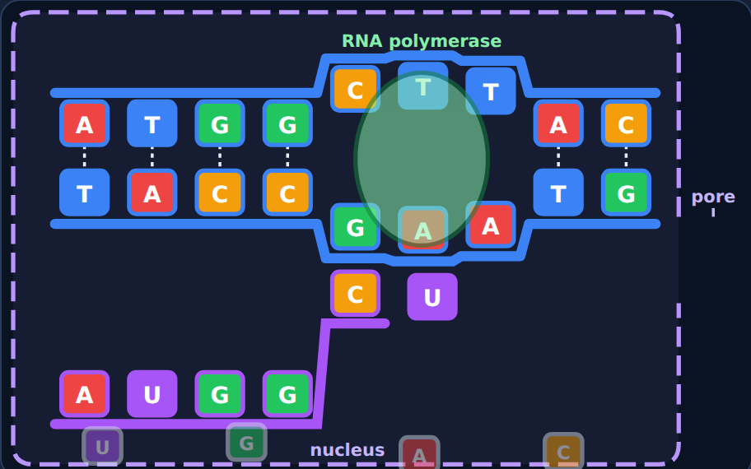
Transcription
Biology · Unit 3: DNA and Protein Synthesis
How a gene's message gets out of the nucleus
Notes:
Students work through the lesson on their Chromebooks (about 40 minutes) while filling in their Cornell notes. Show the animations live from the lesson; these slides use still frames.

Slide 2

1
Section 1 of 7 · about 5 min
The book that can't leave the library
Library
Notes:
Section 1: The book that can't leave the library.

Slide 3
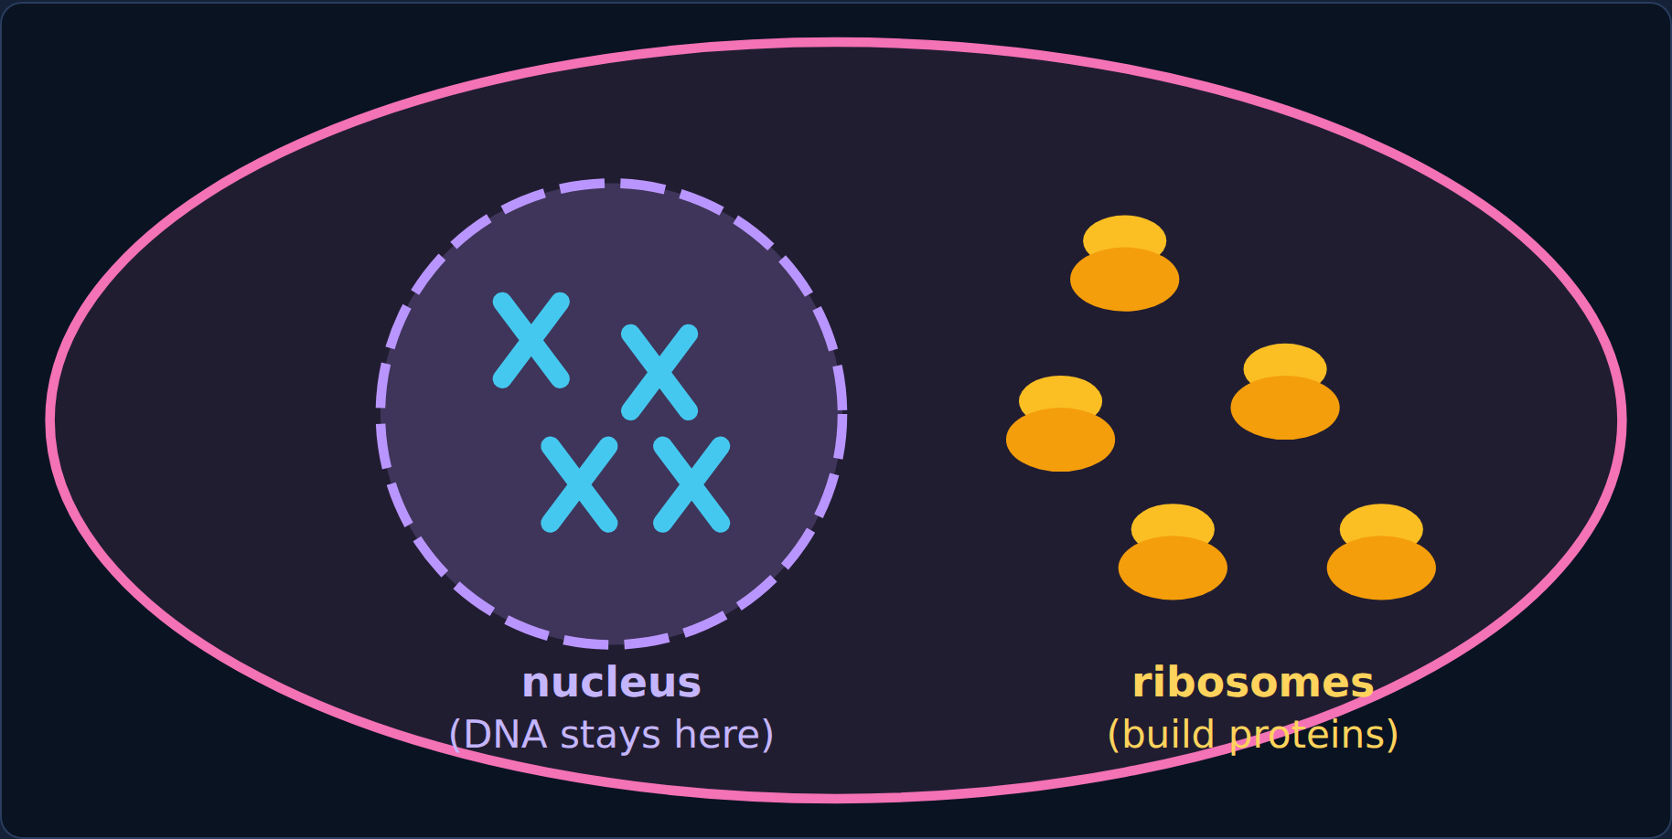
Phenomenon
Phenomenon: the library book
A priceless reference book can't leave the library, but you need one recipe from it at home.
Your cells have the same problem: DNA never leaves the nucleus, but proteins are built by ribosomes outside it.
Transcription
3
Notes:
Ask: if you can't take the book home, how do you get the recipe? (Photocopy the page.)

Slide 4
Phenomenon
Your first idea
Your first idea: How could the instructions in DNA get to the ribosomes without the DNA leaving the nucleus?
Transcription
4
Notes:
Have students write a first idea in the lesson. Section 6 comes back to it.

Slide 5

2
Section 2 of 7 · about 5 min
Meet RNA
RNA
Notes:
Section 2: Meet RNA.

Slide 6
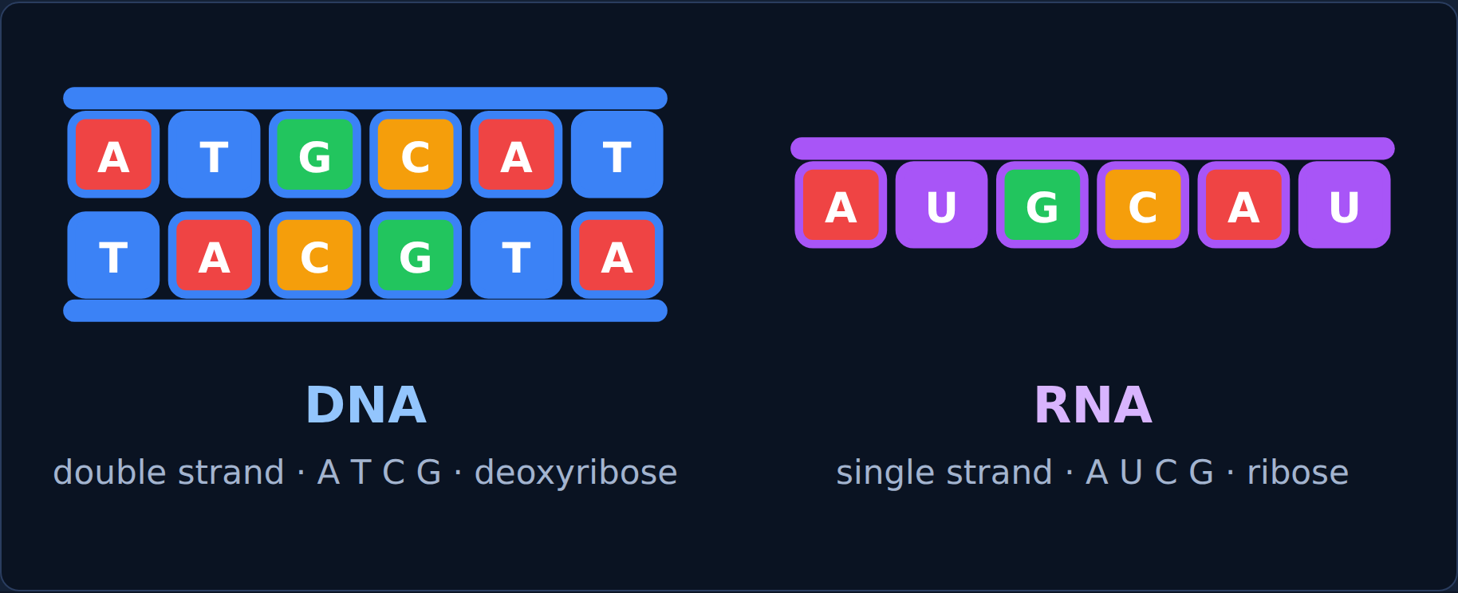
Read
DNA's single-stranded cousin
 | DNA | RNA
Strands | Two (double helix) | One
Sugar | Deoxyribose | Ribose
Bases | A, T, C, G | A, U, C, G
Where | Stays in the nucleus | Can leave the nucleus
The RNA copy of a gene is mRNA (messenger RNA). RNA uses uracil (U) instead of thymine.
Transcription
6
Notes:
The copy molecule is RNA. Point out the three differences.

Slide 7
Try it
Try it: DNA, RNA, or both?
Sort each feature.
Double-stranded
Single-stranded
Has thymine (T)
Has uracil (U)
Sugar is ribose
Made of nucleotides
Has A, C, and G
DNA only
RNA only
Both
Transcription
7
Notes:
Students sort these in the lesson. Have them decide each card before showing the answer.

Slide 8
Answer
Try it: DNA, RNA, or both?
Sort each feature.
DNA only
RNA only
Both
Double-stranded
Single-stranded
Made of nucleotides
Has thymine (T)
Has uracil (U)
Has A, C, and G
Sugar is ribose
Transcription
8
Notes:
RNA: one strand, ribose, U instead of T.

Slide 9
Quick check
Quick check
Which base does RNA use instead of thymine (T)?
Uracil (U)
A
Adenine (A)
B
Guanine (G)
C
Cytosine (C)
D
Transcription
9
Notes:
Give students a moment to choose before showing the answer.

Slide 10
Answer
Quick check
Which base does RNA use instead of thymine (T)?
Uracil (U) ✓
Why
A
RNA has U where DNA has T.
Adenine (A)
B
Guanine (G)
C
Cytosine (C)
D
Transcription
10
Notes:
Correct: Uracil (U). RNA has U where DNA has T. Why not the others: "Adenine (A)": Both have A. "Guanine (G)": Both have G. "Cytosine (C)": Both have C.

Slide 11

3
Section 3 of 7 · about 5 min
RNA base pairing
Pairing
Notes:
Section 3: RNA base pairing.

Slide 12
Read
Same rules, one change
DNA template base | A | T | C | G
mRNA base | U | A | G | C
Same as DNA pairing, except A on the DNA pairs with U on the RNA.
Transcription
12
Notes:
The cell reads one strand of the gene: the template strand.

Slide 13
Try it
Try it: build the mRNA
DNA template | T | A | C | G | G | A | T | T | C
mRNA | ? | ? | ? | ? | ? | ? | ? | ? | ?
A→U · T→A · C→G · G→C
Transcription
13
Notes:
Students pick the mRNA base under each template letter in the lesson.

Slide 14
Answer
Try it: build the mRNA
DNA template | T | A | C | G | G | A | T | T | C
mRNA | A | U | G | C | C | U | A | A | G
A→U · T→A · C→G · G→C
Transcription
14
Notes:
T→A, A→U, C→G, G→C, G→C, A→U, T→A, T→A, C→G.

Slide 15
Quick check
Quick check
A DNA template reads T A C G. What does the mRNA read?
A T G C
A
T A C G
B
U A C G
C
A U G C
D
Transcription
15
Notes:
Give students a moment to choose before showing the answer.

Slide 16
Answer
Quick check
A DNA template reads T A C G. What does the mRNA read?
A T G C
Why
A
T→A, A→U, C→G, G→C.
T A C G
B
U A C G
C
A U G C ✓
D
Transcription
16
Notes:
Correct: A U G C. T→A, A→U, C→G, G→C. Why not the others: "A T G C": RNA uses U, not T. "T A C G": That's the same strand. "U A C G": T pairs with A.

Slide 17

4
Section 4 of 7 · about 7 min
Watch transcription
Transcribe
Notes:
Section 4: Watch transcription.

Slide 18
Read
Copying one gene
Transcription = copying one gene into mRNA, in the nucleus:
1. Unzip. RNA polymerase attaches at the start of a gene and unzips it.
2. Build. It adds matching RNA nucleotides along the template strand.
3. Release. The mRNA peels off; the DNA zips back up, unchanged.
4. Exit. The mRNA leaves through a nuclear pore to a ribosome.
Transcription
18
Notes:
Play the animations from the lesson; these are the steps.

Slide 19
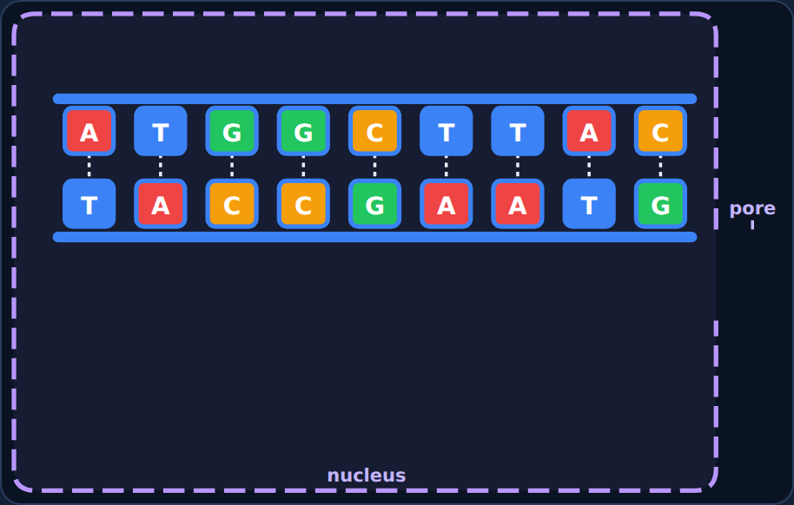
Step through
Transcription: step 1 of 4
A gene in the DNA, inside the nucleus.
Transcription
19
Notes:
Step 1 of the lesson's animation. Play it live from the lesson to show the motion.

Slide 20
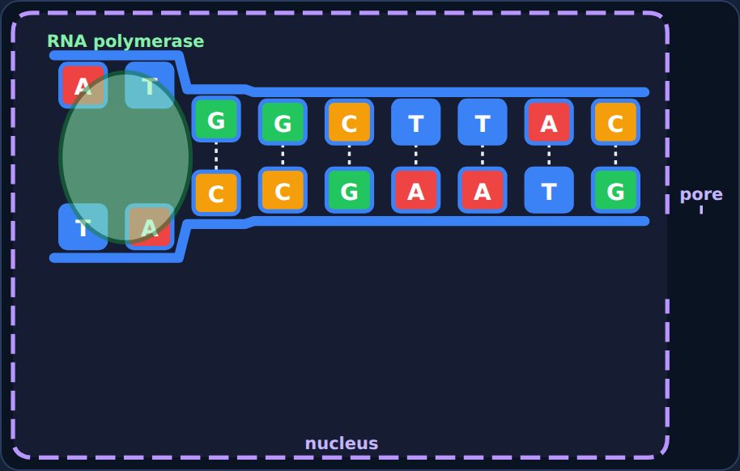
Step through
Transcription: step 2 of 4
Unzip: RNA polymerase attaches and pulls the strands apart.
Transcription
20
Notes:
Step 2 of the lesson's animation. Play it live from the lesson to show the motion.

Slide 21
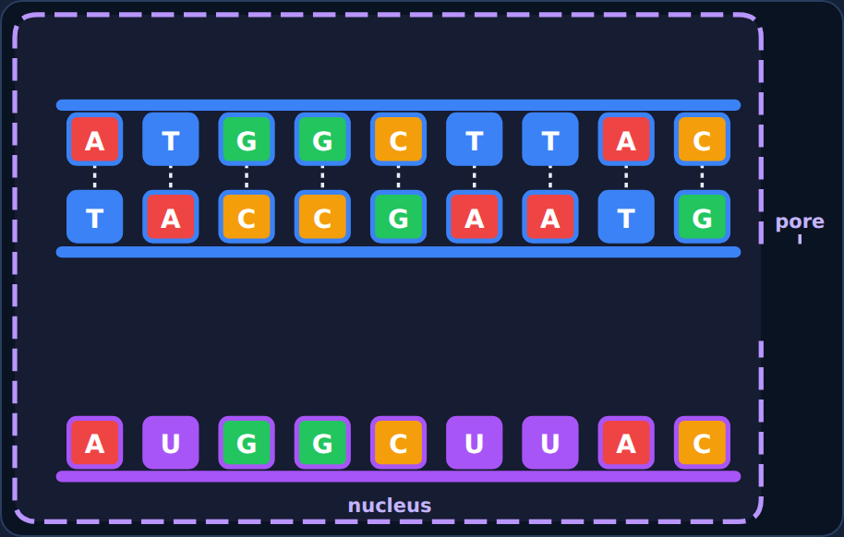
Step through
Transcription: step 3 of 4
Build: RNA nucleotides pair with the template; the mRNA peels off and the DNA zips back up.
Transcription
21
Notes:
Step 3 of the lesson's animation. Play it live from the lesson to show the motion.

Slide 22
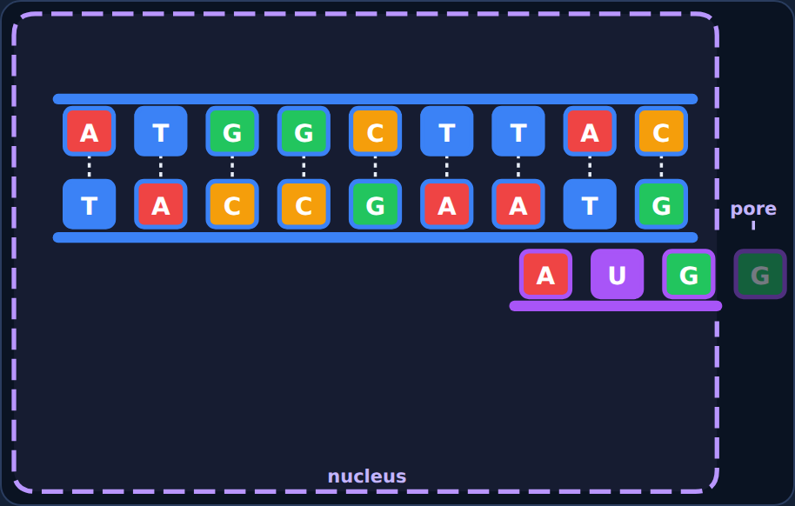
Step through
Transcription: step 4 of 4
Exit: the finished mRNA leaves through a nuclear pore.
Transcription
22
Notes:
Step 4 of the lesson's animation. Play it live from the lesson to show the motion.

Slide 23
Try it
Try it: sort the steps
Which step does each event belong to?
RNA polymerase attaches at the start of a gene
The DNA strands separate
RNA nucleotides pair with the template strand
U is added across from A
The mRNA peels off and the DNA zips back up
The mRNA leaves through a nuclear pore
1: Unzip
2: Build
3: Release and exit
Transcription
23
Notes:
Students sort these in the lesson. Have them decide each card before showing the answer.

Slide 24
Answer
Try it: sort the steps
Which step does each event belong to?
1: Unzip
2: Build
3: Release and exit
RNA polymerase attaches at the start of a gene
RNA nucleotides pair with the template strand
The mRNA peels off and the DNA zips back up
The DNA strands separate
U is added across from A
The mRNA leaves through a nuclear pore
Transcription
24
Notes:
Unzip → build → release and exit.

Slide 25
Quick check
Quick check
Which enzyme builds the mRNA during transcription?
DNA polymerase
A
Ribosome
B
RNA polymerase
C
Helicase
D
Transcription
25
Notes:
Give students a moment to choose before showing the answer.

Slide 26
Answer
Quick check
Which enzyme builds the mRNA during transcription?
DNA polymerase
Why
A
RNA polymerase unzips the gene and builds the mRNA.
Ribosome
B
RNA polymerase ✓
C
Helicase
D
Transcription
26
Notes:
Correct: RNA polymerase. RNA polymerase unzips the gene and builds the mRNA. Why not the others: "Helicase": Helicase unzips DNA in replication. "DNA polymerase": DNA polymerase copies DNA in replication. "Ribosome": Ribosomes read mRNA later.

Slide 27

5
Section 5 of 7 · about 5 min
Replication vs. transcription
Compare
Notes:
Section 5: Replication vs. transcription.

Slide 28
Read
Two kinds of copying
 | DNA replication | Transcription
What is copied | All of the DNA | Just one gene
Product | Two DNA molecules | One mRNA strand
Enzyme | Helicase + DNA polymerase | RNA polymerase
Pairs with A | T | U
When | Before a cell divides | When the cell needs that protein
Transcription
28
Notes:
Both happen in the nucleus and use base pairing.

Slide 29
Try it
Try it: which process?
Sort each statement.
Copies all of the DNA
Copies just one gene
Makes mRNA
Uses helicase and DNA polymerase
Uses RNA polymerase
Uses base pairing
Happens in the nucleus
Replication only
Transcription only
Both
Transcription
29
Notes:
Students sort these in the lesson. Have them decide each card before showing the answer.

Slide 30
Answer
Try it: which process?
Sort each statement.
Replication only
Transcription only
Both
Copies all of the DNA
Copies just one gene
Uses base pairing
Uses helicase and DNA polymerase
Makes mRNA
Happens in the nucleus
Uses RNA polymerase
Transcription
30
Notes:
Replication copies everything into DNA; transcription copies one gene into mRNA.

Slide 31
Quick check
Quick check
Why does the cell make mRNA instead of sending the DNA to the ribosome?
mRNA has more genes than DNA
A
DNA must stay safe in the nucleus, so a copy carries the message out
B
DNA is too small to reach the ribosome
C
Ribosomes destroy DNA on purpose
D
Transcription
31
Notes:
Give students a moment to choose before showing the answer.

Slide 32
Answer
Quick check
Why does the cell make mRNA instead of sending the DNA to the ribosome?
mRNA has more genes than DNA
Why
A
Like the library book, DNA stays put and a copy goes out.
DNA must stay safe in the nucleus, so a copy carries the message out ✓
B
DNA is too small to reach the ribosome
C
Ribosomes destroy DNA on purpose
D
Transcription
32
Notes:
Correct: DNA must stay safe in the nucleus, so a copy carries the message out. Like the library book, DNA stays put and a copy goes out. Why not the others: "DNA is too small to reach the ribosome": DNA is huge. "Ribosomes destroy DNA on purpose": Ribosomes read mRNA, not DNA. "mRNA has more genes than DNA": mRNA copies just one gene.

Slide 33

6
Section 6 of 7 · about 5 min
Spot the mistake
Mistake
Notes:
Section 6: Spot the mistake.

Slide 34
Quick check
Ava's mistake
DNA template: T A C G. Ava's mRNA: A T G C. What's wrong?
She used T instead of U
A
She used too few bases
B
She copied the wrong strand
C
Nothing is wrong
D
Transcription
34
Notes:
Give students a moment to choose before showing the answer.

Slide 35
Answer
Ava's mistake
DNA template: T A C G. Ava's mRNA: A T G C. What's wrong?
She used T instead of U ✓
Why
A
RNA never contains T; A pairs with U.
She used too few bases
B
She copied the wrong strand
C
Nothing is wrong
D
Transcription
35
Notes:
Correct: She used T instead of U. RNA never contains T; A pairs with U. Why not the others: "She used too few bases": She has four bases. "She copied the wrong strand": She used the template correctly. "Nothing is wrong": Look for the letter RNA doesn't use.

Slide 36
Quick check
Now fix it
What is the correct mRNA for the template T A C G?
A T G C
A
U A C G
B
T A C G
C
A U G C
D
Transcription
36
Notes:
Give students a moment to choose before showing the answer.

Slide 37
Answer
Now fix it
What is the correct mRNA for the template T A C G?
A T G C
Why
A
T→A, A→U, C→G, G→C.
U A C G
B
T A C G
C
A U G C ✓
D
Transcription
37
Notes:
Correct: A U G C. T→A, A→U, C→G, G→C.

Slide 38
Quick check
Noah's mistake
Noah wrote: "During transcription, the DNA leaves the nucleus and goes to the ribosome." What's wrong?
Proteins are made in the nucleus
A
Nothing is wrong
B
DNA stays in the nucleus; the mRNA copy leaves
C
Transcription happens at the ribosome
D
Transcription
38
Notes:
Give students a moment to choose before showing the answer.

Slide 39
Answer
Noah's mistake
Noah wrote: "During transcription, the DNA leaves the nucleus and goes to the ribosome." What's wrong?
Proteins are made in the nucleus
Why
A
Only the mRNA copy leaves through a nuclear pore.
Nothing is wrong
B
DNA stays in the nucleus; the mRNA copy leaves ✓
C
Transcription happens at the ribosome
D
Transcription
39
Notes:
Correct: DNA stays in the nucleus; the mRNA copy leaves. Only the mRNA copy leaves through a nuclear pore. Why not the others: "Transcription happens at the ribosome": Transcription happens in the nucleus. "Proteins are made in the nucleus": Proteins are made at ribosomes. "Nothing is wrong": Think about the library book.

Slide 40
Quick check
Now fix it
What carries the gene's message out of the nucleus?
Helicase
A
mRNA
B
DNA
C
The ribosome
D
Transcription
40
Notes:
Give students a moment to choose before showing the answer.

Slide 41
Answer
Now fix it
What carries the gene's message out of the nucleus?
Helicase
Why
A
mRNA is the messenger.
mRNA ✓
B
DNA
C
The ribosome
D
Transcription
41
Notes:
Correct: mRNA. mRNA is the messenger.

Slide 42
Phenomenon
Back to the phenomenon: the library book
Look back at your first idea. How does the gene's message reach the ribosome?
Transcription
42
Notes:
Have students reread their first idea before answering.

Slide 43
Quick check
Part A
How do DNA's instructions get to the ribosome?
A gene is copied into mRNA, which leaves the nucleus and goes to the ribosome
A
The DNA leaves the nucleus
B
The ribosome moves into the nucleus
C
Proteins are made inside the nucleus
D
Transcription
43
Notes:
Give students a moment to choose before showing the answer.

Slide 44
Answer
Part A
How do DNA's instructions get to the ribosome?
A gene is copied into mRNA, which leaves the nucleus and goes to the ribosome ✓
Why
A
Transcription makes a mobile mRNA copy.
The DNA leaves the nucleus
B
The ribosome moves into the nucleus
C
Proteins are made inside the nucleus
D
Transcription
44
Notes:
Correct: A gene is copied into mRNA, which leaves the nucleus and goes to the ribosome. Transcription makes a mobile mRNA copy. Why not the others: "The DNA leaves the nucleus": DNA stays in the nucleus. "The ribosome moves into the nucleus": Ribosomes are in the cytoplasm. "Proteins are made inside the nucleus": Proteins are built at ribosomes.

Slide 45
Quick check
Part B
In the library story, what is the mRNA like?
The whole library
A
The librarian
B
A brand-new book with different recipes
C
A photocopy of one page (one gene) you can take home
D
Transcription
45
Notes:
Give students a moment to choose before showing the answer.

Slide 46
Answer
Part B
In the library story, what is the mRNA like?
The whole library
Why
A
mRNA is a working copy of one gene.
The librarian
B
A brand-new book with different recipes
C
A photocopy of one page (one gene) you can take home ✓
D
Transcription
46
Notes:
Correct: A photocopy of one page (one gene) you can take home. mRNA is a working copy of one gene. Why not the others: "The whole library": mRNA copies only one gene. "The librarian": The enzyme is more like the copier. "A brand-new book with different recipes": mRNA has the same message.

Slide 47

7
Section 7 of 7 · about 5 min
Final check
Final
Notes:
Section 7: Final check.

Slide 48
Read
Final check
Take the final check in the lesson: 10 questions, multiple choice, two-part, and select-all.
You need 8 out of 10 to pass. If you don't pass, you'll get a new set of questions.
Transcription
48
Notes:
Students take the 10-question final check in the lesson (8 of 10 to pass). It is not shown on slides.

