Slide 1

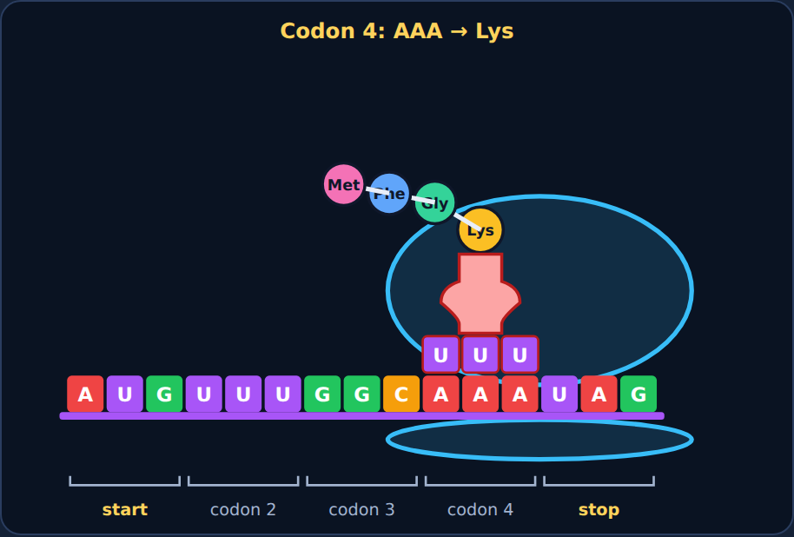
Translation
Biology · Unit 3: DNA and Protein Synthesis
How a ribosome reads mRNA to build a protein
Notes:
Students work through the lesson on their Chromebooks (about 40 minutes) while filling in their Cornell notes. Show the animations live from the lesson; these slides use still frames.

Slide 2

1
Section 1 of 8 · about 5 min
Bacteria that make human insulin
Insulin
Notes:
Section 1: Bacteria that make human insulin.

Slide 3
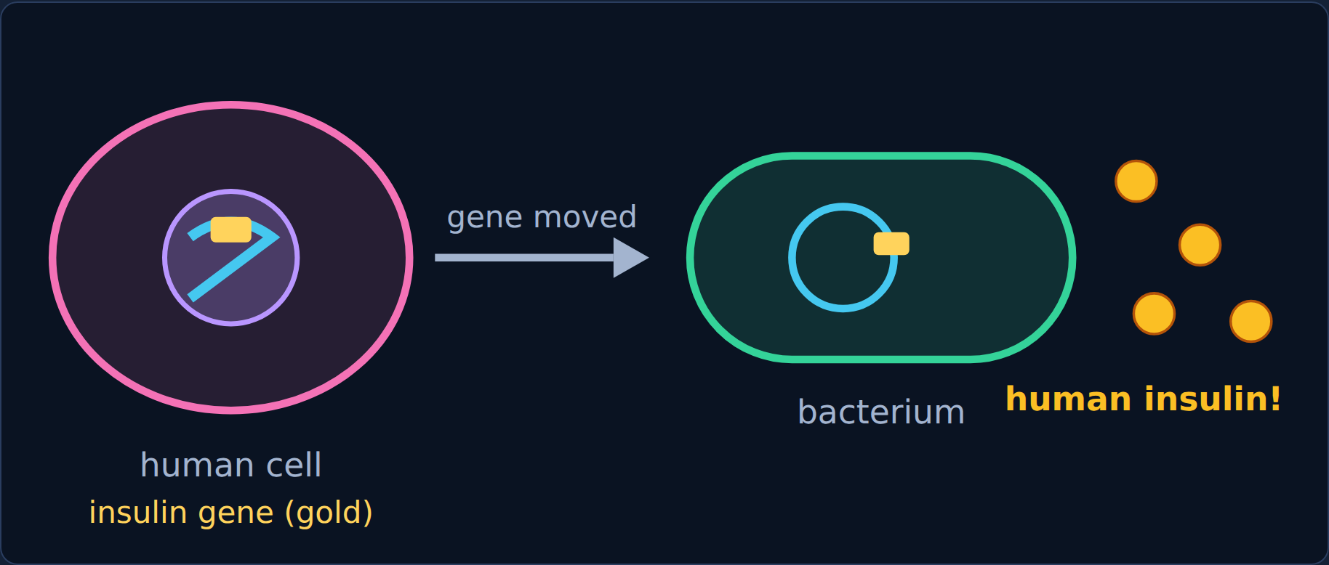
Phenomenon
Phenomenon: human insulin from bacteria
People with type 1 diabetes need insulin, a protein. Most insulin today is made by bacteria.
Scientists put the human insulin gene into bacteria, and the bacteria build real human insulin.
Translation
3
Notes:
Ask: bacteria and people are so different. How could a bacterium build a human protein?

Slide 4
Phenomenon
Your first idea
Your first idea: How can a bacterium read a human gene and build the right human protein?
Translation
4
Notes:
Have students write a first idea in the lesson. Section 7 comes back to it.

Slide 5

2
Section 2 of 8 · about 6 min
Codons: reading in threes
Codons
Notes:
Section 2: Codons: reading in threes.

Slide 6
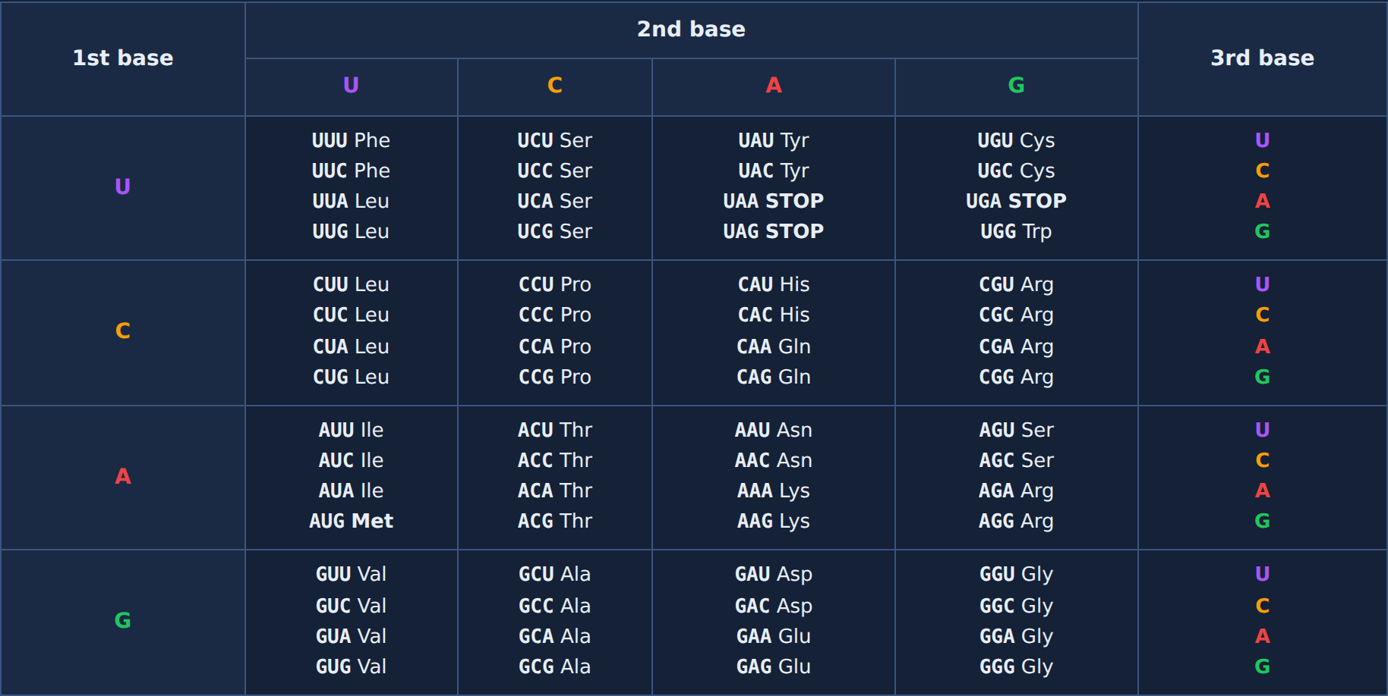
Read
The genetic code
mRNA is read three bases at a time. Each group of three is a codon.
AUG = start (Met). UAA, UAG, UGA = stop.
Every living thing uses the same code.
Translation
6
Notes:
Walk through reading one codon: 1st base on the left, 2nd across the top, 3rd inside the box.

Slide 7
Try it
Try it: decode the codons
Codon | AUG | UUU | GGC
Amino acid | ? | ? | ?
Translation
7
Notes:
Students pick the amino acid for each codon using the chart.

Slide 8
Answer
Try it: decode the codons
Codon | AUG | UUU | GGC
Amino acid | Met | Phe | Gly
Translation
8
Notes:
AUG = Met (start), UUU = Phe, GGC = Gly.

Slide 9
Quick check
Quick check
How many mRNA bases make up one codon?
Three
A
One
B
Two
C
Four
D
Translation
9
Notes:
Give students a moment to choose before showing the answer.

Slide 10
Answer
Quick check
How many mRNA bases make up one codon?
Three ✓
Why
A
A codon is three bases.
One
B
Two
C
Four
D
Translation
10
Notes:
Correct: Three. A codon is three bases. Why not the others: "One": One base can't specify 20 amino acids. "Two": Two bases only make 16 combinations. "Four": Codons are three bases long.

Slide 11

3
Section 3 of 8 · about 5 min
The players
Players
Notes:
Section 3: The players.

Slide 12
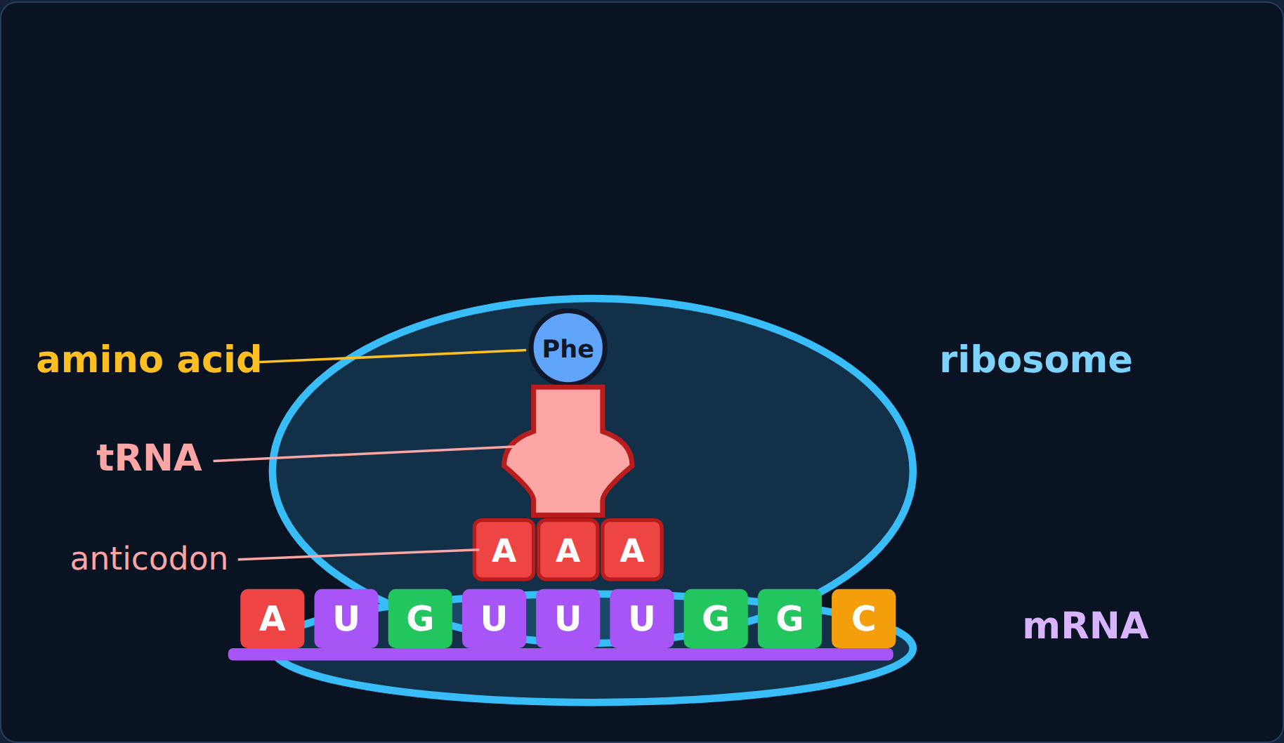
Read
Who builds the protein?
• mRNA carries the codons.
• The ribosome reads them one codon at a time.
• tRNA brings one amino acid. Its anticodon pairs with a codon (A–U, C–G).
Translation
12
Notes:
Translation happens at a ribosome in the cytoplasm.

Slide 13
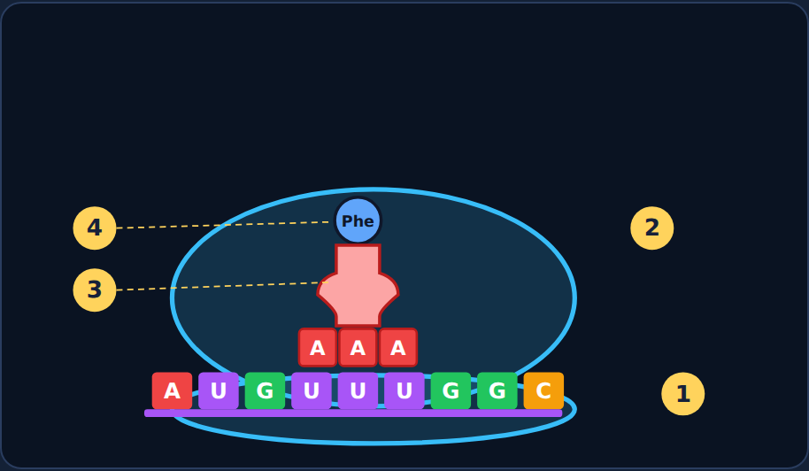
Try it
Try it: label the players
Label spots 1–4.
mRNA · Ribosome · tRNA · Amino acid · DNA
Translation
13
Notes:
Students label spots 1–4. Choices: mRNA, ribosome, tRNA, amino acid, DNA.

Slide 14
Answer
Try it: label the players
1 mRNA
2 Ribosome
3 tRNA
4 Amino acid
Translation
14
Notes:
1 mRNA, 2 ribosome, 3 tRNA, 4 amino acid. DNA isn't part of this picture.

Slide 15
Quick check
Quick check
What does a tRNA carry to the ribosome?
A whole protein
A
A copy of the gene
B
A codon
C
One amino acid
D
Translation
15
Notes:
Give students a moment to choose before showing the answer.

Slide 16
Answer
Quick check
What does a tRNA carry to the ribosome?
A whole protein
Why
A
Each tRNA brings one amino acid; its anticodon matches a codon.
A copy of the gene
B
A codon
C
One amino acid ✓
D
Translation
16
Notes:
Correct: One amino acid. Each tRNA brings one amino acid; its anticodon matches a codon. Why not the others: "A whole protein": Proteins are built from many amino acids. "A copy of the gene": mRNA is the copy of the gene. "A codon": Codons are on the mRNA.

Slide 17

4
Section 4 of 8 · about 7 min
Watch translation
Translate
Notes:
Section 4: Watch translation.

Slide 18
Read
Building a protein
1. Start. The ribosome attaches at the start codon, AUG.
2. Match. A tRNA with the matching anticodon brings its amino acid.
3. Build. Each new amino acid joins the chain; the ribosome slides to the next codon; empty tRNAs leave.
4. Stop. At a stop codon no tRNA fits. The chain is released and folds into a protein.
Translation
18
Notes:
Play the animations from the lesson; these are the steps.

Slide 19
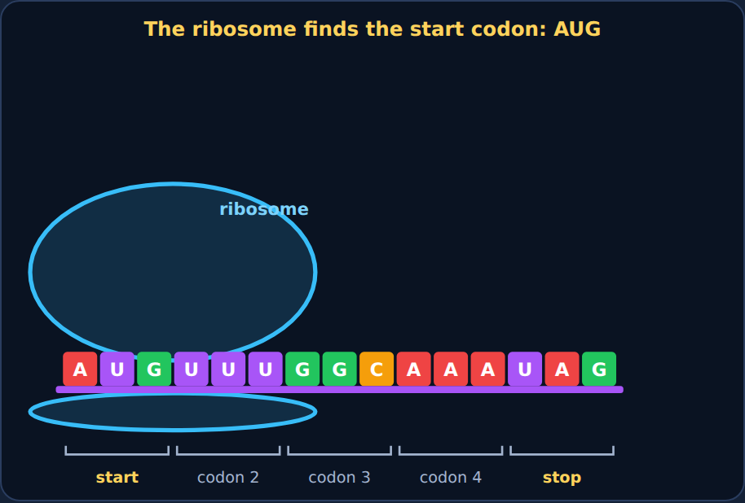
Step through
Translation: step 1 of 4
Start: the ribosome closes around the mRNA at AUG.
Translation
19
Notes:
Step 1 of the lesson's animation. Play it live from the lesson to show the motion.

Slide 20
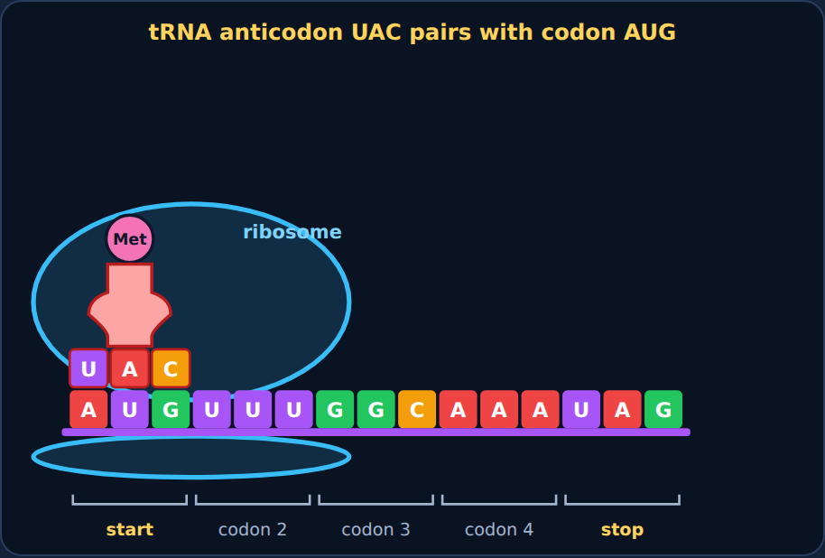
Step through
Translation: step 2 of 4
First tRNA: anticodon UAC pairs with AUG and brings Met.
Translation
20
Notes:
Step 2 of the lesson's animation. Play it live from the lesson to show the motion.

Slide 21
Step through
Translation: step 3 of 4
Build: tRNAs bring Phe, Gly, and Lys; the chain grows as the ribosome slides along.
Translation
21
Notes:
Step 3 of the lesson's animation. Play it live from the lesson to show the motion.

Slide 22
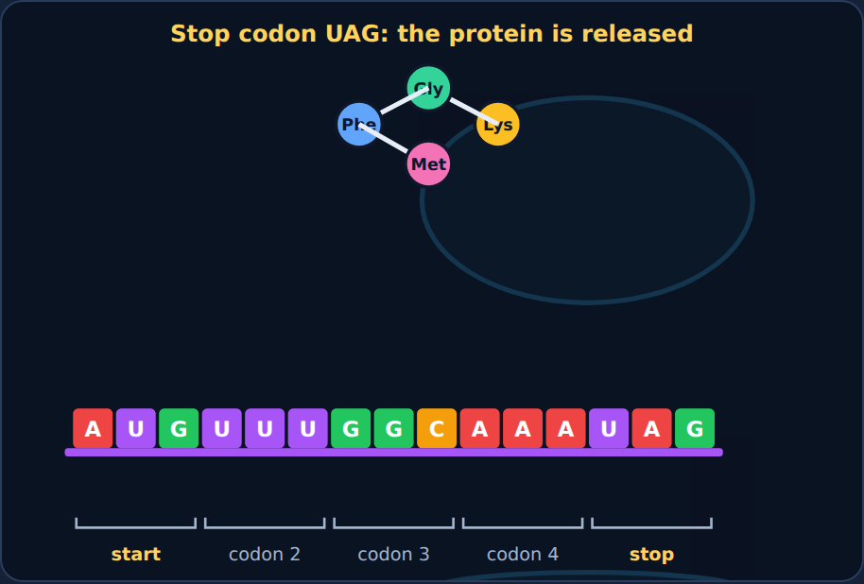
Step through
Translation: step 4 of 4
Stop: at UAG no tRNA fits; the chain is released and folds.
Translation
22
Notes:
Step 4 of the lesson's animation. Play it live from the lesson to show the motion.

Slide 23
Try it
Try it: sort the steps
Which step does each event belong to?
The ribosome attaches at AUG
The first tRNA brings methionine
A tRNA anticodon pairs with the next codon
The new amino acid joins the chain
The ribosome reaches UAA, UAG, or UGA
The chain is released and folds
Start
Build the chain
Stop
Translation
23
Notes:
Students sort these in the lesson. Have them decide each card before showing the answer.

Slide 24
Answer
Try it: sort the steps
Which step does each event belong to?
Start
Build the chain
Stop
The ribosome attaches at AUG
A tRNA anticodon pairs with the next codon
The ribosome reaches UAA, UAG, or UGA
The first tRNA brings methionine
The new amino acid joins the chain
The chain is released and folds
Translation
24
Notes:
Start at AUG → build one codon at a time → stop and fold.

Slide 25
Quick check
Quick check
A codon on the mRNA is UUU. What is the matching tRNA anticodon?
TTT
A
GGG
B
AAA
C
UUU
D
Translation
25
Notes:
Give students a moment to choose before showing the answer.

Slide 26
Answer
Quick check
A codon on the mRNA is UUU. What is the matching tRNA anticodon?
TTT
Why
A
U pairs with A, so the anticodon is AAA.
GGG
B
AAA ✓
C
UUU
D
Translation
26
Notes:
Correct: AAA. U pairs with A, so the anticodon is AAA. Why not the others: "UUU": That's the codon itself. "TTT": RNA has no T. "GGG": G pairs with C.

Slide 27

5
Section 5 of 8 · about 6 min
From gene to protein
Gene to protein
Notes:
Section 5: From gene to protein.

Slide 28
Try it
Try it: transcribe, then translate
DNA template | TAC | AAA | CCG
mRNA codon | ? | ? | ?
Amino acid | ? | ? | ?
DNA → (transcription, nucleus) → mRNA → (translation, ribosome) → protein
Translation
28
Notes:
Students first build the mRNA, then pick each amino acid from the chart.

Slide 29
Answer
Try it: transcribe, then translate
DNA template | TAC | AAA | CCG
mRNA codon | AUG | UUU | GGC
Amino acid | Met | Phe | Gly
DNA → (transcription, nucleus) → mRNA → (translation, ribosome) → protein
Translation
29
Notes:
TAC AAA CCG → AUG UUU GGC → Met – Phe – Gly.

Slide 30
Quick check
Quick check
Put the steps in order.
DNA → protein → mRNA
A
DNA → mRNA → protein
B
Protein → mRNA → DNA
C
mRNA → DNA → protein
D
Translation
30
Notes:
Give students a moment to choose before showing the answer.

Slide 31
Answer
Quick check
Put the steps in order.
DNA → protein → mRNA
Why
A
Transcription first, then translation.
DNA → mRNA → protein ✓
B
Protein → mRNA → DNA
C
mRNA → DNA → protein
D
Translation
31
Notes:
Correct: DNA → mRNA → protein. Transcription first, then translation. Why not the others: "Protein → mRNA → DNA": That's backwards. "mRNA → DNA → protein": DNA comes first. "DNA → protein → mRNA": mRNA is needed before the protein.

Slide 32

6
Section 6 of 8 · about 5 min
One wrong letter
Mutation
Notes:
Section 6: One wrong letter.

Slide 33
Read
When a codon changes
A mutation can change one base in a gene. That changes a codon, which can put the wrong amino acid into the protein.
In sickle cell disease, one hemoglobin codon changes from GAG to GUG.
Translation
33
Notes:
Sickle cell disease: one changed base in the hemoglobin gene.

Slide 34
Try it
Try it: compare the codons
 | Normal | Changed
Codon | GAG | GUG
Amino acid | ? | ?
Translation
34
Notes:
Students find both codons in the chart.

Slide 35
Answer
Try it: compare the codons
 | Normal | Changed
Codon | GAG | GUG
Amino acid | Glu | Val
Translation
35
Notes:
GAG = Glu, GUG = Val. One letter changed one amino acid, and hemoglobin folds the wrong way.

Slide 36
Quick check
Quick check
How can changing one base in DNA change a protein?
It changes a codon, which can change which amino acid is added
A
It changes the ribosome
B
It makes the mRNA leave the nucleus
C
It removes all of the tRNA
D
Translation
36
Notes:
Give students a moment to choose before showing the answer.

Slide 37
Answer
Quick check
How can changing one base in DNA change a protein?
It changes a codon, which can change which amino acid is added ✓
Why
A
DNA → codon → amino acid. A changed codon can mean a changed amino acid.
It changes the ribosome
B
It makes the mRNA leave the nucleus
C
It removes all of the tRNA
D
Translation
37
Notes:
Correct: It changes a codon, which can change which amino acid is added. DNA → codon → amino acid. A changed codon can mean a changed amino acid. Why not the others: "It changes the ribosome": Ribosomes are not changed by the gene. "It makes the mRNA leave the nucleus": mRNA always leaves the nucleus. "It removes all of the tRNA": tRNA is not removed.

Slide 38

7
Section 7 of 8 · about 5 min
Spot the mistake
Mistake
Notes:
Section 7: Spot the mistake.

Slide 39
Quick check
Jayden's mistake
mRNA: AUGGCU. Jayden: "Each base codes for one amino acid, so this makes 6 amino acids." What's wrong?
He should read it backward
A
Each base codes for two amino acids
B
Nothing is wrong
C
Codons are read three bases at a time, so this is only 2 codons
D
Translation
39
Notes:
Give students a moment to choose before showing the answer.

Slide 40
Answer
Jayden's mistake
mRNA: AUGGCU. Jayden: "Each base codes for one amino acid, so this makes 6 amino acids." What's wrong?
He should read it backward
Why
A
Six bases = two codons = two amino acids.
Each base codes for two amino acids
B
Nothing is wrong
C
Codons are read three bases at a time, so this is only 2 codons ✓
D
Translation
40
Notes:
Correct: Codons are read three bases at a time, so this is only 2 codons. Six bases = two codons = two amino acids. Why not the others: "He should read it backward": mRNA is read from start to end. "Each base codes for two amino acids": One codon = one amino acid. "Nothing is wrong": Count codons, not bases.

Slide 41
Quick check
Now fix it
What does AUG GCU code for? (AUG = Met, GCU = Ala)
Met only
A
Six amino acids
B
Met – Ala
C
Ala – Met
D
Translation
41
Notes:
Give students a moment to choose before showing the answer.

Slide 42
Answer
Now fix it
What does AUG GCU code for? (AUG = Met, GCU = Ala)
Met only
Why
A
Two codons: AUG → Met, GCU → Ala.
Six amino acids
B
Met – Ala ✓
C
Ala – Met
D
Translation
42
Notes:
Correct: Met – Ala. Two codons: AUG → Met, GCU → Ala.

Slide 43
Quick check
Mia's mistake
Mia wrote: "Translation happens in the nucleus, where the DNA is read directly to build the protein." What's wrong?
Nothing is wrong
A
Translation happens at a ribosome in the cytoplasm, reading mRNA
B
Translation doesn't need ribosomes
C
Proteins are made of nucleotides
D
Translation
43
Notes:
Give students a moment to choose before showing the answer.

Slide 44
Answer
Mia's mistake
Mia wrote: "Translation happens in the nucleus, where the DNA is read directly to build the protein." What's wrong?
Nothing is wrong
Why
A
Ribosomes in the cytoplasm read mRNA, not DNA.
Translation happens at a ribosome in the cytoplasm, reading mRNA ✓
B
Translation doesn't need ribosomes
C
Proteins are made of nucleotides
D
Translation
44
Notes:
Correct: Translation happens at a ribosome in the cytoplasm, reading mRNA. Ribosomes in the cytoplasm read mRNA, not DNA. Why not the others: "Translation doesn't need ribosomes": Ribosomes build proteins. "Proteins are made of nucleotides": Proteins are made of amino acids. "Nothing is wrong": Where are ribosomes?

Slide 45
Quick check
Now fix it
What does the ribosome read?
mRNA codons
A
DNA directly
B
Amino acids
C
tRNA codons only
D
Translation
45
Notes:
Give students a moment to choose before showing the answer.

Slide 46
Answer
Now fix it
What does the ribosome read?
mRNA codons ✓
Why
A
The ribosome reads mRNA one codon at a time.
DNA directly
B
Amino acids
C
tRNA codons only
D
Translation
46
Notes:
Correct: mRNA codons. The ribosome reads mRNA one codon at a time.

Slide 47
Phenomenon
Back to the phenomenon: human insulin from bacteria
Look back at your first idea. How does the bacterium build human insulin?
Translation
47
Notes:
Have students reread their first idea before answering.

Slide 48
Quick check
Part A
How does the bacterium build human insulin from the human gene?
It copies insulin from a human cell
A
It turns the DNA directly into insulin
B
It makes insulin from sugar without the gene
C
It transcribes the gene into mRNA, and its ribosomes translate the codons into the insulin amino acids
D
Translation
48
Notes:
Give students a moment to choose before showing the answer.

Slide 49
Answer
Part A
How does the bacterium build human insulin from the human gene?
It copies insulin from a human cell
Why
A
Gene → mRNA → ribosome reads codons → amino acid chain.
It turns the DNA directly into insulin
B
It makes insulin from sugar without the gene
C
It transcribes the gene into mRNA, and its ribosomes translate the codons into the insulin amino acids ✓
D
Translation
49
Notes:
Correct: It transcribes the gene into mRNA, and its ribosomes translate the codons into the insulin amino acids. Gene → mRNA → ribosome reads codons → amino acid chain. Why not the others: "It copies insulin from a human cell": No human cells are involved. "It turns the DNA directly into insulin": DNA must be transcribed and translated. "It makes insulin from sugar without the gene": The gene holds the instructions.

Slide 50
Quick check
Part B
Why does the human gene work in a bacterium?
Bacteria are tiny humans
A
The gene changes itself to fit the bacterium
B
All living things use the same genetic code
C
Bacteria have human ribosomes
D
Translation
50
Notes:
Give students a moment to choose before showing the answer.

Slide 51
Answer
Part B
Why does the human gene work in a bacterium?
Bacteria are tiny humans
Why
A
A codon means the same amino acid in nearly every cell.
The gene changes itself to fit the bacterium
B
All living things use the same genetic code ✓
C
Bacteria have human ribosomes
D
Translation
51
Notes:
Correct: All living things use the same genetic code. A codon means the same amino acid in nearly every cell. Why not the others: "Bacteria have human ribosomes": Bacterial ribosomes read the same code. "Bacteria are tiny humans": Bacteria are very different organisms. "The gene changes itself to fit the bacterium": The gene stays the same.

Slide 52

8
Section 8 of 8 · about 5 min
Final check
Final
Notes:
Section 8: Final check.

Slide 53
Read
Final check
Take the final check in the lesson: 10 questions, multiple choice, two-part, and select-all.
You need 8 out of 10 to pass. If you don't pass, you'll get a new set of questions.
Translation
53
Notes:
Students take the 10-question final check in the lesson (8 of 10 to pass). It is not shown on slides.

