Slide 1
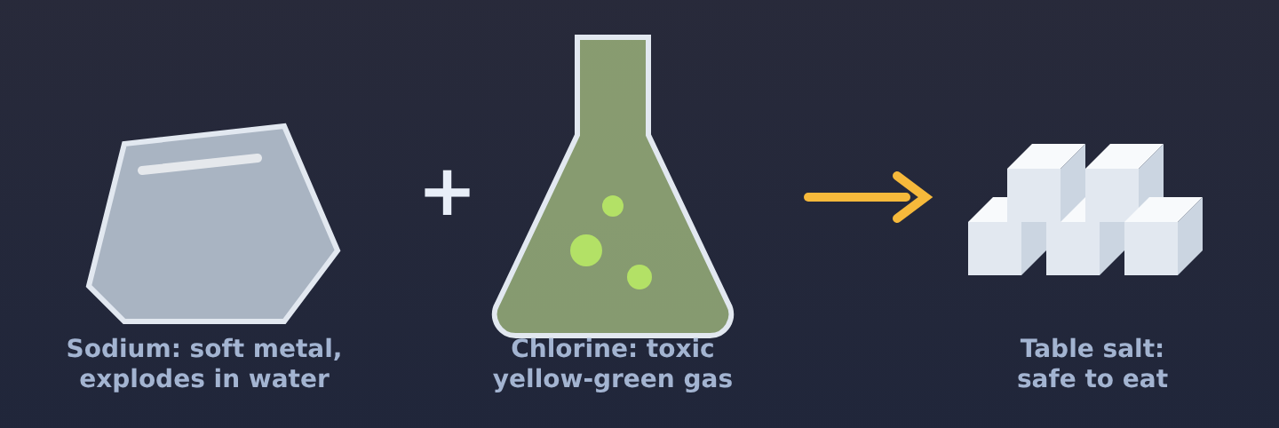
Ionic Bonding
Chemistry · Unit 2: Ions, Periodic Trends, and Bonding · about 40 minutes
Notes:
Opening phenomenon: a dangerous metal plus a toxic gas makes something we eat. Let students wonder before you explain anything.

Slide 2
Two dangerous elements, one thing you eat
Phenomenon
Sodium is so reactive it is stored under oil. Chlorine gas is toxic. Together they make table salt. What do you think happens when they meet?
A. They mix together but each stays the same
B. An electron moves from sodium to chlorine, turning both into new, stable particles
Make a prediction. We'll find out in Section 2.
C. The sodium burns away and only chlorine is left
D. The chlorine turns into sodium
Notes:
Have students commit to a prediction (they pick one in the lesson to unlock Section 1). Do not reveal the answer yet. The answer (B) is revealed on the "Back to the phenomenon" slide in Section 2.

Slide 3









How the lesson works
Why do atoms form ionic bonds?
Watch an electron move
Electron-dot diagrams
about 5 min
about 5 min
about 4 min
When one electron is not enough
Writing ionic formulas
Naming ionic compounds
about 5 min
about 5 min
about 3 min
Crystals and properties
Spot the mistake
Final check
about 3 min
about 3 min
about 7 min
Notes:
Nine short sections, about 40 minutes. Each section: read, try it, quick check. Then 20 to 30 minutes of worksheet practice.

Slide 4
Why do atoms form ionic bonds?
Section 1 of 9 · about 5 min
In this section
To unlock the next section
Phenomenon
Sodium + chlorine = salt?
Make a prediction
Read
Opposites attract
Sort the pairs into ionic and not ionic
Try it
Ionic or not?
Answer the quick check correctly
Quick check
What holds ions together
Notes:
Section 1 takes about 5 minutes.

Slide 5
Opposites attract
Read
Metals lose electrons and become positive ions. Nonmetals gain electrons and become negative ions.
When a metal meets a nonmetal, the metal's electrons move to the nonmetal. The + and − ions attract: that attraction is an ionic bond.
metal
gives electrons →
nonmetal
=
+ ion and − ion attract
Rule of thumb: a metal + a nonmetal makes an ionic compound. Two nonmetals share electrons instead (a different kind of bond).
Notes:
Key idea: an ionic bond is the attraction between oppositely charged ions formed when a metal gives electrons to a nonmetal.

Slide 6
Ionic or not?
Try it
Sort each pair: ionic (metal + nonmetal) or not ionic (two nonmetals)?
Ionic (metal + nonmetal)
Not ionic (two nonmetals)
Na + Cl
Mg + O
C + O
K + Br
Ca + F
Notes:
Students sort the cards, then check once. The lesson only says "all correct" or "something is in the wrong spot."

Slide 7
Ionic or not?
Try it
Answer
Sort each pair: ionic (metal + nonmetal) or not ionic (two nonmetals)?
Ionic (metal + nonmetal)
Not ionic (two nonmetals)
Na + Cl
C + O
Mg + O
K + Br
Ca + F
Notes:
Na, Mg, K, and Ca are metals, so those pairs are ionic. C and O are both nonmetals, so they share electrons instead. Common mistake: thinking any two elements make an ionic bond.

Slide 8
Quick check
Quick check
What holds the ions in an ionic compound together?
A
Shared electrons
B
The attraction between positive and negative ions
C
Gravity
D
Extra neutrons
Notes:
A: shared electrons describe covalent bonds, not ionic. C: gravity is far too weak at this scale. D: neutrons have no charge and do not bond atoms.

Slide 9
Quick check
Quick check
Answer
What holds the ions in an ionic compound together?
A
Shared electrons
B
The attraction between positive and negative ions
C
Gravity
D
Extra neutrons
Why: After the electron moves, the + and − ions attract. That attraction is the ionic bond.
Notes:
A: shared electrons describe covalent bonds, not ionic. C: gravity is far too weak at this scale. D: neutrons have no charge and do not bond atoms.

Slide 10
Watch an electron move
Section 2 of 9 · about 5 min
In this section
To unlock the next section
Read
Sodium meets chlorine
Watch the Na and Cl transfer
Try it
Move the electron
Move the electron for 3 pairs
Phenomenon
Back to the phenomenon
Answer the quick check correctly
Quick check
Which way does it move?
Notes:
Section 2 takes about 5 minutes. Play the animation in the lesson if you can project it.

Slide 11
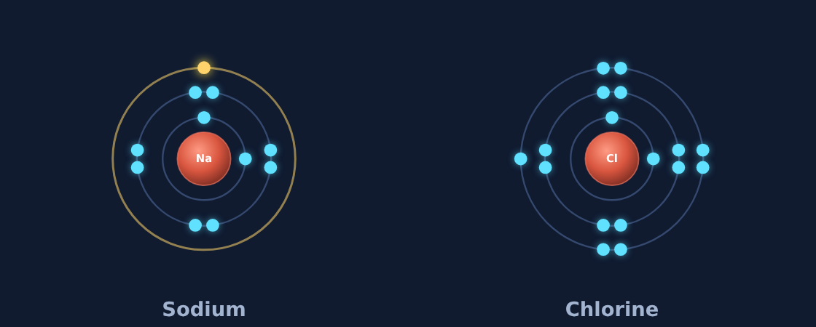
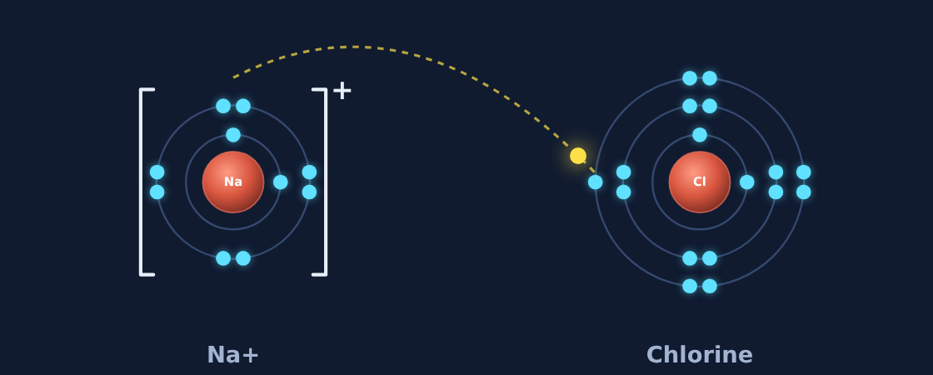
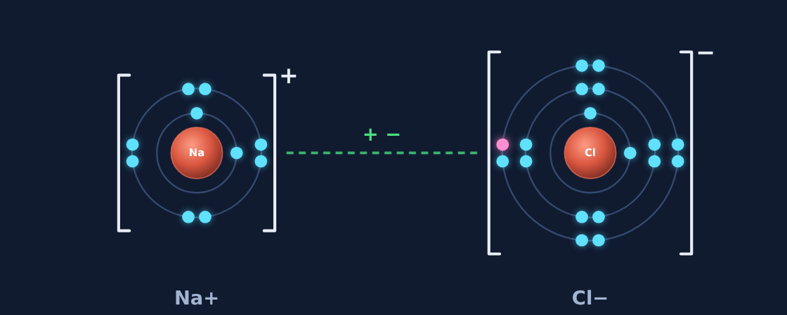
Sodium meets chlorine
Read
Sodium (2, 8, 1) has one valence electron. Chlorine (2, 8, 7) needs one more for a full outer shell.
1. Sodium loses its outer electron; its empty third shell disappears: Na⁺ (2, 8).
2. Chlorine gains it (shown pink): Cl⁻ (2, 8, 8).
3. Na⁺ and Cl⁻ attract: sodium chloride, table salt.
1 Before
2 The electron moves
3 Ions attract
Notes:
Walk through the three frames: the gold valence electron leaves sodium, travels to chlorine, and turns pink when gained. Brackets and charges show the ions. The green dashed line shows the attraction.

Slide 12
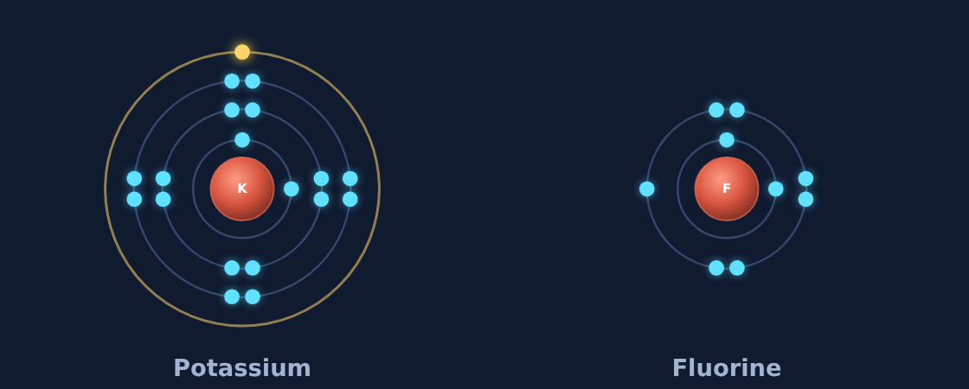
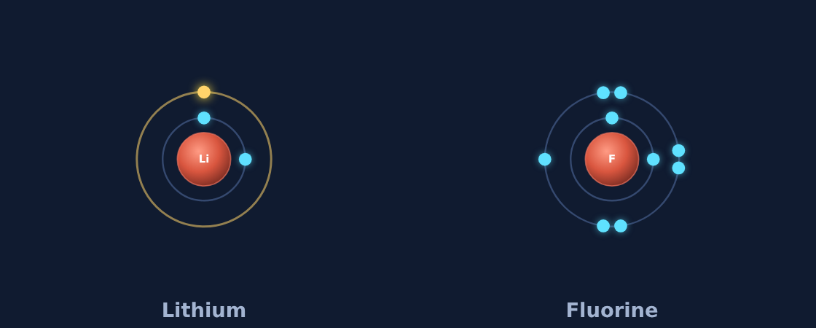
Move the electron
Try it
For each pair: which way does the electron move, and which ions form?
Potassium + fluorine
Which ions form? What is the formula?
Lithium + fluorine
Which ions form? What is the formula?
Notes:
In the lesson, students tap the glowing electron and watch it move.

Slide 13
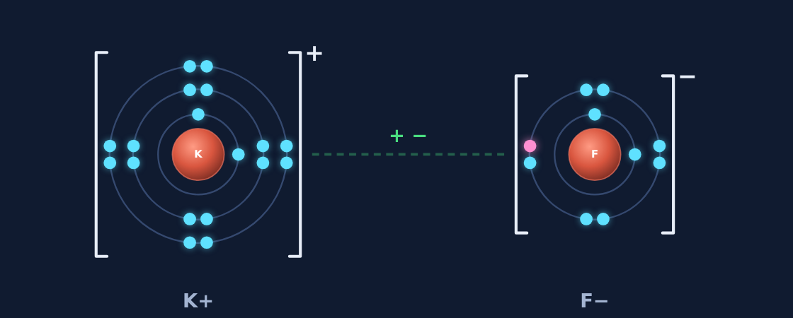
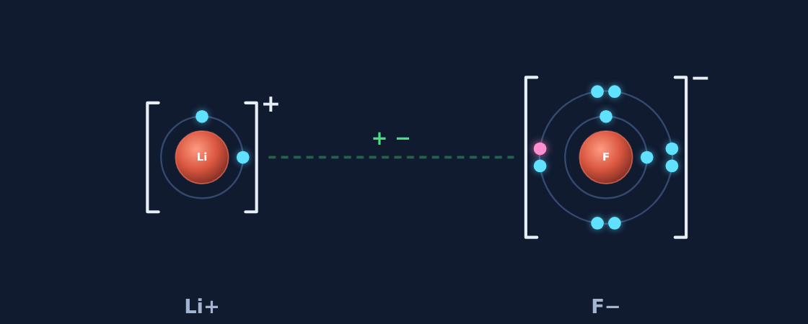
Move the electron
Try it
Answer
Each metal gives its one valence electron to the nonmetal.
Potassium + fluorine
K⁺ and F⁻ → KF, potassium fluoride
Lithium + fluorine
Li⁺ and F⁻ → LiF, lithium fluoride
Notes:
Electrons always move from the metal (K, Li) to the nonmetal (F). If a student says F gives an electron, ask which atom has just 1 valence electron.

Slide 14
Back to the phenomenon
Phenomenon
Answer
Answer: B. An electron moves from sodium to chlorine.
Sodium and chlorine atoms are dangerous because each is one electron away from a full outer shell, so they react with almost anything.
Once the electron moves, Na⁺ and Cl⁻ both have full outer shells, like the noble gases neon and argon. They are stable and locked together in a crystal: the salt you eat.
Notes:
Close the loop on the opening prediction. Ask students who chose A, C, or D what they now think.

Slide 15
Quick check
Quick check
In sodium chloride, which way does the electron move?
A
From chlorine to sodium
B
From sodium to chlorine
C
Both atoms share it
D
It goes into the nucleus
Notes:
A reverses the direction: chlorine needs electrons, it does not give them. C describes a covalent bond. D: electrons never move into the nucleus.

Slide 16
Quick check
Quick check
Answer
In sodium chloride, which way does the electron move?
A
From chlorine to sodium
B
From sodium to chlorine
C
Both atoms share it
D
It goes into the nucleus
Why: Sodium (a metal) gives its one valence electron to chlorine (a nonmetal).
Notes:
A reverses the direction: chlorine needs electrons, it does not give them. C describes a covalent bond. D: electrons never move into the nucleus.

Slide 17
Electron-dot diagrams
Section 3 of 9 · about 4 min
In this section
To unlock the next section
Read
A faster way to draw it
Move the dots for 2 pairs
Try it
Move the dots
Answer the quick check correctly
Quick check
Dots in MgO
Notes:
Section 3 takes about 4 minutes.

Slide 18
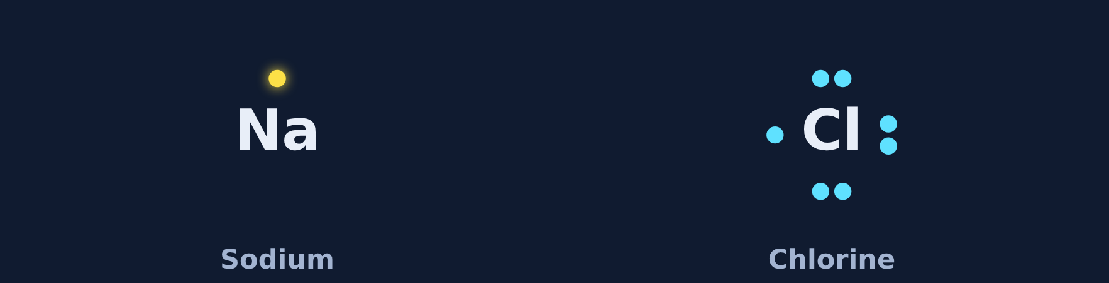

A faster way to draw it
Read
An electron-dot diagram shows only the element symbol and its valence electrons as dots: top, right, bottom, left, then pairs.
Move each dot from the metal to the nonmetal. The metal ends with no dots; the nonmetal ends with 8. Add brackets and charges.
Before
After
Notes:
Dot diagrams are faster than Bohr models because they only show valence electrons. The pink dot is the one chlorine gained.

Slide 19


Move the dots
Try it
How many dots move? Which ions form?
K + Cl
How many dots move? Which ions form?
Mg + O
How many dots move? Which ions form?
Notes:
Students tap the metal to send each dot.

Slide 20


Move the dots
Try it
Answer
Every valence dot moves from the metal to the nonmetal.
K + Cl
1 dot moves: K⁺ and Cl⁻ (KCl)
Mg + O
2 dots move: Mg²⁺ and O²⁻ (MgO)
Notes:
Magnesium is in group 2, so it has 2 valence dots and both move. A common mistake is moving only 1 dot, which leaves oxygen with 7.

Slide 21
Quick check
Quick check
In an electron-dot diagram of MgO, how many dots move from magnesium to oxygen?
A
1
B
6
C
8
D
2
Notes:
A leaves oxygen with 7. B confuses oxygen's own 6 dots with the dots that move. C is the total oxygen ends with, not how many moved.

Slide 22
Quick check
Quick check
Answer
In an electron-dot diagram of MgO, how many dots move from magnesium to oxygen?
A
1
B
6
C
8
D
2
Why: Magnesium has 2 valence electrons and oxygen needs 2 more. Both move: Mg²⁺ and O²⁻.
Notes:
A leaves oxygen with 7. B confuses oxygen's own 6 dots with the dots that move. C is the total oxygen ends with, not how many moved.

Slide 23
When one electron is not enough
Section 4 of 9 · about 5 min
In this section
To unlock the next section
Read
Sometimes you need more atoms
Build 2 compounds with the right number of atoms
Try it
Build the compound
Answer the quick check correctly
Quick check
Calcium and fluorine
Notes:
Section 4 takes about 5 minutes.

Slide 24
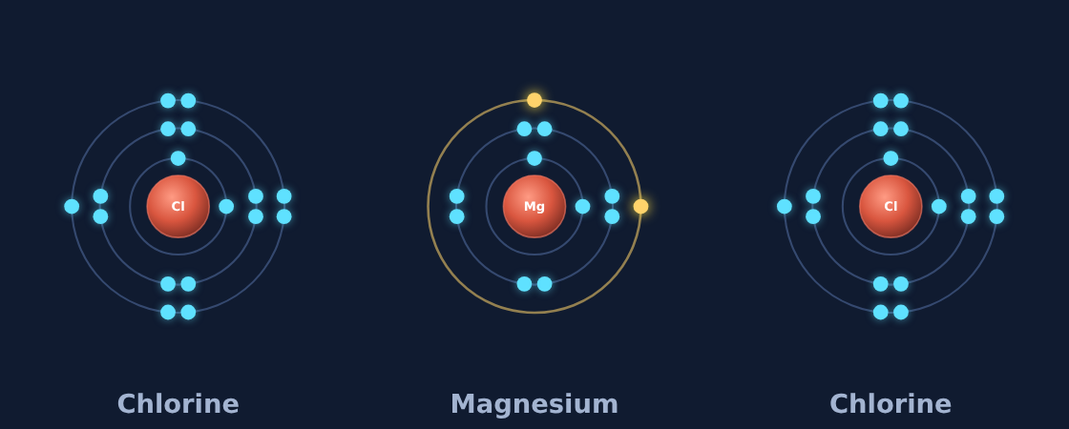
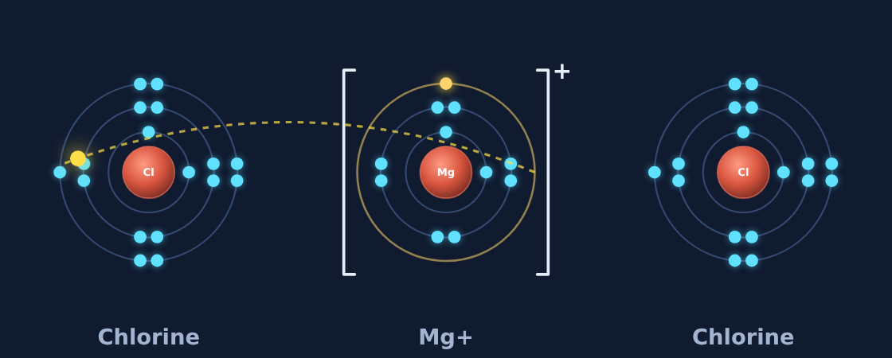
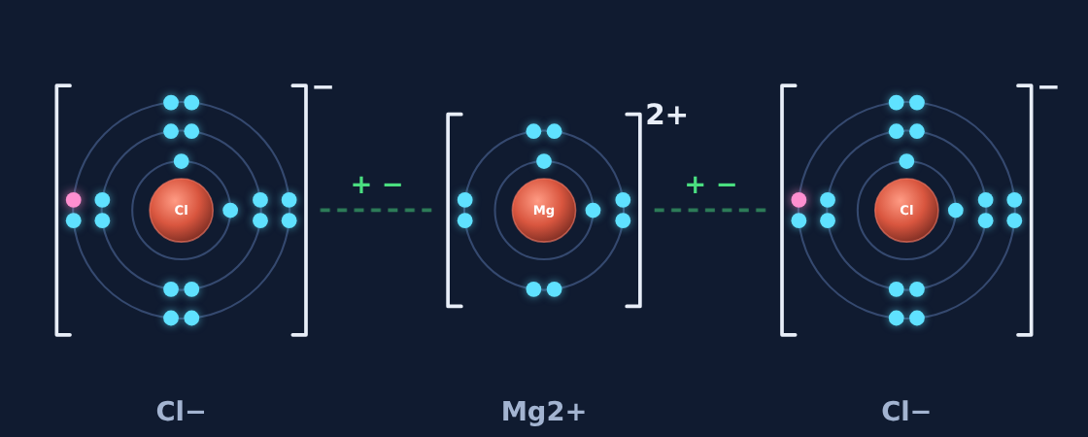
Sometimes you need more atoms
Read
Magnesium gives 2 electrons, but one chlorine takes only 1. So magnesium needs two chlorine atoms.
The rule: electrons given = electrons taken.
1 Before
2 Electrons move
It works the other way too: oxygen takes 2 electrons, but sodium gives only 1, so oxygen needs two sodium atoms: Na₂O.
3 MgCl₂
Notes:
Count electrons given and electrons taken. They must match. Add atoms until they do.

Slide 25
Build the compound
Try it
How many of each atom do you need?
Magnesium + chlorine
Mg gives 2 · Cl takes 1
How many of each atom?
Sodium + oxygen
Na gives 1 · O takes 2
How many of each atom?
Notes:
In the lesson, students set the number of atoms, check, then move every electron themselves.

Slide 26
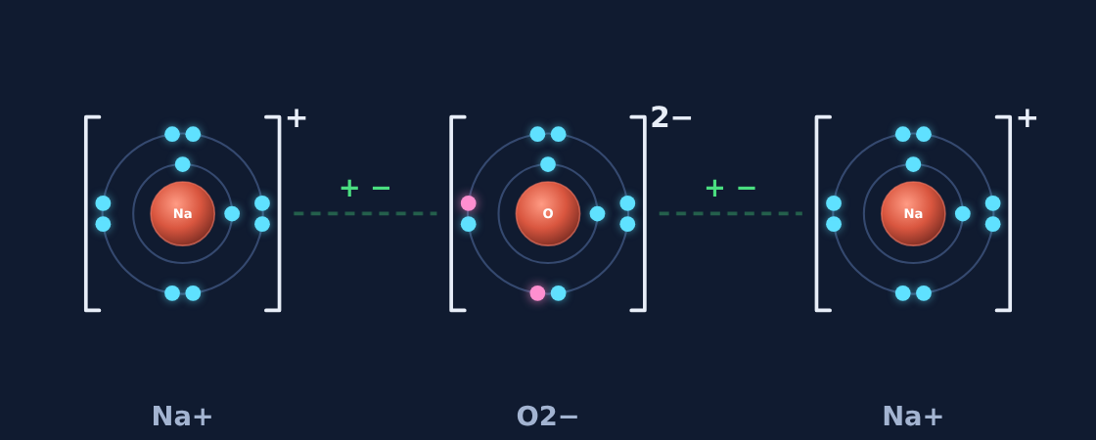
Build the compound
Try it
Answer
How many of each atom do you need?
Magnesium + chlorine
Mg gives 2 · Cl takes 1
1 Mg and 2 Cl → MgCl₂
Sodium + oxygen
Na gives 1 · O takes 2
2 Na and 1 O → Na₂O
Notes:
Wrong answers usually balance the atoms instead of the electrons (for example 1 Na and 1 O). Ask: how many electrons does each atom give or take?

Slide 27
Quick check
Quick check
Calcium gives 2 electrons. Fluorine takes 1. How many fluorine atoms does one calcium atom need?
A
1
B
3
C
2
D
4
Notes:
A leaves one electron with nowhere to go. B and D give fluorine more electrons than calcium has.

Slide 28
Quick check
Quick check
Answer
Calcium gives 2 electrons. Fluorine takes 1. How many fluorine atoms does one calcium atom need?
A
1
B
3
C
2
D
4
Why: Each fluorine takes one electron, so two fluorines take calcium's two electrons: CaF₂.
Notes:
A leaves one electron with nowhere to go. B and D give fluorine more electrons than calcium has.

Slide 29
Writing ionic formulas
Section 5 of 9 · about 5 min
In this section
To unlock the next section
Read
From ions to a formula
Write 3 formulas
Try it
Formula builder
Answer the quick check correctly
Quick check
Aluminum chloride
Notes:
Section 5 takes about 5 minutes.

Slide 30
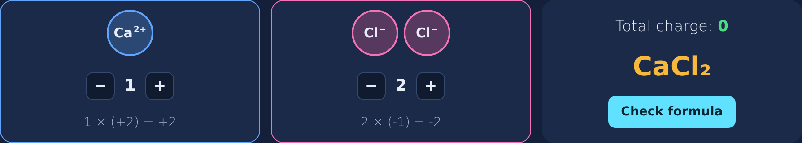
From ions to a formula
Read
1. Write the metal first, then the nonmetal.
2. Use the smallest numbers that make the total charge zero.
3. Show how many of each ion with a subscript. Don't write a 1.
Example: Ca²⁺ and Cl⁻. One Ca²⁺ (+2) needs two Cl⁻ (−1 each) → CaCl₂
Shortcut (criss-cross): each ion's charge becomes the other's subscript. Al³⁺ + O²⁻ → Al₂O₃. Reduce if you can.
Notes:
The formula builder in the lesson shows the total charge updating as students add ions.

Slide 31
Formula builder
Try it
Write the formula for each pair of ions.
Ca²⁺ + Cl⁻
Li⁺ + O²⁻
Al³⁺ + O²⁻
?
?
?
Notes:
Students add ions until the total charge reads 0.

Slide 32
Formula builder
Try it
Answer
Write the formula for each pair of ions.
Ca²⁺ + Cl⁻
Li⁺ + O²⁻
Al³⁺ + O²⁻
CaCl₂
Li₂O
Al₂O₃
+2 and 2 × (−1) = 0
2 × (+1) and −2 = 0
2 × (+3) = +6 and 3 × (−2) = −6
Notes:
Watch for Ca₂Cl (subscript on the wrong element) and LiO (charges do not cancel). Always check: does the total charge equal zero?

Slide 33
Quick check
Quick check
Which is the correct formula for the compound of Al³⁺ and Cl⁻?
A
AlCl
B
Al₃Cl
C
Cl₃Al
D
AlCl₃
Notes:
A does not cancel the charge (+3 and −1). B puts the subscript on the wrong element. C writes the nonmetal first.

Slide 34
Quick check
Quick check
Answer
Which is the correct formula for the compound of Al³⁺ and Cl⁻?
A
AlCl
B
Al₃Cl
C
Cl₃Al
D
AlCl₃
Why: Al³⁺ (+3) needs three Cl⁻ (−1 each). Metal first, and the 3 goes after Cl: AlCl₃.
Notes:
A does not cancel the charge (+3 and −1). B puts the subscript on the wrong element. C writes the nonmetal first.

Slide 35
Naming ionic compounds
Section 6 of 9 · about 3 min
In this section
To unlock the next section
Read
Two words, one rule
Answer 3 naming rounds
Try it
Name it
Answer the quick check correctly
Quick check
Name Li₂O
Notes:
Section 6 takes about 3 minutes.

Slide 36
Two words, one rule
Read
1. Say the metal's name as it is: sodium, magnesium.
2. Change the nonmetal's ending to -ide.
Subscripts don't change the name: CaCl₂ is just calcium chloride.
fluorine → fluoride
chlorine → chloride
bromine → bromide
oxygen → oxide
sulfur → sulfide
nitrogen → nitride
Notes:
Ionic compounds never use number prefixes like di- or mono-. Those are for covalent compounds, coming later.

Slide 37
Name it
Try it
Name each compound.
KBr
?
MgO
?
CaF₂
?
Notes:
In the lesson these are multiple choice.

Slide 38
Name it
Try it
Answer
Name each compound.
KBr
potassium bromide
MgO
magnesium oxide
CaF₂
calcium fluoride
Notes:
Common wrong answers: "potassium bromine" (forgot -ide), "magnesium dioxide" (number prefix), "calcium difluoride" (the subscript is not part of the name).

Slide 39
Quick check
Quick check
What is the name of Li₂O?
A
dilithium oxide
B
lithium oxygen
C
lithium oxide
D
lithium dioxide
Notes:
A and D add number prefixes, which ionic names never use. B forgets the -ide ending.

Slide 40
Quick check
Quick check
Answer
What is the name of Li₂O?
A
dilithium oxide
B
lithium oxygen
C
lithium oxide
D
lithium dioxide
Why: Metal name first, then oxygen → oxide. Subscripts are not part of the name.
Notes:
A and D add number prefixes, which ionic names never use. B forgets the -ide ending.

Slide 41
Crystals and properties
Section 7 of 9 · about 3 min
In this section
To unlock the next section
Read
Ions stack into crystals
Try the crystal as a solid and dissolved
Try it
Crystal simulator
Sort the property statements
Try it
True or false?
Answer the quick check correctly
Quick check
Salt water
Notes:
Section 7 takes about 3 minutes.

Slide 42
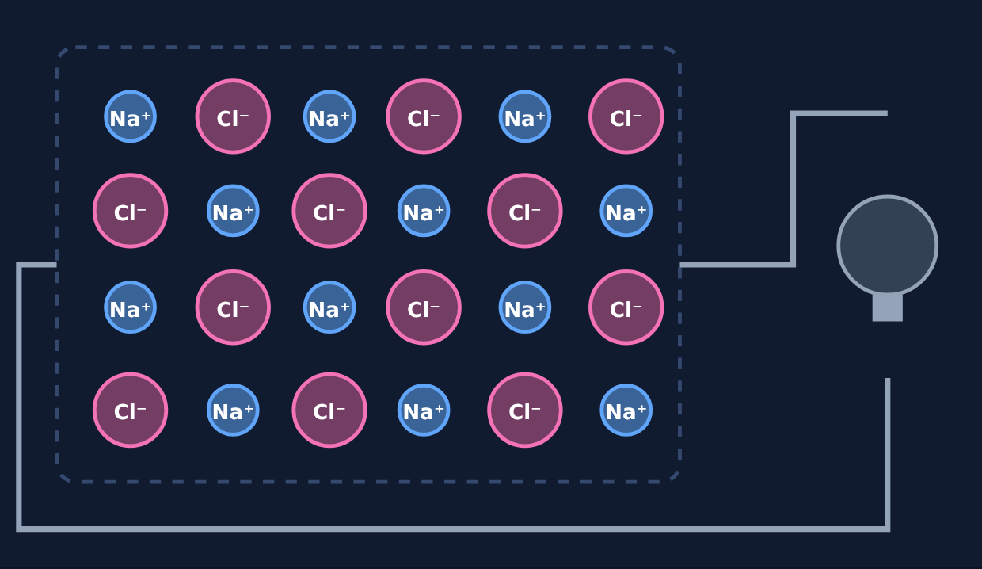
Ions stack into crystals
Read
Each positive ion is surrounded by negative ions and each negative ion by positive ions, in a repeating crystal lattice.
High melting point: lots of attractions to break.
Hard but brittle: shift a layer and like charges repel.
Conducts only when melted or dissolved: then the ions can move.
Notes:
Salt grains are tiny cubes because of the lattice.

Slide 43
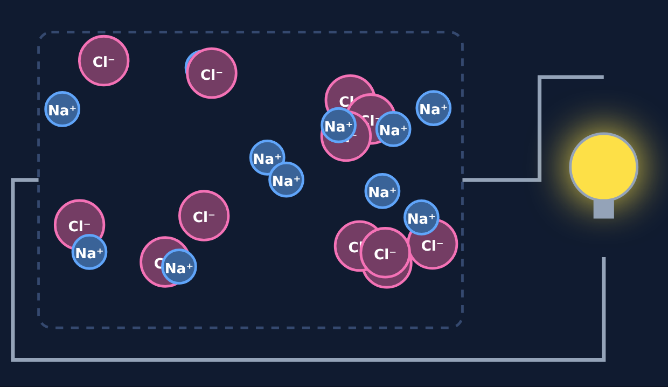
Crystal simulator: solid vs. dissolved
Try it
Solid crystal
Melted or dissolved
Solid: ions only vibrate, so no current flows. Dissolved: ions move and carry the current, so the bulb lights.
Notes:
Ask students to predict which state lights the bulb before showing the right image.

Slide 44
True or false?
Try it
Is each statement about ionic compounds true or false?
They have high melting points
?
They conduct electricity as solids
?
They conduct when dissolved in water
?
Notes:
Students sort these, then check once.

Slide 45
True or false?
Try it
Answer
Is each statement about ionic compounds true or false?
They have high melting points
True
They conduct electricity as solids
False
They conduct when dissolved in water
True
Notes:
The tricky one is conducting as a solid. Remind students the ions are locked in place until melted or dissolved.

Slide 46
Quick check
Quick check
Why does salt water conduct electricity but solid salt does not?
A
Water has more electrons
B
Dissolved ions can move, but in a solid they are locked in place
C
Solid salt has no ions
D
Salt water is a metal
Notes:
A: the water itself is not what carries the current here. C: solid salt is made of ions, they just cannot move. D: salt water is not a metal.

Slide 47
Quick check
Quick check
Answer
Why does salt water conduct electricity but solid salt does not?
A
Water has more electrons
B
Dissolved ions can move, but in a solid they are locked in place
C
Solid salt has no ions
D
Salt water is a metal
Why: Current needs moving charged particles. In solution, Na⁺ and Cl⁻ are free to move.
Notes:
A: the water itself is not what carries the current here. C: solid salt is made of ions, they just cannot move. D: salt water is not a metal.

Slide 48
Spot the mistake
Section 8 of 9 · about 3 min
In this section
To unlock the next section
Read
Check the work
Find the mistake in 3 student examples
Try it
Spot the mistake
Answer the quick check correctly
Quick check
Correct formula
Notes:
Section 8 takes about 3 minutes.

Slide 49
Check the work
Read
1
Direction
2
Balance
Did the electrons move from the metal to the nonmetal?
Do electrons given equal electrons taken?
3
Formula
4
Name
Metal first, smallest numbers, total charge zero?
Does the nonmetal end in -ide?
Notes:
A four-question checklist students can use on any ionic bonding problem.

Slide 50
Spot the mistake
Try it
Each student example has one mistake. Find it.
1. A student drew an arrow showing an electron moving from chlorine to sodium.
What is wrong?
2. A student wrote the formula of magnesium chloride as MgCl.
What is wrong?
3. A student named NaCl "sodium chlorine."
What is wrong?
Notes:
Let groups discuss before revealing.

Slide 51
Spot the mistake
Try it
Answer
Each student example has one mistake. Find it.
1. A student drew an arrow showing an electron moving from chlorine to sodium.
Fix: The electron should move from sodium (the metal) to chlorine.
2. A student wrote the formula of magnesium chloride as MgCl.
Fix: It should be MgCl₂: Mg²⁺ needs two Cl⁻.
3. A student named NaCl "sodium chlorine."
Fix: The nonmetal ends in -ide: sodium chloride.
Notes:
Have students say which checklist step catches each mistake: 1 direction, 2 formula/balance, 3 name.

Slide 52
Quick check
Quick check
Which formula is written correctly?
A
Cl₂Ca
B
CaCl
C
CaCl₂
D
Ca₂Cl
Notes:
A writes the nonmetal first. B does not cancel the charges. D puts the subscript on calcium instead of chlorine.

Slide 53
Quick check
Quick check
Answer
Which formula is written correctly?
A
Cl₂Ca
B
CaCl
C
CaCl₂
D
Ca₂Cl
Why: Metal first, and Ca²⁺ needs two Cl⁻: CaCl₂.
Notes:
A writes the nonmetal first. B does not cancel the charges. D puts the subscript on calcium instead of chlorine.

Slide 54
Final check
Section 9 of 9 · about 7 min
In this section
To unlock the next section
Read
Ten questions on the Chromebook
Score 8 or more out of 10
Try it
Multiple choice, two-part, select all
Notes:
The final check is done in the lesson on the Chromebook. It is not in these slides.

Slide 55
Wrap-up: how does an ionic bond form?
1
2
3
4
Metal has few valence electrons
Electrons move to the nonmetal
Both ions have full outer shells
+ and − ions attract in a lattice
Next: 20 to 30 minutes of worksheet practice.
Notes:
Return to the essential question. Have students explain the chain for MgO using the four steps.

