Slide 1
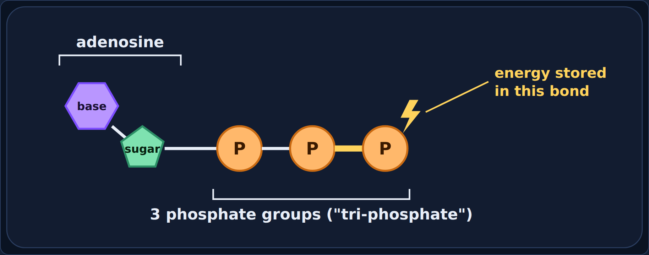
ATP: The Energy Currency
Biology · Unit 2: Energy Flow
Why every cell "pays" for its work with ATP
Notes:
Students work through the lesson on their Chromebooks. Use this deck to go through it together, one section at a time.

Slide 2

The firefly glow test
1
Section 1 of 7 · about 7 min
Fireflies

Slide 3
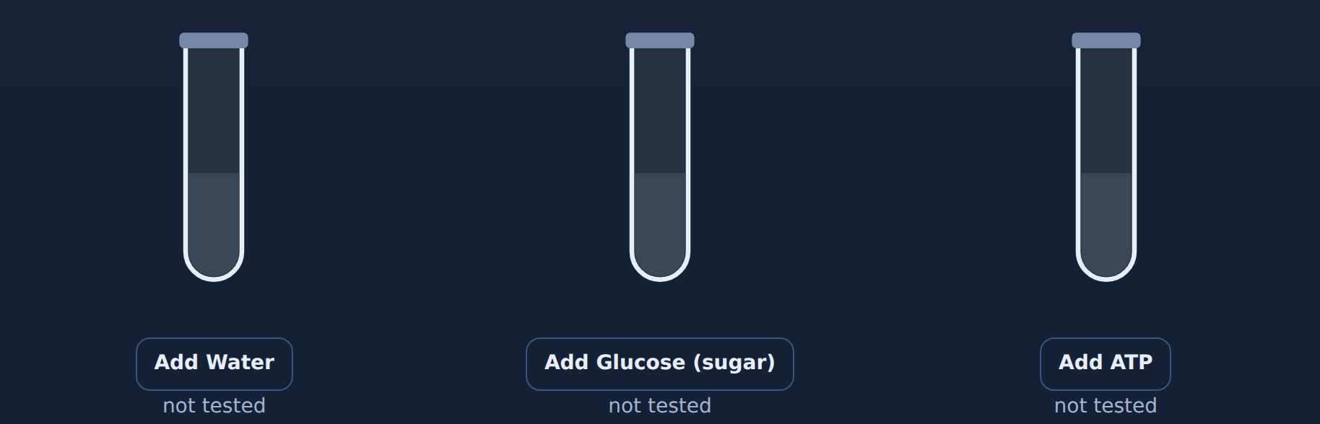
Phenomenon: the firefly glow test
Read
Fireflies make light with chemicals in their tails. In 1947, scientists ground up firefly tails in water. The mixture glowed for a few minutes and then went dark.
They added different things to three tubes of the dark mixture. Glucose holds much more energy than one molecule of ATP. Which one will bring back the glow?
Notes:
Read aloud. Ask: glucose has more energy, so which tube do you predict will glow? Take a quick vote before running the tubes.

Slide 4
Predict: which tube will glow?
Quick check
Which one will bring the glow back?
A
Adding water
B
Adding glucose (sugar)
C
Adding ATP
D
All three
Notes:
Give students a moment to commit to a letter before advancing to the answer slide.

Slide 5
Predict: which tube will glow?
Answer
Which one will bring the glow back?
A
Adding water
Why
Only ATP brought back the glow, even though glucose has more energy.
B
Adding glucose (sugar)
C
Adding ATP
✓
D
All three
Notes:
Correct: Adding ATP. Only ATP brought back the glow, even though glucose has more energy. Why not the others: "Adding water": Water stayed dark. "Adding glucose (sugar)": Glucose stayed dark, even with more energy. "All three": Only one tube glowed.

Slide 6
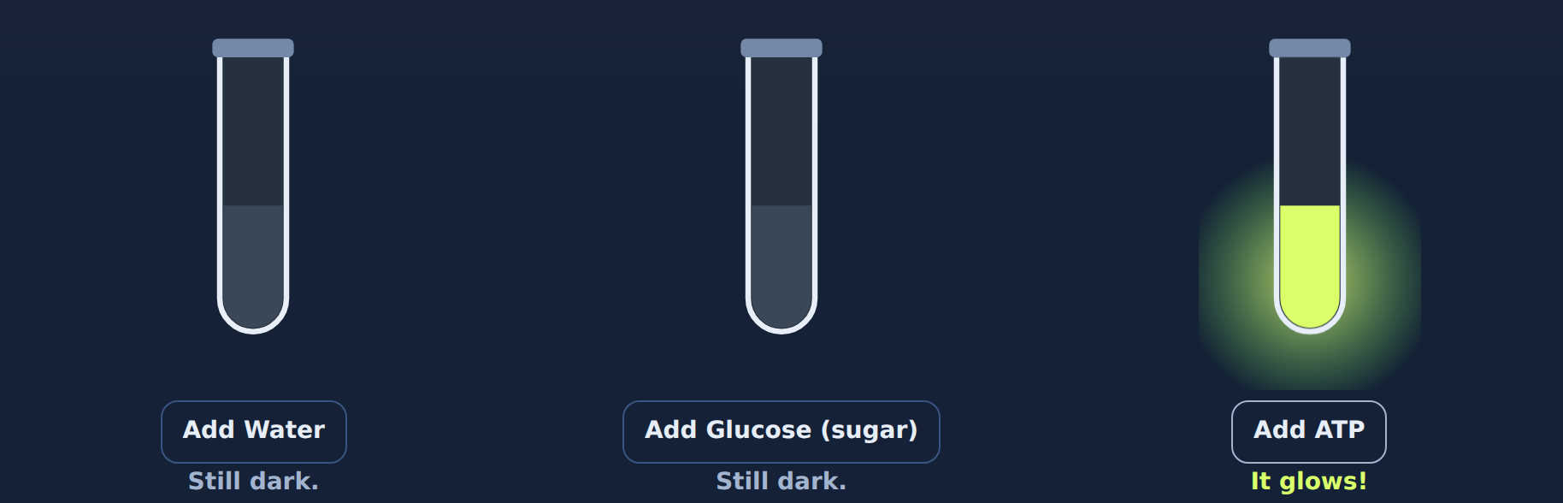
The result
Answer
Your first idea: glucose has more energy. So why did only ATP bring back the glow?
Notes:
Then ask students to write their first idea in the lesson. Don't explain yet; the rest of the lesson answers it.

Slide 7

What ATP is
2
Section 2 of 7 · about 6 min
ATP

Slide 8
A molecule built to carry energy
Read
ATP = adenosine triphosphate
• Adenosine: a base attached to a sugar
• Three phosphate groups ("tri" = three)
The energy is chemical energy stored in the bonds between the phosphates. The last bond is the one the cell usually breaks.
Notes:
Point to each part: base and sugar (adenosine), then the three phosphates. The energy is in the bonds, especially the last one.

Slide 9
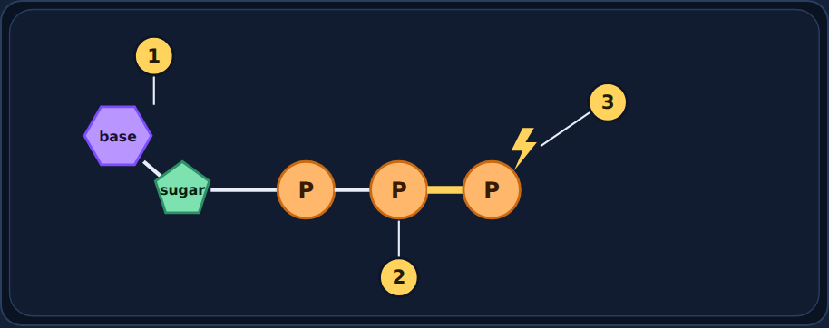
Try it: label ATP
Try it
Label spots 1, 2, and 3.
Choices:
Adenosine (base + sugar) · Phosphate groups · Bond that stores energy · Glucose
Notes:
Students label spots 1–3 in the lesson. Choices: adenosine, phosphate groups, bond that stores energy, glucose.

Slide 10
Try it: label ATP
Answer
1 Adenosine (base + sugar)
2 Phosphate groups
3 Bond that stores energy
Notes:
1 = adenosine (base + sugar). 2 = phosphate groups. 3 = the bond that stores energy. Glucose is not part of ATP.

Slide 11
Quick check
Quick check
Where is the energy in ATP stored?
A
Inside the sugar only
B
In the water around ATP
C
In the cell's DNA
D
In the chemical bonds between the phosphate groups
Notes:
Give students a moment to commit to a letter before advancing to the answer slide.

Slide 12
Quick check
Answer
Where is the energy in ATP stored?
A
Inside the sugar only
Why
ATP stores chemical energy in the bonds between its phosphates.
B
In the water around ATP
C
In the cell's DNA
D
In the chemical bonds between the phosphate groups
✓
Notes:
Correct: In the chemical bonds between the phosphate groups. ATP stores chemical energy in the bonds between its phosphates. Why not the others: "Inside the sugar only": The usable energy is in the phosphate bonds. "In the water around ATP": Water isn't part of ATP. "In the cell's DNA": DNA stores genetic information.

Slide 13
Quick check
Quick check
What does "tri" in adenosine triphosphate mean?
A
Three bonds to glucose
B
Three cells
C
Three phosphate groups
D
Three sugars
Notes:
Give students a moment to commit to a letter before advancing to the answer slide.

Slide 14
Quick check
Answer
What does "tri" in adenosine triphosphate mean?
A
Three bonds to glucose
Why
Tri = three. ATP has three phosphate groups.
B
Three cells
C
Three phosphate groups
✓
D
Three sugars
Notes:
Correct: Three phosphate groups. Tri = three. ATP has three phosphate groups. Why not the others: "Three sugars": There is one sugar. "Three bonds to glucose": ATP isn't bonded to glucose. "Three cells": It's one molecule.

Slide 15
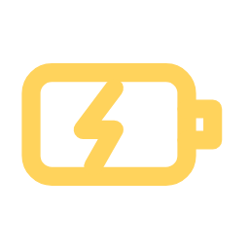
Charging and spending ATP
3
Section 3 of 7 · about 7 min
Recharge

Slide 16
A rechargeable battery
Read
Spending: ATP → ADP + P + energy
Charging: ADP + P + energy → ATP
When a cell needs energy, it breaks the last bond and pops off one phosphate. That releases energy, and ATP becomes ADP ("di" = two phosphates).
Cellular respiration uses energy from glucose to stick the phosphate back on, recharging ADP into ATP. Your cells recycle each ATP over and over, about your whole body weight in ATP every day.
Notes:
"Di" = two. Your body recycles about its own weight in ATP each day, so each molecule is used over and over.

Slide 17
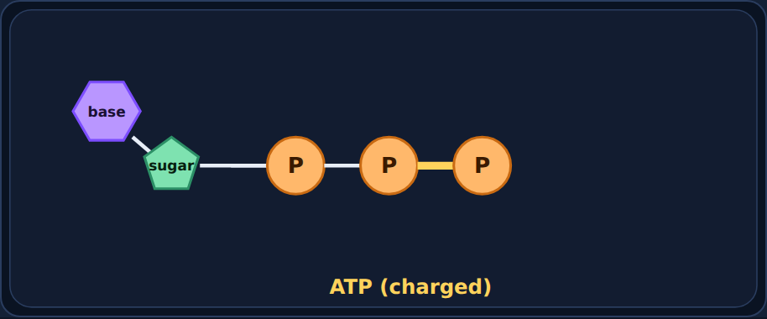
The ATP cycle: 1. Charged
Worked example
ATP has three phosphates. Like a fully charged battery.
Notes:
Step 1 of 4 in the lesson's step-through.

Slide 18
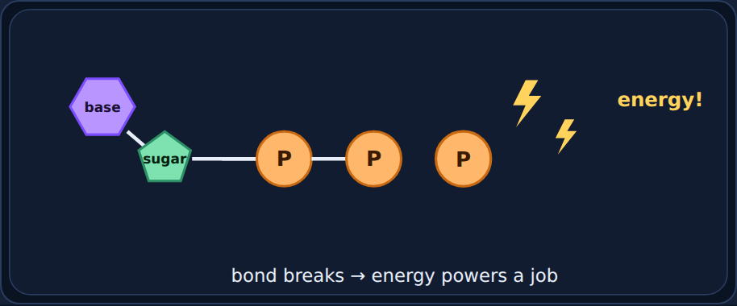
The ATP cycle: 2. Spend
Worked example
The cell breaks the last bond to power a job. Energy is released.
Notes:
Step 2 of 4 in the lesson's step-through.

Slide 19
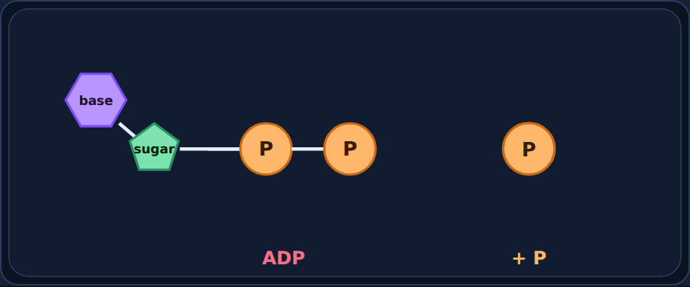
The ATP cycle: 3. Left over
Worked example
Now it is ADP (two phosphates) plus a loose phosphate. Like a used battery.
Notes:
Step 3 of 4 in the lesson's step-through.

Slide 20
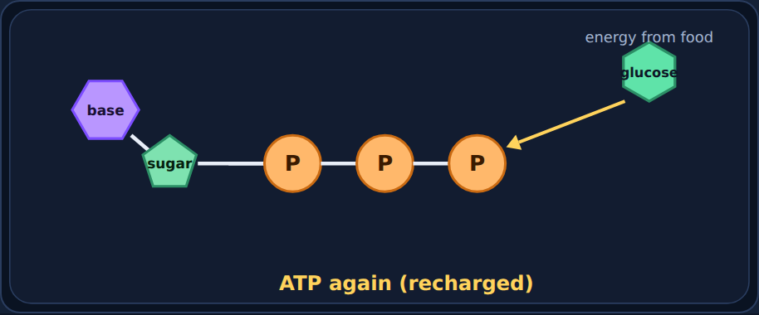
The ATP cycle: 4. Recharge
Worked example
Cellular respiration in the mitochondria uses energy from glucose to reattach the phosphate. ADP becomes ATP again, and the cycle repeats.
Notes:
Step 4 of 4 in the lesson's step-through.

Slide 21
Try it: charging or spending?
Try it
Does each process charge ADP → ATP or spend ATP → ADP?
Cellular respiration breaking down glucose
The light reactions of photosynthesis
A muscle contracting
A firefly making light
Pumping molecules across the membrane
Building a protein
Charges ADP → ATP
Spends ATP → ADP
Notes:
Students sort in the lesson. Ask a few for their reasoning ("does it tell you which way?") before showing the answer.

Slide 22
Try it: charging or spending?
Answer
Does each process charge ADP → ATP or spend ATP → ADP?
Charges ADP → ATP
Spends ATP → ADP
Cellular respiration breaking down glucose
A muscle contracting
A firefly making light
The light reactions of photosynthesis
Pumping molecules across the membrane
Building a protein
Notes:
Respiration (and the light reactions in plants) charge ATP. Almost every job a cell does spends it.

Slide 23
Quick check
Quick check
When ATP releases its energy, what is left over?
A
Carbon dioxide and water
B
ADP and a phosphate group
C
Glucose and oxygen
D
Nothing; ATP is destroyed
Notes:
Give students a moment to commit to a letter before advancing to the answer slide.

Slide 24
Quick check
Answer
When ATP releases its energy, what is left over?
A
Carbon dioxide and water
Why
ATP → ADP + P + energy. The ADP gets recharged later.
B
ADP and a phosphate group
✓
C
Glucose and oxygen
D
Nothing; ATP is destroyed
Notes:
Correct: ADP and a phosphate group. ATP → ADP + P + energy. The ADP gets recharged later. Why not the others: "Glucose and oxygen": Those are inputs of respiration. "Nothing; ATP is destroyed": ATP is recycled, not destroyed. "Carbon dioxide and water": Those are products of respiration.

Slide 25

Why ATP is the energy currency
4
Section 4 of 7 · about 5 min
Currency

Slide 26
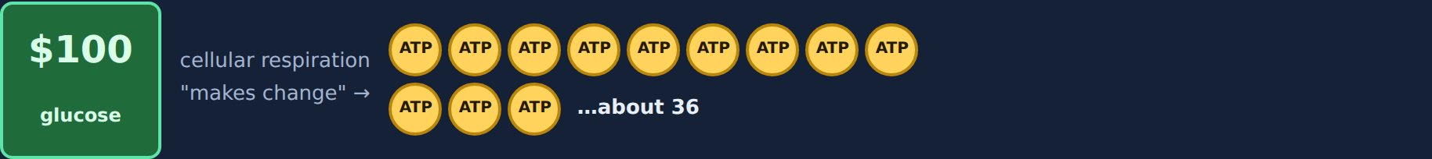
A $100 bill vs. quarters
Read
Glucose holds a lot of energy, like a $100 bill. But a vending machine only takes quarters. The machines inside a cell (the proteins that move muscles, pump molecules, and make light) can only "take" ATP.
Cellular respiration turns one glucose into about 36 ATP with oxygen, or only 2 with fermentation. That is why ATP is the cell's energy currency.
Notes:
A vending machine only takes quarters. The cell's machines only take ATP. Respiration "makes change."

Slide 27
Try it: count the ATP
Try it
A muscle cell breaks down 2 glucose with oxygen. About how many ATP?
Without oxygen, that cell uses fermentation on 2 glucose. How many ATP?
A cell breaks down 5 glucose with oxygen. About how many ATP?
Notes:
Give students a minute to solve all three before showing answers.

Slide 28
Try it: count the ATP
Answer
A muscle cell breaks down 2 glucose with oxygen. About how many ATP?
2 × 36 = 72 ATP
Without oxygen, that cell uses fermentation on 2 glucose. How many ATP?
2 × 2 = 4 ATP
A cell breaks down 5 glucose with oxygen. About how many ATP?
5 × 36 = 180 ATP
Notes:
Multiply glucose × ATP per glucose: about 36 with oxygen, 2 with fermentation.

Slide 29
Quick check
Quick check
Why is ATP called the "energy currency" of the cell?
A
It directly powers most cell processes with small, ready-to-use amounts of energy
B
It stores the cell's genetic information
C
It breaks down nutrients into smaller molecules
D
It is only used in muscle cells
Notes:
Give students a moment to commit to a letter before advancing to the answer slide.

Slide 30
Quick check
Answer
Why is ATP called the "energy currency" of the cell?
A
It directly powers most cell processes with small, ready-to-use amounts of energy
✓
Why
Like money, ATP is the form of energy every cell job can spend.
B
It stores the cell's genetic information
C
It breaks down nutrients into smaller molecules
D
It is only used in muscle cells
Notes:
Correct: It directly powers most cell processes with small, ready-to-use amounts of energy. Like money, ATP is the form of energy every cell job can spend. Why not the others: "It stores the cell's genetic information": That's DNA. "It breaks down nutrients into smaller molecules": Respiration breaks down nutrients; ATP is what it produces. "It is only used in muscle cells": Every cell uses ATP.

Slide 31

What cells spend ATP on
5
Section 5 of 7 · about 6 min
Jobs

Slide 32
Jobs that cost ATP
Read
Almost everything a cell does costs ATP:
• Moving: muscles contracting
• Building: making proteins and DNA
• Dividing: splitting into two cells
• Pumping: active transport, low → high concentration
• Signaling: nerve cells sending messages
• Making light: fireflies!
No ATP needed: passive transport (diffusion and osmosis). Molecules spread from high to low concentration on their own, like a ball rolling downhill.
Notes:
Connect to cell transport: active transport (low → high) costs ATP; diffusion and osmosis (high → low) don't.

Slide 33
Try it: does it cost ATP?
Try it
Sort each cell job.
A muscle contracting
Pumping sodium out (low → high)
Building a protein
A cell dividing in two
A firefly glowing
Oxygen diffusing in (high → low)
Water moving by osmosis
Needs ATP
No ATP needed
Notes:
Students sort in the lesson. Ask a few for their reasoning ("does it tell you which way?") before showing the answer.

Slide 34
Try it: does it cost ATP?
Answer
Sort each cell job.
Needs ATP
No ATP needed
A muscle contracting
Oxygen diffusing in (high → low)
Pumping sodium out (low → high)
Water moving by osmosis
Building a protein
A cell dividing in two
A firefly glowing
Notes:
Doing work and moving "uphill" costs ATP; diffusion and osmosis go "downhill" on their own.

Slide 35
Quick check
Quick check
Why is ATP essential for the survival of all living things?
A
It is only needed for muscles in animals
B
It stores oxygen for the cell
C
It is only used during photosynthesis
D
It provides the energy for vital processes like cell division, building proteins, and moving
Notes:
Give students a moment to commit to a letter before advancing to the answer slide.

Slide 36
Quick check
Answer
Why is ATP essential for the survival of all living things?
A
It is only needed for muscles in animals
Why
Every organism needs ATP to run its cells.
B
It stores oxygen for the cell
C
It is only used during photosynthesis
D
It provides the energy for vital processes like cell division, building proteins, and moving
✓
Notes:
Correct: It provides the energy for vital processes like cell division, building proteins, and moving. Every organism needs ATP to run its cells. Why not the others: "It is only needed for muscles in animals": Plants, fungi, and bacteria use ATP too. "It stores oxygen for the cell": ATP doesn't store oxygen. "It is only used during photosynthesis": All organisms use ATP.

Slide 37

Spot the mistake
6
Section 6 of 7 · about 6 min
Mistake

Slide 38
Jordan's mistake
Quick check
Jordan wrote: "ATP stores the cell's genetic information." What's wrong?
A
ATP has four phosphates
B
Nothing is wrong
C
ATP stores energy, not genetic information
D
ATP is only found in muscles
Notes:
Give students a moment to commit to a letter before advancing to the answer slide.

Slide 39
Jordan's mistake
Answer
Jordan wrote: "ATP stores the cell's genetic information." What's wrong?
A
ATP has four phosphates
Why
DNA stores genetic information; ATP carries energy.
B
Nothing is wrong
C
ATP stores energy, not genetic information
✓
D
ATP is only found in muscles
Notes:
Correct: ATP stores energy, not genetic information. DNA stores genetic information; ATP carries energy. Why not the others: "ATP is only found in muscles": Not Jordan's mistake. "ATP has four phosphates": ATP has three phosphates, but that isn't what Jordan said. "Nothing is wrong": Think about what DNA does.

Slide 40
Now fix it
Quick check
Where is the energy in ATP stored?
A
In the nucleus
B
In the bonds between its phosphate groups
C
In its DNA
D
In the water it carries
Notes:
Give students a moment to commit to a letter before advancing to the answer slide.

Slide 41
Now fix it
Answer
Where is the energy in ATP stored?
A
In the nucleus
Why
Chemical energy is stored in the phosphate bonds.
B
In the bonds between its phosphate groups
✓
C
In its DNA
D
In the water it carries
Notes:
Correct: In the bonds between its phosphate groups. Chemical energy is stored in the phosphate bonds.

Slide 42
Sam's mistake
Quick check
Sam wrote: "Once a cell uses ATP, that molecule is gone forever." What's wrong?
A
It becomes ADP + P and gets recharged into ATP
B
It turns into glucose
C
It turns into DNA
D
Nothing is wrong
Notes:
Give students a moment to commit to a letter before advancing to the answer slide.

Slide 43
Sam's mistake
Answer
Sam wrote: "Once a cell uses ATP, that molecule is gone forever." What's wrong?
A
It becomes ADP + P and gets recharged into ATP
✓
Why
ATP is recycled over and over.
B
It turns into glucose
C
It turns into DNA
D
Nothing is wrong
Notes:
Correct: It becomes ADP + P and gets recharged into ATP. ATP is recycled over and over. Why not the others: "It turns into glucose": ATP doesn't become glucose. "It turns into DNA": ATP doesn't become DNA. "Nothing is wrong": ATP is reused.

Slide 44
Now fix it
Quick check
What recharges ADP back into ATP?
A
Diffusion
B
Osmosis
C
The nucleus
D
Cellular respiration, using energy from glucose
Notes:
Give students a moment to commit to a letter before advancing to the answer slide.

Slide 45
Now fix it
Answer
What recharges ADP back into ATP?
A
Diffusion
Why
Respiration uses energy from food to reattach the phosphate.
B
Osmosis
C
The nucleus
D
Cellular respiration, using energy from glucose
✓
Notes:
Correct: Cellular respiration, using energy from glucose. Respiration uses energy from food to reattach the phosphate.

Slide 46
Riley's mistake
Quick check
Riley wrote: "A muscle cell uses the energy in glucose directly to contract." What's wrong?
A
Muscles don't need energy
B
Nothing is wrong
C
The energy must be moved into ATP first; muscle proteins only use ATP
D
Muscles use DNA for energy
Notes:
Give students a moment to commit to a letter before advancing to the answer slide.

Slide 47
Riley's mistake
Answer
Riley wrote: "A muscle cell uses the energy in glucose directly to contract." What's wrong?
A
Muscles don't need energy
Why
Glucose is the $100 bill; ATP is the quarters.
B
Nothing is wrong
C
The energy must be moved into ATP first; muscle proteins only use ATP
✓
D
Muscles use DNA for energy
Notes:
Correct: The energy must be moved into ATP first; muscle proteins only use ATP. Glucose is the $100 bill; ATP is the quarters. Why not the others: "Muscles use DNA for energy": DNA isn't an energy source. "Muscles don't need energy": Muscles need lots of energy. "Nothing is wrong": Remember the vending machine.

Slide 48
Now fix it
Quick check
What process turns glucose energy into ATP?
A
Diffusion
B
Cellular respiration
C
Osmosis
D
Photosynthesis only
Notes:
Give students a moment to commit to a letter before advancing to the answer slide.

Slide 49
Now fix it
Answer
What process turns glucose energy into ATP?
A
Diffusion
Why
Respiration "makes change" from glucose into ATP.
B
Cellular respiration
✓
C
Osmosis
D
Photosynthesis only
Notes:
Correct: Cellular respiration. Respiration "makes change" from glucose into ATP.

Slide 50
Back to the phenomenon: the firefly glow
Read
Look back at your first idea. Now use what you learned: why did only ATP bring back the glow?
Notes:
Have students reread their first idea from Section 1 before answering.

Slide 51
Part A
Quick check
Why did ATP bring back the glow, but glucose didn't?
A
The glow reaction can only spend ATP, and the ground-up tails couldn't turn glucose into ATP
B
Glucose has less energy than ATP
C
Glucose blocks light
D
Water was mixed into the glucose
Notes:
Give students a moment to commit to a letter before advancing to the answer slide.

Slide 52
Part A
Answer
Why did ATP bring back the glow, but glucose didn't?
A
The glow reaction can only spend ATP, and the ground-up tails couldn't turn glucose into ATP
✓
Why
Cell machines take ATP. Without working cells doing respiration, the glucose couldn't be "changed" into ATP.
B
Glucose has less energy than ATP
C
Glucose blocks light
D
Water was mixed into the glucose
Notes:
Correct: The glow reaction can only spend ATP, and the ground-up tails couldn't turn glucose into ATP. Cell machines take ATP. Without working cells doing respiration, the glucose couldn't be "changed" into ATP. Why not the others: "Glucose has less energy than ATP": Glucose has more energy, but not in a usable form. "Glucose blocks light": Glucose doesn't block light. "Water was mixed into the glucose": Every tube had water.

Slide 53
Part B
Quick check
After the glow faded again, what had the ATP become?
A
Glucose
B
Light bulbs
C
DNA
D
ADP and phosphate
Notes:
Give students a moment to commit to a letter before advancing to the answer slide.

Slide 54
Part B
Answer
After the glow faded again, what had the ATP become?
A
Glucose
Why
The glow spent the ATP: ATP → ADP + P + energy (light).
B
Light bulbs
C
DNA
D
ADP and phosphate
✓
Notes:
Correct: ADP and phosphate. The glow spent the ATP: ATP → ADP + P + energy (light). Why not the others: "Glucose": ATP doesn't turn back into glucose. "Light bulbs": The light was energy released. "DNA": ATP doesn't become DNA.

Slide 55

Final check
7
Section 7 of 7 · about 8 min
Final

Slide 56
Final check
Read
Take the final check in the lesson: 10 questions, multiple choice, two-part, and select-all.
You need 8 out of 10 to pass. If you don't pass, you'll get a new set of questions.
Notes:
Students take the 10-question final check in the lesson (8 of 10 to pass). It is not shown on slides.

