Slide 1
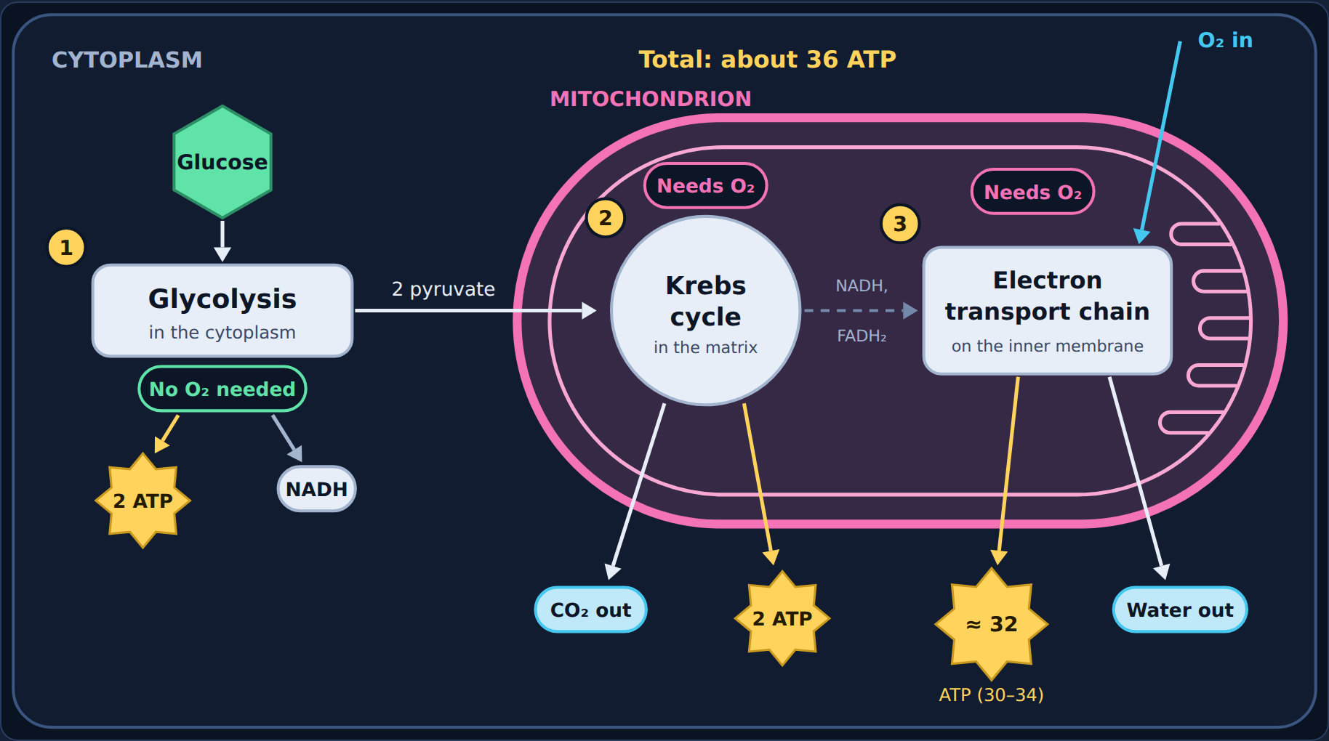
Cellular Respiration
Biology · Unit 2: Energy Flow
How cells turn food into ATP
Notes:
Students work through the lesson on their Chromebooks (about 40 minutes). Use this deck to go through it together.

Slide 2
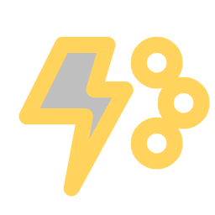
Why cells need energy
1
Section 1 of 9 · about 6 min
Energy

Slide 3
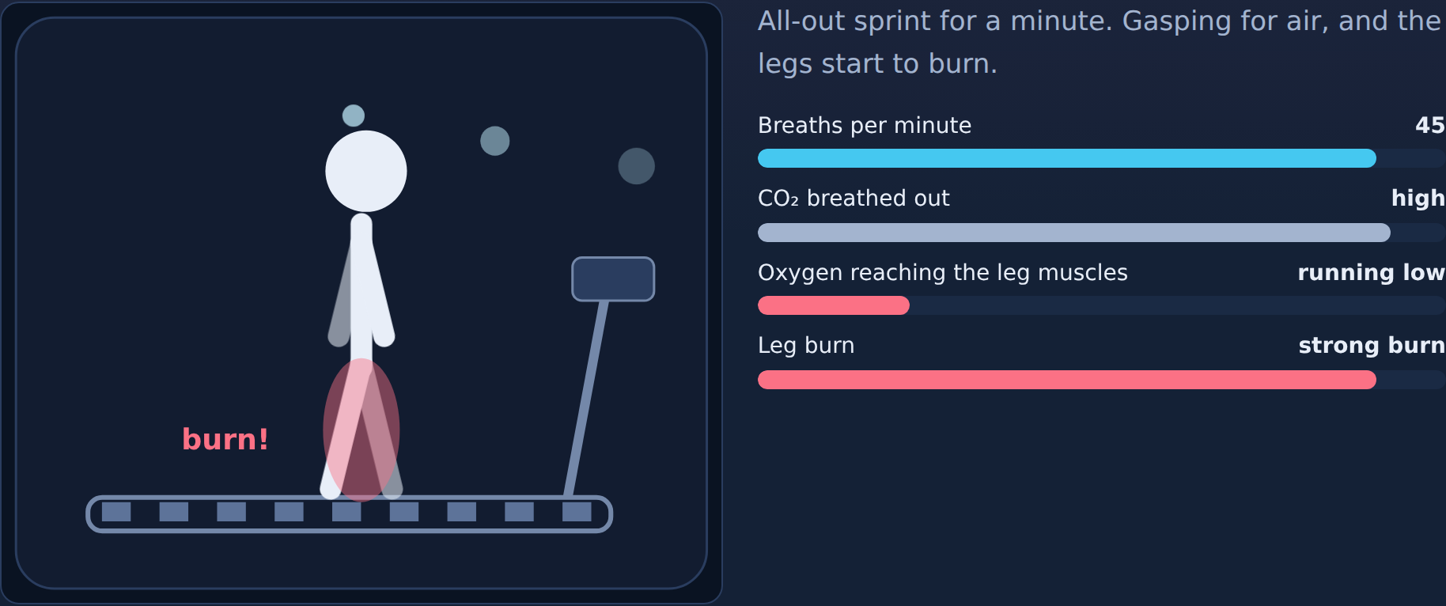
Phenomenon: out of breath
Read
Your first idea: why do we breathe harder when we exercise, and why do the legs burn?
Notes:
Ask: what changes as exercise gets harder? Students try Rest, Jog, and Sprint in the lesson, then write a first idea. Don't explain yet.

Slide 4
ATP: the energy cells spend
Read
Cells can't use the energy in food directly. They store it in ATP, a small molecule they "spend."
Cellular respiration breaks down glucose to make ATP, in almost every living cell, plants and animals.
glucose + oxygen → carbon dioxide + water + ATP
C₆H₁₂O₆ + 6O₂ → 6CO₂ + 6H₂O + ATP
Notes:
Point out the opposite of photosynthesis.

Slide 5
Try it: in or out?
Try it
Does it go in, come out, or is it not part of respiration?
Glucose
Oxygen (O₂)
Carbon dioxide (CO₂)
Water (H₂O)
ATP
Sunlight
Chlorophyll
Goes in
Comes out
Not part of respiration
Notes:
Students sort in the lesson. Ask a few for their reasoning ("does it tell you which way?") before showing the answer.

Slide 6
Try it: in or out?
Answer
Does it go in, come out, or is it not part of respiration?
Goes in
Comes out
Not part of respiration
Glucose
Oxygen (O₂)
Carbon dioxide (CO₂)
Sunlight
Chlorophyll
Water (H₂O)
ATP
Notes:
Sunlight and chlorophyll belong to photosynthesis. Cells respire in the dark too.

Slide 7
Quick check
Quick check
What is the main purpose of cellular respiration?
A
To make ATP the cell can use for energy
B
To make glucose from sunlight
C
To make oxygen for the air
D
To store water
Notes:
Give students a moment to commit to a letter before advancing to the answer slide.

Slide 8
Quick check
Answer
What is the main purpose of cellular respiration?
A
To make ATP the cell can use for energy
✓
Why
Respiration breaks down glucose to make ATP.
B
To make glucose from sunlight
C
To make oxygen for the air
D
To store water
Notes:
Correct: To make ATP the cell can use for energy. Respiration breaks down glucose to make ATP. Why not the others: "To make glucose from sunlight": That is photosynthesis. "To make oxygen for the air": Respiration uses oxygen. "To store water": Water is a product, not the purpose.

Slide 9

The mitochondrion: where it happens
2
Section 2 of 9 · about 4 min
Mito

Slide 10
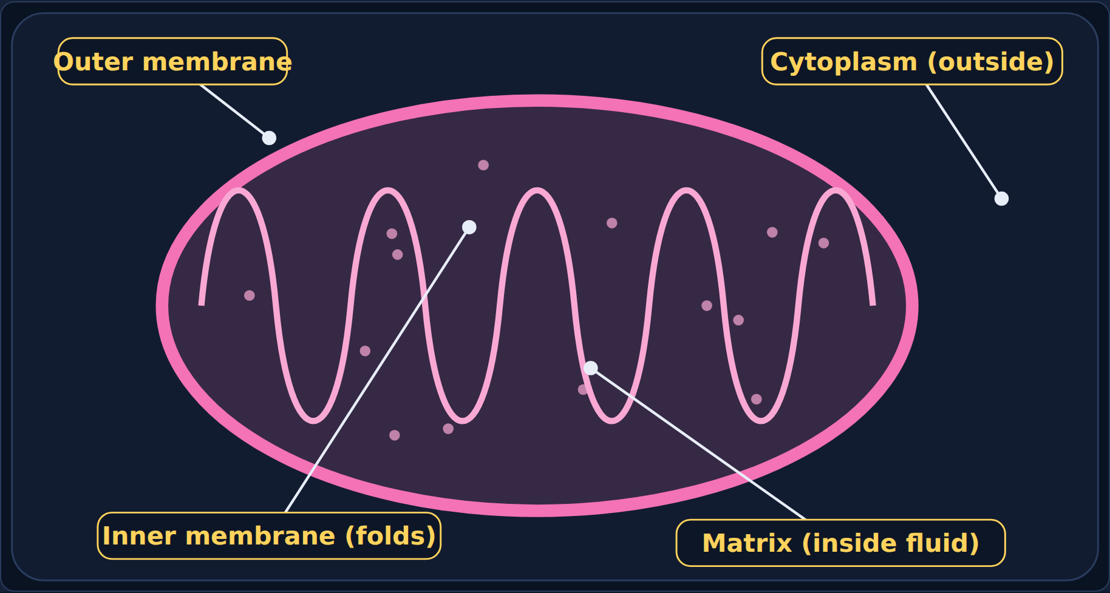
The powerhouse of the cell
Read
Stage | Where
1. Glycolysis | Cytoplasm
2. Krebs cycle | Matrix (inside fluid)
3. Electron transport chain | Inner membrane (folds)
Notes:
Stage 1 is outside the mitochondrion; stages 2 and 3 are inside.

Slide 11
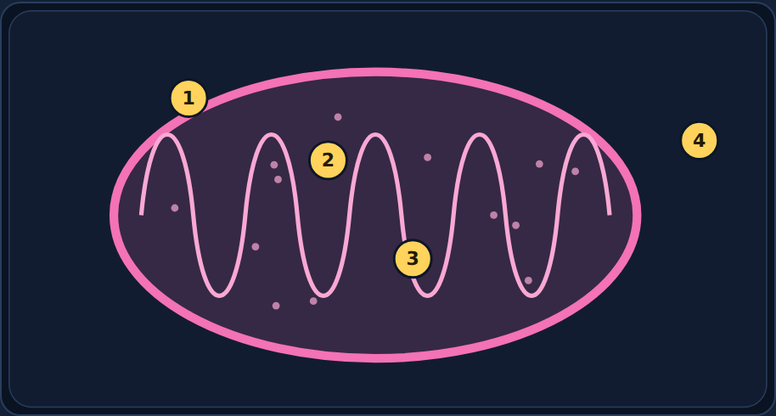
Try it: label the mitochondrion
Try it
Label spots 1–4.
Outer membrane · Inner membrane (folds) · Matrix (inside fluid) · Cytoplasm (outside)
Notes:
Students label spots 1–4 in the lesson.

Slide 12
Try it: label the mitochondrion
Answer
1 Outer membrane
2 Inner membrane (folds)
3 Matrix (inside fluid)
4 Cytoplasm (outside)
Notes:
1 outer membrane, 2 inner membrane (folds), 3 matrix, 4 cytoplasm. The folds give more surface for making ATP.

Slide 13
Quick check
Quick check
Why is the inner membrane of the mitochondrion folded?
A
The folds store glucose
B
The folds keep oxygen out
C
The folds are where glycolysis happens
D
The folds give more surface, so there's room to make more ATP
Notes:
Give students a moment to commit to a letter before advancing to the answer slide.

Slide 14
Quick check
Answer
Why is the inner membrane of the mitochondrion folded?
A
The folds store glucose
Why
More folds, more ETCs, more ATP.
B
The folds keep oxygen out
C
The folds are where glycolysis happens
D
The folds give more surface, so there's room to make more ATP
✓
Notes:
Correct: The folds give more surface, so there's room to make more ATP. More folds, more ETCs, more ATP. Why not the others: "The folds store glucose": Glucose isn't stored there. "The folds keep oxygen out": Oxygen is needed inside. "The folds are where glycolysis happens": Glycolysis is in the cytoplasm.

Slide 15

Stage 1: Glycolysis
3
Section 3 of 9 · about 4 min
Glycolysis

Slide 16
Splitting sugar
Read
Glycolysis means "sugar splitting." It happens in the cytoplasm and does not need oxygen.
One glucose (6 carbons) splits into two pyruvate (3 carbons each). This makes 2 ATP and loads electron carriers (NADH) for stage 3.
Where | Cytoplasm
Needs oxygen? | No
In | Glucose
Out | 2 pyruvate, NADH
ATP made | 2
Notes:
Glycolysis is the only stage that works without oxygen.

Slide 17
Try it: inputs and outputs of glycolysis
Try it
In, out, or not part of glycolysis?
Glucose
2 pyruvate
2 ATP
NADH
Oxygen
Carbon dioxide
In
Out
Not part of glycolysis
Notes:
Students sort in the lesson. Ask a few for their reasoning ("does it tell you which way?") before showing the answer.

Slide 18
Try it: inputs and outputs of glycolysis
Answer
In, out, or not part of glycolysis?
In
Out
Not part of glycolysis
Glucose
2 pyruvate
2 ATP
NADH
Oxygen
Carbon dioxide
Notes:
Glucose in; 2 pyruvate, 2 ATP, NADH out. No oxygen; CO₂ comes later.

Slide 19
Quick check
Quick check
How many ATP does glycolysis make from one glucose?
A
About 32
B
About 36
C
2
D
0
Notes:
Give students a moment to commit to a letter before advancing to the answer slide.

Slide 20
Quick check
Answer
How many ATP does glycolysis make from one glucose?
A
About 32
Why
Glycolysis makes 2 ATP.
B
About 36
C
2
✓
D
0
Notes:
Correct: 2. Glycolysis makes 2 ATP. Why not the others: "0": It does make some. "About 32": That is the ETC. "About 36": That is the total.

Slide 21

Stage 2: The Krebs cycle
4
Section 4 of 9 · about 4 min
Krebs

Slide 22
Breaking down pyruvate
Read
Pyruvate moves into the mitochondrion. In the matrix, the Krebs cycle breaks it down completely.
The carbon leaves as carbon dioxide (CO₂), the gas you breathe out. It makes 2 ATP and loads electron carriers (NADH and FADH₂). It needs oxygen.
Where | Mitochondrion (matrix)
Needs oxygen? | Yes
In | Pyruvate
Out | CO₂, NADH, FADH₂
ATP made | 2
Notes:
Connect to breathing out CO2.

Slide 23
Try it: inputs and outputs of the Krebs cycle
Try it
In, out, or not part of the Krebs cycle?
Pyruvate
Carbon dioxide
2 ATP
NADH and FADH₂
Glucose
Water
In
Out
Not part of Krebs
Notes:
Students sort in the lesson. Ask a few for their reasoning ("does it tell you which way?") before showing the answer.

Slide 24
Try it: inputs and outputs of the Krebs cycle
Answer
In, out, or not part of the Krebs cycle?
In
Out
Not part of Krebs
Pyruvate
Carbon dioxide
2 ATP
Glucose
Water
NADH and FADH₂
Notes:
Pyruvate in; CO₂, 2 ATP, electron carriers out.

Slide 25
Quick check
Quick check
Which gas does the Krebs cycle release?
A
Water vapor
B
Carbon dioxide
C
Oxygen
D
Nitrogen
Notes:
Give students a moment to commit to a letter before advancing to the answer slide.

Slide 26
Quick check
Answer
Which gas does the Krebs cycle release?
A
Water vapor
Why
The carbon from pyruvate leaves as CO₂.
B
Carbon dioxide
✓
C
Oxygen
D
Nitrogen
Notes:
Correct: Carbon dioxide. The carbon from pyruvate leaves as CO₂. Why not the others: "Oxygen": Oxygen is used, not released. "Nitrogen": Not part of respiration. "Water vapor": Water is made in the ETC.

Slide 27

Stage 3: The electron transport chain
5
Section 5 of 9 · about 5 min
ETC

Slide 28
Where most of the ATP is made
Read
The electron transport chain sits on the folded inner membrane. Electron carriers drop off electrons, and the energy makes about 32 ATP (30–34).
At the end, oxygen catches the electrons and forms water. That's why you need to breathe oxygen.
Where | Inner membrane (folds)
Needs oxygen? | Yes
In | NADH, FADH₂, oxygen
Out | Water
ATP made | About 32 (30–34)
Notes:
Oxygen is the final electron acceptor.

Slide 29
Try it: inputs and outputs of the ETC
Try it
In, out, or not part of the ETC?
NADH and FADH₂
Oxygen
Water
About 32 ATP
Glucose
Pyruvate
In
Out
Not part of the ETC
Notes:
Students sort in the lesson. Ask a few for their reasoning ("does it tell you which way?") before showing the answer.

Slide 30
Try it: inputs and outputs of the ETC
Answer
In, out, or not part of the ETC?
In
Out
Not part of the ETC
NADH and FADH₂
Oxygen
Water
About 32 ATP
Glucose
Pyruvate
Notes:
Electron carriers + oxygen in; water + about 32 ATP out.

Slide 31
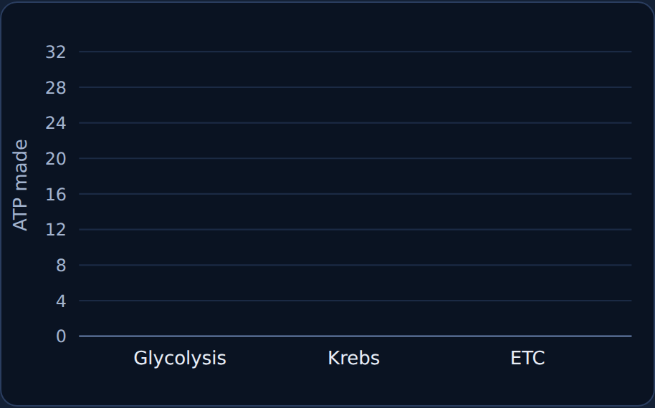
Try it: add up the ATP
Try it
Glycolysis: ?
Krebs cycle: ?
ETC: ?
Total: ?
Notes:
How many ATP does each stage make?

Slide 32
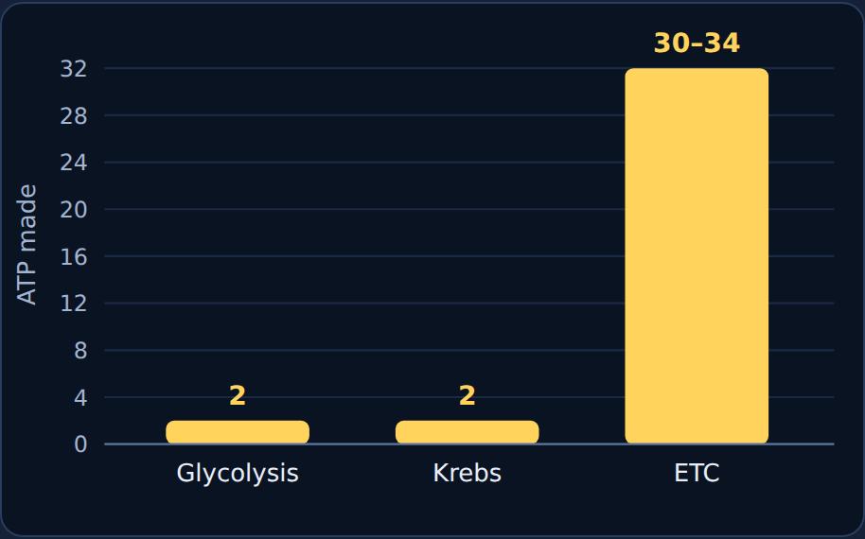
Try it: add up the ATP
Answer
Glycolysis: 2
Krebs cycle: 2
ETC: 30–34
Total: about 36 ATP
Notes:
2 + 2 + about 32 = about 36 ATP per glucose with oxygen.

Slide 33
Quick check
Quick check
What is oxygen's job in the electron transport chain?
A
It catches the electrons at the end and forms water
B
It splits glucose
C
It carries electrons from glycolysis
D
It is released as a waste gas
Notes:
Give students a moment to commit to a letter before advancing to the answer slide.

Slide 34
Quick check
Answer
What is oxygen's job in the electron transport chain?
A
It catches the electrons at the end and forms water
✓
Why
Oxygen is the final electron catcher.
B
It splits glucose
C
It carries electrons from glycolysis
D
It is released as a waste gas
Notes:
Correct: It catches the electrons at the end and forms water. Oxygen is the final electron catcher. Why not the others: "It splits glucose": Glycolysis splits glucose. "It carries electrons from glycolysis": NADH and FADH₂ carry electrons. "It is released as a waste gas": CO₂ is the waste gas.

Slide 35
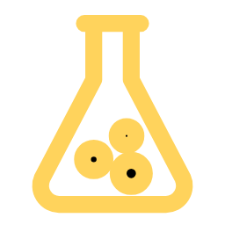
Fermentation: when there's no oxygen
6
Section 6 of 9 · about 4 min
Ferment

Slide 36
Glycolysis without oxygen
Read
Without oxygen, nothing catches electrons at the end of the ETC. The ETC stops, and the Krebs cycle stops with it. Only glycolysis keeps going. Fermentation keeps it running, so the cell still gets 2 ATP.
 | Lactic acid fermentation | Alcoholic fermentation
Who | Your muscle cells; some bacteria | Yeast; some bacteria
Makes | Lactic acid | Alcohol + carbon dioxide
Examples | Muscle burn; yogurt and cheese | Bread rising; making ethanol
ATP | 2 per glucose (from glycolysis only)
Notes:
Only glycolysis keeps going; fermentation adds no extra ATP.

Slide 37
Try it: which kind of fermentation?
Try it
Lactic acid or alcoholic?
Legs burn during a sprint
Bacteria make yogurt
Happens in human muscle cells
Bread dough rises
Yeast make ethanol
Makes CO₂ bubbles
Lactic acid fermentation
Alcoholic fermentation
Notes:
Students sort in the lesson. Ask a few for their reasoning ("does it tell you which way?") before showing the answer.

Slide 38
Try it: which kind of fermentation?
Answer
Lactic acid or alcoholic?
Lactic acid fermentation
Alcoholic fermentation
Legs burn during a sprint
Bacteria make yogurt
Bread dough rises
Yeast make ethanol
Happens in human muscle cells
Makes CO₂ bubbles
Notes:
Muscles and yogurt: lactic acid. Yeast and bread: alcohol + CO₂.

Slide 39
Quick check
Quick check
How many ATP does fermentation get from one glucose?
A
About 36
B
About 32
C
0
D
2
Notes:
Give students a moment to commit to a letter before advancing to the answer slide.

Slide 40
Quick check
Answer
How many ATP does fermentation get from one glucose?
A
About 36
Why
Only the 2 ATP from glycolysis.
B
About 32
C
0
D
2
✓
Notes:
Correct: 2. Only the 2 ATP from glycolysis. Why not the others: "About 36": That needs oxygen. "About 32": That is the ETC. "0": Glycolysis still makes 2.

Slide 41

Aerobic vs. anaerobic
7
Section 7 of 9 · about 5 min
Aerobic?

Slide 42
With and without oxygen
Read
 | Aerobic respiration | Anaerobic (fermentation)
Oxygen? | Needed | Not needed
Stages | Glycolysis → Krebs → ETC | Glycolysis → fermentation
Where | Cytoplasm and mitochondria | Cytoplasm only
ATP per glucose | About 36 | 2
Products | CO₂, water, ATP | Lactic acid, or alcohol + CO₂
Notes:
Both start with glucose and glycolysis.

Slide 43
The oxygen switch: oxygen ON
Worked example
Notes:
All three stages run: about 36 ATP.

Slide 44
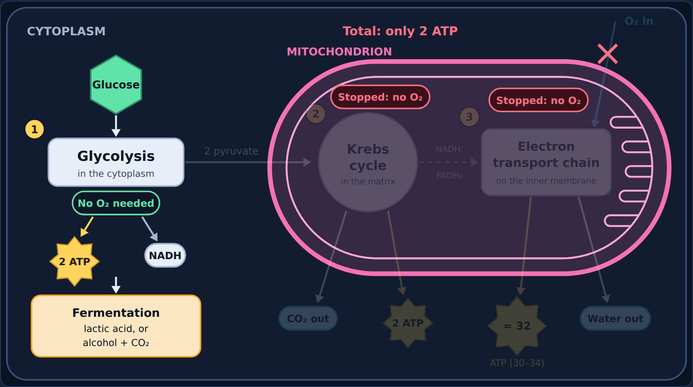
The oxygen switch: oxygen OFF
Worked example
Notes:
Krebs and the ETC stop; only glycolysis + fermentation run: 2 ATP.

Slide 45
Try it: aerobic, anaerobic, or both?
Try it
Sort each statement.
Needs oxygen
Makes about 36 ATP
Uses the mitochondria
Makes only 2 ATP
Makes lactic acid or alcohol
Starts with glycolysis
Starts with glucose
Happens partly in the cytoplasm
Aerobic only
Anaerobic only
Both
Notes:
Students sort in the lesson. Ask a few for their reasoning ("does it tell you which way?") before showing the answer.

Slide 46
Try it: aerobic, anaerobic, or both?
Answer
Sort each statement.
Aerobic only
Anaerobic only
Both
Needs oxygen
Makes only 2 ATP
Starts with glycolysis
Makes about 36 ATP
Makes lactic acid or alcohol
Starts with glucose
Uses the mitochondria
Happens partly in the cytoplasm
Notes:
Both start with glucose and glycolysis; only aerobic uses oxygen and the mitochondria.

Slide 47
Quick check
Quick check
Which stages stop when there is no oxygen?
A
All three stages
B
None of them
C
The Krebs cycle and the electron transport chain
D
Only glycolysis
Notes:
Give students a moment to commit to a letter before advancing to the answer slide.

Slide 48
Quick check
Answer
Which stages stop when there is no oxygen?
A
All three stages
Why
Without oxygen the ETC stops, and Krebs stops with it.
B
None of them
C
The Krebs cycle and the electron transport chain
✓
D
Only glycolysis
Notes:
Correct: The Krebs cycle and the electron transport chain. Without oxygen the ETC stops, and Krebs stops with it. Why not the others: "Only glycolysis": Glycolysis keeps running. "All three stages": Glycolysis keeps running with fermentation. "None of them": The ETC needs oxygen.

Slide 49

Spot the mistake
8
Section 8 of 9 · about 4 min
Mistake

Slide 50
Sam's mistake
Quick check
Sam wrote: "The Krebs cycle breaks down pyruvate and releases oxygen (O₂), which we breathe out." What's wrong?
A
The Krebs cycle happens in the cytoplasm
B
The gas released is wrong
C
The Krebs cycle doesn't break down pyruvate
D
We don't breathe out anything
Notes:
Give students a moment to commit to a letter before advancing to the answer slide.

Slide 51
Sam's mistake
Answer
Sam wrote: "The Krebs cycle breaks down pyruvate and releases oxygen (O₂), which we breathe out." What's wrong?
A
The Krebs cycle happens in the cytoplasm
Why
The Krebs cycle releases carbon dioxide, not oxygen.
B
The gas released is wrong
✓
C
The Krebs cycle doesn't break down pyruvate
D
We don't breathe out anything
Notes:
Correct: The gas released is wrong. The Krebs cycle releases carbon dioxide, not oxygen. Why not the others: "The Krebs cycle doesn't break down pyruvate": It does break down pyruvate. "We don't breathe out anything": We breathe out CO₂. "The Krebs cycle happens in the cytoplasm": Sam didn't say that.

Slide 52
Now fix it
Quick check
Which gas does the Krebs cycle release?
A
Carbon dioxide (CO₂)
B
Oxygen (O₂)
C
Nitrogen (N₂)
D
Hydrogen (H₂)
Notes:
Give students a moment to commit to a letter before advancing to the answer slide.

Slide 53
Now fix it
Answer
Which gas does the Krebs cycle release?
A
Carbon dioxide (CO₂)
✓
Why
The carbon from pyruvate leaves as CO₂.
B
Oxygen (O₂)
C
Nitrogen (N₂)
D
Hydrogen (H₂)
Notes:
Correct: Carbon dioxide (CO_{2}). The carbon from pyruvate leaves as CO₂.

Slide 54
Riley's mistake
Quick check
Riley wrote: "When there's no oxygen, the cell switches to fermentation and the ETC keeps making about 32 ATP." What's wrong?
A
Fermentation needs oxygen
B
Cells die right away without oxygen
C
Glycolysis stops without oxygen
D
The ETC stops without oxygen, so the cell only gets 2 ATP
Notes:
Give students a moment to commit to a letter before advancing to the answer slide.

Slide 55
Riley's mistake
Answer
Riley wrote: "When there's no oxygen, the cell switches to fermentation and the ETC keeps making about 32 ATP." What's wrong?
A
Fermentation needs oxygen
Why
Without oxygen only glycolysis runs, with fermentation.
B
Cells die right away without oxygen
C
Glycolysis stops without oxygen
D
The ETC stops without oxygen, so the cell only gets 2 ATP
✓
Notes:
Correct: The ETC stops without oxygen, so the cell only gets 2 ATP. Without oxygen only glycolysis runs, with fermentation. Why not the others: "Fermentation needs oxygen": Fermentation happens without oxygen. "Cells die right away without oxygen": Cells survive a while with fermentation. "Glycolysis stops without oxygen": Glycolysis keeps going.

Slide 56
Now fix it
Quick check
How many ATP does a cell get per glucose using fermentation?
A
About 36
B
0
C
2
D
About 32
Notes:
Give students a moment to commit to a letter before advancing to the answer slide.

Slide 57
Now fix it
Answer
How many ATP does a cell get per glucose using fermentation?
A
About 36
Why
Only the 2 ATP from glycolysis.
B
0
C
2
✓
D
About 32
Notes:
Correct: 2. Only the 2 ATP from glycolysis.

Slide 58
Back to the phenomenon: out of breath
Read
Look back at your first idea. Now explain the sprinter using what you learned.
Notes:
Have students reread their first idea before answering.

Slide 59
Part A
Quick check
Why does the sprinter breathe harder?
A
Because glycolysis needs oxygen
B
To bring in more oxygen for the electron transport chain and get rid of the extra CO₂ from the Krebs cycle
C
To bring in more glucose through the lungs
D
To breathe out extra oxygen the muscles made
Notes:
Give students a moment to commit to a letter before advancing to the answer slide.

Slide 60
Part A
Answer
Why does the sprinter breathe harder?
A
Because glycolysis needs oxygen
Why
Working muscles need more ATP; the ETC needs oxygen to make it, and the Krebs cycle makes more CO₂.
B
To bring in more oxygen for the electron transport chain and get rid of the extra CO₂ from the Krebs cycle
✓
C
To bring in more glucose through the lungs
D
To breathe out extra oxygen the muscles made
Notes:
Correct: To bring in more oxygen for the electron transport chain and get rid of the extra CO_{2} from the Krebs cycle. Working muscles need more ATP; the ETC needs oxygen to make it, and the Krebs cycle makes more CO₂. Why not the others: "To bring in more glucose through the lungs": Glucose comes from food. "To breathe out extra oxygen the muscles made": Muscles use oxygen. "Because glycolysis needs oxygen": Glycolysis doesn't need oxygen.

Slide 61
Part B
Quick check
Why do the legs burn during the sprint?
A
The muscles run low on oxygen and switch to lactic acid fermentation
B
The muscles make too much oxygen
C
The Krebs cycle makes lactic acid
D
The muscles stop doing glycolysis
Notes:
Give students a moment to commit to a letter before advancing to the answer slide.

Slide 62
Part B
Answer
Why do the legs burn during the sprint?
A
The muscles run low on oxygen and switch to lactic acid fermentation
✓
Why
Lactic acid fermentation helps cause the burn.
B
The muscles make too much oxygen
C
The Krebs cycle makes lactic acid
D
The muscles stop doing glycolysis
Notes:
Correct: The muscles run low on oxygen and switch to lactic acid fermentation. Lactic acid fermentation helps cause the burn. Why not the others: "The muscles make too much oxygen": Muscles use oxygen. "The Krebs cycle makes lactic acid": Lactic acid comes from fermentation. "The muscles stop doing glycolysis": Glycolysis keeps going.

Slide 63

Final check
9
Section 9 of 9 · about 5 min
Final

Slide 64
Final check
Read
Take the final check in the lesson: 10 questions, multiple choice, two-part, and select-all.
You need 8 out of 10 to pass. If you don't pass, you'll get a new set of questions.
Notes:
Students take the 10-question final check in the lesson (8 of 10 to pass). It is not shown on slides.

