Slide 1

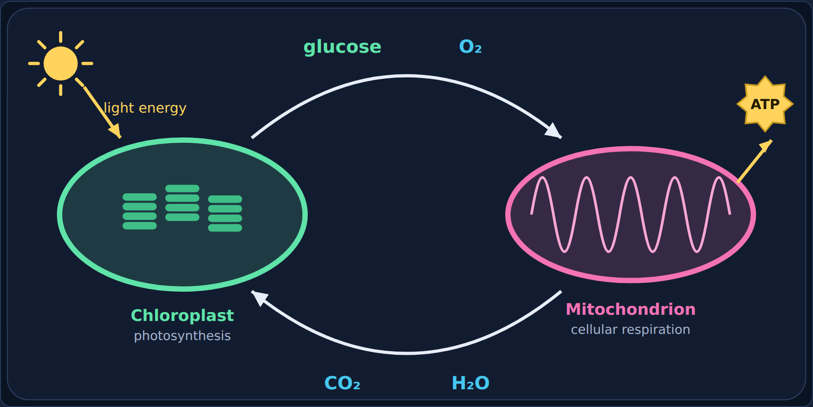
How Photosynthesis and Respiration Connect
Biology · Unit 2: Energy Flow
How two processes feed each other, day and night
Notes:
Students work through the lesson on their Chromebooks (about 35 minutes) while filling in their Cornell notes. Use this deck to go through it together.

Slide 2

1
Section 1 of 8 · about 6 min
The snail and the water plant
Tubes
Notes:
Section 1: The snail and the water plant.

Slide 3
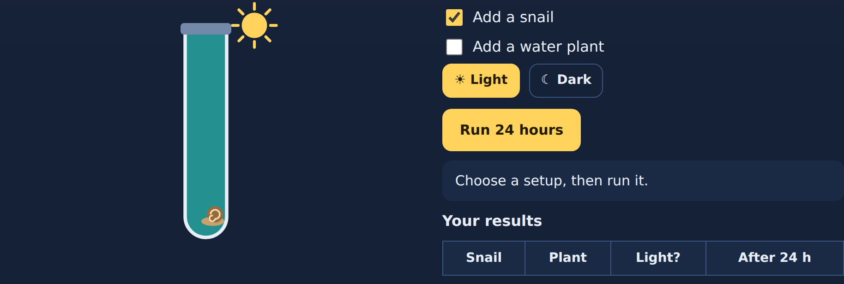
Phenomenon
Phenomenon: the snail and the water plant
Scientists filled sealed test tubes with water and a few drops of bromothymol blue (BTB). BTB is a color indicator for CO₂.
Then they added a snail, a water plant, both, or neither, and left each tube in the light or the dark for 24 hours.
How Photosynthesis and Respiration Connect
3
Notes:
Read aloud. Make sure students know the BTB colors before predicting.

Slide 4
Quick check
Predict
A tube with only a snail sits in the light for 24 hours. What color will the BTB turn?
Yellow
A
Blue
B
Blue-green (no change)
C
Clear
D
How Photosynthesis and Respiration Connect
4
Notes:
Give students a moment to choose before showing the answer.

Slide 5
Answer
Predict
A tube with only a snail sits in the light for 24 hours. What color will the BTB turn?
Yellow ✓
Why
A
The snail does cellular respiration, which gives off CO₂, so the BTB turns yellow.
Blue
B
Blue-green (no change)
C
Clear
D
How Photosynthesis and Respiration Connect
5
Notes:
Correct: Yellow. The snail does cellular respiration, which gives off CO₂, so the BTB turns yellow. Why not the others: "Blue": Blue means less CO₂; nothing in this tube removes CO₂. "Blue-green (no change)": The snail is alive and respiring. "Clear": BTB doesn't turn clear.

Slide 6
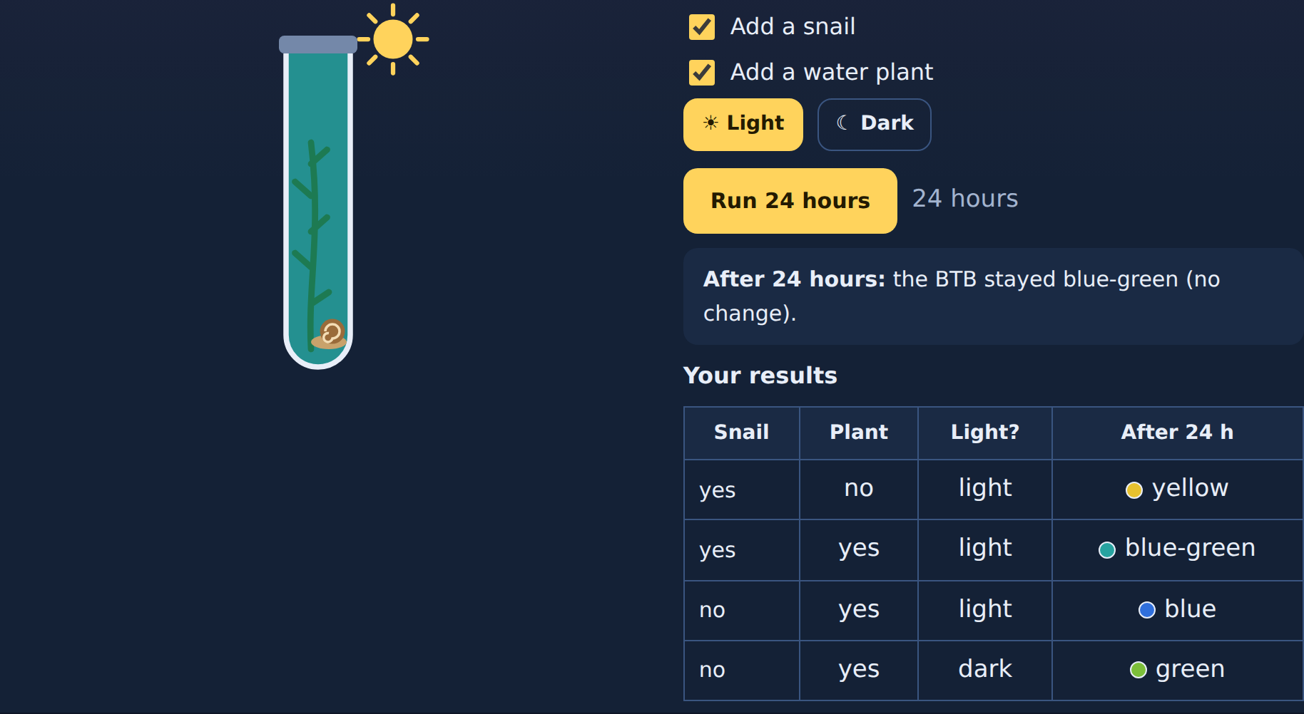
Read
The results
Your first idea: Why did the snail + plant tube in the light barely change, while the others did?
How Photosynthesis and Respiration Connect
6
Notes:
Have students write their first idea in the lesson. Don't explain yet; the rest of the lesson answers it.

Slide 7
Quick check
Quick check
A tube of BTB turns yellow. What does that tell you?
There is less CO₂ in the water than before
A
There is more oxygen in the water
B
Nothing changed
C
There is more CO₂ in the water than before
D
How Photosynthesis and Respiration Connect
7
Notes:
Give students a moment to choose before showing the answer.

Slide 8
Answer
Quick check
A tube of BTB turns yellow. What does that tell you?
There is less CO₂ in the water than before
Why
A
BTB turns yellow when CO₂ builds up.
There is more oxygen in the water
B
Nothing changed
C
There is more CO₂ in the water than before ✓
D
How Photosynthesis and Respiration Connect
8
Notes:
Correct: There is more CO₂ in the water than before. BTB turns yellow when CO₂ builds up. Why not the others: "There is less CO₂ in the water than before": Less CO₂ would turn it blue. "There is more oxygen in the water": BTB shows CO₂, not oxygen. "Nothing changed": A color change means the CO₂ changed.

Slide 9

2
Section 2 of 8 · about 4 min
Two equations, one flipped
Equations
Notes:
Section 2: Two equations, one flipped.

Slide 10
Read
Look at the two equations
Photosynthesis (in the chloroplast)
6CO₂ + 6H₂O + light energy → C₆H₁₂O₆ + 6O₂
Cellular respiration (in the mitochondrion)
C₆H₁₂O₆ + 6O₂ → 6CO₂ + 6H₂O + ATP
Look closely: the two equations are flipped. The products of photosynthesis (glucose and oxygen) are the reactants of cellular respiration, and the products of respiration (carbon dioxide and water) are the reactants of photosynthesis.
The one thing that doesn't flip is the energy: photosynthesis takes in light energy; respiration gives off energy as ATP.
How Photosynthesis and Respiration Connect
10
Notes:
Point out that the products of one are the reactants of the other. The only thing that does not flip is the energy.

Slide 11
Try it
Try it: which process makes it?
Sort each molecule by the process that makes it.
Glucose
Oxygen (O₂)
Carbon dioxide (CO₂)
Water (H₂O)
ATP
Made by photosynthesis
Made by cellular respiration
How Photosynthesis and Respiration Connect
11
Notes:
Students sort these in the lesson. Have them decide each card before showing the answer.

Slide 12
Answer
Try it: which process makes it?
Sort each molecule by the process that makes it.
Made by photosynthesis
Made by cellular respiration
Glucose
Carbon dioxide (CO₂)
Oxygen (O₂)
Water (H₂O)
ATP
How Photosynthesis and Respiration Connect
12
Notes:
What photosynthesis makes, respiration uses, and what respiration makes, photosynthesis uses. ATP is the energy respiration releases.

Slide 13
Quick check
Quick check
The products of photosynthesis are the ______ of cellular respiration.
wastes
A
enzymes
B
reactants
C
products
D
How Photosynthesis and Respiration Connect
13
Notes:
Give students a moment to choose before showing the answer.

Slide 14
Answer
Quick check
The products of photosynthesis are the ______ of cellular respiration.
wastes
Why
A
Glucose and oxygen come out of photosynthesis and go into respiration.
enzymes
B
reactants ✓
C
products
D
How Photosynthesis and Respiration Connect
14
Notes:
Correct: reactants. Glucose and oxygen come out of photosynthesis and go into respiration. Why not the others: "products": Respiration's products are CO₂, water, and ATP. "wastes": They aren't wastes; respiration uses them. "enzymes": Enzymes aren't in these equations.

Slide 15

3
Section 3 of 8 · about 4 min
The cycle
Cycle
Notes:
Section 3: The cycle.

Slide 16
Read
Matter goes around and around
Put the two processes side by side and they make a cycle. The chloroplast sends glucose and oxygen to the mitochondrion. The mitochondrion sends carbon dioxide and water back.
Light energy goes in at the chloroplast; ATP comes out of the mitochondrion.
How Photosynthesis and Respiration Connect
16
Notes:
In a plant, both organelles are in the same cell. Animals get glucose and oxygen from plants and breathe out the CO₂ plants use.

Slide 17
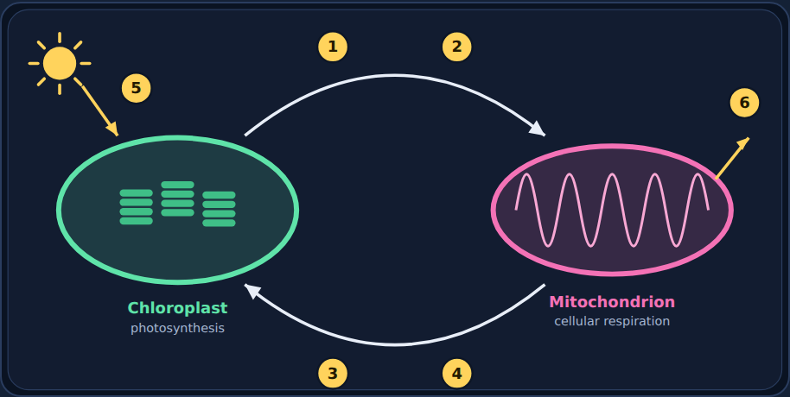
Try it
Try it: label the cycle
Label spots 1–6.
Glucose · Oxygen (O₂) · Carbon dioxide (CO₂) · Water (H₂O) · Light energy · ATP
How Photosynthesis and Respiration Connect
17
Notes:
Students label spots 1–6 in the lesson.

Slide 18
Answer
Try it: label the cycle
1 Glucose
2 Oxygen (O₂)
3 Carbon dioxide (CO₂)
4 Water (H₂O)
5 Light energy
6 ATP
How Photosynthesis and Respiration Connect
18
Notes:
1 glucose and 2 oxygen travel from the chloroplast to the mitochondrion. 3 carbon dioxide and 4 water go back. 5 is light energy in; 6 is ATP out.

Slide 19
Quick check
Quick check
Where does the CO₂ that a plant uses for photosynthesis come from?
Sunlight
A
Cellular respiration, in the plant and in animals
B
The plant's chloroplasts
C
Glucose in the soil
D
How Photosynthesis and Respiration Connect
19
Notes:
Give students a moment to choose before showing the answer.

Slide 20
Answer
Quick check
Where does the CO₂ that a plant uses for photosynthesis come from?
Sunlight
Why
A
Respiration in the plant's own mitochondria and in animals releases the CO₂ plants use.
Cellular respiration, in the plant and in animals ✓
B
The plant's chloroplasts
C
Glucose in the soil
D
How Photosynthesis and Respiration Connect
20
Notes:
Correct: Cellular respiration, in the plant and in animals. Respiration in the plant's own mitochondria and in animals releases the CO₂ plants use. Why not the others: "The plant's chloroplasts": Chloroplasts use CO₂; they don't make it. "Glucose in the soil": Plants make glucose; they don't get it from soil. "Sunlight": Sunlight is energy, not CO₂.

Slide 21

4
Section 4 of 8 · about 3 min
Who has which organelle?
Cells
Notes:
Section 4: Who has which organelle?.

Slide 22
Read
Plants have both
A common mistake is thinking plants do photosynthesis and animals do respiration. Actually, plants do both. Plant cells have chloroplasts and mitochondria. They need ATP too, so they break down the glucose they make.
Organism | Chloroplasts? | Mitochondria? | Photosynthesis? | Cellular respiration?
Plants and algae | Yes | Yes | Yes (in light) | Yes (all the time)
Animals | No | Yes | No | Yes (all the time)
Fungi (mushrooms, yeast) | No | Yes | No | Yes (all the time)
How Photosynthesis and Respiration Connect
22
Notes:
Address the common misconception directly: plants do photosynthesis AND cellular respiration.

Slide 23
Try it
Try it: sort the organisms
Which organelles does each organism have?
Oak tree
Grass
Algae
Water plant
Human
Snail
Mushroom
Yeast
Chloroplasts and mitochondria
Mitochondria only
How Photosynthesis and Respiration Connect
23
Notes:
Students sort these in the lesson. Have them decide each card before showing the answer.

Slide 24
Answer
Try it: sort the organisms
Which organelles does each organism have?
Chloroplasts and mitochondria
Mitochondria only
Oak tree
Human
Grass
Snail
Algae
Mushroom
Water plant
Yeast
How Photosynthesis and Respiration Connect
24
Notes:
Every one of these organisms does cellular respiration. Only plants and algae also do photosynthesis. Yeast and mushrooms are fungi, not plants.

Slide 25
Quick check
Quick check
Does a plant cell do cellular respiration?
Yes, in its mitochondria, all the time
A
No, plants only do photosynthesis
B
Only at night
C
Only when it is cut
D
How Photosynthesis and Respiration Connect
25
Notes:
Give students a moment to choose before showing the answer.

Slide 26
Answer
Quick check
Does a plant cell do cellular respiration?
Yes, in its mitochondria, all the time ✓
Why
A
Plant cells have mitochondria and respire day and night.
No, plants only do photosynthesis
B
Only at night
C
Only when it is cut
D
How Photosynthesis and Respiration Connect
26
Notes:
Correct: Yes, in its mitochondria, all the time. Plant cells have mitochondria and respire day and night. Why not the others: "No, plants only do photosynthesis": Plants need ATP too, so they respire. "Only at night": They respire all the time; it's just more noticeable at night. "Only when it is cut": Respiration doesn't need damage.

Slide 27

5
Section 5 of 8 · about 5 min
Day and night
Day/night
Notes:
Section 5: Day and night.

Slide 28
Read
Photosynthesis needs light. Respiration never stops.
A plant does photosynthesis only when there is light. But it does cellular respiration all the time, day and night, because its cells always need ATP.
During the day, photosynthesis is usually much faster than respiration, so a plant gives off more oxygen than it uses. At night, only respiration runs, so the plant takes in oxygen and gives off CO₂, just like an animal.
How Photosynthesis and Respiration Connect
28
Notes:
Emphasize: respiration never stops; photosynthesis needs light.

Slide 29
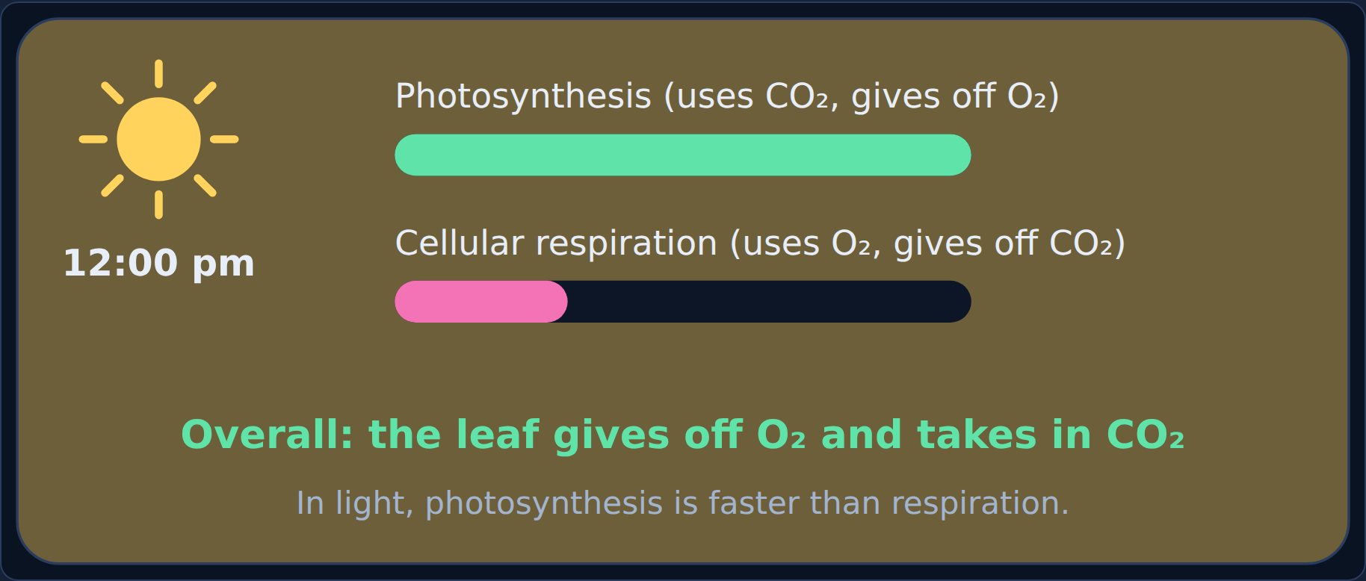
Step through
24 hours in a plant: 12:00 pm
How Photosynthesis and Respiration Connect
29
Notes:
Step 1 of 2 in the lesson's slider. In light, both run, but photosynthesis is faster.

Slide 30
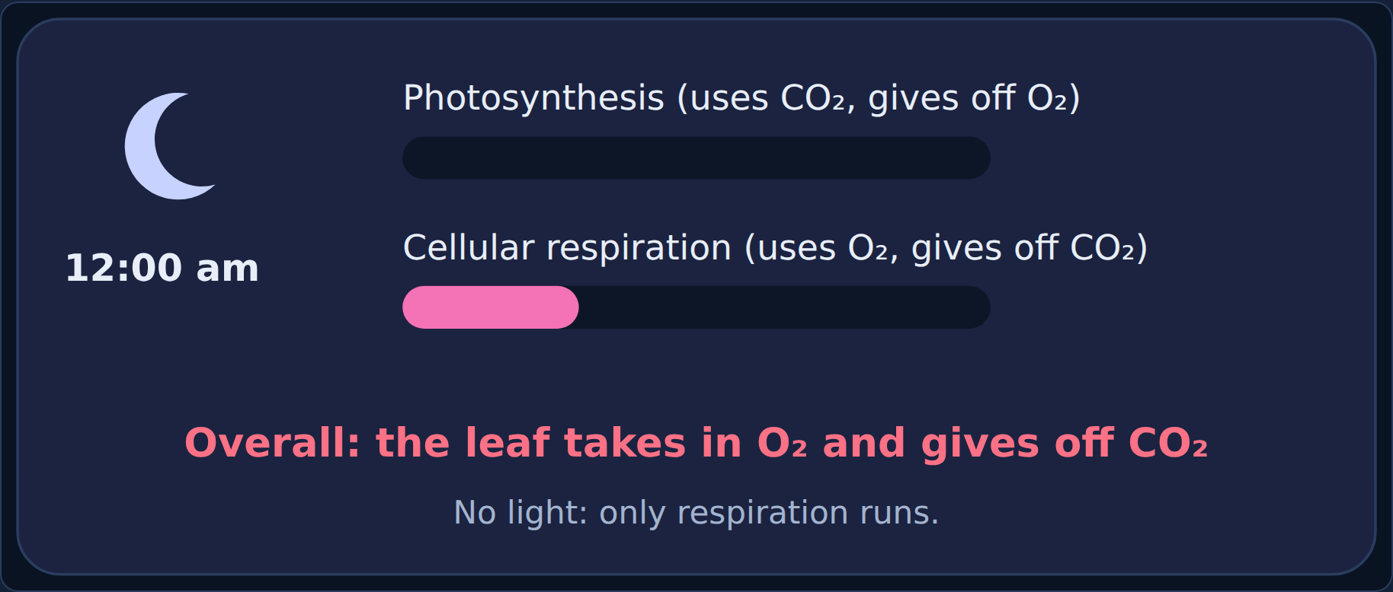
Step through
24 hours in a plant: 12:00 am
How Photosynthesis and Respiration Connect
30
Notes:
Step 2 of 2. No light: photosynthesis stops, respiration keeps going.

Slide 31
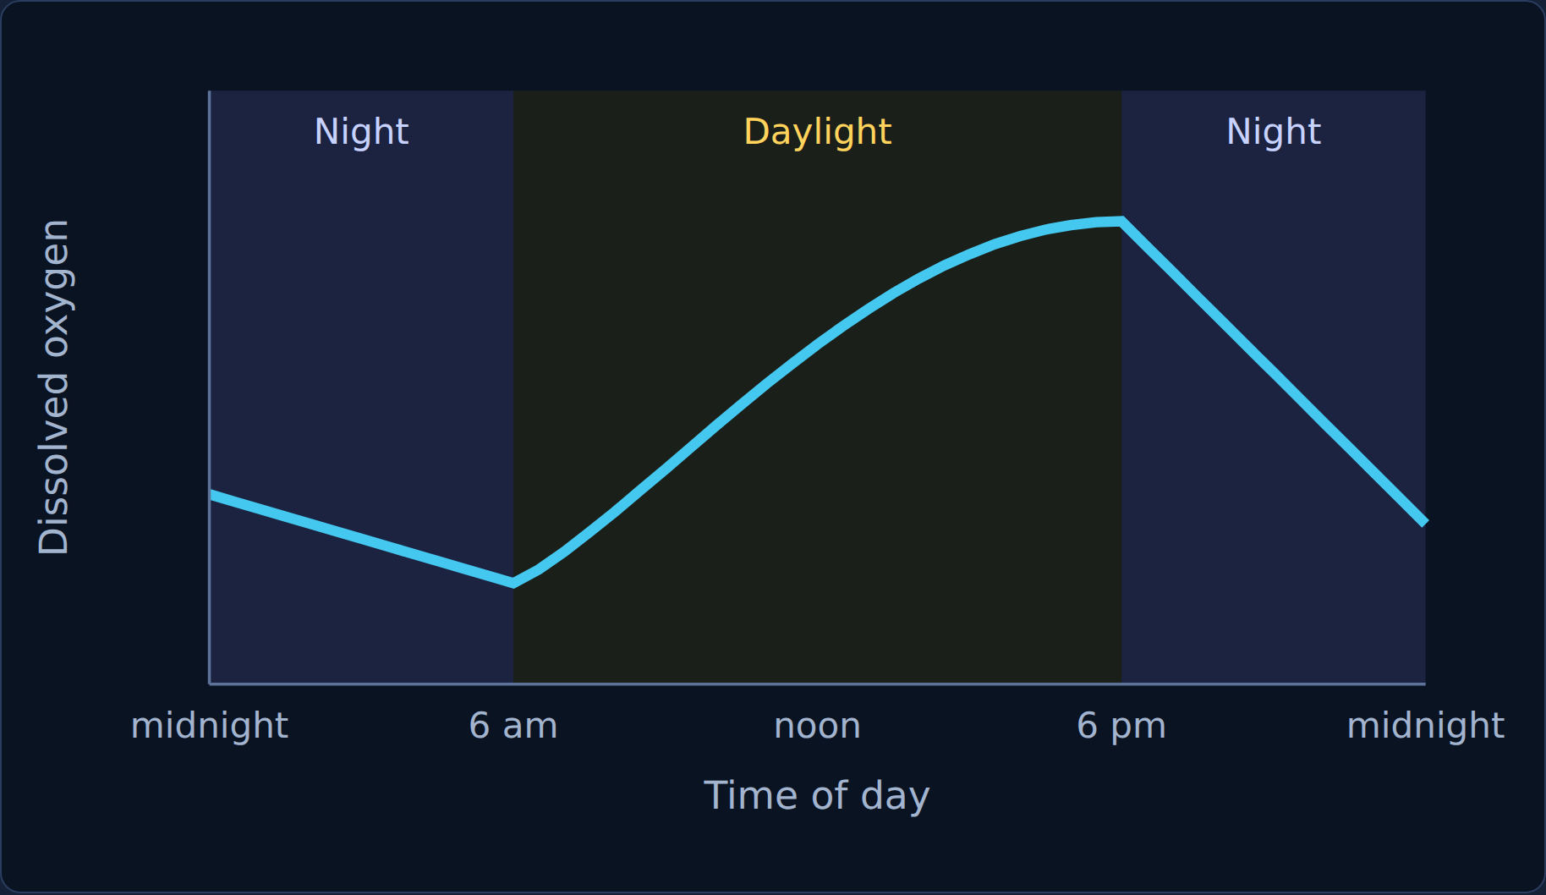
Read
A whole pond over 24 hours
Scientists measured the oxygen dissolved in a pond full of algae, plants, and fish over one day and night.
How Photosynthesis and Respiration Connect
31
Notes:
Ask: when is oxygen highest? Lowest? Why?

Slide 32
Quick check
Quick check
Use the pond graph. Why does dissolved oxygen drop at night?
The water gets warmer at night
A
Plants do more photosynthesis at night
B
Fish stop breathing at night
C
Photosynthesis stops, but every living thing keeps using oxygen for respiration
D
How Photosynthesis and Respiration Connect
32
Notes:
Give students a moment to choose before showing the answer.

Slide 33
Answer
Quick check
Use the pond graph. Why does dissolved oxygen drop at night?
The water gets warmer at night
Why
A
No light means no photosynthesis, but respiration keeps using oxygen.
Plants do more photosynthesis at night
B
Fish stop breathing at night
C
Photosynthesis stops, but every living thing keeps using oxygen for respiration ✓
D
How Photosynthesis and Respiration Connect
33
Notes:
Correct: Photosynthesis stops, but every living thing keeps using oxygen for respiration. No light means no photosynthesis, but respiration keeps using oxygen. Why not the others: "The water gets warmer at night": Water usually cools at night. "Plants do more photosynthesis at night": Photosynthesis needs light. "Fish stop breathing at night": Fish respire all the time.

Slide 34

6
Section 6 of 8 · about 4 min
Back to the tubes
Explain
Notes:
Section 6: Back to the tubes.

Slide 35
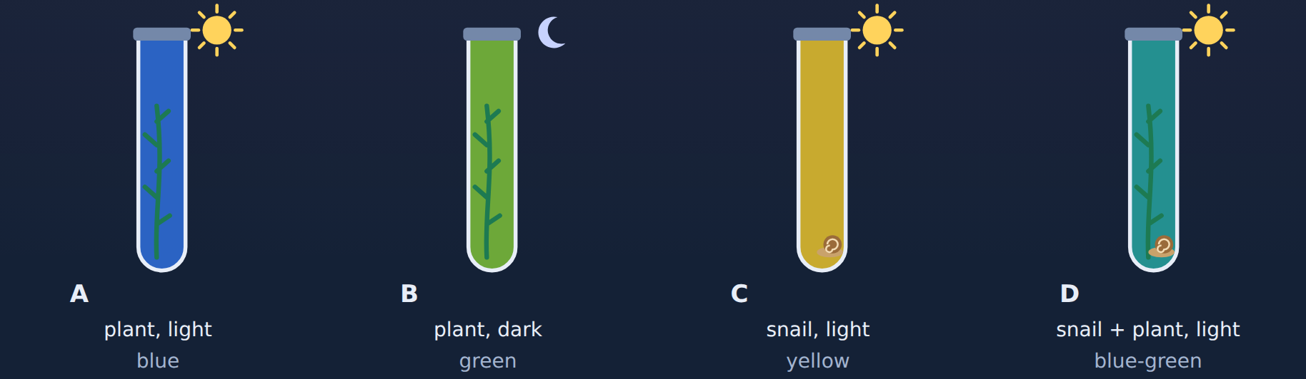
Phenomenon
Back to the phenomenon: explain the tubes
Look back at your first idea. Now use photosynthesis and cellular respiration to explain each tube.
How Photosynthesis and Respiration Connect
35
Notes:
Have students reread their first idea from Section 1 before answering.

Slide 36
Quick check
Explain tube B
Tube B (plant in the dark) turned green. Why did the CO₂ go up?
Plants make CO₂ by photosynthesis
A
The BTB was broken
B
In the dark, the plant only did cellular respiration, which gives off CO₂
C
The plant did extra photosynthesis in the dark
D
How Photosynthesis and Respiration Connect
36
Notes:
Give students a moment to choose before showing the answer.

Slide 37
Answer
Explain tube B
Tube B (plant in the dark) turned green. Why did the CO₂ go up?
Plants make CO₂ by photosynthesis
Why
A
No light means no photosynthesis, but respiration kept adding CO₂.
The BTB was broken
B
In the dark, the plant only did cellular respiration, which gives off CO₂ ✓
C
The plant did extra photosynthesis in the dark
D
How Photosynthesis and Respiration Connect
37
Notes:
Correct: In the dark, the plant only did cellular respiration, which gives off CO₂. No light means no photosynthesis, but respiration kept adding CO₂. Why not the others: "The plant did extra photosynthesis in the dark": Photosynthesis needs light. "Plants make CO₂ by photosynthesis": Photosynthesis uses CO₂. "The BTB was broken": The other tubes show the BTB works.

Slide 38
Quick check
Predict
A snail + plant tube is left in the dark for 24 hours. What color will it turn?
Green, because only the plant respires
A
Yellow, because the snail and the plant both respire and nothing uses the CO₂
B
Blue, because the plant uses the CO₂
C
Blue-green, because nothing happens in the dark
D
How Photosynthesis and Respiration Connect
38
Notes:
Give students a moment to choose before showing the answer.

Slide 39
Answer
Predict
A snail + plant tube is left in the dark for 24 hours. What color will it turn?
Green, because only the plant respires
Why
A
In the dark both respire and there is no photosynthesis, so CO₂ builds up fast.
Yellow, because the snail and the plant both respire and nothing uses the CO₂ ✓
B
Blue, because the plant uses the CO₂
C
Blue-green, because nothing happens in the dark
D
How Photosynthesis and Respiration Connect
39
Notes:
Correct: Yellow, because the snail and the plant both respire and nothing uses the CO₂. In the dark both respire and there is no photosynthesis, so CO₂ builds up fast. Why not the others: "Blue, because the plant uses the CO₂": The plant can't do photosynthesis in the dark. "Blue-green, because nothing happens in the dark": Respiration happens in the dark. "Green, because only the plant respires": The snail respires too.

Slide 40

7
Section 7 of 8 · about 3 min
Spot the mistake
Mistake
Notes:
Section 7: Spot the mistake.

Slide 41
Quick check
Jordan's mistake
Jordan wrote: "Plants do photosynthesis. Animals do cellular respiration." What's wrong?
Plants do cellular respiration too
A
Animals do photosynthesis too
B
Plants don't do photosynthesis
C
Nothing is wrong
D
How Photosynthesis and Respiration Connect
41
Notes:
Give students a moment to choose before showing the answer.

Slide 42
Answer
Jordan's mistake
Jordan wrote: "Plants do photosynthesis. Animals do cellular respiration." What's wrong?
Plants do cellular respiration too ✓
Why
A
Plants have mitochondria and respire all the time.
Animals do photosynthesis too
B
Plants don't do photosynthesis
C
Nothing is wrong
D
How Photosynthesis and Respiration Connect
42
Notes:
Correct: Plants do cellular respiration too. Plants have mitochondria and respire all the time. Why not the others: "Animals do photosynthesis too": Animals have no chloroplasts. "Plants don't do photosynthesis": Plants do photosynthesis. "Nothing is wrong": Look at what plants do.

Slide 43
Quick check
Now fix it
Which organisms do cellular respiration?
Only animals
A
Only plants
B
Only fungi
C
Plants, animals, and fungi
D
How Photosynthesis and Respiration Connect
43
Notes:
Give students a moment to choose before showing the answer.

Slide 44
Answer
Now fix it
Which organisms do cellular respiration?
Only animals
Why
A
Almost all living things respire.
Only plants
B
Only fungi
C
Plants, animals, and fungi ✓
D
How Photosynthesis and Respiration Connect
44
Notes:
Correct: Plants, animals, and fungi. Almost all living things respire. Why not the others: "Only animals": Plants and fungi respire too. "Only plants": Animals and fungi respire too. "Only fungi": Plants and animals respire too.

Slide 45
Quick check
Riley's mistake
Riley wrote: "At night, plants give off extra oxygen." What's wrong?
Plants make glucose faster at night
A
Nothing is wrong
B
At night plants only do cellular respiration, so they use oxygen and give off CO₂
C
Plants stop all processes at night
D
How Photosynthesis and Respiration Connect
45
Notes:
Give students a moment to choose before showing the answer.

Slide 46
Answer
Riley's mistake
Riley wrote: "At night, plants give off extra oxygen." What's wrong?
Plants make glucose faster at night
Why
A
Without light, photosynthesis stops; respiration keeps going.
Nothing is wrong
B
At night plants only do cellular respiration, so they use oxygen and give off CO₂ ✓
C
Plants stop all processes at night
D
How Photosynthesis and Respiration Connect
46
Notes:
Correct: At night plants only do cellular respiration, so they use oxygen and give off CO₂. Without light, photosynthesis stops; respiration keeps going. Why not the others: "Plants stop all processes at night": Respiration never stops. "Plants make glucose faster at night": Photosynthesis needs light. "Nothing is wrong": Look at the pond graph at night.

Slide 47
Quick check
Now fix it
What do plants give off at night?
Light
A
Carbon dioxide
B
Oxygen
C
Glucose
D
How Photosynthesis and Respiration Connect
47
Notes:
Give students a moment to choose before showing the answer.

Slide 48
Answer
Now fix it
What do plants give off at night?
Light
Why
A
At night, plants only respire, so they give off CO₂.
Carbon dioxide ✓
B
Oxygen
C
Glucose
D
How Photosynthesis and Respiration Connect
48
Notes:
Correct: Carbon dioxide. At night, plants only respire, so they give off CO₂. Why not the others: "Oxygen": Oxygen comes from photosynthesis, which needs light. "Glucose": Glucose is made by photosynthesis and kept in the plant. "Light": Plants don't give off light.

Slide 49

8
Section 8 of 8 · about 5 min
Final check
Final
Notes:
Section 8: Final check.

Slide 50
Read
Final check
Take the final check in the lesson: 10 questions, multiple choice, two-part, and select-all.
You need 8 out of 10 to pass. If you don't pass, you'll get a new set of questions.
How Photosynthesis and Respiration Connect
50
Notes:
Students take the 10-question final check in the lesson (8 of 10 to pass). It is not shown on slides.

