Slide 1
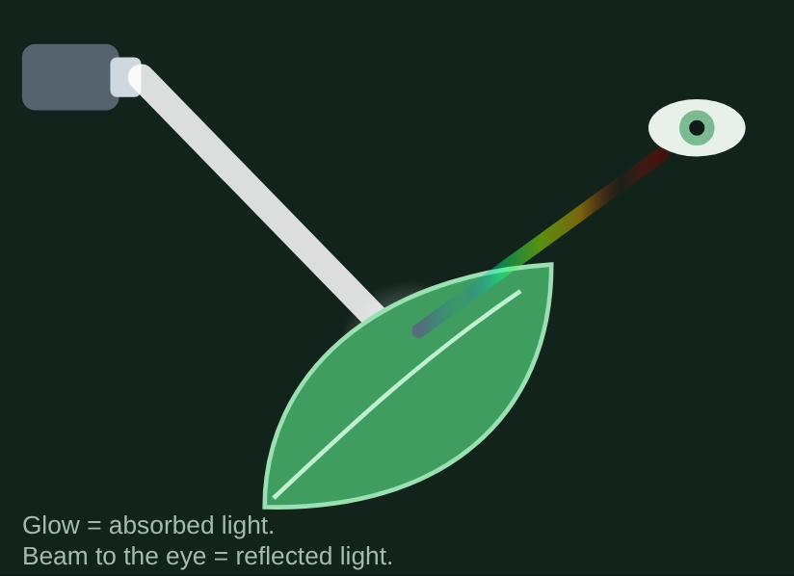
Photosynthesis
Biology Unit 2: Cell Transport, Photosynthesis, and Cellular Respiration
Light, pigments, and the two stages: which colors plants use, how stage 1 charges up ATP and NADPH, and how the Calvin cycle spends them to build sugar.
Notes:
This deck follows the 60-minute self-taught lesson section by section. Read slides introduce each idea. Every question slide is followed by an answer slide, so students can think first.

Slide 2
What we are learning
Overview
Objective
Standard
I can explain how a plant captures light energy and stores it in glucose: which colors of light its pigments absorb, what the light-dependent reactions make, and how the Calvin cycle uses those products to build sugar.
NGSS HS-LS1-5. Use a model to illustrate how photosynthesis transforms light energy into stored chemical energy.

Slide 3
Lesson goals
Overview
I can explain what photosynthesis makes and where it happens.
I can explain why a leaf absorbs some colors of light and reflects others.
I can read absorption and action spectra and explain how they match.
I can describe what the light-dependent reactions use and make.
I can explain how the Calvin cycle uses ATP, NADPH, and CO₂ to build sugar.

Slide 4
The lesson map
Overview
1
2
3
4
5
6
7
8
Cp
Lt
Pg
El
S1
S2
⇄
✓
What photosynthesis does
Light and color
Pigments and the absorption spectrum
Which light drives photosynthesis?
Stage 1: the light-dependent reactions
Stage 2: the Calvin cycle
How the two stages work together
Final check
Each section has Read slides that introduce the idea, Try it slides from the lesson activities, and a Quick check. Every question slide is followed by an Answer slide.

Slide 5
What photosynthesis does
Section 1 of 8, about 6 minutes
1
Cp
Chloroplast
Read
Plants make their own food
Read
Inside a chloroplast
Try it
Label the chloroplast
Try it
In or out? (sort)
Quick check
1 question

Slide 6
Plants make their own food
Read
Section 1 of 8: What photosynthesis does
Photosynthesis turns light energy into chemical energy stored in sugar. The plant takes in carbon dioxide from the air and water from its roots, uses light to rearrange them, and makes glucose and oxygen.
6 CO₂ + 6 H₂O + light energy → C₆H₁₂O₆ + 6 O₂
Stage 1: light-dependent reactions
Stage 2: Calvin cycle
In the thylakoids. Capture light, split water, release O₂, and make the energy carriers ATP and NADPH.
In the stroma. Uses ATP and NADPH from stage 1 to build glucose from CO₂.

Slide 7
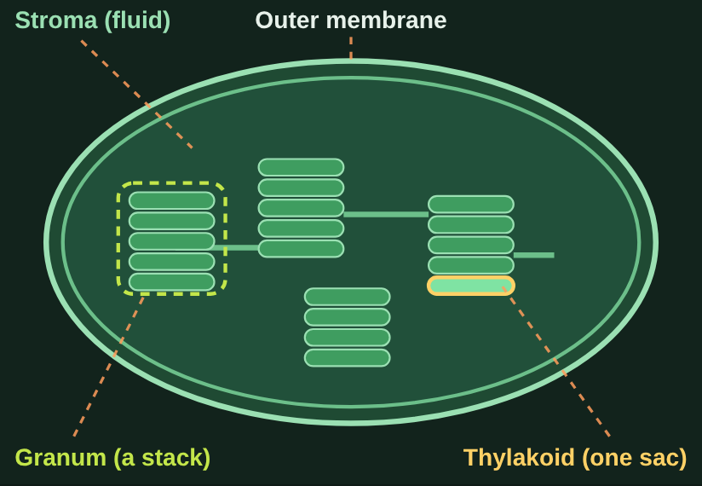
Inside a chloroplast
Read
Section 1 of 8: What photosynthesis does
Outer membrane. Two membranes wrap the chloroplast and control what goes in and out.
Thylakoid. One flat sac packed with chlorophyll. Stage 1 happens here.
Granum. A stack of thylakoids, like a stack of coins. Plural: grana.
Stroma. The thick fluid around the grana. Stage 2 happens here.

Slide 8
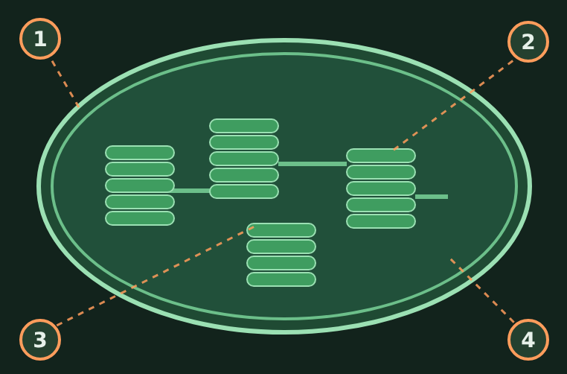
Label the chloroplast
Try it
Section 1 of 8: What photosynthesis does
Match each label to its number.
1. _______________
2. _______________
3. _______________
4. _______________
Labels: Thylakoid · Outer membrane · Stroma (the fluid) · Granum (a stack of thylakoids)

Slide 9
Label the chloroplast
Answer
Section 1 of 8: What photosynthesis does
Answers
1. Outer membrane
2. Granum (a stack of thylakoids)
3. Thylakoid
4. Stroma (the fluid)

Slide 10
In or out?
Try it
Section 1 of 8: What photosynthesis does
Does the plant take it in, or does photosynthesis make it?
Water (H₂O)
Glucose (C₆H₁₂O₆)
Carbon dioxide (CO₂)
Oxygen (O₂)
Light energy
Goes in (reactants)
Comes out (products)
Notes:
Have students sort each item (call them out, or use sticky notes on the board), then reveal the answer on the next slide.

Slide 11
In or out?
Answer
Section 1 of 8: What photosynthesis does
Does the plant take it in, or does photosynthesis make it?
All sorted.
Goes in (reactants)
Comes out (products)
Carbon dioxide (CO₂)
Water (H₂O)
Glucose (C₆H₁₂O₆)
Oxygen (O₂)
Light energy
Notes:
Carbon dioxide (CO₂): Taken in from the air.
Water (H₂O): Taken in by the roots.
Light energy: Absorbed by chlorophyll.
Glucose (C₆H₁₂O₆): The sugar the plant makes.
Oxygen (O₂): Released into the air.

Slide 12
Quick check 1
Quick check
Section 1 of 8: What photosynthesis does
Which list shows only the inputs (reactants) of photosynthesis?
Glucose and oxygen
Carbon dioxide, water, and light energy
A
B
Carbon dioxide, glucose, and light energy
Oxygen, water, and glucose
C
D
Notes:
Give students a moment to pick an answer (hands up, whiteboards, or a quick poll) before revealing it on the next slide.

Slide 13
Quick check 1
Answer
Section 1 of 8: What photosynthesis does
Which list shows only the inputs (reactants) of photosynthesis?
Glucose and oxygen
Carbon dioxide, water, and light energy
A
✓
Carbon dioxide, glucose, and light energy
Oxygen, water, and glucose
C
D
Correct: B. The plant takes in CO₂ and water and uses light energy. Glucose and oxygen are what it makes.
Notes:
Answer: B. The plant takes in CO₂ and water and uses light energy. Glucose and oxygen are what it makes.
If students chose A: Those are the products.
If students chose C: Glucose is made, not taken in.
If students chose D: Oxygen and glucose are products.

Slide 14
Light and color
Section 2 of 8, about 7 minutes
2
Lt
Light
Read
White light is a mix of colors
Try it
Light lab (3 missions)
Quick check
1 question

Slide 15
White light is a mix of colors
Read
Section 2 of 8: Light and color
Sunlight looks white, but it is a mix of every color. Each color has its own wavelength, measured in nanometers (nm): violet is about 400 nm and red is about 700 nm.
When light hits something, it can absorb some colors and reflect others. You see the colors that are reflected. A red apple reflects red light and absorbs the rest.
A leaf absorbs most violet, blue, and red light and reflects much of the green. Only absorbed light can power photosynthesis.

Slide 16
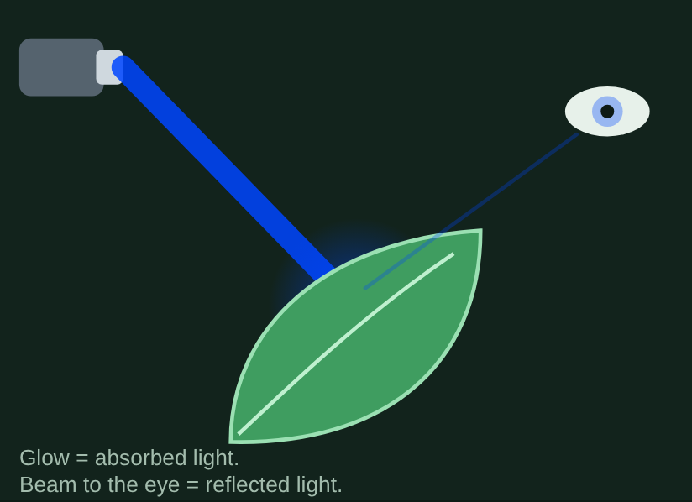
Light lab
Try it
Section 2 of 8: Light and color
Shine different colors on a leaf and watch what is absorbed and reflected.
Mission 1. Find a color of light the leaf absorbs at least 85% of.
Mission 2. Find the color the leaf reflects the most.
Mission 3. Shine white light (all colors). What color reaches the eye?
Notes:
In the lesson, students do these missions in the interactive. Have students predict first, then reveal.

Slide 17
Light lab
Answer
Section 2 of 8: Light and color
What students should find:
Mission 1. Violet-blue (about 430–450 nm) or red (about 660 nm): about 95% absorbed.
Mission 2. Green, around 550 nm: about 80% reflected, only about 20% absorbed.
Mission 3. The red and blue parts are absorbed. Mostly green bounces back, so the leaf looks green.
Notes:
Answers shown.

Slide 18
Quick check 2
Quick check
Section 2 of 8: Light and color
A ripe tomato looks red. Which statement explains why?
It absorbs red light and reflects the other colors
It makes its own red light
A
B
It reflects red light and absorbs most other colors
It reflects every color equally
C
D
Notes:
Give students a moment to pick an answer (hands up, whiteboards, or a quick poll) before revealing it on the next slide.

Slide 19
Quick check 2
Answer
Section 2 of 8: Light and color
A ripe tomato looks red. Which statement explains why?
It absorbs red light and reflects the other colors
It makes its own red light
A
B
It reflects red light and absorbs most other colors
It reflects every color equally
✓
D
Correct: C. You see the colors an object reflects. A tomato reflects red and absorbs the rest, just like a leaf reflects green.
Notes:
Answer: C. You see the colors an object reflects. A tomato reflects red and absorbs the rest, just like a leaf reflects green.
If students chose A: Absorbed light doesn't reach your eye.
If students chose B: Tomatoes don't glow.
If students chose D: Reflecting every color equally would look white.

Slide 20
Pigments and the absorption spectrum
Section 3 of 8, about 8 minutes
3
Pg
Pigments
Read
More than one pigment
Try it
Read the absorption spectrum (3 missions)
Try it
2 graph questions
Quick check
1 question

Slide 21
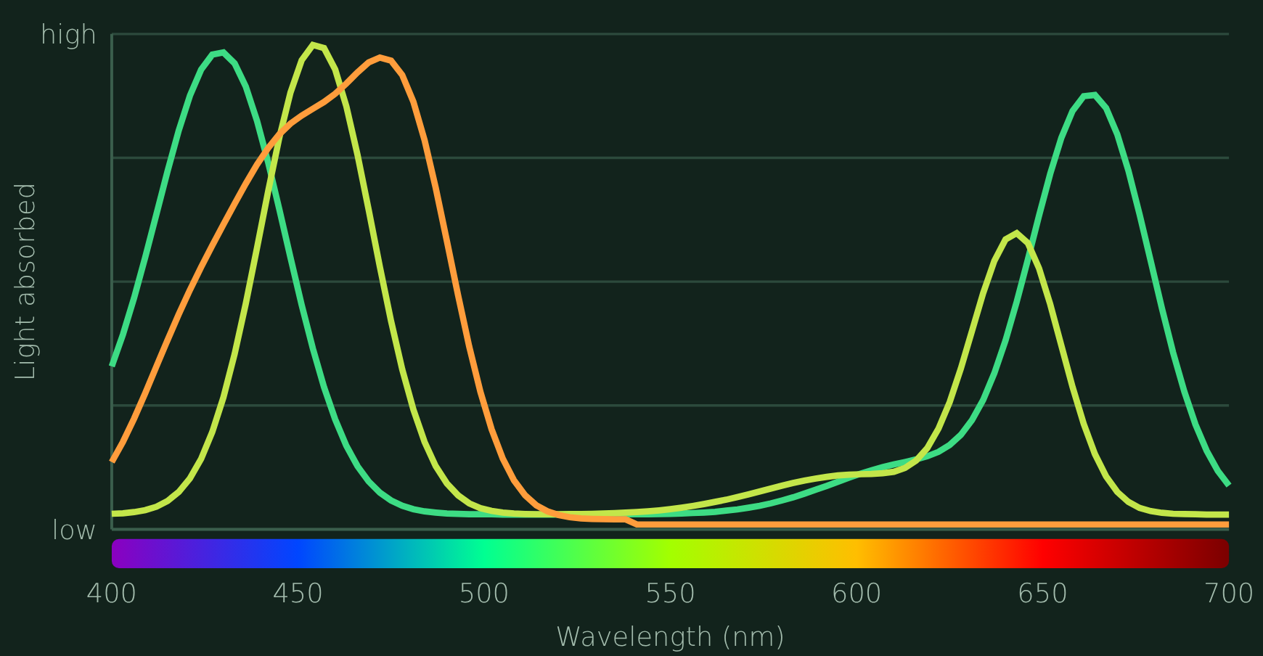
More than one pigment
Read
Section 3 of 8: Pigments and the absorption spectrum
A pigment absorbs certain colors of light. The main one is chlorophyll a. Chloroplasts also hold chlorophyll b and orange-yellow carotenoids. These accessory pigments absorb colors chlorophyll a misses and pass the energy along.
An absorption spectrum graphs how much light a pigment absorbs at each wavelength. Tall peak = lots absorbed. Low spot = reflected.
In fall, chlorophyll breaks down and the carotenoids' yellow and orange show.
Green: chlorophyll a · Yellow-green: chlorophyll b · Orange: carotenoids

Slide 22
Read the absorption spectrum
Try it
Section 3 of 8: Pigments and the absorption spectrum
Use the graph to complete each mission.
Mission 1. Find chlorophyll a's tallest peak.
Mission 2. Find a wavelength where chlorophyll b absorbs more than chlorophyll a.
Mission 3. Find a wavelength where all three pigments absorb very little.
Notes:
In the lesson, students do these missions in the interactive. Have students predict first, then reveal.

Slide 23
Read the absorption spectrum
Answer
Section 3 of 8: Pigments and the absorption spectrum
What students should find:
Mission 1. About 430 nm (violet-blue). Its second peak is in the red, near 660 nm.
Mission 2. About 455 nm or about 640 nm: chlorophyll b catches light chlorophyll a misses.
Mission 3. About 525–600 nm (green-yellow). That light is reflected, which is why leaves look green.
Notes:
Answers shown.

Slide 24
Graph question 1
Try it
Section 3 of 8: Pigments and the absorption spectrum
Use the graph. Which pigment absorbs the most light at 480 nm?
Chlorophyll a
Chlorophyll b
A
B
Carotenoids
All three absorb the same
C
D
Notes:
Give students a moment to pick an answer (hands up, whiteboards, or a quick poll) before revealing it on the next slide.

Slide 25
Graph question 1
Answer
Section 3 of 8: Pigments and the absorption spectrum
Use the graph. Which pigment absorbs the most light at 480 nm?
Chlorophyll a
Chlorophyll b
A
B
Carotenoids
All three absorb the same
✓
D
Correct: C. At 480 nm the carotenoid line is near its peak; both chlorophylls are much lower.
Notes:
Answer: C. At 480 nm the carotenoid line is near its peak; both chlorophylls are much lower.

Slide 26
Graph question 2
Try it
Section 3 of 8: Pigments and the absorption spectrum
Which range of wavelengths do all three pigments absorb the least?
400–450 nm (violet-blue)
450–500 nm (blue)
A
B
525–600 nm (green-yellow)
640–680 nm (red)
C
D
Notes:
Give students a moment to pick an answer (hands up, whiteboards, or a quick poll) before revealing it on the next slide.

Slide 27
Graph question 2
Answer
Section 3 of 8: Pigments and the absorption spectrum
Which range of wavelengths do all three pigments absorb the least?
400–450 nm (violet-blue)
450–500 nm (blue)
A
B
525–600 nm (green-yellow)
640–680 nm (red)
✓
D
Correct: C. Every line dips low between about 525 and 600 nm. That green-yellow light is reflected.
Notes:
Answer: C. Every line dips low between about 525 and 600 nm. That green-yellow light is reflected.

Slide 28
Quick check 3
Quick check
Section 3 of 8: Pigments and the absorption spectrum
Why does a plant benefit from accessory pigments like chlorophyll b and carotenoids?
They reflect extra light so the leaf stays cool
They absorb wavelengths chlorophyll a misses, so the plant captures more light energy
A
B
They make glucose without any light
They are what make leaves look green
C
D
Notes:
Give students a moment to pick an answer (hands up, whiteboards, or a quick poll) before revealing it on the next slide.

Slide 29
Quick check 3
Answer
Section 3 of 8: Pigments and the absorption spectrum
Why does a plant benefit from accessory pigments like chlorophyll b and carotenoids?
They reflect extra light so the leaf stays cool
They absorb wavelengths chlorophyll a misses, so the plant captures more light energy
A
✓
They make glucose without any light
They are what make leaves look green
C
D
Correct: B. Each pigment absorbs a different set of colors. Together they capture more of the spectrum.
Notes:
Answer: B. Each pigment absorbs a different set of colors. Together they capture more of the spectrum.
If students chose A: Accessory pigments are about absorbing.
If students chose C: Glucose is built in the Calvin cycle.
If students chose D: Leaves look green because chlorophyll reflects green.

Slide 30
Which light drives photosynthesis?
Section 4 of 8, about 9 minutes
4
El
Elodea
Read
Absorbed light should mean faster photosynthesis
Try it
Elodea bubble lab
Try it
2 data questions
CER
Claim, evidence, reasoning
Quick check
1 question

Slide 31
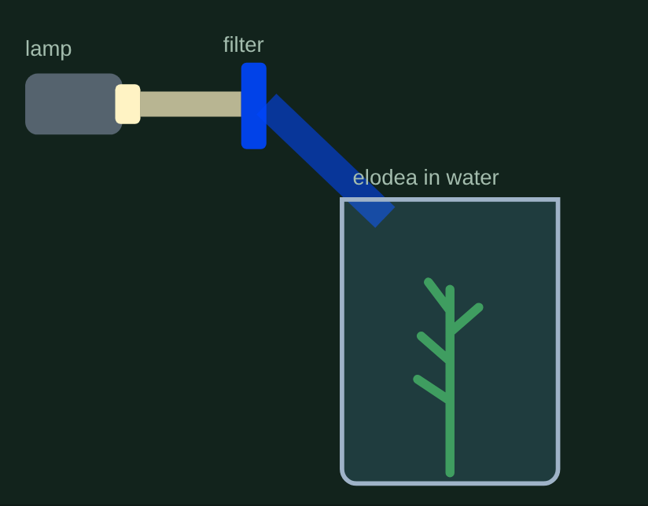
Which light drives photosynthesis?
Read
Section 4 of 8: Which light drives photosynthesis?
The absorption spectrum shows which colors the pigments absorb. But does that light actually power photosynthesis?
Scientists measure how fast photosynthesis happens under each color. That graph is an action spectrum.
One way: put elodea, an underwater plant, under colored light and count the oxygen bubbles it gives off each minute. More bubbles = faster photosynthesis.

Slide 32
Elodea bubble lab
Try it
Section 4 of 8: Which light drives photosynthesis?
Predict: which two filters will give the most oxygen bubbles? Which will give the fewest?
Filter | Wavelength | Bubbles/min
Violet | 410 nm | ?
Blue | 450 nm | ?
Green | 530 nm | ?
Yellow | 580 nm | ?
Orange | 610 nm | ?
Red | 660 nm | ?

Slide 33
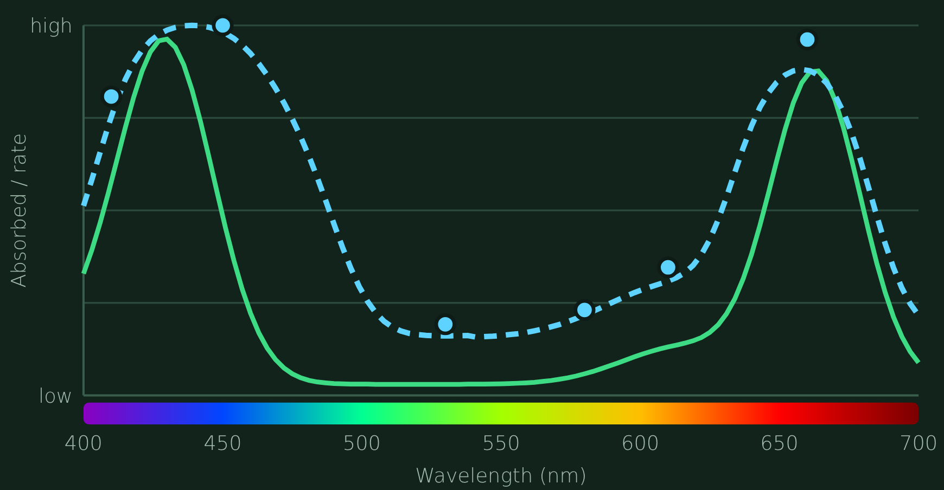
Elodea bubble lab
Answer
Section 4 of 8: Which light drives photosynthesis?
Results: bubbles of O₂ per minute
Filter | Wavelength | Bubbles/min
Violet | 410 nm | 21
Blue | 450 nm | 26
Green | 530 nm | 5
Yellow | 580 nm | 6
Orange | 610 nm | 9
Red | 660 nm | 25
Dots: bubble data · dashed line: action spectrum · solid line: chlorophyll a absorption

Slide 34
Data question 1
Try it
Section 4 of 8: Which light drives photosynthesis?
Which two filters made the elodea give off the most oxygen bubbles?
Green and yellow
Blue and red
A
B
Violet and orange
Yellow and red
C
D
Notes:
Give students a moment to pick an answer (hands up, whiteboards, or a quick poll) before revealing it on the next slide.

Slide 35
Data question 1
Answer
Section 4 of 8: Which light drives photosynthesis?
Which two filters made the elodea give off the most oxygen bubbles?
Green and yellow
Blue and red
A
✓
Violet and orange
Yellow and red
C
D
Correct: B. Blue (26 bubbles per minute) and red (25) were highest. Green (5) was lowest.
Notes:
Answer: B. Blue (26 bubbles per minute) and red (25) were highest. Green (5) was lowest.

Slide 36
Data question 2
Try it
Section 4 of 8: Which light drives photosynthesis?
Compare the action spectrum to chlorophyll a's absorption spectrum. What does the match show?
Plants use green light more than any other color
Absorbed light is wasted, so absorption and rate are unrelated
A
B
The colors pigments absorb best are the colors that drive photosynthesis fastest
Photosynthesis runs at the same rate under every color
C
D
Notes:
Give students a moment to pick an answer (hands up, whiteboards, or a quick poll) before revealing it on the next slide.

Slide 37
Data question 2
Answer
Section 4 of 8: Which light drives photosynthesis?
Compare the action spectrum to chlorophyll a's absorption spectrum. What does the match show?
Plants use green light more than any other color
Absorbed light is wasted, so absorption and rate are unrelated
A
B
The colors pigments absorb best are the colors that drive photosynthesis fastest
Photosynthesis runs at the same rate under every color
✓
D
Correct: C. Both graphs peak in the blue and red and dip in the green. Light must be absorbed before its energy can be used.
Notes:
Answer: C. Both graphs peak in the blue and red and dip in the green. Light must be absorbed before its energy can be used.

Slide 38
Claim, evidence, reasoning
CER
Section 4 of 8: Which light drives photosynthesis?
Which colors of light does a plant use best for photosynthesis? Use your elodea data and the absorption spectrum.
Claim: Plants use …
Evidence: In my data, …
Reasoning: This is because …
Notes:
Have students write their CER before revealing a strong sample answer.

Slide 39
Claim, evidence, reasoning
Answer
Section 4 of 8: Which light drives photosynthesis?
Which colors of light does a plant use best for photosynthesis? Use your elodea data and the absorption spectrum.
Claim: Plants use red and blue light best.
Evidence: In my data, the elodea gave off 26 bubbles per minute under blue light and 25 under red light, but only 5 under green.
Reasoning: This is because chlorophyll absorbs blue and red light, and only absorbed light gives the plant energy for photosynthesis. Green light is mostly reflected.
Notes:
In the lesson, each CER part is checked for key ideas: claim names red and blue; evidence uses bubble numbers; reasoning connects absorbed light to energy for photosynthesis.

Slide 40
Quick check 4
Quick check
Section 4 of 8: Which light drives photosynthesis?
Under green light, the elodea gave off only 5 bubbles per minute. Which explanation fits both graphs?
Green light has no energy at all
The plant is green, so it absorbs green light best
A
B
Green light breaks down chlorophyll
Chlorophyll absorbs little green light, so little energy is captured for photosynthesis
C
D
Notes:
Give students a moment to pick an answer (hands up, whiteboards, or a quick poll) before revealing it on the next slide.

Slide 41
Quick check 4
Answer
Section 4 of 8: Which light drives photosynthesis?
Under green light, the elodea gave off only 5 bubbles per minute. Which explanation fits both graphs?
Green light has no energy at all
The plant is green, so it absorbs green light best
A
B
Green light breaks down chlorophyll
Chlorophyll absorbs little green light, so little energy is captured for photosynthesis
C
✓
Correct: D. Green light is mostly reflected. Light that isn't absorbed can't power photosynthesis.
Notes:
Answer: D. Green light is mostly reflected. Light that isn't absorbed can't power photosynthesis.
If students chose A: All visible light carries energy.
If students chose B: Looking green means green is reflected.
If students chose C: Nothing shows chlorophyll breaking down.

Slide 42
Stage 1: the light-dependent reactions
Section 5 of 8, about 8 minutes
5
S1
Stage 1
Read
Light in, oxygen out, energy stored
Watch it
Step through stage 1 (5 steps)
Try it
In or out? (sort)
Quick check
1 question

Slide 43
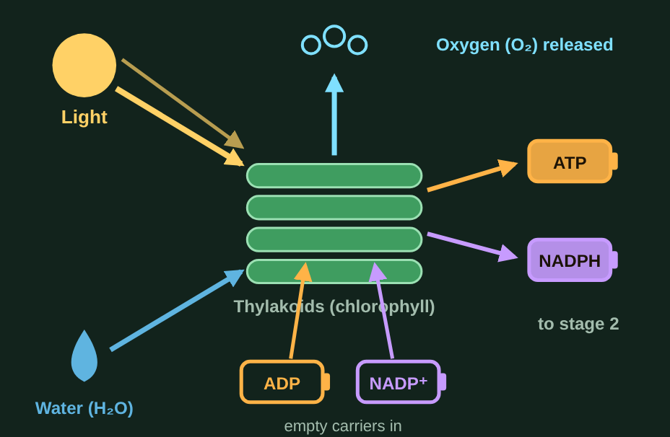
Light in, oxygen out, energy stored
Read
Section 5 of 8: Stage 1: the light-dependent reactions
Stage 1, the light-dependent reactions, happens in the thylakoids, where the chlorophyll is. Chlorophyll captures light energy, and that energy does two jobs:
1. Split water. The oxygen is released into the air. That's the O₂ you breathe.
2. Charge up energy carriers. ADP becomes ATP, and NADP⁺ becomes NADPH.
Think of them as batteries: ADP and NADP⁺ are empty, ATP and NADPH are charged and get carried to stage 2.

Slide 44
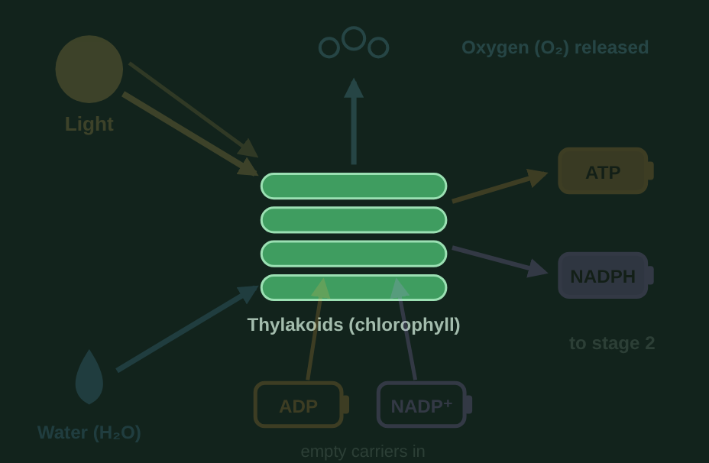
Step through stage 1
Watch it
Section 5 of 8: Stage 1: the light-dependent reactions
Step 1 of 5
Stage 1 happens in the thylakoids, the flat sacs packed with chlorophyll.

Slide 45
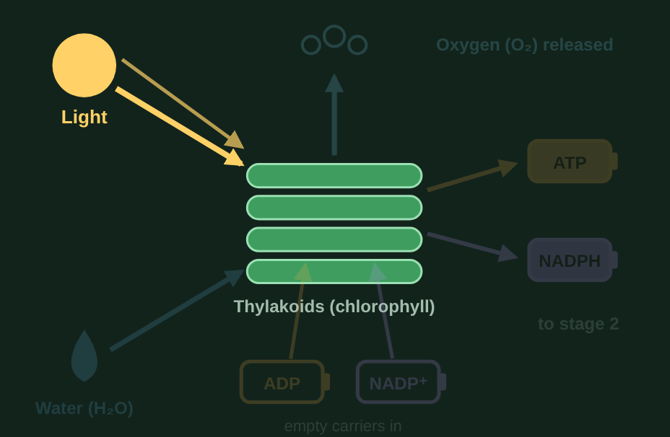
Step through stage 1
Watch it
Section 5 of 8: Stage 1: the light-dependent reactions
Step 2 of 5
Light goes in. Chlorophyll absorbs the light energy.

Slide 46
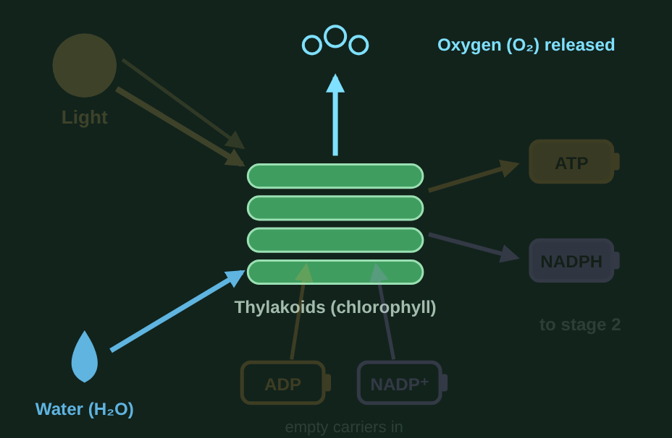
Step through stage 1
Watch it
Section 5 of 8: Stage 1: the light-dependent reactions
Step 3 of 5
The light energy splits water. The oxygen is released into the air. That is where the O₂ from photosynthesis comes from.

Slide 47
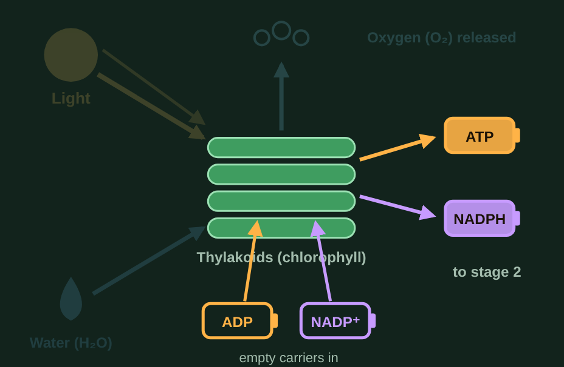
Step through stage 1
Watch it
Section 5 of 8: Stage 1: the light-dependent reactions
Step 4 of 5
The energy also charges up the carriers: empty ADP becomes ATP, and empty NADP⁺ becomes NADPH.

Slide 48
Step through stage 1
Watch it
Section 5 of 8: Stage 1: the light-dependent reactions
Step 5 of 5
Summary. In: light, water, ADP, and NADP⁺. Out: oxygen (released), plus charged ATP and NADPH, which go to stage 2.

Slide 49
Stage 1: in or out?
Try it
Section 5 of 8: Stage 1: the light-dependent reactions
Is it used by the light-dependent reactions, or made by them?
ATP
ADP
Water (H₂O)
Oxygen (O₂)
Light energy
NADPH
NADP⁺
Used (goes in)
Made (comes out)
Notes:
Have students sort each item (call them out, or use sticky notes on the board), then reveal the answer on the next slide.

Slide 50
Stage 1: in or out?
Answer
Section 5 of 8: Stage 1: the light-dependent reactions
Is it used by the light-dependent reactions, or made by them?
All sorted.
Used (goes in)
Made (comes out)
Light energy
Water (H₂O)
ADP
NADP⁺
Oxygen (O₂)
ATP
NADPH
Notes:
Light energy: Absorbed by chlorophyll.
Water (H₂O): Split to release oxygen.
ADP: Empty carrier to be charged.
NADP⁺: Empty carrier to be charged.
Oxygen (O₂): Released from split water.
ATP: Charged carrier sent to stage 2.
NADPH: Charged carrier sent to stage 2.

Slide 51
Quick check 5
Quick check
Section 5 of 8: Stage 1: the light-dependent reactions
The oxygen released by photosynthesis comes from which molecule?
Carbon dioxide (CO₂)
Water (H₂O)
A
B
Glucose
ATP
C
D
Notes:
Give students a moment to pick an answer (hands up, whiteboards, or a quick poll) before revealing it on the next slide.

Slide 52
Quick check 5
Answer
Section 5 of 8: Stage 1: the light-dependent reactions
The oxygen released by photosynthesis comes from which molecule?
Carbon dioxide (CO₂)
Water (H₂O)
A
✓
Glucose
ATP
C
D
Correct: B. Light energy splits water in stage 1, and the oxygen is released as O₂.
Notes:
Answer: B. Light energy splits water in stage 1, and the oxygen is released as O₂.
If students chose A: CO₂ is used in stage 2 to build sugar.
If students chose C: Glucose is a product.
If students chose D: ATP carries energy.

Slide 53
Stage 2: the Calvin cycle
Section 6 of 8, about 8 minutes
6
S2
Stage 2
Read
Spending the energy to build sugar
Watch it
Step through stage 2 (5 steps)
Try it
In or out? (sort)
Quick check
1 question

Slide 54
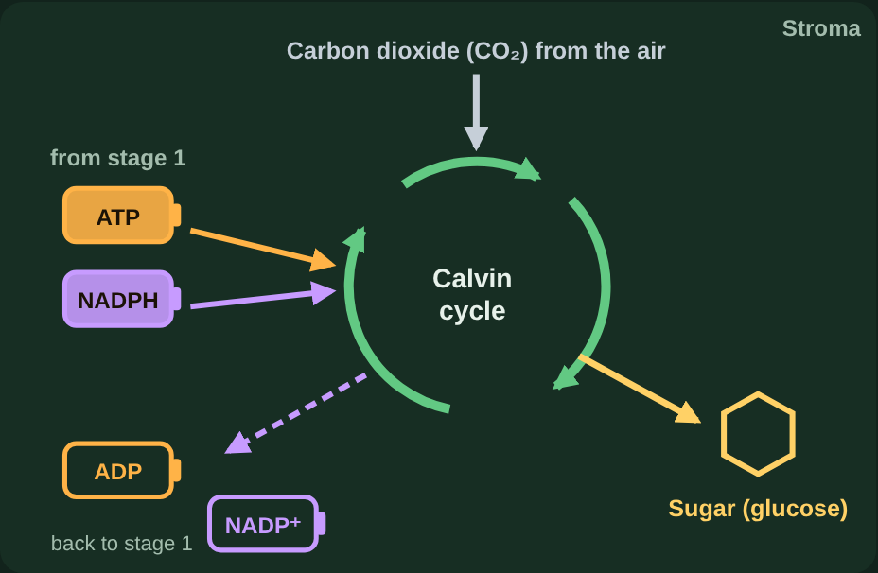
Spending the energy to build sugar
Read
Section 6 of 8: Stage 2: the Calvin cycle
Stage 2, the Calvin cycle, happens in the stroma. It takes in carbon dioxide from the air and uses the energy in the ATP and NADPH from stage 1 to build sugar (glucose).
The used-up carriers, ADP and NADP⁺, go back to stage 1 to be recharged.
It's also called the light-independent reactions because it doesn't use light directly. That does not mean it happens in the dark: it needs the ATP and NADPH that stage 1 makes with light.

Slide 55
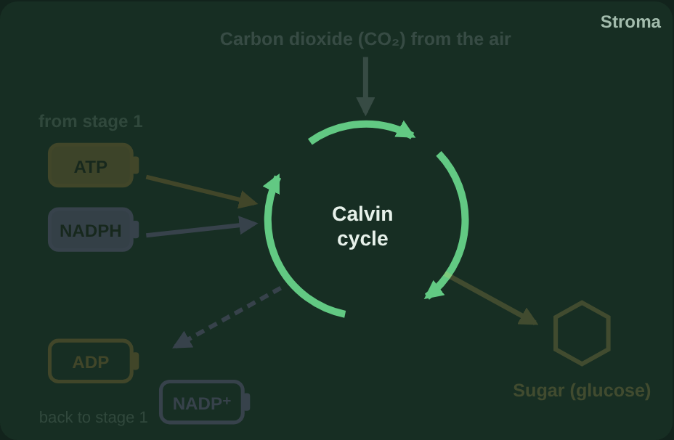
Step through stage 2
Watch it
Section 6 of 8: Stage 2: the Calvin cycle
Step 1 of 5
Stage 2, the Calvin cycle, runs in the stroma, the fluid around the thylakoids.

Slide 56
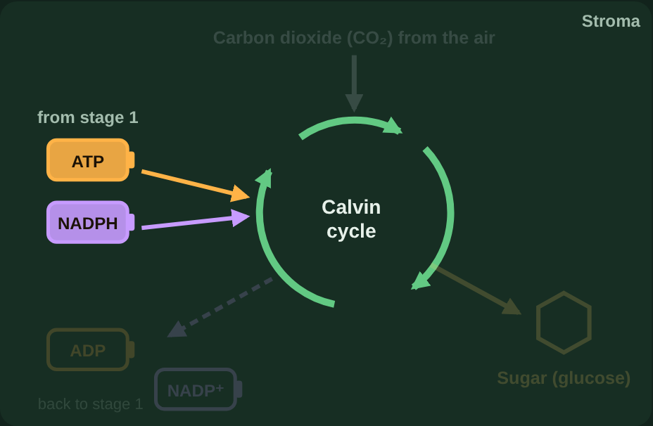
Step through stage 2
Watch it
Section 6 of 8: Stage 2: the Calvin cycle
Step 2 of 5
Charged ATP and NADPH arrive from stage 1. They bring the energy captured from light.

Slide 57
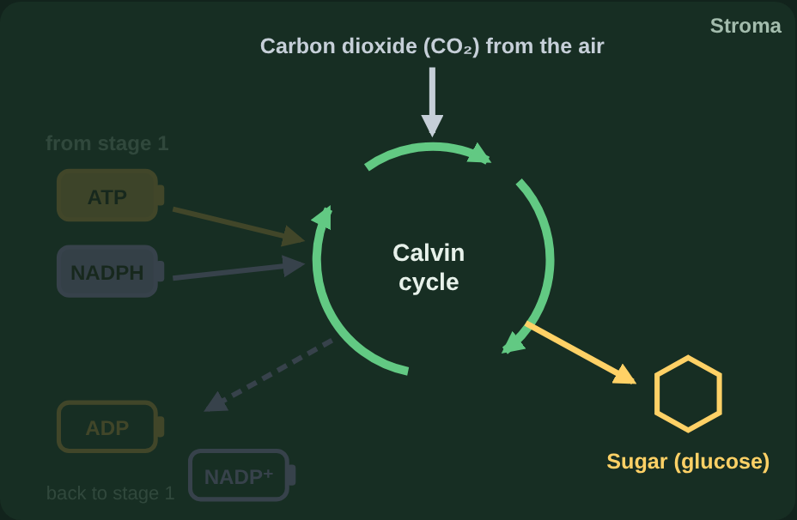
Step through stage 2
Watch it
Section 6 of 8: Stage 2: the Calvin cycle
Step 3 of 5
Carbon dioxide comes in from the air. The cycle uses the energy from ATP and NADPH to build the carbon into sugar (glucose).

Slide 58
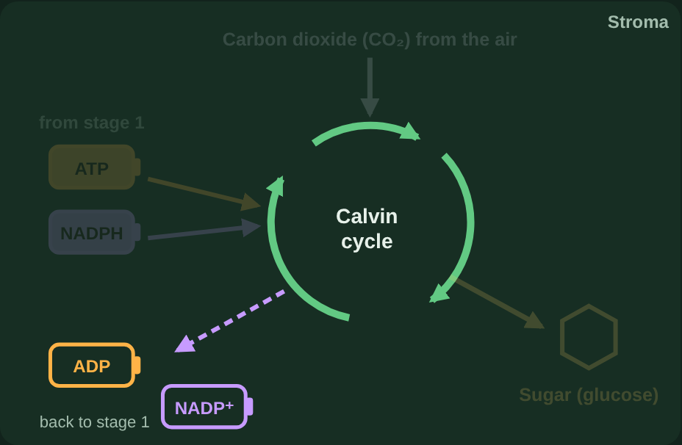
Step through stage 2
Watch it
Section 6 of 8: Stage 2: the Calvin cycle
Step 4 of 5
The empty ADP and NADP⁺ go back to stage 1 to be recharged.

Slide 59
Step through stage 2
Watch it
Section 6 of 8: Stage 2: the Calvin cycle
Step 5 of 5
Summary. In: CO₂, ATP, and NADPH. Out: sugar (glucose), plus ADP and NADP⁺, which return to stage 1.

Slide 60
Stage 2: in or out?
Try it
Section 6 of 8: Stage 2: the Calvin cycle
Is it used by the Calvin cycle, or made by it?
ATP
ADP
Glucose (sugar)
Carbon dioxide (CO₂)
NADP⁺
NADPH
Used (goes in)
Made (comes out)
Notes:
Have students sort each item (call them out, or use sticky notes on the board), then reveal the answer on the next slide.

Slide 61
Stage 2: in or out?
Answer
Section 6 of 8: Stage 2: the Calvin cycle
Is it used by the Calvin cycle, or made by it?
The outputs of each stage are the inputs of the other.
Used (goes in)
Made (comes out)
Carbon dioxide (CO₂)
ATP
NADPH
Glucose (sugar)
ADP
NADP⁺
Notes:
Carbon dioxide (CO₂): Taken in from the air.
ATP: Energy from stage 1.
NADPH: Energy from stage 1.
Glucose (sugar): The sugar it builds.
ADP: Empty carrier sent back.
NADP⁺: Empty carrier sent back.

Slide 62
Quick check 6
Quick check
Section 6 of 8: Stage 2: the Calvin cycle
Why is the Calvin cycle called "light-independent"?
It only happens at night
It doesn't need any energy
A
B
It happens outside the chloroplast
It doesn't use light directly, but it needs ATP and NADPH from the light-dependent reactions
C
D
Notes:
Give students a moment to pick an answer (hands up, whiteboards, or a quick poll) before revealing it on the next slide.

Slide 63
Quick check 6
Answer
Section 6 of 8: Stage 2: the Calvin cycle
Why is the Calvin cycle called "light-independent"?
It only happens at night
It doesn't need any energy
A
B
It happens outside the chloroplast
It doesn't use light directly, but it needs ATP and NADPH from the light-dependent reactions
C
✓
Correct: D. Light never hits the Calvin cycle directly, but it can't run without the charged carriers that light makes.
Notes:
Answer: D. Light never hits the Calvin cycle directly, but it can't run without the charged carriers that light makes.
If students chose A: It needs ATP and NADPH, made while there is light.
If students chose B: Building sugar takes energy.
If students chose C: It happens in the stroma.

Slide 64
How the two stages work together
Section 7 of 8, about 7 minutes
7
⇄
Both stages
Read
Two stages, one system
Try it
Chloroplast simulator (3 missions)
Try it
Which stage? (sort)
Quick check
1 question

Slide 65
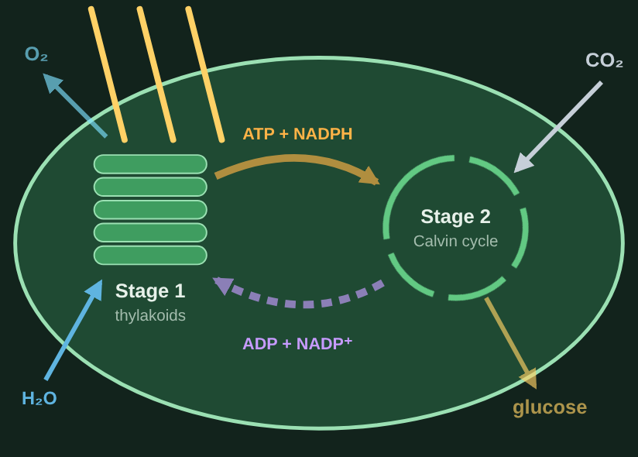
Two stages, one system
Read
Section 7 of 8: How the two stages work together
The two stages depend on each other. Stage 1 charges up ATP and NADPH. The Calvin cycle spends them to build sugar, then sends the empty ADP and NADP⁺ back to be recharged.
So if either stage stops, the other one soon stops too.

Slide 66
Chloroplast simulator
Try it
Section 7 of 8: How the two stages work together
Predict what happens before revealing.
Mission 1. Turn light and CO₂ on. Make 5 glucose.
Mission 2. Turn the light off but keep CO₂ on. What happens to the Calvin cycle?
Mission 3. Light back on, but CO₂ at 0%. What happens?
Notes:
In the lesson, students do these missions in the interactive. Have students predict first, then reveal.

Slide 67
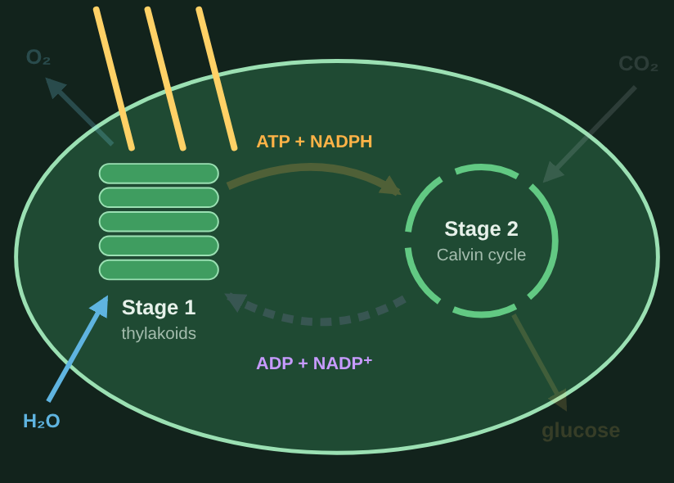
Chloroplast simulator
Answer
Section 7 of 8: How the two stages work together
What students should find:
Mission 1. With light and CO₂ both on, the carriers cycle back and forth and sugar keeps coming.
Mission 2. Nothing recharges ATP and NADPH. Once they run out, the Calvin cycle stops too, even with plenty of CO₂.
Mission 3. Sugar stops right away. ATP and NADPH pile up; with no empty carriers left, stage 1 slows and O₂ stops.
Notes:
Light off: see the dark simulator image in the lesson. CO₂ off: charged carriers pile up to nearly 100%.

Slide 68
Which stage?
Try it
Section 7 of 8: How the two stages work together
Sort each statement into the stage it describes.
Releases oxygen
Uses carbon dioxide
Builds glucose
Happens in the stroma
Splits water
Happens in the thylakoids
Uses ATP and NADPH
Makes ATP and NADPH
Light-dependent reactions
Calvin cycle (light-independent)
Notes:
Have students sort each item (call them out, or use sticky notes on the board), then reveal the answer on the next slide.

Slide 69
Which stage?
Answer
Section 7 of 8: How the two stages work together
Sort each statement into the stage it describes.
All sorted.
Light-dependent reactions
Calvin cycle (light-independent)
Happens in the thylakoids
Splits water
Happens in the stroma
Uses carbon dioxide
Releases oxygen
Makes ATP and NADPH
Builds glucose
Uses ATP and NADPH
Notes:
Happens in the thylakoids: Where chlorophyll is.
Splits water: Stage 1.
Releases oxygen: From split water.
Makes ATP and NADPH: Charged carriers.
Happens in the stroma: The fluid around the thylakoids.
Uses carbon dioxide: Stage 2.
Builds glucose: Stage 2.
Uses ATP and NADPH: Spends the carriers.

Slide 70
Quick check 7
Quick check
Section 7 of 8: How the two stages work together
A plant is kept in bright light but sealed with no CO₂. What happens?
The plant makes glucose faster because it has more light
Sugar production stops, ATP and NADPH pile up, and then the light-dependent reactions slow down
A
B
Only oxygen production stops, and sugar production keeps going
Nothing changes, because the two stages don't depend on each other
C
D
Notes:
Give students a moment to pick an answer (hands up, whiteboards, or a quick poll) before revealing it on the next slide.

Slide 71
Quick check 7
Answer
Section 7 of 8: How the two stages work together
A plant is kept in bright light but sealed with no CO₂. What happens?
The plant makes glucose faster because it has more light
Sugar production stops, ATP and NADPH pile up, and then the light-dependent reactions slow down
A
✓
Only oxygen production stops, and sugar production keeps going
Nothing changes, because the two stages don't depend on each other
C
D
Correct: B. Without CO₂ the Calvin cycle can't build sugar or empty the carriers, so stage 1 slows down too.
Notes:
Answer: B. Without CO₂ the Calvin cycle can't build sugar or empty the carriers, so stage 1 slows down too.
If students chose A: Glucose is built from CO₂.
If students chose C: Sugar needs CO₂.
If students chose D: The stages trade carriers back and forth.

Slide 72
Final check
Section 8 of 8, about 10 minutes
8
✓
Final check
Review
The big picture
Final check
How the final check works

Slide 73
The big picture
Review
Section 8 of 8: Final check
1
2
3
4
Light
Stage 1
Stage 2
Connected
Pigments absorb violet-blue and red light; green is reflected.
In the thylakoids: light splits water, releases O₂, and charges ATP and NADPH.
In the stroma: ATP and NADPH + CO₂ → glucose. ADP and NADP⁺ go back.
If either stage stops, the other soon stops too.

Slide 74
How the final check works
Final check
Section 8 of 8: Final check
10
6 + 2 + 2
80%
questions, picked at random
multiple choice, two-part, select-all
needed to pass
Two-part and select-all questions give partial credit.
You won't see right or wrong until you submit. If you don't pass, you get new questions; after 3 tries, a quick review comes first.
The lesson runs in full screen. Leaving the page locks it until your teacher unlocks it.
Notes:
The final check questions come from a bank in the lesson and are not shown in this deck.

