Slide 1
Introducing Intel`s Advances in Silicon Photonics

Slide 2
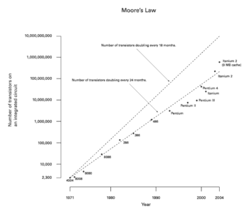
Intro
Moore`s Law
IC performance doubles every 24 months
Increasing design and manufacturing costs
Tunneling Effect Occurred

Slide 3
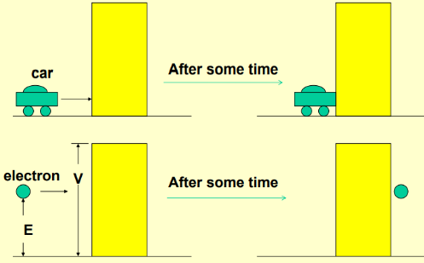
Intro
Tunneling effect

Slide 4
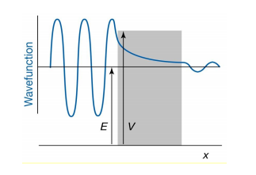
Intro
Tunneling effect
The properties of the waves of particles in quantum mechanics
short circuit phenomenon
fatal error occurrence

Slide 5
Intro
Intel`s research into silicon photonics
= an end-to-end program to extend Moore`s Law into new areas, such as fiber optics

Slide 6
Intro
Benefit of using light signal
Significantly greater capacity
Farther and faster then cooper
Can transmit numerous lightwaves simultaneously
Lighter and impervious ( no electrical interference and crosstalk)

Slide 7
Intro
“Siliconize”
Intel have been actively exploring the use of silicon as the primary basis of photonic components.
This research has established Intel`s reputation in a specialized field called silicon photonics, which appears poised to provide solutions that break through longstanding limitations of silicon as a material for fiber optics.
This white paper discusses Intel`s quest to siliconize photonics by using silicon to create these building blocks.

Slide 8
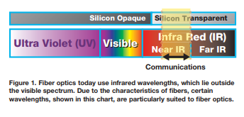
Basic Photonics
Today’s fiber optic lasers primarily use infrared wavelengths for communication

Slide 9
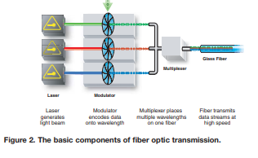
Basic Photonics
A laser creates a beam of light onto which a modulator encodes data
The light is then transported via a glass fiber to a destination of interest
Fibers often carry multiple wavelengths of light simultaneously-each one encoded with its own data stream. These wavelengths are combined by a device called a multiplexer and placed on the fiber

Slide 10
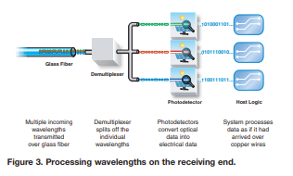
Basic Photonics
The laser light is demultiplexed
Each wavelength is routed to a separate photodetector, which converts the light into an electric signal

Slide 11
Basic Photonics
Fiber optic systems may also use other items such as mirrors, splitters, and switches to manipulate the light or add and drop the optical signal to various locations.
Optical devices typically have been made from exotic materials such as such as gallium arsenide and indium phosphide that are complicated to process. In addition, many photonic devices today are hand assembled and often require active or manual alignment to connect the components and fibers onto the devices. This nonautomated process tends to contribute significantly to the cost of these optical devices. With the recent slow down of the telecom industry and the subsequent focus on price/performance for optical devices, these factors have emerged as important limitations. The silicon photonics research at Intel aims at establishing whether manufacturing processes using silicon can overcome some of these limitations.

Slide 12
Silicon Photonics
“Silicon”
Small, low-cost, Plentiful
well understood material for producing electronic devices
Intel`s goal is then to integrate the resulting devices onto a single chip.
Intel has recently been able to demonstrate basic feasibility to siliconize many of the components needed for optical communication.
The most recent advance involves encoding high-speed data on an optical beam.

Slide 13
High-Speed silicon Modulation
When the laser is turn..
“ON” as 1
“OFF” as 0
At high speeds
Another option
-> The simplest method of performing modulation
the use of an external modulator that acts as a shutter that opens and closes at high speeds
Constantly heating and cooling the laser
Constant changes in temperature can create problems – such as shifts in the wavelength the laser generates- that distor the optical data

Slide 14
High-Speed silicon Modulation
Modulator are not currently made from silicon
Tend to be considerably slower than what is required for even basic enterprise communication
The fastest silicon-based modulator`s speed = 20MHz
This limitation is a function of how the light beam is modulated within its silicon channel. Specifically, previous approaches turned the light on and off by using a diode to inject electrical current into the silicon conduit through which the light was traveling.
PN junction, CMOS

Slide 15
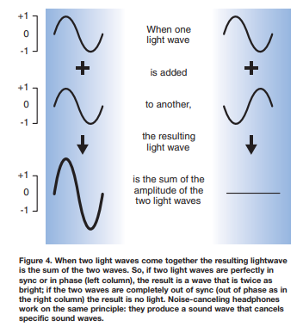
High-Speed silicon Modulation
phase shifting
The modulator breaks the light beam into two smaller beams.
It then makes the lightwaves of one beam out of sync (that is, out of phase) with those of the other
then, it merges the beams back together.
This on-and-off activity is then translated into patterns of 1s and 0s
amplitude modulation (AM)

Slide 16
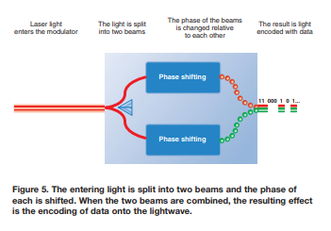
High-Speed silicon Modulation
Intel is now demonstrating its latest advance: a version of this phase-shifting technique that can modulate data at speeds in excess of 1GHz. This rate is more than a 50-fold increase over the previous threshold of about 20MHz.
Intel believes this technology can be extended to run at even higher speeds in the future, possibly to 10GHz and beyond. This breakthrough could move silicon photonics into important new areas. For the first time, silicon-based optical devices may be able to deliver the bandwidth load formerly managed only by high-end, expensive systems. The key concept here is that fiber optic capacity becomes available inexpensively.
A proof of concept of a CMOS-based modulator

Slide 17
The Optical Future
As Moore’s Law continues to push microprocessor speeds, and as increasing volumes of data are sent across the Internet, the demands placed on network infrastructure will increase significantly. By taking advantage of silicon photonics, new products can scale bandwidth availability to meet this demand.
In addition, due to the low cost of silicon solutions, we can expect that servers and high-end PCs might one day come standard with an optical port for high-bandwidth communication. Likewise, other devices will be able to share in the bandwidth explosion provided by the optical building blocks of silicon photonics.
Intel’s silicon photonics research is an end-to-end program that extends Moore’s Law into new areas. It brings the benefits of CMOS and Intel’s volume manufacturing expertise to fiber optic communications.
The goal is not only achieving high-performance in silicon photonics, but doing so at a price point that makes the technology a natural fit-even an automatic feature—for all devices that consume bandwidth. Intel’s breakthrough silicon modulator will undoubtedly contribute to the reality of this vision.

