Slide 1
Strain Engineering of Plasma Dispersion Effect for SiGe Optical Modulators
Mitsuru Takenaka, Member, IEEE, and Shinichi Takagi, Member, IEEE

Slide 2
Introduction

Slide 3
Introduction
2004년 Si 변조기의 속도 – 1GHZ
Franz-Keldysh effect, QCSE 등의 다양한 노력이 있었으나, Si 변조기를 만드는 가장 흔한 방식은 plasma dispersion effect를 employ 하는 것!
그럼.. What is Plasma Dispersion Effect?

Slide 4
Introduction – P.D.E
Change refractive index!
-> change carrier density.. How?
Need to Know about Carrier injection, depletion and accumulation

Slide 5
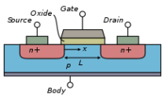
Introduction - P.D.E
Forward vias?
Reverse vias?
How about p-i-n?
Gate의 아래에 hole이 훨씬 많이 쌓인다
-> Capacitor로의 역할, Capacitance 증가
-> MOSCAP, carrier accumulation 이다!
Gate의 아래에 electron이 쌓인다
-> Under V_th, OFF 상태 = depletion
-> Over V_th, ON 상태 = inversion
Forward를 걸어주면 양쪽의 carrier 들이 injection 된다! 이때, hole 이동도가 더 높으므로 p+ injection

Slide 6
Introduction
Carrier Injection enables greater modulation of free-carrier density than carrier depletion, and ring-based modulators!
=> Makes free-carrier absorption greater!
Q1) What is free-carrier density and absorption?
Q2) What is ring-based modulators?

Slide 7
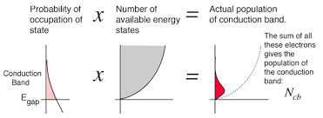
Introduction - free-carrier absorption
Free-carrier absorption = inter-band absorption
More density -> more absorption -> more V_piL

Slide 8
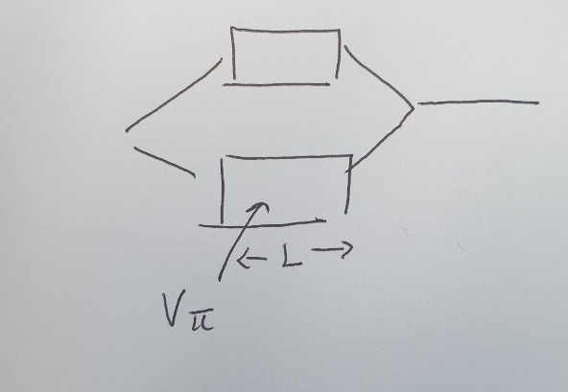

Introduction – V_piL
The parameter that means modulation efficiency
$$V_{π}=Voltage for Phase shifting, determine refractive index$$
$$L=a length of MZI$$

Slide 9
Introduction - Summary
Q. How to enhance SiGe modulator?
Improve V_piL
-> enhance Plasma Dispersion Effect
-> enhance Free-Carrier absorption
-> strain SiGe
-> Reduce hole conductivity mass

Slide 10
Introduction
we`ll using the 6-band k.p method and the Drude model!
We predict that the application of compressive strain to SiGe will reduce the hole conductivity mass, resulting in enhanced plasma dispersion effect and free-carrier absorption.

Slide 11
EFFECT OF STRAIN ON PLASMA DISPERSION EFFECT AND FREE-CARRIER ABSORPTION OF SiGe

Slide 12
Effect of strain

Slide 13
Effect of strain

Slide 14
Effect of strain

Slide 15
Effect of strain

Slide 16
Effect of strain

