Slide 1
논문 요약 – PART 1

Slide 2
Introduction
“We are on the cusp of revolutionary changes in communication and microsystems technology”
through the marriage of photonics and electronics on a single platform.

Slide 3
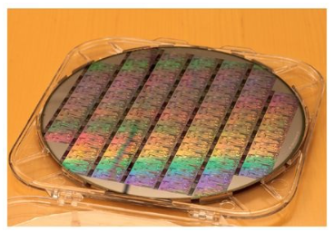
Introduction
Electronic-photonic
circuits
Will play a ubiquitous role globally
High-speed communications
Ex) High-performance computing
medical applications
data centers

Slide 4
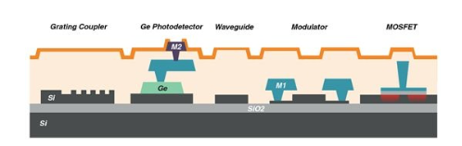
Introduction
Electronic-photonics circuits
Can we reused electronic industry`s capabilities?
Every attempts to directly integrate photonic functionally into CMOS or bipolar silicon has yielded poorly-performing devices
Using the tools for truly advanced microelectronics to try to build photonics is a mistake

Slide 5
Introduction
Silicon
Silicon
Photonics
Fantastic material system for building photonic devices as well as electronic ones!
Re-use is possible!

Slide 6
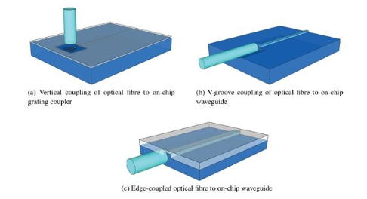
Technical challenges
Waveguides and passive components
SOI wafers
Reduce the losses
Cost effective

Slide 7
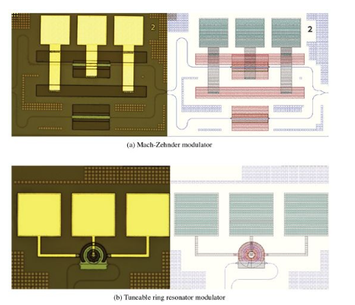
Technical challenges
Modulators
Plasma Dispersion Effect
MZI used
Significantly cost
High thermal sensitivity
Carrier-depletion mode device,
Based on a Reverse-biased pn junction

Slide 8
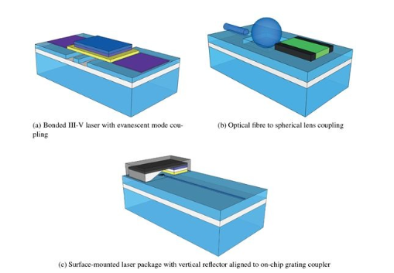
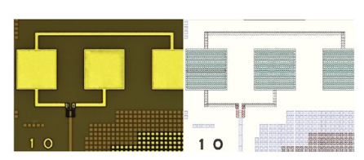
Technical challenges
Photodetectors, Light sources ..

Slide 9
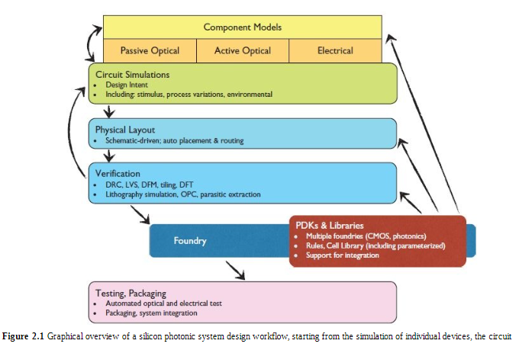
Modelling and design approaches
About silicon photonics!
Component Models
Passive Optical
Active Optical
Electrical

Slide 10
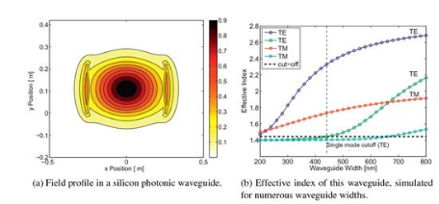
Optical waveguide mode solver
Waveguide mode
Transverse field
Do not change shape
Time-invariant

Slide 11
Optical waveguide mode solver
What is an eigenmode?
Boundary condition에 따라 결정되는 전자기파의 해
Mode?
파면의 형태

Slide 12
Optical waveguide mode solver
Eigenmode Solvers
Determine time-harmonic solutions to Maxwell`s equations in the frequency domain
Numerous simulations are required to obtain wavelength sweeps needed to study waveguide dispersion
FEM, FD, EIM

Slide 13
Optical waveguide mode solver
FEM – Finite Element Method
Mesh is unstructured(Flexible meshing is desirable)
Useful for three-dimensional structures
FD – Finite Difference
Particularly well suited for high-index contrast structures
Has the benefit that the mesh is compatible with the finite difference time domain(FDTD)

Slide 14
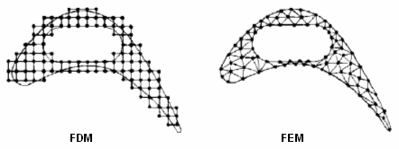
Optical waveguide mode solver

Slide 15
The simulation steps
Define waveguide structure including the waveguide and the cladding
Specify the materials
Choose a mesh and accuracy
Choose boundary conditions
Specify the wavelength, or range of wavelengths

Slide 16
Wave propagation
“The design of photonic devices usually requires an understanding of how light will propagate in the structure”
Non-uniform devices
Reflections
Interference
Scattering
Radiation
FDTD

Slide 17
Wave propagation- 3D FDTD
Computationally intensive
FDTD
Numerical method for solving the 3D Maxwell equations (exact)
Useful for analyzing the interaction of light with complicated structures
Simulates the propagation of a pulse of light which contains a broad spectrum
A single simulation provides the response of the optical system for a wide range of wavelengths at once
Can model materials that are dispersive and nonlinear (of course LTI too)

Slide 18
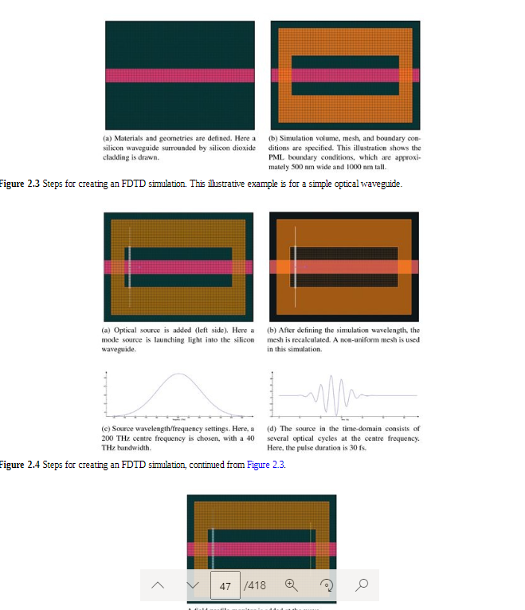
Wave propagation- 3D FDTD

Slide 19
Wave propagation- 2D, 2.5D FDTD
2D FDTD
Dramatically improving speed
The structure is invariant in one dimension
2.5D FDTD
Faster than 3D
Invariant 한 part -> 2D, 아닌거 3D

Slide 20
Wave propagation- Other Method
BPM – Beam Propagation Method
An approximate solution, ‘exact’ solution of Maxwell`s equations
For structures with small index of refraction contrasts, typically as a scalar solution
Useful for designing Mach-Zehnder interferometers
EME – Eigenmode Expansion Method
Considered the propagation of light by decomposing
Accurate for an infinite numbers of modes

Slide 21
Wave propagation- Other Method
CMT – Coupled Mode Theory
Widely used for solving optical structures such as couplers
Based on perturbation
TMM – Transfer Matrix Method
Very simple and fast technique
For refraction profile
Provides an exact answer for one-dimensional structures such as TF reflectors

Slide 22
Modellings

