Slide 1
pn Junction

Slide 2
What is the pn junction?
P-type semiconductor
Majority carriers = electrons(donor)
Mainly using the group 5 element
P
N
N-type semiconductor
Majority carriers = holes(acceptors)
Mainly using the group 3 element
Metallurgical junction

Slide 3


What is the pn junction?
P
N
What`s happening around the junction?
Majority carriers will begin diffusing into the other region
As electrons diffuse, positively charged donor atoms are left behind
As holes diffuse, negatively charged acceptor atoms are left behind
$$N_{a}$$
$$N_{d}$$
Hole diffusion
Electron diffusion
Doping concentration is uniform in each region
Abrupt change in doping at the junction

Slide 4
What is the pn junction?
-
-
-
-
+
+
+
+
-
-
-
-
+
+
+
+
P
-
-
-
-
N
+
+
+
+
-
-
-
-
+
+
+
+
Space charge region
E-field
Hole diffusion
Electron diffusion
E-field on holes
E-field on electrons
Space charge region is also referred to as the depletion region
In thermal equilibrium, the diffusion force and the E-field force exactly balance each other

Slide 5
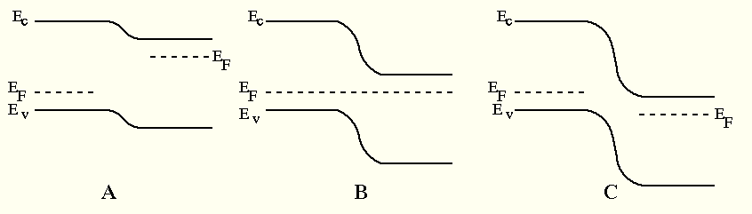
Three-ways of band diagrams
What is the fermi level

Slide 6
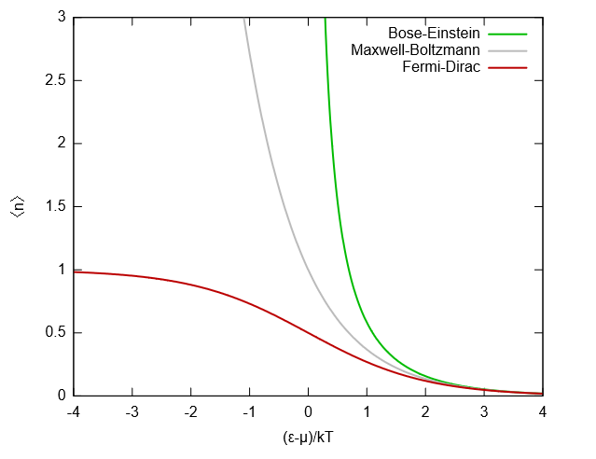

Fermi Level - DOS
Maxwell-Boltzmann distribution
The quantization of the former was not considered.
Quite different from the actual distribution
Under certain conditions, use as an approximation,
Notes:
전자가 채워져 있음에대한 확률을 계산하는 확률함수

Slide 7
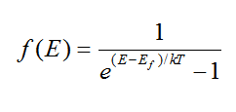
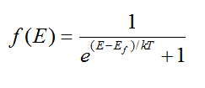
Fermi Level - DOS
Bose-Einstein distribution
Do not consider the principle of foul exclusion
Quite different from the actual distribution
Fermi-dirac distribution
Consider the principle of foul exclusion
actual distribution

Slide 8
Fermi Level
Definition of Fermi Level
Maximum energy level an electron can have at 0K
Energy level with a half chance of electrons being filled at any temperature T

Slide 9

Zero applied bias
Two assumptions
Boltzmann approximation is valid
Complete ionization exists
Each semiconductor region is non-degenerately doped
The temperature of the pn junction is not ‘too low’
$E_{F}=$Fermi level of intrinsic semiconductor

Slide 10
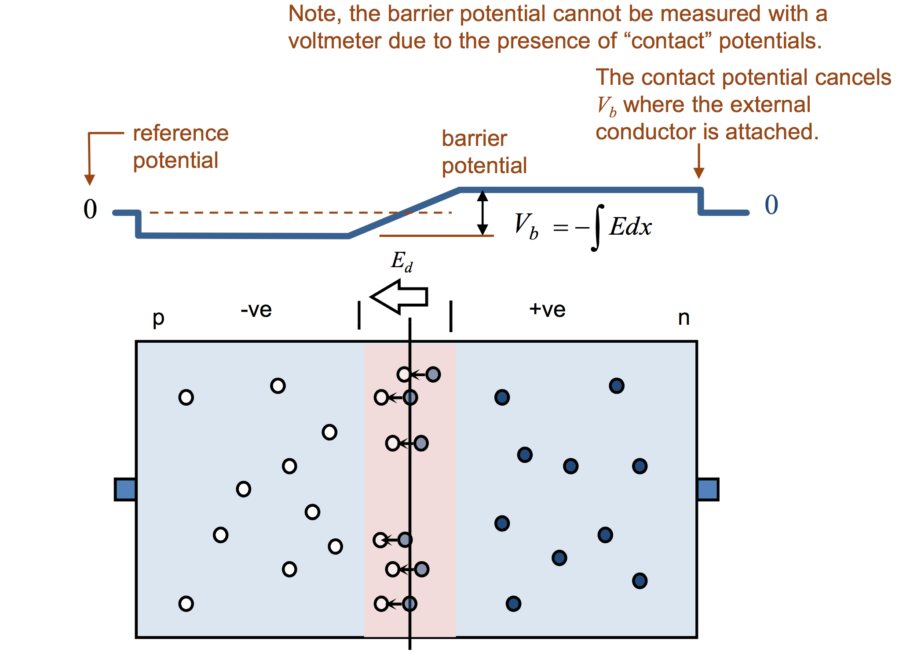
Zero applied bias
Bulit-in Potential Barrier
N영역, 컨덕션 밴드의 전자는 P영역으로 가려한다
이 사이에는 V_bi라고 부르는 Potential Barrier가 존재하며, 이를 Built-in Potential Barrier라고 한다.
Built-in Potential Barrier는 majority carriers 과 minority carriers의 평형에 의해 유지된다.

Slide 11
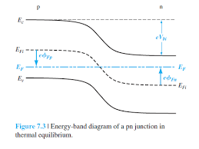
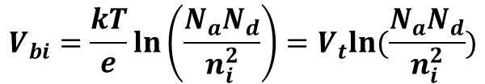


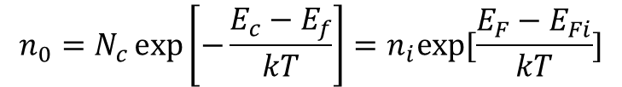

Zero applied bias
Built-in Potential Barrier
$$V_{bi}=\left|∅_{Fn}\right|+|∅_{Fp}|$$
$$n_{0}=N_{c}\exp\left[−\frac{E_{c}−E_{f}}{kT}\right]=n_{i}exp⁡[\frac{E_{F}−E_{Fi}}{kT}]$$
$$∅_{Fn}=E_{F}−E_{Fi}=−\frac{kT}{e}ln⁡(\frac{N_{d}}{n_{i}})$$
$$∅_{Fp}=E_{Fi}−E_{F}=\frac{kT}{e}ln⁡(\frac{N_{a}}{n_{i}})$$
$E_{F}=$Fermi level of intrinsic semiconductor
$$V_{bi}=\frac{kT}{e}\ln\left(\frac{N_{a}N_{d}}{n_{i}^{2}}\right)=V_{t}ln⁡(\frac{N_{a}N_{d}}{n_{i}^{2}})$$

Slide 12









Zero applied bias – Charges
Poisson`s equation
P
N
Derive from Coulomb`s Law
$$\overset{⃑}{∇}∙\overset{⃑}{D}=ρ$$
$$+eN_{d}$$
+
$$\frac{d^{2}∅(x)}{dx^{2}}=−\frac{ρ\left(x\right)}{ε_{s}}=−\frac{dE\left(x\right)}{dx}$$
$$−x_{p}$$
-
$$+x_{n}$$
$$E=−\frac{eN_{a}}{ε_{s}}\left(x+x_{p}\right), −x_{p}≤x≤0$$
$$−eN_{a}$$
$$E=−\frac{eN_{d}}{ε_{s}}\left(x_{n}−x\right), −x≤x≤x_{n}$$
$$N_{a}x_{p}=N_{d}x_{n}$$

Slide 13


Zero applied bias – Voltage
Poisson`s equtation
P
N
Derive from Coulomb`s Law
$$\overset{⃑}{∇}∙\overset{⃑}{D}=ρ$$
$$\frac{d^{2}∅(x)}{dx^{2}}=−\frac{ρ\left(x\right)}{ε_{s}}=−\frac{dE\left(x\right)}{dx}$$
$$−x_{p}$$
$$+x_{n}$$
$$E=−\frac{eN_{a}}{ε_{s}}\left(x+x_{p}\right), −x_{p}≤x≤0$$
$$E=−\frac{eN_{d}}{ε_{s}}\left(x_{n}−x\right), −x≤x≤x_{n}$$
$$N_{a}x_{p}=N_{d}x_{n}$$

Slide 14



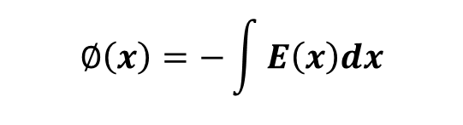
Zero applied bias – Electric Field
P
N
P
N
$$V_{bi}$$
$$−x_{p}$$
$$+x_{n}$$
$$−x_{p}$$
$$+x_{n}$$
$$∅\left(x\right)=−\int{E\left(x\right)dx}$$

Slide 15


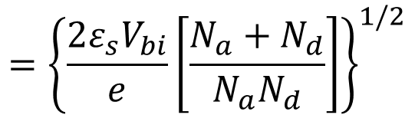

Space Charge Width
$$N_{a}x_{p}=N_{d}x_{n}$$
$$x_{p}=\frac{N_{d}x_{n}}{N_{a}}$$
$$W=x_{n}+x_{p}$$
$$={\left\{\frac{2ε_{s}V_{bi}}{e}\left[\frac{N_{a}+N_{d}}{N_{a}N_{d}}\right]\right\}}^{1/2}$$
$$→Space Charge Width$$

Slide 16
Reverse applied bias
Reverse applied bias
평형상태가 아니다
포텐셜 배리어가 커짐
Space Charge Width의 증가
전압의 인가로 인해 평형상태가 깨지고, 페르미 준위 또한 변한다.
Junction이 만드는 전기장과 인가한 전압의 전기장 방향이 같기때문에 포텐셜 배리어가 커진다
도핑 농도에는 변함이 없지만, 전기장이 증가했기에 W가 늘어나야한다. (Bulk 부분에는 전기장이 미세)

Slide 17
Reverse applied bias - Junction Capacitance
P
N
Junction Capacitance
Charge에 변화가 생긴다
평면 Capacitor와 같은 식 유도
$$+eN_{d}$$
+
Capacitor에서 일어나는 현상이, Junction에서 그대로 생긴다. -> Capacitacne가 생김
$$−x_{p}$$
-
$$+x_{n}$$
$$−eN_{a}$$
Bulk부분은 변화가 거의 없는 두개의 전하덩어리라고 보면, 결국은 평면 캐패시터 꼴이니까!

Slide 18

Reverse applied bias – One-Sided Junctions
P
N
Junction Capacitance
Charge에 변화가 생긴다
평면 Capacitor와 같은 식 유도
$$+eN_{d}$$
+
Capacitor에서 일어나는 현상이, Junction에서 그대로 생긴다. -> Capacitacne가 생김
$$−x_{p}$$
-
$$+x_{n}$$
$$−eN_{a}$$
T= 0K인 상황이

