Slide 1
Health Data (JSON) in R
Xavier Babu
Ashok Srinivasan
Data Engineering for Business Analysis
02nd May 2018

Slide 2
Agenda
Dataset for the project
Demo
Sample Data Analysis
Resources
Take Away

Slide 3
Dataset
Dataset includes adult’s (18+ years) health measures on
Unhealthy Behaviors
Health Outcomes
Use of Preventive Services
Data on responses to the following measures
Unhealthy Behaviors
5 measure questions
Measures on Smoking, Drinking and Physical Activity
Health Outcomes
13 measure questions
Measures on various diseases and health disorders
Preventive Services
10 measure questions
Measures on preventive diagnostics, doctor visits and intake of medication
Notes:
The dataset that we used for this project includes health related data about adults on the 3 categories. First one is their Unhealthy behaviors like Smoking, Drinking and physical activity.
Another category is the health outcomes due to their habits. It includes measurement on various diseases and health disorders.
The last category of measurement is on their medical discipline like preventive diagnostics, doctor visits and medicine intake.
Each category has a set of questions based on which the measurement is captured.

Slide 4
Dataset contd.
Total Data rows - 810103
2 years of data (2015 and 2016)
50 states, and national data
Value measurement – percentages
Data from Behavioral Risk Factor Surveillance System (BRFSS)
Notes:
The dataset has a total of 810103 records in it. It has two years of data for 50 states and a national level data. All the measurements are in %ages. The source for this data is from a system call BRFSS.

Slide 5
DEMO
Importing JSON data into R
File Format Validations
Storing Data in multiple Dataframe
Return City name using Latitude and Longitude
Creating Graphs
Plotting Data on Map
* Above topics will be covered depending the time available

Slide 6
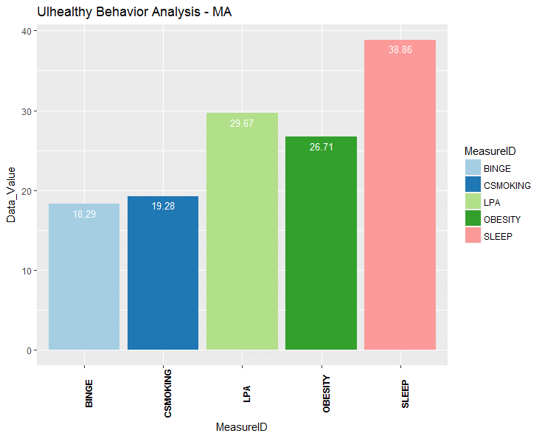
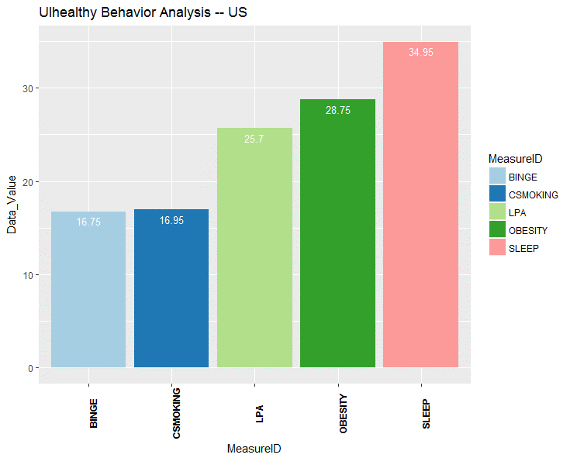
Data Analysis
Key Observations on Unhealthy Behaviors
More adult smokers in MA compared nationally (19.28 vs 16.95)
MA is lower obesity rate than overall US (26.71 vs 28.75)
More MA adults sleep less than 7 hours a day (38.86 vs 34.95)
More MA adults lack physical activity (29.67 vs 25.70)
Drinking is higher among MA adults (18.29 vs 16.75)

Slide 7
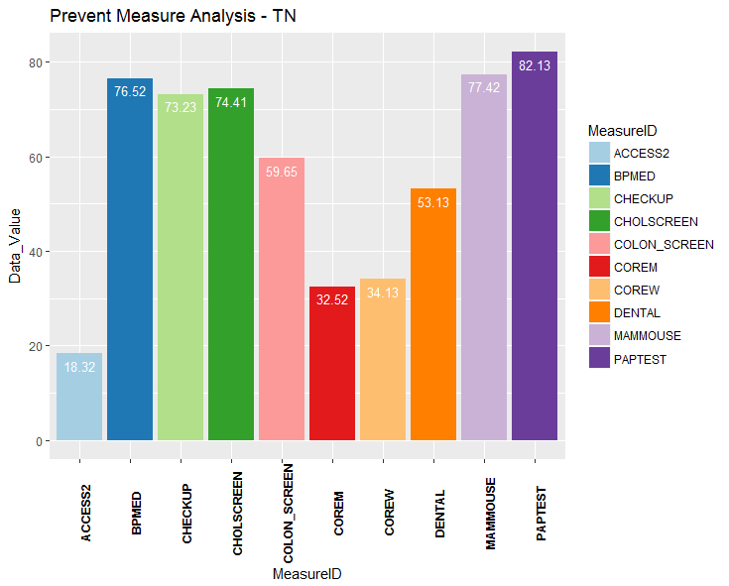
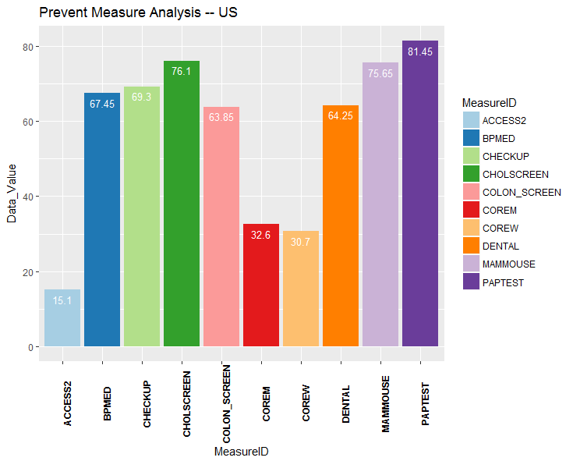
Data Analysis contd.
Key Observations on Preventive Measures
More women > 65 years in TN do preventive checkup than men (34.13 vs 32.52)
TN has more adults have high blood pressures than national avg. (76.52 vs 67.45)
TN has lesser % of adults going to dentist regularly (53.13 vs 64.25)
TN has more % of adults visiting doctors for routine checkup than national avg. (73.23 vs 69.30)

Slide 8
Resources
Project Documents
https://github.com/FromXavierBabu/Data_Analytics
Documents Attached
Code
Dataset
Readme
Presentation

Slide 9
Take Aways
Extracting JSON Data from web
Using the data for analysis
Perform Validations
Use of important Features
Resources

