Slide 1

Tech pro presentation I
Kyriaki savvoulidou
19/10/2023

Slide 2
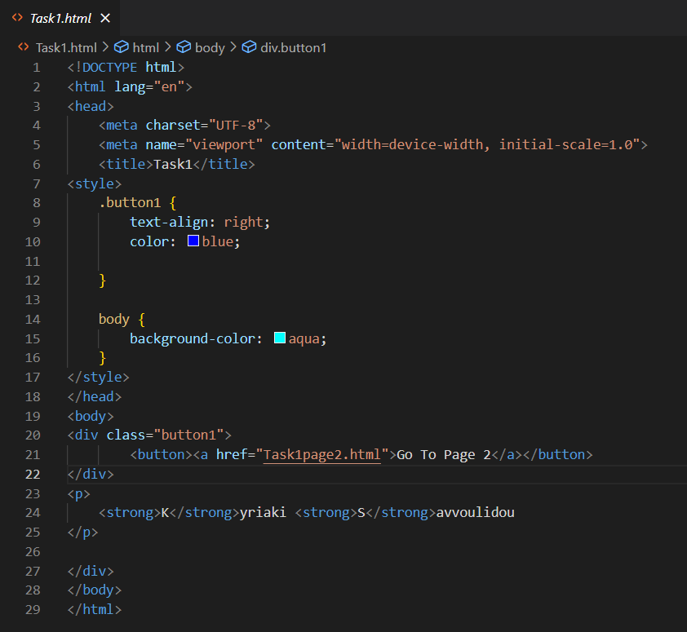
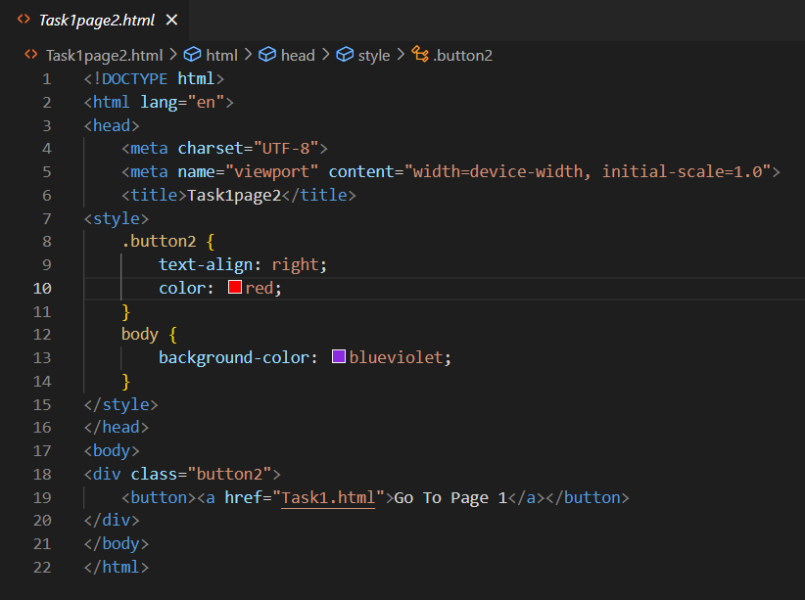
Task I CODE

Slide 3


TASK I OUTPUT

Slide 4
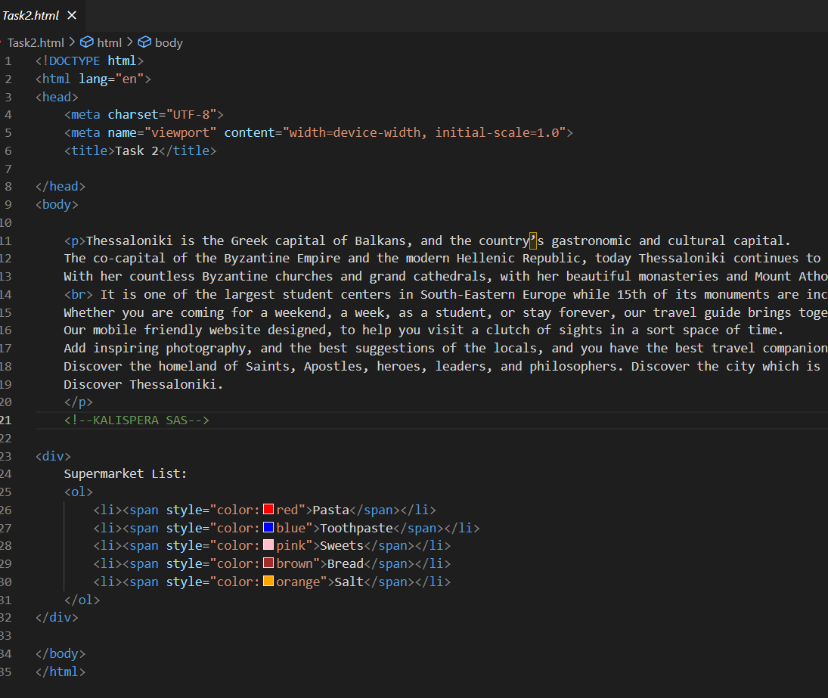
TASK II CODE

Slide 5
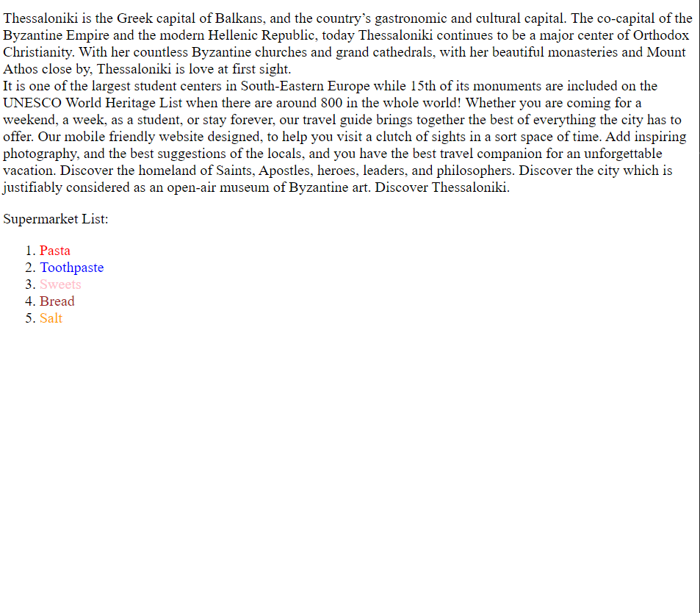
TASK II OUTPUT

Slide 6
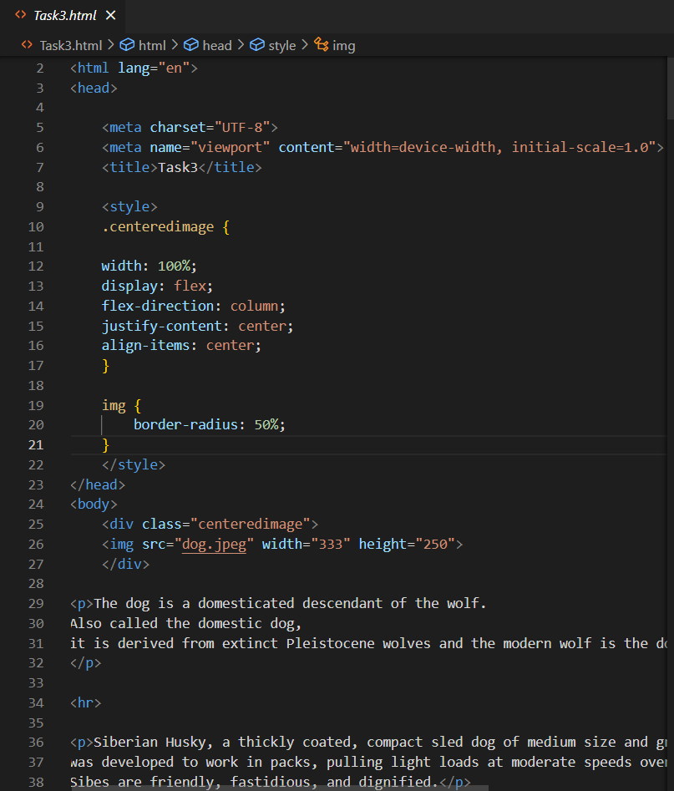
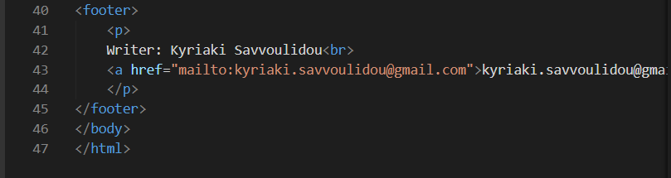
TASK III CODE

Slide 7
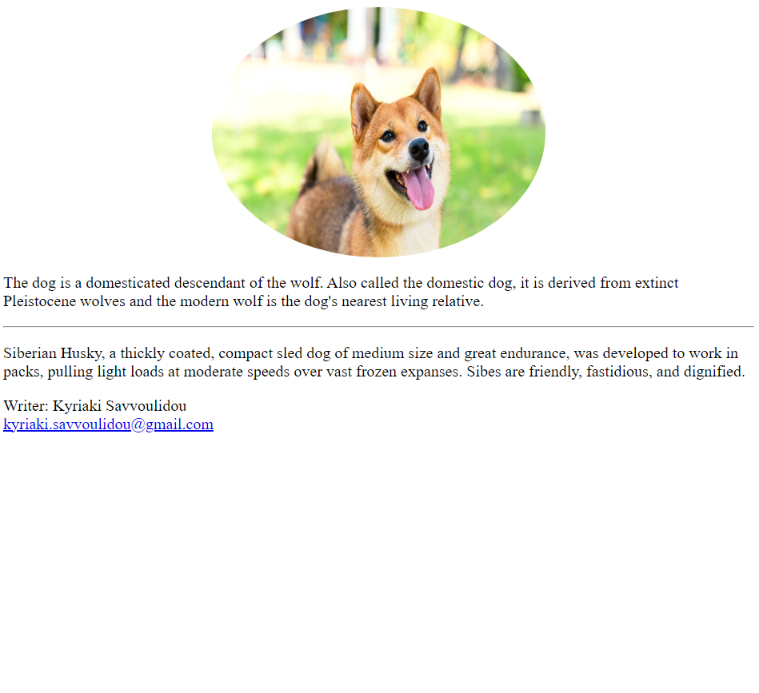
TASK III OUTPUT

Slide 8
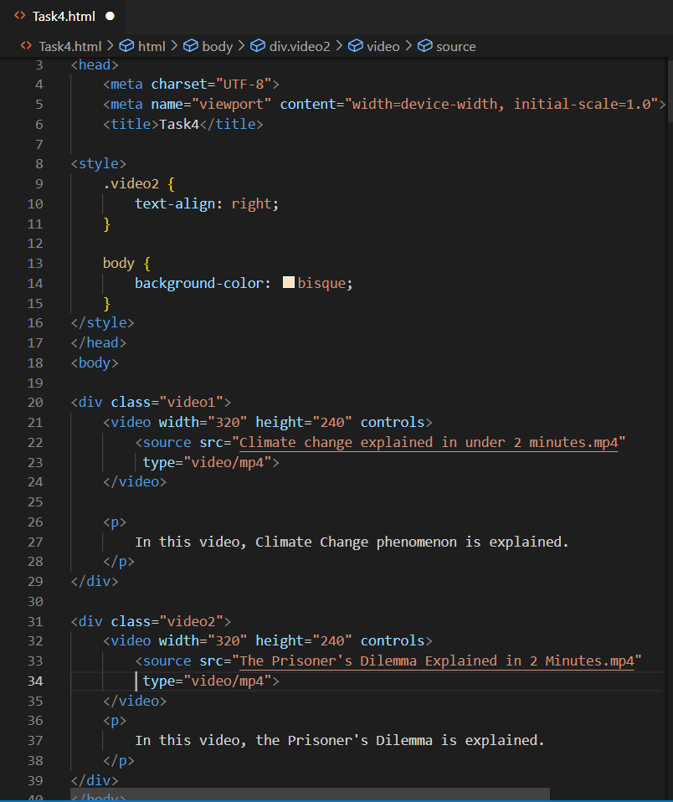
TASK IV CODE

Slide 9
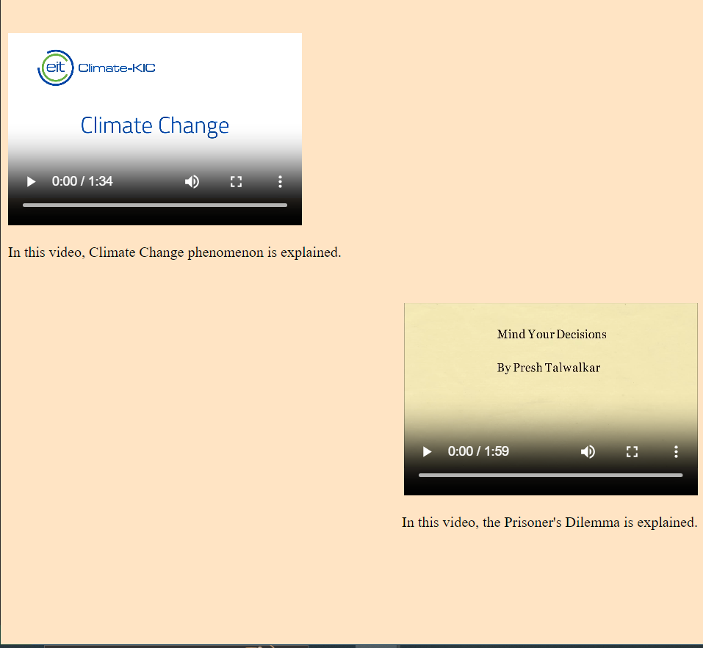
TASK IV OUTPUT

Slide 10
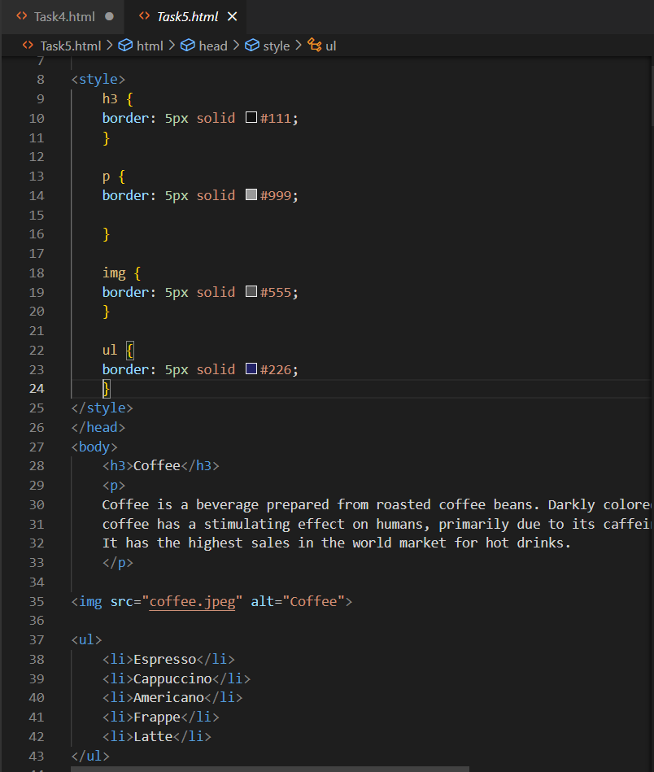
TASK V CODE

Slide 11
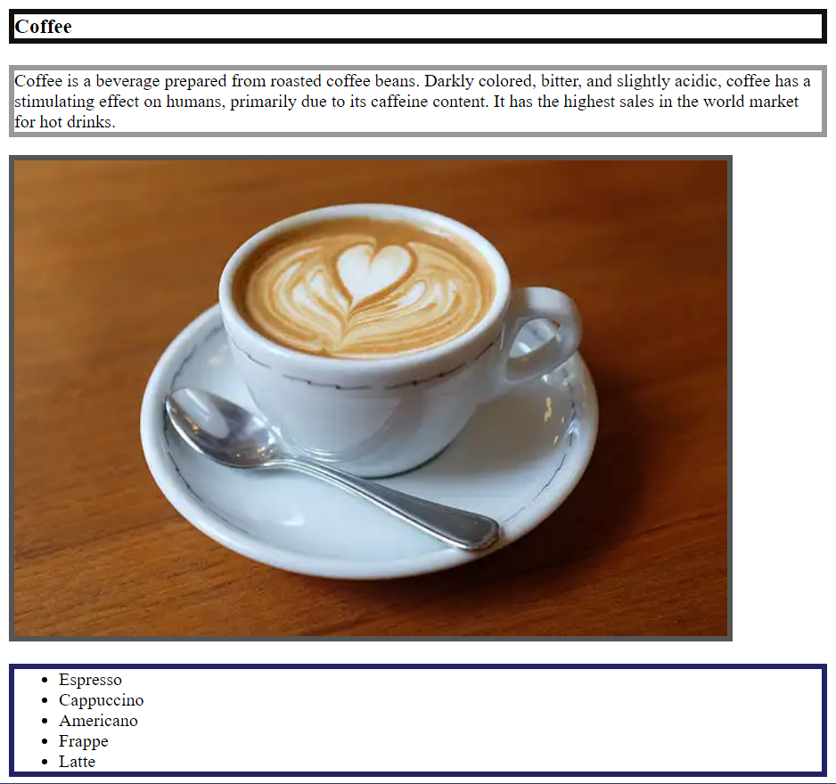
TASK V OUTPUT

Slide 12
THANK YOU FOR YOUR TIME :)

