Slide 1
Spiros Litsas
22/10/2023

Slide 2
Week 3 task 3
Εκφώνηση του task:
Create a site with an image at the center. The image must be round-shaped.
Describe the image and place an hr tag anywhere inside the page.
Add a footer.

Slide 3
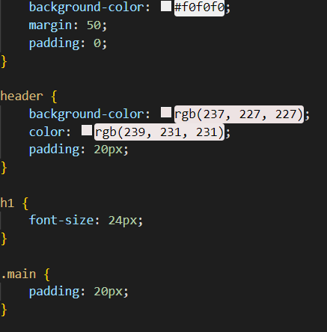
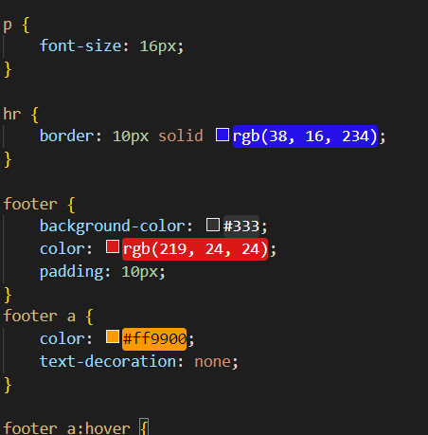
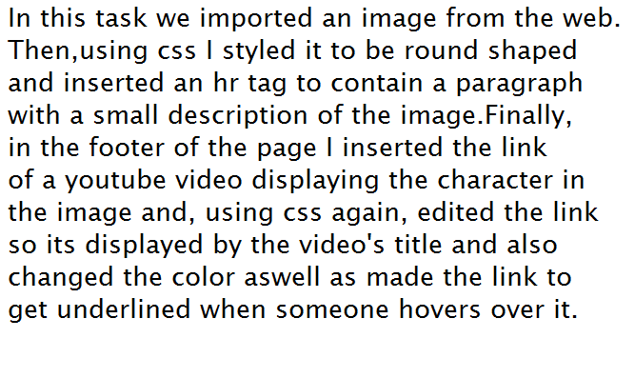
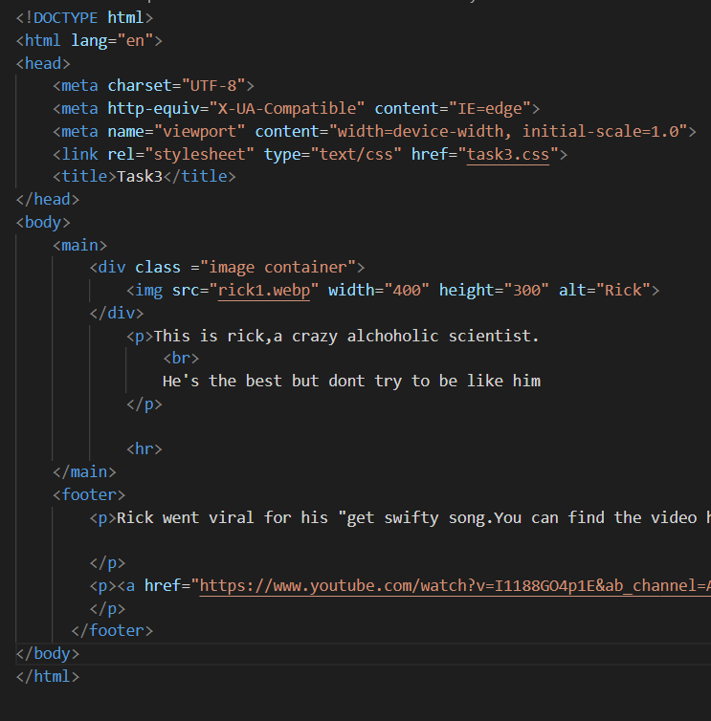
Implementation:

Slide 4
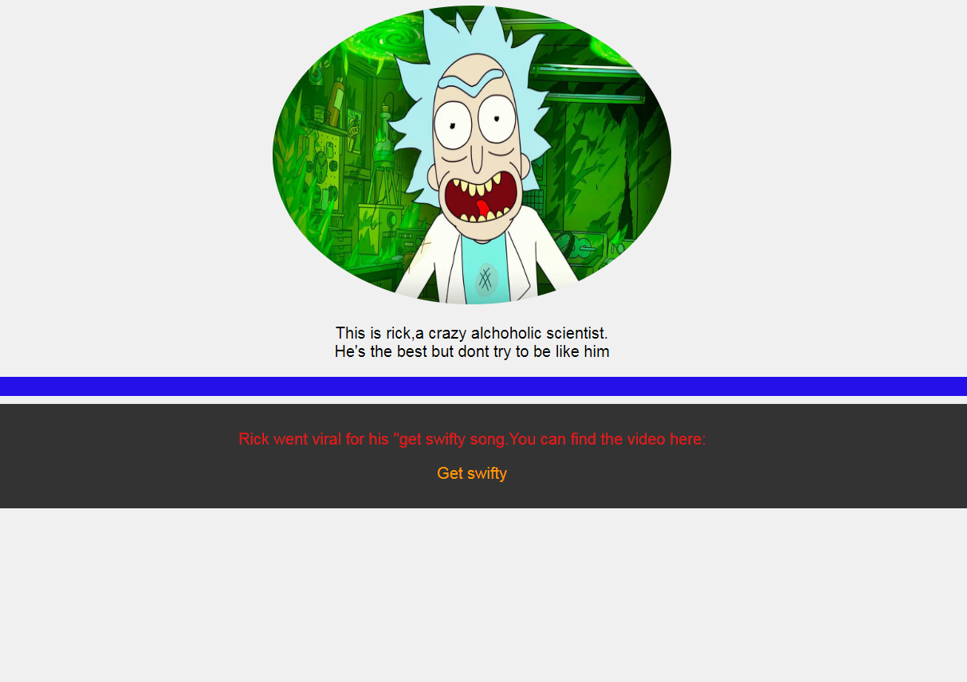
Final Result:

Slide 5
Thank you

