Slide 1
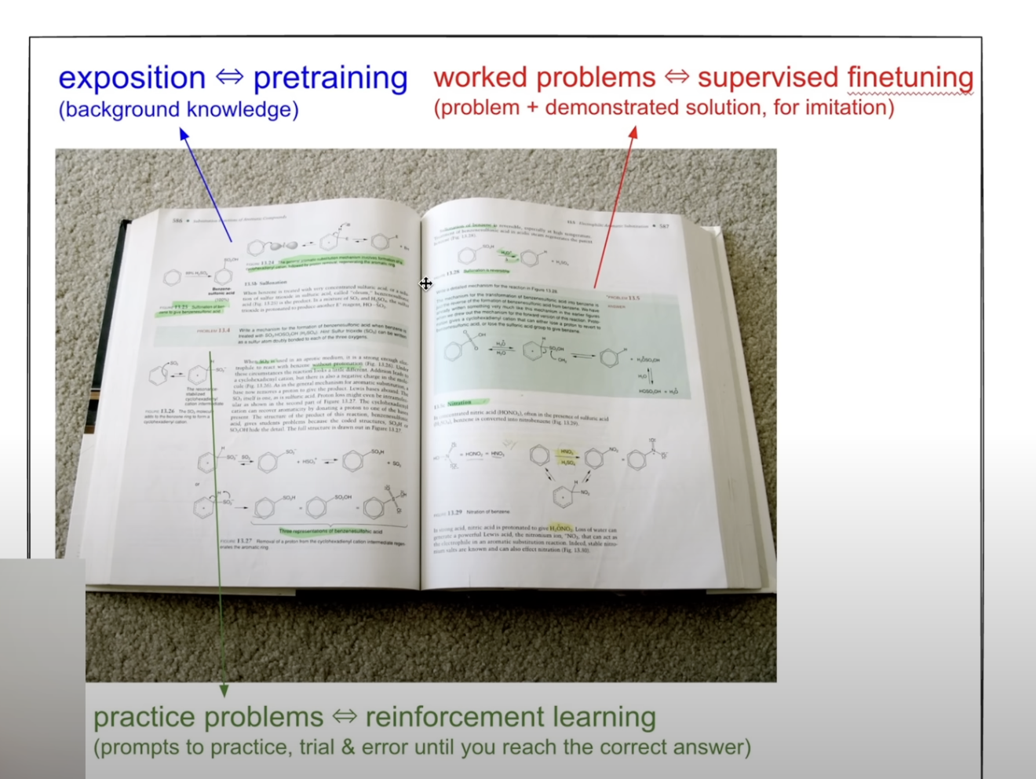
Going back to school with LLMs

Slide 2
RL – a story of reward and polices

Slide 3
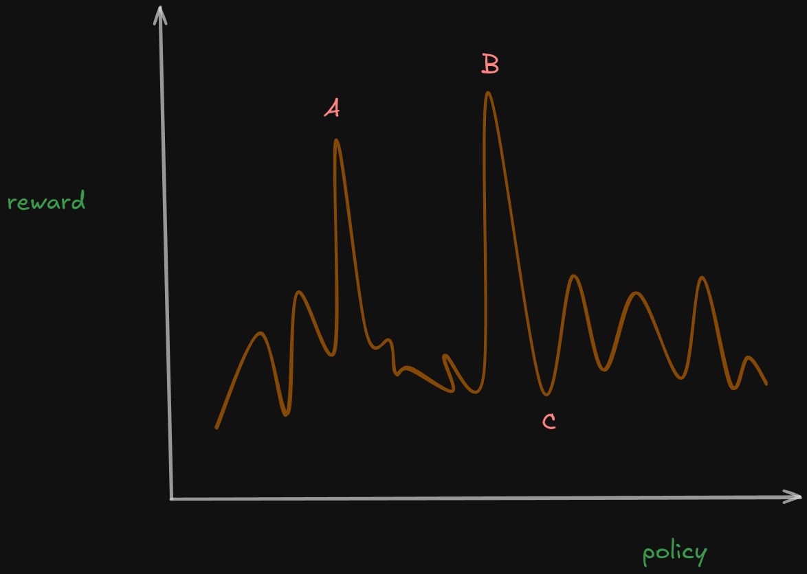

Slide 4
Optimal policy = policy with reward(max(R(P1)), max (R(P2)), max (R(P3)),…)

Slide 5
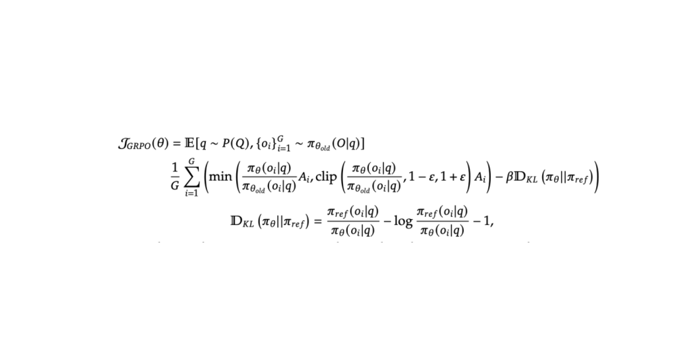

Slide 6
The breakdown of the GRPO equation
1. Considering all possible scenarios
2. Making small updates
3. Clipping the parts to make sure there’s often clipping done that model doesn’t go offshoot
4. KL-divergence measures if the model doesn’t measure

Slide 7
Expectation/considering all possibilities
P(Q) represents empirical distribution of queries in training data
Π (old) (O\q) – samples from old distribution over queries q

Slide 8
Making small updates – min, CLIP and KL divergence steps
Π ϴ (oi/q) / Π ϴ old (oi/q) – are small updates that are done
Clippings are done between Π ϴ (oi/q) / Π ϴ old (oi/q), 1 + e and 1-e
And subtracted KL divergence factor from (we reduce the high diversion candidates)
1/G is used to ”normalize” – each query is contributing equally to the final say

Slide 9
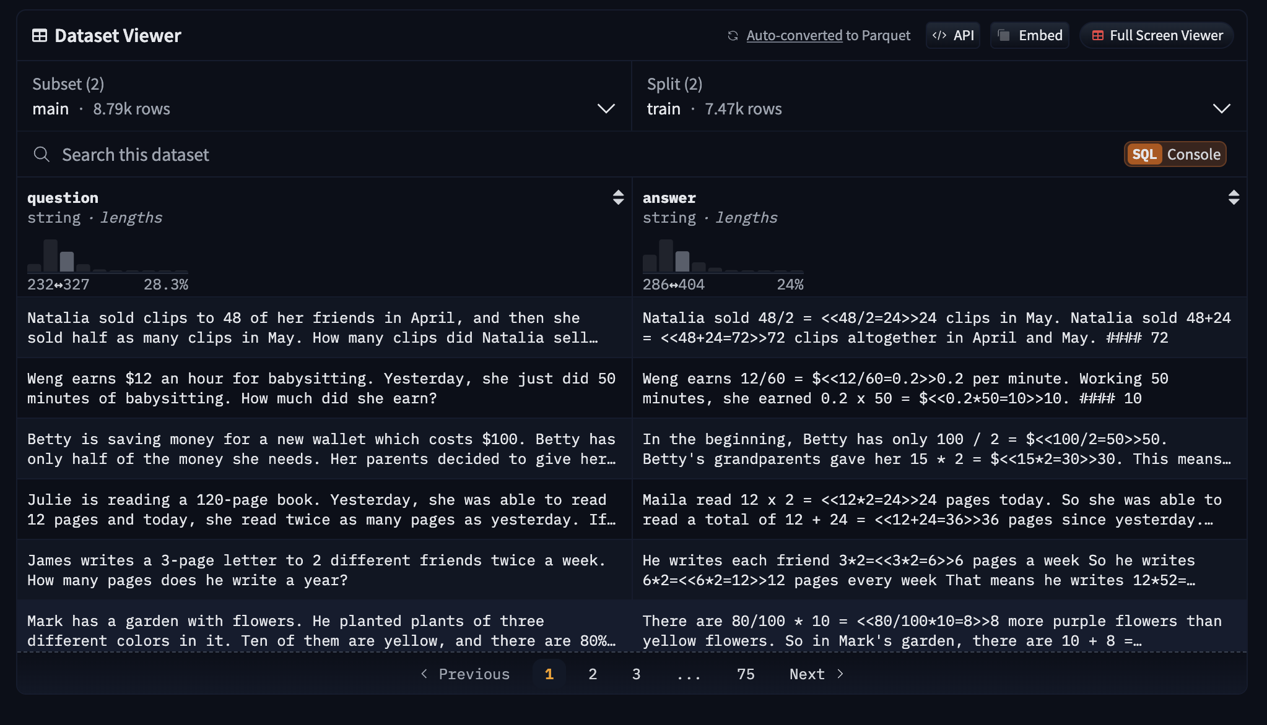

Slide 10
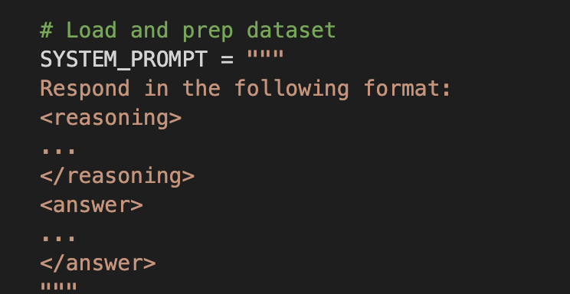
Dataset preprocessing
GSM8k – question and answer format
Answer is put in the format of <answer></answer>
We have template for the model to produce -

Slide 11
Generating COT and rewarding
Reward the <reasoning><reasoning><answer></answer> template
Deepseek R1 leverages XML format to first create outputs from the model

Slide 12
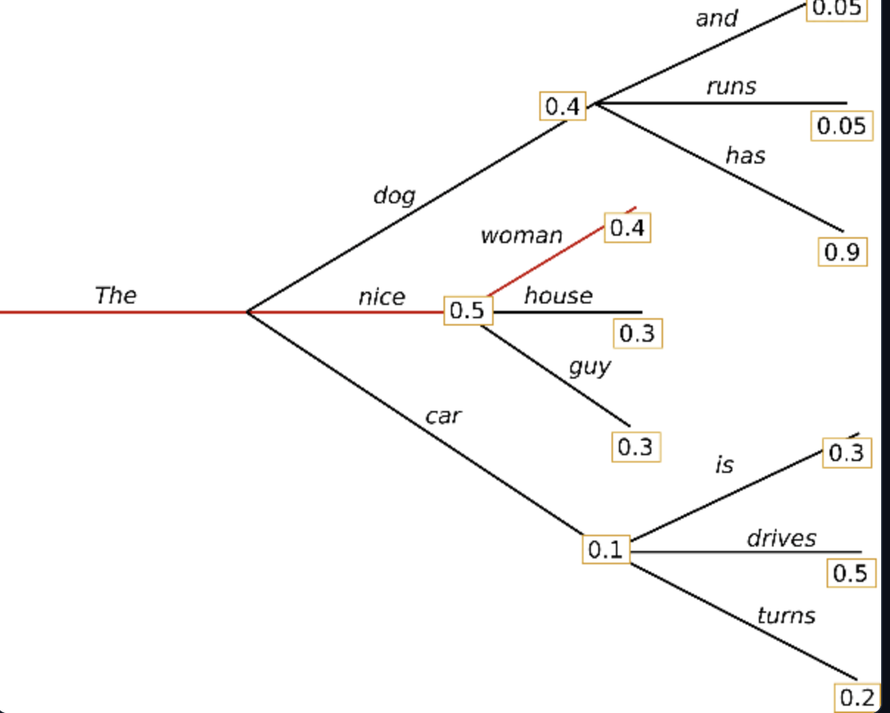
How does model generate multiple COT?

Slide 13
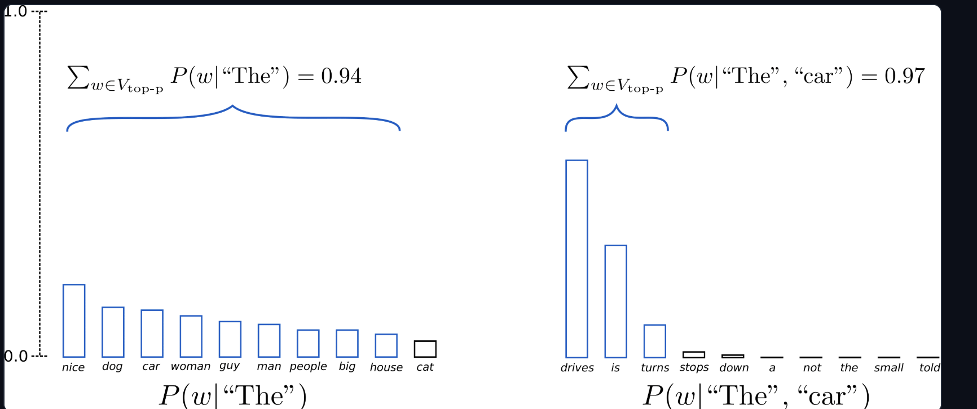
Top-p sampling

Slide 14
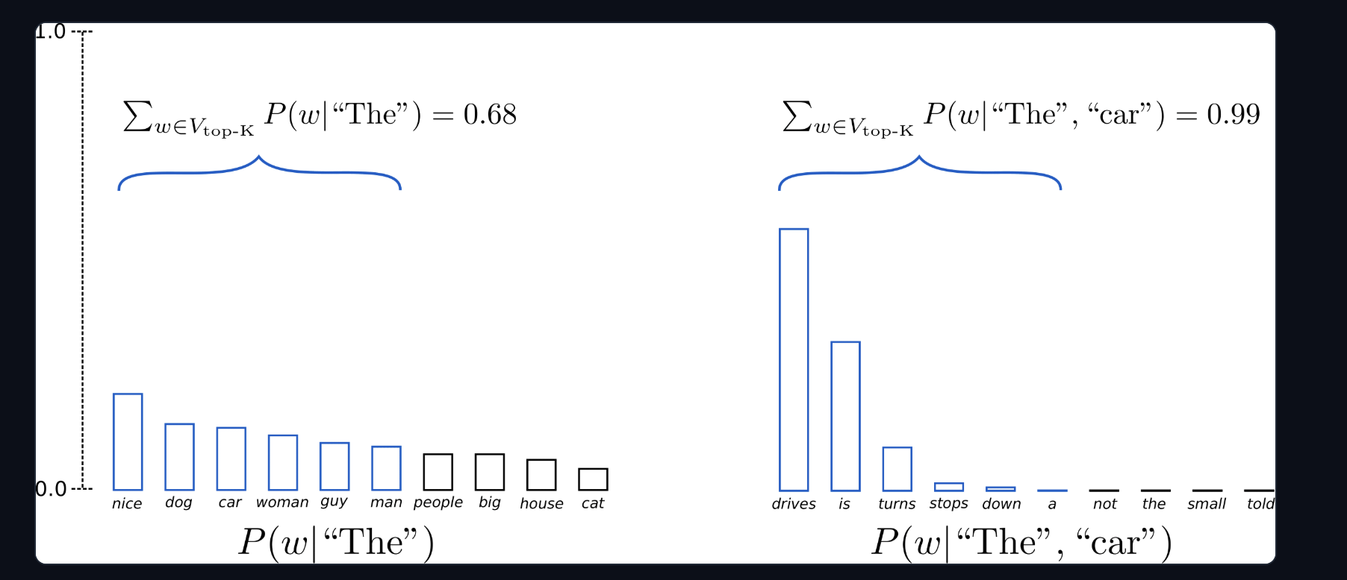
Top k sampling

