Slide 1
CS 6050 · GRADUATE ALGORITHM PROJECT 2
Breaking Paragraphs into Lines
The Knuth-Plass line breaking algorithm
Jacob Beal
Knuth & Plass, Software: Practice and Experience, 1981

Slide 2
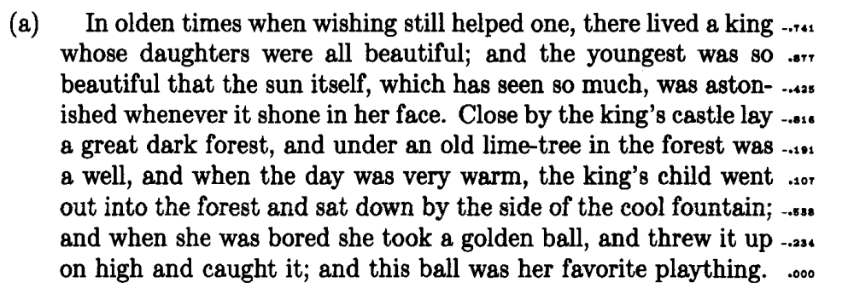
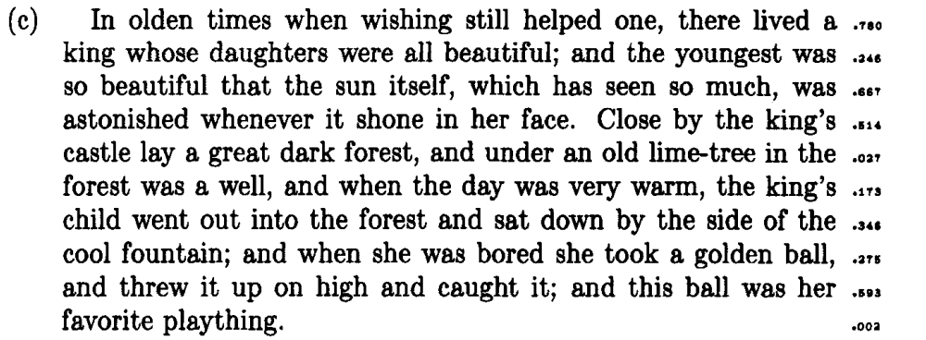
THE PROBLEM
Where should each line of a paragraph end?
One line at a time (first fit): 13,218 demerits
INPUT
A paragraph, a column width, and the places a word can be hyphenated
OUTPUT
The line breaks that keep the spacing as even as possible
Whole paragraph at once (Knuth-Plass): 4,030 demerits
2¹²⁹
ways to break the paper's sample paragraph, so we can't just try them all
It sounds like bin packing, which is NP-complete. But each line holds text in order, and that is what makes DP work.
Figure 4 and demerits table: Knuth & Plass 1981, pp. 1129-1130
2

Slide 3
THE PROBLEM
A paragraph is just boxes, glue and penalties
when
wish
ing
still
helped
Box
Glue
Penalty
A word or a piece of one. It only has a width.
A space between words. It has a normal width and can stretch or shrink.
A spot where a line could break, like a hyphen, with a cost for breaking there.
w = 41 for "when"
(width, stretch, shrink) = (6, 3, 2)
p = 50 for a hyphen
HOW MUCH DOES A LINE HAVE TO STRETCH?
WHICH LINES ARE ALLOWED?
r = (width − L) / Y
r < −1: spaces would have to shrink past their limit, so it never fits
if the line is too short
r = (width − L) / Z
if the line is too long
r > ρ: too loose. ρ is a tolerance you pick (the paper uses 1.26)
L = natural width of the line, Y = total stretch, Z = total shrink
Knuth & Plass, "Breaking Paragraphs into Lines," Software: Practice and Experience, 1981
3

Slide 4
THE PROBLEM
Every line gets a score, and we want the lowest total
DEMERITS FOR ONE LINE
r
DEMERITS
badness = 100 |r|³
0.00
1
demerits = (1 + badness + p)²
0.25
7
0.50
182
p is the penalty for the break at the end of the line
1.00
10,201
PLUS, FOR PAIRS OF LINES
FITNESS CLASSES
+ α
if two lines in a row end in a hyphen
0
tight
r < −0.5
+ γ
if a tight line sits next to a loose one
1
normal
−0.5 to 0.5
2
loose
0.5 to 1
Negative penalty: (1 + badness)² − p². Forced break: (1 + badness)². The paper uses α = γ = 3000.
3
very loose
r > 1
Classes more than 1 apart are the ones that pay γ.
Knuth & Plass, "Breaking Paragraphs into Lines," Software: Practice and Experience, 1981
4

Slide 5
THE SUBPROBLEMS
Each DP entry is the cheapest way to reach a break
D[b, c]
The fewest total demerits to set everything from the start of the paragraph through break b, if the line ending at b has fitness class c.
b
A legal place to end a line. There are B of them.
EACH ENTRY ALSO STORES
A pointer to the break it came from, which is how we get the lines back at the end
c
Tight, normal, loose or very loose, so 4 values.
Start
D[0, 1] = 0. Nothing set yet, treated as a normal line.
WHY c IS IN THE TABLE
The next line's cost depends on how tight this one was, so the break alone isn't enough to know what comes next
Answer
The smallest D[m, c], where m is the forced break at the very end.
Knuth & Plass, "Breaking Paragraphs into Lines," Software: Practice and Experience, 1981
5

Slide 6
THE RECURRENCE
Try every place the last line could start
D[0, 1] = 0
D[b, c] = min over active breaks a and classes c′ of
D[a, c′] + demerits(a → b) + α·(a, b both hyphens) + γ·(|c − c′| > 1)
only where the line from a to b fits (−1 ≤ r ≤ ρ) and its class is c
READING IT OFF
D[a, c′]
demerits(a → b)
α and γ
best way to set everything before this line
this line's own cost, (1 + 100|r|³ + p)²
cost of this line next to the line before it
r comes from running totals of width, stretch and shrink, so each check is O(1). With line numbers in the state, the same idea handles different line lengths.
Knuth & Plass, "Breaking Paragraphs into Lines," Software: Practice and Experience, 1981
6

Slide 7
THE RECURRENCE
Why the best answer has to be one of those cases
1
Every setting has a last line
WHY c HAS TO BE THERE
It starts right after some earlier break a, or at the start. Trying every a covers every possible setting.
Keep only the cheapest way to reach each break and #2 stops being true. A costlier way in can win later by avoiding γ.
2
What came before only matters through (a, c′)
Later lines only see where the last break was and how tight that line was. Swap in a cheaper way to reach (a, c′) and the total can only go down.
40 of 148,000
random paragraphs got a worse answer when I dropped the classes
3
Throwing out a break is safe
If a line from a is already too long (r < −1), it only gets longer for every later break, so a can never start another line.
Rare enough that random tests missed it, so one of them is now a unit test.
Knuth & Plass, "Breaking Paragraphs into Lines," Software: Practice and Experience, 1981
7

Slide 8
THE RECURRENCE
Only a short list of breaks stays in play
O(B · W)
for each legal break b:
for each active node a:
r = ratio(a, b)
if r < -1: remove a
if -1 <= r <= rho:
update D[b, class(r)]
add the best entries for b
to the active list
B breakpoints, each checking about W active nodes, where W is words per line
17
active breaks at one point in the paper's example, with 836,272,858 possible settings
A break stays active only while a line starting there can still fit. So the list is about one line of text long, and it does not grow with the size of the paragraph.
Each break can have up to 4 nodes, one per class. That is hidden in the constant, and it shows up in my results later.
Running time and 17 active nodes: Knuth & Plass 1981, pp. 1148, 1151
8

Slide 9
A WORKED EXAMPLE
A small example with 8,192 possible settings
THE INPUT (WORD WIDTHS UNDERNEATH)
when
she
was
bored
she
took
a
golden
ball,
and
threw
it
up
on
41
25
29
44
25
35
9
51
34
29
45
12
20
19
COLUMN WIDTH
SPACES
TOLERANCE
CONTRAST COST
236 units
(6, 3, 2)
ρ = 1
γ = 3,000
ONE LINE BY HAND
3
4
"when she was bored she took"
L = 199 + 5 × 6 = 229, which is 7 short
Y = 5 × 3 = 15, so r = 7 / 15 = 0.467
(1 + 100 · 0.467³)² = 124.6 demerits
settings where every line fits
breaks are ever reachable: "took", "a", "up", "on"
Knuth & Plass, "Breaking Paragraphs into Lines," Software: Practice and Experience, 1981
9

Slide 10
A WORKED EXAMPLE
Filling in the table, one break at a time
BREAK b
FROM a
LINE
L
r
CLASS
DEMERITS
γ
D[b, c]
took
start
when she was bored she took
229
+0.467
1
124.6
124.6
a
start
when she was bored she took a
244
-0.667
0
938.2
938.2
up
took
a golden ball, and threw it up
236
+0.000
1
1.0
125.6
up
a
golden ball, and threw it up
221
+1.000
2
10,201.0
3,000
14,139.2
on
a
golden ball, and threw it up on
246
-0.833
0
3,465.7
4,403.9
on
up
on
19
+0.002
1
1.0
126.6
"up" and "on" each get a second candidate in a different class. Both cost more than the best entry plus γ, so they can never catch up and get dropped (gray).
If they were closer we would have to keep both, since the cheaper class might still pay γ later. Highlighted rows are the optimal path.
Knuth & Plass, "Breaking Paragraphs into Lines," Software: Practice and Experience, 1981
10

Slide 11
A WORKED EXAMPLE
Follow the pointers back to get the answer
EVERY FEASIBLE LINE, WITH ITS DEMERITS
126.6
took
1.0
up
124.6
1.0
smallest entry at the last break, in class 1
start
on
10,201 + γ
POINTERS, BACKWARD
938.2
a
3,465.7
on ← up ← took ← start
KNUTH-PLASS: 127 DEMERITS, 3 LINES
FIT AS MANY WORDS AS POSSIBLE: 4,404 DEMERITS, 2 LINES
when she was bored she took
a golden ball, and threw it up
on
when she was bored she took a
golden ball, and threw it up on
Taking the longest line first costs about 35× more here, because it forces tight lines.
Knuth & Plass, "Breaking Paragraphs into Lines," Software: Practice and Experience, 1981
11

Slide 12
THE ANALYSIS AND RESULTS
10 test cases, each twice the size of the last
10
2,353–1,216,218
6.7 s
paragraphs, from 2,048 to 1,048,576 words
legal breakpoints B
for the largest case
HOW I MADE THEM
HOW I KNOW THE ANSWERS ARE RIGHT
Words sampled with a fixed seed from the paper's example paragraph, so lengths and hyphens stay realistic.
All use a 500-unit column and the paper's settings, so W stays at about 12.3 and only B changes.
10 of 10
cases match a separate backward DP
21 of 21
line breaks match the paper's figures
2,748
small paragraphs match exhaustive search
10 of 10
bugs I planted on purpose get caught
Timed on an Apple M1 Max, Python 3.12, garbage collector off, minimum of at least 3 runs
12

Slide 13
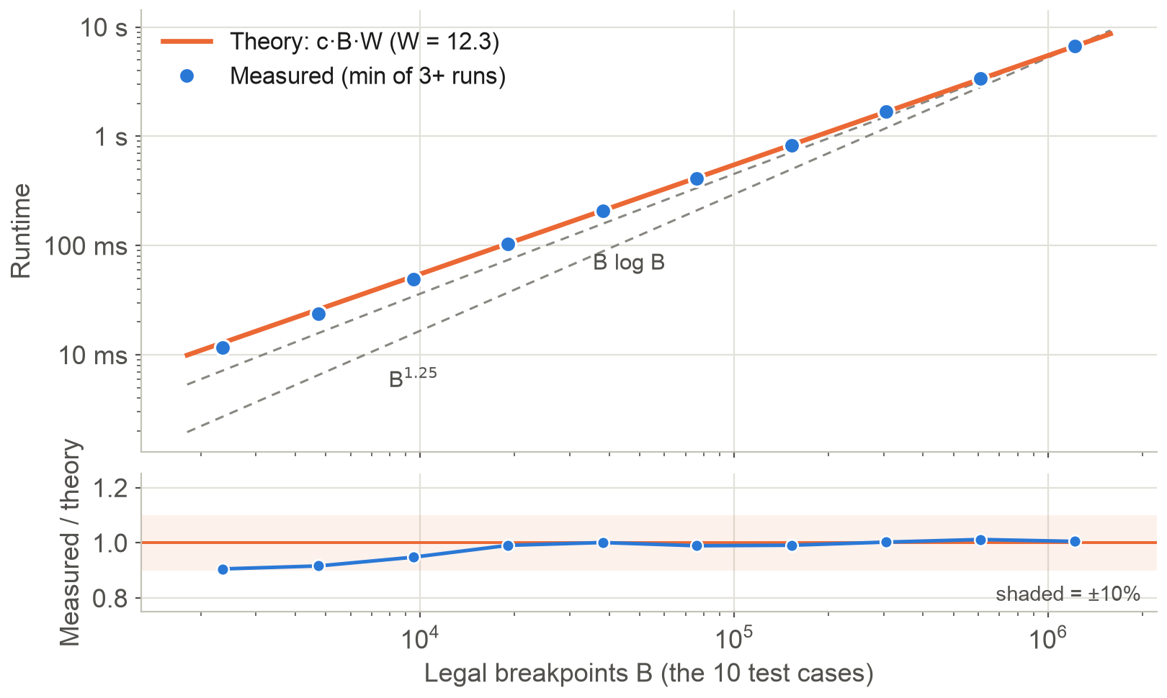
THE ANALYSIS AND RESULTS
Runtime grows linearly with B, just like the theory says
1.008
log-log slope on the 5 largest cases, 1.017 on all 10
1.97–2.09×
as long each time the size doubled
An extra log factor would show: B log B has a slope of 1.079 over these sizes.
Smallest cases run about 10% low. The first 250 words average 11 active nodes per break, not 18, and each check is a bit cheaper.
Log-log axes, so linear growth is a straight line with slope 1. Dashed lines go through the largest point. c fit on the 5 largest cases.
13

Slide 14
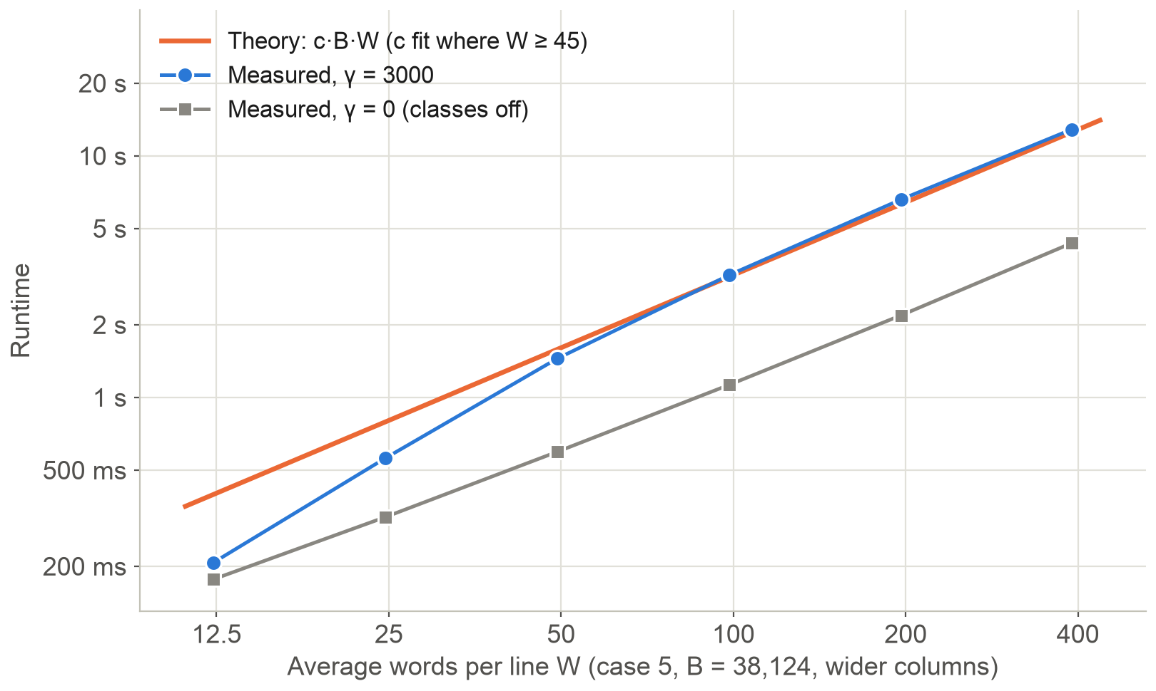
THE ANALYSIS AND RESULTS
Runtime grows with W too, with one catch
1.054
slope once W reaches 45, but 1.193 overall
1.5 → 3.5
active nodes per W as lines get longer, then it levels off
That is the constant hiding in the O. Long lines let a break keep more of its 4 class nodes. Turn classes off (γ = 0) and the ratio stays at 1.2–1.3, with slope 0.93.
Slopes on log-log axes. Same text (case 5), wider and wider columns, so B stays at 38,124.
14

Slide 15
THE ANALYSIS AND RESULTS
My runtimes match O(B · W)
1.008
Slope against B with W fixed. Linear, and clearly not B log B.
1.054
Slope against W with B fixed, once the fitness class constant levels off.
281–302 ns
Cost of checking one active node across all 10 cases. Almost constant, so counting nodes explains the runtime.
Keep in mind: this is one machine, and W is the average words per line, not the max. The paper doesn't print its full font table, so I estimated some letter widths. Line breaks match its figures, but total demerits are 9% and 16% off.
Thanks! Questions?
Knuth & Plass, "Breaking Paragraphs into Lines," Software: Practice and Experience, 1981
15

