Slide 1
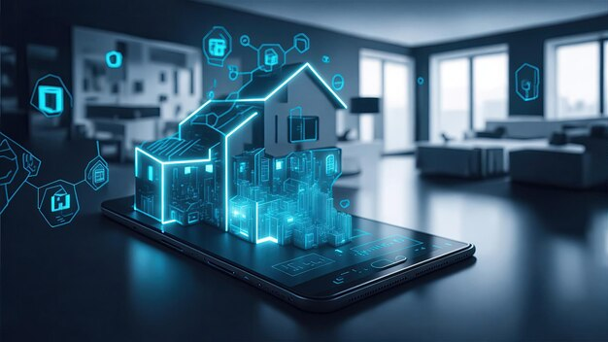
SMART HOME MANAGEMENT SYSTEM
(Module-3)
Real Time Monitoring
Presented By-
Dibya Patra
Under The Guidance Of-
Dr. T. Premalatha

Slide 2
  About Real Time Energy Tracking
What is Real Time Energy Tracking?
Definition:
Real-time energy tracking allows the system to measure, collect, and show live power usage of devices like AC, lights, washing machine, and water heater through a software dashboard or mobile app
In the Smart Home Energy Management System, real-time energy tracking continuously monitors the live electricity consumption of household devices using smart sensors. The collected data is sent to the server and displayed on a dashboard, helping users identify high energy usage, receive alerts, and reduce power wastage.
It Prevents energy wastage and Helps users to understand appliance usage,
Supports automated energy control, Reduces electricity bills
Improves overall energy efficiency

Slide 3
Linking of Modules for Real Time Energy Tracking
(Module 3)
Module 1:
User & Access Management
Module 1 controls who can access the system.
It ensures that only authorized users (admin or resident) can view real-time energy data.
Admin has full access, while users have limited access like viewing usage and switching devices ON/OFF.
Module 2:
Device Management
Module 2 manages which devices are tracked
Each device is registered with details such as device type, power rating, location, and current status.
This information is essential for calculating energy consumption.
Module 3:
Real-Time Energy Tracking
Module 3 uses user permissions from Module 1 and device data from Module 2 to continuously monitor and display device-wise and total energy consumption in real time

Slide 4
Classes in Real-Time Energy Tracking Module (Module 3)
EnergyUsage
Stores real-time power consumption data
Includes (device ID, timestamp, and energy usage)
Uses device details from Module 2 (Device Management)
2. EnergyController
Acts as an interface between user and system
Handles requests to view energy data
Checks user access from Module 1 (User Management)
3. EnergyService
Performs energy calculations and processing
Calculates total and device-wise consumption
Uses power ratings from Module 2
4. EnergyRepository
Stores and retrieves energy data from the database
Saves data generated by EnergyService

Slide 5
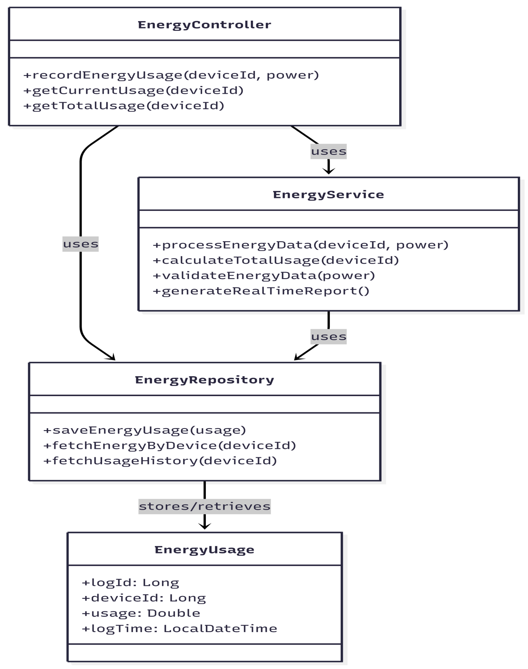
CLASS DAIGRAM FOR MODULE-3
EnergyTrackingController
↓
EnergyTrackingService
↓
UsageRepository
↓
DATABASE (usage_logs table)

Slide 6
ENERGY USAGE (stores usage data)
CLASS EnergyUsage
Deviceld
energyUsed
time
ENERGY CONTROLLER
CLASS EnergyController
FUNCTIONrecordEnergy(data)
EnergyService.saveEnergy(data)
END FUNCTION
FUNCTIONviewEnergy(deviceld)
EnergyService.getEnergy(deviceld)
END FUNCTION
ENERGYSERVICE
CLASS EnergyService
FUNCTION saveEnergy(data)
store energy usage
END FUNCTION
FUNCTION getEnergy(deviceld)
return energy data
END FUNCTION
ENERGY REPOSITORY
CLASS EnergyRepository
FUNCTION save(data)
store energy data
END FUNCTION
FUNCTION find(deviceld)
return energy data
END FUNCTION

Slide 7
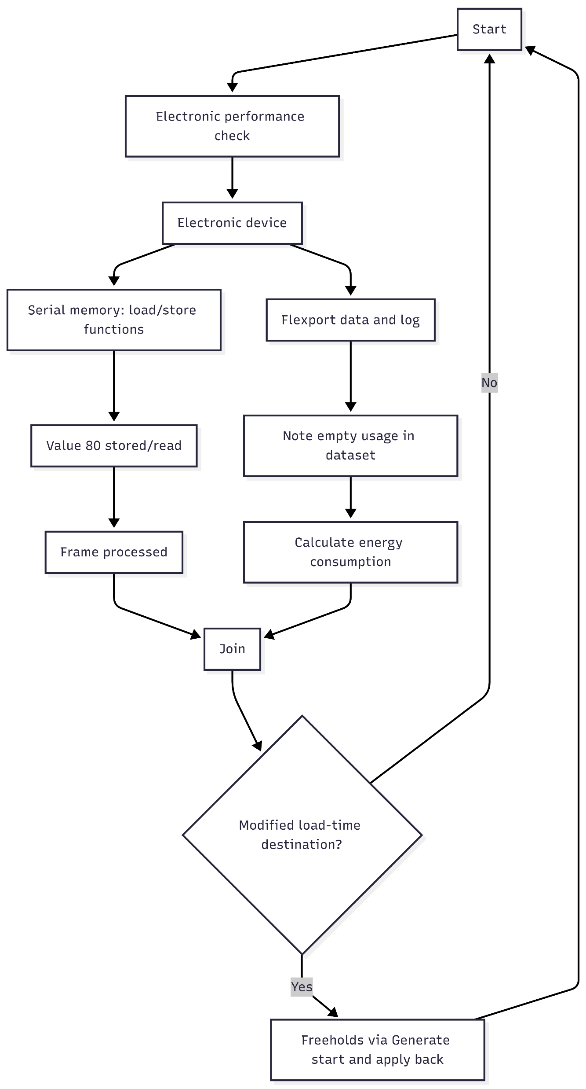
Activity Daigram:-

Slide 8
Data Base Schema for Module 3
CREATE TABLE usage_logs(
log_id BIGINT PRIMARY KEY AUTO_INCREMENT,
device_id BIGINT, …refers to devices.device_id
usage_kw DECIMAL (10,3) …electricity consumption
log_time TIMESTAMP DEFAULT CURRENT_TIMESTAMP

Slide 9


