Slide 1

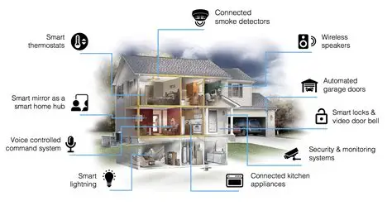
Smart Home Energy Management System
Presented By-
Dibya Patra
Under The Guidance Of-
Dr. T. Premalatha

Slide 2


|
SMART HOME ENERGY MANAGEMENT
SHEM: A software platform that monitors, controls, and optimizes household energy flows (generation, storage consumption) to reduce cost, improve comfort and lower emissions.
Smart Home
It residence equipped with devices that can be controlled remotely or autonomously. These devices are interconnected and integrated with a central system
Energy Management
Encompasses the planning and operation of energy production and consumption. /in a smart home context, it focuses on optimizing energy use for efficiency and cost savings.

Slide 3
|
EXISTING SYSTEM CHALLENGES
Current traditional home energy setups face significant limitations that lead to inefficiency and user frustration.
No Real-Time Visibility: Users only see their consumption
when the monthly bill arrives, making it impossible to
adjust habits proactively
Manual Control:-Devices must be physically switched
on/off. No automation exists for "forgotten" lights or appliances.
High Energy Waste: -"Vampire power" and inefficient scheduling contribute to higher carbon footprints and electricity costs.

Slide 4
|
Proposed System & Modules
  Proposed System:
    Smart automated control of home devices
    Real-time energy monitoring and reports
    Secure Java-based login with role-based access
Modules And Works
There are 6 module:--
User Authentication & Access Control: Secure login, user roles, and access permissions.
Device Registration & Management: Add, update, and manage smart devices in the home.
Real-Time Energy Monitoring: Track energy usage of connected devices in real time
Automation Rules / Scheduling: Automate device operations using rules and time schedules.
Alerts & Notifications: Send alerts on abnormal usage or important energy events.
Analytics & Reports: Generate insights, trends, and usage reports for optimization.

Slide 5
|
SYSTEM CONFIGURATION
Frontend:- HTML, CSS3, Bootstrap, Thymeleaf
Backend:- Java 21, Spring Boot, Spring MVC, Hibernate/JPA,
REST API
Database:- MySQL/MYSQL Workbench•
Tools & IDE:-IntelliJ IDEA
Postman
-Testing REST APIS
- Checking backend functionality
Maven
- Automatically manage project dependencies
GitHub
- To upload project online

Slide 6
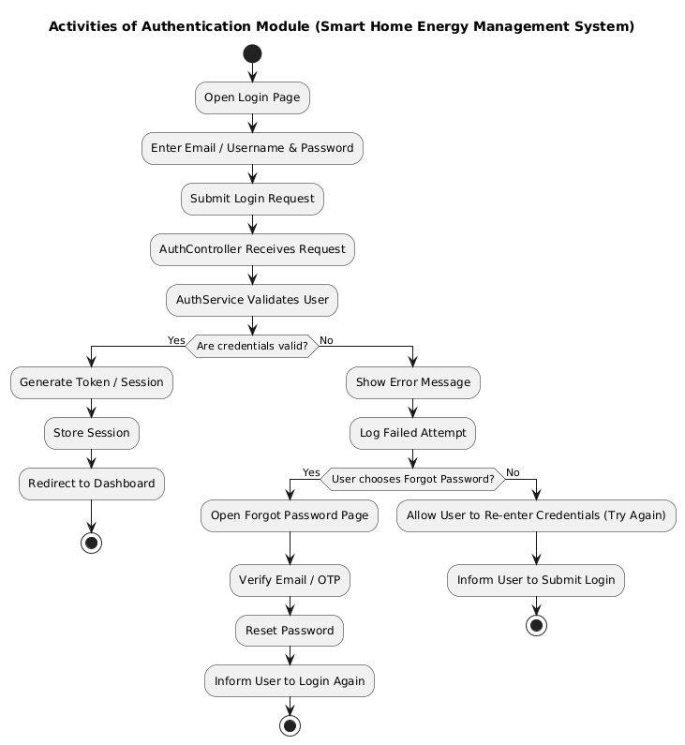

Slide 7
Includes 4 Main Classes:-
These module manages login, registration, user validation,access control, and database linkage.
Usage of Each Class
User:- Represents database table for storing user details.
UserRepository:-Performs CRUD operations and DB queries.
AuthService:-Contains authentication business logic (login, register, logout).
AuthController:- Handles HTTP API requests and communicates with AuthService.
User
↓
AuthController
↓
AuthService
↓
UserRepository
↓
Database (User Table)
↑
AuthService
↑
AuthController
↑
User (Response)

Slide 8
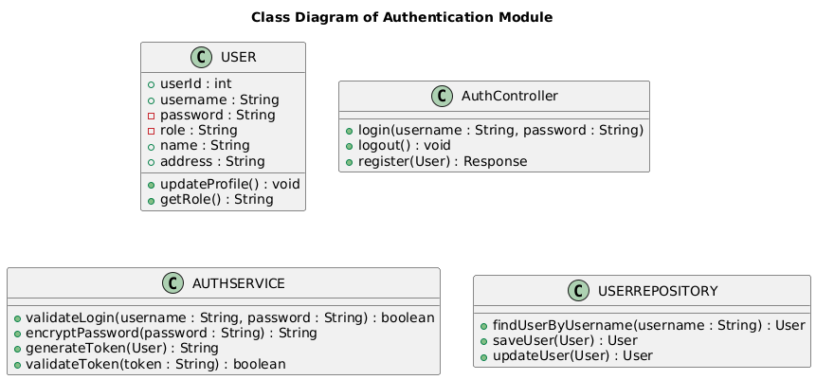

Slide 9
|
Data Base Schema for Module 1
CREATE TABLE users (
user-id BIGINT PRIMARY KEY AUTO_INCREMENT,
username VARCHAR(50) UNIQUE NOT NULL,
email VARCHAR(100) UNIQUE NOT NULL,
password VARCHAR(255) NOT NULL,
role VARCHAR(30),
is_active BOOLEAN DEFAULT TRUE,
created_at TIMESTAMP DEFAULT CURRENT_TIMESTAMP );

Slide 10
Thank you

