Slide 1
CS307 Database Project 2 Presentation
12011525 徐延楷
12011528 张艺严
12012524 陈张杰

Slide 2
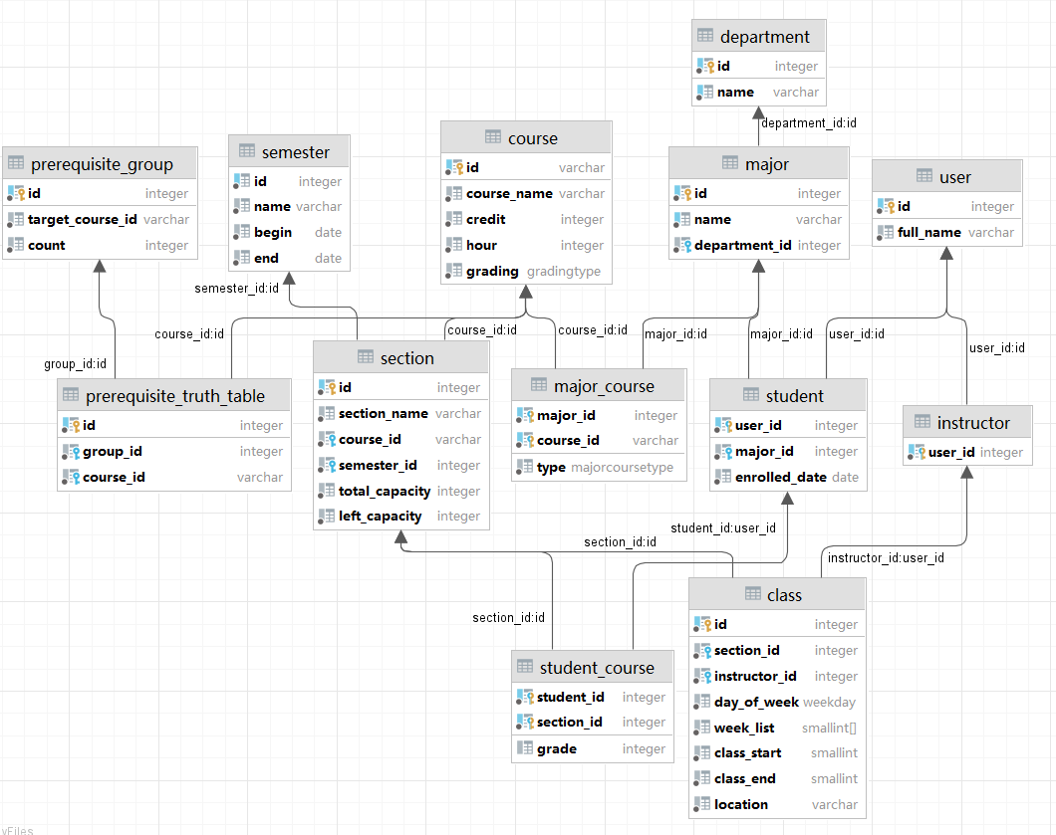
Database Design

Slide 3
Prerequisites
A truth table
A table to store the group(lines) in truth table
In db, the row of truth table will only contain column with value 1. So, the truth table a little special. It is consisted of several groups, every group contains a linear independent combination of "columns" to make the output true.

Slide 4
Importing Data
packed into BatchedStatement

Slide 5
Search course

Slide 6
Enroll course
COURSE_NOT_FOUND: searching the corresponding course ID in table section.
​ALREADY_ENROLLED: searching the section ID in student_course table.
​ALREADY_PASSED: searching the section IDs related to the course ID in student_course table, where grade is over 60.
​PREREQUISITES_NOT_FULFILLED: using is_prerequisite_satisfied().
​COURSE_CONFLICT_FOUND: search the same course first, then search whether time conflict exists.
If all upper failures don’t occur. Return SUCCESS and alter the table.

Slide 7
Enroll course
Multiple queries, using SQL function to process.
if (exists(select course_id, semester_id from section join course c on c.id = section.course_id where section.id = $2 intersect select course_id, semester_id from section join course c on c.id = section.course_id join student_course sc on section.id = sc.section_id where student_id = $1)) then return 'COURSE_CONFLICT_FOUND'; end if;
if (exists(with target_section as (select semester_id as semester, day_of_week as day, unnest(week_list) as week, class_start as start_time, class_end as end_time from class join section on class.section_id = section.id where section_id = $2), enrolled_section as (select semester_id as semester, day_of_week as day, unnest(week_list) as week, class_start as start_time, class_end as end_time from (select section_id from student_course where student_id = $1) as t join section on t.section_id = section.id join class on t.section_id = class.section_id) select from enrolled_section, target_section where enrolled_section.semester = target_section.semester and enrolled_section.day = target_section.day and enrolled_section.week = target_section.week and ((target_section.start_time between enrolled_section.start_time and enrolled_section.end_time) or (target_section.end_time between enrolled_section.start_time and enrolled_section.end_time)) )) then return 'COURSE_CONFLICT_FOUND'; end if;

Slide 8
Get course table
return query with temp_sections as (select section_id from student_course where student_id = $1) select c.day_of_week as day, c2.course_name || '[' || s.section_name || ']' as class_name, c.instructor_id as instructor_id, u.full_name as instructor_full_name, c.class_start as class_begin, c.class_end as class_end, c.location as location from temp_sections join section s on section_id = s.id join class c on s.id = c.section_id join instructor i on i.user_id = c.instructor_id join "user" u on u.id = i.user_id join course c2 on s.course_id = c2.id where semester_id = current_semester_id and week_list @> array[cast(week_num as smallint)];
Input: student ID, date
Output: course table
Problem: get target week
ceil(((date – semester.begin_date) + 1) / 7.0)

Slide 9
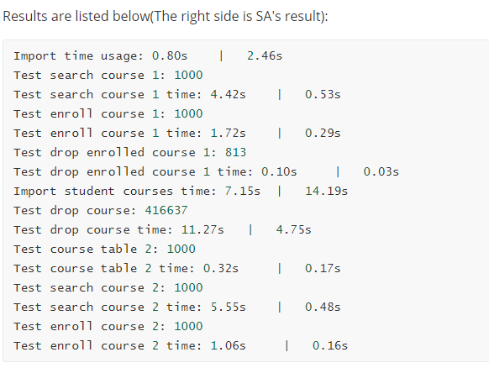
Performance

Slide 10
Thanks for listening!

