Slide 1
Detection of Human Biological Emotions using OpenCV and TensorFlow

Slide 2
Introduction
Human emotions are natural expressions that people tend to make naturally, instead of any conscious effort that is accompanied by the reflexing of facial muscles.
The system uses GPU (Tensor core) accelerated API (Tensorflow) to predict emotions expressed by persons in a video stream.
The system requires localized features which form a pattern to be evaluated against known patterns, for this the system uses OpenCv hardware acceleration to detect face in video stream and provide data to the model for extraction of patterns.
OpenCv uses cascade classifiers to determine these features.
Matplotlib is used by system during model generation to plot accuracy and error curves.

Slide 3
Project Structure
The system consists of three modules as Preprocessing, Model Generation and Training, Emotion Prediction
Preprocessing:
In preprocessing the data set acquired to train the model is extracted cleaned and converted into 48*48 pixel data images.
Model Generation and Training:
The model is created using Tensorflow API which will be trained on Preprocessing Data and then used to predict emotion.
Emotion Prediction:
The trained model (neural network) is provided image data from video source and know patterns are inferred from it.

Slide 4
EXPLANATION OF PREPROCESSING MODULES..
WHAT IS .CSV FORMAT
HOW IT IS UED AS DATASET.
WHY CONVERT INTO IMAGE DATA
HOW IT IS DONE
WILL BE PROVIDED BY JANVHI

Slide 5
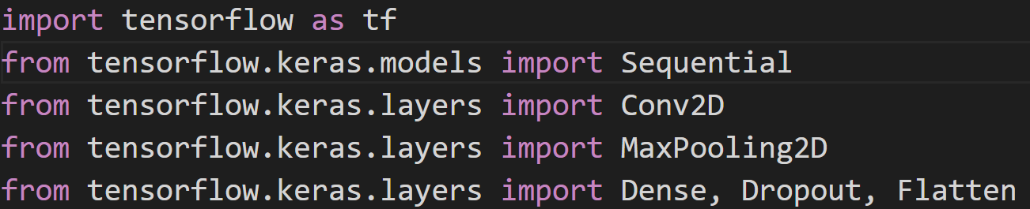
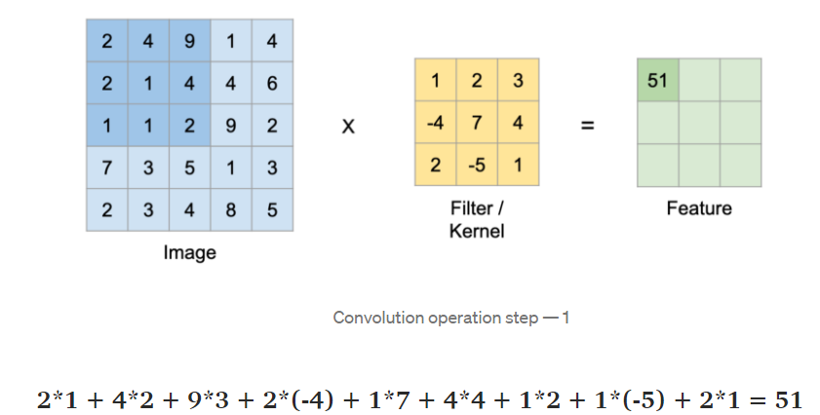
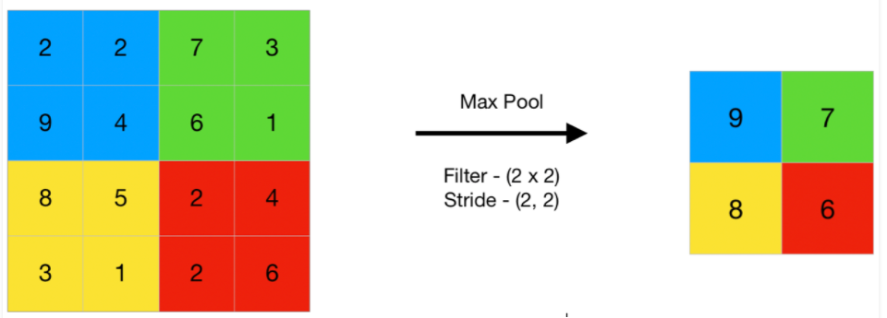

Convolution:
Creating a model:
TensorFlow is a free and open-source software library for machine learning. TensorFlow was developed by Google Brain Team
Keras is a deep learning API written in Python, running on top of the machine learning platform TensorFlow.
The core idea of Sequential API is simply arranging the Keras layers in a sequential order and so, it is called Sequential API.
MaxPlooling:

Slide 6
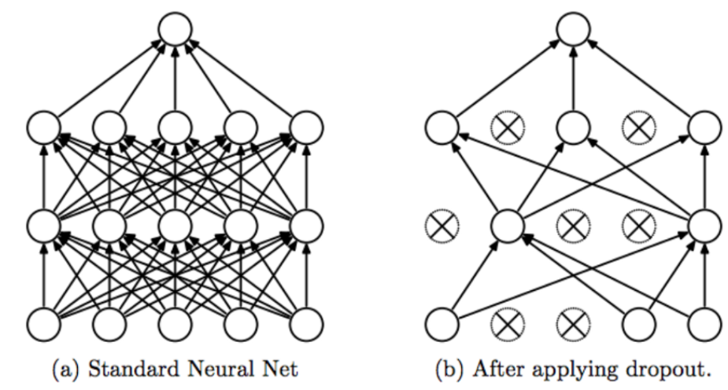
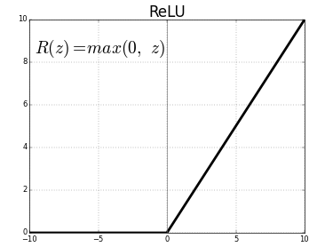
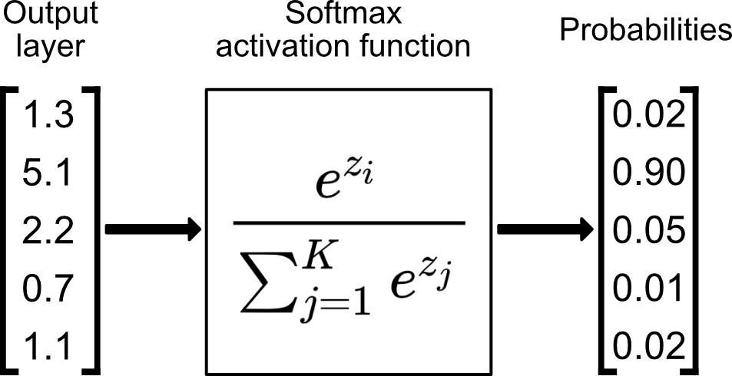
Dropout:The term “dropout” refers to dropping out units (hidden and visible) in a neural network. Dropout is a Simple Way to Prevent Neural Networks from Overfitting.
Activation functions:
1.ReLU(Rectified Linear Unit):
2.Softmax:

Slide 7
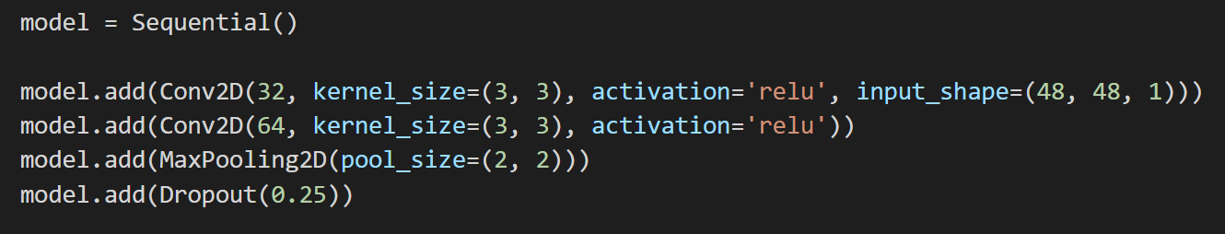
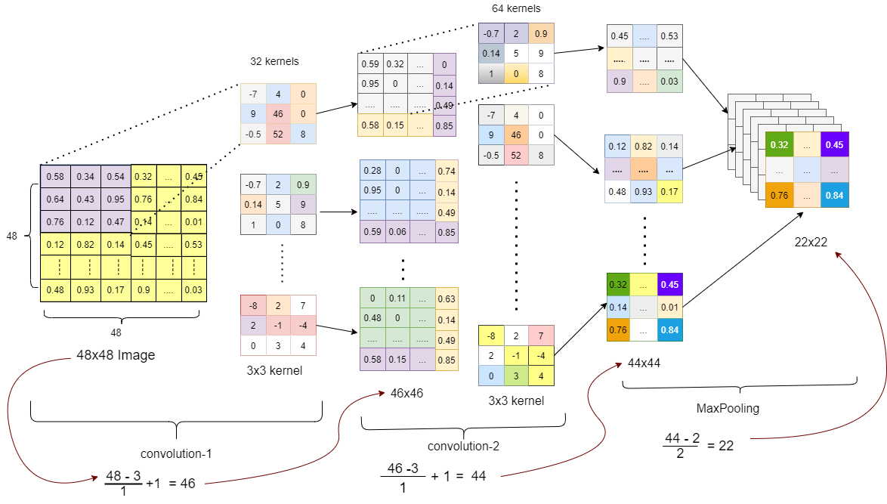

Slide 8
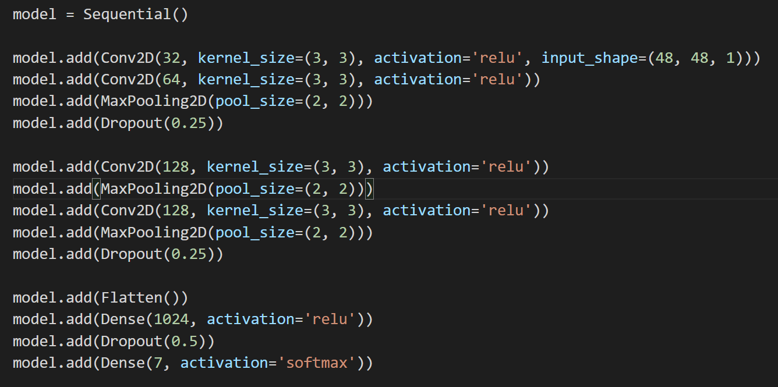
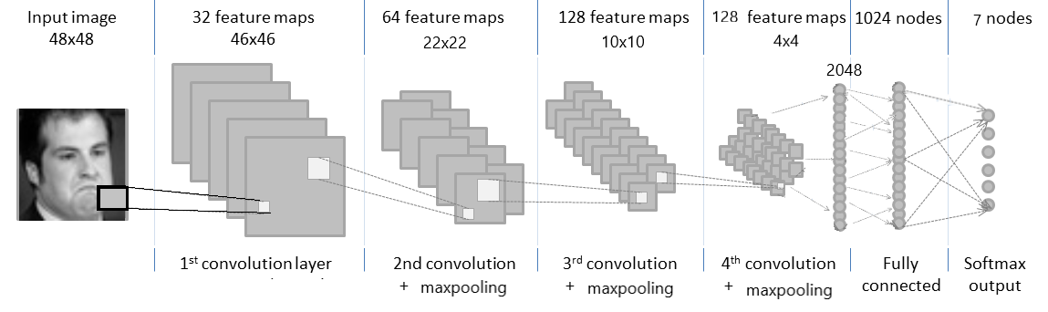

Slide 9
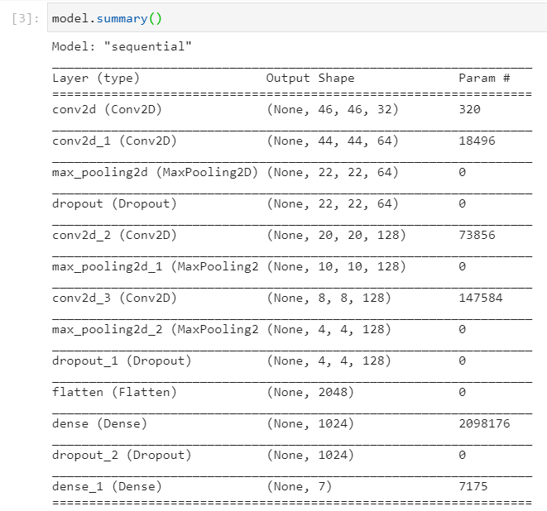

Slide 10
SAGAR --DATA OBTAINED
MODEL TRAINING AND MOTPLOTLIB USES EXPLAIN

Slide 11
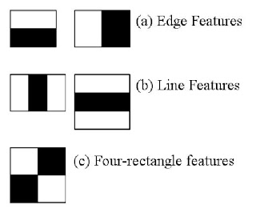
Emotion is detected from a input video stream by using the trained model and opencv hardware acceleration to extract feature vectors and provide them to model.
The processs is as: the system loads trained weights into the model, then the system opens a video stream from default webcam using OpenCv
The calculations are reduced using integral images.then best feature are used using Adaboost.

Slide 12
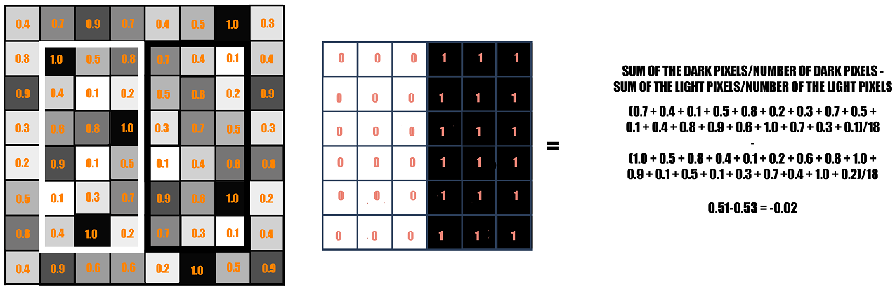
Harr Cascade Classifer: Face detection
Feature are used In identification, face is detected by calculation the sudden change in pixel intensity in an image. This change signifies edge of a face.
The rectangle on the left is a sample representation of an image with pixel values 0.0 to 1.0. The rectangle at the center is a haar kernel which has all the light pixels on the left and all the dark pixels on the right. The haar calculation is done by finding out the difference of the average of the pixel values at the darker region and the average of the pixel values at the lighter region. If the difference is close to 1, then there is an edge detected by the haar feature.

Slide 13
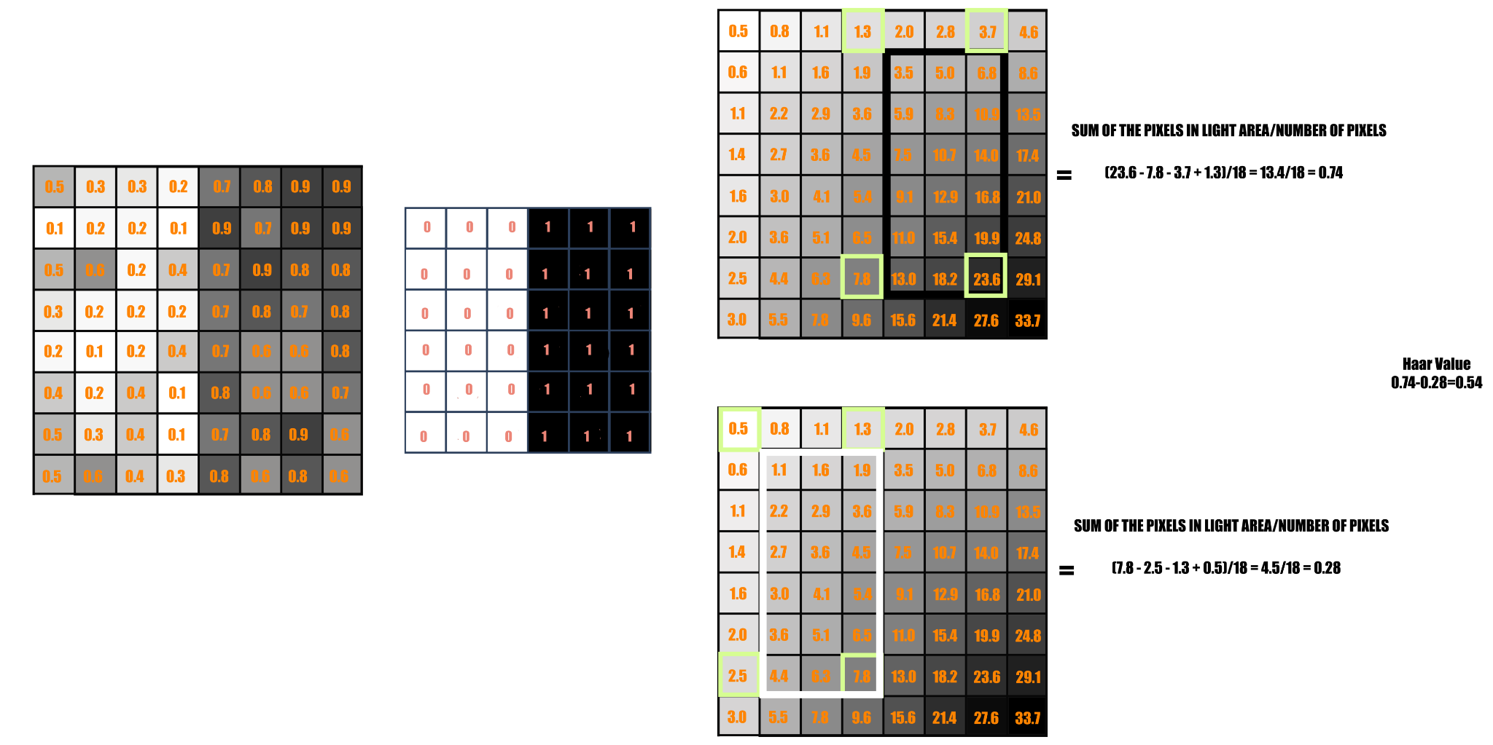
Each pixel in an Integral image is the sum of all the pixels in its left and above
Each feature is a single value obtained by subtracting sum of pixels under the white rectangle from sum of pixels under the black rectangle. all possible sizes and locations of each kernel are used to calculate lots of features, approx 160000 for a 24*24 pixel image These are redued using Integral image to only four constant value addition for each image

Slide 14
A majority of feature will not be useful, as a face if not deatected by simple feature will not be actually present. A feature selection technique called ada boost is used where each of 180000 of feature weer applied to the image individually and classified as weak learners . This was useful as they classifed positive and negative images efficemtely. which reduce feature to 6000.
In an image, most of the image is non-face region. So it is a better idea to have a simple method to check if a window is not a face region. If it is not, discard it in a single shot, and don't process it again. Instead, focus on regions where there can be a face. This way, we spend more time checking possible face regions.
Now as the Face is detected by the harr casccde , the image data is cropped and transferred to the NN model. where it extracts deeper features match them with trained weighted model. the output value of output neuron is matched with a dictionary specifying the emotion. The emotion using opencv is pasted as text on the input stream and provided to user.

Slide 15
Work in Progress
System detects emotion in a video frame with a train accuracy of 0.5472 % the system could be optimized using different model optimizers, and datasets.
The system proposes work to be done for a graphical interface, optimization of model and a standalone process which can be migrated over different systems.
The GUI would be constructed using PyQt/Tkinter.
Pyinstaller will be used to construct standalone package.

Slide 16
Thank You

