Slide 1
Detection of Human Biological Emotions using OpenCV and TensorFlow

Slide 2
Introduction
Human emotions are natural expressions that people tend to make naturally, instead of any conscious effort that is accompanied by the reflexing of facial muscles.
The system uses GPU (Tensor core) accelerated API (Tensorflow) to predict emotions expressed by persons in a video stream.
The system requires localized features which form a pattern to be evaluated against known patterns, for this the system uses OpenCv hardware acceleration to detect face in video stream and provide data to the model for extraction of
patterns.
OpenCv uses cascade classifiers to determine these features.
Matplotlib is used by system during model generation to plot accuracy and error curves.

Slide 3
Project Structure
The system consists of three modules as Preprocessing, Model Generation and Training, Emotion Prediction.
Preprocessing:
In preprocessing the data set acquired to train the model is extracted cleaned and converted into 48*48 pixel data images.
Model Generation and Training:
The model is created using Tensorflow API which will be trained on Preprocessing Data and then used to predict emotion.
Emotion Prediction:
The trained model (neural network) is provided image data from video source and know patterns are inferred from it.

Slide 4
Preprocessing
The FER2013 dataset is used in our projet to train CNN modal, this dataset has .csv extension, cvs files Are plain text it contain record and the values in a record is separated by a comma.
The CSV file has been converted into image file and the image file is used to train the modal.
The keras function accepts inputs as images and the CSV file is an array so it is converted into images.
The file has a column named pixels which contain strings, these strings are converted into integers then images are reshaped to 48*48. All imges are divided into different classes of emotions.

Slide 5
1 | emotion | Pixels | Usage
2 | 0 | 70 80 82 72 58 58 60 63 54 58 60 48 89 115 121 119 | Training
3 | 0 | 151 150 147 155 148 133 111 140 170 174 182 154 | Training
4 | 2 | 231 212 156 164 174 138 161 173 182 200 106 38 39 | Training
5 | 4 | 24 32 36 30 32 23 19 20 30 41 21 22 32 34 21 19 43 5 | Training
6 | 6 | 4 0 0 0 0 0 0 0 0 0 0 0 3 15 23 28 48 50 58 84 115 127 | Training
7 | 2 | 55 55 55 55 55 54 60 68 54 85 151 163 170 179 18 | Training
8 | 4 | 20 17 19 21 25 38 42 42 46 54 56 62 63 66 82 108 | Training
9 | 3 | 77 78 79 79 78 75 60 55 47 48 58 73 77 79 57 50 37 | Training
10 | 3 | 85 84 90 121 101 102 133 153 153 169 177 189 195 | Training
11 | 2 | 255 254 255 254 179 122 107 95 124149 150 169 | Training

Slide 6
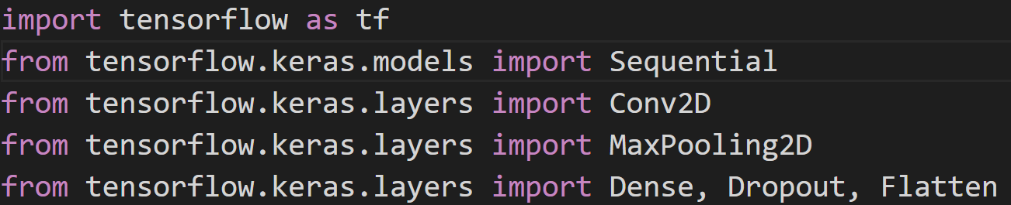
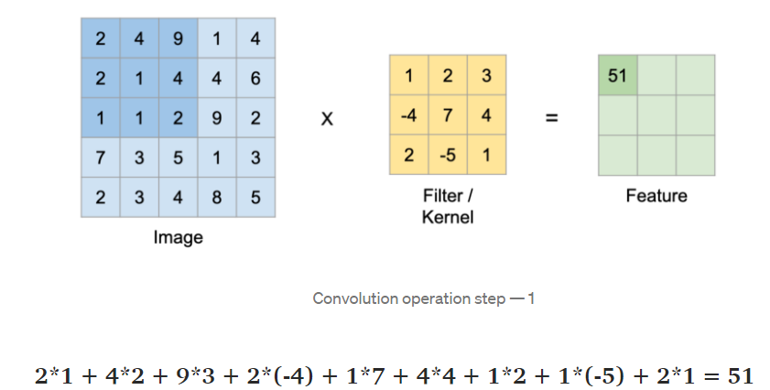
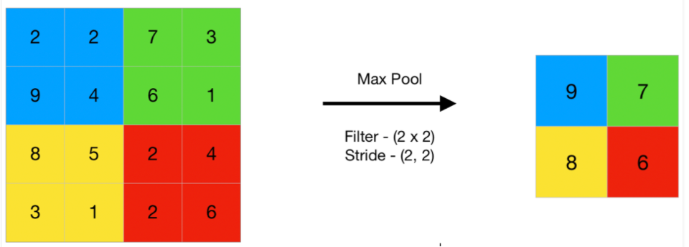

Model Generation
TensorFlow is a free and open-source software library for machine learning. TensorFlow was developed by Google Brain Team.
Keras is a deep learning API written in Python, running on top of the machine learning platform TensorFlow.
The core idea of Sequential API is simply arranging the Keras layers in a sequential order and so, it is called Sequential API.
convolution
Max Pooling

Slide 7
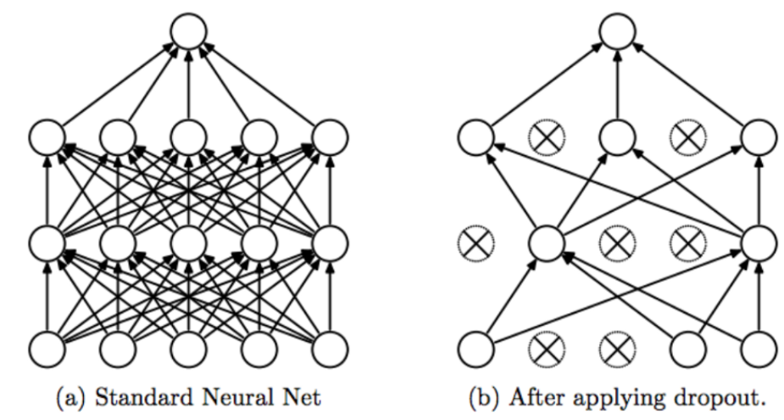
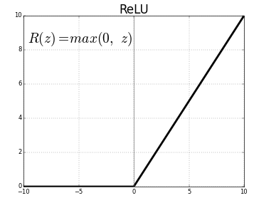
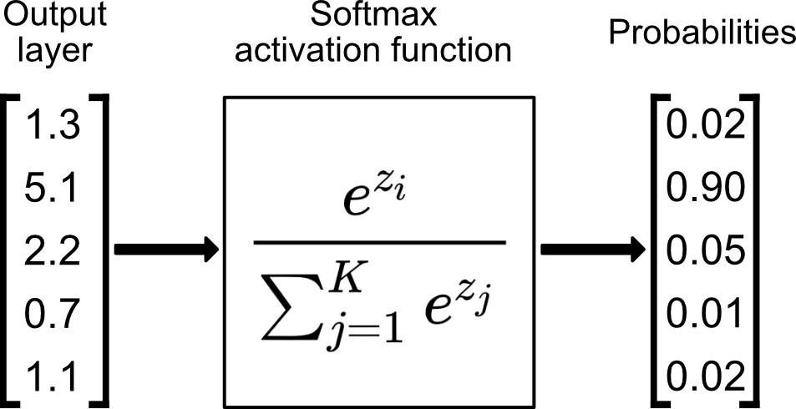
Dropout: The term “dropout” refers to dropping out units (hidden and visible) in a neural network. Dropout is a Simple Way to Prevent Neural Networks from Overfitting.
Activation functions:
1.ReLU(Rectified Linear Unit):
2.Softmax:

Slide 8
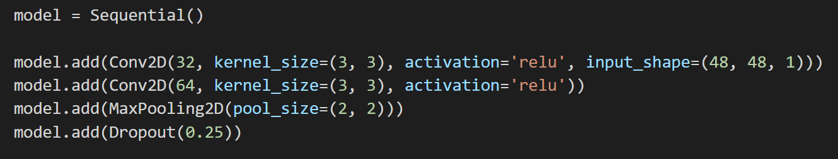
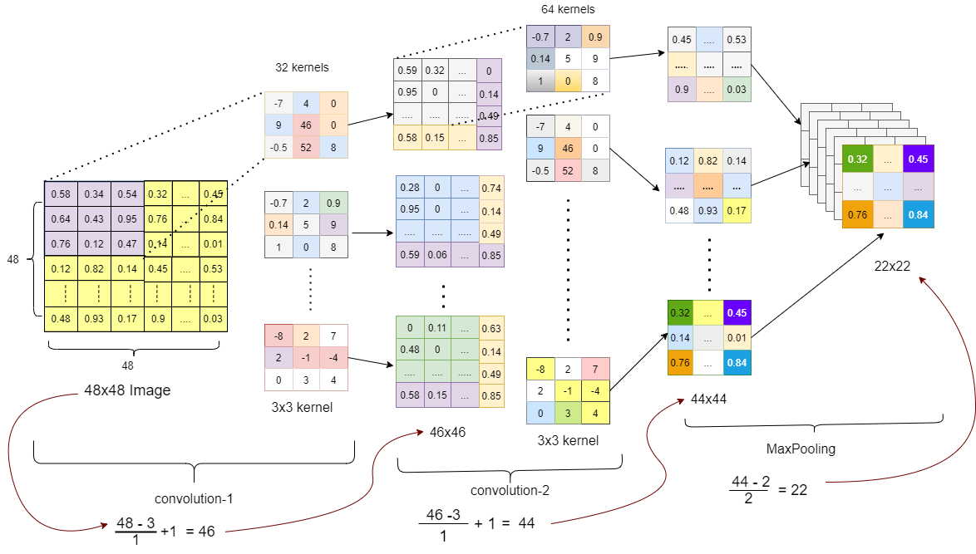

Slide 9
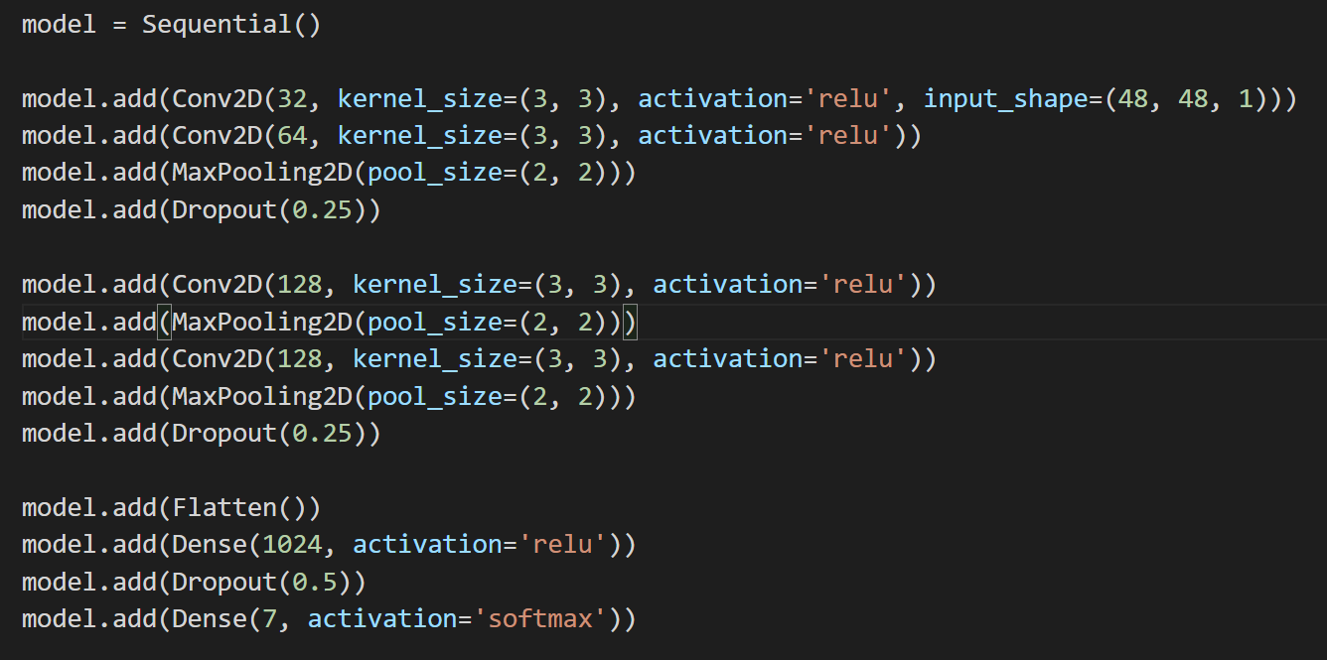
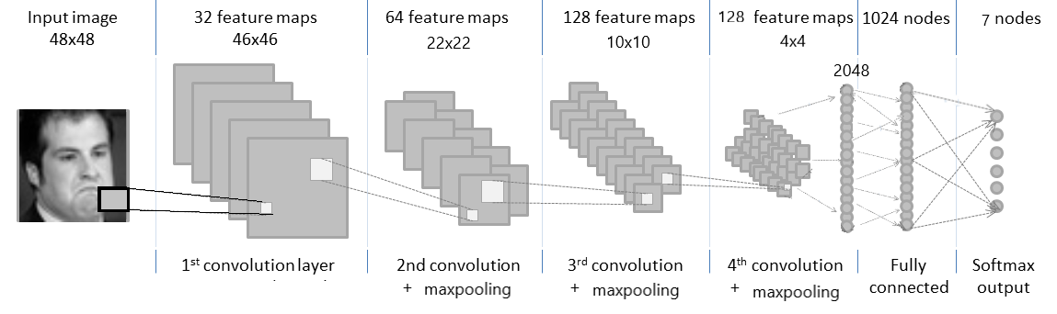

Slide 10
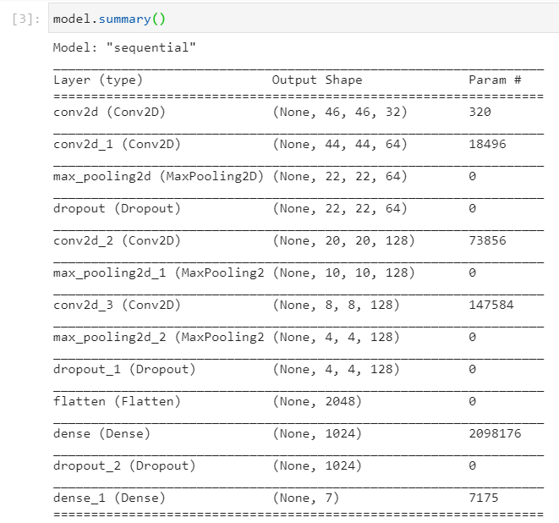

Slide 11

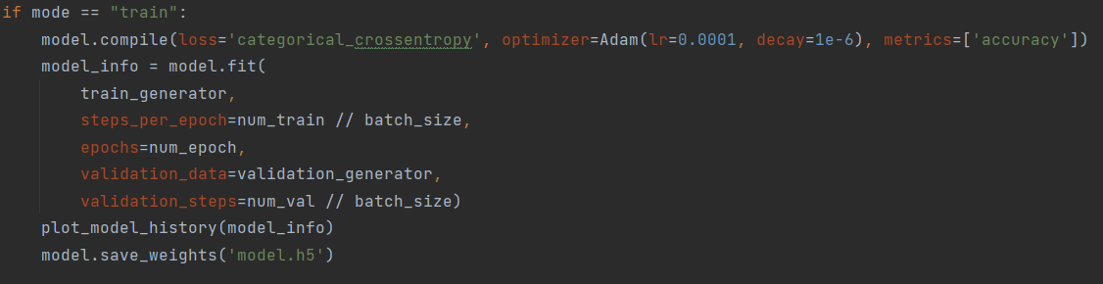
Model Training
Fit_generator: It requires two generators, one for the training data and another for validation. both of them should return a tuple (inputs, targets) as well as can be instance of Sequence class.
Training using the data generator
This is where Keras shines and provides these training abstractions which allow you to quickly train your models. This is very good for rapid prototyping. And the training samples would be generated on the fly using multi-processing [if it is enabled] thereby making the training faster.

Slide 12
Model generator parameters:
1) steps_per_epoch: Integer.
2) epochs: Integer.
3) workers: Integer.
4) use_multiprocessing: Boolean.
If True, use process-based threading.
If unspecified, use_multiprocessing will default to False.
5) validation_data: \
â€£ a generator or a Sequence object for the validation data
â€£ tuple (x_val, y_val)
â€£ tuple (x_val, y_val, val_sample_weights)
on which to evaluate the loss and any model metrics at the end of each epoch.
6) validation_steps: Only relevant if validation_data is a generator.
Categorical_Crossentropy :
Computes the cross entropy loss between the labels and predictions.
Use this crossentropy loss function when there are two or more label classes. We expect labels to be provided in a one_hot representation.

Slide 13
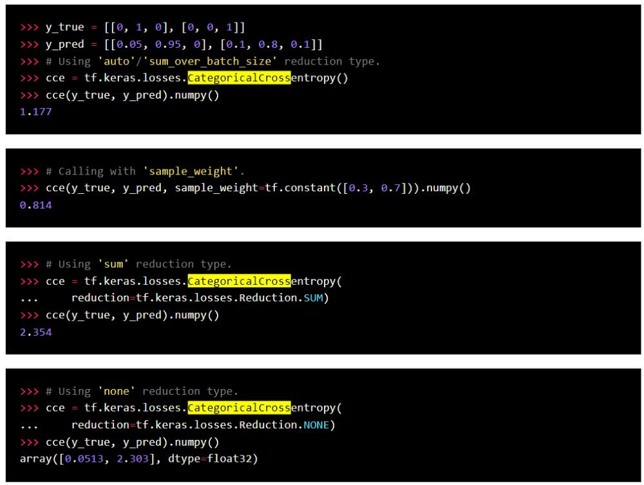
If you want to provide labels as integers, please use Sparse Categorical Cross entropy loss. There should be # classes floating point values per feature.
Usage with the compile() API:

Slide 14
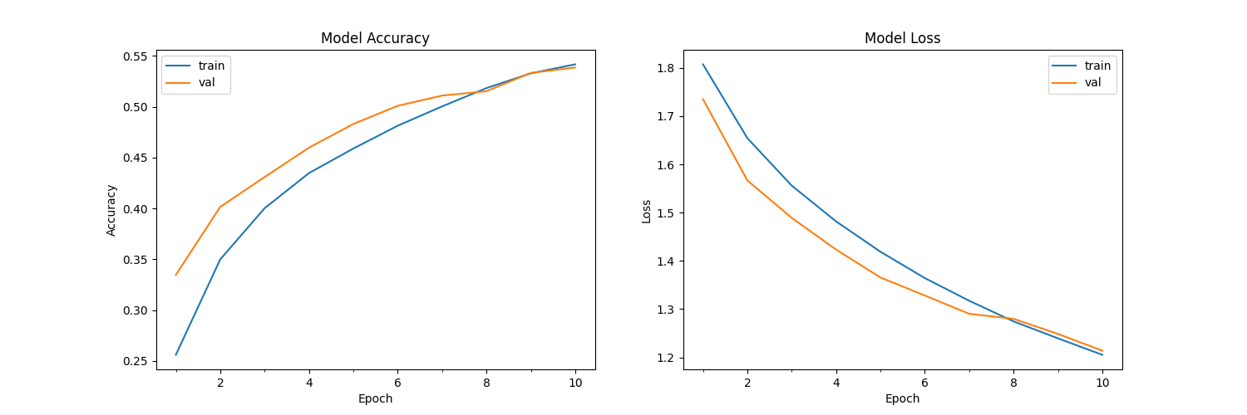
Graph Plotting Using Matplotlib:
Matplotlib :- Matplotlib is a plotting library for the Python programming language and its numerical mathematics extension NumPy. It provides an object-oriented API for embedding plots into applications using general-purpose GUI toolkits like Tkinter, wxPython, Qt, or GTK
Here We plot two graph
1)Model Accuracy Curve for given model_history
2) Model Loss curves for given model_history

Slide 15
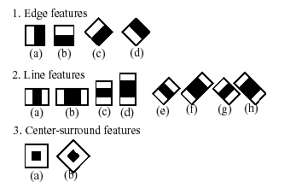
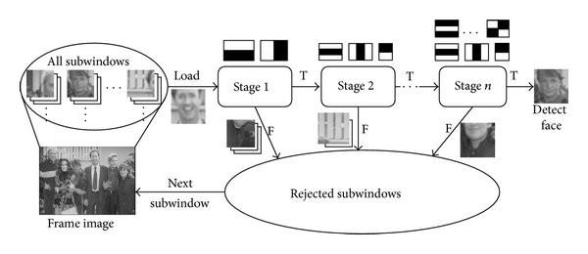
Emotion is detected from a input video stream by using the trained model and opencv hardware acceleration to extract feature vectors and provide them to model.
Emotion Prediction
The process is as the system loads trained weights into the model, then the system opens a video stream from default webcam using OpenCv.
The calculations are reduced using integral images.then best feature are used using Adaboost.

Slide 16
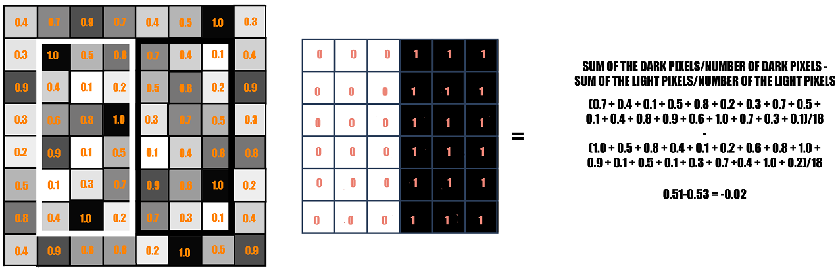
Haar Cascade Classifier: Face detection
Feature are used In identification, face is detected by calculation the sudden change in pixel intensity in an image. This change signifies edge of a face.
The rectangle on the left is a sample representation of an image with pixel values 0.0 to 1.0.
The rectangle at the center is a haar kernel which has all the light pixels on the left and all the dark pixels on the right.
If the difference is close to 1, then there is an edge detected by the haar feature.

Slide 17
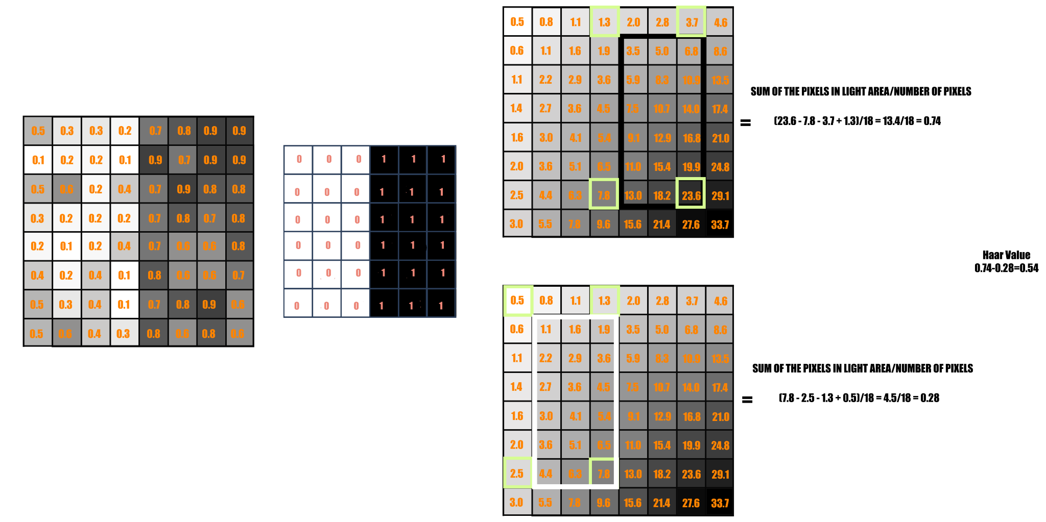
Integral Image:
Each pixel in an Integral image is the sum of all the pixels in its left and above
All possible sizes and locations of each kernel are used to calculate lots of features, approx 160000 for a 24*24 pixel image.
These are reduced using Integral image to only four constant value addition for each image

Slide 18
Adaboost:
A feature selection technique called adaboost is used where each of 180000 of feature were applied to the image individually and classified as weak learners . This was useful as they classified positive and negative images efficiently. which reduce feature to 6000.
Cascade of classifiers: The subset of all 6000 features will again run on the training images to detect if there’s a facial feature present or not.
Attention classifier
In an image, most of the image is non-face region. So it is a better idea to have a simple method to check if a window is not a face region. If it is not, discard it in a single shot, and don't process it again. Instead, focus on regions where there can be a face. This way, we spend more time checking possible face regions.
Emotion Detection
Now as the Face is detected by the haar cascade , the image data is cropped and transferred to the NN model. where it extracts deeper features match them with trained weighted model. The output value of output neuron is matched with a dictionary specifying the emotion. The emotion using opencv is pasted as text on the input stream and provided to user.

Slide 19
The system proposes work to be done for a graphical interface, optimization of model and a standalone process which can be migrated over different systems.
The GUI would be constructed using PyQt/Tkinter.
Pyinstaller will be used to construct standalone package.
Work in Progress
System detects emotion in a video frame with a train accuracy of 0.5472% the system could be optimized using different model optimizers, and datasets.

Slide 20
Thank You

