Slide 1
Detection of Human Biological Emotions using OpenCV and TensorFlow
Presentators:
Sagar Ramrao Bharad
Prashish Gautam Borkar
Shreya Bhojraj Gawali
Janhavi Jayant Karande
AnilKumar Ramji Sharma
Seminar IV
Guided By:
Prof.: D. J. Choudhari
HOD,Computer Science and Engineering , GCOEC

Slide 2
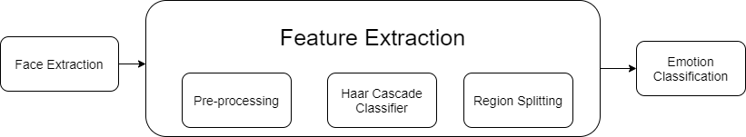
Introduction
Human emotions are natural expressions that people tend to make naturally, instead of any conscious effort that is accompanied by the reflexing of facial muscles.

Slide 3
Project Structure and Modules
The system consists of three modules as Preprocessing, Model Generation and Training, Emotion Prediction
Preprocessing:
In preprocessing the data set acquired to train the model is extracted cleaned and converted into 48*48 pixel data images.
Model Generation and Training:
The model is created using Tensorflow API which will be trained on Preprocessing Data and then used to predict emotion.
Emotion Prediction:
The trained model (neural network) is provided image data from video source and know patterns are inferred from it.

Slide 4
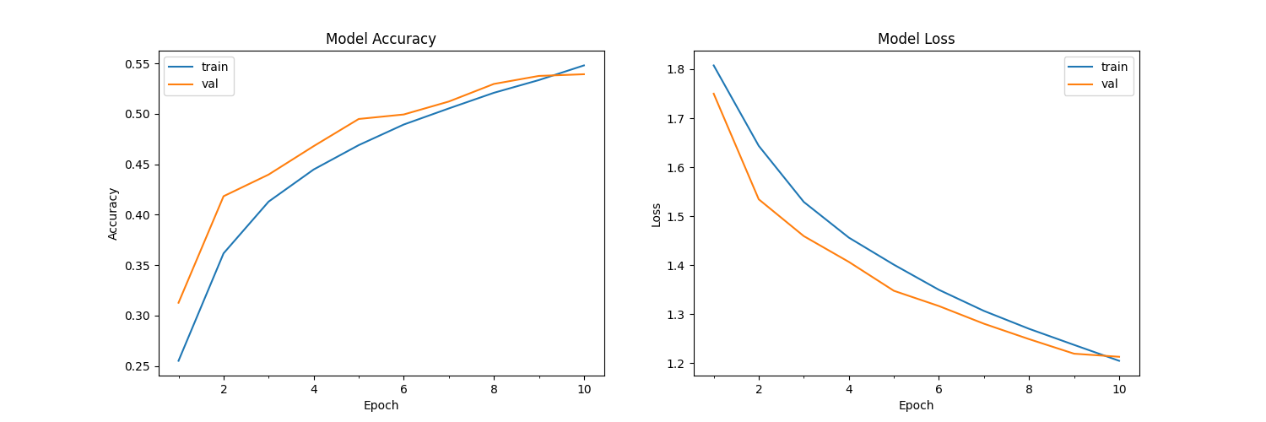
Validation and Optimization
The system was optimized using different loss functions and model optimizer algorithm.
Initially model used categorical cross-entropy and Adam as loss function and model optimizer algorithm,which gave an accuracy of 0.6385 and validation accuracy of 0.5968

Slide 5

Then on changing loss function to sparse_categorical_crossentropy the model reported accuracy of 0.6512 and validation accuracy of 0.6150.

Slide 6
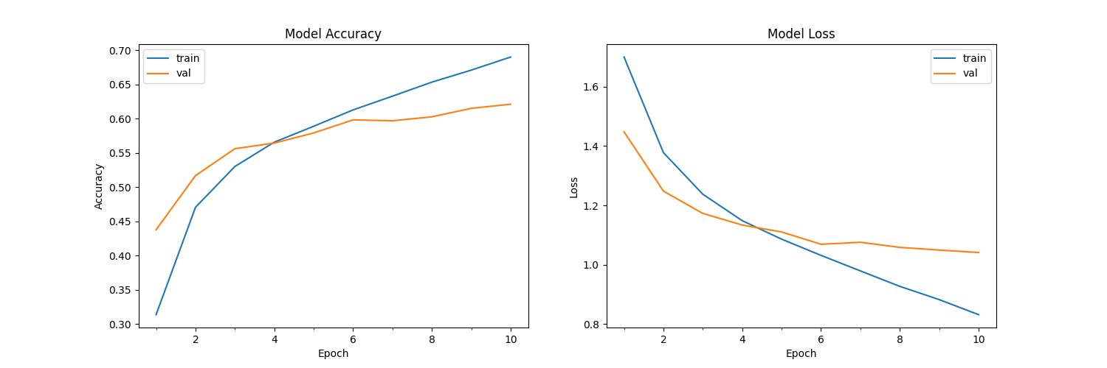
Again when the model was optimized and Nadam model optimizer with categorical cross entropy as loss function gave 0.7324 of accuracy and 0.6218 of validation accuracy.
much higher than previous optimizations.
i.e. Growth of 9.39 from initial model to final model.

Slide 7
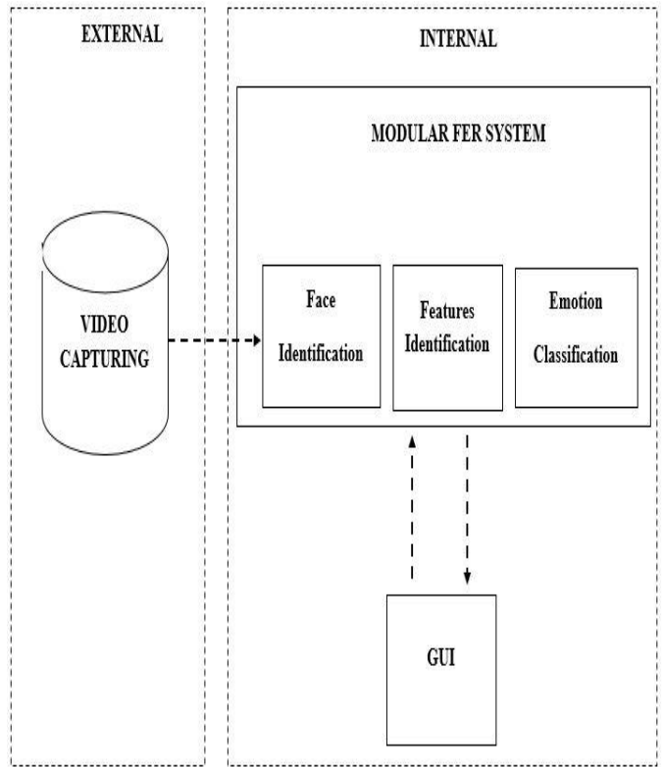
Working
The system uses two video source for emotion detection , one integrated webcam and another recorded video.
The Data flow diagram of System is as:

Slide 8
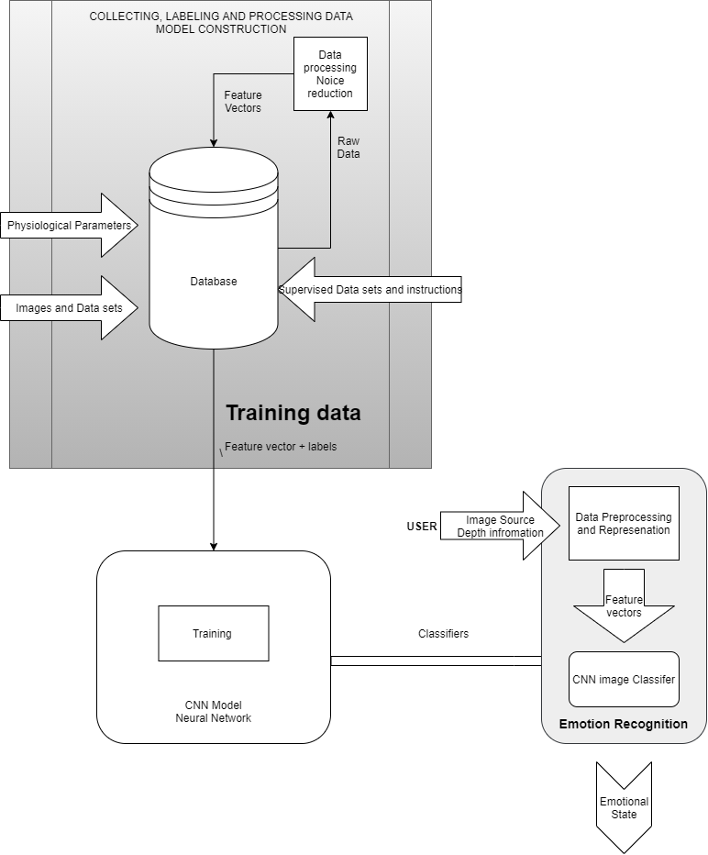
Data Flow Diagram

Slide 9
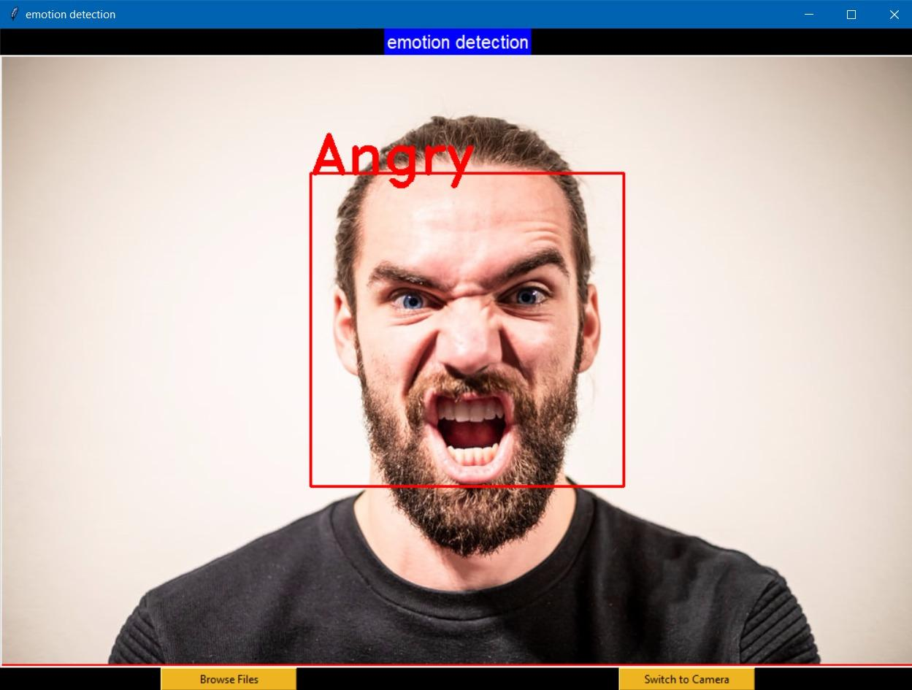
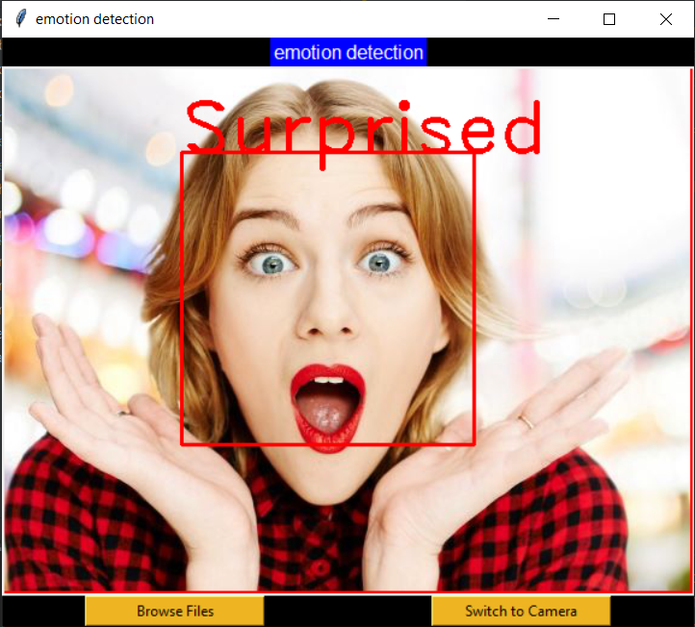
Output:
Emotion detected by system.

Slide 10
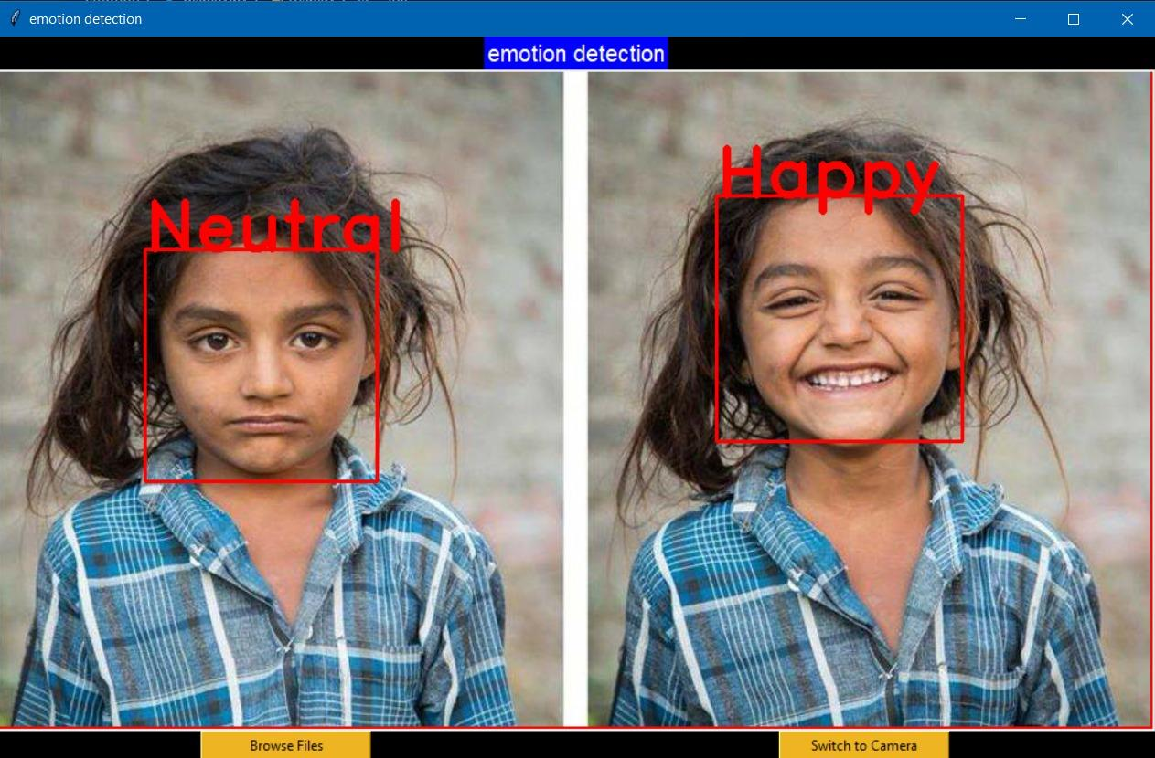

Slide 11
Project Demo
A live emotion recognition demo using the system.
Webcam video capture
Still image capture
A Motion video capture

Slide 12
Hardware/Software Requirement
Hardware specification:
Processor: Intel i5 1.2 GHz or higher AMD
Ryzen 3 2.0 GHz or higher
Ram: 8 GB DDR4 2400 MHz or higher
Host OS: Windows 7 SP1, Ubuntu Linux 16.07 or higher
with webcam support
Software specification:
Front-End: Python, C++
Development Environment: JetBrains Pycharm 2020.2.1
Back-End: OpenCV 2.4.13.7, TensorFlow Core 2.3.0
UI Interfacing: PyQt, Tk
VCS (Version Control System): Local – Git 2.27
Cloud- Microsoft Github

Slide 13
Thank You

