Slide 1
paT2 and pgT2
Polymer series pXT2

Slide 2
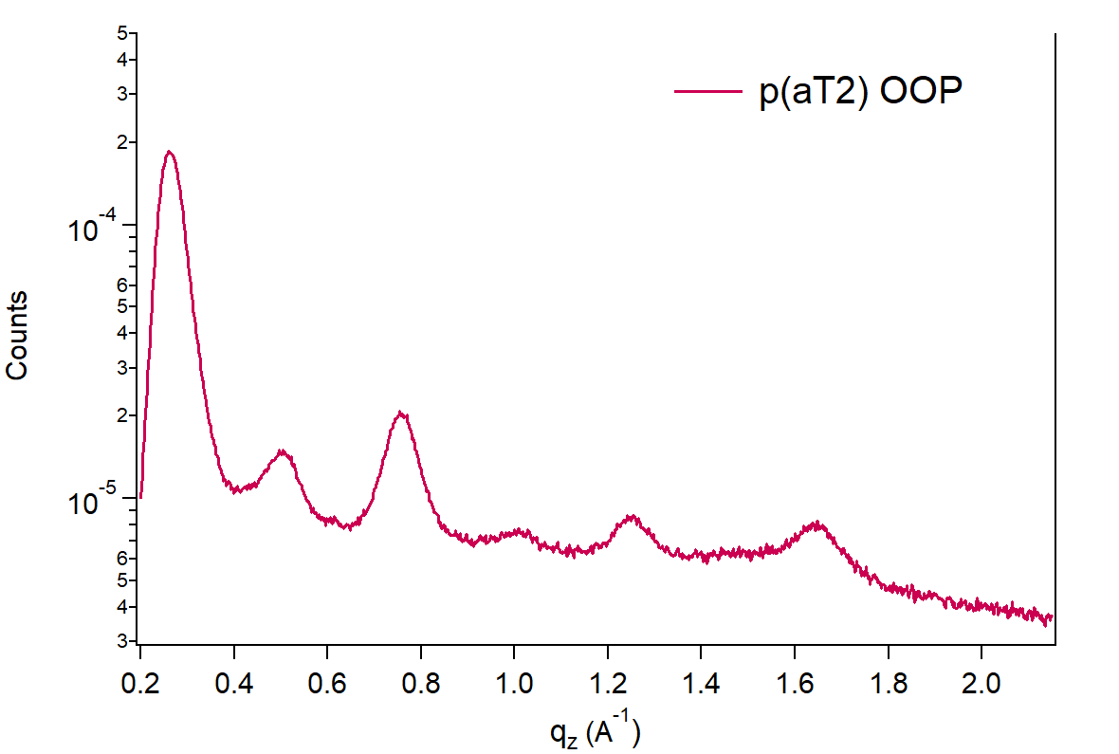
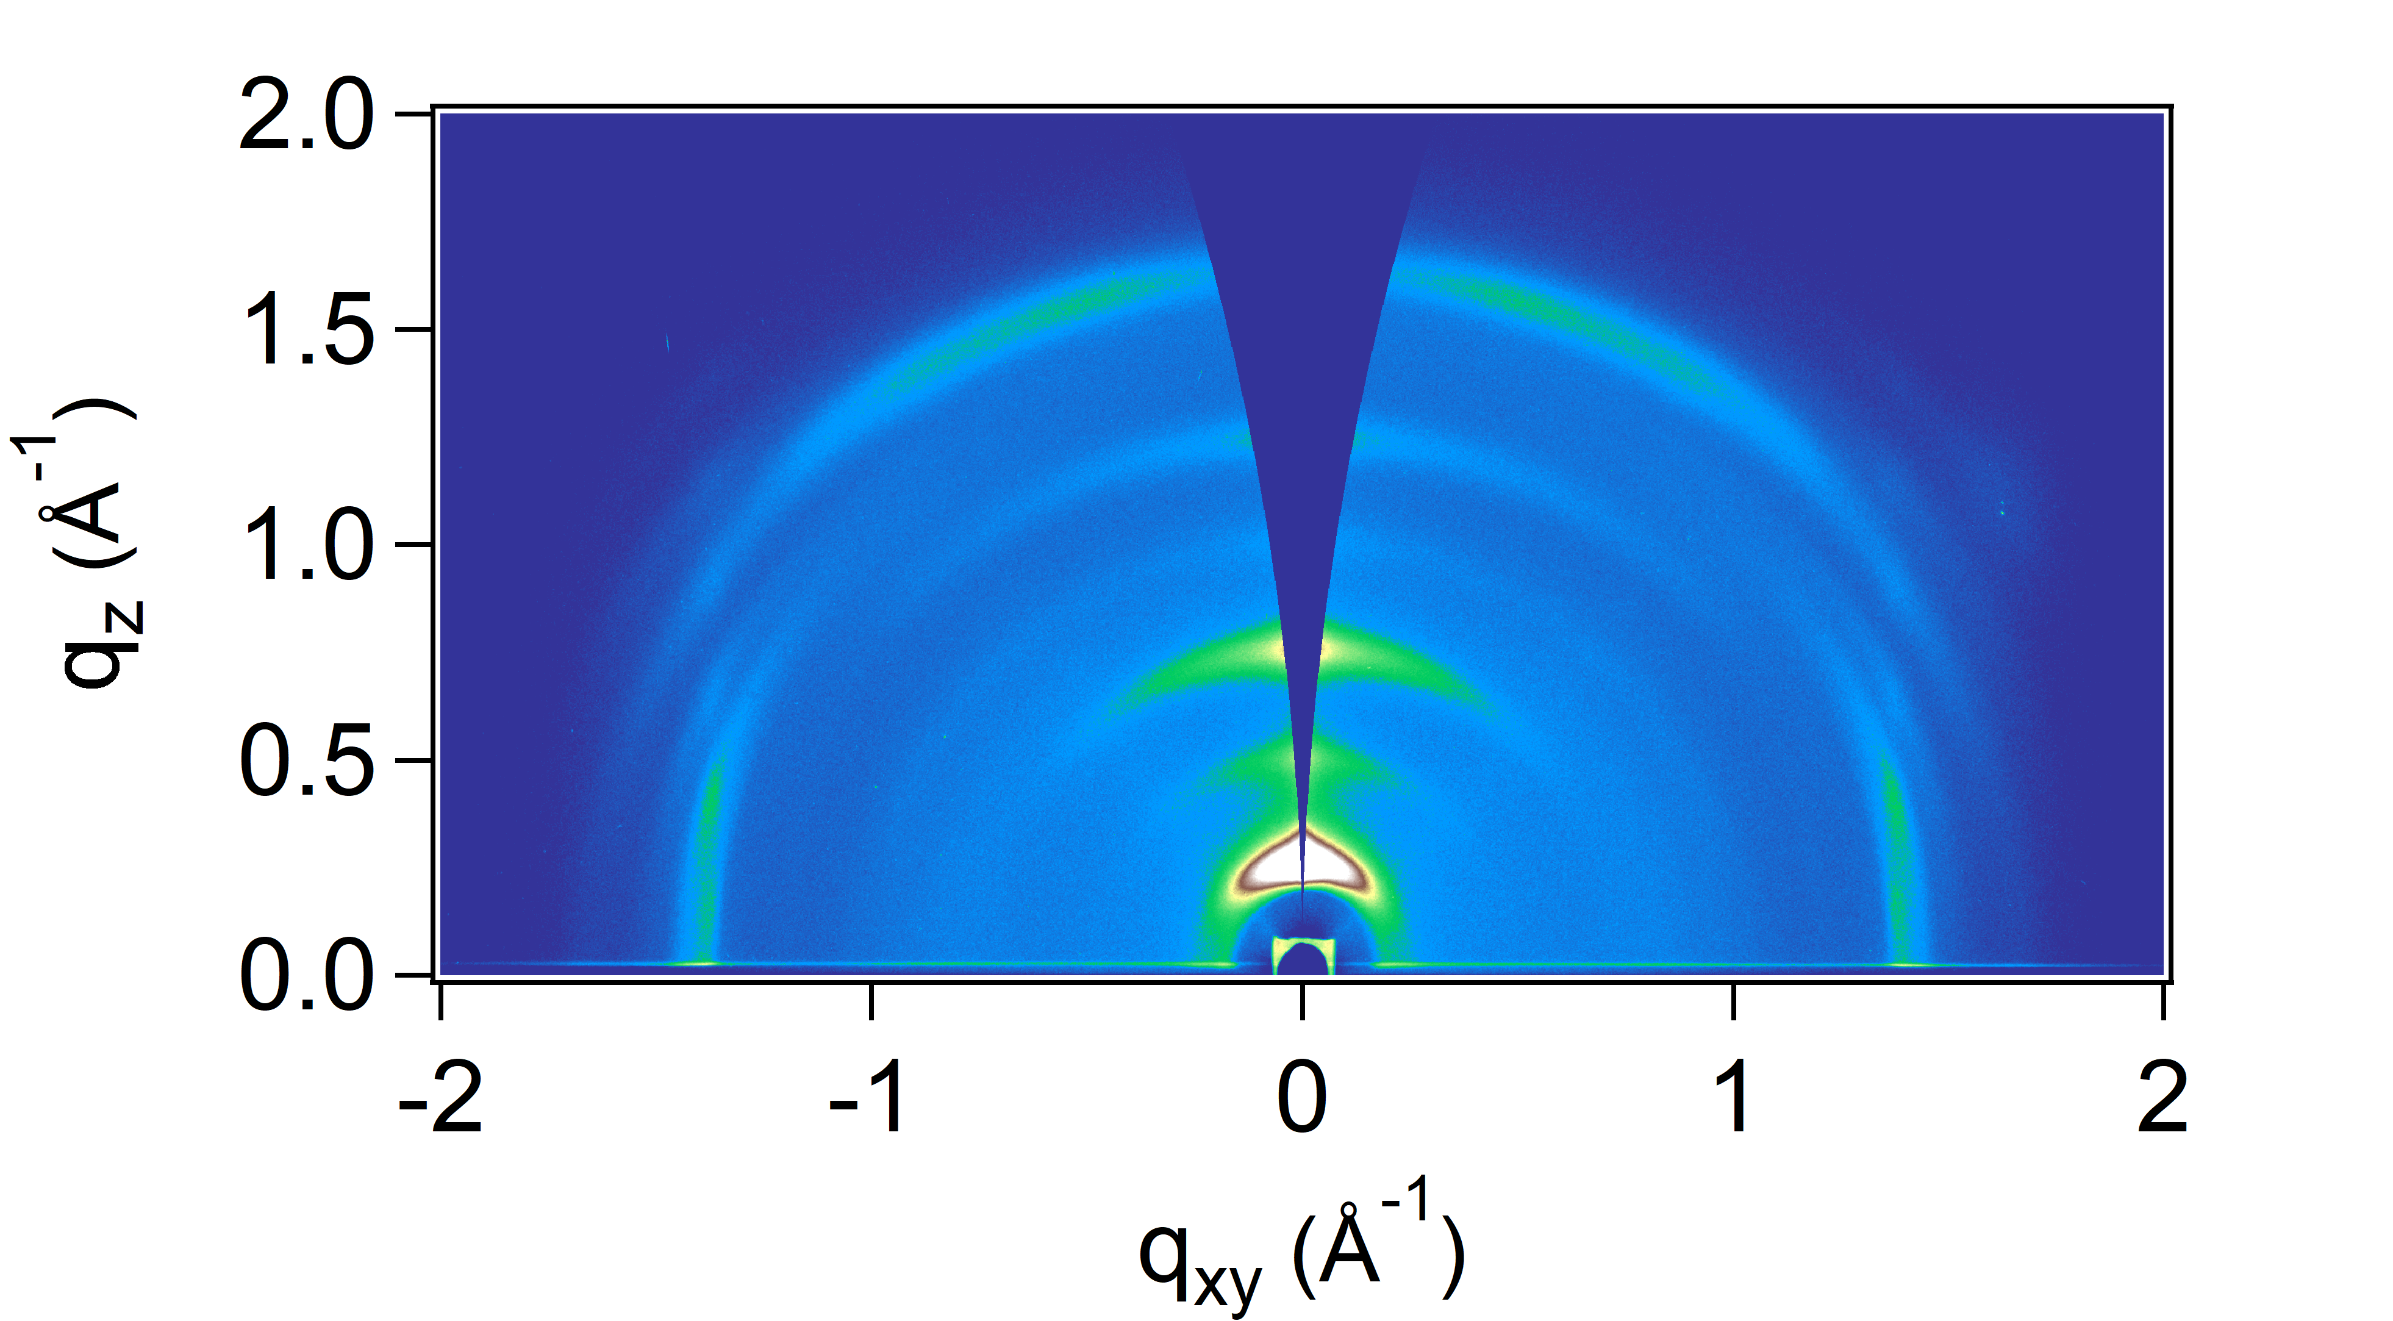
paT2: Out-of-plane (OOP) information
OOP
(100)
(200)
(300)
(400)
(500)
?
Peak fitting results / Å⁻¹ |  |  |  |  |  |  |  |  | Lattice spacing / Å
Direction | Family | Type | Peak order (m) | Location | LocSigma | FWHM | FWHM Sigma |  | d=2πm/q | δd=d*(δq/q)
OOP | h00 | Gauss | 1 | 0.260144 | 1.01E-04 | 5.78E-02 | 3.61E-04 |  | 24.15 | 9.3E-03
OOP | h00 | Gauss | 2 | 0.50434 | 1.90E-04 | 6.74E-02 | 6.22E-04 |  | 24.92 | 9.4E-03
OOP | h00 | Gauss | 3 | 0.757888 | 1.06E-04 | 7.28E-02 | 3.16E-04 |  | 24.87 | 3.5E-03
OOP | h00 | Gauss | 4 | 1.01083 | 4.27E-04 | 7.87E-02 | 1.31E-03 |  | 24.86 | 1.1E-02
OOP | h00 | Gauss | 5 | 1.25233 | 1.59E-04 | 8.25E-02 | 5.11E-04 |  | 25.09 | 3.2E-03
OOP | ?? | Gauss | 1 | 1.64496 | 0.000185 | 0.108124 | 0.0005679 |  | 3.82 | 4.3E-04
Predominant alkyl distance: 2.48 +/- 0.03 nm

Slide 3
paT2: Decoupling crystallite size in alkyl direction and lattice disorder
We extract a coherence length of 10.2 nm in the alkyl (h00) direction. That is ~ 4.1 (= 10.2 nm/2.5 nm) planes of the polymer stacked in the alkyl direction.
Because paT2 shows cumulative disorder, the width of a first order scattering peak cannot provide grain size. To separate coherence length from lattice disorder, we can plot peak breadth vs diffraction order and extract the coherence length from the intercept (m =0), while the slope can give us information englobing all disorder terms. More info on Section 4 of this paper: https://pubs.acs.org/doi/abs/10.1021/cr3001109
Coherence length analysis
Alkyl stacking direction (h00)
 |  |  |  |  |  |  |  |  | m2 | FWHM
 |  |  |  |  |  |  |  |  | 1 | 5.78E-02
 |  |  |  |  |  |  |  |  | 4 | 6.74E-02
 |  |  |  |  |  |  |  |  | 9 | 7.28E-02
 |  |  |  |  |  |  |  |  | 16 | 7.87E-02
 |  |  |  |  |  |  |  |  | 25 | 8.25E-02
 |  |  |  |  |  |  |  |  | Decoupled coherence length in (h00) direction
 |  |  |  |  |  |  |  |  | Intersection | 0.0614
 |  |  |  |  |  |  |  |  | Lc / nm | 10.23
 |  |  |  |  |  |  |  |  | AVG # planes | 4.11

Slide 4
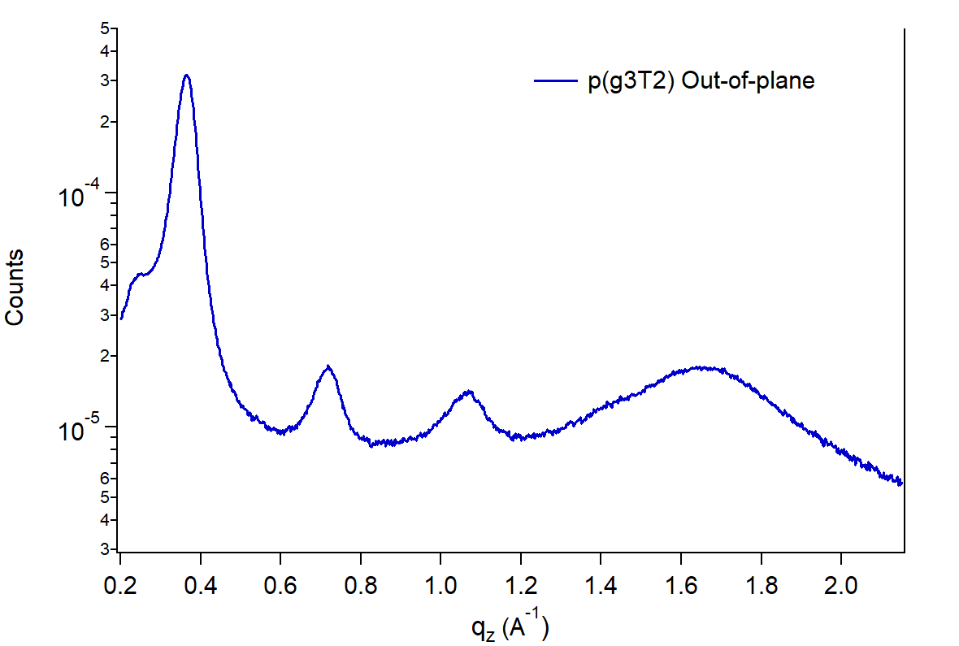
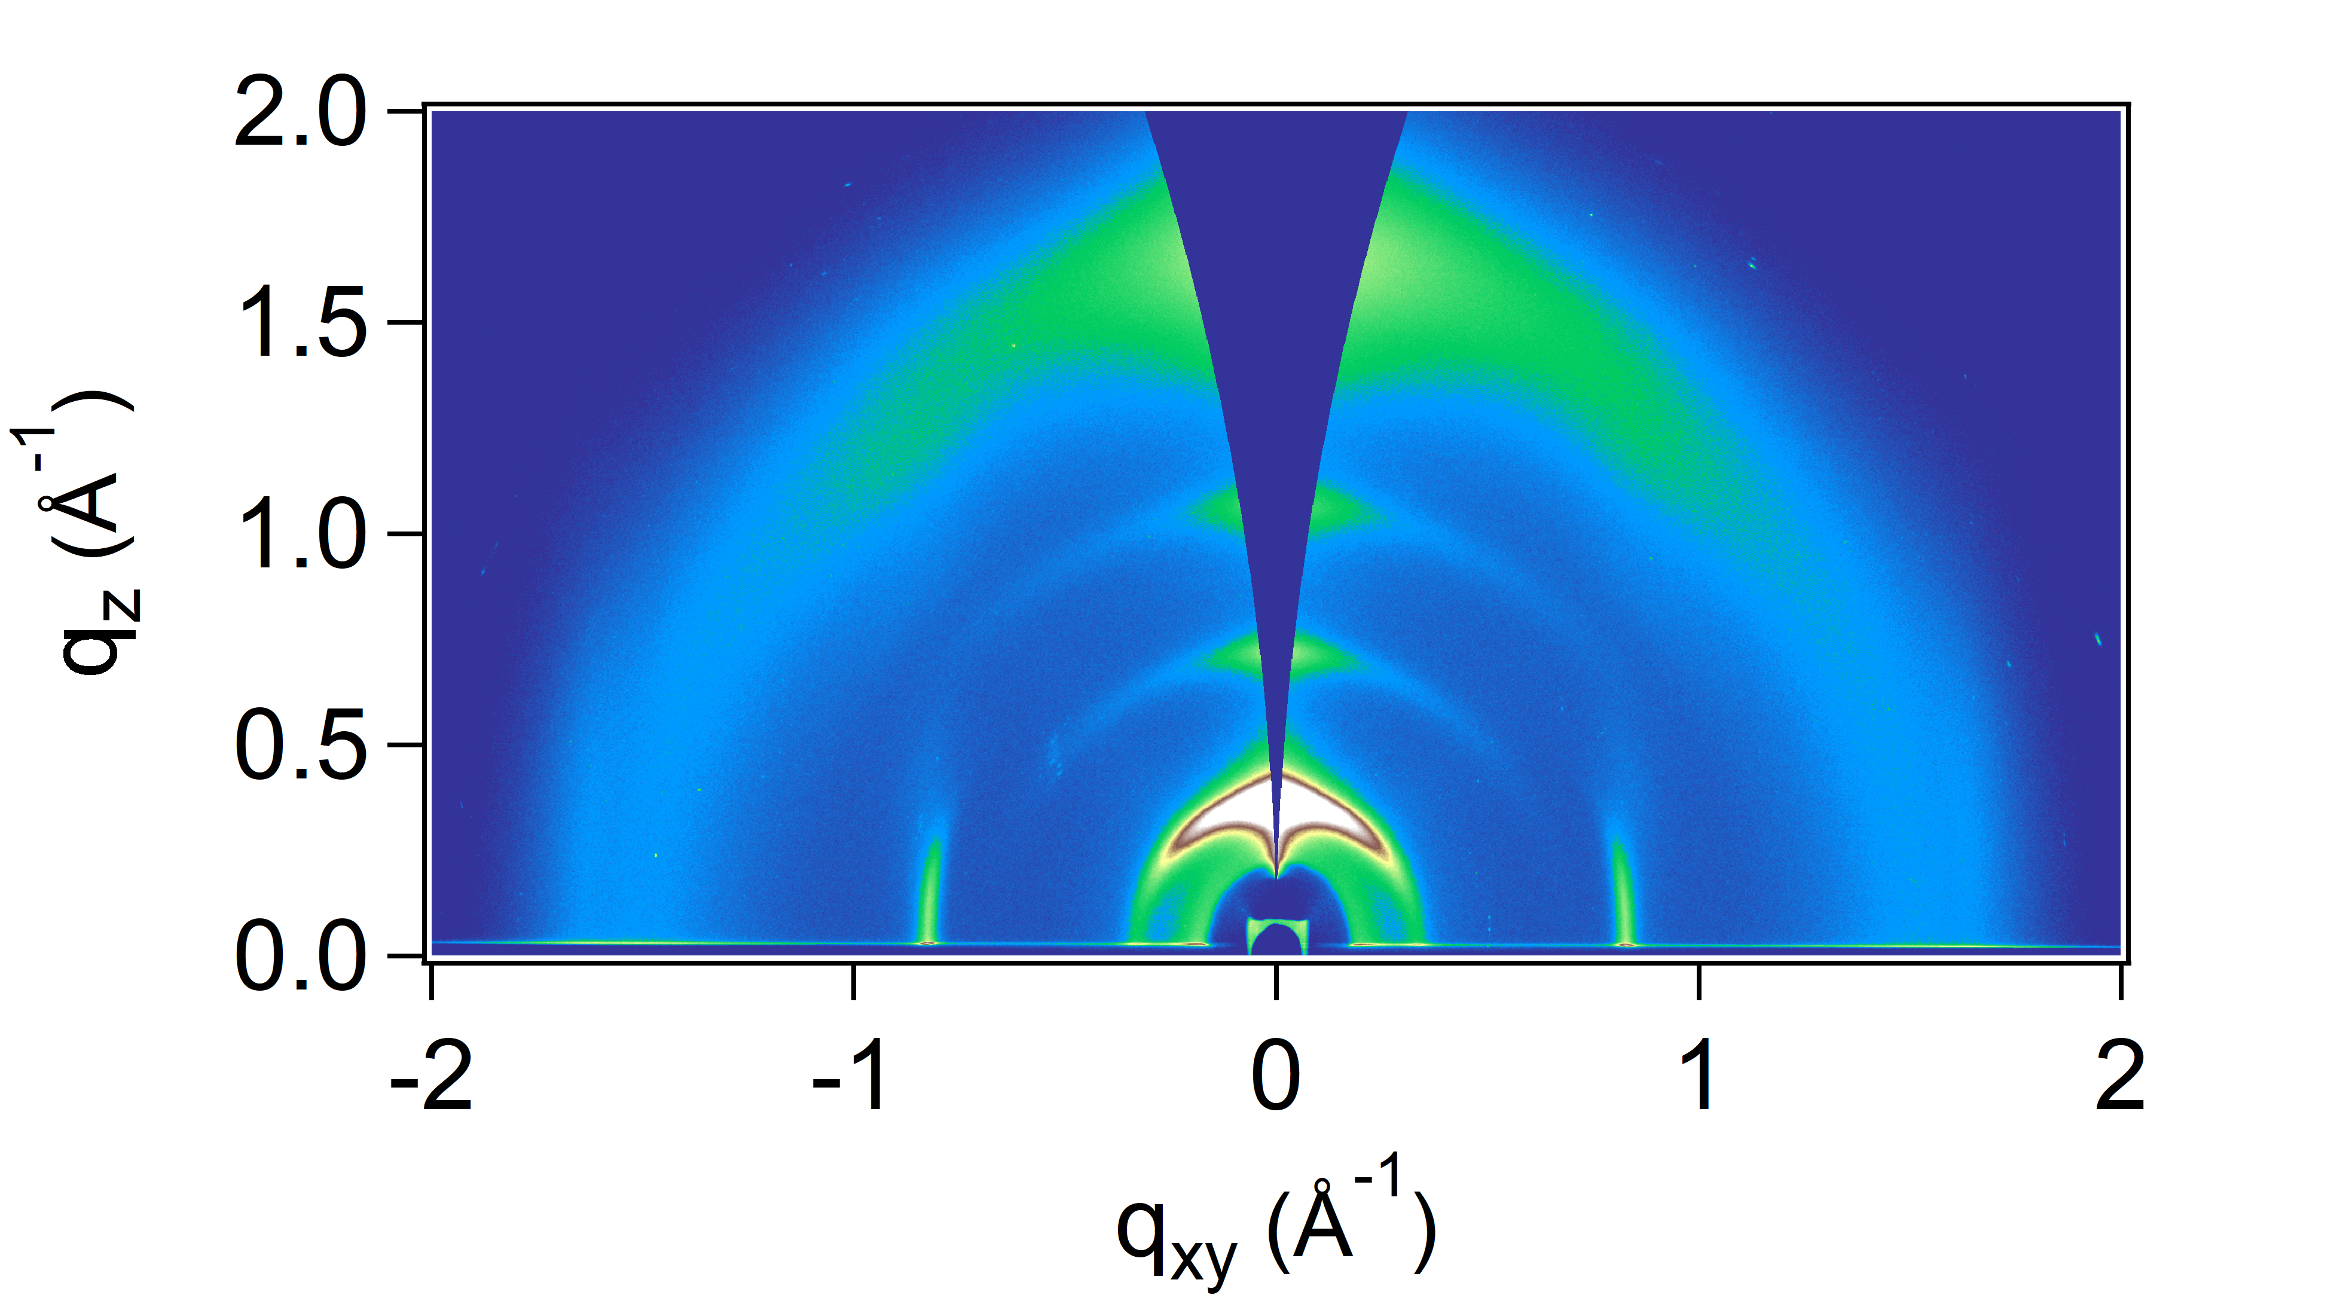
pg3T2: Out-of-plane (OOP) information
(100)
OOP
Broad scattering halo, possibly coming from side chains
(200)
(300)
Peak fitting results / Å⁻¹ |  |  |  |  |  |  |  |  | Lattice spacing / Å
Direction | Family | Type | Peak order (m) | Location | LocSigma | FWHM | FWHM Sigma |  | d=2πm/q | δd=d*(δq/q)
OOP | h00 | Gauss | 1 | 0.364037 | 9.31E-05 | 0.046661 | 0.000314 |  | 17.26 | 4.4E-03
OOP | h00 | Gauss | 2 | 0.716617 | 0.000144 | 0.069481 | 0.000408 |  | 17.54 | 3.5E-03
OOP | h00 | Gauss | 3 | 1.06417 | 0.000172 | 0.092226 | 0.000547 |  | 17.71 | 2.9E-03
OOP | ? | Gauss | 1 | 1.66306 | 0.000383 | 0.34882 | 0.001502 |  | 3.78 | 8.7E-04
Predominant alkyl distance: 1.75 nm +/- 0.02 nm

Slide 5
pg3T2: Decoupling crystallite size in alkyl direction and lattice disorder
We extract a coherence length of 14.5 nm in the alkyl (h00) direction. That is ~ 8.25 (= 14.5 nm/1.75 nm) planes of the polymer stacked in the alkyl direction.
pg3T2 also shows cumulative disorder, so we perform the same analysis as with p(aT2)
Coherence length analysis
Alkyl stacking direction (h00)
 |  |  |  |  |  |  |  |  | m2 | FWHM
 |  |  |  |  |  |  |  |  | 1 | 0.0466612
 |  |  |  |  |  |  |  |  | 4 | 0.0694806
 |  |  |  |  |  |  |  |  | 9 | 0.0922257
 |  |  |  |  |  |  |  |  | Decoupled coherence length in (h00) direction
 |  |  |  |  |  |  |  |  | Intersection | 0.0434
 |  |  |  |  |  |  |  |  | Lc / nm | 14.5
 |  |  |  |  |  |  |  |  | AVG # planes | 8.25

Slide 6
Qualitative comparison between paT2 and pg3T2 in the alkyl stacking direction
The slope of peak breadth vs alkyl spacing diffraction order can provide qualitative insights into the overall disorder (i.e. lattice non idealities) of the crystallites in the alkyl direction. The slope of paT2 is shallower, indicating that this material under the current processing condition shows overall less disorder in the crystallites. Because it is more ordered, we also see diffraction peaks up to the 5th order.
In terms of coherence length in the alkyl direction, crystallites in pg3T2 have approximately twice the number of planes than paT2, however the lamellar spacing of paT2 is much larger (due to its longer side chains).
Alex also pointed out that the pg3T2 film was most possibly partially oxidized during processing, which might be altering the spacing and disorder of the crystallites, though this should be a secondary effect on microstructure.

Slide 7
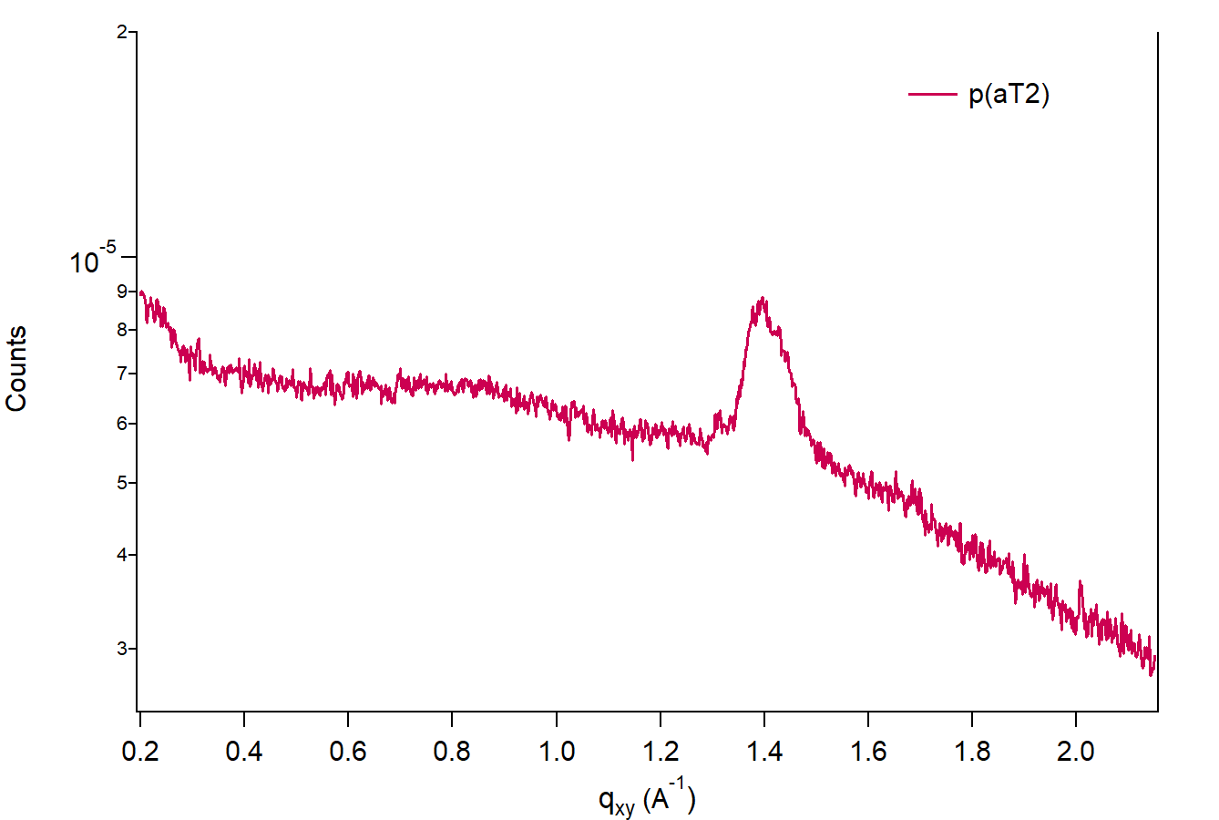
paT2: In-plane (IP) information
(010)
IP
We cannot see backbone peak (001) in paT2
Pi-stacking peak (010) for the edge-on population of crystallites shows strong signal so we can estimate a few features:

Slide 8
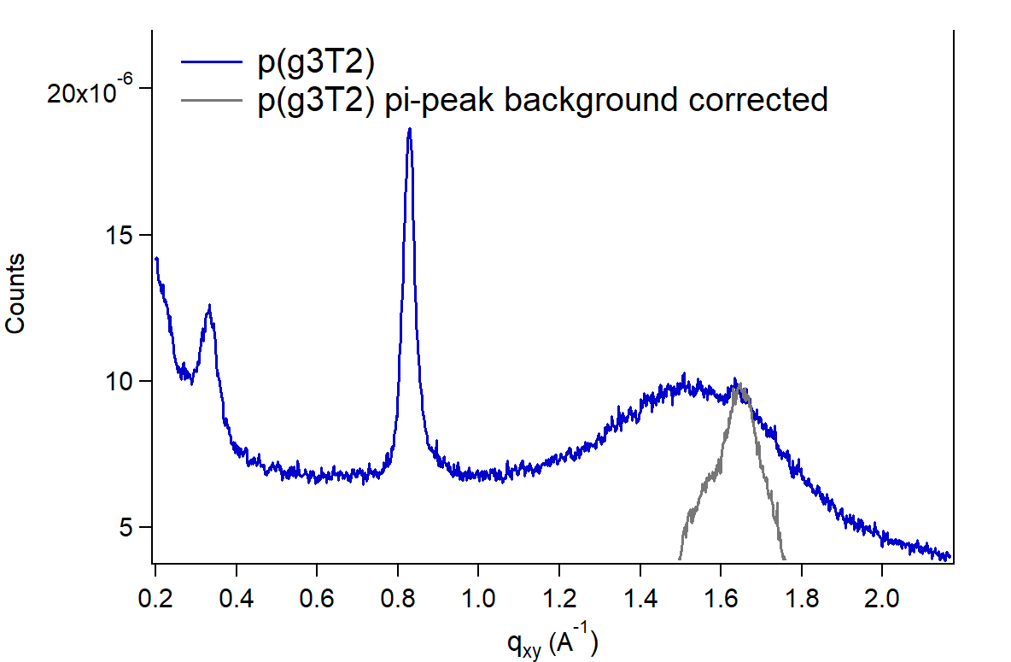
pg3T2: In-plane (IP) information
(001)
(100)
(010)
IP
Since we can see the (100) peak IP, there is a small population of crystallites with in-plane texture
Backbone peak (001) is quite strong in pg3T2
Pi-stacking peak (010) for the edge-on population of crystallites is faint and overlaps with a broad scattering halo. I think we can estimate the pi-stacking distance reasonably well, but it is challenging to perform peak breadth analysis since the peak is weak and overlapping with a broader peak. In the lineout in gray shown above, I subtracted the scattering intensity of the broad halo to find the peak center position of the (010) peak.
Pi-stacking distance: 3.79 Å (1.66 Å⁻¹) +/- 0.1 Å (error extracted from peak fit)

