Slide 1
paT2 and pgT2
Polymer series pXT2
Beamline 11-3
December 2019

Slide 2
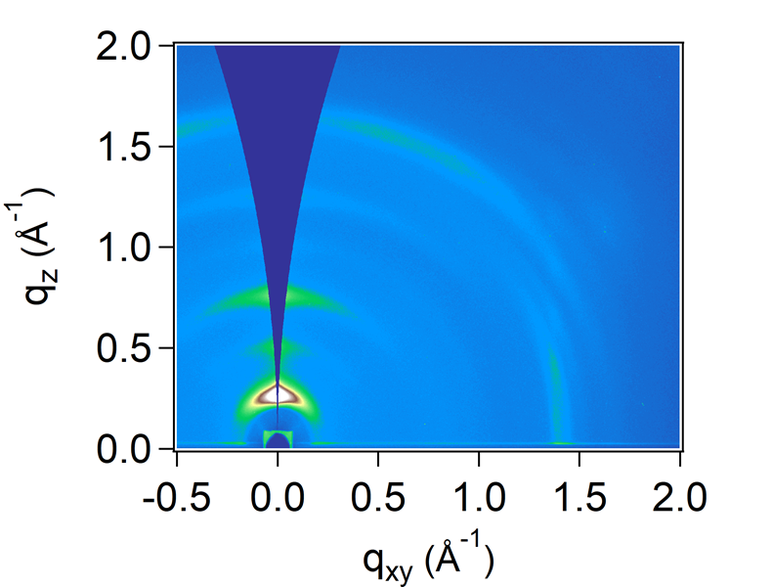
GIWAXS paT2
Peak assignment need to be confirmed
1
 | qz
1 (100) | 0.26 (24.1 nm)
2 (200) | 0.507
3 (300) | 0.76
4 (400) | 1.013
5 (500) | 1.256
6 (pi-pi) | 1.647 (3.81 nm)
3
2
5
6
4
Spin cast from 10mg/mL
This feature is hard to tell if it is a peak coming from the polymer because it’s too close to the beam stop and seems to be originating from bleeding of the incident beam
 | qxy
1 | 0.21
2 | 1.4
1
2

Slide 3
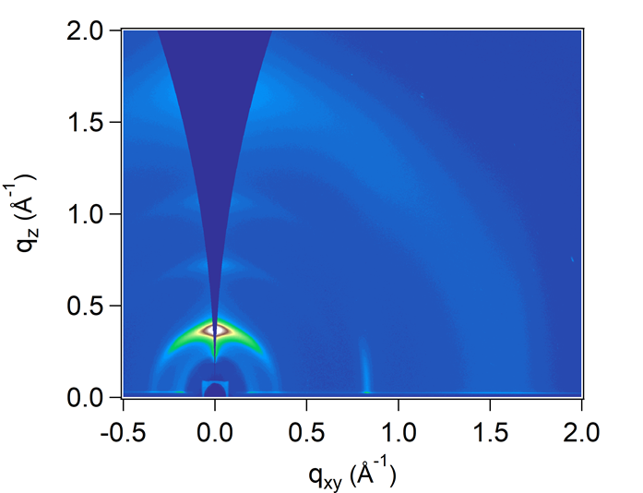
GIWAXS pgT2
Peak 1 here is most possibly the Yoneda peak, which is due to total reflection of the incident beam on the surface of the polymer and is not a polymer feature. The q value of this peaks matches very closely the expected peak position of the Yoneda peak (q ~0.22)
Peak assignment need to be confirmed
 | qz
1 | Yoneda peak
2 (100) | 0.364 (17.2 nm)
3 (200) | 0.719
4 (300) | 1.068
5 (400) | 1.416
5 pi-pi | Broad 1.683 (3.73 nm)
2
1
6
3
4
5
Spin cast from 10mg/mL
Peak here probably comes from the same feature as in paT2
3
 | qxy
1 | 0.2
2 | 0.34
3 (most possibly backbone repeat) | 0.83
4 | broad
1
2
4
This tiny peak in intensity is the Yoneda peak

