Slide 1
High-throughput screening of spin states for transition metal complexes with spin-polarized extended tight-binding methods
Neugebauer H, Bädorf B, Ehlert S, Hansen A, Grimme S., Journal of Computational Chemistry. 2023 Oct 15;44(27):2120–9.
Joseph Harries Journal Club 14/2/25

Slide 2
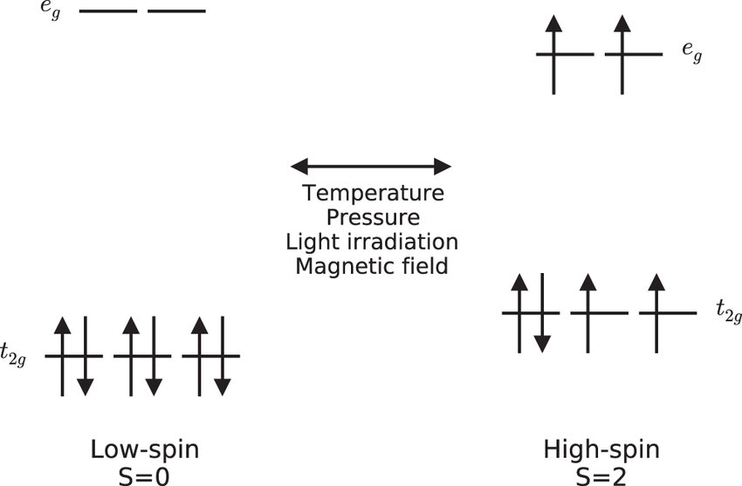
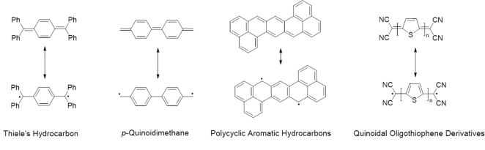
Background
Transition Metal Complexes: Balance of LS and HS depending on CFSE, ligands, etc
Organics: majority LS, though HS rarely observed - diradicals and excited states
https://doi.org/10.1038/s41467-022-29918-w
Resonance!

Slide 3
Motive
Wavefunction Theory – Quantum mechanics: Highly accurate for small molecules but too computationally expensive for large-scale studies
Density Functional Theory (DFT): Cheaper than pure QM but still relatively expensive, can give qualitatively incorrect results for electronically complex transition metal systems
Machine Learning (ML) Models: Training datasets needed that closely resemble target systems – directly contradicting screening point of study, limiting general applicability also
Extended tight binding (xTB) Models: Computationally cheap semiempirical methods based on DFT parameters, OK accuracy generally but especially limited for complex electronic systems due to spin coupling

Slide 4
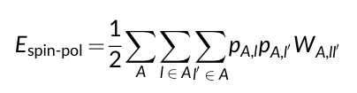
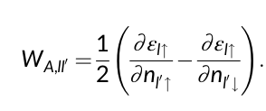

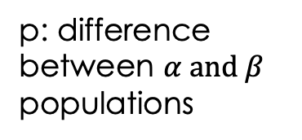
Theory
E_{GFN2-xTB}​ = E_{EHT}​ + E_{IES}+ E_{rep}​ + E_{XC} ​+ E_{AES} + E_{AXC}
ε: eigenvalues of AO
n: occupation numbers
L: orbital angular momentum
Spin constant: parameterized by DFT reference datasets
Penalty for how ”sensitive” an AO is to adding/removing electrons of opposing spins
W is large → Strong penalty for spin polarisation → Low-spin states stabilised
W is small → Weak penalty for spin polarisation → High-spin states can be stabilized
p: difference between $α and β$
populations
q: Mulliken spin population
E_{(sp)GFN2-xTB}​ = E_{EHT}​ + E_{IES}+ E_{rep}​ + E_{XC} ​+ E_{AES} + E_{AXC} + E_{spin-pol​}

Slide 5
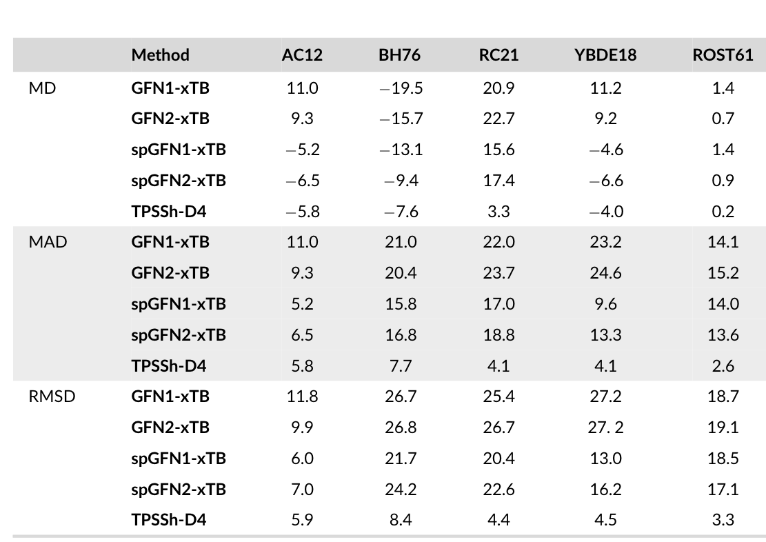
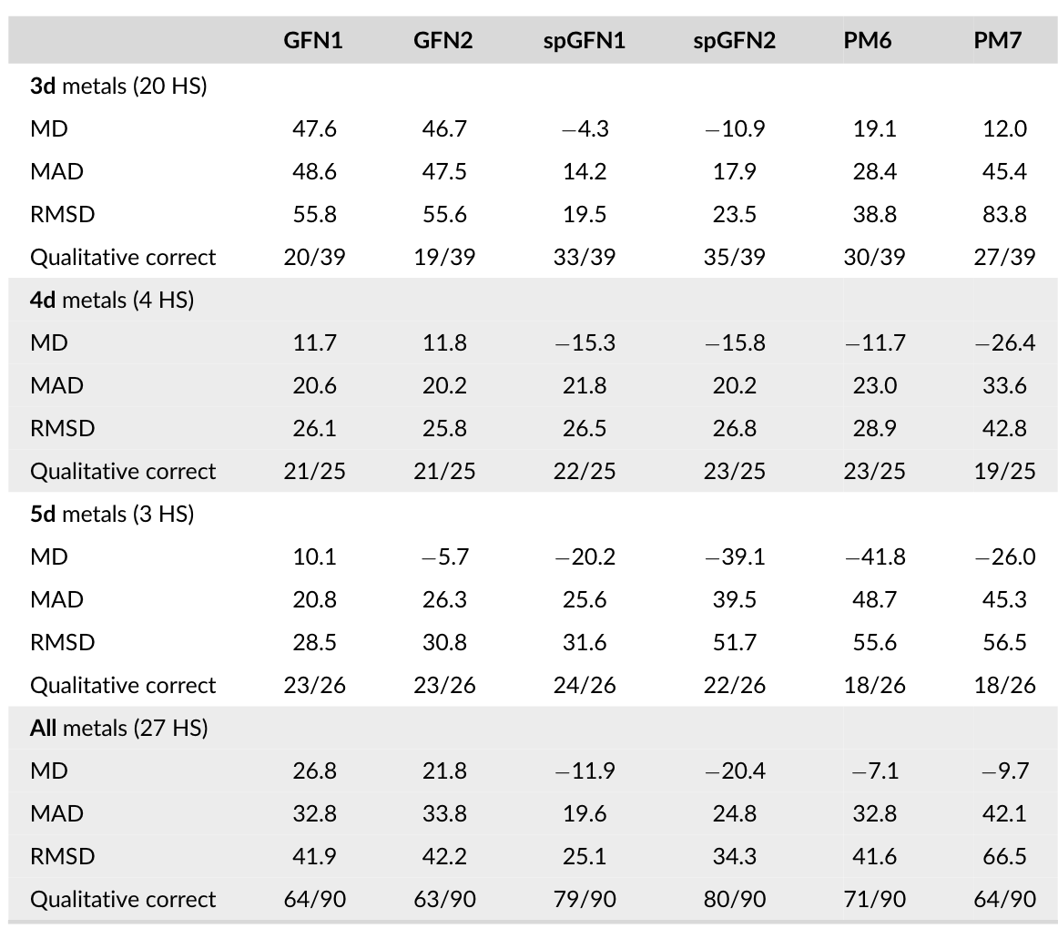
Accuracy/Performance
“Simple” energies for benchmark sets:
Spin splitting's for TM90S:

Slide 6
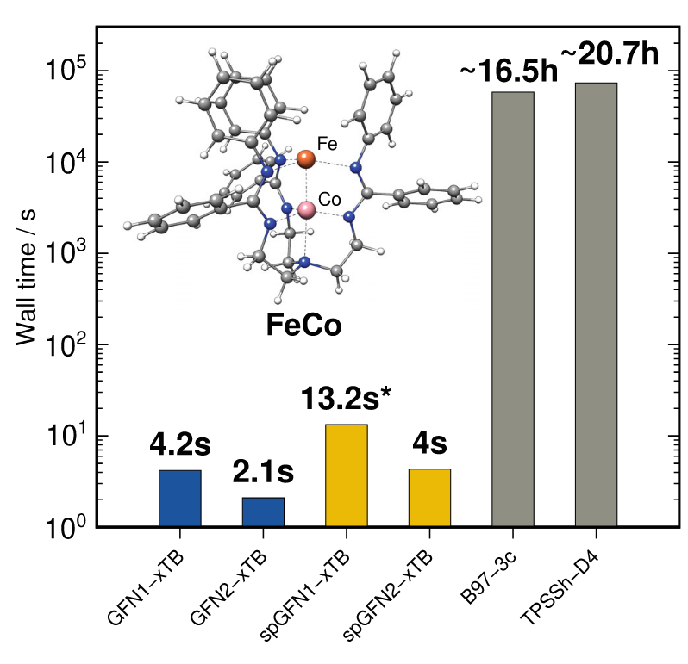
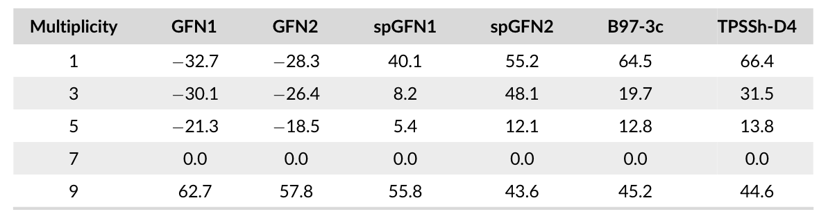
Accuracy/Performance (cont.)
Wall time to identify minimized spin state:
Spin splitting relative to ground spin state:

Slide 7
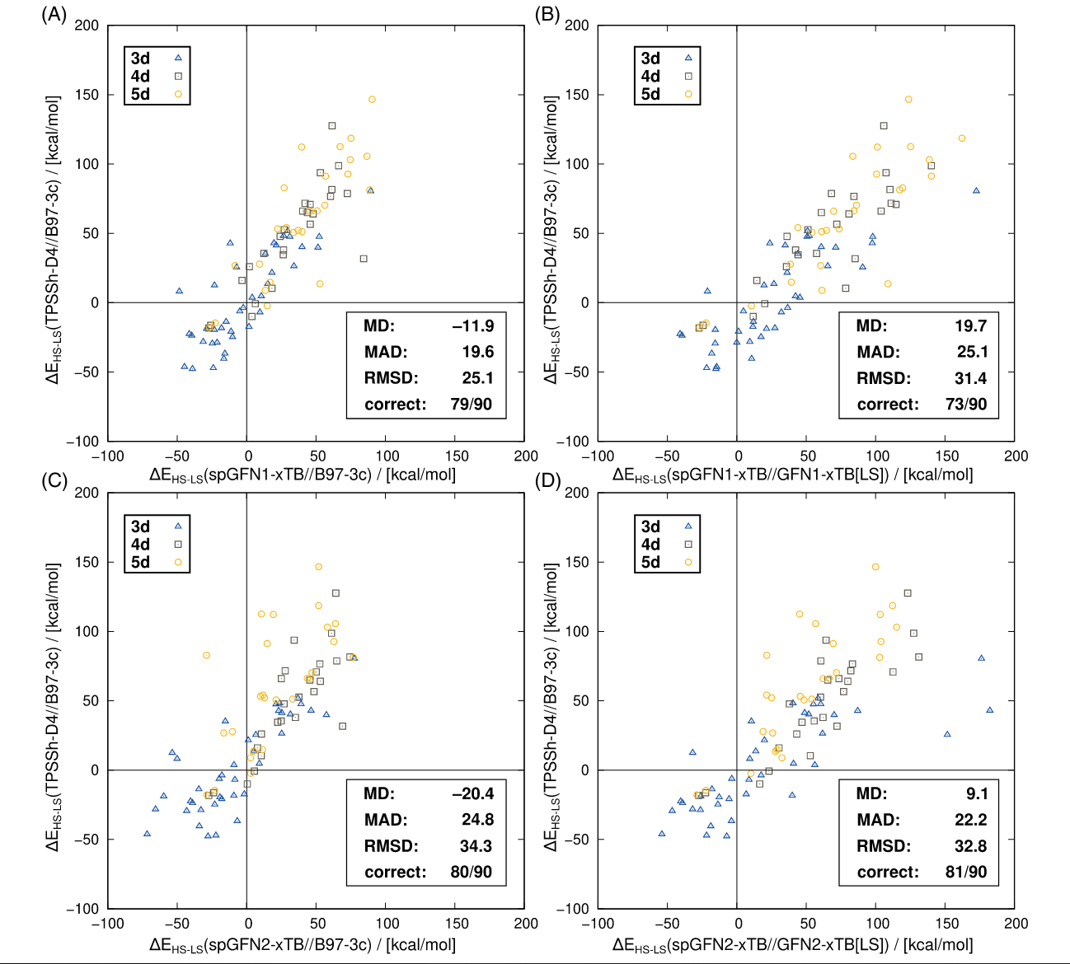
Accuracy/Performance (cont.)

Slide 8
Limitations
Validated primarily on 3d transition metal complexes: Limited Performance for 4d and 5d Transition Metals, specifically for 5d high spin preferentially incorrectly stabilised high spin:
Spin Orbital Coupling increases with atomic number – correction already incorporated for xTB in other literature*
Relativistic effects?
Creates SCF convergence ”smoothness” issues
* https://doi.org/10.1063/5.0129071

Slide 9
Summary
Fast and accurate screening of spin states is an essential consideration for electronically complex molecules in material and drug discovery
spGFN-xTB successfully incorporates spin-dependent energy corrections
Significantly improves MD/MAD/RMSD of energies, outperforming GFN-xtb methods and approaching DFT accuracy
Accurate for identifying high ground spin states
computationally efficient (much, much faster than DFT), making it suitable for high-throughput screening
Use in screening workflows where consideration of HS states is necessary, but with caution!

