Slide 1

Sports Betting Website
By: Daniel Beauchemin & Zachary Roy

Slide 2
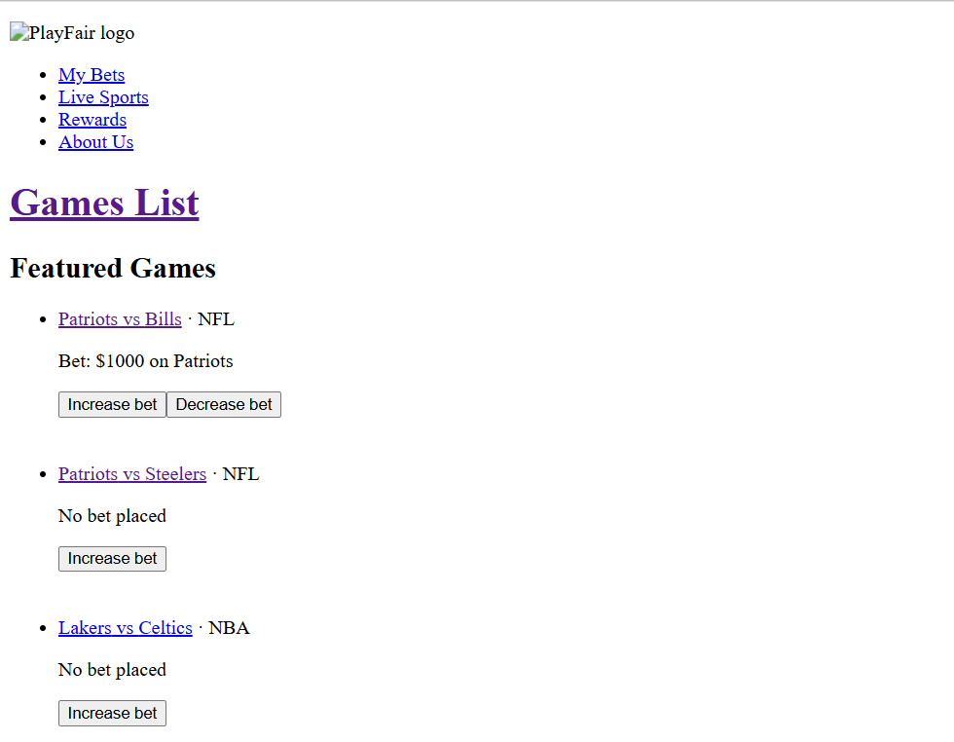
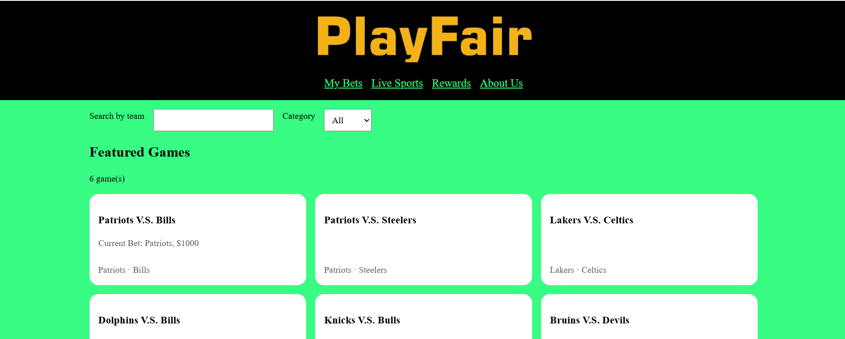
Current Website
After React Implement
HTML with CSS

Slide 3
Current State of PlayFair
Since converting to React/Vite we have had issues getting our CSS to implement into our App. Logo also wouldn’t appear.
CRUD: The Create portion of CRUD isn’t finished yet. We were planning to create a new game or bet option.
Split Flexbox and Grid. Flexbox for one-direction rows and Grid for out multi-column areas.
Flex was best for our search bar and category dropdown
Grid was used to handle our header and cards.

Slide 4
Main Data/API Contract
Increase and Decrease Bet (Can’t go below 0)
Category of Game (NFL, NBA, etc.)
Show Home and Away Team
Scores of Home and Away Team
Status of Game (In Progress, Scheduled, Final)

