Slide 1
PharmaColdOps
Cold-chain decisions and delivery replanning
Project Group 41
Final briefing 17 October 2026
Simulated data. Human review governs consequential actions.
Notes:
D, 20 seconds. Introduce the business problem and disclose simulated inputs. The team should write and speak its own final wording. Do not claim real hospital deployment or clinical validation. Sources: docs/FINAL_REPORT_EN.md, member-github.txt.

Slide 2
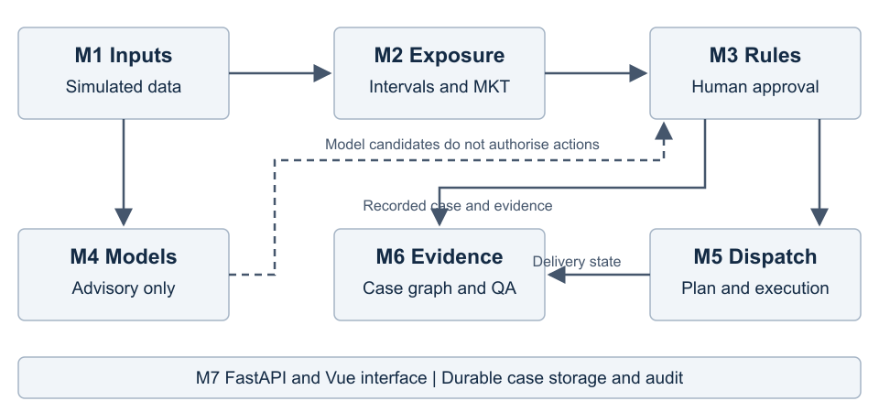
System workflow
Recorded evidence and effective human decisions remain separate
Group report, implemented architecture and workflow
02
Notes:
A, 35 seconds. Explain the event, rule, human review, dispatch and case-evidence path. M4 stays advisory. Describe why raw records and human outcomes remain separate.
Sources: docs/FINAL_REPORT_EN.md, sections 3–4
Data are simulated. Metrics retain their original dataset, split and denominator. Human presentation only.

Slide 3
Rule evaluation
Historical label | Support | Recall | F1
release | 13 | 1.0000 | 0.9286
retest | 8 | 1.0000 | 0.9412
quarantine | 3 | 0.0000 | 0.0000
scrap | 33 | 1.0000 | 1.0000
54/57 agreement. Macro-F1 0.7174. Quarantine recall 0/3.
Synthetic historical scenarios, with known policy disagreements
M3 formal report, frozen synthetic scenarios
03
Notes:
A, 30 seconds. State 54/57 historical agreement and expose the quarantine failures. Distinguish engine-to-gold kappa 0.9097 from human-human kappa 0.6434. The review workflow protects execution but does not change frozen automatic predictions.
Sources: docs/M3正式评估.md, historical rubric v1.1
Data are simulated. Metrics retain their original dataset, split and denominator. Human presentation only.

Slide 4
Risk and candidate-cause models
Shipment-risk measure | Five-fold result
F1 | 0.6635 +/- 0.0179
ROC-AUC | 0.9045 +/- 0.0092
PR-AUC | 0.7087 +/- 0.0296
Brier, raw to calibrated | 0.1091 to 0.0933
Monthly causes: macro-F1 0.1322, Top-1 0.1713
Random-fold full15 results. Candidate associations require review.
M4 formal report, outer five-fold experiments
04
Notes:
B, 40 seconds. Risk and causes are separate prediction tasks. Explain calibration and why monthly cause classification remains weak. There are no brand-specific potency labels or verified causal diagnoses.
Sources: docs/M4正式实验.md, formal outer folds
Data are simulated. Metrics retain their original dataset, split and denominator. Human presentation only.

Slide 5
Temporal event study
Macro-F1 (0–1)
Supported coverage: 17.33%, 20.67%, 13.83%, 2.50%, 0%
Same simulator. All 3,000 test events still require human review.
Event-v2 report, same five held-out simulated cohorts
05
Notes:
B, 35 seconds. Compare models on the same frozen simulated test cohorts. Explain missing multi-fault mechanisms, uncalibrated scores and screening coverage. Extreme screening supports zero events, and all results require human review.
Sources: docs/事件时序模型v2评估.md, five held-out roles
Data are simulated. Metrics retain their original dataset, split and denominator. Human presentation only.

Slide 6
Static route comparison
Total distance (km)
3 vehicles in each plan. 49 static comparisons overall.
Complete feasibility comes before fleet size and distance.
M5 formal report, frozen Singapore static instance
06
Notes:
C, 35 seconds. Both plans use three vehicles. The distance reduction is 16.59% for one frozen static instance, not a measured operational saving. Explain the fleet-first objective and why different-fleet BKS distances are incomparable.
Sources: docs/M5正式评估.md, frozen Singapore instance
Data are simulated. Metrics retain their original dataset, split and denominator. Human presentation only.

Slide 7
Delivery execution constraints
Explicit adoption changes the operation
Urgent orders share the current delivery operation
Delay and failure handling retain completed work
Day-end terminals are selected warehouses only
Orders, progress and available resources are simulated
Execution acceptance and warehouse parking contracts
07
Notes:
C, 25 seconds. Distinguish route previews, adopted plans and actual simulated delivery state. Explain the five-warehouse parking restriction and that hospitals cannot be final terminals. Do not invent vehicle-to-vehicle transfer.
Sources: docs/完整演示与端到端验收.md; docs/独立加急与仓库停车规则.md
Data are simulated. Metrics retain their original dataset, split and denominator. Human presentation only.

Slide 8
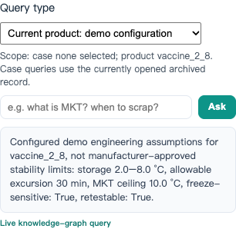
M6 question-answering repairs
Explicit query types and visible case scope
Unsupported questions receive a refusal
Concepts do not become case evidence
Reference links preserve recorded provenance
Frozen review results remain distinct from repaired-system quality
Observed review failures and developer software checks
08
Notes:
D, 35 seconds. Describe exact scope: deterministic routing, five explicit structured queries, labelled concepts, refusal outside scope, reference links and stale-response cancellation. The old frozen review remains unchanged. Regression checks do not establish new independent accuracy.
Sources: docs/M6问答修复与新版本验收.md; reviewer A observations
Data are simulated. Metrics retain their original dataset, split and denominator. Human presentation only.

Slide 9
Verification and human review
Full regression: 926 passed, no skips
36 API workflow checks
Persistence, graph recovery and read-only advisory checks
M6: reviewer B and process evidence remain pending
Current-router independent accuracy is not established
Release verification and frozen human-review records
09
Notes:
D, 25 seconds. State the software verification evidence. If B is missing, say so. Human process declarations are not identity authentication. Do not substitute developer-authored checks for an independent benchmark.
Sources: PROGRESS.md; process-validated M6 report when supplied
Data are simulated. Metrics retain their original dataset, split and denominator. Human presentation only.

Slide 10
Limitations and delivery
Engineering thresholds require product-level evidence
Model candidates cannot authorise medicine disposition
The local prototype has no public-user authentication
Human recordings, review and individual reports remain team tasks
Runnable prototype, inspectable evidence and reproducible experiments
Course requirements and final delivery checklist
10
Notes:
D, 20 seconds. Close with supported capabilities and honest limits. Remaining human items include B review/provenance, recordings, individual reflection and confidential peer evaluation. Original proposal slides are historical, and the current group is 41.
Sources: docs/最终交付与验收.md
Data are simulated. Metrics retain their original dataset, split and denominator. Human presentation only.

