Slide 1

PharmaColdOps
An Intelligent System for Temperature-Excursion Disposition and Delivery Re-routing in Cold-Chain Pharmaceuticals
Project Group 41 · Xu Wenzhe · Zhu Jianyu · Wang Lepeng · Shen Ziyi
IRS Practice Module · Proposal Presentation · 22 Sep 2026

Slide 2

Cold-Chain Excursions Threaten Drug Safety
Temperature-Sensitive Products
Manual, Inconsistent Decisions
Vaccines and biologics can lose efficacy after even a brief deviation in transport or storage.
Common tools only raise an alarm: they record the deviation but do not decide what to do with the batch.
Mixed Handling, Weak Traceability
Practices vary by site and shift; the reasoning behind a disposition is rarely reconstructable.

Slide 3


GAP ANALYSIS
Where Existing Tools Fall Short
Fragmented, Not Absent
Disconnected Workflows
Black-Box AI
A recommendation that cannot show its rule, evidence and limits will not be signed off in an audit.
Monitoring exists; what is missing is a rule path linking the disposition to the order, route and evidence.
Disposition decisions and logistics re-routing exist in separate, siloed systems with no automated handoff.

Slide 4


Our Solution: PharmaColdOps
A closed-loop decision system that acts the moment an excursion is detected — with full regulatory grounding and audit readiness.
Explainable Disposition
Automated Re-routing
Four outcomes with a traceable rule path; reshipment is a separate logistics action.
A reshipment order solved as a capacity- and time-window routing problem.
Regulatory Grounding
Every decision cites its rule, regulation or SOP and evidence limits.

Slide 5
Where PharmaColdOps Sits
Positioning · market context and related work
● Commercial platforms already monitor temperature and automate parts of the quality process — we do not claim to be first.
● We build on existing foundations: Solomon's VRPTW benchmark, OR-Tools, gradient-boosted trees, SHAP.
● The gap we address is the unbroken, inspectable chain from event to disposition to order to route to cited evidence.
Proposal §3.2–3.3 · Figure 1. Market value still requires user interviews and operational data.

Slide 6





Data: Verifiable, Disclosed Provenance
Cold Chain Silent Failure (Kaggle)
Vaccine Distribution w/ Temp Logging (Kaggle)
Electric Sheep Africa Dataset
≈8,000 rows — failure classification.
≈26,700 rows — sequence and MKT work.
Simulated facility-monthly records.
CVRPLIB Benchmarks
Domain Rules
WHO / EU GDP / ICH · CDC. Thresholds are prototype assumptions.
Six Solomon instances + OSM road network.

Slide 7
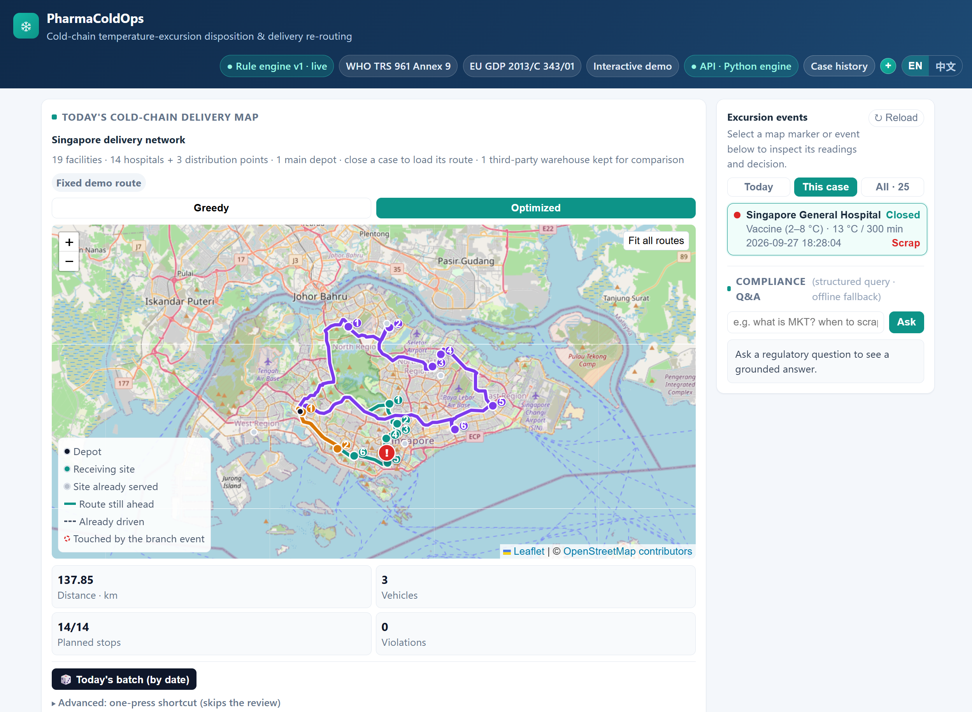
Built and Running Today
Measured from the repository, 2026-09-27
● 23 HTTP endpoints, 13 of them dispatch operations.
● One Vue 3 client, 23 components; EN/ZH and offline mode.
● 25 archived cases; 56 dispatch operations persisted.
● 305 test functions across 35 files.
● Still missing: cloud deploy, de-duplication, destination pool.
Screenshot: Vue client in API mode (2026-09-27; route and evidence computed live by the backend, not mocked).
Screenshot: the Vue client in API mode, 2026-09-27.

Slide 8
Results So Far
Every number reproducible in the repo
● Engine vs human gold: 54/57 = 94.7%; scrap recall 33/33.
● Annotator agreement κ = 0.6434 — below our 0.80 target.
● Routing: 142.63 → 133.81 km (−6.19%, 0 violations); Solomon optima reached in 10 s.
● Risk model: F1 0.691 / ROC-AUC 0.925; cause Top-1 0.143 is below the majority baseline and reported as such.
Boundaries: suspected-synthetic data, single random split, time-bounded solver — these do not establish real-world or operational savings.

Slide 9



Risks, Team & Next Steps
Risk Mitigations
Team Roles
Annotator agreement κ = 0.6434 vs our 0.80 target → report it
Quarantine recall 0/3 3 gold cases → report support counts
Immediate Next Steps
W1: threshold review; multi-fold risk experiments
W3: integrated acceptance and failure states
W5: reproduce cleanly; videos by 25 Oct
Synthetic data suspected-synthetic → disclose the limit
Project Lead / Rules · Xu Wenzhe: rules, evidence, evaluation
Data & ML · Zhu Jianyu: data, risk, causes, SHAP
Optimisation · Wang Lepeng: VRPTW, routes, dispatch
KG + QA + Frontend · Shen Ziyi: KG, QA, API, frontend

Slide 10
Conclusion and Next Steps
What we commit to
● The reasoning path exists and carries its own critique: rule-versus-judgement disagreement, a weak cause classifier, prototype thresholds.
● All four IRS technique groups are covered, against a requirement of three.
● By 25 Oct: integrated acceptance with failure states, clean-environment reproduction, the two videos.
● It does not replace the quality lead's approval, and does not authorise real product release, destruction or transport.
Thank you — we are happy to take questions.
Thank you — we are happy to take questions.

