Slide 1

PharmaColdOps
An Intelligent System for Temperature-Excursion Disposition and Delivery Re-routing in Cold-Chain Pharmaceuticals
Xu Wenzhe · [Member 2] · [Member 3] · [Member 4]
IRS Practice Module · Proposal Presentation · 13 Sep 2026

Slide 2

Cold-Chain Excursions Threaten Drug Safety
Temperature-Sensitive Products
Manual, Inconsistent Decisions
Vaccines, biologics, and insulin can lose efficacy with even minor temperature deviations during transport, warehousing, or airport dwell.
After an excursion, release / quarantine / retest / scrap is decided manually — with no standardized logic or audit trail.
One-Size-Fits-All Handling
Blanket policies cause excessive scrapping of salvageable product — or worse, improper release of compromised batches.

Slide 3




Why It Matters: The Cost of Getting It Wrong
Quality Leads & QA
Logistics Dispatchers
Compliance & Auditors
Patients
Need compliant, explainable, and fully traceable disposition decisions that hold up under scrutiny.
Depend on correct outcomes — fewer improper releases of degraded product, and fewer supply shortages.
Need replacement stock identified and delivery routes re-planned — fast, before patient supply is disrupted.
Need the full decision chain, regulatory basis, and documentation ready for EU GDP / ICH audit at any moment.

Slide 4


GAP ANALYSIS
Where Existing Tools Fall Short
Record, Not Decide
Disconnected Workflows
Black-Box AI
Opaque ML models are not trusted by quality leads or auditors — explainability is non-negotiable in regulated environments.
Spreadsheets and simple alarms log the deviation — but cannot answer "stop this batch?" or "reroute where?"
Disposition decisions and logistics re-routing exist in separate, siloed systems with no automated handoff.

Slide 5


Our Solution: PharmaColdOps
A closed-loop decision system that acts the moment an excursion is detected — with full regulatory grounding and audit readiness.
Explainable Disposition
Automated Re-routing
Release / quarantine / retest / scrap / reshipment (derived flag) — with a traceable rule path every time.
Replacement stock allocation and optimized delivery re-routing generated automatically.
Regulatory Grounding
Every decision anchored in WHO / EU GDP / ICH rules — quantitatively evaluable and audit-ready.

Slide 6
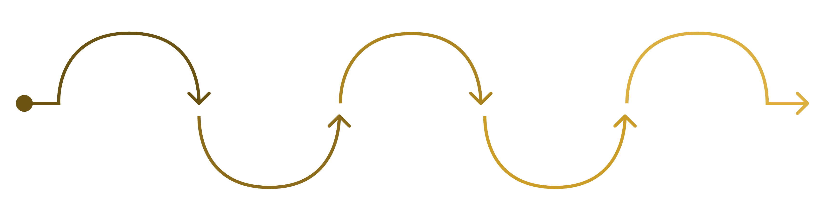
System Architecture: End-to-End Pipeline
Detect Excursion
Root-Cause Diagnosis
Ingest & Normalize
Rule Engine
Optimiser
Compute MKT and classify transport-level silent-failure risk
Link anomalies to equipment and events
Disposition: release, quarantine, retest, scrap, reship (derived)
Re-route reshipment orders via VRPTW
Collect sensor, GPS, order, inventory, vehicle, stability
Input: Sensor · GPS · Order · Inventory · Vehicle · Stability data → Output: Disposition + Re-routed routes + Audit report

Slide 7

Technique Mapping: All Four IRS Groups Covered
1
2
Decision Automation
Resource Optimisation
Rule engine for release / quarantine / retest / scrap / reshipment (derived flag) with full rule-path traceability.
OR-Tools Routing Solver with guided local search on cold-chain Vehicle Routing with Time Windows (VRPTW).
3
4
Knowledge Discovery & Mining
Cognitive Systems
Risk prediction, root-cause classification, and risk grading from historical excursion data.
Knowledge graph with natural-language compliance Q&A and explainable audit report generation.

Slide 8
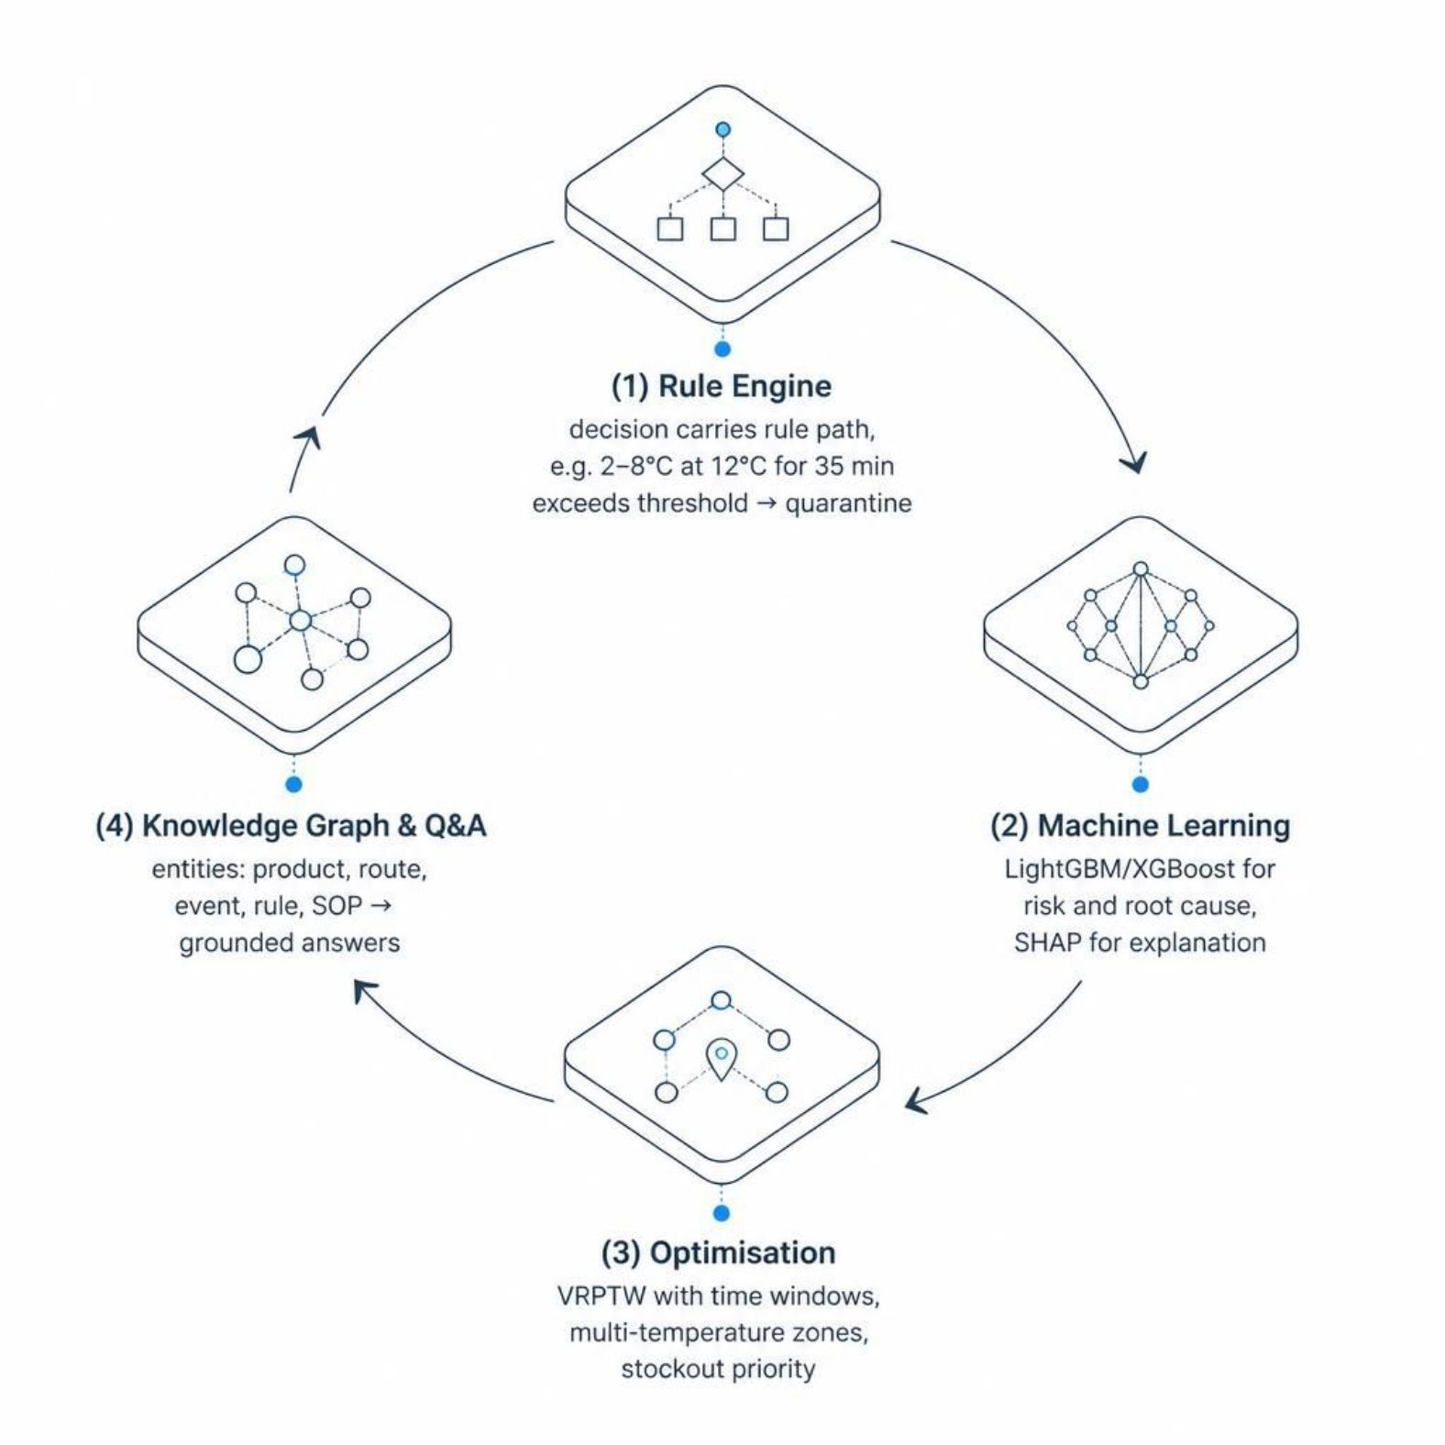


Four Modules, One Closed Loop
Rule Engine
Machine Learning
Every disposition carries a full rule path — e.g. "2–8°C product @ 12°C for 35 min > 30 min threshold → quarantine."
LightGBM / XGBoost for risk scoring and root-cause classification. SHAP values ensure every prediction is explainable.
Optimisation
Knowledge Graph & Q&A
VRPTW solver handles time windows, multi-temperature zones, and stockout priority simultaneously.
Entities — product, route, event, rule, SOP — linked to deliver grounded, auditable natural-language answers.

Slide 9





Data Sources: Public, Downloadable Datasets
Cold Chain Silent Failure (Kaggle)
Vaccine Distribution w/ Temp Logging (Kaggle)
Electric Sheep Africa Dataset
~8,000 rows — risk prediction and failure classification across cold-chain shipments.
~26,700 rows — anomaly detection and Mean Kinetic Temperature (MKT) computation.
30,000 rows — facility and route-level anomaly detection across a synthetic (simulated) vaccine cold-chain network.
CVRPLIB Benchmarks
Domain Rules
WHO TRS 961 Annex 9 · EU GDP 2013/C 343/01 · ICH Quality Guidelines — the authoritative regulatory foundation.
Standard VRP benchmark instances for validating the re-routing solver against established baselines.

Slide 10
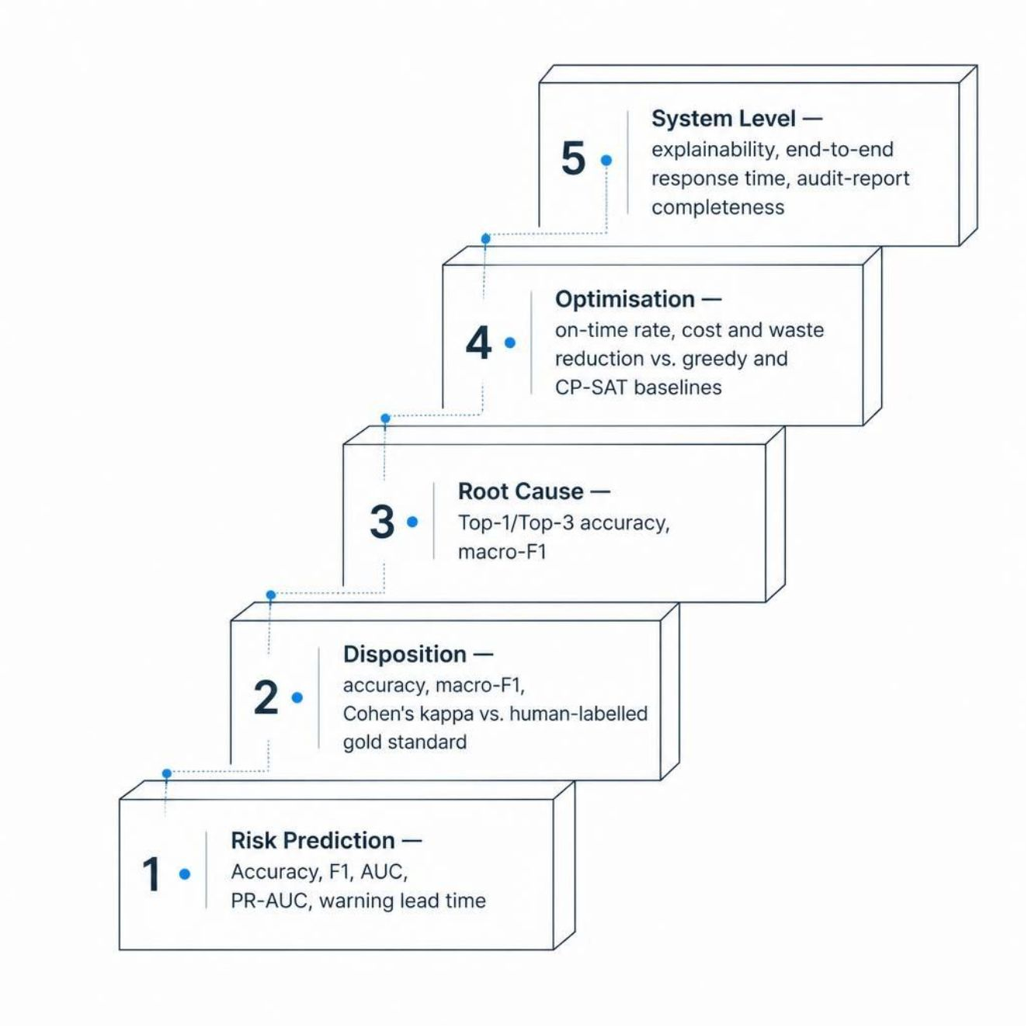
Evaluation: Layered, Quantitative Metrics
Risk Prediction
Accuracy, F1, ROC-AUC and PR-AUC, against a majority-class baseline.
Disposition
Macro-F1 and Cohen's kappa benchmarked against a human-labelled gold standard.
Root Cause
Top-1 and Top-3 accuracy with macro-F1 across failure-cause classes.
Optimisation
On-time delivery rate, cost and waste reduction vs. the greedy baseline.
System Level
Explainability score, end-to-end response time, and audit-report completeness.

Slide 11

Scoped MVP & Seven-Week Plan
W0
1
Proposal submission
2
W1
Data ingestion & rule library
W2
3
Rule-engine MVP live
4
W3
End-to-end pipeline v1
W4
5
Optimise & explain
6
W5
Test & demo video
W6
7
Final delivery — 25 Oct
MVP Scope: Single-city (Singapore) network · 1–2 product classes · Rule engine first, then greedy → OR-Tools / GA. Excluded: ERP/WMS integration, real IoT hardware, real patient data.

Slide 12



Risks, Team & Next Steps
Risk Mitigations
Team Roles
Small data → cross-validation and augmentation strategies
Rule complexity → scoped to 1–2 product classes for MVP
Immediate Next Steps
Confirm and download all datasets by end of Week 0
Build rule-engine v1 against WHO / EU GDP rules
Submit proposal by 13 September 2026
Scope creep → hard MVP boundary enforced from Week 0
Project Lead / Rules — Xu Wenzhe: rule engine design & regulatory mapping
Data & ML — [Member 2]: risk prediction, root-cause classification, SHAP
Optimisation — [Member 3]: VRPTW solver, OR-Tools routing (extensions optional)
KG + QA + Frontend — [Member 4]: knowledge graph, Q&A interface, audit UI

